Slide 1
Transparency and accountability in education governance reform
Daniel P. Funeriu
danielpfuneriu@gmail.com

Slide 2
PRECISION not SLOGAN
DISCIPLINE of reform

Slide 3
Transparency and accountability in education governance reform
Daniel P. Funeriu
danielpfuneriu@gmail.com

Slide 4
Definitions
Questions to be answered
Theoretical considerations
Empirical evidence
Conclusions

Slide 5
Why being accountable?
No accountability=dictatorship or totalitarian regime
We want electoral decisions to be taken based on truth

Slide 6
Why being accountable?
No accountability=dictatorship or totalitarian regime
We want electoral decisions to be taken based on truth

Slide 7
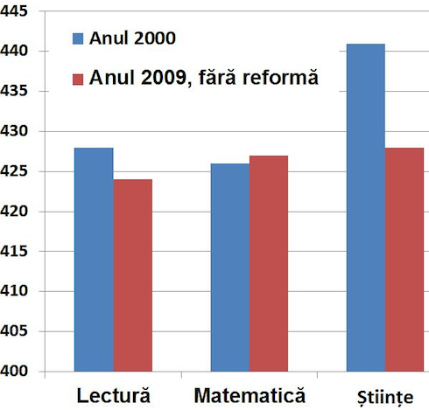
What „reform”?
Budget 2003: 1,35 Mld Euro
Budget 2009: 4,96 Mld Euro
Rezults PISA
2003
2009

Slide 8
What „reform”?
Diagnosis
General solutions
National Pact
Elections
Law
Implementation
Measurable results

Slide 9
What „reform”?
Diagnosis
General solutions
National Pact
Elections
Law
Implementation
Measurable results

Slide 10
What „reform”?
Diagnosis
General solutions
National Pact
Elections
Law
Implementation
Measurable results

Slide 11
What „reform”?
Diagnosis
General solutions
National Pact
Elections
Law
Implementation
Measurable results

Slide 12
What „reform”?
Diagnosis
General solutions
National Pact
Elections
Law
Implementation
Measurable results

Slide 13
What „reform”?
Diagnosis
General solutions
National Pact
Elections
Law
Implementation
Measurable results

Slide 14
What „reform”?
Diagnosis
General solutions
National Pact
Elections
Law
Implementation
Measurable results

Slide 15
What is transparency?

Slide 16
What is transparency?
Is it a democratic virtue or administrative tool?

Slide 17
Transparency in the TEU
Article 11
1. The institutions shall, by appropriate means, give citizens and representative associations the opportunity to make known and publicly exchange their views in all areas of Union action.
2. The institutions shall maintain an open, transparent and regular dialogue with representative associations and civil society.
3. The European Commission shall carry out broad consultations with parties concerned in order to ensure that the Union's actions are coherent and transparent.

Slide 18
Why being transparent?
Axiom 1: transparency produces trust of the public.
Is that true?
Axiom 2: more people involved bring better solutions
is that true?

Slide 19
Why being transparent?
Axiom 1: transparency produces trust of the public.
is that true?
Axiom 2: more people involved bring better solutions
is that true?

Slide 20
Why being transparent?
Axiom 1: transparency produces trust of the public.
is that true?
Axiom 2: more people involved bring better solutions
is that true?

Slide 21
Why being transparent?
Axiom 1: transparency produces trust of the public.
is that true?
Axiom 2: more people involved bring better solutions
is that true?

Slide 22
Why being transparent?
Axiom 1: transparency produces trust of the public.
is that true?
medicine

Slide 23
Why being transparent?
Axiom 1: transparency produces trust of the public.
is that true?
DJT

Slide 24
Why being transparent?
Axiom 2: more people involved bring better solutions
is that true?
Iceland, California, Switzerland (irreproducible singularity)
Descartes,

Slide 25
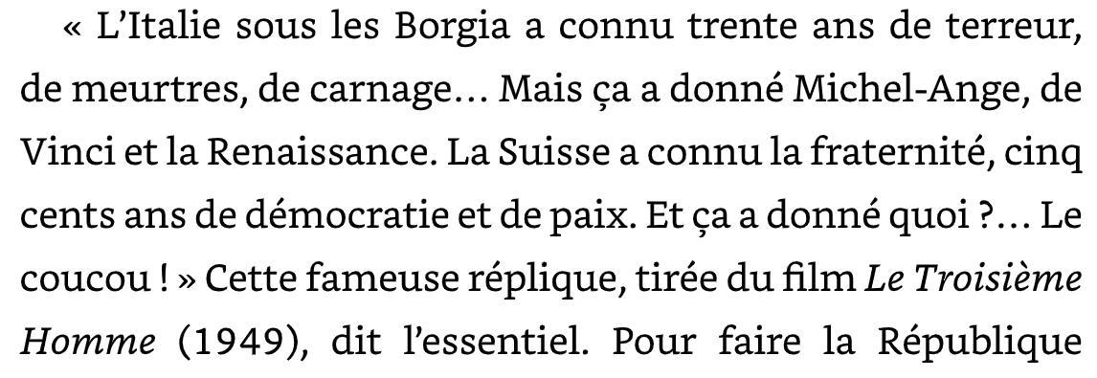
Why being transparent?
Axiom 2: more people involved bring better solutions
is that true?
Descartes, Iceland, California, Switzerland

Slide 26
Why being transparent?
Axiom 2: more people involved bring better solutions
is that true?
Iceland, California, Switzerland (irreproducible singularity)
Descartes

Slide 27
Issues talking about transparency
East of Vienna the lack of transparency is a historic trauma
West of Vienna excess transparency is considered by scholars as a disease of democracy

Slide 28

Issues with transparency?

Slide 29
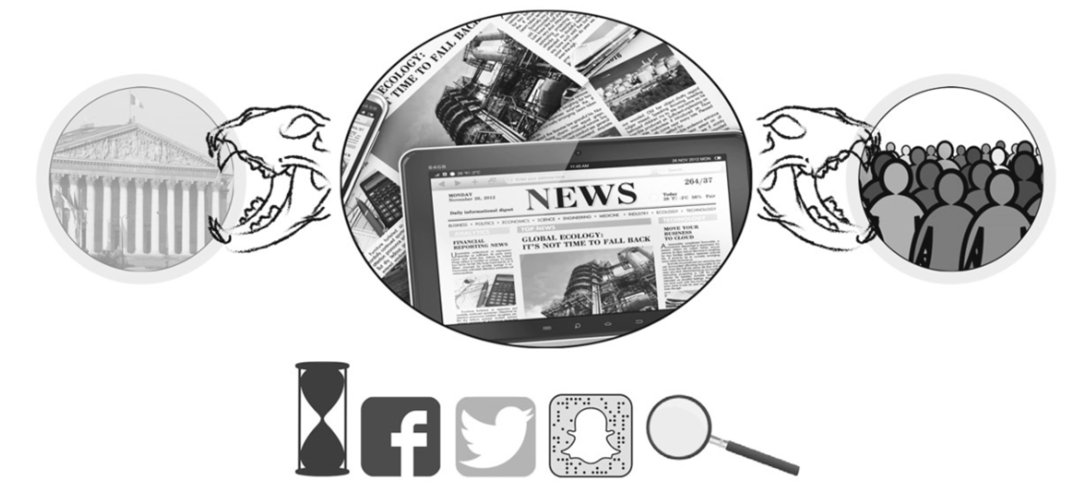
Issues with transparency?
STATE
OPINION
SOCIETY

Slide 30
Issues with transparency?
THEATROCRACY
TYRANY OF OPINIONS

Slide 31
Driver of change
POWER

Slide 32
Driver of democratic change
POWER censored by ACCOUNTABILITY and fuled by TRANSPRENCY

Slide 33
Driver of democratic change
POWER censored by ACCOUNTABILITY and fuled by TRANSPRENCY

Slide 34
Driver of democratic change
POWER censored by ACCOUNTABILITY and fuled by TRANSPARENCY

Slide 35
WHAT IS POWER?
HOW MUCH POWER?

Slide 36
WHAT IS POWER?
HOW MUCH POWER?
Energy is limited
Time is limited
P=E/t

Slide 37
WHAT IS POWER?
HOW MUCH POWER?
Energy is limited
Time is limited
P=E/t

Slide 38
WHAT IS POWER?
HOW MUCH POWER?
Energy is limited
Time is limited
P virtually infinte

Slide 39
Solid moral foundation
Box-ticking bureaucracy

Slide 40
Solid moral foundation
Box-ticking bureaucracy
High standards
Laxity

Slide 41
Solid moral foundation
Box-ticking bureaucracy
High standards
Laxity
The teacher’s intellectual and behavioural authority
The authority of parents and the child-king

Slide 42
Solid moral foundation
Box-ticking bureaucracy
High standards
Laxity
The teacher’s intellectual and behavioural authority
The authority of parents and the child-king
Excellence-focused universities
Welfare-focused universities

Slide 43
Solid moral foundation
Box-ticking bureaucracy
High standards
Laxity
The teacher’s intellectual and behavioural authority
The authority of parents and the child-king
Excellence-focused universities
Welfare-focused universities
Top teachers
Teachers “by default”

Slide 44
Solid moral foundation
Box-ticking bureaucracy
High standards
Laxity
The teacher’s intellectual and behavioural authority
The authority of parents and the child-king
Excellence-focused universities
Welfare-focused universities
Top teachers
Teachers “by default”
“Equity” by lifting those at the bottom
“Equity” by lowering those at the top

Slide 45
Solid moral foundation
Box-ticking bureaucracy
High standards
Laxity
The teacher’s intellectual and behavioural authority
The authority of parents and the child-king
Excellence-focused universities
Welfare-focused universities
Top teachers
Teachers “by default”
“Equity” by lifting those at the bottom
“Equity” by lowering those at the top
Transmitting solid knowledge
Transmitting “soft skills”

Slide 46
Solid moral foundation
Box-ticking bureaucracy
High standards
Laxity
The teacher’s intellectual and behavioural authority
The authority of parents and the child-king
Excellence-focused universities
Welfare-focused universities
Top teachers
Teachers “by default”
“Equity” by lifting those at the bottom
“Equity” by lowering those at the top
Transmitting solid knowledge
Transmitting “soft skills”
Geared to producing material and spiritual wealth
Geared to consumption and entertainment

Slide 47
Solid moral foundation
Box-ticking bureaucracy
High standards
Laxity
The teacher’s intellectual and behavioural authority
The authority of parents and the child-king
Excellence-focused universities
Welfare-focused universities
Top teachers
Teachers “by default”
“Equity” by lifting those at the bottom
“Equity” by lowering those at the top
Transmitting solid knowledge
Transmitting “soft skills”
Geared to producing material and spiritual wealth
Geared to consumption and entertainment

Slide 48
Solid moral foundation
Box-ticking bureaucracy
High standards
Laxity
The teacher’s intellectual and behavioural authority
The authority of parents and the child-king
Excellence-focused universities
Welfare-focused universities
Top teachers
Teachers “by default”
“Equity” by lifting those at the bottom
“Equity” by lowering those at the top
Transmitting solid knowledge
Transmitting “soft skills”
Geared to producing material and spiritual wealth
Geared to consumption and entertainment

Slide 49
Anecdotical evidence:
baccalaureate
Radical reform of baccalureate: video surveilance
No (rather... cryptical) transparency in decision making
Huge consultation efforts in implementation

Slide 50
Anecdotical evidence:
baccalaureate
Radical reform of baccalureate: video surveilance
No (rather... cryptical) transparency in decision making
Huge consultation efforts in implementation

Slide 51
Anecdotical evidence:
plagiarism
Legislation against plagiarism
Cryptical transparency in announcing
No transparency in decision making
No transparency in implementation

Slide 52
Anecdotical evidence:
plagiarism
Legislation against plagiarism
Cryptical transparency in announcing
No transparency in decision making
No transparency in implementation

Slide 53
Anecdotical evidence:
legislation

Slide 54
Anecdotical evidence:
legislation
Stabilise the concept before writing the legislation
Total transparency in intentions
Transparency in writing consensual measures
No transparency in writing „tough” measures
No transparency in adoption mecanisms of the law
Total transparency in implementation

Slide 55
Anecdotical evidence:
university classification

Slide 56
Anecdotical evidence:
university classification
Total transparency in intentions
Total transparency in collecting data
Total transparency in procedure
No transparency in formula
No transparency in expectation
Total transparency in implementation

Slide 57
Anecdotical evidence:
Compulsory education at 6 yrs old

Slide 58
Anecdotical evidence:
Compulsory education at 6 yrs old
Total transparency in intentions
Total transparency in regulation
Total transparency in procedure
Total transparency in implementation

Slide 59
Conclusions
Transparency is neither good nor bad
it is USEFUL or NOT USEFUL
depending on
local culture and to what is applied

Slide 60
Conclusions
Capture risk: deliberate not debate
Transparency „of the after”
Transparency cannot replace trust, expertise, responsibility or deliberation. It supports them

Slide 61
Conclusions
Be transparent about
Do not mistake it for
Your objectives
Your evidence
The reasons of your decisions
Implementation
Your results
Your corrections
Your needs
Informing your enemies
Liquid democracy
Breach of intimacy
Permanent consultation
Continuous renegociation
Public performance Institutional paralysis

Slide 62
Conclusions
Be transparent about
Do not mistake it for
Your objectives
Your evidence
The reasons of your decisions
Implementation
Your results
Your corrections
Your needs
Informing your enemies
Liquid democracy
Breach of intimacy
Permanent consultation
Continuous renegociation
Public performance Institutional paralysis
Not every conversation must be public, but every decision must be accountable.

Slide 63
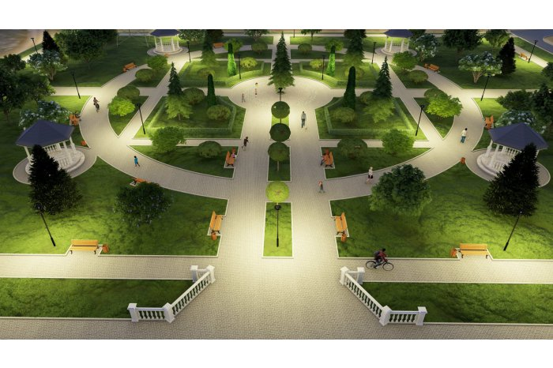
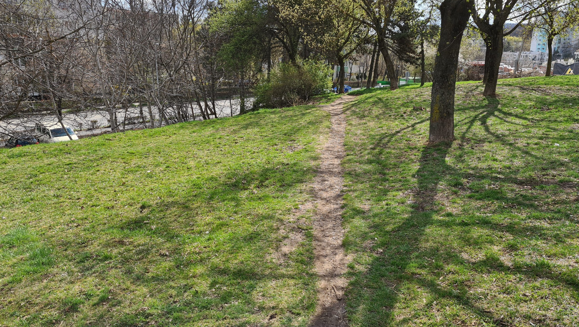
„top-down” vs „bottom-up”

