Slide 1


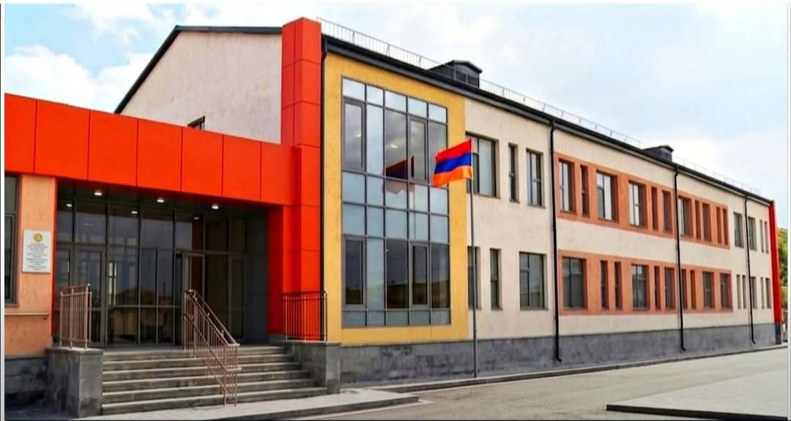
Education Reforms
in Armenia
From challenges to systemic solutions
ARMENIA CASE STUDY
Araksia Svajan
Deputy Minister of Education, Science, Culture and Sport
24 June 2026, Stresa
Notes:
Open with the framing: Armenia is presenting its education governance reform pathway in connection with the ETF RED and Functional Review findings.

Slide 2
Policy framework and reform priorities
Guided by SDG 4 and Armenia’s Education Development State Programme until 2030.
Core policy commitment: equitable, inclusive and high-quality education for all.
MAIN REFORM AREAS
Education content
Teachers
Governance
modern quality
standards
professional growth and incentives
leadership and accountability
Access
Infrastructure
Financing
equity and sustainability
quality education for every child
modern schools, labs and equipment
Notes:
State that reform priorities are system-wide but the presentation focuses on preschool, general education and TVET, in line with the Deputy Minister’s mandate.

Slide 3
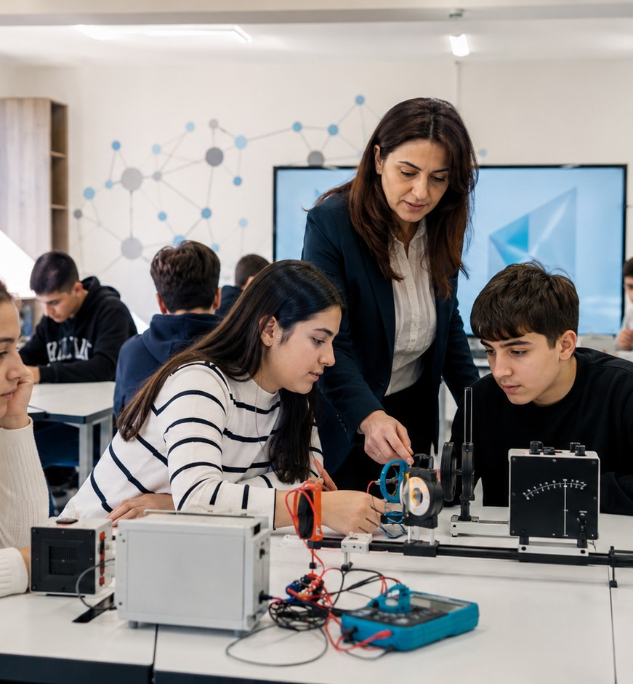
1. Educational content and learning quality
Reforms move the system from knowledge transmission toward competencies, motivation and relevance.
State Standards for Preschool and General Education revised, approved and implemented
Competency-based approach: knowledge, practical skills, values and learner motivation
New general education standard pilot evaluated by the World Bank with stronger outcomes than the previous framework
Qualitatively new level of preparation both for vocational education and training and for university entrance examination

Slide 4
Learning quality: from standards to classroom practice
The reform is not one document; it is a package of standards, materials, assessment and personalised pathways.
Standards
Textbooks
Assessment
Personalisation
Preschool and general education standards are competency-based and implemented nationwide.
New textbooks and learning materials have been developed alongside the new standards.
Numerical grading removed in primary education; formative assessment tools introduced.
Project-based learning and extracurricular activities support individual interests and abilities.
Next phase: measure how content reform affects student progress and whether benefits reach rural and small schools equally.

Slide 5

Content reform beyond the classroom
VET, non-formal education and AI initiatives extend the reform agenda into skills and innovation.
VET CONTENT
Curricula are being revised with the private sector; work-based and dual education models are expanding; sectoral qualifications frameworks are being developed.
NON-FORMAL EDUCATION
AI in education: from July 1, Armenia has an agreement with OpenAI; 50,000 ChatGPT Edu accounts will be distributed across educational institutions.
~600 schools host Armath Engineering Laboratories
TUMO Centers operate in many communities
Parents can reclaim ~EUR 250 annually from income tax for extracurricular education
Governance link: innovation must be accompanied by teacher support, safe use, equitable access and impact monitoring.
Sources: MoESCS speech draft; ETF RED; ETF Functional Review

Slide 6

2. Professional development and incentives
for teaching staff
Teacher capacity is one of the strongest determinants of education quality.
REFORM PRINCIPLE
Professional growth + career progression + salary incentives
The reform links training, attestation, career categories and remuneration across preschool, general education, VET and non-formal education.
07

Slide 7
Teacher reform: progress and next question
Incentives are designed to attract, retain and develop teachers,
especially in rural schools.
30%+
2-5x
~4,000
>50%
general education teachers have undergone certification
salary increase potential through attestation and career progression
new teachers joined last year
of new teachers work in rural communities; ~80% are under 45
TARGETED MEASURES
STEM teachers
25% salary supplement
Small rural schools
full-time salary compensation even with reduced teaching load
Teacher absence
remote teaching to prevent missed subjects
Next phase
assess impact on student learning outcomes
The next challenge is to connect attestation and incentives with student progress data and teacher retention evidence.
08

Slide 8
3. Education governance and leadership reforms
Governance is a critical determinant of education quality and implementation capacity.
Mandatory certification for prospective leaders across education levels
New school principal appointment procedures
Strengthening school governing boards
Leadership renewal can be complex and time-consuming, but it strengthens the system by bringing new educational leaders into school development.
09

Slide 9
School governance: separating pedagogical and administrative roles
The principal’s time is redirected from administration to education quality and school development.
Pedagogical leadership
Administrative-financial management
School principal
Administrative coordinator
Learning quality
Accounting
Teacher support
Procurement
New standards implementation
Security
School development
Facility management
Progress: more than half of Armenia’s schools have transitioned to the new governance model; operational services are progressively outsourced to specialized providers.
10

Slide 10
Governance transition and digital transformation
Central steering is used to build common standards before future decentralisation.
TWO-TRACK GOVERNANCE MODEL
Regional oversight
Ministry oversight
Local communities
historical operational management by regional authorities / Yerevan municipality
phased move to direct MoESCS oversight for unified standards
long-term transfer in line with decentralisation policy
DIGITAL TRANSFORMATION
Enrollment systems for preschools, schools and colleges have been digitized.
Student and staff administrative records and document flows are increasingly digital.
11

Slide 11
4. Education financing reforms
Effective and sustainable financing is essential for implementing all ongoing reforms.
GENERAL EDUCATION
VET FINANCING
A new VET financing system will be introduced from September. It accounts for resource needs and material costs of different professions, addressing underfunding in high-cost programs.
Per-student
Per-class
The per-class model promotes equity among schools regardless of size or location and supports implementation of standards and teacher development.
Institutional
base institutional capacity
Program-based
costs of specific occupations
Next year: performance-based support and incentive system for schools.
Cost groups
five groups by resource intensity
12

Slide 12
5. Programs to ensure access to quality education
All reforms ultimately aim to guarantee equitable access to quality education for every child.
PRESCHOOL ACCESS
75% → ~85%
95%
5 - 6
preschool enrolment:
2024 to 2025
target by 2030
planned compulsory education for 5-6-year-olds
OTHER ACCESS MECHANISMS
Transport cost reimbursement for students and teachers where needed
Inclusive education across levels: ~2,000 children with SEN in preschool and ~8,500 in general education
Inclusion in VET colleges is being further strengthened

Slide 13
Access support: school feeding and participation
Participation barriers are addressed through targeted social and health-related support.
107 000
86.2%
Yerevan
children in grades 1 - 4 and preschool groups receive nutritious, balanced meals across Armenia’s regions
of primary school students benefit from the School Feeding Program
program expansion has recently begun in the capital
14

Slide 14
6. Educational infrastructure and equipment modernization
Successful reform depends on safe, inclusive, modern and well-equipped learning environments.
300 Schools & 500 Kindergartens
Over the past five years, this has been one of the Government’s flagship initiatives, resulting in numerous modern institutions equipped with new furniture and digital technologies.
PROGRESS
Modern school buildings and kindergartens constructed or renovated
All new and renovated institutions equipped with furniture and technology
Construction and modernization in VET colleges will accelerate in the coming years

Slide 15
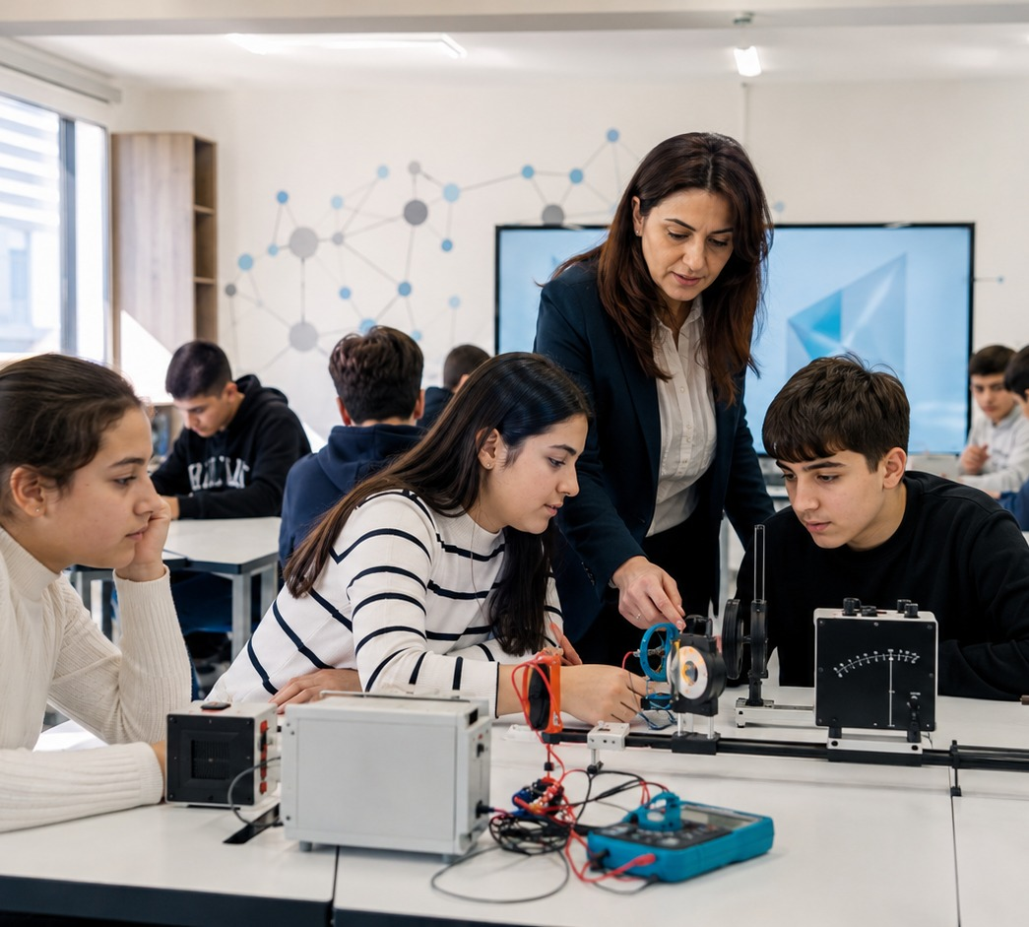
Infrastructure for modern learning:
ICT & STEM laboratories
Equipment investments are linked with curriculum, teacher capacity and applied learning.
Nationwide science and engineering labs
all schools nationwide have been equipped with contemporary science and engineering laboratories.

Slide 16
Thank you
RED and Functional Review findings remain central to the next phase of reform implementation.
Reforms are ongoing and need further deepening to address remaining systemic challenges.
Partner recommendations are valuable for improving policy, governance and implementation.
International exchange of good practices is essential for sustainable progress.

