Slide 1


Shaping Future-Ready Inclusive Education Systems: Global Trends and Policy Priorities for 2030–2040
João Costa, EASNIE Director
24 June 2026, ETF

Slide 2





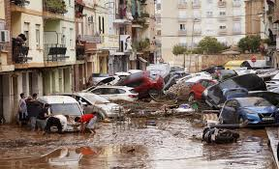

Education today
Volatility
Complexity
Ambiguity

Slide 3
Impacts
INFRASTRUCTURE
CURRICULUM DESIGN
HUMAN RESOURCES
MONITORING POLICIES

Slide 4
Impacts (2)
Socio-economic benefits of education
Equity and inclusion in and through education
Cognitive and socio-emotional skills – the concept of well-being
Digital transformation
Lifelong learning
How humans learn
Cost efficiency in education
The role of innovation

Slide 5
What is inclusive education?
Equity and access
Achievement opportunities for all
Participation and belonging
Notes:
What is Inclusive Education?
Inclusive education has developed from a single-layered concept, focused on ‘mainstreaming’ learners with disabilities or special needs into regular schools.. to a multi-layered concept. (EASNIE input paper, 2023)
Inclusive education is an approach that seeks to ensure all learners, regardless of their background, abilities, or circumstances, have equitable opportunities and access to high-quality education.
It ensures that all learners, regardless of ability or background, can participate fully in high-quality education. it encourages belonging and participation in the mainstream classroom.
It is about breaking down barriers to learning and participation, fostering a learning environment that accommodates diversity and provides equal chances of success in school and life
"Inclusion is about creating a system that is flexible and responsive to all learners, not just a few.”

Slide 6
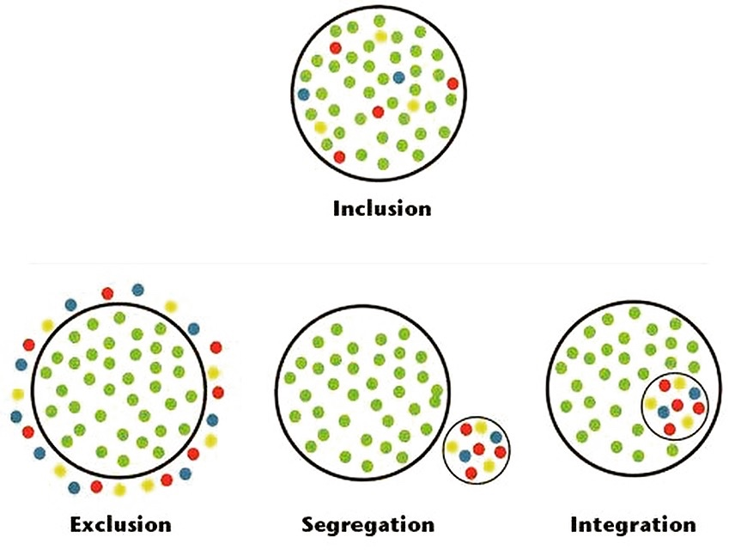
What is inclusive education? (2)

Slide 7

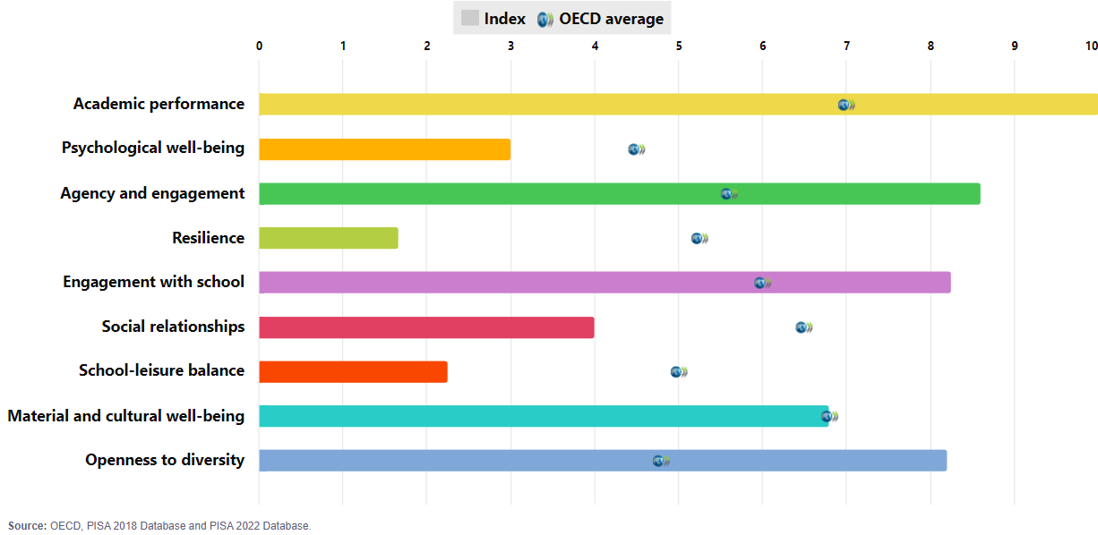
PISA 2022: Singapore

Slide 8

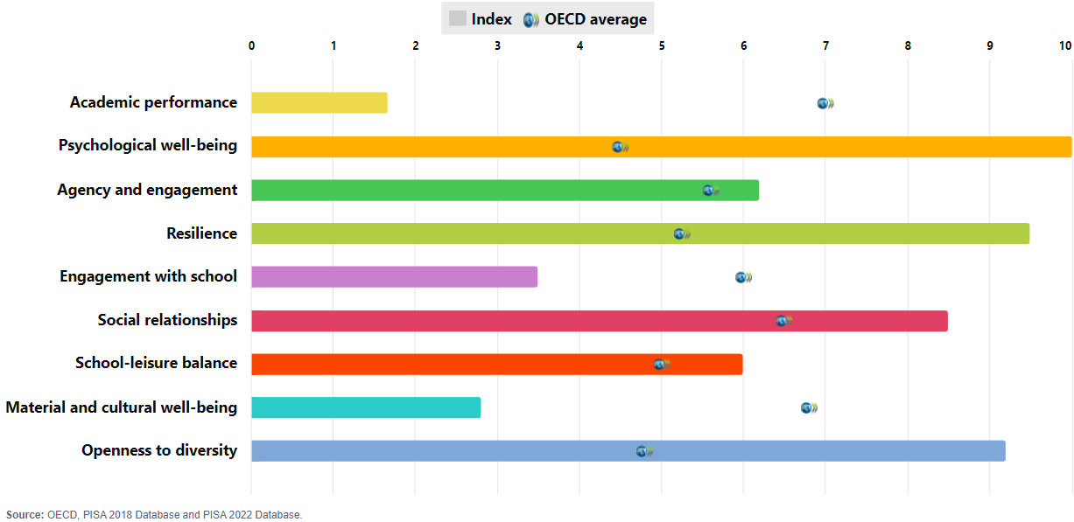
PISA 2022: Albania

Slide 9

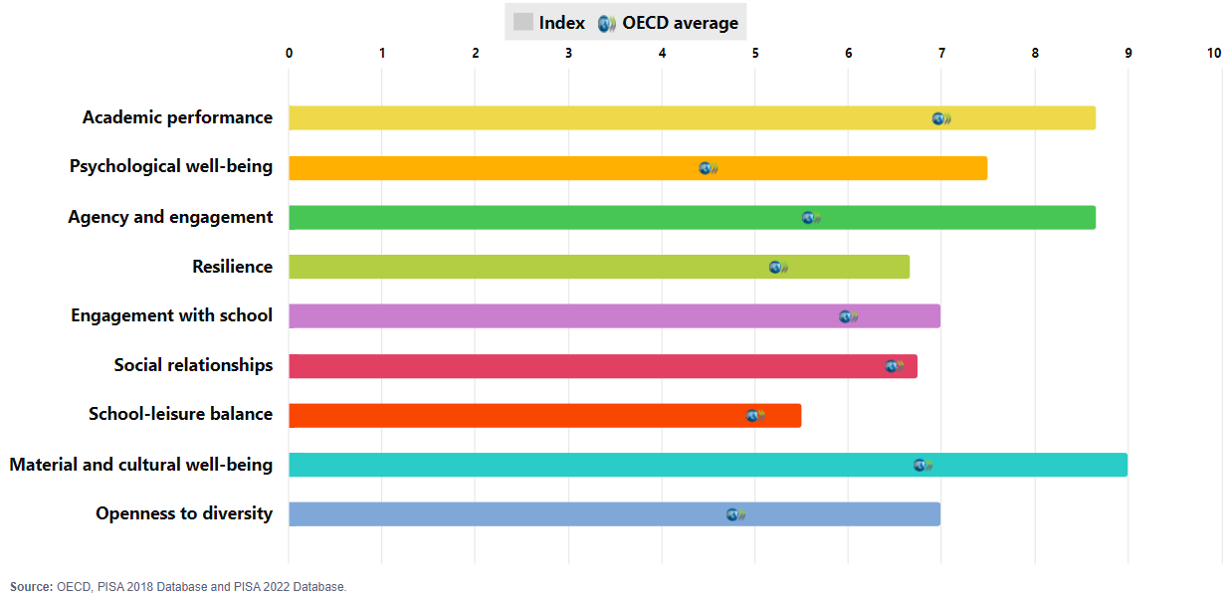
PISA 2022: Denmark

Slide 10
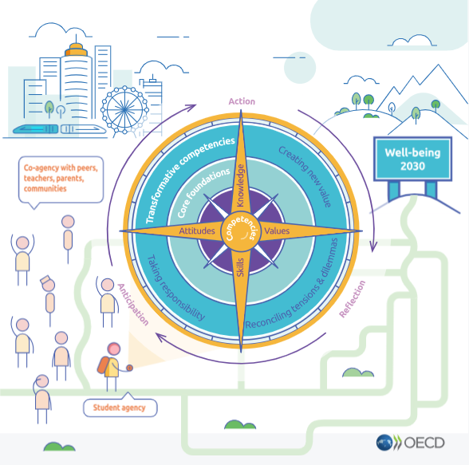
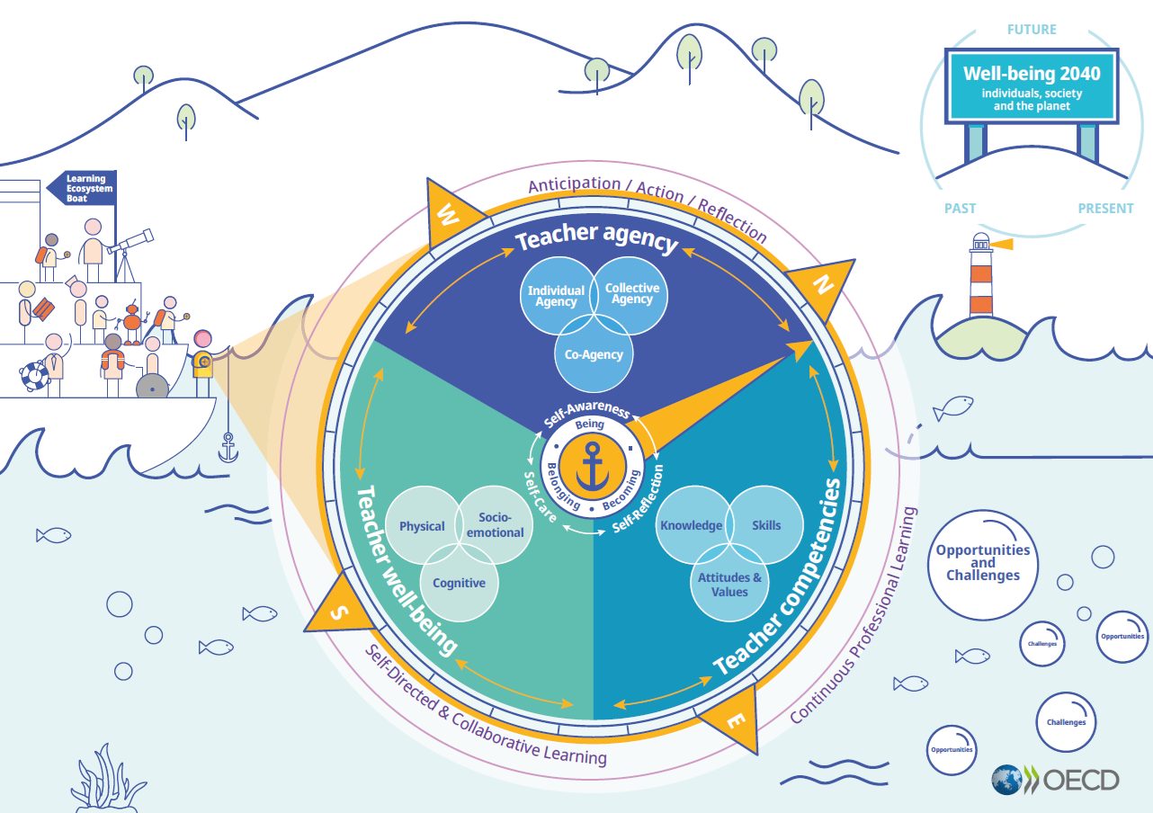
SUCCESS? OECD Learning Compass……OECD Teaching Compass
DRAFT VISUAL
Notes:
Conceptual Outline:
Making the “Future We Want” a Reality - Well-being 2040:
Balancing between innovation, resilience, and sustainability
Future is built on past & present (human flourishing)
"Anchoring" the Teaching Compass: Navigating Change with Strong self-concepts
Being, Belonging, Becoming
Self-awareness, Self-reflection, Self-care
Three pillars of the Compass:
Teacher Well-being (cognitive, physical, socio-emotional);
Teacher Agency (individual; co-agency; collective agency);
Teacher Competencies (knowledge, skills, attitudes & values)
No One Thrives Alone
Teachers in a Larger Learning Ecosystem
Overall purpose:
It aims to serve as an aspirational, future-oriented policy tool to address teacher shortages, and ensure quality and relevance of teaching and, to empower teachers.
It is the extension of the Learning Compass, not a stand-alone teaching framework
Expected output type:
Education Policy Perspectives paper (~30-pager, incl. visual)
Planned timeline:
To be published on 30 May 2025
Key conceptual blocks:
Well-being 2040: Balancing between innovation, resilience, and sustainability
Towards 2040: Both opportunities & challenges in socio-demographic, geopolitical, and technological shifts
Three pillars of the Compass:
Teacher Agency (individual; co-agency; collective agency);
Teacher Well-being (cognitive, physical, socio-emotional);
Teacher Competencies (knowledge, skills, attitudes & values)
"Anchor" in self-concepts – for sustainable teaching workforce
Being, Belonging, Becoming
Self-awareness, Self-reflection, Self-care

Slide 11
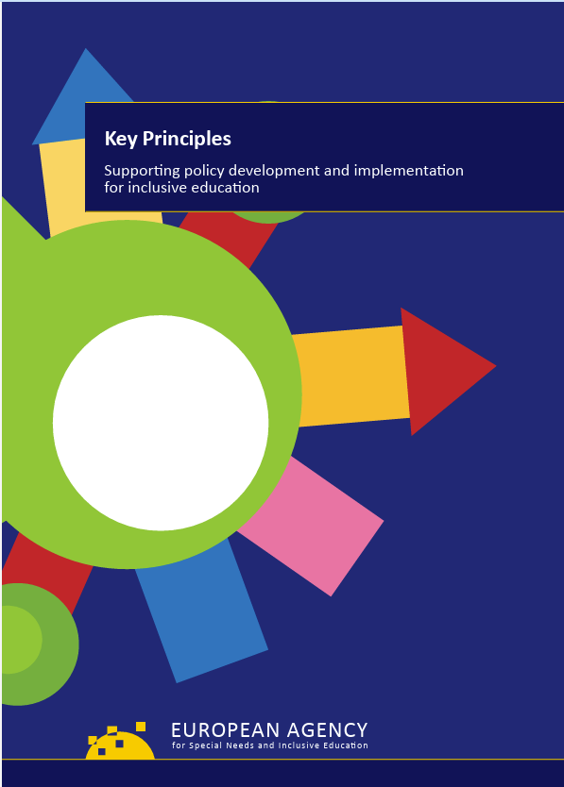
30 years... 10 pillars. Why?
All learners of any age are provided with meaningful, high-quality educational opportunities in their local community, alongside their friends and peers.
A focus on learners’ needs in general, without labelling groups of learners: a move towards a rights-based approach.
A focus on the system’s capacity to identify and remove barriers to learning.

Slide 12
Strong achievements with emerging challenges – shaping the future
Rising inequality and poverty
Digital divide
Economic instability and job insecurity
Polarisation and radicalisation
Financial uncertainty in the context of emerging geopolitical conflicts
Increased mental health and well-being issues
Climate change
Demographic changes
Educational practices that no longer match the scale or complexity of contemporary needs.

Slide 13

Ten Pillars
FINANCING AND RESOURCE ALLOCATION
LEARNER WELL-BEING AND BELONGING
QUALITY ASSURANCE
AND MONITORING
FAMILY AND COMMUNITY PARTICIPATION
INCLUSIVE GOVERNANCE
AND LEADERSHIP
LIFELONG LEARNING
CROSS-SECTOR COLLABORATION
TEACHER DEVELOPMENT AND WELL-BEING
DIGITAL TRANSFORMATION AND AI
INNOVATIONS IN CURRICULUM AND ASSESSMENT
Notes:
The Ten Pillars offer a framework for considering how education systems might evolve to better prepare learners for a future shaped by complexity, diversity and continuous innovation.
Intended for policy-makers and system leaders, the framework draws together insights from EU policy documents and initiatives, work by the OECD, UNESCO and EASNIE and recent peer-reviewed research (mainly from 2020 to 2026), as well as expert input, into a set of shared priorities.
The Ten Pillars are not sequential, but are interrelated. Progress in one area is likely to depend on developments in others - each one sits within and reinforces the others, creating a connected structure.
Each Pillar includes a short set of key actions. These identify practical steps that different system actors might consider in advancing work within that domain.
In this way, the Pillars aim to offer a point of reference for reflection and future planning, linking broad principles to possible areas for action.

Slide 14

1. LEARNER WELL-BEING AND BELONGING
Learners’ well-being, safety, participation and sense of belonging are essential foundations for meaningful learning. Systems must strengthen agency, support ethical participation and promote social and emotional learning, family engagement and digital/media literacy.
Key actions
Make well‑being and belonging core system goals.
Embed authentic learner voice in decision‑making.
Ensure access to mental health support, nutrition and digital literacy.
Notes:
EASNIE’s long-standing work shows that well‑being and belonging are preconditions for learning, not add-ons.
Well‑being is directly tied to meaningful engagement and equity.
The Voices into Action (VIA) and Learner Participation in Inclusive Education (LPIE) activities emphasise meaningful participation, emotional security and learner agency.
Participation, voice and relational trust are fundamental to inclusion.
Digital/media literacy and SEL are integral to resilience - not separate from learning.

Slide 15

2. FAMILY AND COMMUNITY PARTICIPATION
Strong education systems rely on family engagement and community partnerships. Inclusive schools function as community hubs that integrate services, offer varied learning opportunities and foster social cohesion.
Key actions
Strengthen authentic family and community partnership.
Develop inclusive, culturally-responsive engagement approaches that reach all families.
Position schools as community hubs.
Notes:
EASNIE has consistently promoted whole‑community approaches - schools as professional learning communities / hubs see ‘Raising the Achievement of All Learners in Inclusive Education’ activity
Recently, EASNIE’s Learners and Families Shaping Action work highlights the role of families as essential partners in creating inclusive classrooms
Strong partnerships reduce fragmentation and support learners facing disadvantage.

Slide 16

3. LIFELONG LEARNING
Learning must be understood as a continuous, flexible trajectory across the life course. Coherent pathways, reduced transition barriers and opportunities to adapt or reskill help prevent early categorisation or inequalities, promote resilience and ensure all learners can navigate changing personal, social and economic realities.
Key actions
Ensure coherent, flexible learning pathways across all stages of education.
Strengthen adaptability, learner agency and opportunities to reskill throughout life.
Support smooth transitions through co-ordinated policies linking education, training, work and family engagement.
Notes:
EASNIE’s work on transitions stresses continuity. Learning is a trajectory, not isolated stages.
Early childhood education and care (ECEC), vocational education and training (VET), higher education and adult learning are no longer treated as discrete policy domains but as interconnected components of a single learning continuum.
Across EASNIE work (i.e. Inclusive Early Childhood Education, Vocational Education and Training, Preventing School Failure activities), the message is clear: systems must support coherent pathways.
Flexibility and permeability prevent early stratification and protect equity.
Lifelong learning is a rights‑based commitment for all ages.

Slide 17

4. TEACHER DEVELOPMENT AND WELL-BEING
Teachers are central to inclusive education. They need sustained professional learning to equip them with relevant skills, and supportive working conditions to meet diverse learner needs. Collaborative cultures, inclusive pedagogies and attention to teachers’ well‑being enable high‑quality teaching and strengthen system‑wide capacity for inclusive practice.
Key actions
Provide continuous professional learning for inclusive pedagogy, digital literacy and reflective practice.
Create supportive professional environments that strengthen teacher well‑being.
Promote culturally responsive and collaborative teaching.
Notes:
Teacher well‑being determines system well‑being.
EASNIE consistently promotes collaborative, reflective professional cultures, not one‑off training.
EASNIE work on teacher professional learning (see Teacher Professional Learning for Inclusion (TPL4I) activity) highlights the need for continuous, collaborative learning cultures and attention to teacher well‑being.
The Profile of Inclusive Teachers (or more recent update - Profile for Inclusive Teacher Professional Learning) remains a useful tool for TPL policy development.
The Profile highlights the essential core values of teacher education and competence areas for inclusive teachers.

Slide 18

5. INNOVATIONS IN CURRICULUM AND ASSESSMENT
Curricula should be interdisciplinary, competence-based and aligned with sustainability and democratic participation. Assessment must value diverse abilities and support human flourishing.
Key actions
Embed inclusion as a core principle in curriculum and assessment.
Promote equitable, learner‑centred assessment that recognises diverse abilities.
Develop future‑oriented, interdisciplinary curricula that develop human values, active citizenship, critical thinking and digital literacy.
Notes:
EASNIE’s position: assessment must recognise diverse abilities and support human flourishing.
EASNIE emphasises the strong alignment between school-level curriculum decisions and national inclusion policy commitments
Curriculum innovation must embed inclusion as a core principle - not a separate strand.
Need for coherent curriculum frameworks that embed inclusive principles across content, pedagogy and assessment, and that move away from categorical or deficit-based approaches that persist in many legislative and policy contexts

Slide 19

6. DIGITAL TRANSFORMATION AND AI
Digitalisation requires equitable access, ethical governance and strong media literacy. Technology must support, not replace, pedagogy, while safeguarding privacy and diversity.
Key actions
Ensure equitable access to digital tools and infrastructure.
Promote strong media literacy and safe digital practices.
Use AI responsibly to support personalised learning within ethical guidelines.
Notes:
EASNIE’s work reinforces these EU priorities by framing digital transformation as inseparable from inclusion.
Digitalisation must reduce barriers, not replicate them, ensuring accessible design, ethical data practices and UDL principles across digital tools (EASNIE, 2024 - Transforming Education in a Digital World to Enable Inclusive Learning Experiences: A think piece for education and technology stakeholders)
EASNIE’s collaboration with UNESCO on information and communication technologies for learners with disabilities (EASNIE & Global Initiative for Inclusive Information and Communication Technologies, 2014) and its emphasis on accessible learning environments – provides clear guidance: digital strategies must be aligned with rights-based, learner-centred approaches
Digital transformation and AI can significantly advance inclusion and personalise learning – but only with equitable access, ethical governance, high-quality professional learning and a strong emphasis on digital and media literacy.

Slide 20

7. CROSS-SECTOR COLLABORATION
Inclusive education depends on co-operation among education, health, social welfare and other sectors. Shared goals, clear frameworks and transparent communication are essential to address complex learner needs.
Key actions
Integrate education, health, social and community services.
Strengthen multi-professional and cross‑sector teams.
Promote shared governance and aligned responsibilities across sectors.
Notes:
Complex needs require collaborative systems; no single sector can deliver inclusion alone.
EASNIE’s Changing Role of Specialist Provision in Supporting Inclusive Education (CROSP) activity illustrates the value of flexible, multi‑professional arrangements.
More recent work on CSC (Collaborative Action For Inclusive Education – CAFIE / Advancing Collaboration in Education – ACE ) reinforces that system coherence increases when collaboration is embedded across all governance levels -> importance of shared governance frameworks.
Cross‑sectoral work builds resilience during crises (health, migration, digital risks).
Inclusive education systems must operate as interconnected ecosystems, where education, health, social protection and community services work seamlessly together.
Need for 'connective professionalism', where teachers work across disciplines, sectors and professional fields

Slide 21

8. INCLUSIVE GOVERNANCE AND LEADERSHIP
Strong governance and inclusive leadership are essential for building coherent, equitable systems. Distributed, participatory and networked leadership cultures help align policy and practice, foster collaboration and sustain long‑term system improvement grounded in shared responsibility.
Key actions
Strengthen distributed, collaborative leadership that drives equity and shared responsibility across the system.
Build coherent governance structures aligning policy, practice and accountability.
Promote networked collaboration across schools and sectors.
Notes:
EASNIE argues for participatory, networked leadership - not hierarchical mandates.
Emerging models highlight a shift towards polycentric governance, characterised by distributed authority and multiple centres of decision-making.
Supporting Inclusive School Leadership (SISL) activity provides concrete, policy‑level evidence on how distributed, collaborative leadership strengthens inclusive governance.
Strong governance aligns policy, accountability and support for inclusion. Leadership is a cultural, not just organisational, driver of equitable systems.

Slide 22

9. QUALITY ASSURANCE AND MONITORING
Continuous improvement of systems requires robust monitoring, transparent data use and long‑term, equitable investment. Multi‑level evaluation systems ensure resilience, accountability and the capacity to innovate in the face of evolving social and global challenges.
Key actions
Develop robust monitoring and evaluation mechanisms for improvement.
Ensure sustained, equitable investment to build long‑term capacity.
Use transparent, data‑informed processes to guide decision-making.
Notes:
A recent (TCCA) Literature Review identifies that very few countries operate integrated QA systems, making multi-level, multi-stakeholder QA a priority.
The recent Quality Assurance, Monitoring and Accountability (QAMA) work sets out the structural elements of QA/monitoring and shows how improvement depends on coherent processes across school, local, regional and national levels.
High‑quality inclusive systems rely on robust, fair monitoring that avoids punitive approaches.
Data must illuminate inequities and support action, not label learners.
Evaluation requires sustained investment aligned with long-term system goals.

Slide 23

10. FINANCING AND RESOURCE ALLOCATION
Inclusive systems depend on strategic, fair and transparent resource allocation. Investment must reach learners with the greatest needs, build system capacity and safeguard education as a public good, supported by responsible regulation of private involvement.
Key actions
Ensure sustained, equitable investment to support innovation and inclusion.
Allocate resources strategically to strengthen inclusive practice.
Regulate private‑sector involvement to uphold the public good.
Notes:
Financing is a rights issue: resources must support equity and capacity-building.
The Financing Policies for Inclusive Education Systems (FPIES) Policy Guidance Framework places monitoring and accountability at the core of financing for inclusion.
Public responsibility must be protected - regulation of private actors matters.
Strategic resource allocation underpins every other pillar.

Slide 24

Call to action
Inclusive education requires a paradigm shift and a collective responsibility.
Shared understanding of concepts and exchange of practices and experiences are key to progress in the area.
‘Diversity is being asked to the party;
inclusion is being asked to dance.’
Vernā Myers
Notes:
Drawing on its 30 years of experience, EASNIE continues to position itself as a key partner in supporting countries on their inclusive journeys – for example, in translating this framework into country-specific strategic pathways and action plans, developed through participatory processes with national, regional and local stakeholders.

Slide 25


Contact
www.european-agency.org
European Agency for Special Needs and Inclusive Education
Østre Stationsvej 33, DK-5000 Odense C, Denmark
secretariat@european-agency.org
brussels.office@european-agency.org
Tel.: +45 64 41 00 20
Follow us and stay connected #EASNIE
Funded by the European Union. Views and opinions expressed are however those of the author(s) only and do not necessarily reflect those of the European Union or the European Commission. Neither the European Union nor the European Commission can be held responsible for them.

