Slide 1
Transforming Education System
Education Policy Lab 24-25 June 2026
Jaana Palojärvi

Slide 2
One of the top OECD countries in education
OECD, Better Life Index 2023
World’s 5th in Press Freedom
Press Freedom Index 2023
Nr. 1 - Happiest Country in the World
World Happiness Report
2023
6th in Human Capital Index
World Bank 2020
World’s Least Fragile State
Fund for Peace, Fragile States Index, 2021
World’s 2nd Least Corrupt Country
Corruption Perceptions Index,
Transparency International 2023
The Best Public Administration
Legatum Institute, The Legatum Prosperity Index 2021
Nr. 1 in Digital Skills
WEF, Global Competitiveness Report 2020
Among the developed countries, 5th most dedicated to policies that benefit people living in poorer nations.
The Commitment to Development Index 2023 (CDI), Centre for Global Development
World’s 2nd in Gender Equality
WEF, Global Gender Gap Report 2024
Nr. 1 - Performance on economic transformation readiness WEF, Global Competitiveness Report 2020
Country score on Academic Freedom: 4/4
Freedom House ‘Freedom in the World 2022/ Global Freedom Scores

Slide 3

Finland’s underlying educational understanding is based on equity
Everyone has the right to basic education free of charge. The public authorities shall guarantee for everyone equal opportunity to receive other educational services in accordance with their ability and special needs, as well as the opportunity to develop themselves without being prevented by economic hardship.
Constitution of Finland

Slide 4
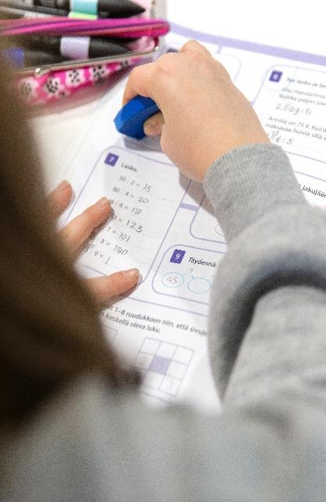
History of Basic Education
Comprehensive school act was introduced in 1921, curriculum based on act in 1925.
Modern comprehensive school reform took place between 1972-1977.
Major Curriculum reforms in Finland have been made in 1881, 1925, 1952,1972, 1985, 1994, 2004 and 2016.
Basic Education Act in English: https://www.finlex.fi/fi/laki/kaannokset/1998/en19980628.pdf

Slide 5
Finnish education system is a result of continuous development
Compulsory education
extended to 18 years of age
2021
Vocational education reform
2018
Universities of Applied Sciences reform, new “dual model” in H.E.
1990s
Curriculum reforms
approx. every 10 years
First national core
curriculum introduced
1985
Comprehensive school reform
1972-1977
Education for the people
(voluntary,
for 4 years)
Basic ability to read required in order to marry
Degree on compulsory basic education for all
Free school meals nationwide
1700s
1866
1921
1948
Notes:
Finnish education system is under continuous development:
Finnish elementary school system dates back to 1866, when the Basic Education act came into force. Elementary schools provided voluntary basic education.
Finland gains independence in 1917. Few years later, in 1921 attending basic education was made compulsory.
Since 1948 municipalities were required to provide students with a free school meal each school day.
During the 1970s reforms were made and municipalities shifted to the new comprehensive school system (peruskoulu). Nine year long compulsory education was founded on the idea of providing all citizens with equal opportunities.
Since the 1980s curriculum reforms have been made approximately every 10 years. The national core curriculum for basic education is a framework around which local curricula are designed. It is both an administrative steering document and a tool for teachers.

Slide 6
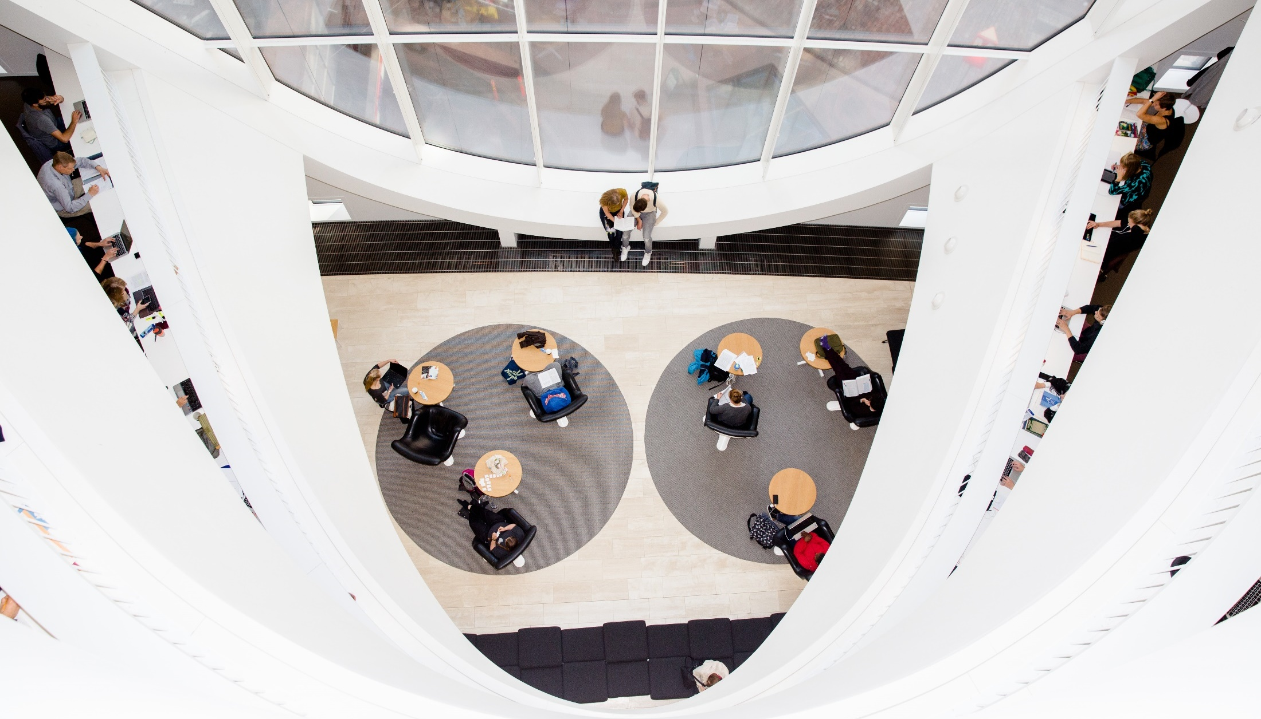
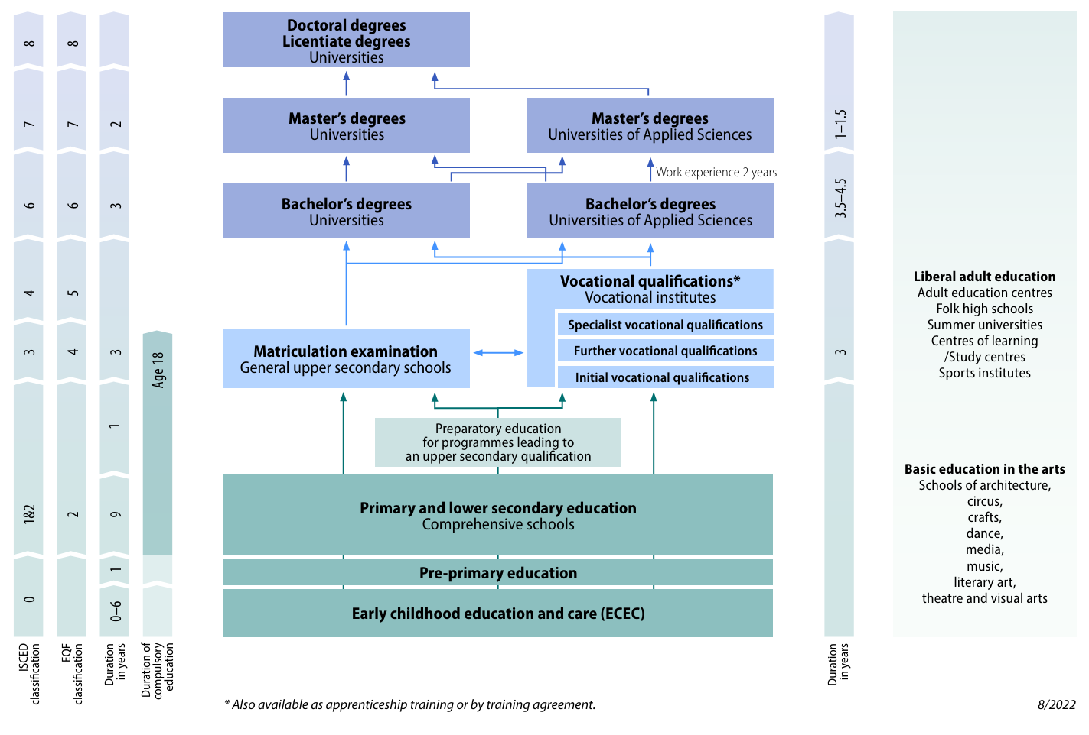
The Finnish Education System
  Gives each student flexibility.
  Binding decisions are not expected to be made at an early stage.
  The path all the way to tertiary education is untracked, with none of the paths leading to a dead end.

Slide 7
BUILDING POLITICAL CONSENSUS AND TRUST
Political culture hard to change
Time span between decision and impact/results
Culture, expectations, stakeholder involvement
Evolution, not a revolution; continuation
VISION and shared values & goals
System-wide approach – education not an island
Vision, stakeholder commitment and solid ground -> flexibility

Slide 8
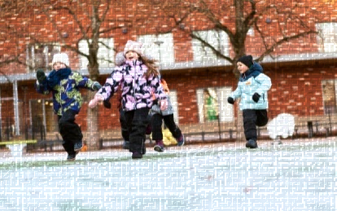
Finnish education is characterized by…
Joy of learning and importance of student wellbeing - no one is left behind
Flexible system with no dead ends, lifelong learning
Critical thinking, creativity, and innovation play an important role
Low hierarchies, local autonomy, culture of mutual trust
World-class media education and literacy
Free at all levels from pre-primary onward; modest fees for early childhood care
Long-term commitment to equality
Highly trained and respected teachers
No ranking of schools, students or teachers

Slide 9

Finnish education in international comparison
Small differences between schools
Moderate costs
Socio-economic gaps moderate
Teachers competent & committed
Girls outperform boys
Instruction
time low

Slide 10
EQUITY AND TRUST
Finnish identity: Nordic welfare state
  Few inhabitants, scarce natural resources, relatively poor agrarian society up to 1950s/60s
  Innovation and knowledge-based economy
  Quality education for all: a unified school system covering the entire country
    Public funding, taxpayers expectations
    No rankings in basic education
    Paradox: decentaralisation vs. equity and equality
  All major reforms made with stakeholders; process as important as the outcome
  Shared core vision

Slide 11
CHALLENGES
AI, technological development, future skills and changes in labor market
Declining learning outcomes
Impact of social background, polarisation
  Back to basics: more lesson hours for reading & maths
  Crtitical thinking and anlytical skills
  Creativity and innovation
  More HE degrees needed
Teacher motivation, potential retention
Mobile phones and social media
  Legistalative ban for mobile phones in lessons in 2025
  Role of media literacy and education

Slide 12
Challenges
Financial challenges:
  International funding to education, moral responsibility
  Demografic pyramid, ageing population
  More funds for defence and security
  Cuts in social welfare > impact on families and children
  Education should be seen as an investment, not an expenditure

