Slide 1


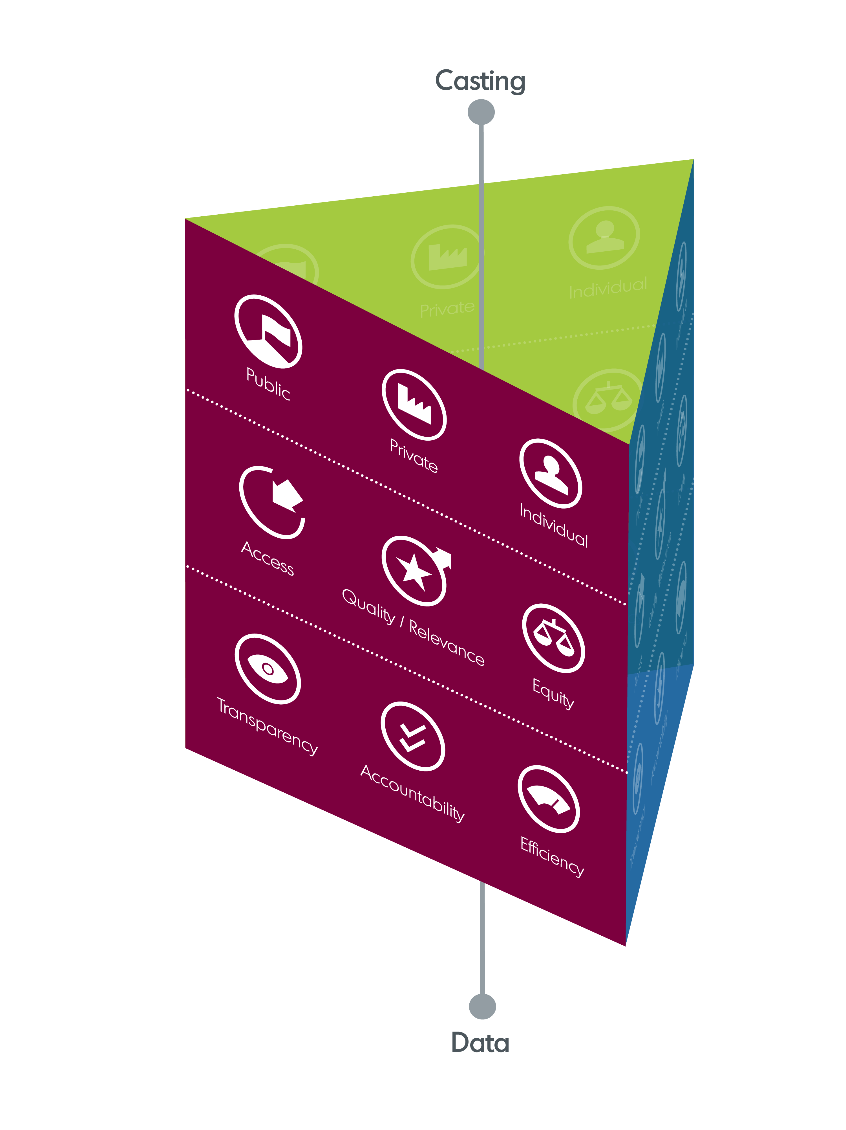
From resource allocation to equal learning opportunities: Using financing instruments as drivers for education policies
A peer learning week for Eastern Partnership countries
9-13 March 2026, Lisbon - Portugal
Overview of the Portuguese education system
AGSE
DGEPA

Slide 2
Table of Contents
01
Overview of the financing and governance of the Portuguese education system and broad policy lines of action
AGSE
04
Monitoring and reporting results
DGEPA
02
05
Laranjeiras School Cluster
AEL
Education System Financing
AGSE
03
Financing of school clusters and non-grouped schools
AGSE

Slide 3

Overview of the financing and governance of the Portuguese education system and broad policy lines of action

Slide 4
Topics
I – Education Policy Framework in Portugal
II – Education System Financing
III – Procedures for the financial management of the Portuguese education system

Slide 5
I.i – Constitution of the Portuguese Republic*
Article 74 – (English)
1. Everyone is entitled to education and to equal opportunities of access and educational success.
2. When putting in place educational policies, the role of the State to: (a) ensure universal, compulsory and free basic education; (b) establish a public system and develop the general system of early childhood education; (...) ( F) insert schools in the communities serving and interlinking economic, social and cultural education and activities; g) To promote and support the access of students with disabilities to education and to support special education, whenever necessary; (...) (I) ensuring that the children of the emigrants are taught the Portuguese language and access to Portuguese culture; (...)
02
* Decree of 10 April Approval of the Constitution
As amended by: Constitutional Law No. 1/82; Constitutional Law 1/89; Constitutional Law 1/92; Constitutional Law No. 1/97; Constitutional Law 1/2001; Constitutional Law No 1/2004; Constitutional Law 1/2005.

Slide 6
I.i- Constitution of the Portuguese Republic
Article 75 (Public, private and cooperative education)
The state will set up a network of public education institutions covering the needs of the whole population.
The State recognises and oversees private and cooperative education, in accordance with the law.

Slide 7
I.ii – Educational System Base Law*
Education policy is governed by the Education System Basic Law.
It aims to ensure equal access to public education by promoting educational success and, by doing so, equal opportunities for compulsory 12-year schooling.
The Portuguese education system is divided into three levels of education: pre-school education, basic education and secondary education.
Pre-school education, with an optional frequency cycle from 3 to 6 years old.
Basic education, which comprises three sequential cycles:
1st cycle, 4 years duration and start of compulsory education (expected age group 6 – 10 years)
2nd cycle, 2 years duration (expected age group 10 – 12 years)
3rd cycle, with a duration of 3 years (expected age group 12 – 15 years).
Secondary education – three years (10th, 11th and 12th grades, 3 years duration), (expected age group 15 – 18 years old) and aims at further education and or integration into the labour market. Available courses: Scientific and Humanistic; Vocational courses; Specialised Artistic Courses with their own plans (dance, music, and drama).
03
Law No 46/86 of 14 October 1986, as amended;

Slide 8
I.iii Programme of the XXV Constitutional Government (2025-2029)
04

Slide 9
Policy goals
Bring Portuguese students with above OECD-average performance levels in PISA 2029 assessments;
Universalisation of access to early childhood from the age of 3 years old onwards;
Ensuring effective integration of foreign students into public education and schools
Attract and train new teachers and improve their placement process in schools to eliminate students without classes/subjects by 2029.
Raise the excellence and quality of educational outcomes whereas leaving no students behind;
Implement robust information and integrated management systems that ensure accurate information and data, simplify administrative procedures and guarantee the transparency of processes.

Slide 10
Measure(s)
Modernising the education system relying on public schools' clusters: more autonomy to teach and manage
Valuing teachers' careers and jobs
Start early: education services delivery from 0 to 6 years old
Enhancing learning: a quality and flexible curriculum for uncertainty settings
Support measures targeting inclusive education for all
Addressing social inequalities by granting access and success in education pathways
Diversity and freedom to learn

Slide 11
II. Educational system funding
05
The financing of the education system in Portugal is mainly provided by the (central) State Budget, through revenue from taxes, covering expenditure on staff (teaching/non-teaching) and operational costs.
It includes school social support (Ação Social Escolar - ASE) for families in need, tax benefits and support for special educational needs. School clusters own revenues and funding via European funds (Recovery and Resiliance Plan and Funds, European Social Funds - Pessoas2030, Erasmus+ funds) for innovation and digitalisation.

Slide 12
II.i Legislative framework for financing
The Budget Framework Law (Law No 151/2015 of 11 September 2015 as amended) – lays down the rules for the preparation, approval, implementation and monitoring of the State budget.
Main Budgetary Lines for Budget for 2023 – 2026 (Law No 38/2023 of 2 August 2023) – multiannual programming
State Budget Law for 2026 (Law No 73-A/2026 of 30 December 2026) and Reports of the proposal for SO – Presentation and justification of the proposed fiscal policy for the economic year 2026.
The Budget Execution Decree-Law aims to ensure adequate control of budget implementation, which is indispensable for compliance with the provisions of the State Budget Law.

Slide 13
II.ii Preparation of the Education Draft State Budget
The draft State Budget submitted by the Government (Ministry of Finance) to the Portuguese Parliament includes:
the planned estimations of revenues and expenditures,
the Accounting Maps with information on revenues and expenditures according to the budget classifiers (covering the aggregate budget of non-aggregated school and school clusters), and autonomous services and funds.
The information accompanying the draft State Budget Law is detailed in Article 37 of the Budgetary Framework Law.

Slide 14
II.iii Preparation of the Draft State Budget
The Financial Management Department works on information submitted by all School Clusters and the Non-grouped schools and logs on the platform of the State Budget System.

Slide 15
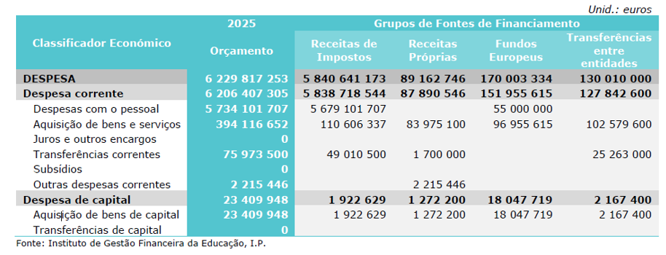
II.iv Preparation of the Draft State Budget (example of 2025 budget execution)

Slide 16
II.v Individual budgets from School Clusters and the Non-grouped schools
With the entry into force of Decree-Law No 21/2019 of 30 January 2019, which lays down the framework for transferring competences to municipal bodies and intermunicipal bodies in the field of education, the proposed operational budget only provides for the economic classifications that fall within the remit of the Ministry of Education, namely expenditure on transport, staff, examinations, teacher training, personal teaching and non-teaching competitions, surveillance, advertising.

Slide 17
II. Funding sources
Tax revenues
OWN RESOURCES
Sources of income
European funds (ESF, RRF, others)
Transfers within the Public Administration (Municipalities and Parishes)
Projects funded by partners

Slide 18
III – Educational System (financial actors)
Local Authorities (Municipalities and Parishes)
Non-grouped school and school Clusters
Agency for the Management of the Education System (AGSE)
Supervisory bodies (Accounts Court and Inspectorates)
Ministry of Finance
Parliament of the Portuguese Republic
06

Slide 19
III. i Transfer of Competences in education field to Municipalities
Decree-Law No 21/2019 of 30 January 2019 implements the transfer of competences from the central government to municipal bodies and intermunicipal entities in the field of education, aimed at:
Decentralisation and autonomy
Improvement of school infrastructure
Reducing inequalities across school clusters and territories
Support for Transport and Accommodation

Slide 20
III.ii Non-aggregated schools and School Clusters
In Portugal, the establishment of school clusters started in the late 1990s and was intensified from 2002 onwards.
Decree-Law No 115-A/98, dated of 4 May 1998, as amended, brings together educational establishments (individual schools) from early childhood education to elementary education (three cycles) and secondary education (high-school).
The School Clusters aim to promote a more efficient and joint management of human, material (financial) and pedagogical resources, through the implementation of a common educational project to foster continuity and co-linking curricula, as well as improving the quality of teaching and learning across all levels of education.
07

Slide 21
III.iii Financial management bodies of School Clusters
07
General Assembly (or Council): Sets the guidelines for the establishment of the budget; It evaluates the management accounts report.
Executive Directorate (or Management Team): Draws up the draft budget in accordance with the guidelines of the Assembly.
Governing Board – is the administrative and financial decision-making body:
— Approves the draft annual budget and prepares the management accounts report;
— Authorises expenses

Slide 22
III.iv Reform of the Ministry of Education, Science and Innovation (on-going)
08
Ensuring equal opportunities in access to quality education across the national territory, as well as generating and transforming talent and knowledge into social and economic value.

Slide 23
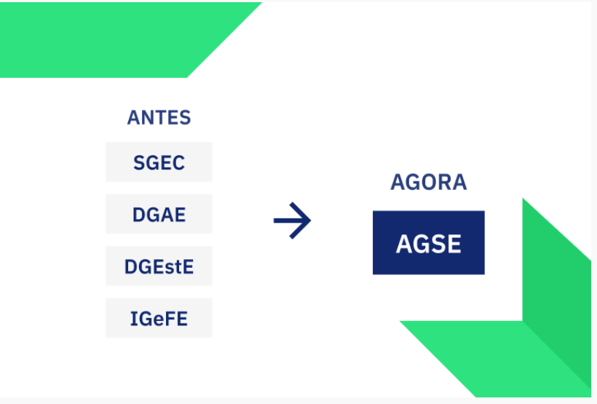
III.V Reform of the Ministry of Education, Science and Innovation
The Agency for the Management of the Education System, I. P. (AGSE, I. P.), established by Decree-Law No 99/2025 of 28 August, is a body of the indirect state administration, within the remit of the Ministry of Education, Science and Innovation (MECI), to manage the education system in its different dimensions and areas.
The AGSE is the result of the reform of public administration and aggregates, in whole or in part, the powers of the Secretariat-General for Education and Science (SGEC), the Directorate-General for School Administration (DGAE), the Directorate-General for School Establishments (DGEstE) and the Institute for Financial Management of Education (IGeFE, I.P.)

Slide 24
III. vi The AGSE
Main objectives:
To fulfil its mission, the AGSE has a set of strategic objectives that guide their daily action and strengthen support for the functioning of education communities:
Making schools simpler and more autonomous
Coordination and efficiency in education administration
Single channel of communication in the education system
Rationalisation of human and financial resources
Digital transformation and educational innovation
Ensure strategic alignment with education policies

Slide 25
III. vii The AGSE Department of Financial Management
The Financial Management Department (Article 9 of Ministerial Implementing Order No 296-A/2025/1 of 5 September 2025) is responsible for:
Prepare the budget proposal for all School Clusters to integrate the State budget
Defining the criteria and procedures for the distribution of the budget among School Clusters
Monitor and report on the budgetary implementation of School Clusters projects and actions
Providing financial support to School Clusters
Propose budgetary changes within the School Clusters' budget
Implementing revenue collection allocated to the School Clusters

Slide 26
III.Viii Final budget proposal
Approved budget proposal for the Ministry of Education- includes the budget of all School Clusters to be submitted to the Portuguese Parliament in the context of the preparation of the draft State Budget Law.

Slide 27
III. Parliament of the Portuguese Republic
Approves, through the State Budget Law, the budget of all School Clusters (single budget) for a given economic year.

Slide 28

General framework of policies and processes for funding and resource management of the Portuguese education system

Slide 29

General framework of policies and processes for funding and resource management of the Portuguese education system Topics:
Setting up school Clusters
Social Support System for vulnerable students and families (ASE)
Decentralisation of competences regarding education

Slide 30

School Clusters
The creation of the School Clusters was part of public policies to reorganise the educational network, started in Portugal in the late 1990s and strengthened in the 2000s.
This model brings together schools from early childhood (3 years old) to elementary (1st, 2nd, and 3rd cycle of basic education) and upper-secondary education (12th grade) in one unique entity aggregating different individual schools.

Slide 31
Purposes
1. Promoting a sequential and articulated learning journey of students covered by compulsory education (12 years of schooling) in a given geographical area;
2. Overcoming situations of isolation of individual schools and preventing social exclusion and early drop-outs;
3. Strengthening the educational capacity of its member institutions (individual schools of different education levels) and the rational use of resources (human and financial);
4. Ensuring the implementation of a system of school autonomy, and stronger administration and management procedures;
5. Valuing and encouraging on-going experiences at different individual schools.

Slide 32
Main advantages
1. Pedagogical and curricular coherence
The vertical integration of the education cycles allows for continuous monitoring of students’ educational pathways, ensuring greater curricular articulation, uniformity of pedagogical practices and smoother transitions between education levels.
2. Improvement of organisational management
The existence of a single management team favours the rationalisation of resources, the standardisation of procedures, the reduction of administrative dispersion and the creation of more consistent decision-making structures.

Slide 33
Main advantages
3. Strengthening community responsiveness
School Clusters allow for a closer relationship with local authorities, families and local partners, promoting educational projects that are more aligned with territorial characteristics and needs.
4. Optimising human and material resources
Joint management facilitates the balanced distribution of non-teaching staff, the sharing of facilities and the more efficient use of equipment and services.
5. Institutional identity building
Creating a common organisational culture contributes to greater stability, sense of belonging and continuity of educational practices.

Slide 34
Challenges
Leadership
The director and management team are faced with increased responsibilities, which require leadership, mediation and conflict management skills on a broader scale.
Administrative management
The management of multiple, sometimes geographically dispersed individual schools, increases the administrative burden and requires strong coordination and supervisory capacity.
School identity
Smaller schools may experience a loss of autonomy and dilution of their local or pedagogical specificity within a larger cluster.

Slide 35
Challenges
Resource management
The distribution of resources and attention can become uneven across schools, especially where there are significant differences in size, socio-economic contexts, or specific needs of students, families and communities.
Internal communication
Physical distance between individual schools and the multitude of teams and services can make it difficult to communicate and standardise practices.

Slide 36

School Social Action (ASE)
Social and educational support measures integrated in family-supporting social policies (articulation with the Ministry of Social Affairs).
It promotes equal opportunities in educational access and success.
It ensures that compulsory education is carried out until the age of 18, regardless of socio-economic conditions.

Slide 37
Objectives of the ASE
Ensuring equal opportunities in access to education.
Combating social exclusion and early school leaving.
Fostering educational success.
Mitigating the effects of socio-economic inequalities.
Support households in most vulnerable situations.

Slide 38
Recipients of the ASE
Children and pupils taking part in early childhood education, elementary education (three cycles) and upper-secondary education.
Recipients of social benefits are aligned with social security categories for other social assistance programs:
Category A – group 1 of student's benefits
Category B – group 2 of student's benefits

Slide 39
Modalities of support for the ASE
Provision of school meals with full or partial co-payments.
Economic aid
Textbooks (one-size-fits-all and free application)
Schooling and accommodation
Merit Fellowships
For secondary school pupils with relevant school achievement and in need of economic situation (b or b)
School Insurance
Transportation to students living at a certain distance from school
Medical care and medicines.
School milk
School material (bucket A and Scottish B)
Study visits (bucket A and Scottish B)
Transporting to students with specific needs
Housing support for secondary school students
Transport, accommodation, food
Protes/technical aid
Compensation
Food support
Damage to third parties
Funeral expenditure
(pre-primary and 1st cycle)

Slide 40

Decentralisation
It consists of transferring competences from the central state to local authorities, bringing the management of public services closer to citizens.
In the education sector, decentralisation aims to strengthen the responsiveness of schools, improve resource efficiency, better link with local needs and ensure the quality of the school network closer to management, respecting the pedagogical autonomy of non-aggregated school/school clusters.

Slide 41
Decentralisation Key transferred competences for Municipalities
ASE – Social Support for Education
2008
2014
2019
Meals (pre-primary and 1st cycle)
Management of school equipment (pre-school and 1st cycle)
Education transport
Management of food support
Organising school transport for students with specific needs
Support for accommodation
Extension to primary and secondary education
Notes:
3) School Social Action
Managing the ESA for all levels of basic education (1st, 2nd and 3 rd cycles), including:
meals;
socio-economic support
organisation of school transport,
school residences.

Slide 42
Decentralisation over time
The 1990s
School autonomy, administration and management
Late 1990s and 2000 Creation of School Clusters
Years 2000 Modernisation and strengthening of autonomy
2013–2021 Progressive transfer of skills to municipalities
2022 Full Decentralisation of Education
Notes:
1. 1980s – First foundations of autonomy and participation
Legal acts:
Law No 46/86 of 14 October – Educational System Base Act (LBSE) → Introduces principles of educational community participation and school autonomy.
Decree-Law No 769-A/76 (albeit earlier) influences the structuring of collegiate bodies and democratic management.
2. 1990s – school autonomy, administration and management
Key legal acts:
Decree-Law No 115‐A/98 of 4 May 1998 Restructures management.
It strengthens the participation of the education community.
It consolidates the logic of school autonomy and accountability.
The need for re-organisation of the school network is emerging.
Decree-Law No 172/91 (first steps in reorganisation of non-high education) → Influences subsequent policies.
3. Late 1990s and 2000 – Creation of school groupings
Structural acts:
Decree-Law No 115‐ A/98 (cited) → Formally creates the concept of grouping.
→ Restructuring of management.
→ Strengthen the participation of the education community.
→ Consolidates the logic of school autonomy and accountability.
Order No 13313/2003 → Guides the principles and criteria for establishing clusters.
4. The 2000s – Modernisation and strengthening of autonomy
Relevant legislation:
Decree-Law No 30/2002 (organisation of the school network) → Supports territorial reorganisation and logic of mega-clusters (later reinforced in 2010–12).
Decree-Law No 75/2008 of 22 April 2008 → Restructuring of management; it establishes the General Council as a strategic body.
Decree-Law No 7/2003 → Lays down the rules governing educational charters, increasing the role of municipalities in the planning of the school network.
Programme for the modernisation of the school park (2007–2011) – as part of Council of Ministers Resolution No 1/2007.
5. 2013–2021 – Progressive transfer of skills to municipalities
Basic legislation:
Law No 75/2013 of 12 September 2013 → Establishes the legal framework for local and inter-municipal authorities, paving the way for greater municipal participation.
Decree-Law No 30/2015 → Defines the decentralisation of powers to municipalities and intermunicipal entities.
CAP – Aproximar Programme (2016) (Resolution of the Council of Ministers 44/2016) → Drives the gradual transfer of operational areas (maintenance, meals, transport...).
Law No 50/2018 of 16 August 2018 → Framework law on the transfer of competences to local and regional authorities.
Decree-Law No 21/2019 of 30 January 2019 → Regulates the transfer of skills to municipalities in the field of education.
6. 2022 – Full decentralisation of education
Structural acts:
Ministerial Implementing Order No 72‐C/2022 → Implement operating procedures for the full transfer.
Resolution of the Council of Ministers No 123/2022 → Consolidates decentralisation in the education sector.

Slide 43
Guiding principles for Decentralisation
1. Subsidiarity
Decisions need to be taken at the level closest to citizens, where that level is able to implement them effectively.
2. Autonomy and responsibility
Municipalities receive competences, resources and responsibility for their successful implementation.
3. Proximity
Recognising that local and regional authorities are better aware of the social, demographic and territorial realities of their educational communities.

Slide 44
Guiding principles
4. Institutional cooperation
Need for articulation between Ministry of Education, Science and Innovation, Municipalities, Non-grouped Schools/Schools Clusters and Intermunicipal Communities.
5. Equity
Ensuring that skills transfer does not create inequalities in access or quality of education.
6. Transparency and accountability
Local and regional authorities should report and ensure the sound management of the transferred resources.

Slide 45
Main changes Competences transferred from the Ministry to the Municipalities
Management of Non-Docent Staff (Operational Assistants and Technical Assistants).
Infrastructure and equipment.
Educational offers and complementary activities (AEC, AAAF, CAF).
Financial management.
Social Support for Education (ASE)
School network.
Notes:
1) Management of non-teaching staff
Transfer to municipalities of the management of non-teaching staff, such as operational assistants and technical assistants, including:
recruitment;
allotment,
assessment;
training;
links (with public administration rules).
2) Infrastructure and equipment
Municipal responsibility for:
day-to-day maintenance and upkeep of school buildings
small reparations,
purchase of equipment (IT, furniture, etc.)
management of school transport.
3) Educational offer and complementary activities
Municipal competence in the organisation and operation of:
curriculum enrichment activities (AEC)
animation and family support activities (AAAF)
family support components (CAF),
managing local educational programmes.
4) Financial management
Transfer of funds:
maintenance funds;
service contracts;
food,
operating expenditure.
Greater autonomy and also greater accountability.
5) School social activity
Managing the ESA for all levels of basic education (1st, 2nd and 3 rd cycles), including:
meals;
socio-economic support
organisation of school transport,
school residences.
6) School network
Involvement of municipalities in planning and streamlining the establishment network:
opening and closing schools
defining up- or reskilling needs
articulation with the DGE in the most impact decisions.

Slide 46

Financing of school clusters and non-grouped schools

Slide 47
Legislative framework
The Budget Framework Law (Law No 151/2015 of 11 September 2015 as amended) lays down the rules for the preparation, approval, implementation and monitoring of the State budget.
The State Budget Law (Law No 73-A/2025 of 30 December) contains the presentation and justification of the proposed fiscal policy.
Budget Execution Decree-Law (DL No 13-A/2025 of 10 March 2025) aims to ensure adequate monitoring of budget implementation, which is indispensable for compliance with the provisions of the State Budget Law
Circular Serie A-1412 with instructions for the preparation of the State Budget for 2026.
Circular Serie A-1411 with the instructions applicable to the 2025 budget implementation (in force until the 2026 instructions are published)
01

Slide 48
Description of the Budgetary Process
Analysis of results
Enforcement
Approval
Based on previous year’s track record and outturn
Budget cycle
Preparation of the Proposal
Sending to the Budgetary Authority
Submission to the SOE
Notes:
Portugal’s education system is financed mainly through the State Budget, covering expenditure on staff (teaching/non-teaching) and operating. Includes school social support (SEA) for families in need, tax benefits and support for special educational needs, and funding via European funds (RRP, People 2030, Erasmus+) for innovation and digitalisation

Slide 49
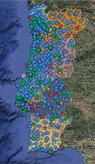
The School Public Network
The public school network consists of 809 non-grouped schools and school clusters that are aggregated into a single integrated service, the Basic and Secondary Education and Education Institutions (EEEBS – 4266), which aggregates all budgetary and financial information for these entities.

Slide 50
Preparation of the EEEBS Budget Proposal
The Aggregator carries out the recording of the budget proposal directly in SIGO/SOE (Fiscal Management Information System/State Budget System) of the Budget Entity, adopting a simplified version of the economic classification of public revenue and expenditure.
Measure: 017 – Education (most representative)
Activities: 510 – Building the Future: 6-18 years old
Organic Budget (activities and projects)
Education Budget proposal
By source of funding.
By economic classification of revenue and expenditure

Slide 51
Funding sources
Tax revenue
Own income
FUNDING SOURCES
European Union (i.e. ESF+ and others)
Transfers within the Public Administration (Municipalities)
Project funding (i.e. Recovery and Resilience Plan and Funds)

Slide 52
Funding sources

Slide 53
Activity codes
Designation
Sport activities
Universal pre-schooling
Building the Future: from 6 to 18 years old
Lifelong Learning: Adult training
Extra-curricular activies for Elementary and Secondary Education
Portuguese for non-Native Speakers
ASE – Public Education (social support measures)
Priority Intervention Education Territories (TEIPs)
External assessment: Evalution to learn better
Public education – Artistic Courses
New pedagogical methodologies
Public Education – VET
Digitalisation and deburocratisation
Financial Resources Management

Slide 54
Fiscal programme and measures

Slide 55
By economic classification of revenue and expenditure

Slide 56
EEEBS – OE2026 Initial Allocation by FF/Grouping

Slide 57
EEEBS – OE2025 Budget execution by FF/Aggregation

Slide 58
Individualised Budget by Organic Unit
02

Slide 59
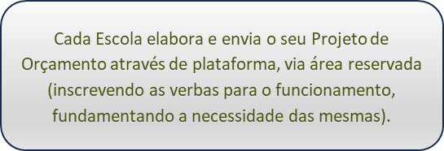
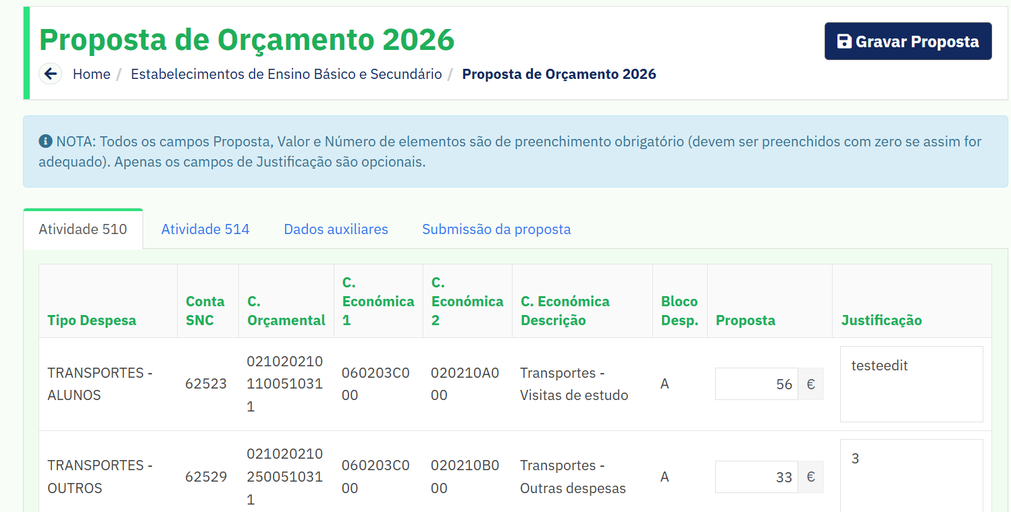
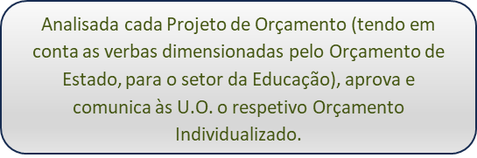
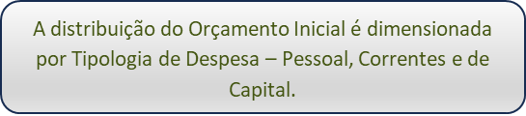
Proposal for an Individual Budget by School Cluster (organic unit)

Slide 60
Budget Individualised by School Cluster (Organic Unit)
With the entry into force of Decree No 21/2019, which lays down the framework for transferring competences to municipal bodies and intermunicipal entities in the field of education, the proposed operating budget only provides for the economic classifications that fall within the remit of the MECI, namely the expenditure on Block A (transport, staff, examinations) and Bloco G (training of teachers, teaching and non-teaching competitions, surveillance, advertising)

Slide 61
Allocation of the Individual Budget by OU
Prior to the approval of the Individualised Budget to the U.O. to cover its expenditure, it implements a transitional budget on the basis of the twelfths of the budget approved in the previous year.
The allocation of the Initial Budget (IB) is made available through the School Reserve Area and is then uploaded via webservice to the local applications by the software providers.
When the budget is approved, each EU will readjust the value of its twelfths to the new figures.

Slide 62
Monitoring of budget execution
03

Slide 63
Guidelines and Monitoring
Communication of Information Note with the annual update in the first half of each calendar year:
Fiscal classifiers;
List of Receipts and guidelines on the delivery of balances from last year.
The calls for funds drawn up by the EA/NAS are monitored/verified by technicians, who monitor the implementation of the budget and analyse whether the amounts required by the OUs correspond to their assets.
The technical staff responsible for the School Cluster also settle the requests for reinforcement of funds requested by the EA/NSA in the context of projects such as RBE, PNL, European Clubs, among others.

Slide 64
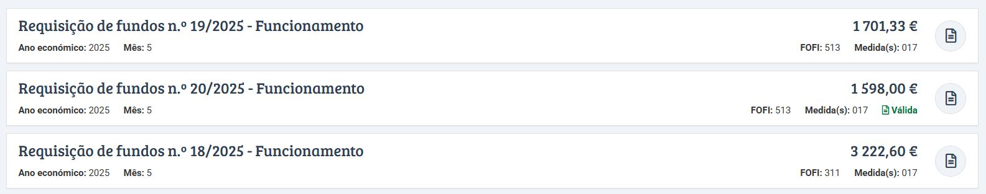
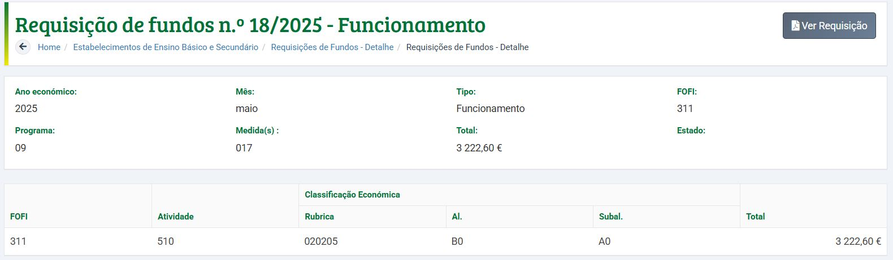
Budget monitoring – Operating requirements – GesEdu Platform

Slide 65
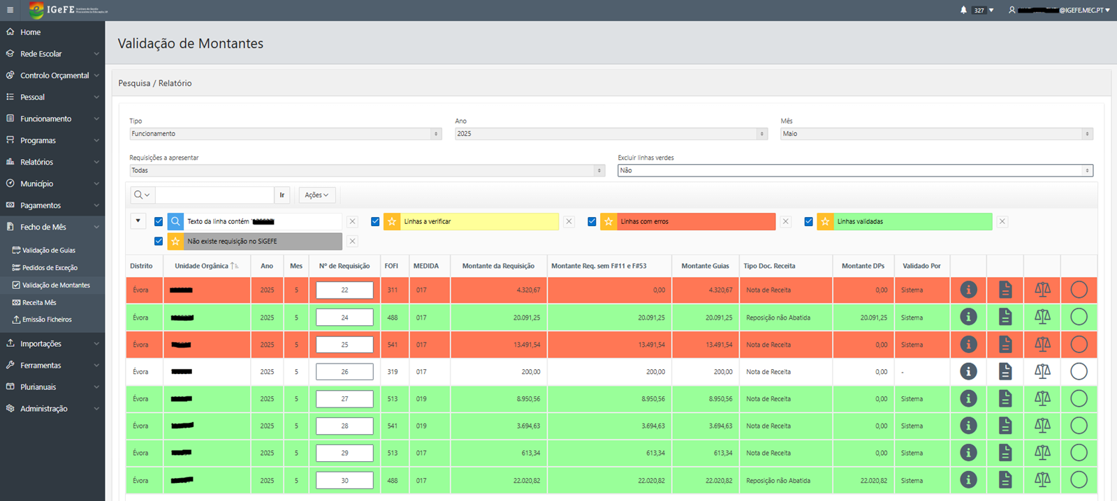
Budget Implementation Validation Requisitions for Operations – SIGeFE Platform

Slide 66
Budget Implementation Staff expenditure
Each School Cluster sends to the AGSE, via webservice, to the SIGeFE platform, the requests for Funds of Teaching Staff (detailed). These requests are also available to the School Cluster in its reserved area (GesEdu).
Actors involved | Before | Centralised
School Clusters | Demand for money | Requisition of funds
AGSE, I.P. | Transfer to each School Cluster | Transfer to DP (NDS for Professional Schools/Agricultures and Higher Techniques and Specialists) Centralised IGCP account
Teachers Payroll | Expiry 23 of each month | Maturity 23 of each month (Notice No 176/2023 of 04/jan)
The EMSA through local software obtains the information from the Teachers Registry in the Single Repository for Human Resources of Education (signature, remuneration index, biographical data).
Centralised maturity payment
(Article 91 of Decree-Law No 108/2023 of 8 February 2023)

Slide 67
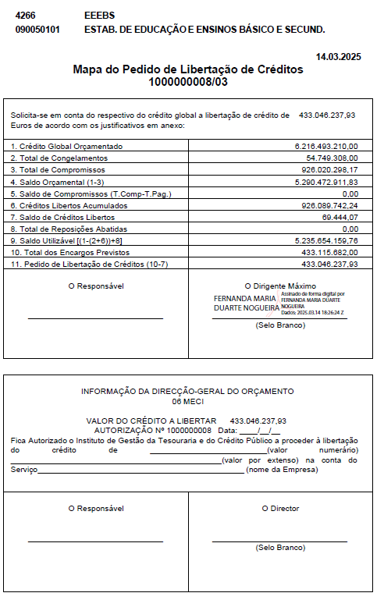
Fiscal monitoring Application for Liberation of Credits
This information is received by AGSE, between 1 and 10 of each month, for its validation. The final figures are obtained, the PLC (Credit Liberation Plan) is drawn up and sent to the Budget Entity by 15.
The accounting information of the organic units is aggregated on a monthly basis in two requests for Liberation of Credits (Activities and Projects) submitted on the GERFIP platform.
On authorisation, the respective payment is made.

Slide 68

Monitoring and reporting results (specific education policies initiatives)
Joaquim Santos
joaquim.santos@dgepa.meci.pt
Margarida Leandro
margarida.leandro@dgeec.medu.pt

Slide 69
About DGEPA
Directorate-general for Studies, Planning and Evaluation
Central service of the direct administration of the State, with administrative autonomy, created by Decree-Law No. 101/2025 of 8 September.
New body that cuts across all areas of the MECI's work, providing technical support for the definition of strategic priorities and educational policies.
Among other duties…
Prepare and promote studies for the formulation of strategic priorities, provide support for the formulation of educational policy programmes or measures, and design instruments for planning, monitoring and evaluating the policies developed within the scope of the MECI, as well as consolidating functions in the field of international relations.
And also…
Coordinating role in budgetary matters, ensuring the monitoring of the preparation, implementation and monitoring of MECI budgetary programmes.

Slide 70
1. At this point…

Slide 71
At this point…
It was assumed the importance of describing specific monitoring processes for specific public education policy measures…
… although there is a willingness to present and discuss broader issues, or even more specific ones if deemed appropriate.

Slide 72
It will be considered…
The monitoring process of two specific support policy measures includes in “Plano A+A”, during the 2024/2025 school year:
psycho-pedagogical tutoring
language and cultural mediators

Slide 73
2. The policies…

Slide 74
The ‘Learn More Now’ plan
‘Learn More Now’ Plan, Council of Ministers Resolution No. 140/2024, 17 October
Causes/motivations
Sharp decline in Portuguese results in international evaluations (PISA, TIMSS), which has reversed much of the robust progress made until 2018.
Inequalities among students from disadvantaged socioeconomic backgrounds
Aims/General goals
A set of measures aimed at improving learning and aligned with the '+Classes +Success' plan, ensuring that all students receive the lessons and learning opportunities they are entitled to
A new external assessment model designed to make the monitoring of the learning process more reliable and comparable

Slide 75
Quality Education for ALL
New model of
external accessment

Slide 76
The ‘Learn More Now’ plan
These current education policies focus on three main areas:
Improving learning outcomes
Supporting the integration of migrant pupils and students
Promoting the responsible use of digital technologies and devices in schools
(priorities addressing emerging challenges in today's education systems)

Slide 77
It will be considered…
I - Improving
learning
Focus on learning, student support and process improvement
II - Integration and sucess of migrant students
Response to Sharp increase of migrant students
III - Recommendations to schools on the use of smartphones
Recommendations to schools on the use of smartphones (and screens and digital technology)
Learn More Now (A+A)

Slide 78
Learn More Now A+A: Specific items (i)
Axis 1
Improving Learning
1.1. Start from age 0
1.2. Invest in reading proficiency during the early school years
1.3. Acting before failure happens
1.4. Involve retired teachers in learning support
1.5. Focus pedagogical assessment on learning outcomes
1.6. Promote independent study
1.7. Share information on the use of mobile phones in schools

Slide 79

Learn More Now A+A: Specific items (ii)
Axis 2
Integration and Success of Migrant Students
2.1. Hire linguistic and cultural mediators
2.2. Review the Portuguese as a Non-Native Language (PLNM) subject
2.3. Clarify the assessment of migrant students
2.4. Simplify equivalency procedures in basic education (primary and lower secondary)
Axis 3
Recommendations regarding the use of smartphones, screens and digital technology in schools
SupportingFile

Slide 80
Learn More Now A+A: “questionnaire”
Axis 2
Integration and Success of Migrant Students
2.1. Hire linguistic and cultural mediators
2.2. Review the Portuguese as a Non-Native Language (PLNM) subject
2.3. Clarify the assessment of migrant students
2.4. Simplify equivalency procedures in basic education (primary and lower secondary)
Axis 3
Recommendations regarding the use of smartphones, screens and digital technology in schools

Slide 81
3. Two specific policy measures

Slide 82
Acting before failure happens / Improving learning
Psycho-pedagogical tutoring
Extension of specific tutorial support to preventive psycho-pedagogical tutoring, targeting students who have not experienced grade repetition but exhibit learning difficulties, starting from the 1st cycle of primary education
Support delivered by teachers with specialized training or by educational psychologists, in close coordination with teaching teams and the Multidisciplinary Support Teams for Inclusive Education (EMAIE)
Main goal: enhance learning outcomes and equip students to make informed choices regarding their academic and professional pathways, ensuring the involvement of qualified and specialized personnel throughout the process.
Starting date: September 2024

Slide 83
Acting before failure happens / Improving learning
Psycho-pedagogical tutoring, selected indicators
Adherence level of schools
No. students covered by psycho-pedagogical tutoring
No. beneficiary students, by grade
No. students by SESS level, with mothers with low educational attainment and/or from migrant families
Who are the tutors (teachers and/or educational psychologists)
No. students tutored, per tutor
No. hours per week tutors devotes to individualized work with students
Proportion (%) of tutored students who complete primary education – 1st. cycle, without retention

Slide 84
Acting before failure happens / Improving learning
Psycho-pedagogical tutoring, some PRELIMINARY results
Adherence level of schools
No. students covered by psycho-pedagogical tutoring
Who are the tutors
No. students tutored, per tutor
SupportingFile

Slide 85
Hire linguistic and cultural mediators
Integrate migrant students
Support schools that receive the highest number of migrant students
Focus on students newly arrived in the Portuguese education system, with foreign nationality and non-CPLP (Community of Portuguese Language Countries) background
Past allocation, 2023/2024 school year: 272 mediators
Ratio: half a mediator for every 10 students (as credit hours or equivalent financial value)

Slide 86
Hire linguistic and cultural mediators
Integrate migrant students, selected indicators
No. mediators (head count and FTE)
Proportion (%) of mediators, by nationality
Proportion (%) of mediators, by intensity
Proportion (%) of mediators, by type of professional or academic qualification
Proportion (%) of mediators who perform other duties at the school / school cluster

Slide 87
Estimating costs with human recourses
Part of the monitoring process for each of the measures in the A+A plan involved estimating human resource costs (where applicable)
The estimates were obtained from the costs incurred by the Ministry in paying the teachers and technicians needed to implement the measures mentioned—annual salaries, social security contributions paid by the employer (MECI), and meal allowances.
In each case, and according to the information collected by the various rating instruments implemented, or administrative data held by the MECI, teachers or technicians are placed on a remuneration index that allows the estimated overall expenditure figures now presented to be obtained
SupportingFile_Finance

Slide 88
4. The intended results of the monitoring process

Slide 89
Intended results of monitoring (i)
Monitoring understood as a systematic process of collecting, analyzing, and interpreting data to understand whether the policy is being implemented as planned and with what immediate effects
Verification of the degree of implementation (e.g., coverage of measures, planned vs. expected)
Assessment of the quality of execution (how the measures were implemented; identification of good practices and operational constraints)
Measurement of immediate effects (early outcomes)

Slide 90
Intended results of monitoring (ii)
Monitoring understood as a systematic process of collecting, analyzing, and interpreting data to understand whether the policy is being implemented as planned and with what immediate effects
Support for decision-making (if necessary, adjust implementation; support better allocation of human, material and financial resources)
Identification of risks and early warnings (and development of mitigation proposals)
Production of evidence for future evaluations (basis for interim or impact evaluations; definition of metrics, baseline indicators, and time series).

Slide 91

Laranjeiras School Cluster
March 2026

Slide 92

Composition of the Grouping
Institutions with pre-school education and the 1st Cycle | 2nd, 3rd Cycles and Upper-Secondary Education institutions
EB1/JI School in Laranjeiras | Basic school 2.3 Professor Delfim Santos
EB1/JI school frei Luís de Sousa | D. Pedro V Secondary School
EB1/JI António Nobre school

Slide 93
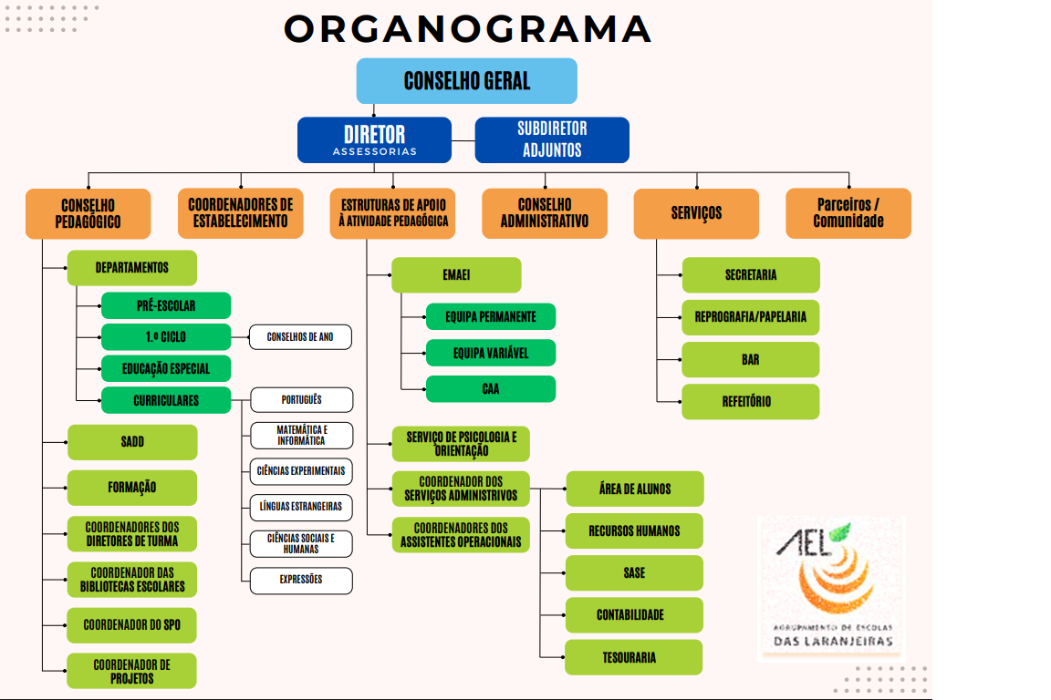
AEL’s institutional organigramme

Slide 94
AEL Management Team School Cluster Management
Director
Amilcar Santos
Assistant director
Anselmo Jorge
Deputy
Maria Rosário Simões
Deputy
Vera S. Miguel
Deputy
Maria Luísa Nogueira

Slide 95
Curriculum
From Preschool to High School
PROFESSIONAL COURSES:
-Performing Arts – actors/Actress
— Computer Systems Management and Programming Technician
— IT Technician – Systems
— Tourism
— Tourism Operations
— Sports Management Support
— Healthcare Assistant

Slide 96
Budget and School funding

Slide 97
Administrative organisational chart Organisational Chart for School Management and Administration
Accounting
Treasury
School social action
Staff area
Attendance
General Council
Technical coordinator
Administrative Council
Director
Salaries
Student area
Digital school
Procurement
Coordination of operational assistants

Slide 98
Revenue
OGE
General State Budget
OCR
Compensation Budget in Revenue

Slide 99
OGE (General State budget) requested in twelfths
Expense
Salaries
— Taxes and fees
— Social Security
Transport
Software licenses
Contracting Services:
— Pest control
— Occupational medicine
— Food control and safety systems

Slide 100
OCR Compensation Budget in Revenue
AGSE
Agency for the Management of the Education System
Own Resources
City Council
Parish Council

Slide 101
OCR Compensation Budget in Revenue
EFSE:
- Certificates
Exam – Registration
— Taxes/Fines
School social action (ASE)
— Buffet
— Stationery – Store
— School Insurance
Rentals Facility
Gyms/Classrooms/Auditorium
Reprography
Expense
- Sports equipment
— School furniture
— Computer equipment
Expense
— Library Books
— Teaching Materials
— Laboratory Materials
Expense
— Supplies
— Personal Uniform
— Equipment
Expense
— Nutrition
— School accidents
— Teaching materials

Slide 102
OCR Compensation Budget in Revenue
Current Expenses:
— Electricity
— Communications
— Cleaning Supplies
Maintenance and
Conservation
Social Support:
— Activity Sheets
— Calculators
— Trips field
— School Supplies

Slide 103
OCR Compensation Budget in Revenue
Parish Council
Current Expenses – Primary Schools:
Cleaning supplies
Consumable materials
Photocopies (Contract)

Slide 104
OCR Compensation Budget in Revenue
AGSE
Agency for the Management of the Education System
Social Supports:
School Accidents
School Supplies
MERIT Scholarships
Study Visits

Slide 105
Monthly Income/Expense Circuit
Income OCR
Revenue OGE
Authorisation from AGSE
Deposit account into the month in question.
Transfer of Entities
Request for operating funds
Personnel fund request

