Slide 1

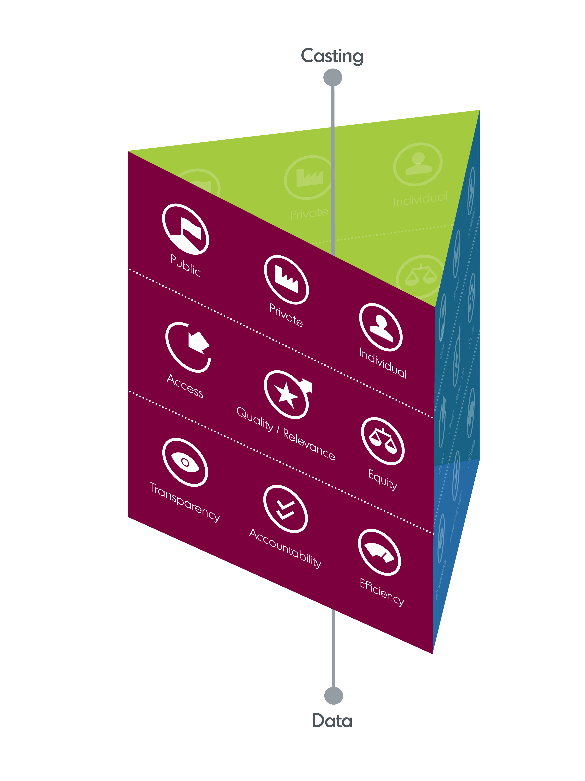
From resource allocation to equal learning opportunities: Using financing instruments as drivers for education policies
A peer learning week for Eastern Partnership countries
9-13 March 2026, Lisbon - Portugal
Overview of questionnaires responses

Slide 2
Main current challenges

Slide 3
Financial instruments in place

Slide 4
Main achievements and best practice

Slide 5
Main achievements/best practice
Formula-based funding mechanisms (per-student, per-class, or hybrid models)
Increased transparency and predictability in financing through formulas or data systems.
Performance-related financing or incentives (for institutions or teachers)
Digitalisation and financial transparency tools.
Armenia
  Per-class funding formulas for general education.
  teacher-related financing mechanisms: teacher bonuses, financing for professional development, performance-related incentives.
  Scholarships targeting priority specialities
Georgia
  “Voucher” (per-student) school financing model
  Recent teacher salary increases linked to reforms.
Ukraine
Formula-based funding systems (esp. schools and higher ed.)
Performance-based funding in higher education
State education subsidies (e.g. teacher salary subsidy to local budgets)
Open data dashboards and digitalisation of expenditure monitoring.
Moldova
  Per-student financing formulas in general education.
  Spending review processes
  Performance-based components in higher education financing,
  Integration with medium-term budgeting frameworks

Slide 6
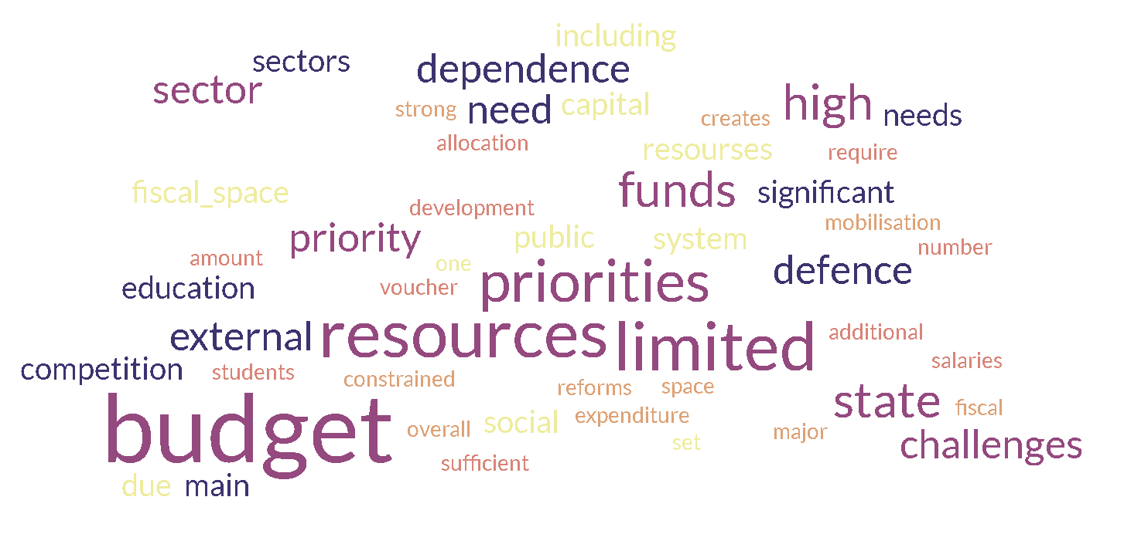
Q5.3 Main challenges in resource mobilisation

Slide 7
Q5.1 Main challenges in resource mobilisation
Limited fiscal space is a major constraint across countries.
External shocks and competing priorities affect education funding: defence spending (Ukraine), economic crises or demographic pressures (Moldova).
Financing reforms and infrastructure improvements.
Armenia
  Overall budget limitations despite education being a government priority.
  Need to better align spending with strategic education priorities.
Georgia
  Inefficiencies in the current funding model.
Moldova
  Limited fiscal space,
  Dependence on external financing.
Ukraine
Severe fiscal constraints due to defence spending
Reliance on international assistance
Limited private sector participation in education financing.

Slide 8
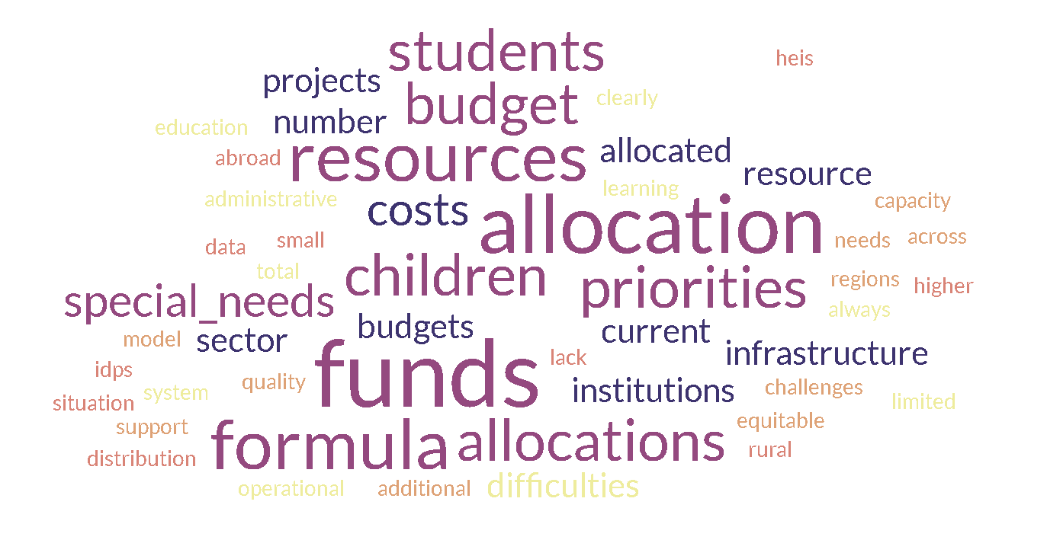
Q5.3 Main challenges in resource allocation

Slide 9
Q5.2 Main challenges in resource allocation
Inequalities between regions or types of schools.
Weak alignment between funding and needs or policy objectives.
Difficulty targeting vulnerable groups or special needs students.
Demographic change and migrations complicate accurate allocation of funds.
Armenia
  Weak connection between strategic objectives and budget allocations.
  Challenges include:
    out-of-school children,
    financing for inclusive education and reintegration.
Georgia
  Salaries ~90% of school budgets, little room for other expenditures.
  Concerns about:
    unequal funding distribution,
    students with special needs.
Moldova
  Persistent territorial disparities, particularly affecting small or rural schools.
  Financing formulas may insufficiently reflect social vulnerability.
Ukraine
Difficulties caused by war and population displacement:
    Internally displaced students,
    Students abroad
    Damage to infrastructure
    Unreliable demographic data

Slide 10
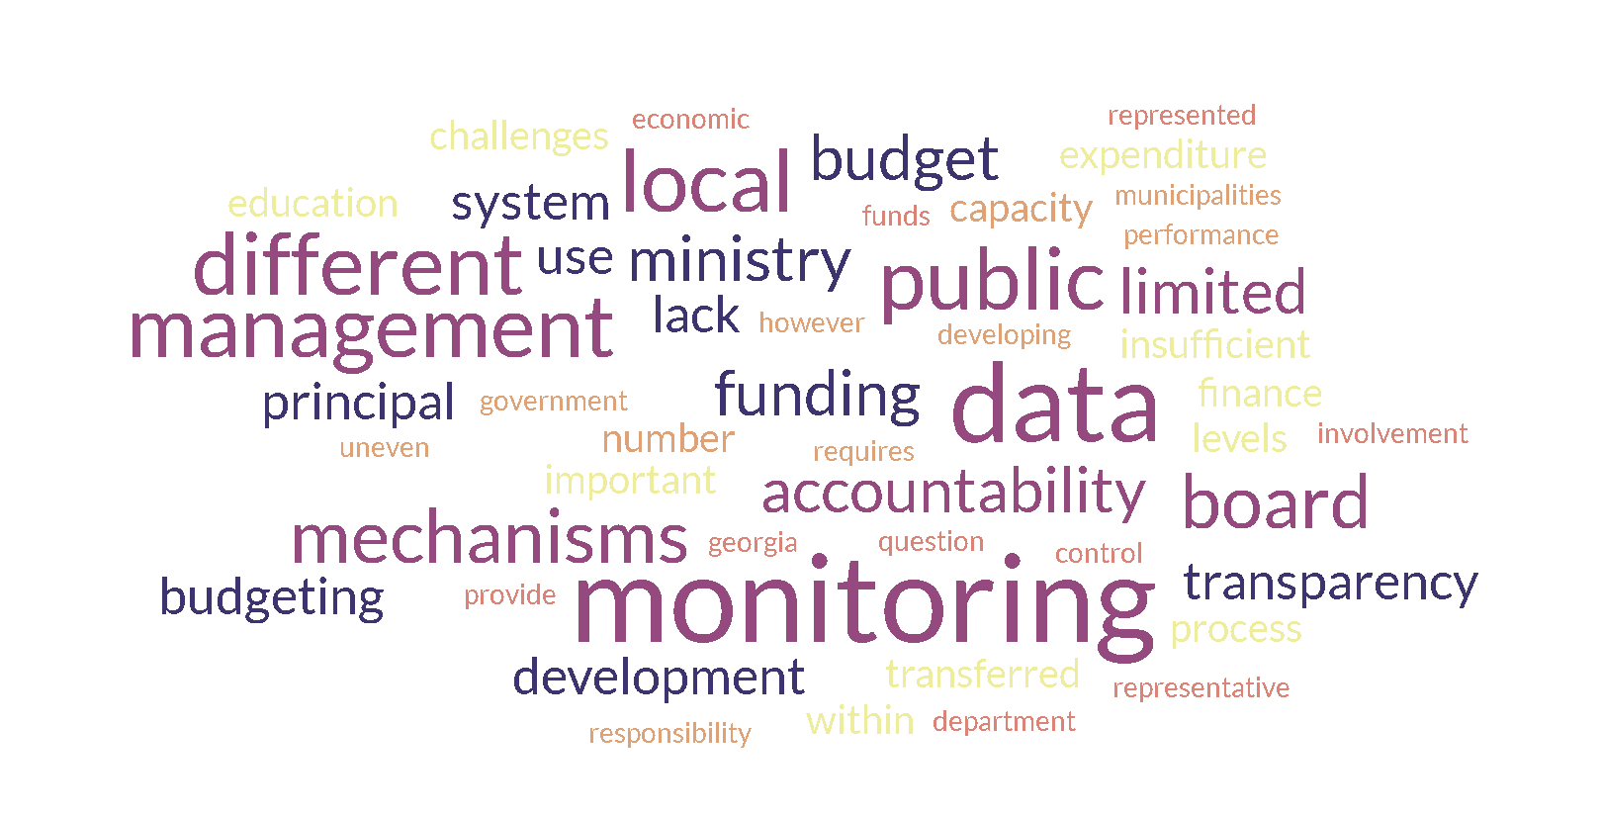
Q5.3 Main challenges in governance of education

Slide 11
Q5.3 Main challenges in governance of education funding
Limited administrative or financial management capacity, particularly at local level.
Weak use of financial and performance data for decision-making.
Need for stronger monitoring, transparency, and outcome-oriented budgeting.
Armenia
  Mixed views:
    limited financial management capacity
    governance mechanisms functioning well.
  Need to better integrate costing into policy planning
Georgia
  Limited financial autonomy of schools.
  Minimal challenges thanks to treasury integration of school accounts.
Ukraine
Fragmented data systems,
Uneven financial management capacity at local levels
Insufficient use of financial data for policy evaluation.
Moldova
  Weak performance monitoring,
  Limited local administrative capacity,
  Insufficient use of non-financial data in budgeting.

