Slide 1
Policy Analysis: Theoretical Foundations
Hugues Moussy
Yerevan, 29 January 2026

Slide 2
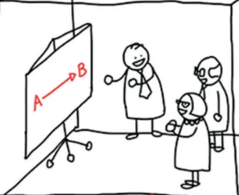
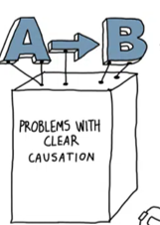
From A to B…
Notes:
That’s usually how we plan to decide…

Slide 3
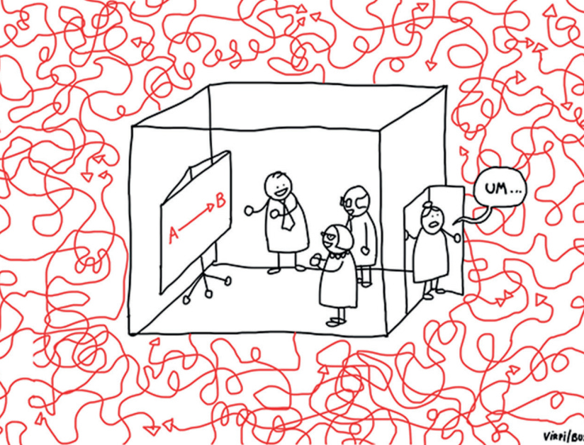
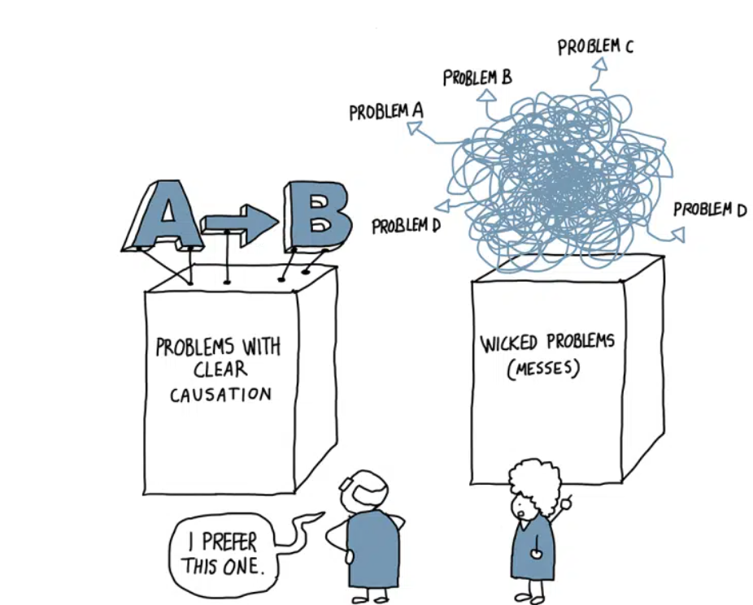

…or is it??
Notes:
... But things are way more complex!

Slide 4
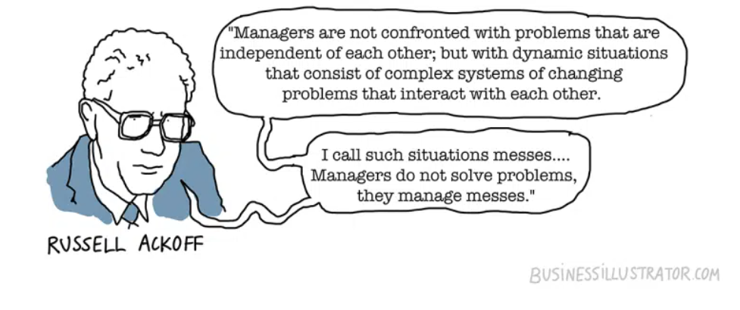
The Science of Muddling Through
Ackoff, R. L. (1974). Redesigning the Future: A Systems Approach to Societal Problems. Wiley. Ackoff, R. L. (1981). Creating the Corporate Future: Plan or Be Planned For. Wiley. Ackoff, R. L. (1978). The Art of Problem Solving: Accompanied by Ackoff’s Fables. Wiley. .
Notes:
Russell L. Ackoff (1919–2009) was a pioneer in the fields of operations research, systems thinking, and organizational theory. He is best known for his work on understanding organizations and public systems as interconnected, dynamic “messes”, rather than as linear structures with isolated problems.
Ackoff rejected traditional, reductionist problem-solving and promoted “interactive planning”—a participatory, iterative, and adaptive approach that accounts for the complexity and unpredictability of real-world systems.
Charles E. Lindblom, another foundational figure in public policy theory, known especially for his concept of incrementalism and his critique of idealized, rational models of decision-making. “Policy-making is a science of the muddled middle”: Lindblom’s phrase captures a core tension:
Policy-making is neither purely rational nor completely random — it's somewhere in between. It’s a process of negotiating trade-offs, balancing interests, and adjusting based on what is politically feasible and administratively manageable.
This “muddled middle” involves:
Working with incomplete knowledge,
Building consensus,
Making iterative improvements,
And accepting uncertainty.
Lindblom, C. E. (1959). The Science of Muddling Through. Public Administration Review, 19(2), 79–88. DOI: 10.2307/973677

Slide 5
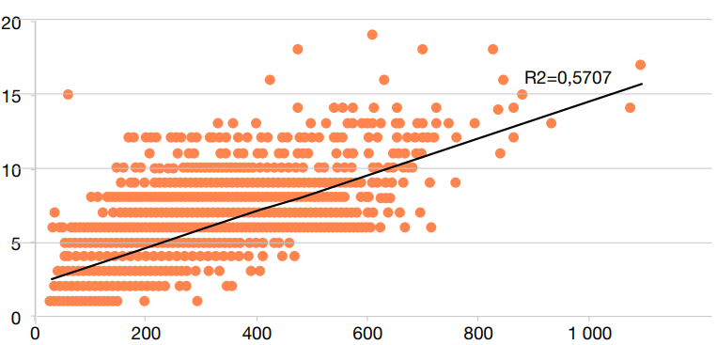
Where Is the Problem?
Number of Teachers
Number of Students
Notes:
RESEN CI 2021. Distribution of teachers.
Le graphique montre que, s’il y a une tendance générale à affecter plus d’enseignants aux écoles ayant plus d’élèves, la situation globale reste très incohérente. À titre d’illustration, des écoles ayant le même nombre d’élèves (par exemple 400 élèves) ont un nombre d’enseignants très variable (entre 3 et 16 enseignants). De même, des écoles qui ont le même nombre d’enseignants (par exemple 5 enseignants) ont à leur charge un nombre très variable d’élèves (de moins de 50 à 700 élèves). Cette répartition peu optimale des enseignants traduit les déséquilibres régionaux en matière du ratio élèves-maître, mais également des disparités intra-régionales dans l’allocation des enseignants. Même au sein d’une même région, les enseignants ne sont pas bien répartis entre districts et écoles. Seules deux régions (Bagoue et Tchologo) témoignent d’une corrélation entre le nombre d’enseignants et le nombre d’élèves élevée (proche ou égale à 0,80). Cette corrélation est particulièrement basse à Abidjan (0,14) où le REM est le plus élevé (52,8:1). Pour une politique éducative plus inclusive et plus efficace 129 L’aléa dans l’allocation des enseignants, de 43 %, est particulièrement élevé en Côte d’Ivoire Malgré sa diminution entre 2007 et 2014, l’aléa dans l’allocation des enseignants reste élevé en Côte d’Ivoire, situant le pays parmi ceux où les aléas sont les plus élevés. En effet, comme le montre le tableau 4.9, le pourcentage des décisions d’affectation des enseignants primaires du secteur public qui ne relève pas de l’effectif des établissements varie entre à peine 13 % pour la Gambie, et 54 % pour le Ghana. La Côte d’Ivoire est proche de ce maximum, avec un degré d’aléa de 43 %.
When we get into the details, the main issues appears to be political, not technical.
What lesson: First of all, we need data to determine the amplitude of a problem. But data don’t solve issues. You need a bunch of analysis.
In general, in education, we have to deal with conflicting objectives, limited data, political agendas, and unintended effects.

Slide 6
Policy Analysis: A Compass in a Messy World
What Is Policy Analysis?
Systematic process of examining policy options and consequences to support informed decision-making.
Not to give “the answer,” but to clarify trade-offs, evidence, and implications.
Why We Need It
To introduce structure, logic, transparency into decision-making.
To unpack assumptions, challenge biases, clarify objectives.
To anticipate impacts and monitor change.

Slide 7

Policy Analysis: A Mindset of Inquiry
Policy analysis is not just a method, it’s a mindset:
Be skeptical of assumptions.
Evidence
Ask: what’s the problem really?
Opinion
Ask: for whom is this a solution?
Interests and rents
Ask: what could go wrong?
Side effects

Slide 8
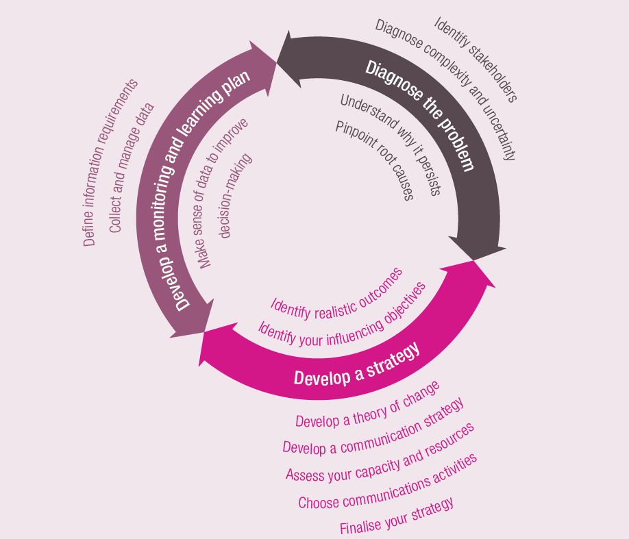
You Still Need a Method…
Notes:
Many approaches exist. More or less the same logic:
Circular and continuous,
Phased and sequenced,
Data and Evidence, Diagnostic, Strategy and Planning
Classic stages: Problem → Option → Assessment → Decision → Implementation → Evaluation.
Reality: messy loops, feedback, political shifts.
Bring in the role of ETF tools (e.g., Torino Process as diagnosis, RED for responsiveness).
Example:
ROMA – Rapid Outcome Mapping Approach. Developed by ODI in 2014.
Each step is associated with a set of tools, to be used with partners and stakeholders to develop a shared understanding of what the objectives are and what needs to be done. In some cases, these tools will be a series of questions to be answered with research and analysis; in others, they will be workshop or interview techniques. Policy processes can be highly political, sometimes involving dense networks of actors and coalitions with competing values and interests. Engaging with policy in these types of environment requires a collaborative approach, and ROMA has been designed specifically to facilitate collaborative engagement. Drawing on the principles of OM, each of the stages includes tools to help groups and networks of policy actors to coordinate their work and learn together.

Slide 9
High level of inequity
Inequitable opportunities
Inequitable outcomes
Inequity in resource allocation
Poor enabling environment
Inefficient monitoring systems
Low levels of learning
Low levels of completion
Lack of equity and inclusion in policy and legal framework
Low levels of stakeholder engagement
Lack of autonomy and capacity at decentralized levels
Exclusion in administration and registration practices
Lack of monitoring data on those at the bottom
Lack of evidence-informed decision-making for those at the bottom
Inequitable budget allocation
Inequity within the educational levels
Low numbers of teachers
Textbooks
Low teacher quality
School distribution

Slide 10
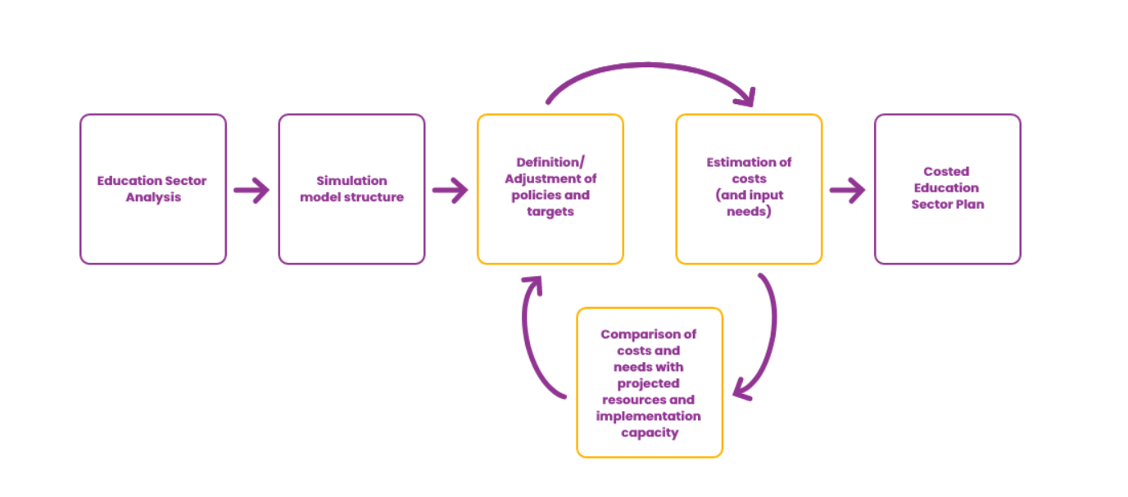
You Need a Development Process…
Notes:
Many approaches exist. More or less the same logic:
Circular and continuous,
Phased and sequenced,
Data and Evidence, Diagnostic, Strategy and Planning
Classic stages: Problem → Option → Assessment → Decision → Implementation → Evaluation.
Reality: messy loops, feedback, political shifts.
Bring in the role of ETF tools (e.g., Torino Process as diagnosis, RED for responsiveness).
Example:
ROMA – Rapid Outcome Mapping Approach. Developed by ODI in 2014.
Each step is associated with a set of tools, to be used with partners and stakeholders to develop a shared understanding of what the objectives are and what needs to be done. In some cases, these tools will be a series of questions to be answered with research and analysis; in others, they will be workshop or interview techniques. Policy processes can be highly political, sometimes involving dense networks of actors and coalitions with competing values and interests. Engaging with policy in these types of environment requires a collaborative approach, and ROMA has been designed specifically to facilitate collaborative engagement. Drawing on the principles of OM, each of the stages includes tools to help groups and networks of policy actors to coordinate their work and learn together.

Slide 11
You Need Tools…
Notes:
Many approaches exist. More or less the same logic:
Circular and continuous,
Phased and sequenced,
Data and Evidence, Diagnostic, Strategy and Planning
Classic stages: Problem → Option → Assessment → Decision → Implementation → Evaluation.
Reality: messy loops, feedback, political shifts.
Bring in the role of ETF tools (e.g., Torino Process as diagnosis, RED for responsiveness).
Example:
ROMA – Rapid Outcome Mapping Approach. Developed by ODI in 2014.
Each step is associated with a set of tools, to be used with partners and stakeholders to develop a shared understanding of what the objectives are and what needs to be done. In some cases, these tools will be a series of questions to be answered with research and analysis; in others, they will be workshop or interview techniques. Policy processes can be highly political, sometimes involving dense networks of actors and coalitions with competing values and interests. Engaging with policy in these types of environment requires a collaborative approach, and ROMA has been designed specifically to facilitate collaborative engagement. Drawing on the principles of OM, each of the stages includes tools to help groups and networks of policy actors to coordinate their work and learn together.

Slide 12
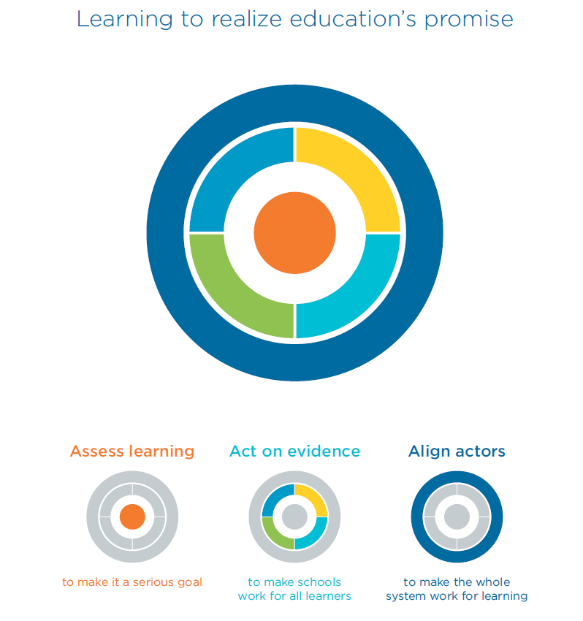
…and You Need Data and Evidence!
Notes:
Types of evidence: statistics, evaluations, expert judgment, stakeholder perspectives.
Caution: Evidence ≠ truth. It must be interpreted, contextualized, communicated.

Slide 13
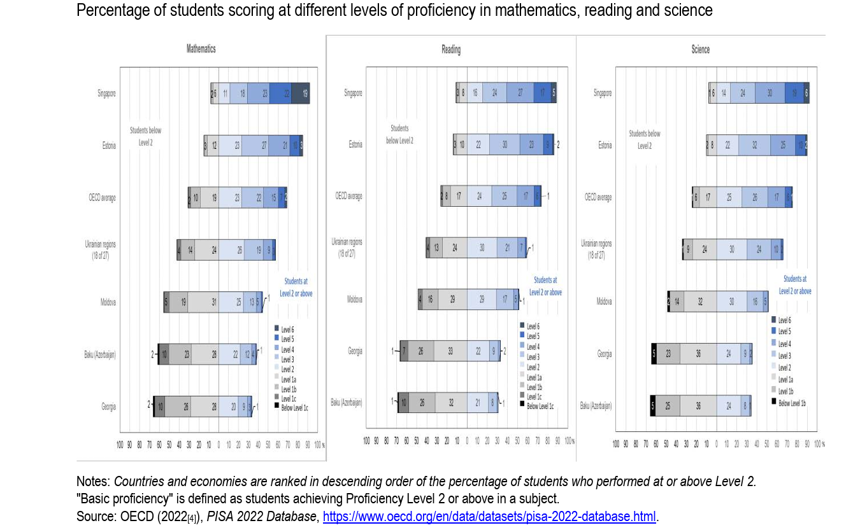
PISA in EaP
Notes:
Learning outcoms assessments are key
Make point on inequality
PISA Education in the Eastern Partnership: Findings from PISA
OECD/UNICEF, 2024

Slide 14
Types of Evidence Needed for Strong Policy Analysis
Monitoring and Statistical Evidence
Time‑series indicators on access, progression, completion, outcomes (e.g., from Education at a Glance, UIS data).
System performance metrics: enrolment, transition rates, attainment levels.
Evaluations
Formative evaluations – early implementation insights
Summative evaluations – assessing outcomes and impact
Process evaluations – how implementation works in context
Meta‑Evaluations and Syntheses
Systematic reviews, meta‑analyses — comparing evidence across contexts to identify what works, where and why.
Academic and Theoretical Research
Peer‑reviewed research providing conceptual grounding, causal understanding and theoretical frameworks for explaining complex policy phenomena.
Rapid Assessment Tools
Rapid Education Diagnostics (RED), policy scans — to inform short‑cycle decision needs.
Qualitative and Stakeholder Evidence
Interviews, focus groups, participatory action research — to capture lived experience, local context, and policy uptake dynamics.
Integrated System Data
Dataset combinations for cross‑cutting insight: linking labour market, skills supply, education outcomes, and employer needs.

Slide 15
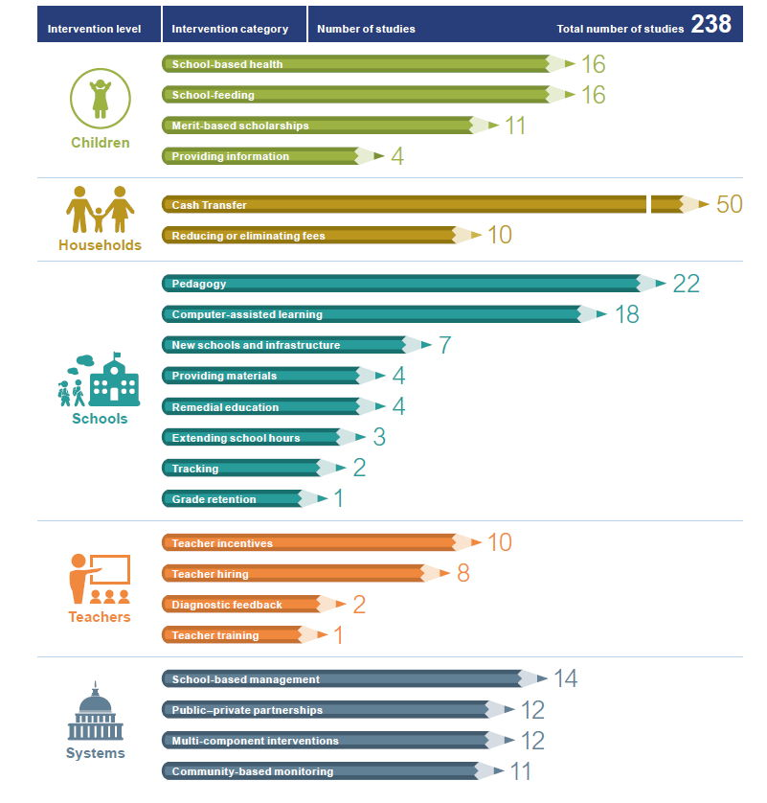
A Wide Range of Evidence, Reports… and Biases
Notes:
Be aware that the distribution of evidence infers its own biases.

Slide 16
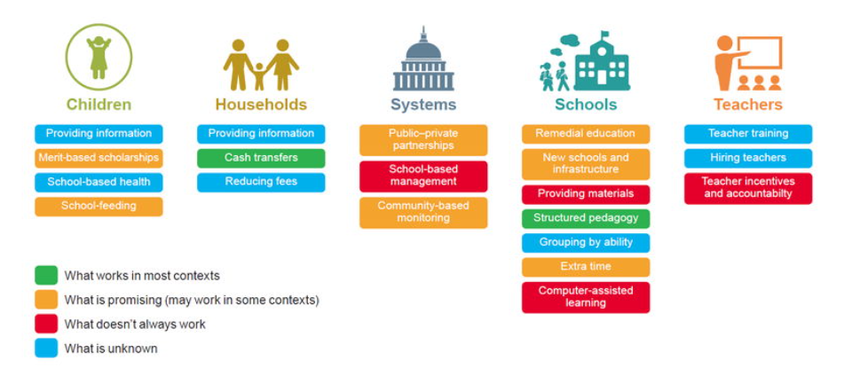
From Evidence to Policy
Notes:
When going from evidence to policies:
Ensure you have the appropriate and relevant evidence to make a decision
Think in terms of policies AND systems, pieces and the whole
Ensure adequate actors have been associated

Slide 17
The Political Economy of Education
Political economy in education refers to the study of how political, institutional, and economic factors interact to shape education policy, planning, and reform. It examines the interests, incentives, power relations, and institutions that influence how education systems are governed, resourced, and changed.
Why do some countries adopt and successfully implement policies that improve learning, but most do not?

Slide 18
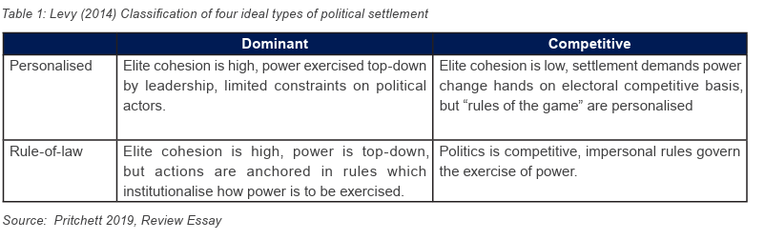
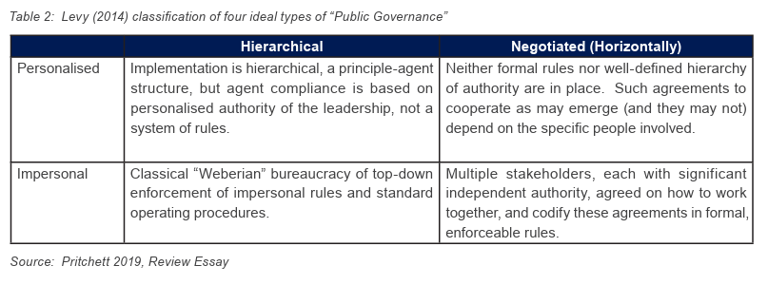
Political Settlement and Public Governance

Slide 19
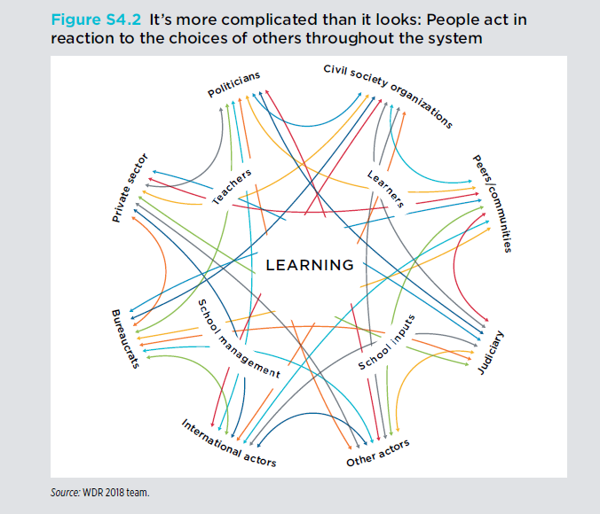
The Political Economy of Education Actors

Slide 20

Final Takeaways
Policymaking is complex, but policy analysis helps:
See clearer,
Choose better,
Justify responsibly.

Slide 21
Thank you!
Hugues Moussy

