Slide 1


EXCELLENCE AT SYSTEM LEVEL:
OPPORTUNITIES AND CHALLENGES
NAME OF THE PROGRAMME
Mervi Jansson
CEO, Omnia Education Partnerships Ltd.
Chair of VETQA Committee Finland
Proposal

Slide 2





OEP - A PART OF THE OMNIA GROUP
Key figures
1200 ^{staff members}
^{Annual budget} 95 M€
3000 Public private partnerships
^{Vocational Qualifications} 13000
^{Professional Development}
^{and upskilling courses} 17000
Liberal Adult Education Courses 20000
Annual enrollment
International
123 ^{nationalities}
Center of Vocational Excellence
^{UNEVOC iHUB}
^{Non-profit, municipality owned}
^{Joint Authority of Education}
^{International Consultancy Arm:}
OEP - Omnia Education Partnerships
© Omnia Education Partnerships Ltd. 2024 ┃ www.oep.fi

Slide 3
OEP MISSION & VISION
GLOBAL NEXT PRACTICES
We transform Finnish education and training best practice into global next practice for public and private sector customers. Our goal is to provide tangible change for individuals and organizations.
EMPLOYABILITY
Education and training are means to ensuring employability and job creation. Our programs follow Finnish standards. Learning outcomes are industry developed and soft skills are blended into professional content.
SUSTAINABLE DEVELOPMENT GOALS
Education and training are core elements in achieving the UN 2030 Agenda. Our programs contribute directly or indirectly to reaching all 17 goals. We support sustainable growth and thriving local ecosystems.
© Omnia Education Partnerships Ltd. 2024 ┃ www.oep.fi

Slide 4
Strategic VET policies up to 2030 in Finland
Comprehensive quality management
Customer-orientation
Continuous improvement towards excellence
Competences and result-orientation
Decision-making, steering and leadership
© Omnia Education Partnerships Ltd. 2024 ┃ www.oep.fi

Slide 5



FINNISH VET MODEL
National level: 160 vocational qualifications, 3000 modules covering all
major industries
National Level: learning outcomes, competence requirements and assessment process feeding into national data base
VET providers design their own curriculum and learning environments, blending core and professional studies
with sustainable skills
Vet providers: diverse partnerships with private sector, universities, local authorities and other VET providers to promote careers, lifelong learning and job creation
VET provider quality assurance with transparent national level reporting
© Omnia Education Partnerships Ltd. 2024 ┃ www.oep.fi

Slide 6
OBJECTIVES OF THE FINNISH VET QUALIFICATIONS
System level
Based on skills forecasting
Needed in working life
Responsiveness to change
Principles
Flexibility
Individual pathways
to qualifications
Upskilling paths
Validated in practice
Focus on
Learning outcomes
Ability to apply and keep learning
High level professional capacity
Assessed in real work context
© Omnia Education Partnerships Ltd. 2024 ┃ www.oep.fi

Slide 7

STRUCTURE OF FINNISH VET PROGRAMS
Learning and assessing professional competencies and soft skills
Flexible learning and assessment in diverse environments;
at workplace, at school workshops and labs, online, through projects, etc.
Diploma
Competence assessment in practice
Competence demonstrations through out the studies in working life environments
Personalized study plan based of RPL*
All qualifications have compulsory and elective modules as well as cross-cutting lifelong learning competence goals
Enrollment
(*Recognition of Prior Learning)
© Omnia Education Partnerships Ltd. 2024 ┃ www.oep.fi

Slide 8

THE VET LEARNING AND ASSESSMENT PROCESS
BUILDS ON NATIONAL QUALIFICATION REQUIREMENTS AND DIVERSE LEARNING ENVIRONMENTS
LEARN
APPLY
REFLECT
Classroom
Theoretical principles and knowledge, core learning skills
Potential theoretical exams to ensure readiness for work-based learning and assessment
School Labs / Simulations
First contact to practice
in a safe learning environment
Guidance and feedback from the teachers
Assessment of competence development
Work-based Learning
Real working life practice
Versatile work tasks according to the competence requirements
Guidance and Feedback from the company mentor
Assessment of competence demonstrated through work tasks
Final Competence Assessment
Summary of all recognized competence
Main focus on competence demonstrated through work tasks
Lab demonstrations, practical exams, theoretic exams may be used to complete the assessment data
© Omnia Education Partnerships Ltd. 2024 ┃ www.oep.fi

Slide 9
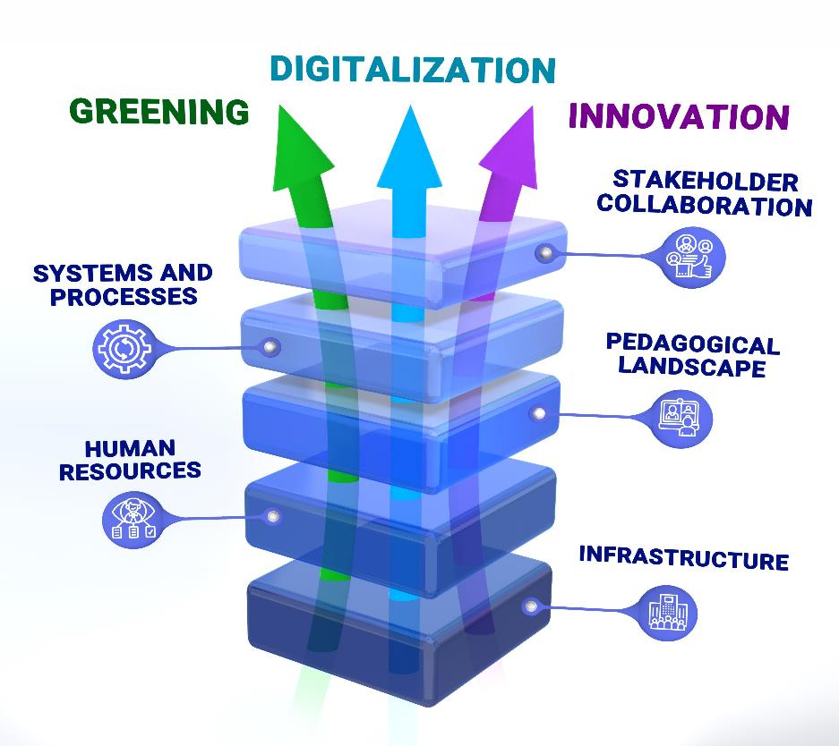
THE OEP BLUEPRINT OF EXCELLENCE FOR VET
STAKEHOLDER COLLABORATION
E.g., agreements, industry partnerships, research and innovation projects
SYSTEMS AND PROCESSES
E.g., quality assurance, data management, enrolment process, reporting
PEDAGOGICAL LANDSCAPE
E.g., qualifications, micro-credentials
LMS, digital tools, learning modalities, work-based learning, career and guidance services
HUMAN
RESOURCES
E.g., staffing plan, teacher development plans, roles and responsibilities
INFRASTRUCTURE
E.g., physical learning environments, equipment and tools, shared spaces with industry
© Omnia Education Partnerships Ltd. 2024 ┃ www.oep.fi

Slide 10
OUR APPROACH
LEARN
APPLY
REFLECT
DEVELOP
Understand the present status quo and set targets and key strategies for further excellence development in selected focus areas
Take action across the organization, measure results, review progress.
Amend development plan and KPI’s as required due to potential changes in technology, operating environment, etc.
Engage in national level dialogue, contribute to international R&D networks, be a beacon of innovation within selected focus areas
Timeline
6 months
1 year
Ongoing loop after first year
10 ┃7

Slide 11
APPLICATIONS OF THE MODEL - A VET EXCELLENCE AUDIT
STAGES
1
2
3
1. Capacity building on excellence and desk review of pre-defined documents
2. Analysis of findings and planning of on-site audit
3. On-site audit planned across horizontals and verticals.
Workshop on excellence for key staff and stakeholders
4. Online follow up survey for management, teaching staff, students and stakeholders
5. Results and recommendations workshop including milestones and actions points
6. Ongoing collaborative activities to improve status quo, set and reach new goals for continued excellence
© Omnia Education Partnerships Ltd. 2024 ┃ www.oep.fi

Slide 12
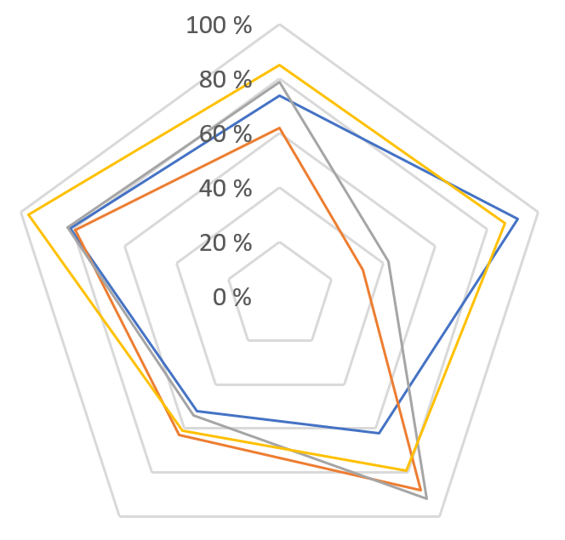
360 Survey - Horizontal Layers
Infrastructure
 | STUDENTS | TEACHERS | MANAGEMENT | STAKEHOLDERS
INFRASTRUCTURE | 74% | 62% | 79% | 85%
HUMAN RESOURCES | 92% | 32% | 42% | 87%
PEDAGOGICAL LANDSCAPE | 62% | 88% | 92% | 79%
SYSTEMS AND PROCESSES | 52% | 63% | 54% | 61%
STAKEHOLDER COLLABORATION | 81% | 79% | 82% | 97%
Stakeholder collaboration
Human resources
Systems and processes
Pedagogical landscape
© Omnia Education Partnerships Ltd. 2024 ┃ www.oep.fi

Slide 13
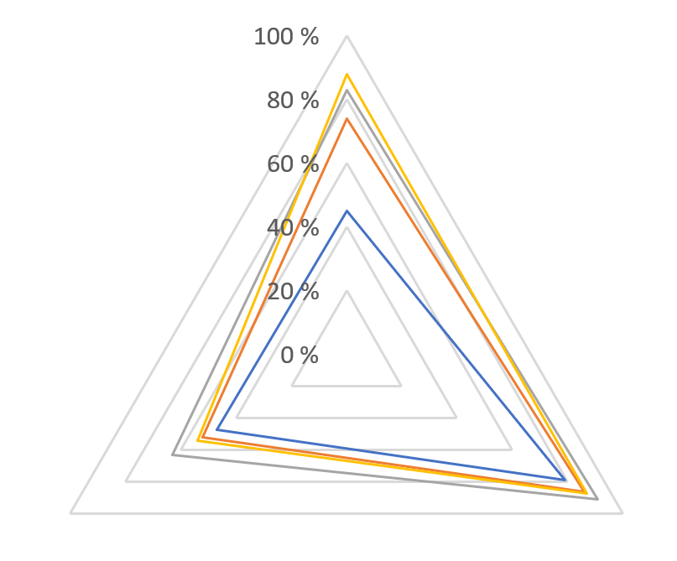
360 Survey - Vertical Layers
Greening
 | GREENING | DIGITALIZATION | INNOVATION
STUDENTS | 45% | 79% | 47%
TEACHERS | 74% | 86% | 52%
MANAGEMENT | 83% | 91% | 63%
STAKEHOLDERS | 88% | 87% | 54%
Innovation
Digitalization
© Omnia Education Partnerships Ltd. 2024 ┃ www.oep.fi

Slide 14
SOME KEY ELEMENTS OF SUCCESS FOR VET EXCELLENCE
POLICY
MISSION
VISION
RECOGNIZE
EFFORT AND
ACHEIVEMENT
OWNERSHIP
OPEN
DIALOGUE
DEVELOPMENT MINDSET
LONG TERM
ORIENTATION
© Omnia Education Partnerships Ltd. 2024 ┃ www.oep.fi

Slide 15
BENEFITS OF THE VET EXCELLENCE PROCESS
Network of leading-edge VET developers
International networks - new perspectives
Excellence
benefits staff, students and stakeholders
Attract high quality staff and students to VET
Roadmap for development of operations, centers, human capital
Driving national-level quality of VET
Opportunities for innovation and peer learning nationally
Future oriented development - link to national anticipation and skills forecasting
Transparent, comparable reports on progress
© Omnia Education Partnerships Ltd. 2024 ┃ www.oep.fi

Slide 16


EXCELLENCE COMES IN MANY SHAPES AND SIZES!
THANK YOU!
Mervi Jansson
www.oep.fi

