Slide 1

Collaborative Tracer Study
Network of VET Institutions for Research and Rapid Appraisal in Georgia
Skills Agency Georgia
29.06.2023
11:15-11:45

Slide 2
Goals and Objectives of Tracer Studies
Internal quality development
Topics of educational economics
Macro-level
  State
External quality management (accreditation)
Analyses on 'study and work'
Meso-level
  Sector
Micro-level
  Institution or program
Student marketing information
Further sociological topics: gender, working conditions
Institution Graduate Surveys
Study reforms evaluation
Alumni work, attachment to institution
Source: Schomburg, 2008

Slide 3
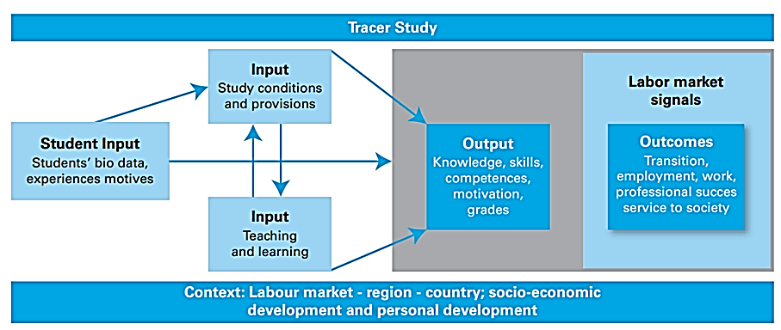
Conceptual Framework
Source: Schomburg, 2003

Slide 4
Key Features of Tracer Study
Research design
Cohort study
Implementation cycle
Annually
Interval between program completion and survey invitation
1-2 years
Main data collection method
Semi-structured online questionnaire
Study instrument structure
Modular
Sampling
All graduates invited, voluntary participation
Administration
Through Institutional Model

Slide 5
Network Institutional Model
Skills Agency Coordination Group
VET Institution
VET Institution
VET Institution
VET Institution
VET Institution
VET Institution
VET Institution
All VET institutions apply the same conceptual framework, administrative process and standardized instrument.

Slide 6
Overview of the Research Process
1. Concept and instrument development; Preparation of data collection (2 months)
Institutional research team recruitment
2. Data collection with reminder actions (1 month)
Invitation of participants
3. Data analysis and report writing; dissemination activities; (3 months)
Data analysis and communication of results
Specifying the cohort study strategy (program selection)
Deciding on the use of modules
Formation of new modules
Piloting new modules
Preparation of informational and supporting materials
Formation/revision of database of graduates
Field implementation and monitoring
Missing data management
Data entry and cleaning
Data analysis
Preparation of reports
Communication of results
3 Basic Steps of Tracer Study
3 Basic Steps of Tracer Study
Challenges
Respone rate
Human resources
Technical difficulties

Slide 7
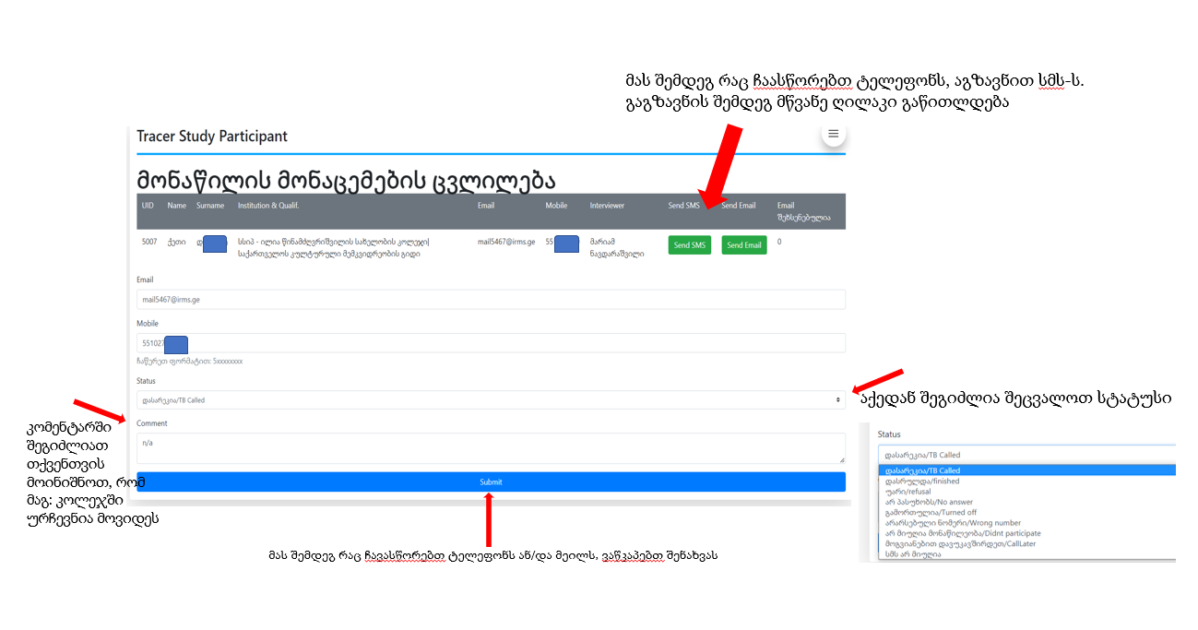
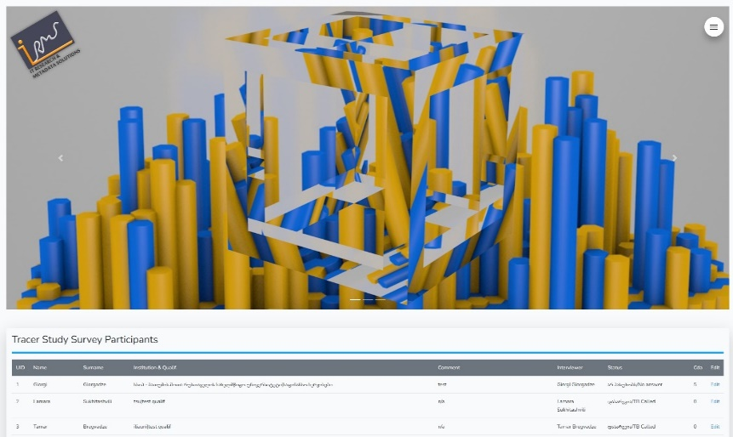
Online Platform
The survey is administered on the electronic platform created specifically for that purpose.
Skills agency provides VET institutions with technical support in the process.
Registration of research coordinators from VET institutions
Automatic sending of e-mails and SMS to graduates
Accumulating data
Downloading research databases

Slide 8
Identified Directions of Future Work
Enhancing employment rates and addressing skills incompatibility
Developing organizational and system mechanisms for identifying market needs
Expanding vocational training and retraining programs
Incorporating graduate and student opinion surveys into the internal quality management system
Promoting the use of digital technologies in the educational process
Developing infrastructure and services for vulnerable groups
Strengthening the emphasis on transferable skills in training programs
Enhancing career development services in VET institutions
Enhancing extracurricular activities in VET institutions
Involving graduates and students in VET institution development and establishing graduate network

Slide 9
Thank you
Questions?

