Slide 1


The international dimension of Centres of vocational excellence: Building Vocational Excellence through international cooperation
TRAINING FOR ISATCOVE PILOT
7th June 2023

Slide 2

AGENDA
Time
10:00 - 10.15 | Introduction: What is the International Self-Assessment Tool for CoVEs? Julian Stanley (ETF)
10:15 - 10.25 | Introducing the ISATCOVE Pilot Doriana Monteleone (ETF)
10:25 - 10:45 | The Basics – how to go about preparing to self-assess using ISATCOVE Julian Stanley (ETF) Questions and Answers
10:45 - 11:15 | Demonstration of the prototype of ISATCOVE Tool Karolis Šaduikis (Civitta)
11:15 - 11:55 | Break out groups
11:55 - 12:00 | Close and next steps Julian Stanley (ETF)

Slide 3
Introduction: What is the International Self-Assessment Tool for CoVEs?
What are CoVEs?
What is the purpose of ISATCOVE – what is its value?
How ISATCOVE works
How does ISATCOVE connect to other opportunities?
Julian Stanley
European Training Foundation (ETF)

Slide 4
Centres of Vocational Excellence
Excellence in scope
Excellence in performance
Capacity for excellence
Range and extent of objectives, activities, functions and partners
Quality of resources, processes and results for stakeholders
Systems, relationships, culture, knowledge, vision

Slide 5
Centres of Vocational Excellence
VET Provider
Beacon or pathfinder – provides a model for excellence, raises expectations..
Active or leading member of a cluster or association of VET Providers
Sectoral
Regional
Project-based
Coordinating centre – not itself a VET Provider but coordinates or supports VET Centres (TKNIKA, Katapult)

Slide 6
International Centre of Vocational Excellence
Internationally agreed framework of vocational excellence
International sharing, leadership and cooperation

Slide 7
ISATCOV provides a shared understanding of the scope, performance level and capacity of vocational excellence that will help CoVEs develop and collaborate
Orientation towards Excellence: where are we in relation to where we want to be?
Learning from relevant other centres – activities, achievements, practices and pace of change
Obtaining recognition of excellence through a label or an award
Consulting widely to build common understanding and shared priorities for our centre
Framework for Excellence:
(Scope , Performance & Capacity)
Data – current, historical, good practices
Guidance, support, mentoring
Reviewing progress in the light of how other CoVEs are progressing
Using evidence to make well informed judgements
Creating and maintaining partnerships, clusters, ecosystems and networks – with whom do we develop?
Where can we get to? Agreeing and setting realistic targets
Creating and sustaining motivation and improvement

Slide 8
Dimension 1: Criteria for teaching and learning
Skills provision is relevant and responsive to the labour market and to social needs
Lifelong learning, transition and progression are supported in an inclusive and comprehensive manner
Enables green transition and operates sustainably
Provides relevant digital skills: coding and programming; key digital competences and digital skills related to academic subjects and vocational occupations.
Teachers and learners integrate digital and on-line learning into teaching, learning and assessment in all environments and programmes in accordance with their needs
Includes and engages all learners and potential learners in all of its activities and communities, and acts to remove barriers, compensate for disadvantage and to adapt and tailor curriculum and teaching to support success for all.
Provides careers education and guidance to all potential and current learners, explicitly addressing careers stereotypes and tailoring support to individual and group needs.
Curricula are renewed, developed and modified to take account of international, national and local needs of employers and learners.
Teachers and trainers have mastered a wide range of pedagogies, learning resources, methods of assessment and educational technologies for VET and they collaborate to improve and innovate teaching and learning throughout the CoVE.
Recognises, validates, valorises and documents learning and skills, wherever and whenever they are acquired, applied or assessed.

Slide 9
Dimension 2: Criteria for partnership and Coordination
Collaborates sustainably and effectively with enterprises to design, deliver and improve training and skills acquisition
Collaborates with SMEs to provide them with tailor-made skills, support, services and expertise
Teaches enterprise competences to all and entrepreneurship is facilitated extensively in partnership with other organisations
Collaborates with enterprises and innovation/technology/research centres to conduct, apply and diffuse innovation and research
Collaborates internationally to provide skills, develop resources, staff and curriculum with international value
Collaborates with other organisations to raise awareness and attractiveness of VET
Collaborates with other skills providers and educational organisations to develop and share resources, provide skills, staff and curriculum and to develop as a learning organisations

Slide 10
Dimension 3: Criteria for governance and funding
Exercises sufficient autonomy to fulfil its own mission, exercising governance and leadership that fully engage all stakeholders at all levels
Engages actively in the development of local, national and international skills systems.
Jointly creates and coordinates a skills ecosystem with a strategic approach to innovation, smart specialisation and socio-economic development
Funding needs for all activities are met from multiple sources in a sustainable, transparent and fully accountable manner.
Infrastructure, technology, learning accommodation and other resources reflect those of corresponding industries and professions for which skills are being developed.
Develops strategically, inclusively and systematically as a learning organisation, making use of feedback and review and employing quality assurance mechanisms in line with EQAVET principles.

Slide 11
Criterion
Themes
Indicators
Structural evidence The CoVE has a formal structure (e.g., a responsible person or a specific unit) that coordinates entrepreneurship education, encourages staff to engage in such activities and provides support to staff to work on entrepreneurship education. – Y/N/planned or in development (If Yes, include description)
Theme PC3-1
The CoVE is committed to entrepreneurship education.
Structural evidence The CoVE has formal arrangements and structures in place to facilitate partnership with other organisations (such as chambers of commerce, companies, sectoral organisations, banks) to support entrepreneurship education and stimulating entrepreneurial attitudes of learners. – Y/N/planned or in development (If Yes, include description)
Explanatory note: that the CoVE has made use of an international framework of entrepreneurial competences in order to map where and how these competences are being taught - in both formal and informal contexts - and to develop the curriculum so that the full range of entrepreneurial competences are being taught to all learners.
Structural evidence The CoVE has formal arrangements and structures in place to facilitate partnership with other organisations (such as chambers of commerce, companies, sectoral organisations, banks) to provide support service for starting an own-business. – Y/N/planned or in development (If Yes, include description)
Quantitative evidence - CoVE internal records: Number of current partnerships with organisations on entrepreneurship education: - overall; - retained for at least three years
Stakeholder evidence – Teachers/Staff members: The CoVE has trained teaching and training staff to support entrepreneurship education
Theme PC3-2
The CoVE integrates entrepreneurship education in all its progammes and other activities
Structural evidence: The programmes offered by the CoVE systematically support (as a cross-cutting issue) the development of entrepreneurship competences. To a large extent, to some extent, to a little extent, not at all, in development/planned
Criterion PC3:
Teaches entrepreneurship competences to all and entrepreneurship is facilitated extensively in partnership with other organisations
Structural evidence: The programmes offered by CoVE take a systematic approach to incorporating entrepreneurship competences by adapting to or aligning with external references, such as EntreComp (The EU Entrepreneurship Competence Framework). - To a large extent, to some extent, to a little extent, not at all, in development/planned
Explanatory note: ‘To a large extent’ could mean that the CoVE systematically supports learners and graduates in business start up, for example, through advisory services, including legal advice, preferential access to equipment or workspaces, financial support, mentoring, support for networks
Structural evidence: The CoVE – in partnership with other organisations – has established a conducive environment for graduates to start their own business (e.g. business incubator; offering advisory services). - To a large extent, to some extent, to a little extent, not at all, in development/planned
Quantitative evidence - CoVE internal records: Percentage of the programmes offered by the CoVE that integrated entrepreneurship competence training . - as % of total number of programmes offered
Quantitative evidence - CoVE internal records: Percentage of recent graduates that made use of the CoVE’s support services for starting their own business
Explanatory note: An entrepreneurial mindset consists of interrelated beliefs and assumptions that inform our decisions and guide our behaviour. Such a mindset can be cultivated and enhanced through entrepreneurial learning. It is a way of creative thinking that helps a person overcome challenges, be decisive and accept responsibility. It also drives them to improve their skills, learn from mistakes, and take continuous action on ideas. See: Entrepreneurial learning for TVET institutions: Online Guide (with worksheets) - Part A: Understanding the basic concepts (unesco.org)
Theme PC3-3
The CoVE is effective in teaching entrepreneurship competences and contributes to entrepreneurial environment in the territory.
Stakeholder evidence – Teachers/Staff members: The CoVE helps learners to develop creative thinking to overcome challenges, be decisive and accept responsibility (i.e. an entrepreneurial mindset)
Stakeholder evidence – Teachers/Staff members: Our graduates are successful in starting their own businesses (or are successful in creative thinking to overcome challenges, be decisive and accept responsibility (i.e. an entrepreneurial mindset) within existing companies)
Stakeholder evidence – Learners/Graduates: We are learning (have learnt) creative thinking to overcome challenges, be decisive and accept responsibility (i.e. we are developing an entrepreneurial mindset)
Stakeholder evidence – Learners/Graduates: We are learning (have learnt) many of the skills that we would need to set up a business or social enterprise
Stakeholder evidence – Graduates: The CoVE offers a lot of assistance and support to graduates that want to set up a business or a social enterprise.
Stakeholder evidence – Employers: The learners of the CoVE demonstrate creative thinking to overcome challenges, be decisive and accept responsibility (i.e. Have an entrepreneurial mindset) when doing their internship /work-based learning in the company
Quantitative evidence graduate tracking: % of recent graduates who set up a business or a social enterprise
Good practice evidence Example(s) – linked to one or more indicators

Slide 12
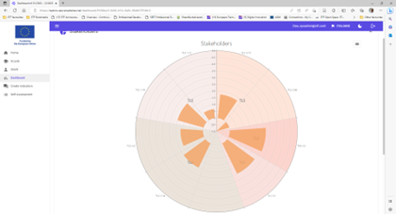
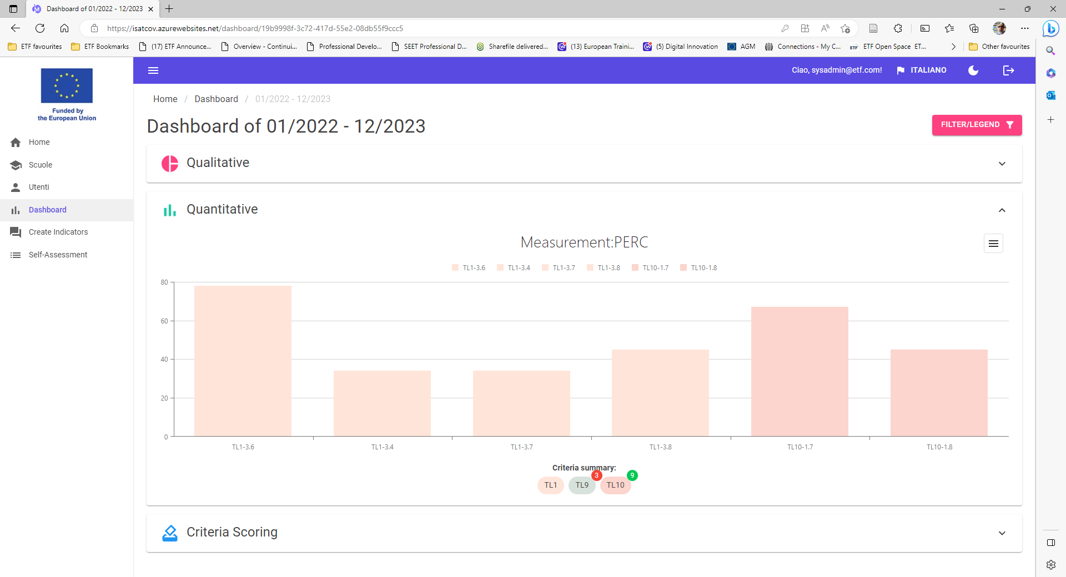


The Self-Assessment Team will have access to a dashboard where they can view the performance of the CoVE in relation to relevant indicators as well as that of comparator schools – to support an informed holistic judgement at the level of the criterion.
Structural and Stakeholder Indicators
Quantitative Indicators
Not at all
Score Criterion​ | 0​ | 1​ | 2​ | 3​ | 4 | 5 | 6 | 7 | 8 | 9 | 10
Systematically and comprehensively
Notes:
Each school should make an independent collective judgement about how excellent it is in relation to each criterion after seeing how well it scores on all of the indicators relating to that criterion. (I agree/ I don’t agree/I am not sure)

Slide 13
Making use of the ISATCOVE
Development of Excellence
Relevant comparisons
Target setting
Monitoring
Recognition of Excellence
Commitment to excellence label
Achieving excellence label
Demonstration of excellence
Erasmus +
National schemes for Vocational Excellence

Slide 14
Introduction to the ISATCOVE PILOT:
Objectives
Stages
support
Doriana Monteleone
European Training Foundation (ETF)

Slide 15


Objectives
1. To test out:
The platform, the indicators and the process of self-assessment with a variety of VET Providers.
Guidance material and support services.
2. To identify issues relating to understanding and usability.
3. To gain feedback to make improvements.

Slide 16


4 stages
Kick-off
Planning sheet for pilot
STAGE 1
Preparation and Design
Individual support
STAGE 2
STAGE 3
Self-assessment
Monitoring and Development
STAGE 4

Slide 17
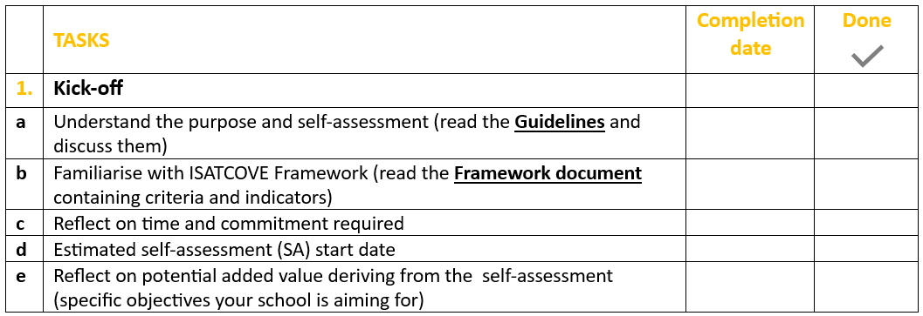
KICK-OFF
STAGE 1
WHO
School’s management
HOW
Read guidance material
Participate in introductory webinars
Speak to an advisor
CHECKPOINT: Decide whether or not to use ISATCOVE
Does ISATCOVE serve organisational learning or development needs of my school?
Do we have enough resources and time to implement it?
OVERALL OBEJECTIVE
What the added value for your school is?
What do you want to learn or gain?

Slide 18
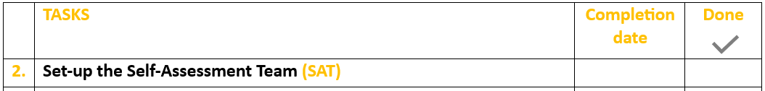
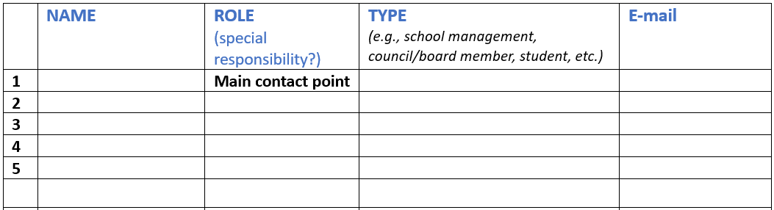

PREPARATION AND DESIGN
STAGE 2
WHO
School’s management
HOW
Discuss the process with all relevant school’s actors
SELECT YOUR SELF-ASSESSMENT TEAM (SAT)
More info on SAT in the next session “How to go about preparing to self-assess using ISATCOVE”

Slide 19
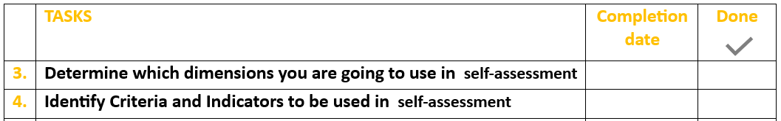
PREPARATION AND DESIGN
STAGE 2
WHO
SAT
HOW
Collective discussion
REVIEW THE CRITERIA AND INDICATORS
Framework document (ISATCOVE criteria and indicators.xls)
Dimensions and Criteria
Respondents
Indicators
Explanatory notes
Glossary

Slide 20
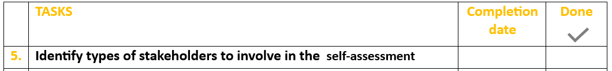
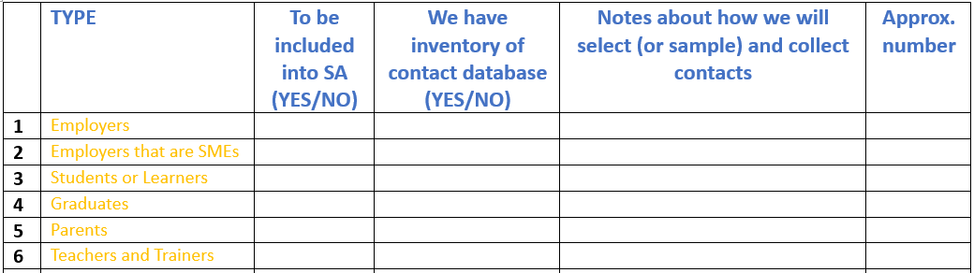
PREPARATION AND DESIGN
STAGE 2
WHO
SAT
HOW
Collective discussion
DECIDE WHICH TYPES OF STAKEHOLDERS TO INCLUDE AND HOW TO SELECT (CONTACT LIST)
More info on which stakeholders to involve in the next session “How to go about preparing to self-assess using ISATCOVE”

Slide 21
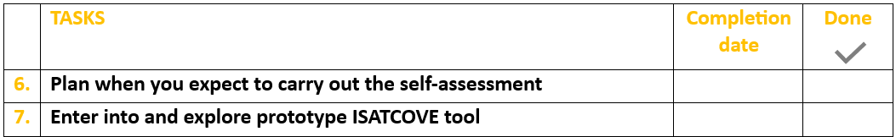
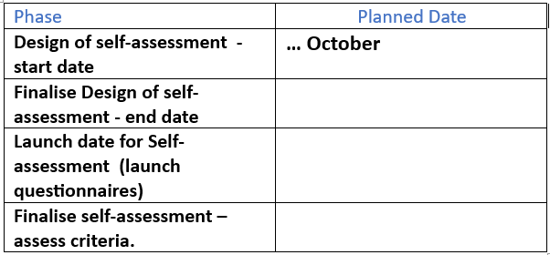

PREPARATION AND DESIGN
STAGE 2
WHO
SAT
HOW
Collective discussion
PLAN WHEN YOU EXPECT TO CARRY OUT THE SELF-ASSESSMENT
Explore ISATCOVE

Slide 22
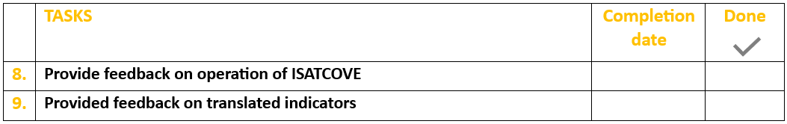
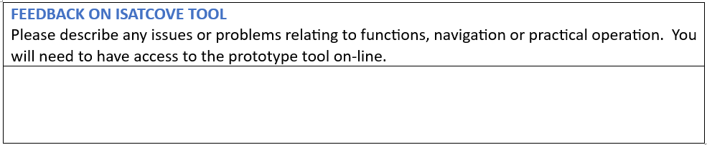

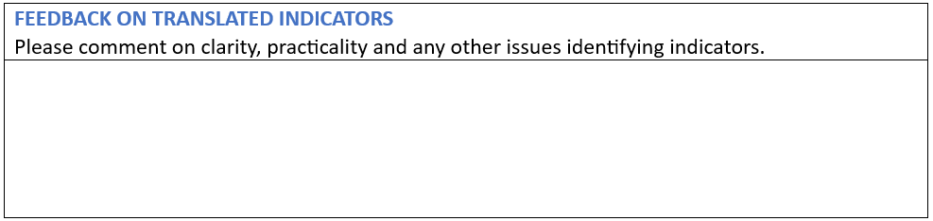
PREPARATION AND DESIGN
STAGE 2
WHO
SAT
HOW
Collective discussion
PROVIDE FEEDBACK TO SUPPORT DEVELOPMENT

Slide 23
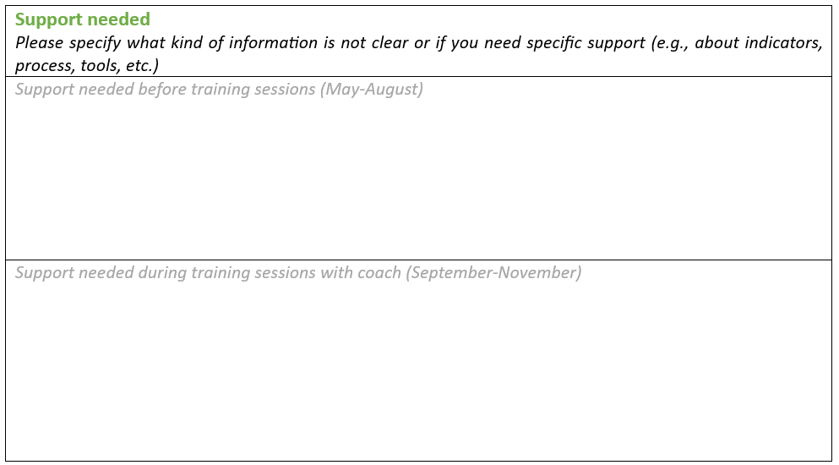
ASK FOR SUPPORT!
STAGE 2
WHO
SAT
HOW
Collective discussion

Slide 24
SELF-ASSESSMENT
STAGE 3
WHAT
1. Collect evidence
2. Make judgments on criteria
Structural indicators
Quantitative indicators
Stakeholder indicators
WHO
SAT
Stakeholders
SAT
HOW
Gather information
Agree on responses
Participate in dedicated surveys
Meet and make collegiate judgement

Slide 25

MONITORING AND DEVELOPMENT
STAGE 4
WHAT
1
Report
2
Set development targets
3
Plan development actions
4
Monitor progress
WHO
SAT
HOW
Collective discussion

Slide 26

support
Introductory training session for ISATCOVE pilot
General introduction to pilot, demonstration of tool
(English)
7th June 23
Full training on using ISATCOVE tool
Full training in all parts of the tool
(English, Spanish & French)
4th October 23
June September
October week 2
October week 3
October week 4
November week 1
Weekly coaching sessions
(to be confirmed with coaches)
Individual support for preparation of assessment plan
(to be confirmed with coaches)
14th, 15th, 16th November Debriefing sessions on Self-assessment

Slide 27
how to go about preparing to self-assess using ISATCOVE
How to manage the process: Self-assessment Team
How many criteria and indicators?
How much time?
Who will be involved?
Julian Stanley
ETF

Slide 28

Managing the Self-assessment Process
What does the School Self-Assessment Team do?
Start and finish the assessment
Select the criteria and indicators to be used
Choose which stakeholders to involve -
Make responses to the qualitative and quantitative indicators
View evidence and make holistic judgement on all criteria
Set targets and make plans
Who to include in the Self-Assessment Team?
Senior Management, e.g. Deputy Principal
Heads of Department or Faculty
School Administrator (with access to data on enrolments, graduates, assessments)
Liaison with enterprise or other partners
Representatives of stakeholders, e.g. teachers, governing body?
How will the Self-Assessment Team work?
Meeting together or working apart..
Sharing or dividing tasks between the Team..

Slide 29

How many of the 23 criteria and of 559 indicators?
Excellence across all three dimensions:
Teaching & Learning; Partnership and Coordination; Governance and Funding
Excellence in a particular dimension…which one?
Which and how many indicators?
Structural indicators
Quantitative
Stakeholder
Interested to apply for a Label?
1. “Committed to Excellence” LABEL (CoEx)
2. “Advancing on Excellence” LABEL (AdEx)
12 Criteria
mandatory indicators for each criterion
18 Criteria
4-5 mandatory indicators for each criterion

Slide 30
How much time?
Week 1 | 1 Meeting of Self Assessment Team | Members familiarise themselves with criteria and indicators School Assessment Team select Criteria and Indicators
Week 2 | 3 Meetings of Self Assessment Team Stakeholders registered and receive questionnaires | School Assessment Team respond to selected structural and quantitative indicators Stakeholders respond to selected indicators
Week 3 | 2 Meeting of Self-Assessment Team Feedback to stakeholders | Assessment of selected criteria Feedback and Target setting

Slide 31
Which stakeholders to involve?
Teachers or Trainers
Other staff in school or centre, including managers and assistants
School Board Members
Learners
Graduates
Employers or employer representatives (includes Sector Organisations)
Employers that are SMEs
Other Social Partners
Local and regional government organisations
National government organisations
Parents
Other educational providers (Other schools or VET providers)
Research organisations and Technology Centres
International partners

Slide 32
Demonstration of ISATCOVE platform
Choosing the criteria and the indicators
Launching questionnaires
Responding to questionnaires
Viewing the evidence with the Dashboard
Scoring criteria
Karolis Šaduikis
Civitta

Slide 33
Next Steps
Start to complete the Planning Sheet – please complete by end of September
You will receive an invitation to access the Pilot Microsoft Teams page
If you have questions or issues – contact your coach – Karolis: karolis.saduikis@civitta.com
If you have general questions about the pilot contact me: julian.stanley@etf.europa.eu
Mark your diary for the training session on 4th October, 10-12.00
We aim to give you access to prototype of ISATCOVE tool soon
Have a great summer!

