Slide 1
The contribution of Youth and Civil Society Organisation (CSOs) to Youth Guarantee (YG) schemes: opportunities ahead
Margareta Nikolovska,
Senior Human Capital Development Expert, ETF
14 December 2022

Slide 2
Youth CENTERS AND CIVIL SOCIETY ORGANISATIONS
Need for collaborative actions between YC, CSOs and Public Sector (institutions, actors)
YC and CSOs contribution
Cooperation and partnerships are becoming requirement
The role of CSOs and other actors is challenged as never before
“There is an increasing need to address a knowledge gap on how governments and societies can respond to dynamically changing needs to ensure sustainability”
Geels et al. (2019)

Slide 3
The ETF STUDY: Role of CSOS in HCD and LLL
ORGANISATION PROFILE
The role in skills development, the beneficiaries,
CSOs RESILIENCE
The adaptability
STAKEHOLDERS AND POLICY DIALOGUE
POTENTIAL FOR FUTURE
The way forward in HCD and LLL
Impacting the policy agenda in HCD and LLL
  1. Participating countries:
  Albania, Jordan, Serbia, Tajikistan, Ukraine, Uzbekistan- implemented in 2020 and 2021
  2. Eligible CSOs: active in non-formal learning, informal learning, and employment-related services (HCD), 1 interview per CSO
Notes:
Slide with few points on survey.

Slide 4

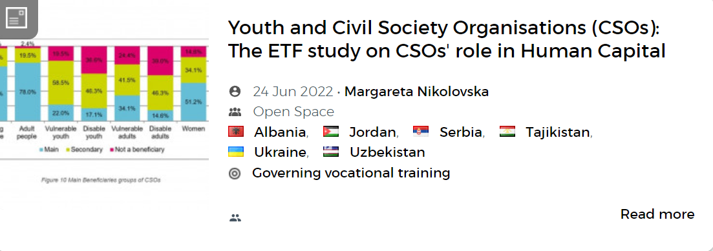
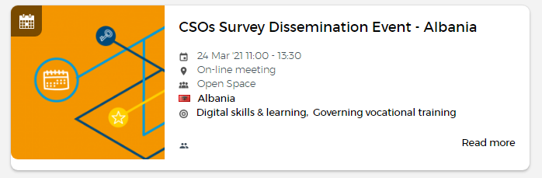

Area 5.1 - Civil society organizations | Open Space (europa.eu)

Slide 5
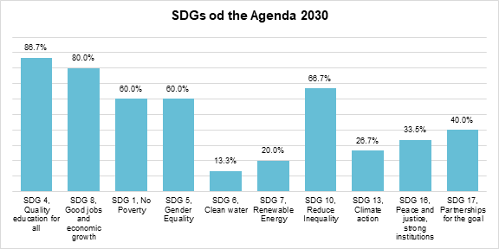
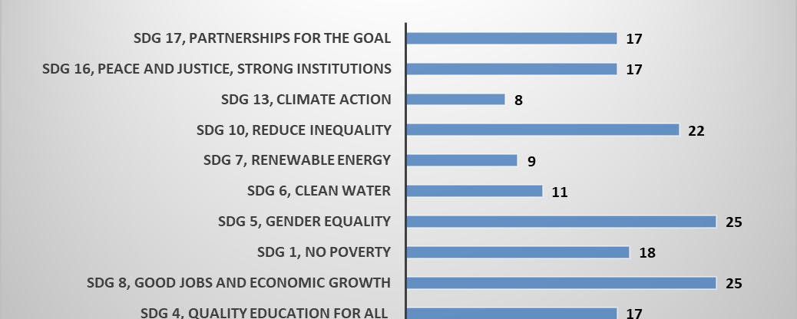
SERBIA
THE ETF Study implemented 2020/2021: CSOs PROFILE
ALBANIA

Slide 6
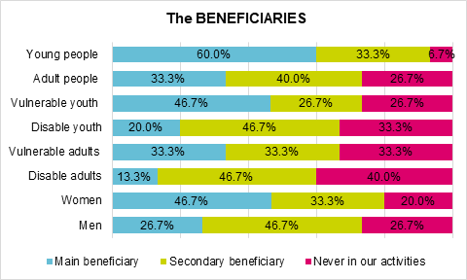
SERBIA

Slide 7
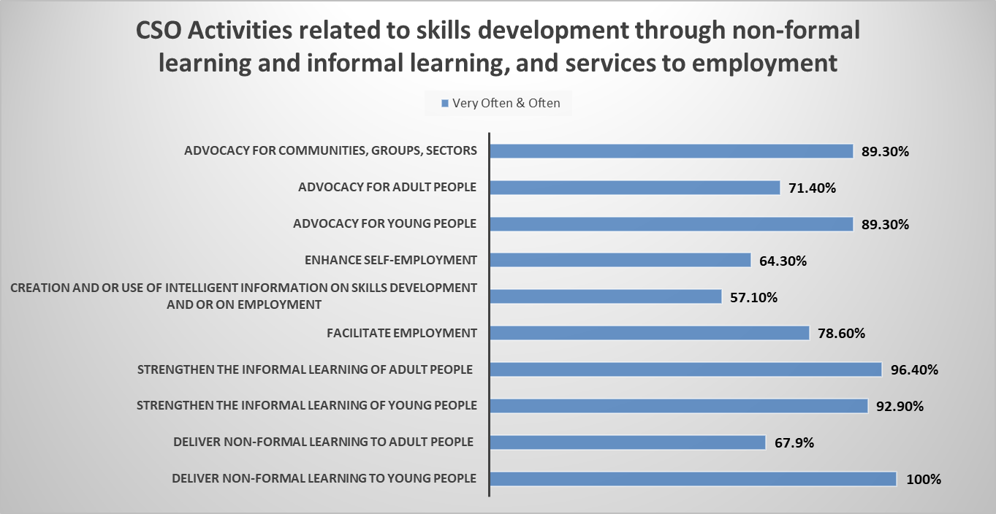
ALBANIA

Slide 8
GOVERNANCE Perspective: STAKEHOLDERS AND POLICY DIALOGUE
Focus on the CSOs participation in policy dialogue with institutional counterparts, and the CSOs contribution to the HCD policy.
This covered:
1) Strategy formulation and policy design
2) Budgeting of programs and actions
3) Implementation and monitoring
4) Policy evaluation and review
Notes:
What ETF understands as HCD?

Slide 9
C1: Is your organisation involved in the POLICY dialogue regarding skills strategies and policies?
Study implemented 2020/2021

Slide 10
The advantage of THE CSO compared to other TYPE OF INSTITUTIONS (public, private)
Study implemented 2020/2021

Slide 11
Highlights from TARGET GROUPS AND beneficiaries: ROLE OF CSOs
Support in getting new perspectives on skills and career development. Follow up activities needed to ensure employability, links to employment services
Help to have a new beginning, like starting a business. Training adapted to working and personal schedules and commitments.
Trainers use and adopt effective training methods - Technology-based learning, Simulators, Roleplaying, Films and videos, and Case studies.
Jjoint training programmes with foreign companies or partners, to exchange experience and obtain recognition of certificates to support employment
Per-training survey: Training Needs Assessment to determine knowledge and skills level
Motivation for young people due to opportunity to improve skills in concrete areas

Slide 12


The advantage of THE CSOs compared to other TYPE OF INSTITUTIONS (public, private)
Provide independent advice to shape HCD policies
Improve the understanding of the policy challenges
Support transparency of public consultations
Improve the outcome of policy dialogue and public consultations
Detect needs of the groups out of the formal learning and employment system, and bring their voice to the policy dialogue
Facilitate transparency and accountability of HCD policy implementation
Support effectiveness of education, training and other learning processes
Monitor skills development policies’ implementation
Evaluate independently HCD policies’ outcomes
Provide innovative advice to shape HCD policies

Slide 13
Instead of CONCLUSIONS:
HOW to increase THE EFFECTIVNESS OF YOUTH Guarantee?
1. What could be the role of YC and CSOs and how to further strengthen the impact?
2. What type of collaborative actions function the best between YC, CSOs and public institutions?
3. What types of dialogue and follow-up would be necessary to support trust building and more enabling environment for YC and CSOs to engage in YG?

Slide 14




