Slide 1

Work Based Learning (WBL)
Vayots Dzor Regional State College

Slide 2

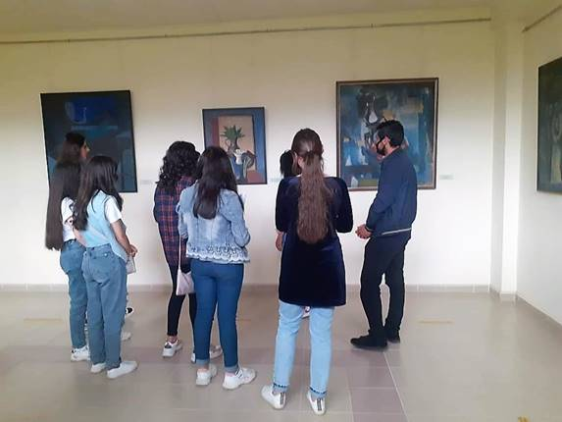
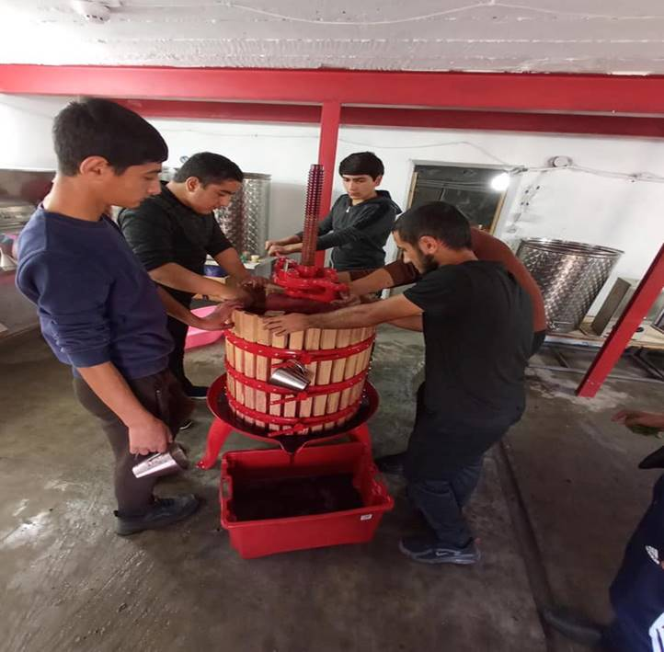
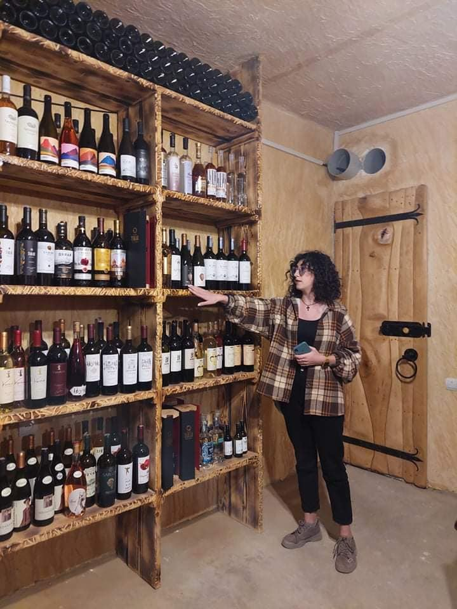
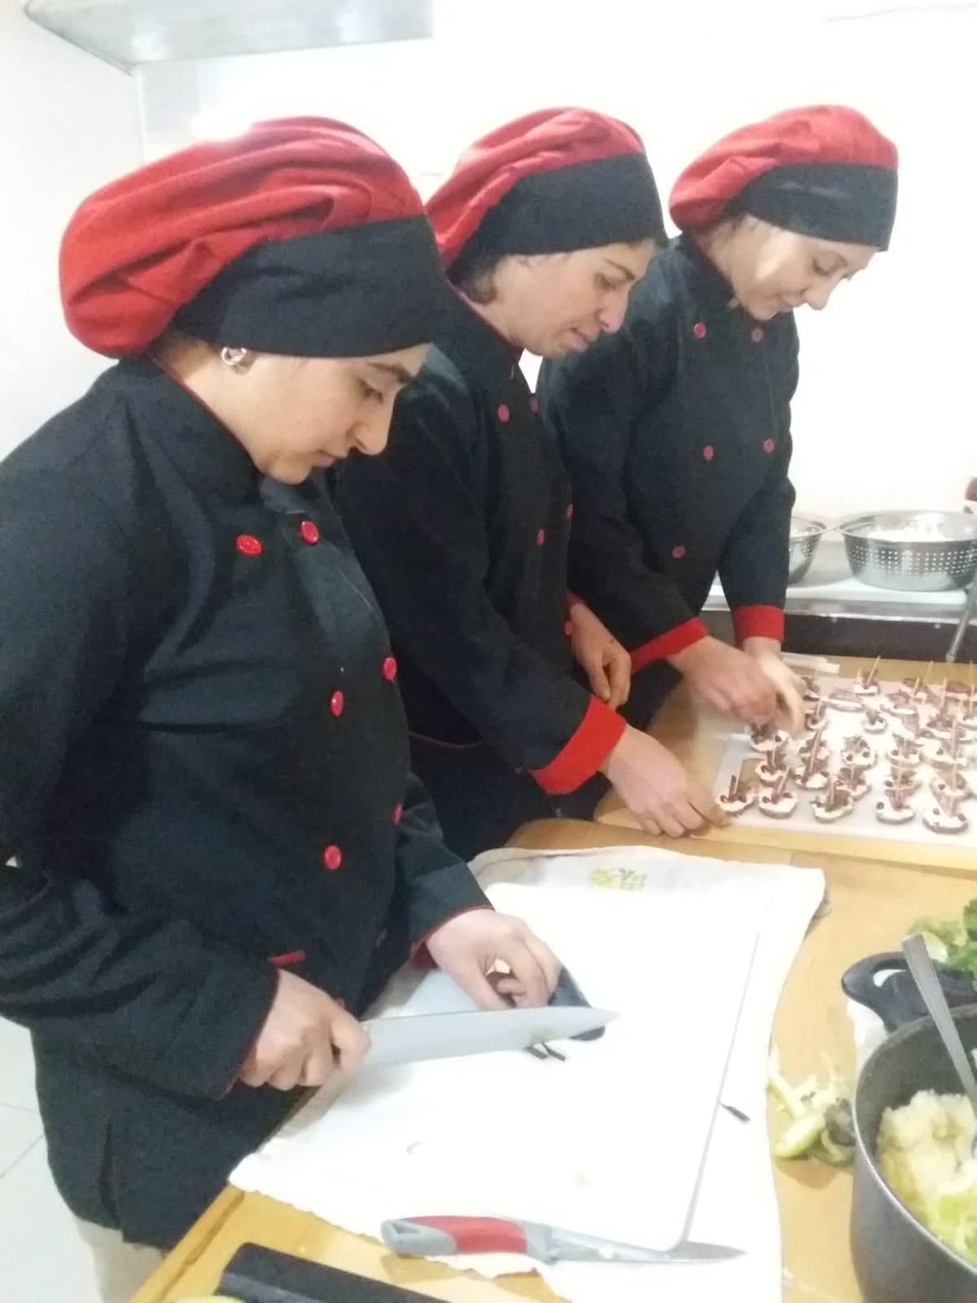
Implemented Practices
Industrial internship and
Pre-postgraduate internship
Students of Tourism
faculty in the Yeghegnadzor Art Gallery
Internship in Wine Factory
Internship at
“Sedrak Mamulyan”
Culinary Studio
Internship in Arpa Parnas Wine Tasting Room
This Photo by Unknown Author is licensed under CC BY-SA-NC

Slide 3
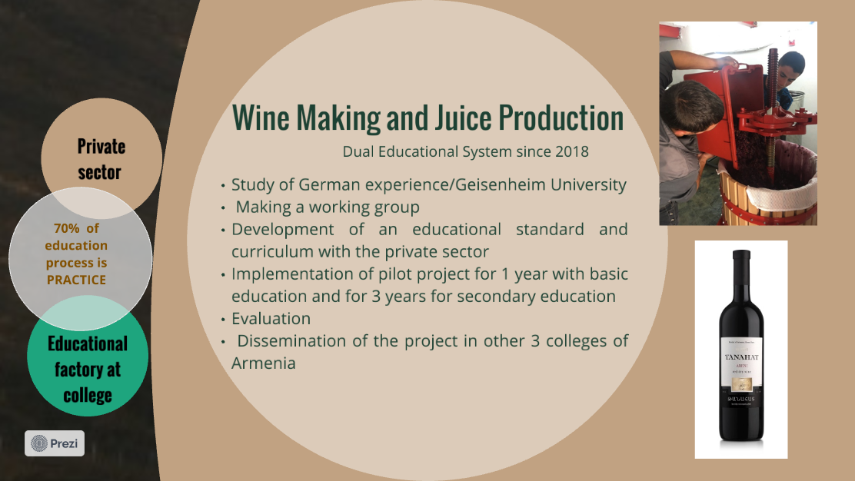
Dual Education and WBL

Slide 4
OUR MISSION IN WBL
1st phase
Participation in “Excellence in Work-based Learning: the Latvian model” and applying in practice at Vayots Dzor Regional State College
2nd phase
3rd phase
Implementation of WBL
4th phase
Development of an educational standard and curriculum with the private sector
Sustainability and Continuity of the projects
5th phase
Evaluation of successful experience,
Ensuring continuity of exchange of experience

Slide 5
Thank you for the attention
This Photo by Unknown Author is licensed under CC BY-SA-NC

