Slide 1
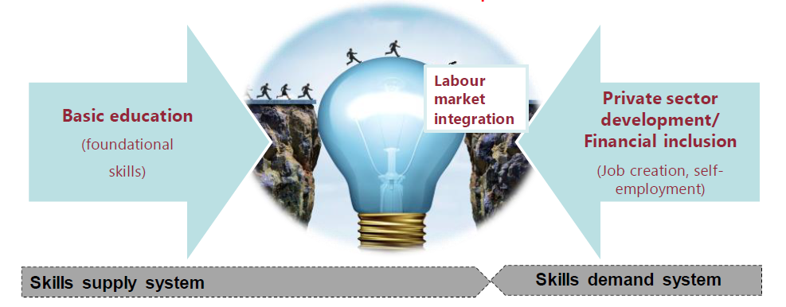
The interaction of the labor market with vocational education
Integration with the labor market
PROFESSIONAL EDUCATION
EMPLOYERS
(job creation, employment)
Offer training and professional skills
Qualification requirements

Slide 2
SECTOR SKILLS COUNCILS
№ | Name of the industry council | Scope area | Responsible ministries and departments | Assigned higher educational institutions | Assigned vocational educational institutions | Assigned scientific organizations
1 | Industry Council for professional qualifications and competencies in the field of personnel work, labor safety, auxiliary intersectoral types of professional activity | Labor relations and workforce development | Ministry of Employment and Labor Relations | Tashkent State University of Economics | Tashkent College of Human Resources Management and Labor Protection | Research Center "Scientific Foundations and Problems of Development of the Economy of Uzbekistan" at the Tashkent State University of Economics
2 | Industry Council for Professional Qualifications and Competences in Healthcare and Pharmaceuticals | Healthcare, pharmaceuticals and social services | Ministry of Health care | Tashkent Medical Academy | 1st Republican College of Public Health named after Abu Ali ibn Sino, Chilanzar College of Public Health named after Abu Ali ibn Sino | Uzbek Research Chemical-Pharmaceutical Institute
… | …….. | ……… | ……….. | ……… | ………. | ………
29 | Industry Council for Professional Qualifications and Competences in the Textile, Garment and Leather Industry | Manufacture of textile, clothing and leather products | Associations "Uztekstilprom" and "Uzcharmsanoat" | Tashkent Institute of Textile and Light Industry | Almazar College of Light Industry, Jarkurgan College of Light Industry | Uzbek Research Institute of Natural Fibers

Slide 3





COMPONENTS OF THE NATIONAL QUALIFICATION SYSTEM IN UZBEKISTAN
NATIONAL QUALIFICATION FRAMEWORK
a set of legal and institutional mechanisms aimed at ensuring the balance between the requirements for the qualification of personnel in the labor market and the supply in the education system
SECTORAL QUALIFICATION FRAME *
CLASSIFICATOR OF OCCUPATION AND POSITIONS
regulates the competence, knowledge and skills of personnel in a particular sector of the economy in accordance with the level of qualifications in the sector
a systematic list of areas of vocational education, specialties and occupations
PROFESSIONAL STANDARDS
EDUCATIONAL PROGRAMS
normative document defining the content of certain professional activity, conditions of its implementation, qualification of personnel and corresponding requirements for professional education and training
educational standards, curriculum, curricula (modules), a set of internships
*Available in international practice
Notes:
© Copyright PresentationGO.com – The free PowerPoint and Google Slides template library

Slide 4
COMPONENTS OF THE NATIONAL QUALIFICATION SYSTEM
RESPONSIBILITIES AND IMPLEMENTATION ORGANIZATIONS
1. Qualification assessment centers
2. Employers
3. Ministry of Higher and Secondary Special Education
Assesment
Educational programs
Ministry of Higher and Secondary Special Education
Employers
Professional standards
Sector Qualifications Board
Line ministries and departments
Employers
Ministry of Employment and Labor Relations
Sector Qualification Framework
Sector Qualifications Board
Sector ministries and departments
Employers
Ministry of Employment and Labor Relations
Republican Coordinating Council
Ministry of Employment and Labor Relations
Ministry of Higher and Secondary Special Education
Line ministries and departments
Employers
National Qualification Framework

Slide 5
DISTRIBUTION OF MID-LEVEL PERSONNEL TRAINING IN THE AREA OF WATER RESOURCES MANAGEMENT ON THE BASIS OF QUOTA FOR THE ACADEMIC YEAR 2020/2021
TOTAL 3 135 PEOPLE IN THE REPUBLIC
2 365 PEOPLE IN COLLEGES OF THE MINISTRY OF WATER RESOURCES (75%)
13%
420
Personnel trained in 14 vocational schools
2365
75%
Of these, 2,245 are in 11 colleges under the ministry
Personnel trained in 15 colleges
3 135
350
11%
Personnel trained in 6 technical schools

Slide 6

PROFESSIONS AND SPECIALTIES TRAINING IN COLLEGES UNDER THE MINISTRY OF WATER RESOURCES
Professional education levels and professions taught on the basis of ISCED
Number of specialties and professions:
12
Level 3
Level 4
Number of specialties and professions: 3
Number of qualifications: 7
Number of specialties and professions: 9
Number of qualifications: 21
Number of qualifications:
28

