Slide 1

GOVERNANCE – LEARNING – ACTION – DIALOGUE

Slide 2



IT’S TIME TO BE GLAD
GLAD - the Governance Learning Action and Dialogue Network - inspires the governance of vocational education and training, skills development and lifelong learning in ETF partner countries.

Slide 3


It involves all key actors in formal, non-formal and informal learning and employment support, including the public and private sectors, social partners, and civil society organisations (CSOs).

Slide 4



HOW WILL GLAD OPERATE?
GLAD is committed to the exchange of practice - both established and experimental - to create knowledge and to implement governance based on a partnership approach.

Slide 5

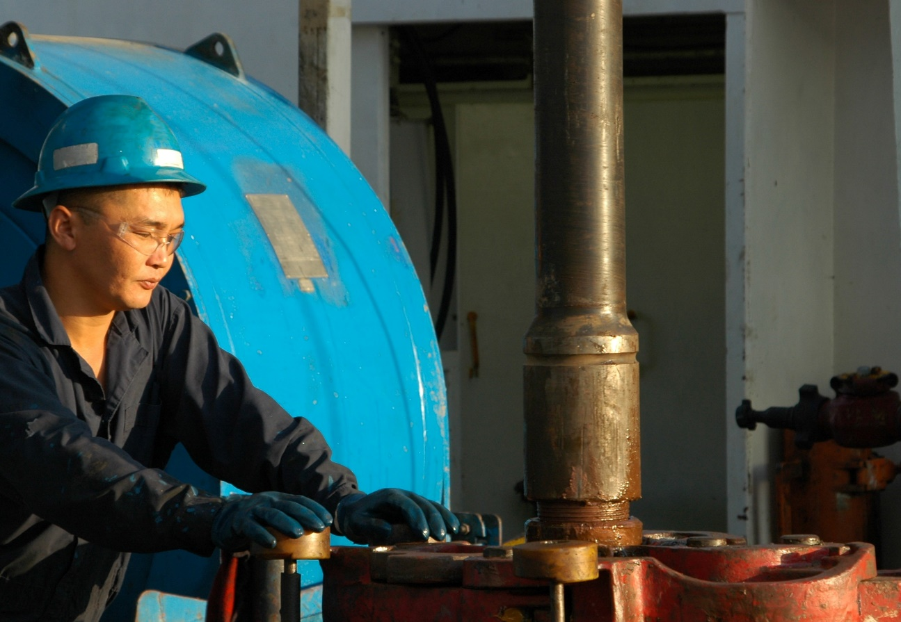
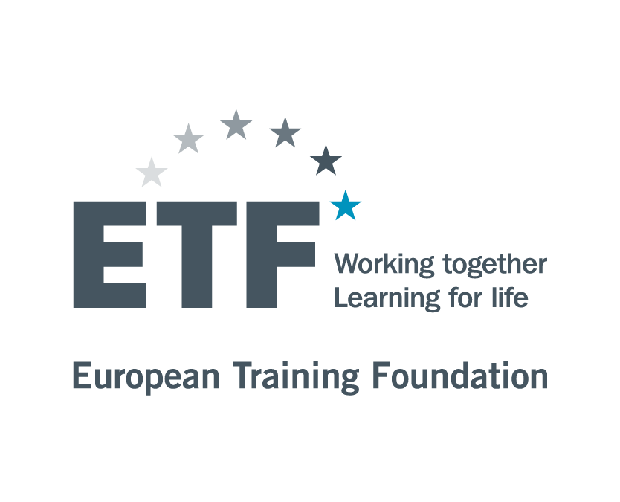
WHO IS GLAD FOR?
GLAD is open to all ETF partner countries
All stakeholders interested in participatory governance in human capital development (HCD).
  They may be providers and demanders of skills, administrators, lawmakers, community organizers, analysts, as well as researchers, pedagogues and other experts.

Slide 6


STATE AND NON-STATE ACTORS:
Civil society representatives
Policy Makers
Private practitioners
Private practitioners
STATE ACTORS
NON-STATE ACTORS
Academics
Public officials
Social partners

Slide 7
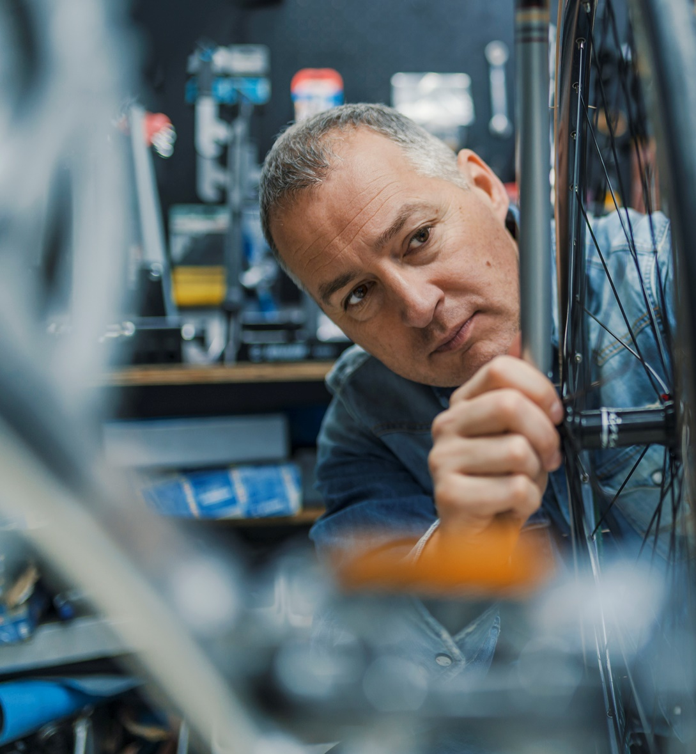

WHAT CAN GLAD DO FOR YOU?
GLAD blends lessons and policy learning,
multi-stakeholder dialogue, and small-scale actions.
It will create:
Spaces for exchange between partner countries on mechanisms for multi-actor and multi-level collaboration.
International connectivity between practitioners, academics, social partners and CSOs.
Access to innovative practice being tested at country and international level.
Action-research to assess participatory governance mechanisms.
Action-learning to test small-scale partnership-based mechanisms and processes.

Slide 8


WHAT CAN YOU DO FOR GLAD?
As a GLAD member, you can choose activities according to your interests and national priorities
You commit to sharing your findings with everyone else. For example, focused discussions and activities might involve countries facing similar challenges, seeking to share knowledge regarding future options.

Slide 9


HOW WILL THIS HAPPEN?
Participation is based on a commitment to governance mechanisms that support quality lifelong learning to inclusive HCD policies into practice.

Slide 10


WHAT ROLE DOES THE ETF PLAY?
The ETF will:
organise mutual learning
share methodologies
provide resources such as expertise and advice,
small-scale action research, peer-learning events,
or networking.
facilitate the dissemination of information and practice from the EU and the global community.

Slide 11
FOLLOW UP: WHAT NEXT

Slide 12
THEMATIC AREAS: CONSULTATION OUTCOME

Slide 13
GLAD CALENDAR
SEET study on WBL and social partners, validation of the methodology | Mid June | Themes: Dual or WBL – Skills governance – Partnerships among LLL stakeholders Online meeting, open to all countries
Quality Assurance capacity building training | 19th May, 15th-16th June | Themes: Quality assurance Online workshop, several countries
Governance inventory results: roundtables with Jordan, Albania, Uzbekistan | Mid June | Theme: VET governance bodies incl. Councils – Skills development governance Online workshops, 1 country each
Participatory governance and financing: the Skills Development Fund case in Palestine | Early July | Themes: Financing of LLL – Skills governance Online workshop, open to all countries
Civil society organizations role in human capital and lifelong learning | October, 18th and 20th | Themes: Partnership between LLL stakeholders – Governance of non-formal and informal learning – Skills development governance YG in WB6, EaP and Semed

Slide 14
GLAD ACTIVITY TYPES
Actions:
  Action-research
  Pilot new partnerships
  Collaboration at regional/local level
  Review what functions and what doesn’t, in a process or in an institution
Learning:
  GLAD members design the agenda of events and other activities
  Sharing practices and drawing lessons
  TED Talks
  Webinars with high level experts
  Mutual advice between peers
  Case studies
Dialogues:
  Diverse stakeholders within each forum (event, activity) to represent different interests, agreements and disagreements
  Creating a community
  Newsletter and blogs with latest updates, GLAD members rotate responsibility each year

