Slide 1



ETF GOVERNANCE INVENTORY: LEARNING FROM THE EXPERIENCE IN ALBANIA, JORDAN, KAZAKHSTAN, MOLDOVA, UZBEKISTAN
ONLINE MEETING
17 November 2021, 10.00 CET

Slide 2
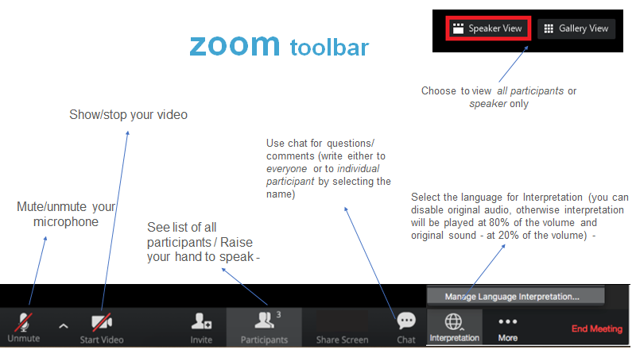

Slide 3

17 NOVEMBER 2021
ETF GOVERNANCE INVENTORY:
LEARNING FROM THE EXPERIENCE IN ALBANIA, JORDAN, KAZAKHSTAN, MOLDOVA, UZBEKISTAN

Slide 4
10:00 – 10:15 | Welcome and Introduction by Mr Hugues Moussy, Head of Systems Performance and Assessment Unit, Knowledge Hub Department, ETF, and Ms Emmanuelle Roure, International Relations Officer, ENP and UfM coordinator, Directorate-General for Employment, Social Affairs and Inclusion, European Commission
10:15 - 10:30 | ETF VET Governance Inventory 4.0: methodology and exercise implemented in 2020 by Mr José Manuel Galvin Arribas, ETF
10:30 – 11:10 | Highlights from the ETF VET Governance Inventory 4.0 in the participating countries: Albania, Jordan, Kazakhstan, Moldova, and Uzbekistan by Ms Margareta Nikolovska, ETF Discussion with the country representatives Mr Silviu Gîncu, Head of VET Department, Ministry of Education, Culture and Research, Republic of Moldova Prof. Qais Alsafasfeh, Technical and Vocational Skills Development Commission, Jordan Moderator: Mr Mounir Baati, ETF
11:10 – 11:20 | Tea/coffee/screen break
11:20 – 12:10 | VET Governance assessment: cross-countries analyses What lessons are we learning from the findings? by Mr Aram Avagyan, ETF expert Discussion with the country representatives Ms Elira Demiraj, General Director, National Employment and Skills Agency, Albania Ms Rashida Shaikenova, Director of Kazakhstan Tourism Association Ms Feruza Rashidova, Expert in TVET institutions, Uzbekistan Moderator: Mr Vincent McBride, ETF
12:10 – 12:20 | Reflecting on the main outcomes of the discussion (by Word Cloud in Mentimeter)
12:20 – 12:40 | Open Discussion and Closing remarks by Ms Siria Taurelli, ETF
AGENDA
Moderator:
Siria Taureli, ETF
Senior Human Capital Development Coordinator for Governance and Quality Assurance

Slide 5

WELCOME AND INTRODUCTION
Hugues Moussy
Head of Systems Performance and Assessment Unit
ETF
Emmanuelle Roure
International Relations Officer,
ENP and UfM coordinator
Directorate-General for Employment, Social Affairs and Inclusion,
European Commission

Slide 6
ETF VET Governance Inventory 4.0: methodology and exercise implemented in 2020
Jose Manuel Galvin Arribas
Senior Human Capital Development Expert - Coordinator for Vocational Excellence Project ETF

Slide 7

VET -& SKILLS- GOVERNANCE INVENTORY 4.0
IN A NUTSHELL
J. Manuel Galvin Arribas
ETF Senior HCD Expert
-VET Excellence Coordinator-
(17th November 2021)21
jmg@etf.europa.eu

Slide 8


WHY ETF VET GOVERNANCE INVENTORY 4.0?
LOOKING AT OUR INTERNAL KITCHEN
Continuity: ETF mandate informing on VET Governance in ETF PCs (2015-20).
Consolidation: Using of Data Collection Tool as key knowledge based source/resource for ETF & VET Governance project-. Key Findings of first wave (cross-analysis 23 ETF PCs)
Complementarity : Torino process (Gov & Fin section) & key international practices (e.g. cooperation with OECD).
Continuous improvement-& Innovation-: Lessons learned monitoring ETF PCs governance arrangements & piloting new wave using an updated tool to support monitoring- & self-assessing- VET governance .

Slide 9
PILOTING VET GOVERNANCE INVENTORY 4.0:
MAIN INGREDIENTS
KEY OBJECTIVE: Tool for implementing regular update and monitoring action- based on key stakeholders’ self-assessment of VET & Skills governance arrangements in ETF PCs, to better understand effectiveness/efficiency of coordination mechanisms in place –or not- for further supporting policy dialogue, advice and/or learning.
PROCESS INDICATORS (I) for stakeholders self-assessment on country performance around key seven governance functions: Policy Framework; legislative arrangements ; VET network management; Financing ;PPPs; Monitoring & Evaluation; MIS & Data.
PROCESS INDICATORS (II) for self- assessing effectiveness/efficiency of country performance on institutional-oriented coordination mechanisms (e.g. performance of councils; relevance of sub-national roles, inter-ministerial interactions). Total : 65 indicators.
TARGETING 7 STAKEHOLDERS PROFILES’ : Key Ministry or Agency in charge of VET skills policies. Key Ministry participating and/or financing VET & Skill policy making. Key Employers organisation. Key representative of relevant national Trade Union organisation Key representative of National and/or sectoral skill councils/committees. Key representative of Regional or local departments/bodies and Key experts on VET & Skills working on and/or with leading institutions.
5 ETF PCs : Albania, Jordan, Moldova, Kazakhstan, Uzbekistan (>100 informants ).
MAIN OUTCOMES: Country profiles, national and cross-country reports.

Slide 10
VET GOVERNANCE INVENTORY 4.0:
A METHODOLOGICAL SNAPSHOT

Slide 11
PILOTING VET GOVERNANCE INVENTORY 4.0:
MAIN METHODOLOGICAL LESSONS LEARNED
Overall: DCT 4.0 works for facilitating self-assessments on VET and skills governance and financing. Process needs investing in time allocation.
The 5 countries found it useful (e.g. monitoring strategic framework; asses/review I.A; awareness on key issues surrounding governance business; mobilizing all possible actors in the system etc.)
DCT fit for purpose: it might inspire other frameworks? VET & LLL vs. HCD
Facilitation processes (COVID 19 times): online vs on-site.
Innovative added value : 7 stakeholders but re-thinking Likert scale? (weight of average answers).

Slide 12

CONCLUDING REMARKS &
FOOD FOR DISCUSSIONS
PERFORMANCE AND QUALITY OF EDUCATION AND TRAINING SYSTEMS
Effective public policies imply good governance. The performance and quality of education and training systems depends on their strong links with the economic and social context as well as coordinated and concerted action among all actors. The ETF will focus on the inclusion of non-traditional actors to further strengthen the effectiveness of policies and will continue to support public-private partnerships and reinforcing cooperation mechanisms.
(Source: ETF Strategy 2020-2027 -A holistic but more targeted thematic approach section- (Third pillar)-
PROVOCATIVE QUESTION:
IS YOUR COUNTRY READY TO CONTINUE WORKING TOGETHER WITH ETF FOR INFORMING ON PERFORMANCE & QUALITY OF VET SYSTEMS LOOKING AT EFFECTIVENESS OF MULTI-STAKEHOLDERS COORDINATION?

Slide 13
THANK YOU VERY MUCH !
LET’S DISCUSS PLEASE !

Slide 14
Highlights from the ETF VET Governance Inventory 4.0 in the participating countries:
Albania, Jordan, Kazakhstan, Moldova, Uzbekistan
Moderator: Mounir Baati, Senior Human Capital Development Expert
Prof. Qais Alsafasfeh,
Technical and Vocational Skills Development Commission
Jordan
Margareta Nikolovska
Senior Human Capital Development Expert
ETF
Silviu Gîncu,
Head of VET Department, Ministry of Education, Culture and
Research
Republic of Moldova

Slide 15

ETF GOVERNANCE INVENtORY in PARTNER COUNTRIES: HIGHLIGHTS FROM THE FINDINGS
ALBANIA, JORDAN, KAZAKHSTAN, MOLDOVA, UZBEKISTAN
Margareta Nikolovska,
Senior HCD Expert, ETF GOV Team

Slide 16
WHY GoverNANCE INVENTORy? (1)
  VET and LLL policies complexity: economy, education, labour market. They address the demand for employability.
  VET and LLL policies are shaped, implemented, reviewed, by multiple actors at different levels.
  Cooperation between different institutions and actors is a requirement to move the agenda in VET and LLL forward.
  The role of institutions and actors in providing suitable learning environments is challenged as never before.
  Self-assessment nature of the governance inventory to bring in forward the “policy learning” dimension

Slide 17
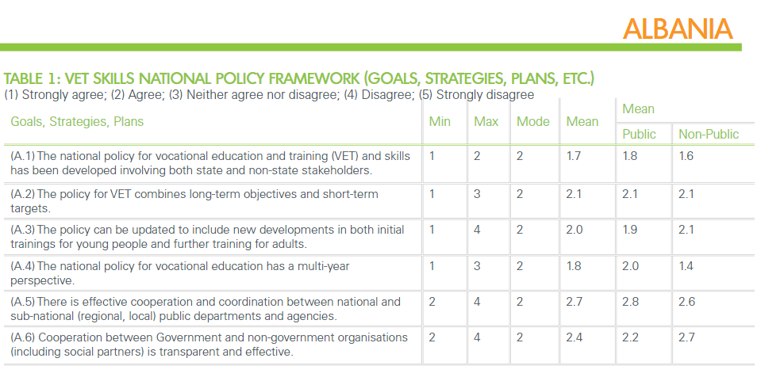
Indicators A: Formulation and implementation of overall policy framework- including strategic policy tools

Slide 18
ALBANIA: EXAMPLES OF POLICY POINTERS
Increase
Increase awareness and information concerning different stakeholders on the VET governance indicators framework and what role each stakeholder plays.
Enhance
Enhance the monitoring of governance aspects in VET & skills as part of the monitoring framework based on the relevant indicators.
Include
Include governance indicators in the annual plans of the VET & skills institutions.
Assess
Periodically assess the activities of VET institutions to guarantee that they have the human capacities, financial means, and operational procedures to play their roles effectively.

Slide 19
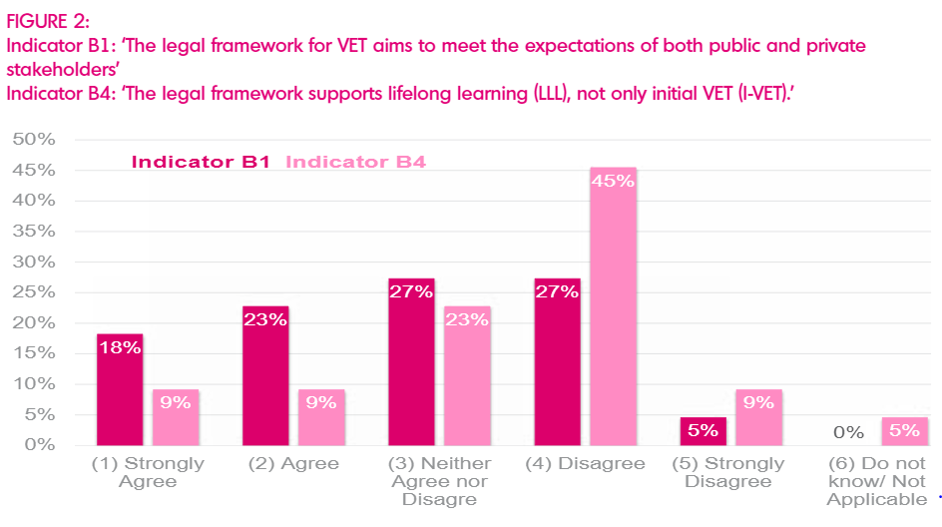
JORDAN
Indicators B: Provision of legal, normative and/or regulatory framework

Slide 20
JORDAN: EXAMPLES OF POLICY POINTERS
Develop
Develop a communication strategy for the TVET sector, highlighting the progress and role of the TVSDC to all stakeholders, and distribute council decisions and outcomes to all stakeholders systematically and transparently.
Empower
Empower regional/local authorities to form local partnerships with employers and other key actors.
Address
Address the absence of local governance and ownership of VET by governorates and municipalities. The governorate councils in Jordan should be empowered to deal with the human resources issue, especially in the VET sector.

Slide 21
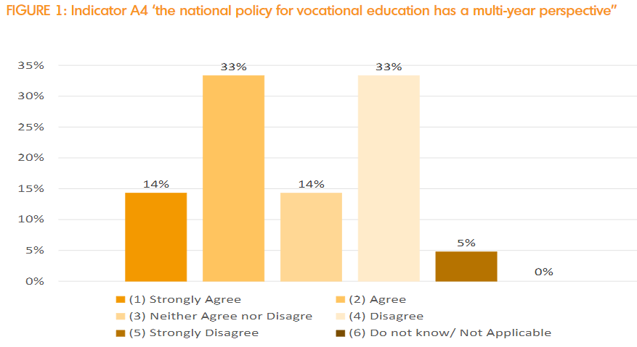
KAZAKHSTAN

Slide 22
KAZAKHSTAN: EXAMPLES OF POLICY POINTERS
Establish
Establish inter-ministerial and multi-level cooperation to improve a national system of VET assessment, certification, and quality assurance.
Develop
Develop the Centres of Vocational Excellence as growth points for new initiatives and other VET institutions to ensure the highest quality provision.
Digitalise
Digitalise VET business management processes and data collection procedures to support monitoring function.
Strengthen
Strengthen analytical and quality development assessments to track the VET policy implementing path.

Slide 23
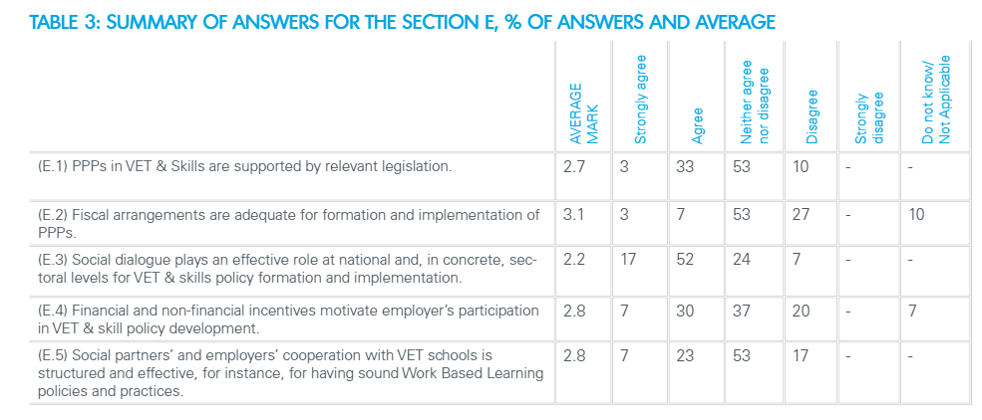
MOLDOVA
Indicators E: Management of public-private partnerships for VET & Skills development

Slide 24
MOLDOVA:EXAMPLES OF POLICY POINTERS
Enhancing cooperation and coordination between public and private stakeholders and strengthening social dialogue by the following means:
Improving stakeholder coordination by revising (or re-establishing) the role and composition of the National Coordination Council for VET and an appointing Secretariat.
Facilitating social dialogue and collaboration at the business level by supporting capacity building and the development of concrete actions within the SCs;
Supporting employers actively involved in VET by financial and non-financial incentives;
introducing a donor/development partner coordination mechanism with a national entity to better align the activities of international agencies and increase their impact, to monitor and coordinate investments and evaluate the impact.

Slide 25
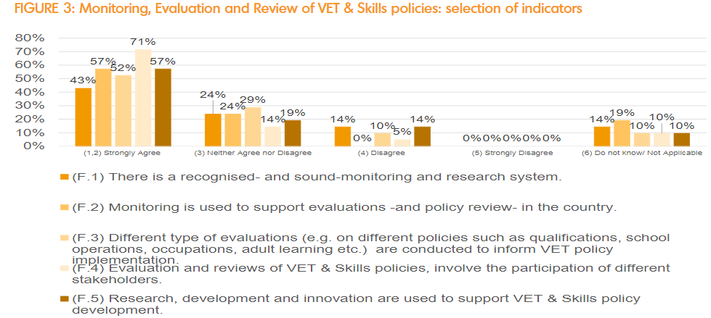
UZBEKISTAN

Slide 26
UZBEKISTAN: EXAMPLES OF POLICY POINTERS
Consistent reforms are being implemented by the government.
Further consultation with key national stakeholders is, however, needed to improve the overall architecture of the VET system, its governance and funding, qualifications, quality assurance, and links with the labour market.
In particular, the roles of the private sector and industries need to be developed.

Slide 27
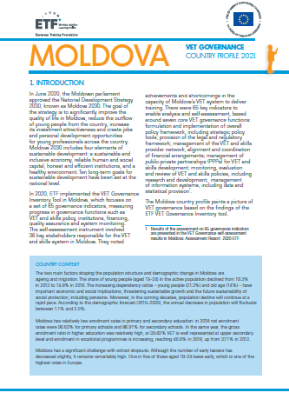
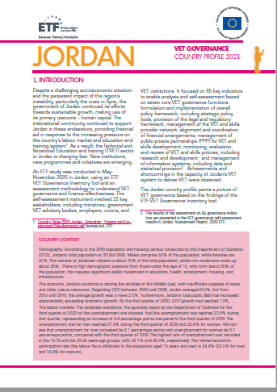

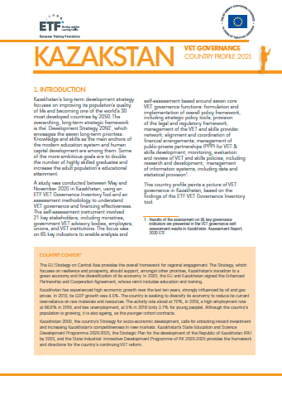
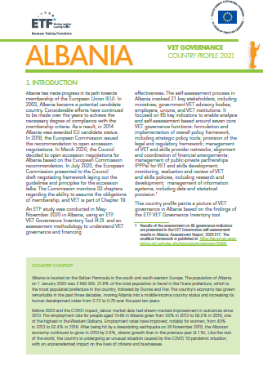
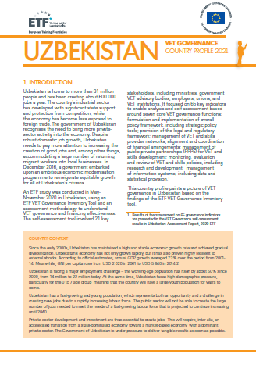

Slide 28
WHY GoverNANCE INVENTORy? (2)
  Work is ongoing on VET/ LLL strategies and policies.
  What about governance and how to measure the progress?
  The Governance Inventory has been prepared with objective to engage in collaborative process of assessment, to allow for self-reflection and improvement of efforts in governance.
  Important vehicle for supporting the partner countries in monitoring governance at different level of the system to support policy dialogue.
  The key pillar is self-assessment dimension to bring in forward the “policy learning” dimension

Slide 29

REFLECTION and QuestionS

Slide 30

TEE/COFFEE
SCREEN BREAK
10 min

Slide 31
VET Governance assessment: cross-countries analyses
What lessons are we learning from the findings?
Moderator: Vincent McBride, Senior Human Capital Development Expert
Rashida Shaikenova Director of Kazakhstan Tourism Association
Kazakhstan
Feruza Rashidova
Expert in TVET Institutions
Uzbekistan
Aram Avagyan
ETF expert
Elira Demiraj
General Director
National Employment and Skills Agency
Albania

Slide 32
VOCATIONAL EDUCATION AND TRAINING & SKILLS GOVERNANCE IN ALBANIA, JORDAN, MOLDOVA, KAZAKHSTAN AND UZBEKISTAN
Comparative analysis
Aram Avagyan

Slide 33
PURPOSE: to present in a comprehensive way the results of the VET governance self-assessment in five countries, namely Albania, Jordan, Kazakhstan, Moldova and Uzbekistan, as well as to carry out a cross-country comparative analysis of the national stakeholders’ positions.
PARTICIPATION: in total, 118 people from 5 countries
Albania – 21;
Jordan – 22;
Kazakhstan – 21;
Moldova – 33;
Uzbekistan – 21.
RESULTS ARE PRESENTED IN 5 CLUSTERS
1. Concise factual background information
2. Discussion of the self-assessment results
3. Conclusions on the most important findings

Slide 34
GRADING and INTERVALS USED
Grading
(1) Strongly Agree,
(2) Agree,
(3) Neither Agree nor Disagree,
(4) Disagree,
(5) Strongly Disagree.
Intervals for average marks per statement:
from 1.0 to 1.4 – Strongly Agree;
from 1.5 to 2.4 – Agree;
from 2.5 to 3.4 – Neither Agree nor Disagree;
from 3.5 to 4.4 – Disagree;
from 4.5 to 5.0 – Strongly Disagree.
Formula for calculating country average marks for every statement:
(N₁ x 1 + N₂ x 2 + N₃ x 3 + N₄ x 4 + N₅ x 5) / N₁₋₅
Agree Neither agree nor disagree Disagree

Slide 35
“C” MANAGEMENT OF VET (AND SKILLS) PROVIDER NETWORK
 | Albania | Jordan | Kazakhstan | Moldova | Uzbekistan | TOTAL
(K.1) The national agency-executive / supervisory body on VET / Qualifications / Quality (etc.) executes national policies in transparent and accountable manner | 2.3 | 3.0 | 2.5 | 2.0 | 2.4 | 2.4
(K.2) There is a recognised level of expertise and good outcomes provided by National Agency to support VET and Skills policy development / implementation, evaluation and review (etc.) | 2.5 | 3.2 | 2.5 | 2.2 | 2.6 | 2.6
(K.3) Overall, governing board representation in the national agency is composed by key VET and Skills stakeholders | 2.6 | 2.9 | 3.0 | 2.1 | 2.7 | 2.7

Slide 36
“C” MANAGEMENT OF VET (AND SKILLS) PROVIDER NETWORK
(K.1) The national agency-executive / supervisory body on VET / Qualifications / Quality (etc.) executes national policies in transparent and accountable manner
(K.2) There is a recognised level of expertise and good outcomes provided by National Agency to support VET and Skills policy development / implementation, evaluation and review (etc.)
(K.3) Overall, governing board representation in the national agency is composed by key VET and Skills stakeholders
Albania
Jordan
Kazakhstan
Moldova
Uzbekistan
Total

Slide 37
COUNTRIES AVERAGE MARKS FOR THE SECTION “C”

Slide 38
“H” NATIONAL VET/SKILLS COUNCILS
 | Albania | Jordan | Kazakhstan | Moldova | Uzbekistan | TOTAL
(H.1) National Council for VET exists and, overall, outcomes meet stakeholder expectations | 3.0 | 3.1 | 2.9 | 2.8 | 2.7 | 2.9
(H.2) The National Council composition represents key VET and Skills stakeholders at national level | 2.0 | 2.6 | 3.1 | 2.3 | 2.8 | 2.6
(H.3) The National Council meets on regular and effective manner in the course of the year coordinating relevant VET and Skill policy agendas | 2.6 | 3.4 | 3.2 | 3.4 | 3.3 | 3.2
(H.4) Advice / feedback processes delivered by the NC is distributed to stakeholders in systematic and transparent way | 3.0 | 3.6 | 3.2 | 3.2 | 3.2 | 3.2

Slide 39
“H” NATIONAL VET/SKILLS COUNCILS
(H.1) National Council for VET exists and, overall, outcomes meet stakeholder expectations
(H.2) The National Council composition represents key VET and Skills stakeholders at national level
(H.3) The National Council meets on regular and effective manner in the course of the year coordinating relevant VET and Skill policy agendas
(H.4) Advice / feedback processes delivered by the NC is distributed to stakeholders in systematic and transparent way
Albania
Jordan
Kazakhstan
Moldova
Uzbekistan
Total

Slide 40
COUNTRIES AVERAGE MARKS FOR THE SECTION “H”

Slide 41
SELECTED COMPARATIVE CONCLUSIONS (1)
High:
In all 5 countries, the national VET policies have been developed involving both state and non-state stakeholders (only in Jordan, some stakeholders were slightly hesitant about this).
In Albania, Jordan, Moldova and Uzbekistan the VET policies have multiyear perspective, combine long-term objectives and short-term targets. Kazakhstani stakeholders are hesitant about this.
Moderate:
Development of the legal framework with involvement of VET stakeholders is a common practice only in Albania and Uzbekistan. For Jordan, Kazakhstan and Moldova, the latter is true to a certain extent only.

Slide 42
SELECTED COMPARATIVE CONCLUSIONS (2)
Medium:
Overall, effectiveness (and transparency) of cooperation and coordination between national and sub-national (regional, local) public departments and agencies on one hand, and between government and non-government organisations (including social partners), on the other, are not satisfactory. Only Uzbekistan accepts the former and Albania the latter.
Only in Moldova, the stakeholders agree that the VET providers’ network is optimal and based on clear governance structure, while in 4 other countries they are hesitant about this.
Only in Moldova the stakeholders accept that VET support structures have necessary expertise for providing good outcomes. In other countries, they neither agree nor disagree with this.
There are no functional National VET Councils in Albania, Kazakhstan, Moldova and Uzbekistan. Only in Jordan, a TVET Skills Development Commission was recently established. The stakeholders, however, are not much satisfied with the TVSDC effectiveness, yet.

Slide 43
SELECTED COMPARATIVE CONCLUSIONS (3)
Low:
In none of the 5 countries there is any comprehensive VET monitoring and evaluation mechanism, specifically at the policy level. Some monitoring functions are spread out across a number of governance and/or support structures but are not consolidated or coordinated.

Slide 44
REFLECTION and QuestionS

Slide 45

Please go to: www.menti.com
and use code 3310 3144

Slide 46
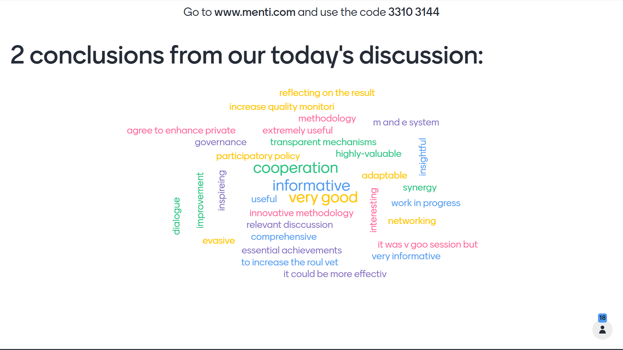

Slide 47
CLOSING SESSION
Siria Taureli,
Senior Human Capital Development Expert
Coordinator for Governance and Quality Assurance
ETF

Slide 48


Slide 49


