Slide 1


Digital Employment
STATE EMPLOYMENT AGENCY
Baku 2021

Slide 2
OUR HISTORY
1991
1 August
2011
16 February
General Employment Office
State Employment Service
2019
30 December
2020
30 June
State Employment Agency
Public Legal Entity
Adoption of
the Charter of State Employment Agency
2

Slide 3
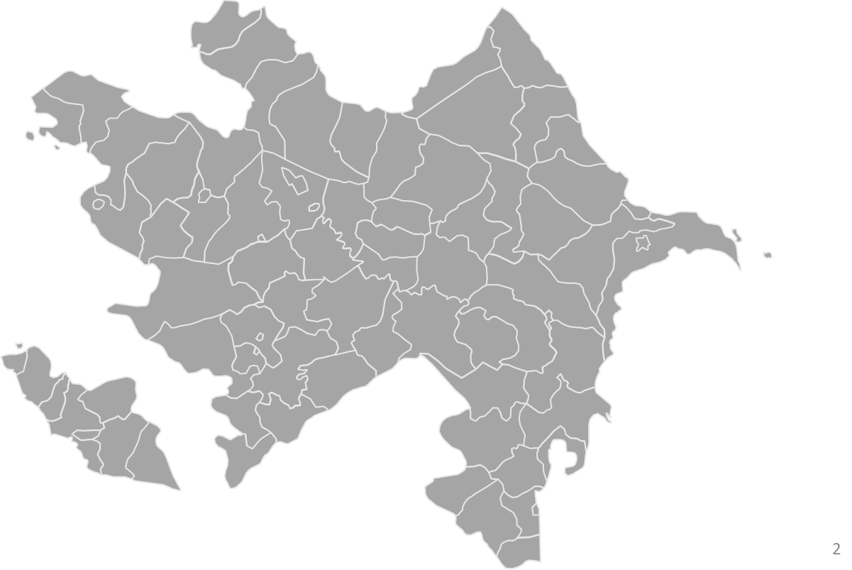

ORGANIZATIONAL STRUCTURE OF THE AGENCY
Central office
9
Central branches
22
Central Finance and Accounting branch
12
10
Central Monitoring and Evaluation branch
6
11
20
8
7
21
3
19
4
5
2
18
1
Local institutions
22 Territorial Employment Branches
17
16
13
14
Subordinated institutions
Baku Vocational Training Center
Ganja Vocational Training Center
Goychay Vocational Training Center
15
3

Slide 4























MAIN AREAS OF ACTIVITY AND OUR SERVICES
1
Registration in an employment agency
2
Employment setting
3
Paid public works
4
Unemployment insurance
5
Professional advice
6
Vocational
training
7
8
Work on Social Quota
10
Job fairs
12
Development of targeted programs
Co-financing salaries
9
Work in addition to Social Quota
11
e-Labor exchange
13
Other employment measures
14
Organization of
Self-employment
15
Bank of vacancies
16
Engagement with recruitment agents
17
Register of employed persons
18
Informal Employment Control
19
Employment Control
20
Development of Employment Programs
21
Engagement with social enterprises
22
Engagement with social partners
23
Employment Map
4

Slide 5

Digitalization
Our projects
8 digital projects
3 000 000 unique users
90 000 employer organizations
Government agencies
5

Slide 6

Subsystem of Labor Relations and Employment
It will act as a unified Labor Relations platform for all employers and employees, central and local executive authorities, as well as other government agencies.
6

Slide 7
"Subsystem of Labor Relations and Employment“ (SLRE) consists of the following functions:
Labor Relations
Formalization of Labor Relations
Organization of Labor
Labor Protection
Payment of Labor
Employment
Registration of unemployed persons and job-seekers
Self-employment
Unemployment insurance
Professional Orientation
Vocational training
Job fairs
Labor exchanges
Paid public works
Engagement with social partners
Bank of vacancies
Control
Electronic penalty
Electronic audit
Informal Employment Control
Control over social legal issues of Labor
Employment Control
Research of accidents in production
Analysis and Reporting
Register of employed persons
Employment Map of the country
Official reports
Analysis
7

Slide 8
Systems related to Subsystem of Labor Relations and Employment (SLRE)
Electronic system for Informal Employment Control
Portal of Public Works
Subsystem of Labor
Relations and
Employment (SLRE)
"BACAR" virtual platform
Register of employed persons
Monitoring and
mobile inspections
Employment Map of the country
Electronic Labor exchange

Slide 9

Informal Employment Control
Processing of data collected based on the criteria
of risk groups on state control
Economic benefits
Reducing the volume of informal employment, supporting Fair Labor, supporting state policy in the fight against the shadow economy.
Target groups
Government agencies,
institutions and organizations,
employed and unemployed persons
9

Slide 10

"BACAR" platform
"BACAR" is a virtual platform offering technical innovations of the modern era, innovative solutions, distance vocational training on international experience and standards.
Economic benefits
ensure the smoothness, accessibility, and mobility of the delivery of active employment measures to target groups, avoiding risks and costs.
Target groups
Unemployed persons and job-seekers, students, pupils and their parents
10

Slide 11

Electronic Labor exchange and fair
"Electronic Labor Exchange and Fair" will serve to ensure permanent and temporary employment of job-seekers and unemployed persons.
Economic benefits
Increase the employment opportunities of the population by attracting unemployed persons and job-seekers to one-time, short-term, and seasonal jobs.
Target groups
Unemployed persons and job-seekers
11

Slide 12

Employment Map
Visibility of employment and social indicators in each administrative region
Economic benefits
It will show the dynamics of the steps to be taken in the social and economic sphere and will allow further improvement of the work on the development and implementation of Employment programs.
Target groups
Government agencies,
institutions and organizations,
employed and unemployed persons
12

Slide 13
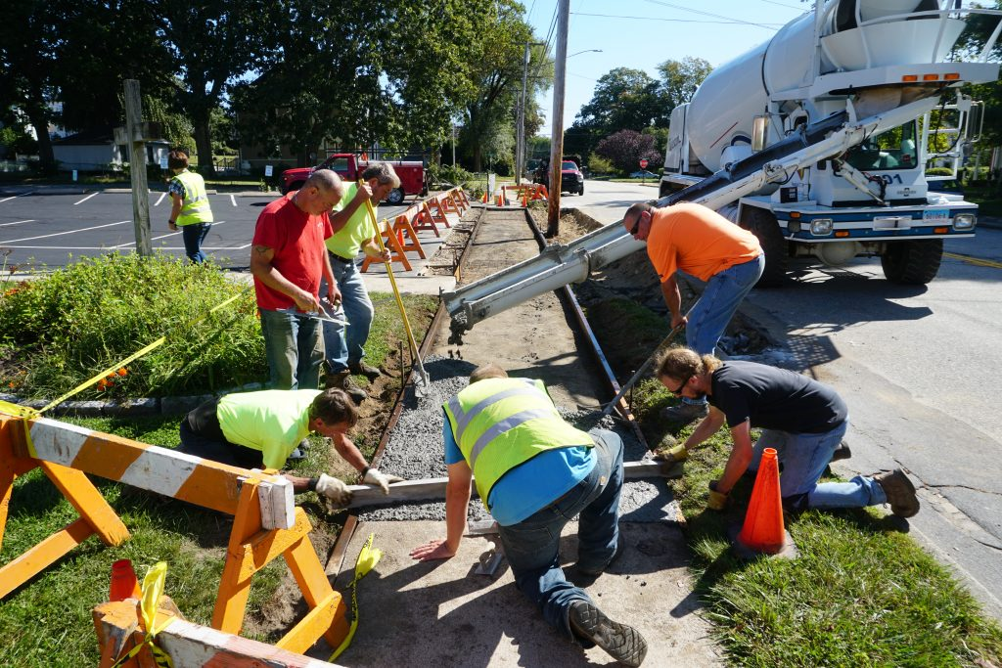
Public Affairs portal
It is designed to make the process of Public Works Organization more simple and operative by means of Digitalization.
Economic benefits
Reduction of unemployment by ensuring employment of persons with low employment opportunities.
Target groups
Unemployed persons without primary vocational training and skills
13

Slide 14

Register of employed persons
Analysis of persons considered to be employed and increase the effectiveness of the fight against
Informal Employment
Economic benefits
Develop an information base on the Labor Market, strengthen measures to control Informal Employment.
Target groups
Government agencies
14

Slide 15

Monitoring and mobile inspections
Implementation of inspections and monitoring carried out in connection with the implementation of service activities based on unified standards.
Economic benefits
Ensuring accountability, transparency, and flexibility in decision making.
Target groups
Employers, low-income families, those involved in self-employment program
15

Slide 16

What we will achieve
reversal of Employment File
rerversal of orders on paper
reversal of business trip cards on paper
reversal of staff schedules on paper
reversal of personnel clerical work on paper
reduction of the number of physical inspections
electronic penalty mechanism
Transition to proactive employment measures
reversal of paper form of employment contracts
reversal of Employment Record Book requirement
reversal of Social Insurance Cards
16

Slide 17

THANK YOU FOR YOUR ATTENTION!
STATE EMPLOYMENT AGENCY

