Slide 1





NEW ECONOMIC AND LABOUR MARKET TRENDS AND THEIR IMPLICATIONS FOR SKILLS DEVELOPMENT
Country Case: AZERBAIJAN
Webinar | 7th October 2021
11.00 – 13.30 (Baku time)
9.00 – 11.30 hrs (CET)

Slide 2
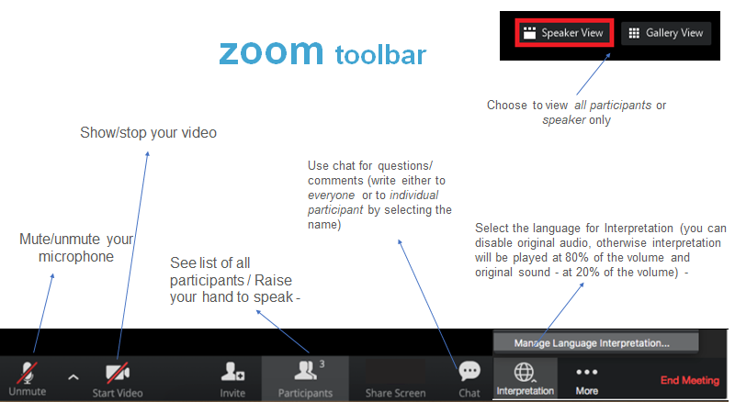

Slide 3

OCTOBER 2021 NEW ECONOMIC AND LABOUR MARKET TRENDS AND THEIR IMPLICATIONS FOR SKILLS DEVELOPMENT Country Case: AZERBAIJAN ETF Study: Eastern Partnership and Platform work

Slide 4

11.00-11.15 Opening session
11.15-12.00 New labour market trends and forms of employment in the EaP countries – approaches and findings for Azerbaijan
12.00-12.15 Coffee break
12.15-13.00 Key policy implications and future opportunities
Presentation from the Ministry of Labour and Social Protection of Population and State Employment Agency under the Ministry of Labour and Social Protection of Population on digital transformation agenda for support of Labour Market in Azerbaijan
13.00-13.30 Wrap up session, next steps
AGENDA

Slide 5
Opening
Anar Aliyev,
Deputy Minister
Ministry of Labour and Social Protection of Population of the Republic of Azerbaijan
Victor Bojkov,
Head of Cooperation
Delegation of the European Union to Azerbaijan
Georgios Zisimos,
Head of Policy Advice and EU Programming Unit
European Training Foundation (ETF)
Mustafa Abbasbayli,
Chairman of the Board
State Employment Agency under the Ministry of Labour and Social Protection of Population of the Republic of Azerbaijan

Slide 6

1. ETF’s recent research on The future of work – New forms of employment in the Eastern Partnership countries: Platform work | ETF (europa.eu) focused on changing patterns of work triggered by digitalisation
2. to discuss with the relevant stakeholders in Azerbaijan the findings of the study, particularly those related to Azerbaijan
3. to foster reflection on strategic developments and policy measures in Azerbaijan on skills demand and new trends in changed context
Moderator:
Margareta Nikolovska, Senior Human Capital Development Expert – Country Liaison Officer, Azerbaijan, ETF
Objectives

Slide 7
SESSION 1: New labour market trends and forms of employment in the EaP countries – approaches and findings for Azerbaijan 11.15-12.00, Baku time 9.15 – 11.15, CET
Iwona Ganko,
Human Capital Development Expert – Labour Market, ETF
Eva Jansova,
Human Capital Development Expert, ETF

Slide 8

NEW ECONOMIC AND LABOUR MARKET TRENDS AND THEIR IMPLICATIONS FOR SKILLS DEVELOPMENT
NEW FORMS OF WORK
IN AZERBAIJAN
Iwona Ganko and Eva Jansova
European Training Foundation
7 October 2021

Slide 9
NEW ECONOMIC AND LABOUR MARKET TRENDS the ETF PARTNER COUNTRIES - CONTEXT
The EU Neighbourhood countries experience different dynamics within the region of the Western Balkans and Turkey, Eastern Partnership, Southern Mediterranean and Central Asia. However, the majority of the countries suffer from low productivity and inefficient use of resources, especially human resources.
The impact of technological change on employment is very intense and has been substantially accelerated by the COVID-19 pandemic, including through remote work. The ICT sector had been expanding before the outbreak of the COVID-19 pandemic and its growth has accelerated by the digitalisation shifts between 2020 and 2021.
Continuous growth has been observed in the ICT sector value added, particularly in Belarus, Serbia, Russia, Israel, Ukraine, Azerbaijan, North Macedonia and Bosnia-Herzegovina.
Changing industrial relations, strong sectoral shift towards services
Economic and labour market volatility (impact of the pandemic)

Slide 10
New forms of work in the ETF PARTNER COUNTRIES - FINDINGS
Increasing self-employment, freelancing, remote work and platform work – outsourcing, emergence of national start-ups, technological parks and growing number of workers on international platforms – Serbia, Ukraine, North Macedonia, Armenia, Montenegro, Bosnia-Herzegovina, Albania, Egypt, Russia
Platform work: Eastern Partnership - prevalent in Ukraine, followed by Belarus. Increasing popularity in Azerbaijan, Georgia and Moldova. Strongly increasing prevalence in Armenia and Azerbaijan
Mostly young people involved, majority educated males from capital and other larger cities
Remote work - ICT, multimedia arts and design, writing and translation
On-location: ride hailing, delivery services

Slide 11
New forms of work in the ETF PARTNER COUNTRIES - FINDINGS
Fostered labour market flexibilization and segmentation: high-skill and low-skill / gender
Limited acknowledgement of the new phenomena in recent policies
In most cases, regulations are not well adapted to new forms of work
Social partners are almost not present – social dialogue, policy making?
Wide-spread informality, limited coverage by employment policies, services or social benefits
Limited career development, algorithmic management
However, new forms of work are not linked with precarity, but rather additional and higher income than in other sectors

Slide 12
New form of work growing in the ETF PARTNER COUNTRIES - IMPLICATIONS
Strong digitalisation push relies on connectivity: infrastructure and digitalal services
Working conditions - labour market regulations, including employment status and taxation
Skills strategies to address skills demand (including implications for education and training systems)
Role of ALMPs and PES in supporting the transition into employment and job-to-job in the platform economy
Access to information: freelancing, platform work may become a pathway to work for the unemployed or underemployed
Access to services: counselling, career guidance and other support services
Limited career development, but skills development opportunities – on-the-job learning
Need to extend knowledge and understanding, not captured by traditional statistics
(Un)observability of platform work or freelance transactions

Slide 13
New form of work growing in the ETF PARTNER COUNTRIES - IMPLICATIONS for skills
Digital skills
STEM and ICT, multimedia arts and design, literacy – writing and translation
Language skills, English and Russian in particular
Entrepreneurship, customer orientation and self-organisation skills
Analytical and problem-solving skills
Self-presentation and communication
Career management and learning to learn
Implications for the education and training: adult skills development, skills recognition, validation, certification

Slide 14
New labour market trends and forms of employment in Azerbaijan - context
Fast economic growth (prior 2020)
High activity and low unemployment
Significant share of self-employed (66.6% in 2019)
Informality and vulnerability are present
Skills mismatch (among youth)
Emerging creative and innovative environment, backed by strong government strategies (e.g., in the field of information technologies)

Slide 15
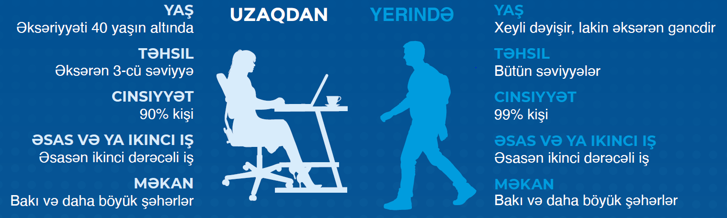
New labour market trends and forms of employment in Azerbaijan – platform work

Slide 16

New labour market trends and forms of employment in Azerbaijan – state of play

Slide 17
New labour market trends and forms of employment in Azerbaijan – platform workers and regulatory framework
Little attention in relevant policies despite strong strategic frameworks e.g. for digitalisation
New forms of work, including platform work not regulated by existing legislation (Labour code and Civil code)
Freelance work and self-employment are often informal employment
Little evidence available
Limited financial security and social protection
Limited attention to skills development

Slide 18
New labour market trends and forms of employment in Azerbaijan – main challenges and opportunities
OPPORTUNITIES
CHALLENGES
New job opportunities (for both highly and low skilled) Alternative to migration Development/strengthening of (new) skills (e.g., language skills, analytical and problem-solving skills, self-presentation and communication)
Shortage of specialists in demanded occupations e.g. IT Informality among platform workers and inadequate regulatory framework insufficient knowledge of English language

Slide 19
ETF recent publications (2021)
The future of work – New forms of employment in the Eastern Partnership countries: Platform work
Platform work in Azerbaijan
Changing skills for a changing world: Understanding skills demand in EU neighbouring countries

Slide 20

REFLECTION and QuestionS

Slide 21

BREAK 12.00-12.15 10.00-10.15
This Photo by Unknown Author is licensed under CC BY

Slide 22
SESSION 2: Key policy implications and future opportunities 12.15-13.00, Baku time 10.15 – 11.00, CET
Rashad Dayieyev,
Head of Employment policy and demographic development issues department, MLSPP
Elman Sadigov,
Head of Labour Market Analysis and Development Department, SEA

Slide 23
MARYAM TO INSERT MR. DAYIEV PRESENTATION
Rashad Dayieyev,
Head of Employment policy and demographic development issues department, MLSPP

Slide 24
REFLECTION and QuestionS

Slide 25

WRAP-UP SESSION 13.00-13.30 Baku Time 11.00 – 11.30 CET

Slide 26


Closure: what’s next?
Ministry of Labour and Social Protection of Population
State Employment Agency under the Ministry of Labour and Social Protection of Population
ETF: Iwona Ganko, Eva Jansova, Margareta Nikolovska
National Observatory on Labour Market and Social Protection Affairs

