Slide 1

Methods, forms, ways and tools of distance learning
Speaker:
K. Sengaziyev

Slide 2












Training is carried out in 12 specialties
Construction and operation of buildings and structures
Organization of hotel services
Interior design, restoration and reconstruction of civil buildings
Tourism
Maintenance, repair and operation of motor transport
Accounting and audit
Computer engineering and software
Electronics and Communication
Exploitation of linear constructions of telecommunication and wire broadcasting
Information system
"Installation and operation of gas supply systems equipment»
Operation of automated communication systems

Slide 3
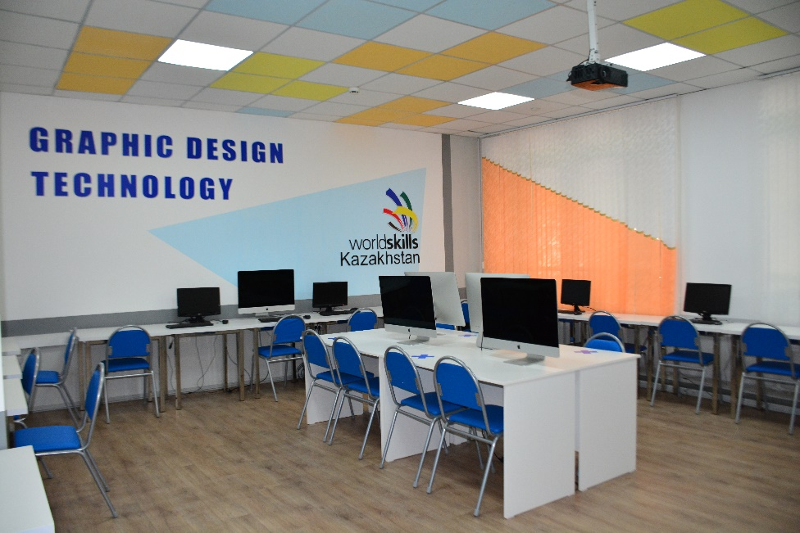
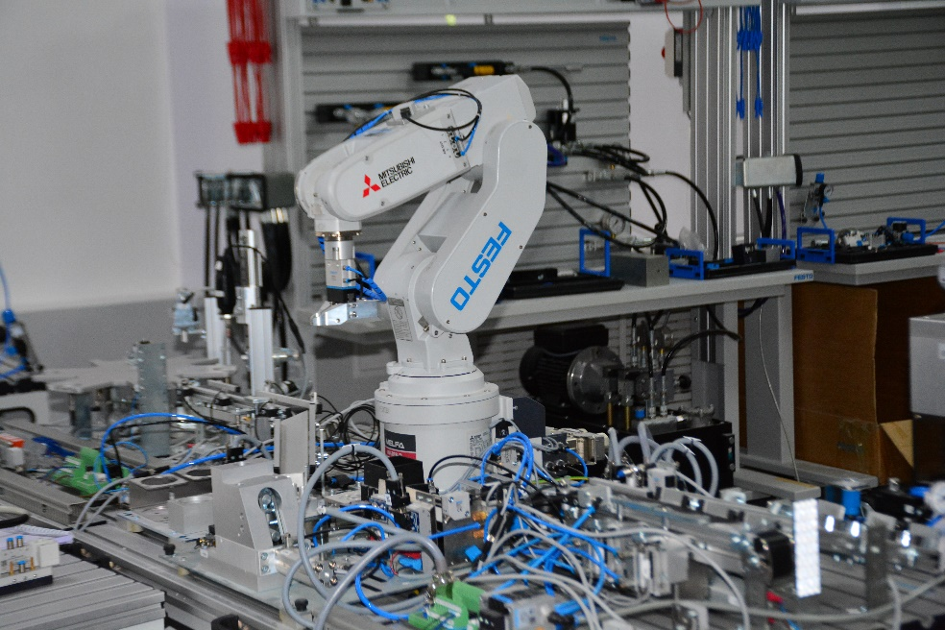
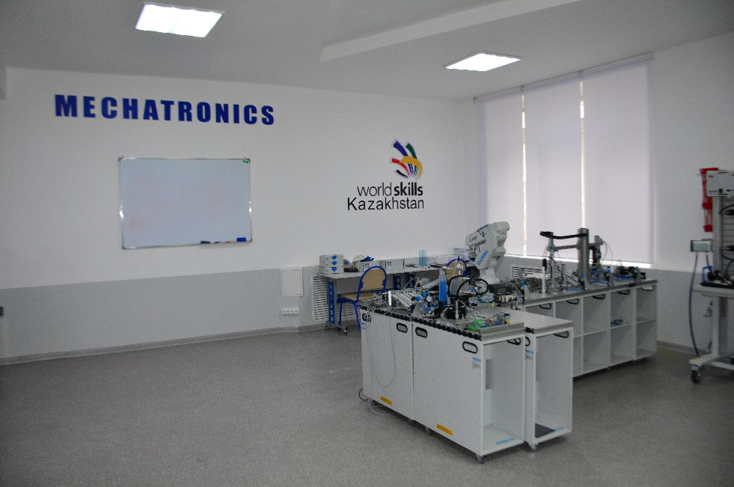
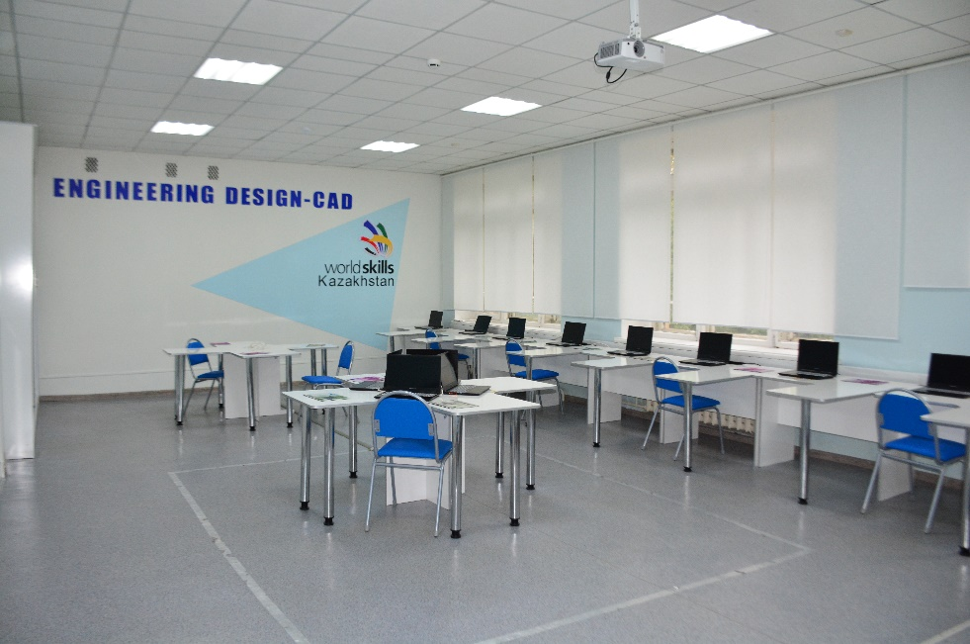
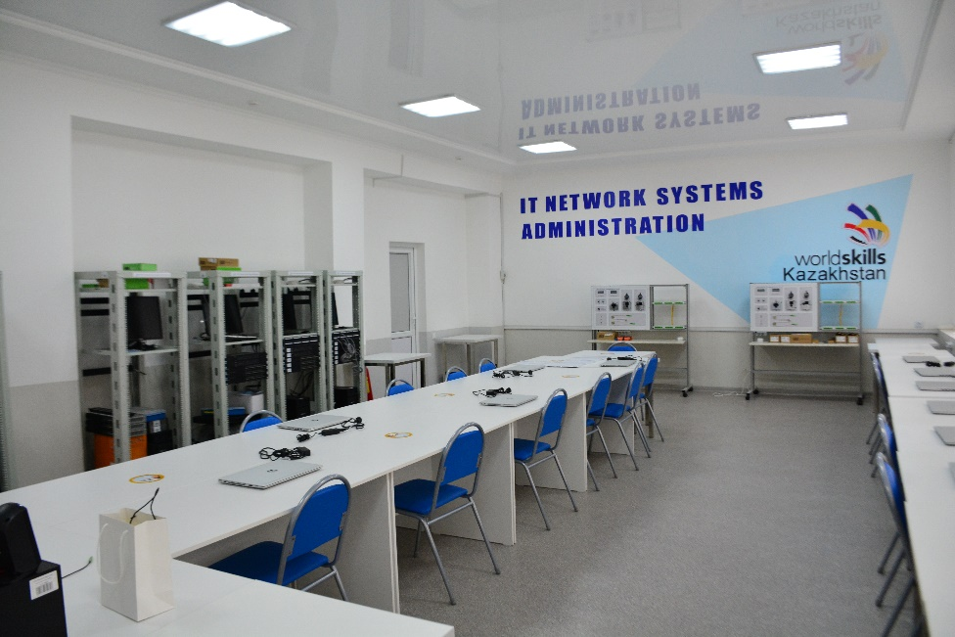
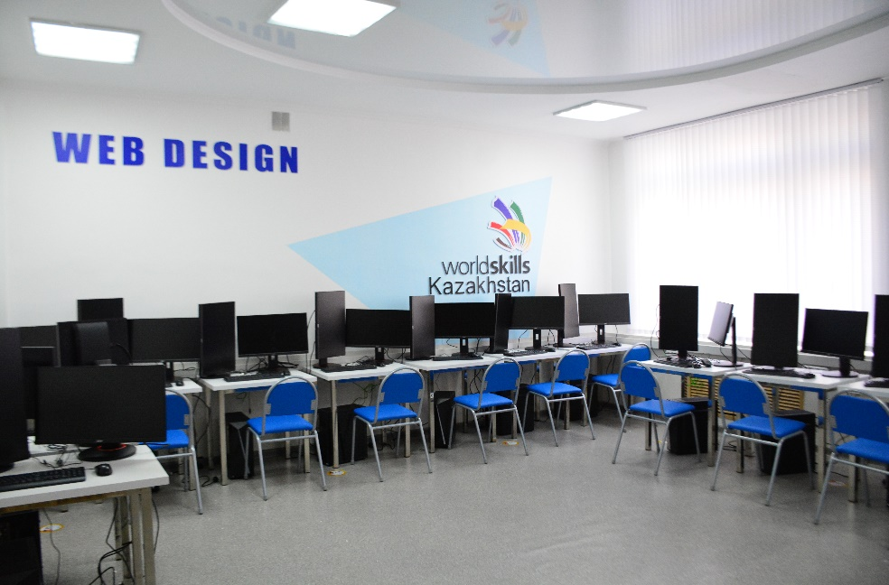
IT competence center

Slide 4
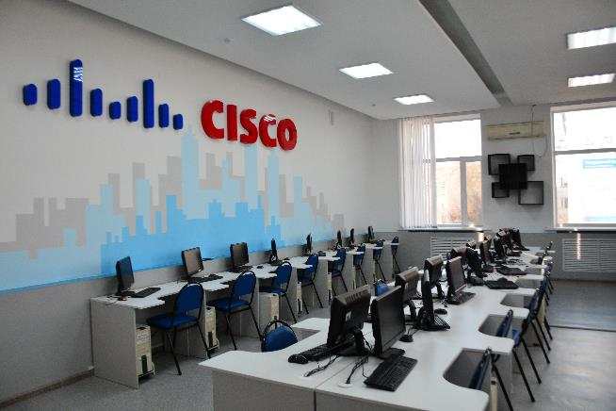
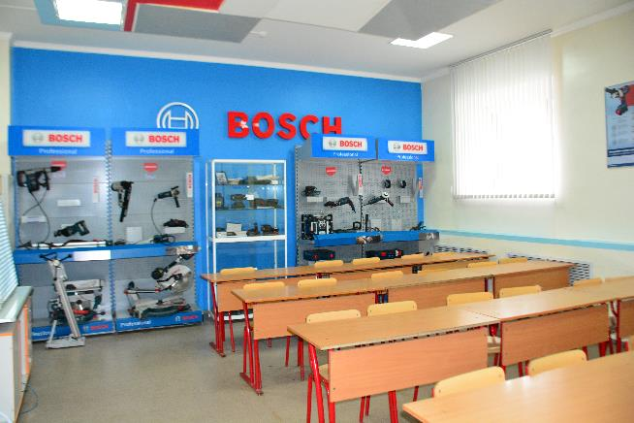
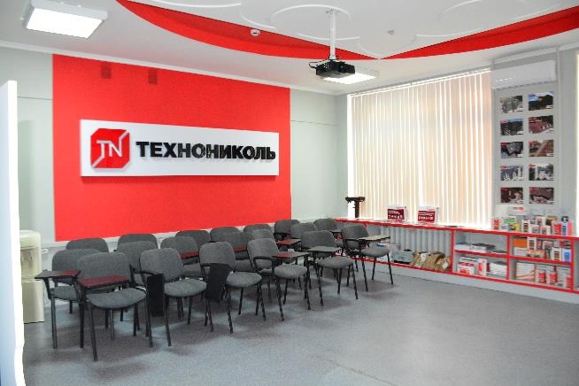
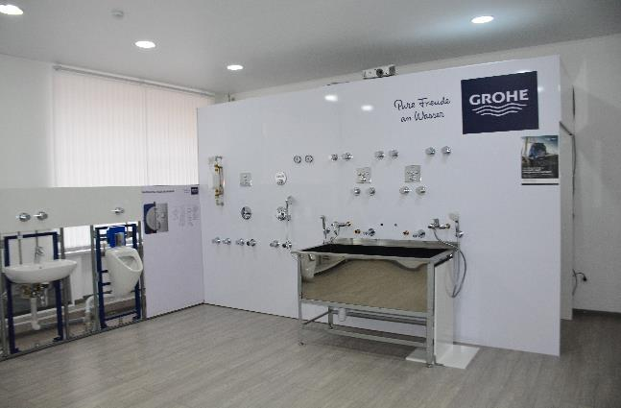
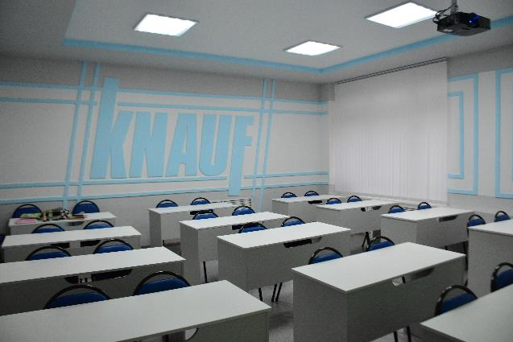
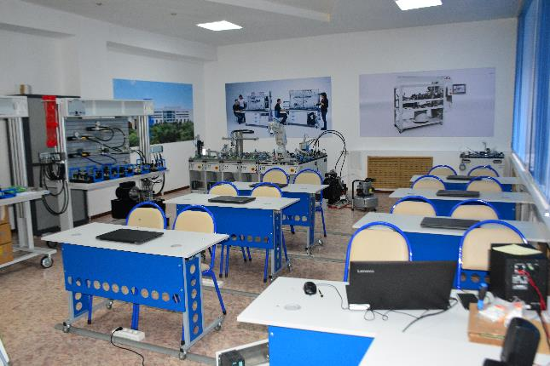








The College has 6 resource centers and 2 regional centers

Slide 5
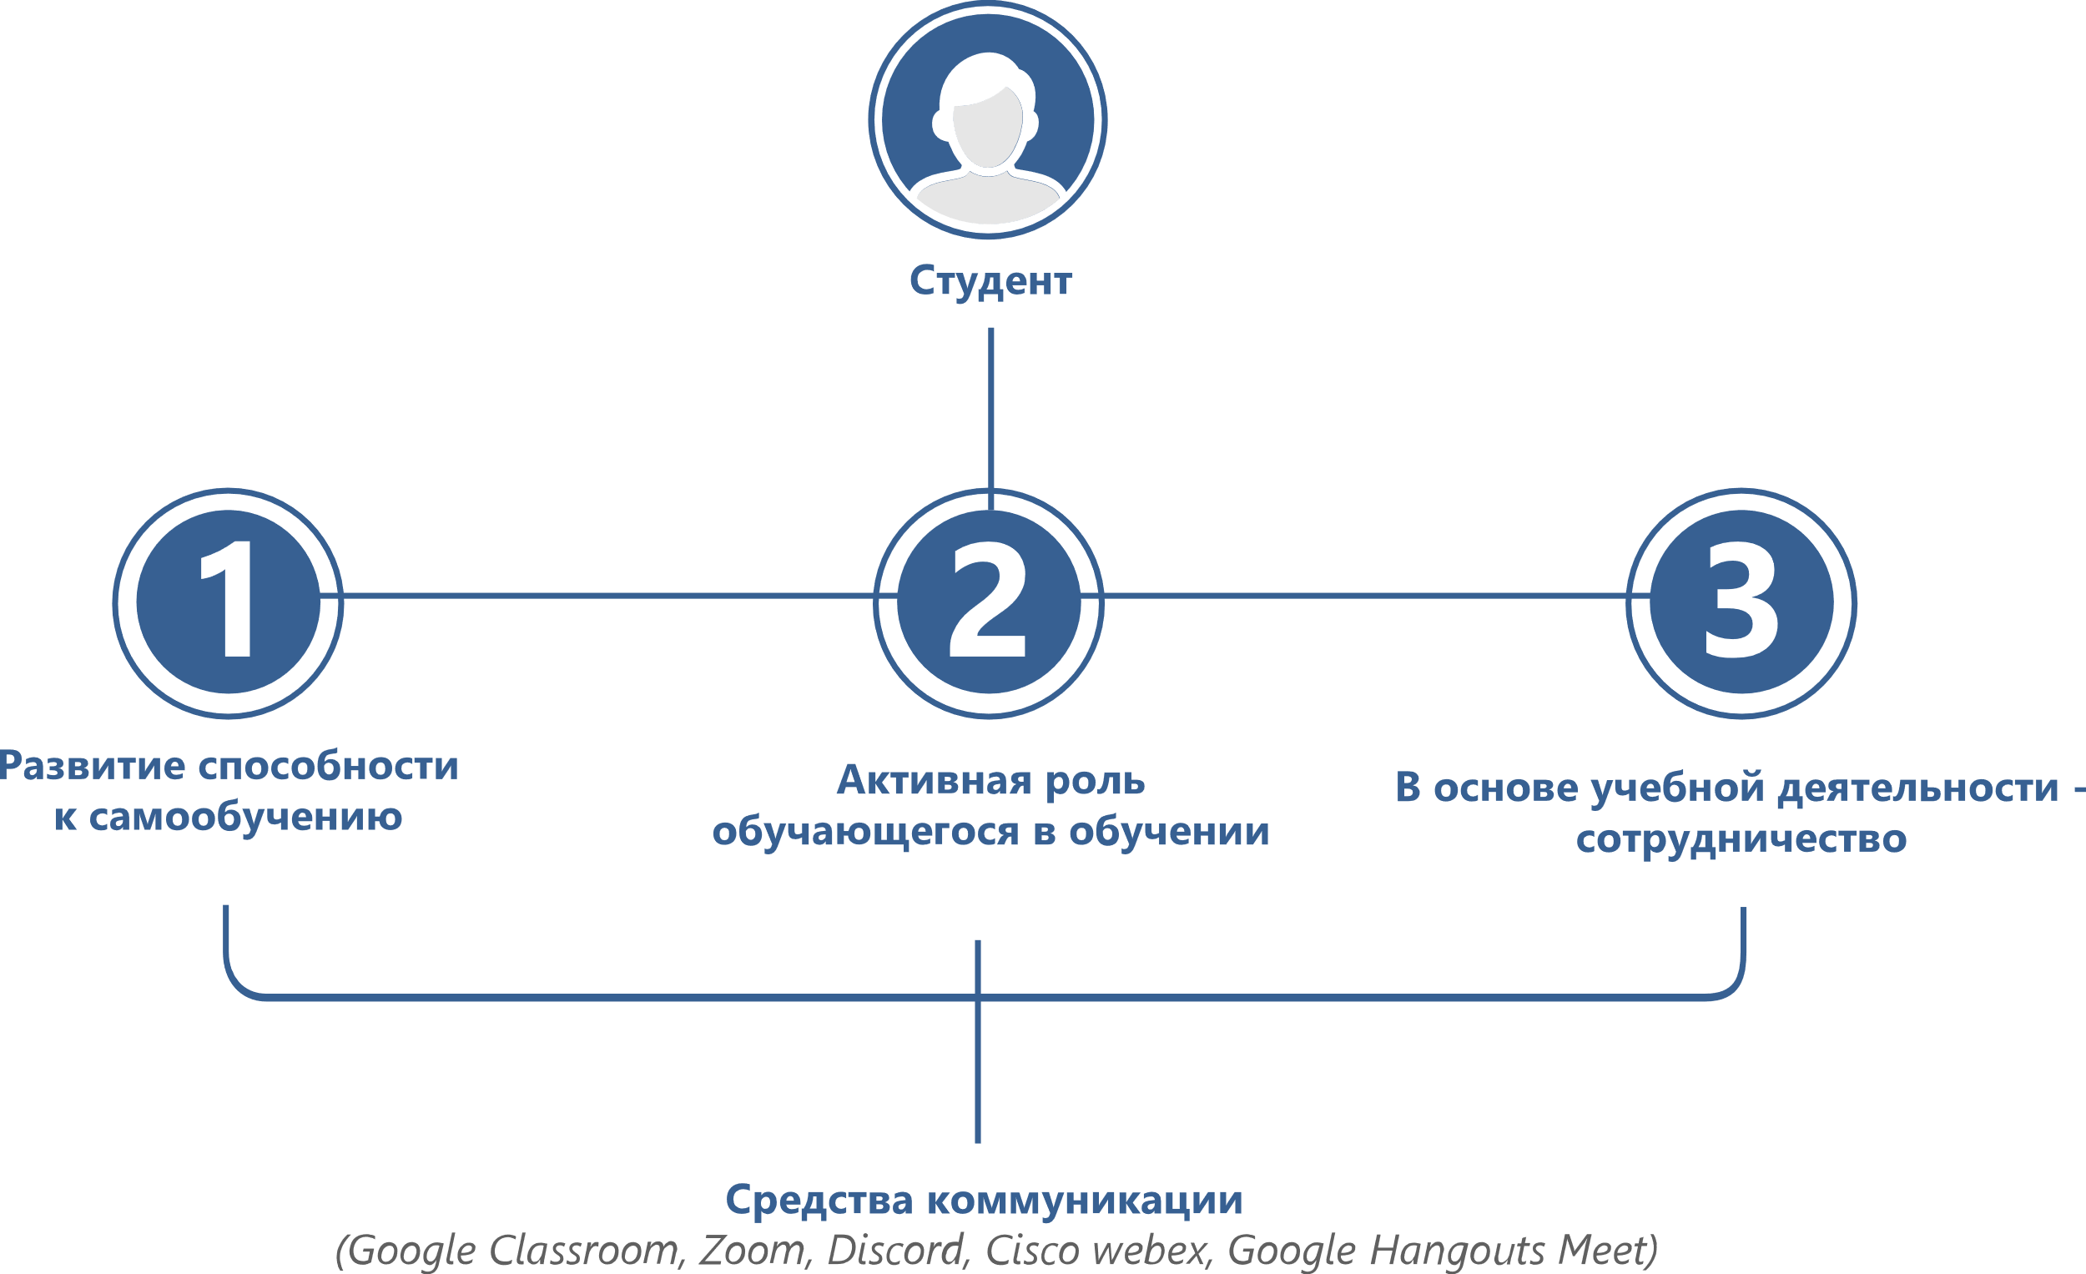
Distance learning

Slide 6
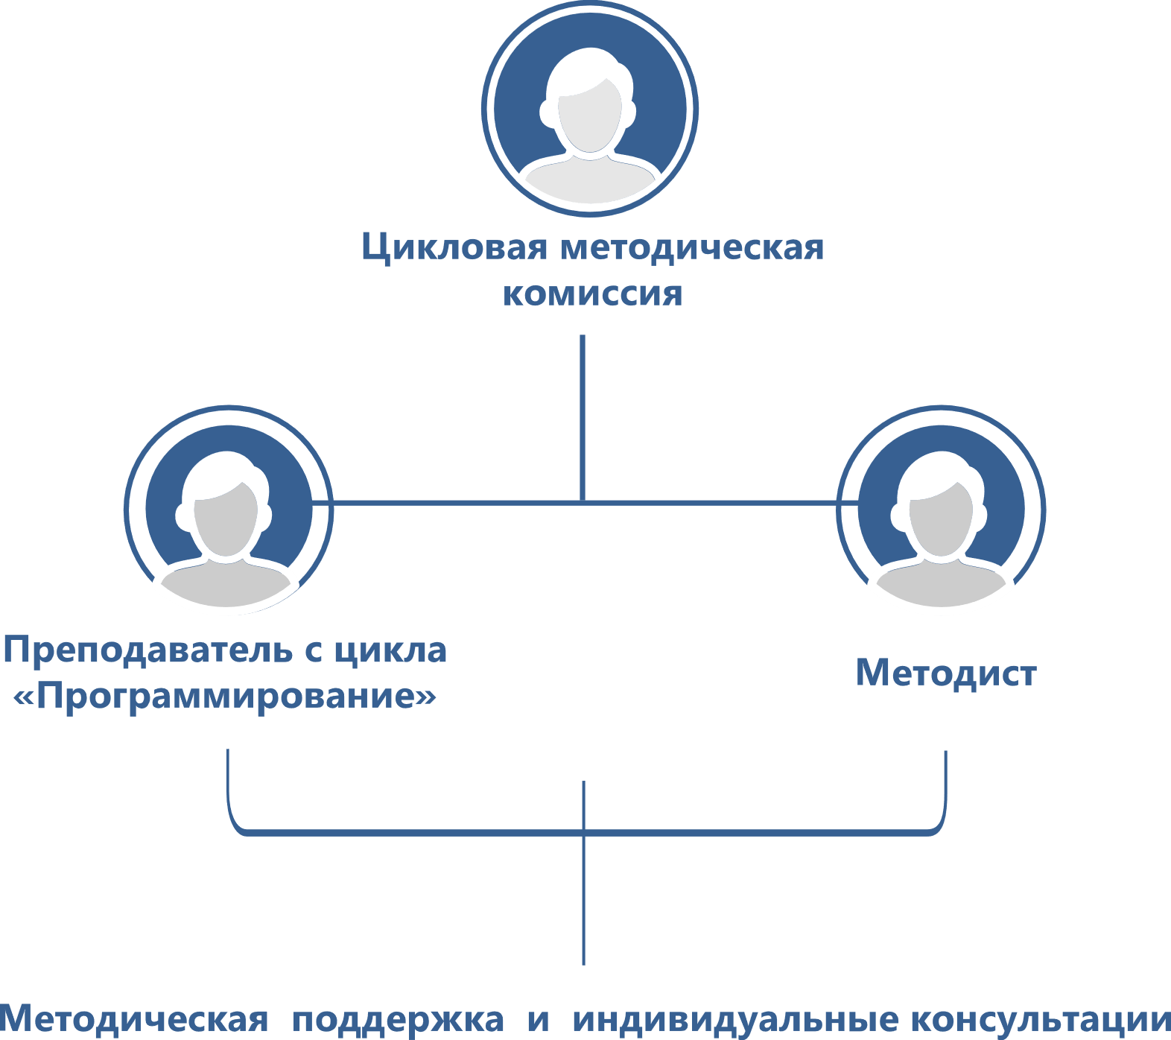
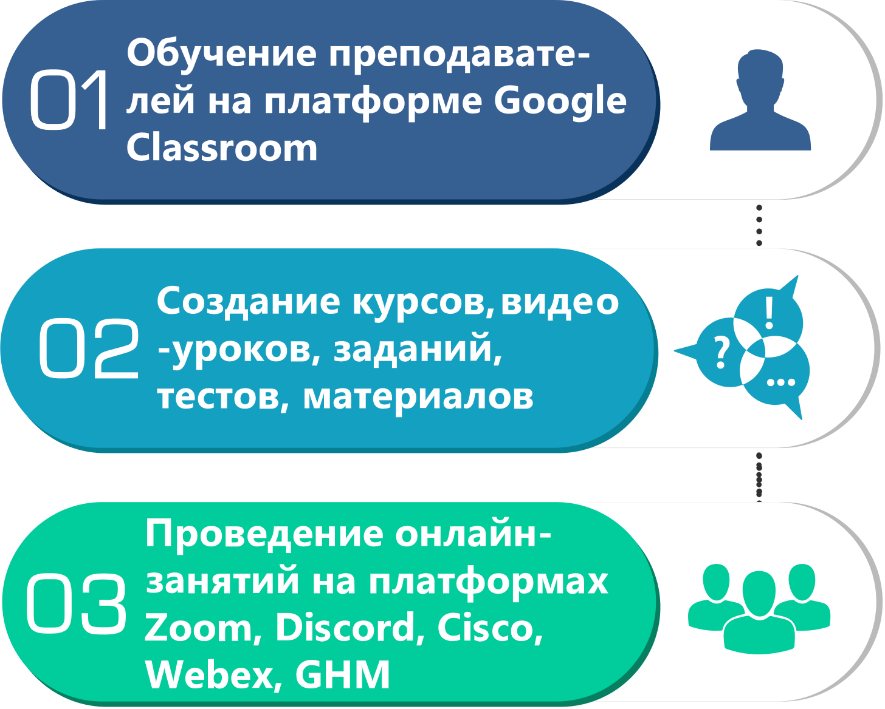
What was the transition like?
With the transition to distance learning technologies, the College created and organized a staff to support teachers

Slide 7
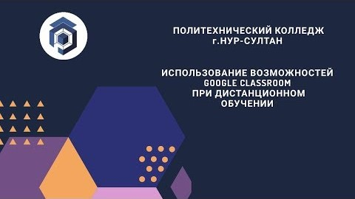
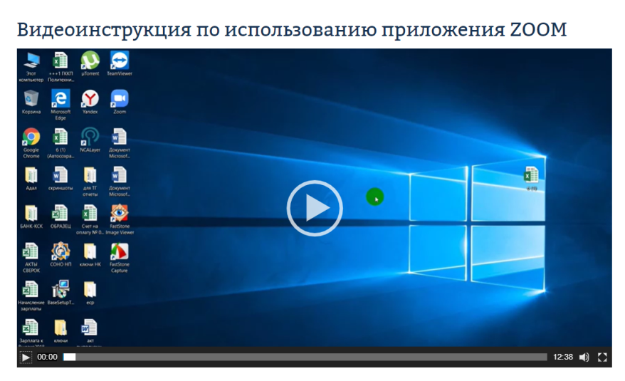

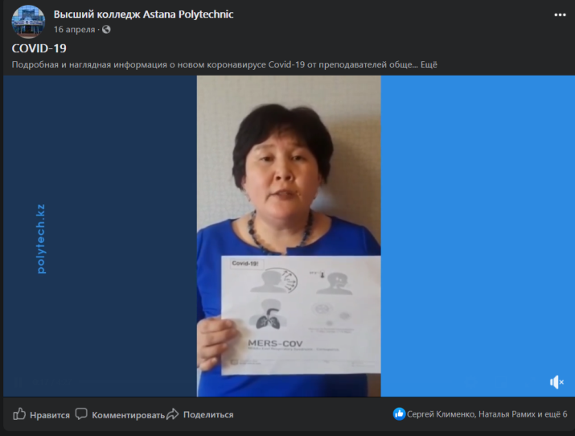
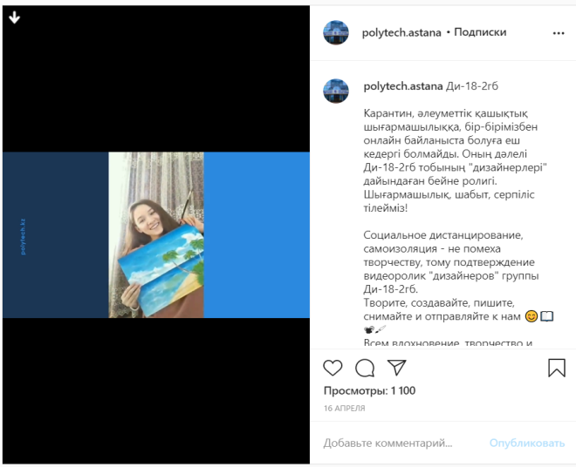
Having successfully mastered DLT, teachers recorded 52 video tutorials on YouTube
Teacher Zhanna Abdrakhmanova
Teacher Klimenko S. V.
Teachers: Bralina R. Sharipovа A. K.
Detailed and visual information about the new coronavirus Covind-19 CMC teachers of General education subjects
Social distancing, self-isolation-not a hindrance to creativity, this is confirmed by the video of the "Designers" of ДИ-18-2ГБ group.

Slide 8
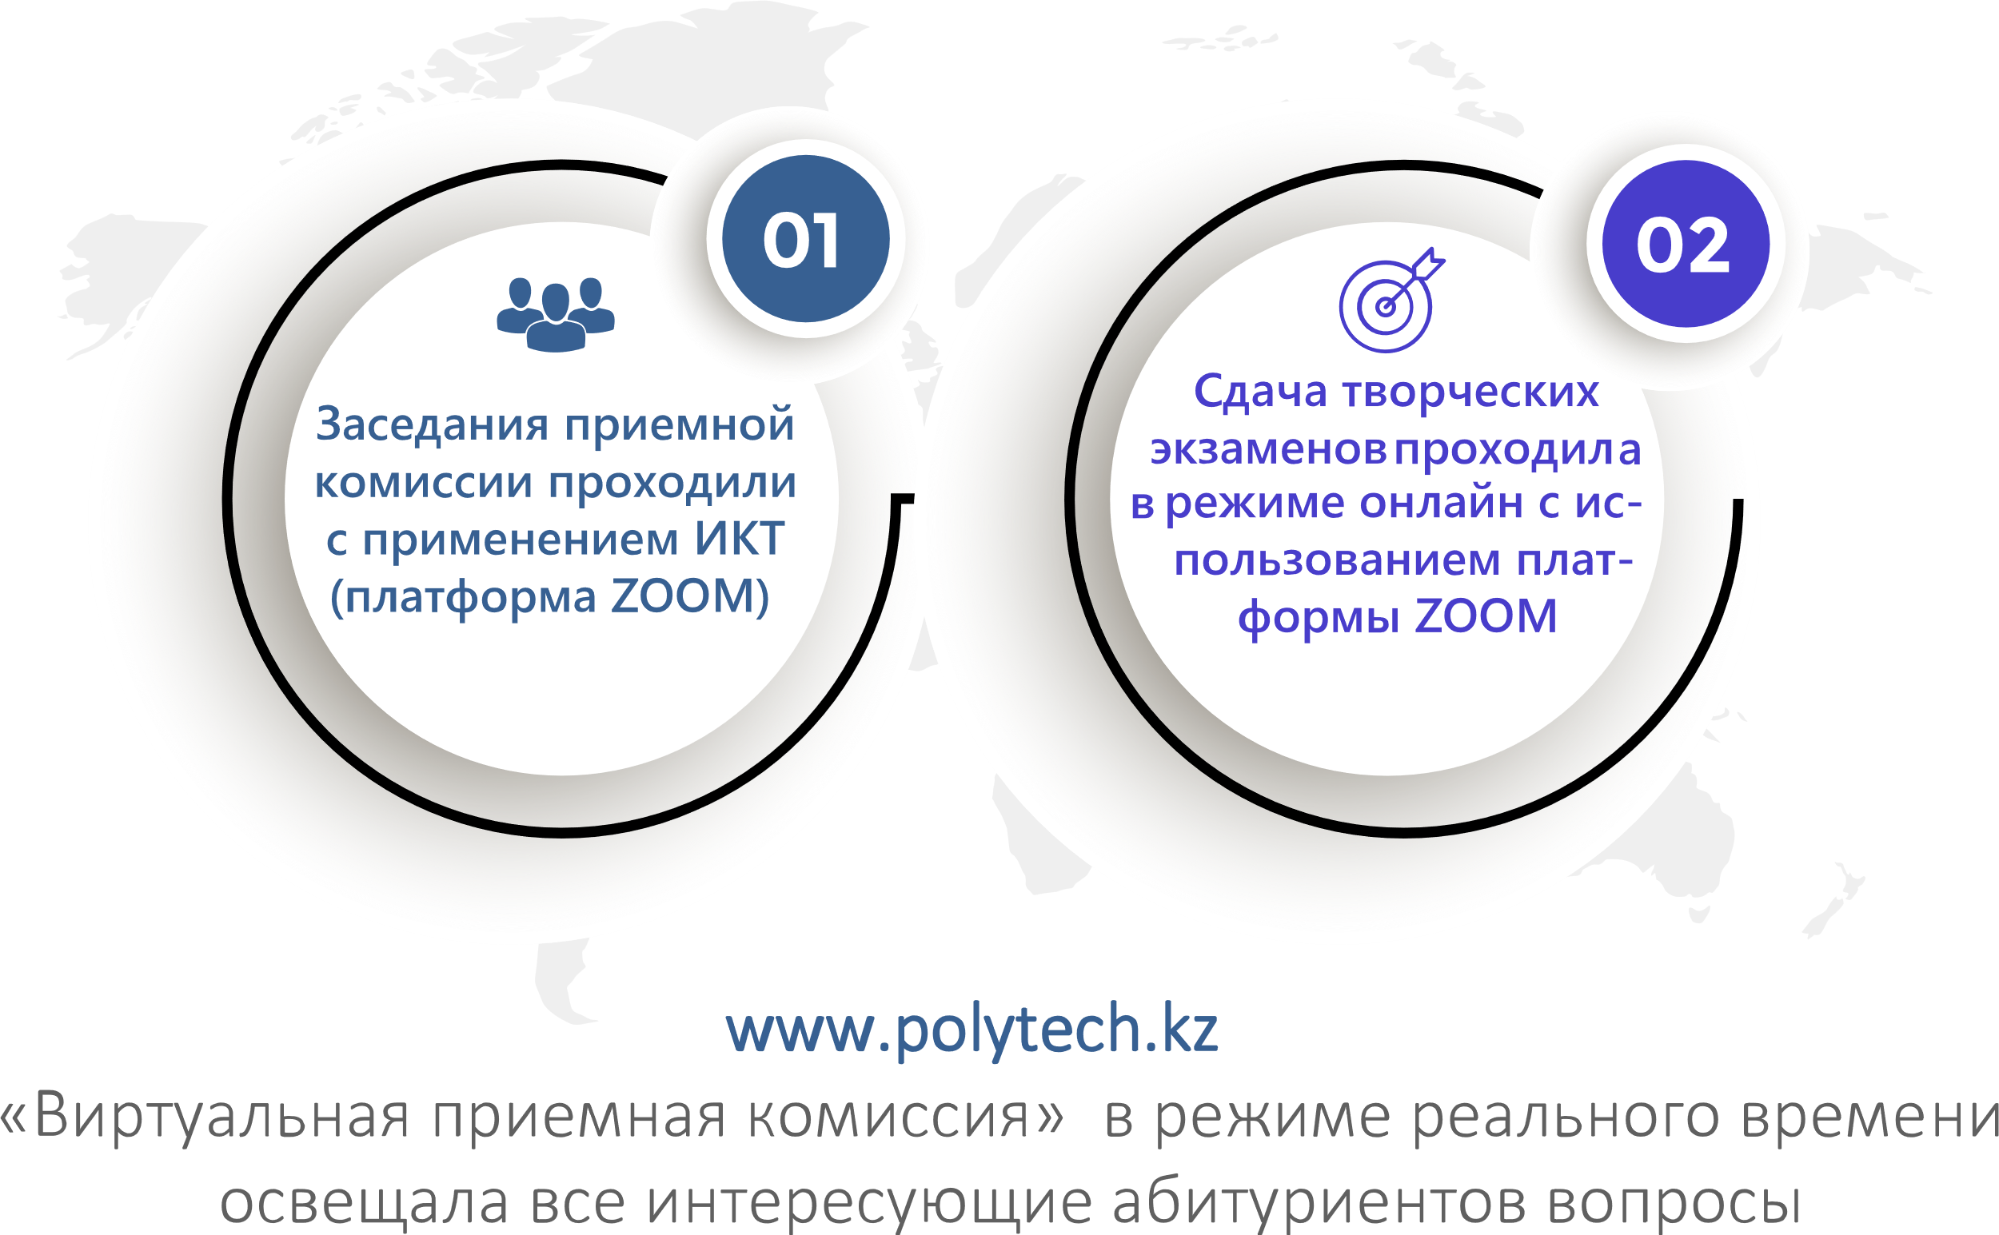
How were applicants accepted?
In the 2020-2021 academic year, the College accepted documents in 11 specialties. Documents were accepted both in electronic format via the E-government web portal: www.egov.kz, and in paper

Slide 9
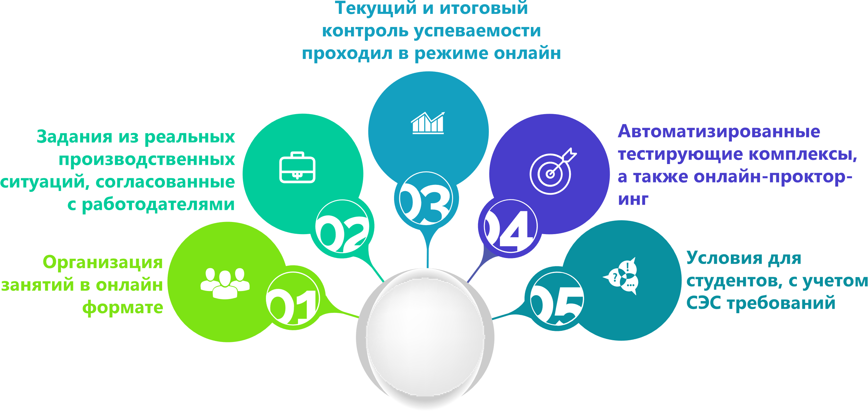
What are the features of industrial training and professional practices?
ДОТ

Slide 10
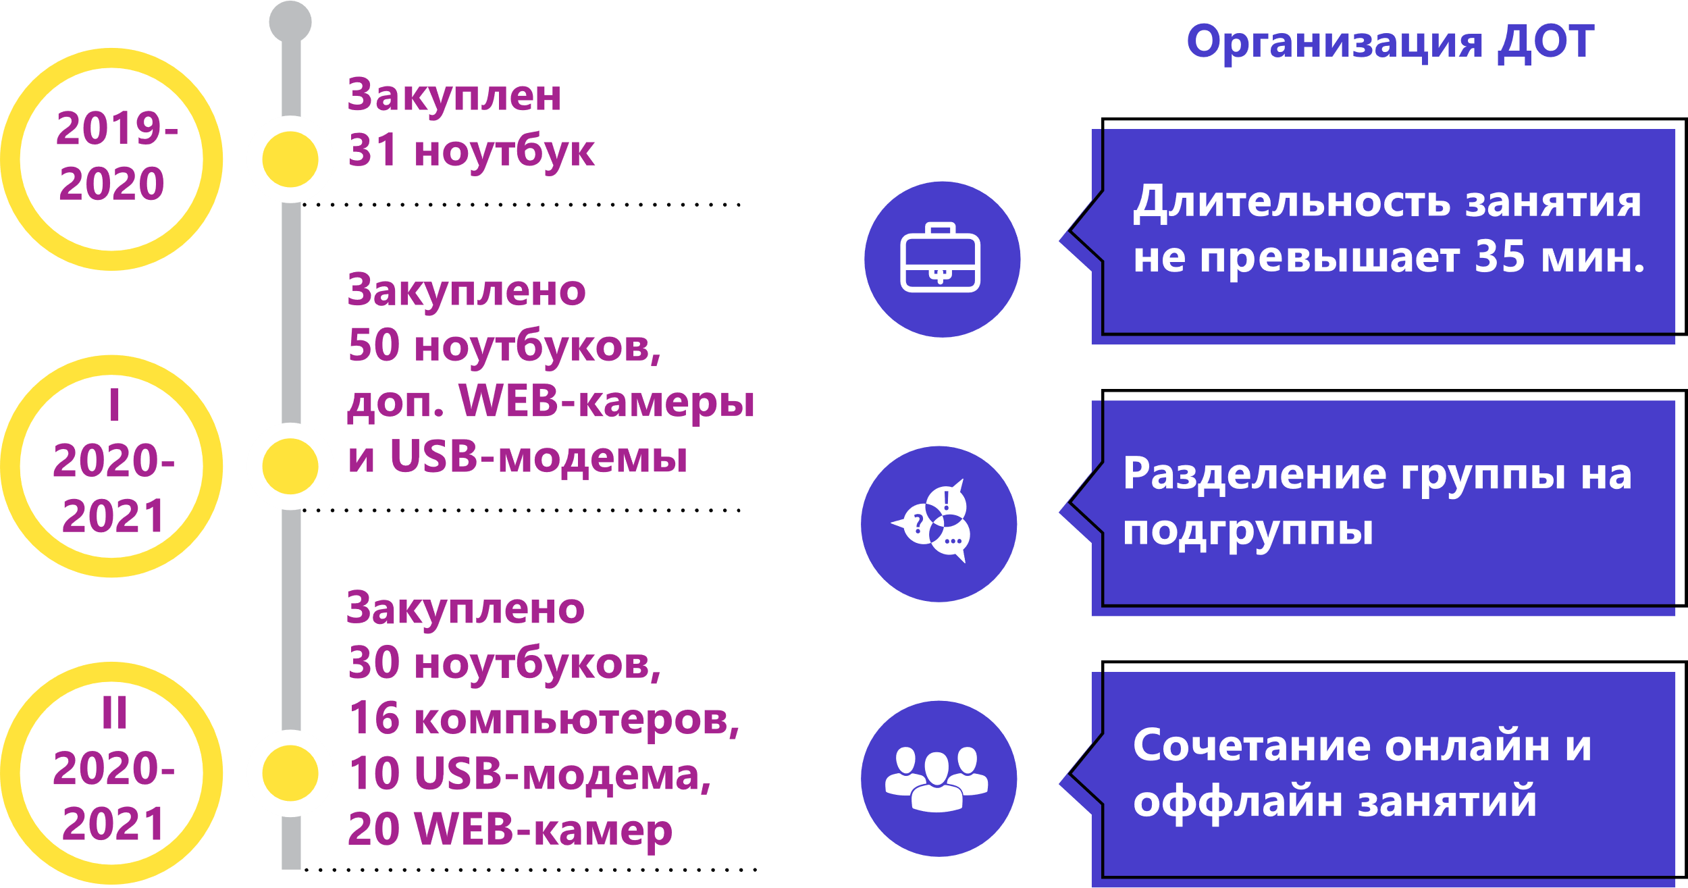
Support of the Ministry of education and science of the Republic of Kazakhstan and The Department of education of the city of Nur-Sultan
At the beginning of the academic year (2020-2021), the Ministry of education and science of the Republic of Kazakhstan developed Guidelines for organizing training in a pandemic
Council for the protection of teachers ' rights established

Slide 11
Thank you for your attention!

