Slide 1

MINISTRY OF EDUCATION AND SCIENCE OF THE REPUBLIC OF KAZAKHSTAN "ALMATY CONSTRUCTION AND TECHNICAL COLLEGE" OF THE DEPARTMENTOF EDUCATION OFALMATY
FORMATION OF A UNIVERSAL EDUCATIONAL SPACE FOR STUDENTS AND TEACHERS THROUGH THE CONSISTENT IMPLEMENTATION OF EDUCATIONAL PROGRAMS TAKING INTO ACCOUNT THE NEW CHALLENGES OF OUR TIME
Aziz Jalilov
Deputy Director for educational and methodical workAlmaty construction and technical College
Phone: +77019323222
E-mail: aziz_0509@bk.ru
Almaty, 2020 г

Slide 2
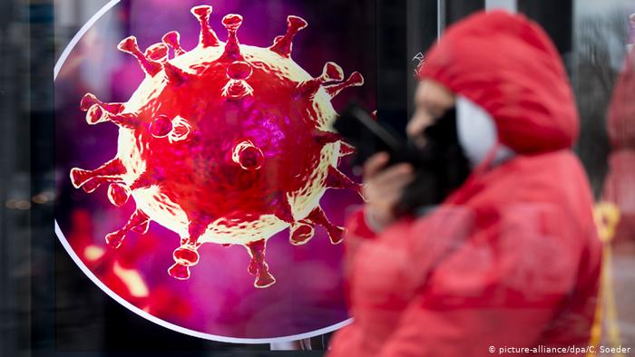
COVID-19 PANDEMIC
Closures of cities
Border closures
Distance learning
Business shutdown
General quarantine

Slide 3

The formation of educational content
MES RK
(Ministry of Education and Science of the Republic of Kazakhstan)
EMA RK
(Educational and methodical Association)
Colleges
Teachers
THE PRESENCE OF A COMPETENT AND EFFICIENT SYSTEM OF FORMATION OF EDUCATIONAL CONTENT IN THE SHORTEST TIME POSSIBLE TO COLLECT THE NECESSARY DIDACTIC MATERIAL
Uploading to the server

Slide 4
PROBLEM!
Creating a universal educational space for students, parents and teachers, taking into account the new challenges of our time, and continuing to work in this format even after all quarantine restrictions are lifted?

Slide 5

"Digital didactics»
Main problem
The digital generation is not ready to integrate into the pre digital educational process
Representatives of the pre digital generation have difficulties integrating into the digital society

Slide 6
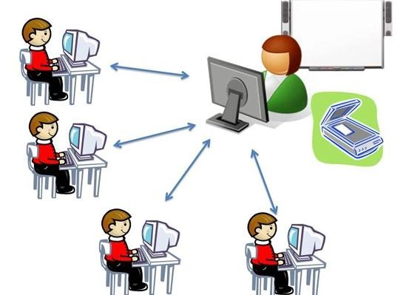
Distance learning

Slide 7

The system “Teacher-student”

Slide 8
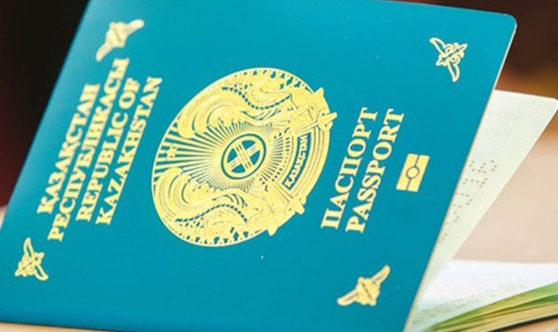
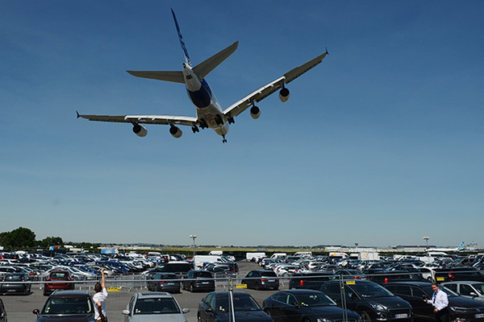
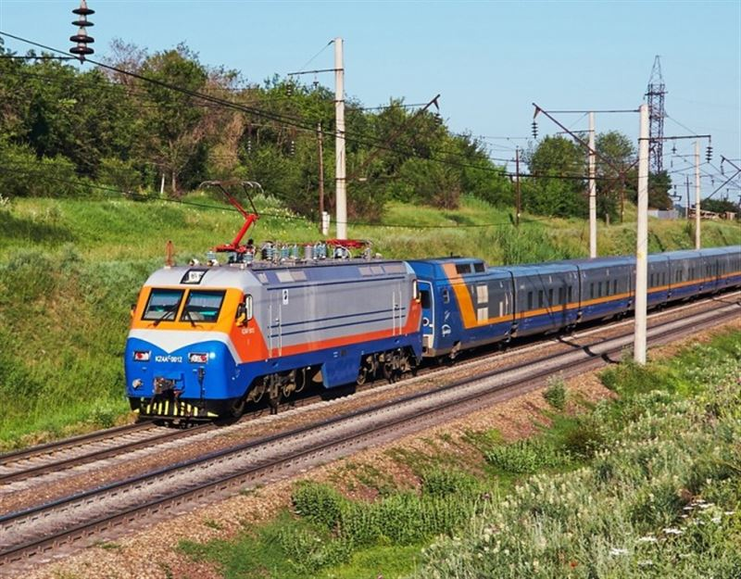
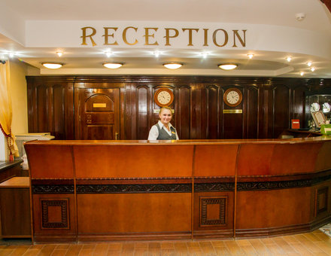

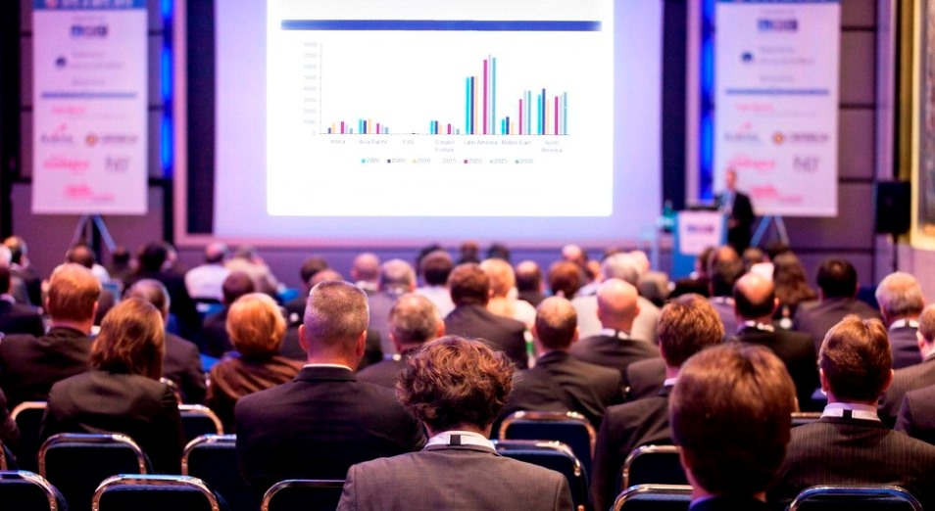
Participation in the conference in the traditional format

Slide 9
Conclusions
The global COVID-19 pandemic has become a catalyst for the development of the entire education system towards digitalization.
Distance education in our country has the right to life and all the prerequisites have been created for this.
The material and technical base of colleges is fully ready for the implementation of DLT (Distance learning technologies).
In the near future, DLT may become the hallmark of the education system of the Republic of Kazakhstan.

Slide 10
THANKS FOR YOUR ATTENTION!

