Slide 1
Methodological support, development and implementation of digital educational resources in the vocational education system under conditions of the coronavirus pandemic
Sh. Sharofaddinov

Slide 2
WHAT HAS BEEN CHANGED?
The Decree of the President of the Republic of Uzbekistan “On additional measures for further professional education system improvement” dated September 6, 2019
340
147
143
1
2
3
Professional schools - primary vocational education
Colleges - secondary vocational education
Technical high schools secondary specialized vocational education

Slide 3
THE MAIN ACTIVITIES OF THE INSTITUTE OF PEDAGOGICAL INNOVATIONS
2 MAIN ACTIVITIES
METHODOLOGICAL SUPPORT OF THE VOCATIONAL EDUCATION AND TRAINING SYSTEM
REFRESHER TRAINING AND CONTINUING PROFESSIONAL DEVELOPMENT OF LEADERSHIP AND PEDAGOGICAL STAFF

Slide 4
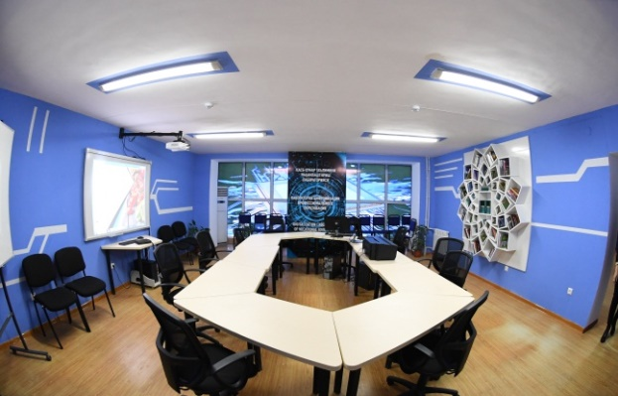
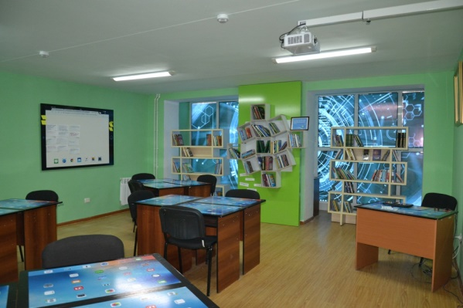
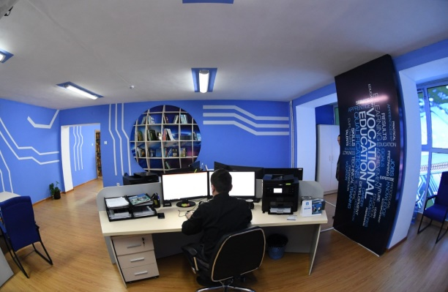
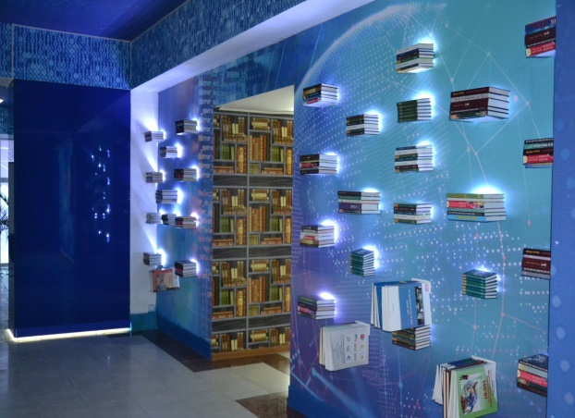
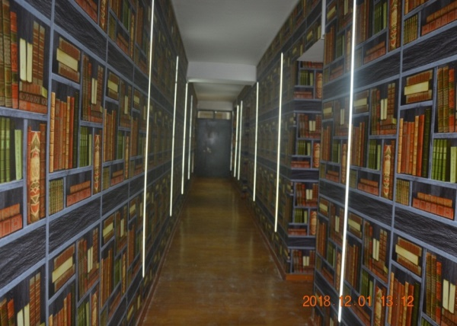
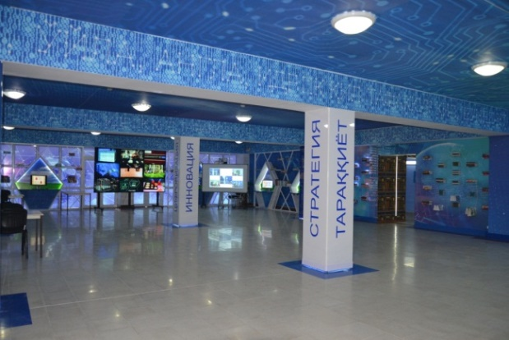
INSTITUTE OF PEDAGOGICAL INNOVATIONS, REFRESHER TRAINING AND CONTINUING PROFESSIONAL DEVELOPMENT OF VOCATIONAL EDUCATION
LEADERSHIP AND PEDAGOGICAL STAFF

Slide 5
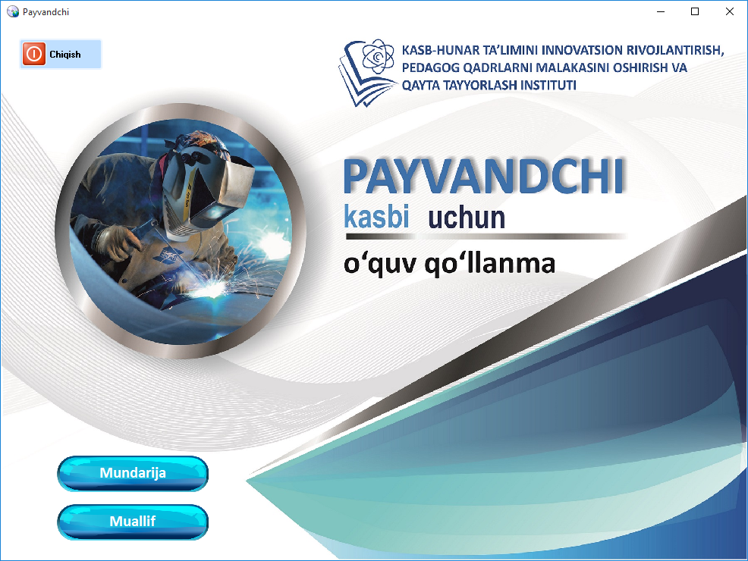
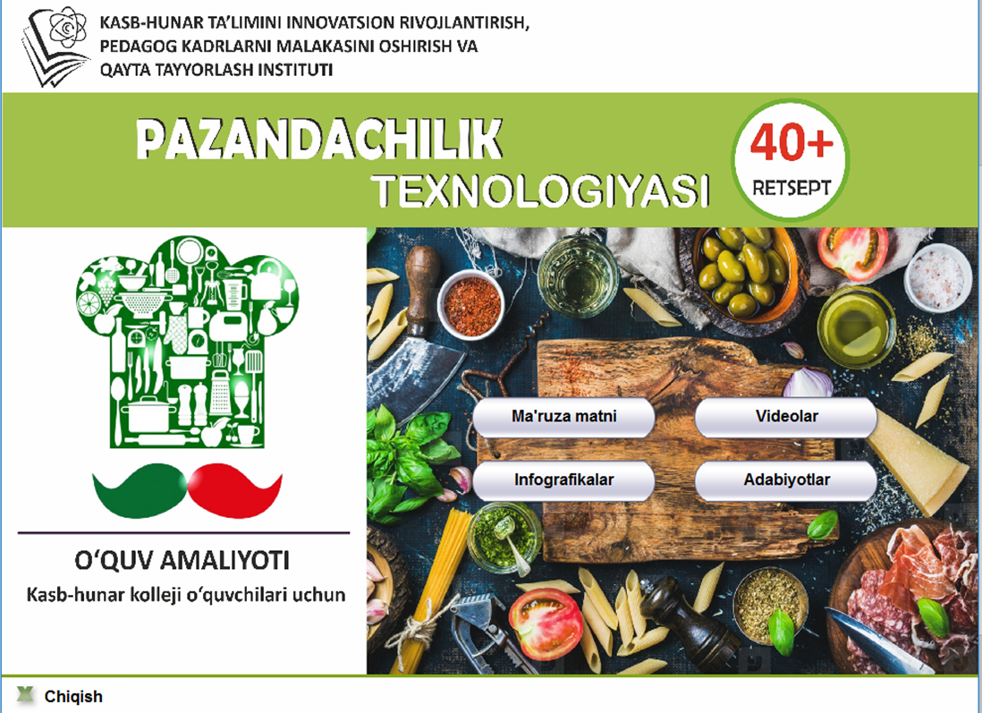


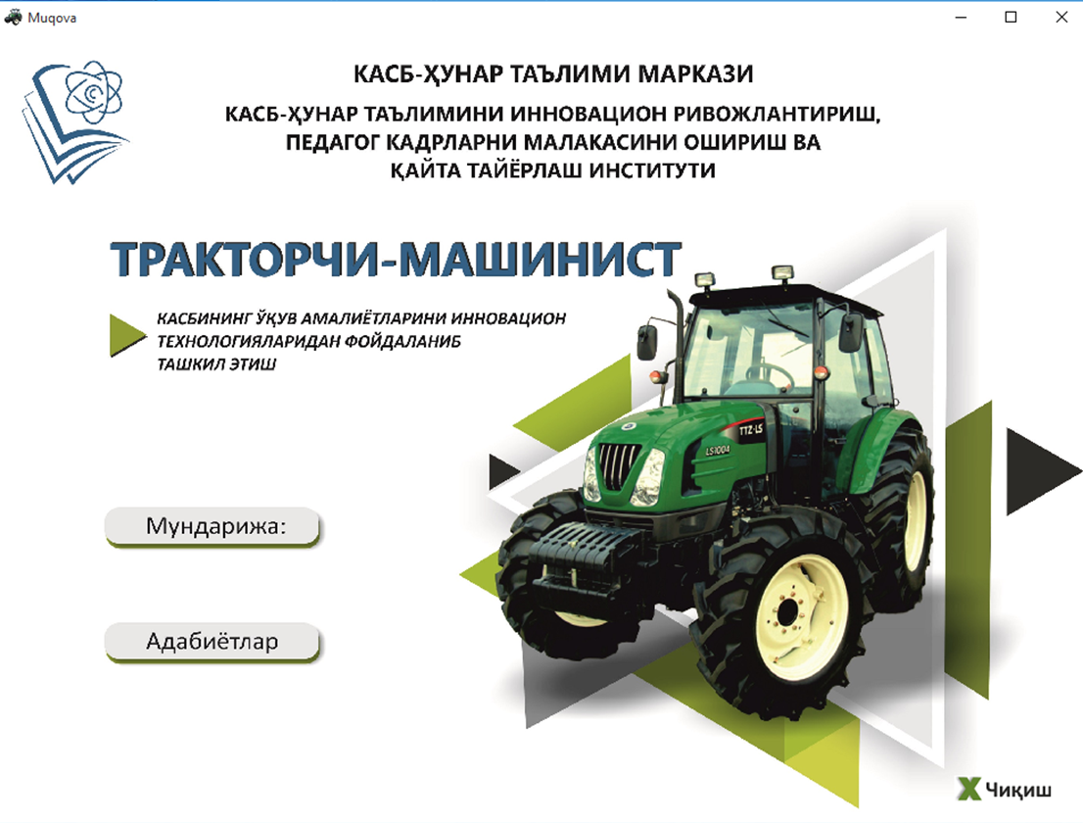


INTRODUCTION OF DIGITAL TECHNOLOGIES IN THE VOCATIONAL EDUCATION AND TRAINING PROCESS
More than 100 electronic educational resources have been created
The Institute has created a “Laboratory for digitalization of vocational education”. This laboratory develops electronic educational resources and distance education platforms
More than 50 training aids has been created

Slide 6
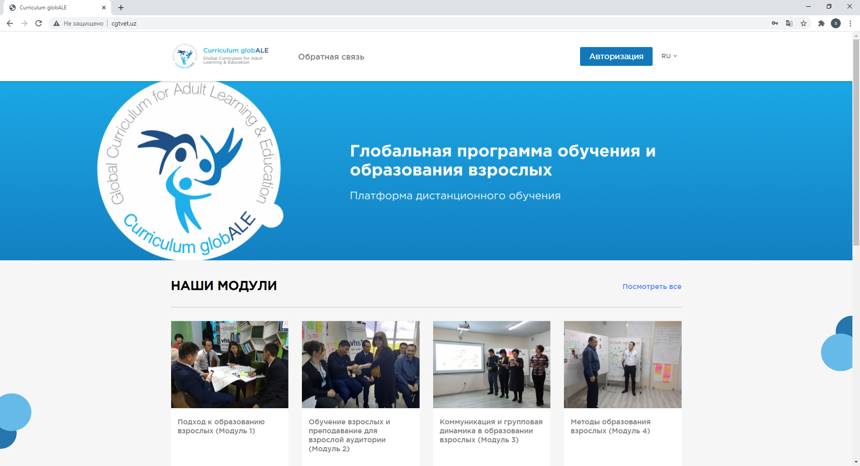
PLATFORMS FOR TRAINING AND METHODOLOGICAL SUPPORT OF THE VOCATIONAL EDUCATION AND TRAINING SYSTEM
The ongoing reforms have changed the requirements for teachers in vocational colleges. Now employees of professional colleges should be able to work not only with young people but also with the adults.
www.cgtvet.uz distance learning platform for adult education under the international curriculum program named globALE
Achieved results
Training materials (including video presentations) for the first module were prepared and tested for distance learning (in Uzbek);
The distance learning platform has been tested and its functions have been improved;
4 tutors from a partner organization gained practical experience in arrangement of distance learning. Each tutor can independently teach 30 persons at the moment;
We got the opportunity to reach more people at lower financial costs.
Difficulties :
A high level of participants’ failure to complete the course – only 19 reached the course end out of 32 participants, and only 14 completed the training and passed the final examination (some of the participants did not even try to pass it for unknown reasons). It is required to study these aspects but the influence of such factors as lack of ICT skills, sufficient motivation, ability to manage time and lack of self-study ability can be seen from the first glance.

Slide 7
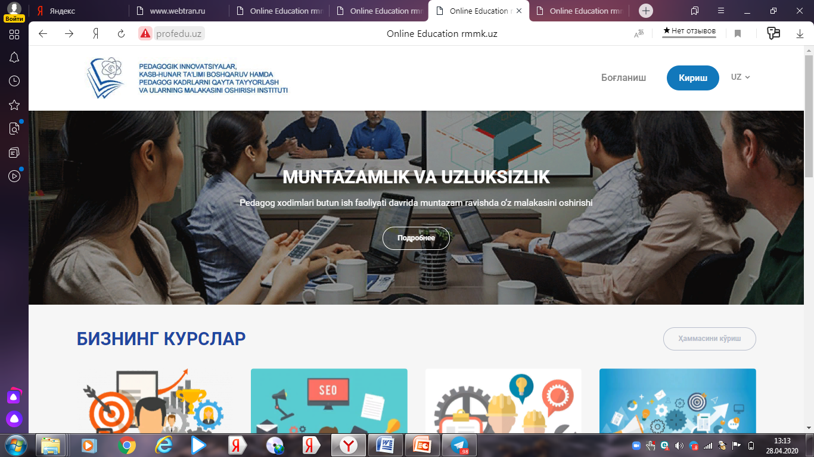
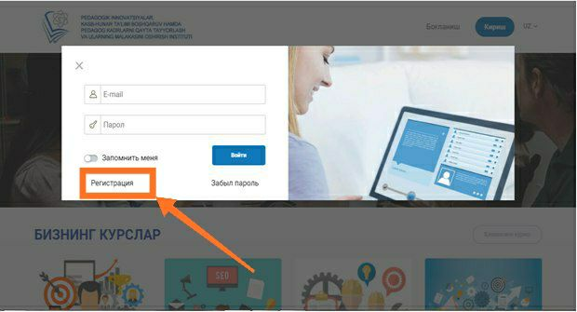
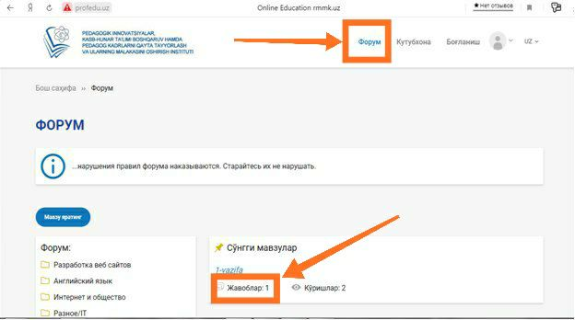
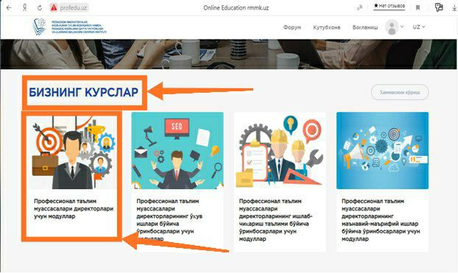
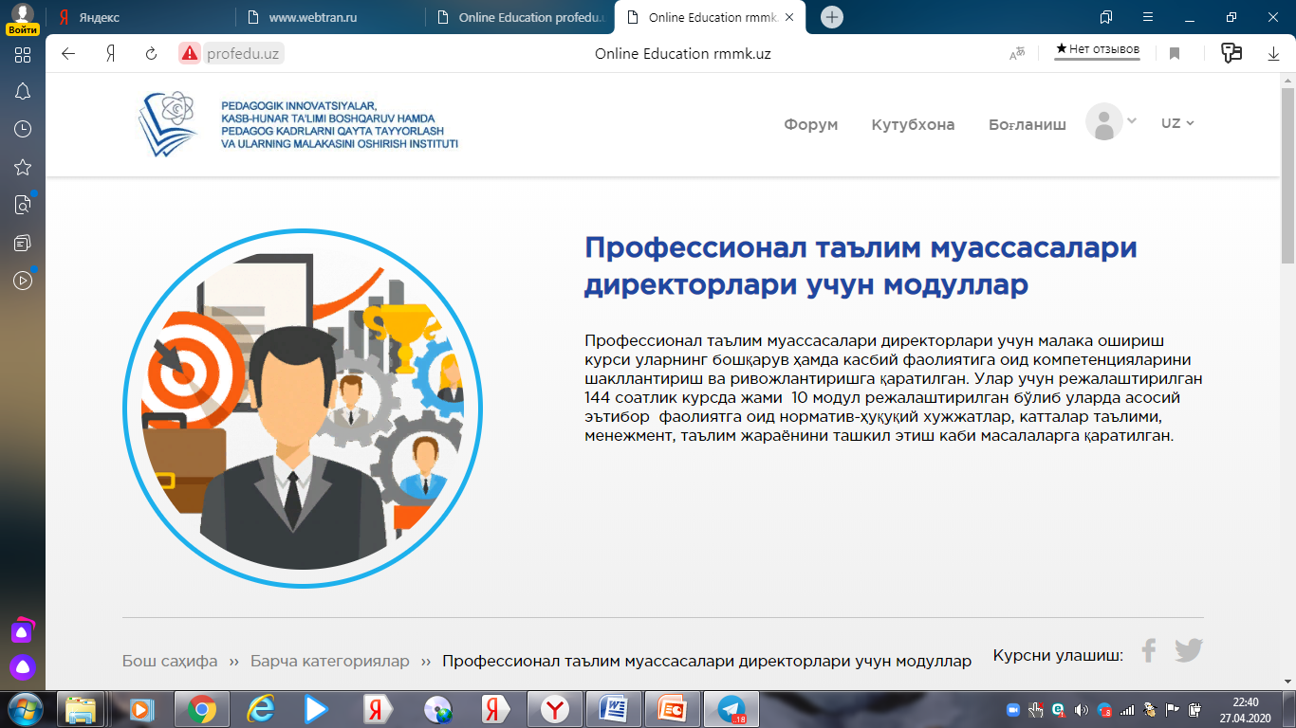
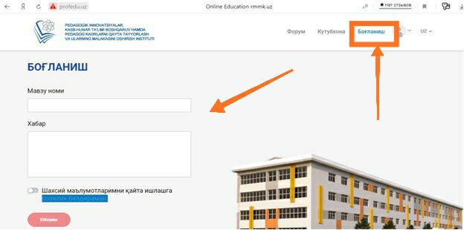
CONTINUING PROFESSIONAL DEVELOPMENT PLATFORMS AND METHODOLOGICAL SUPPORT OF THE VOCATIONAL EDUCATION AND TRAINING SYSTEM
www.profedu.uz platform for remote professional development of management personnel of the vocational education and training system

Slide 8
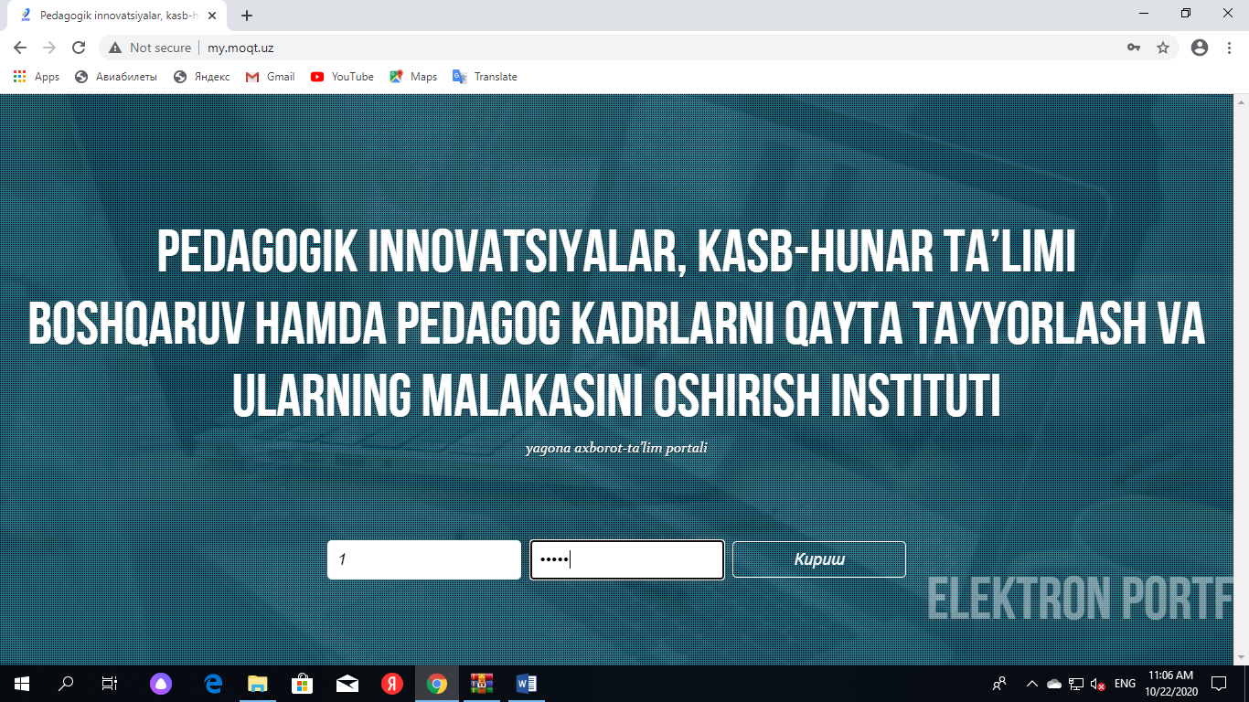
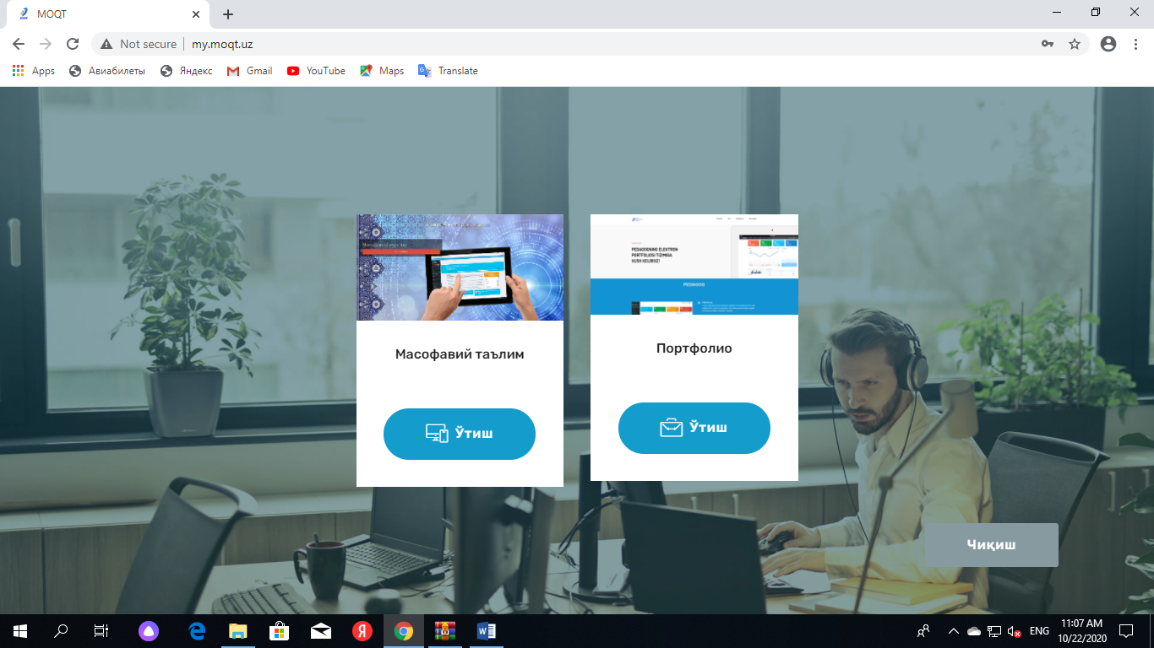
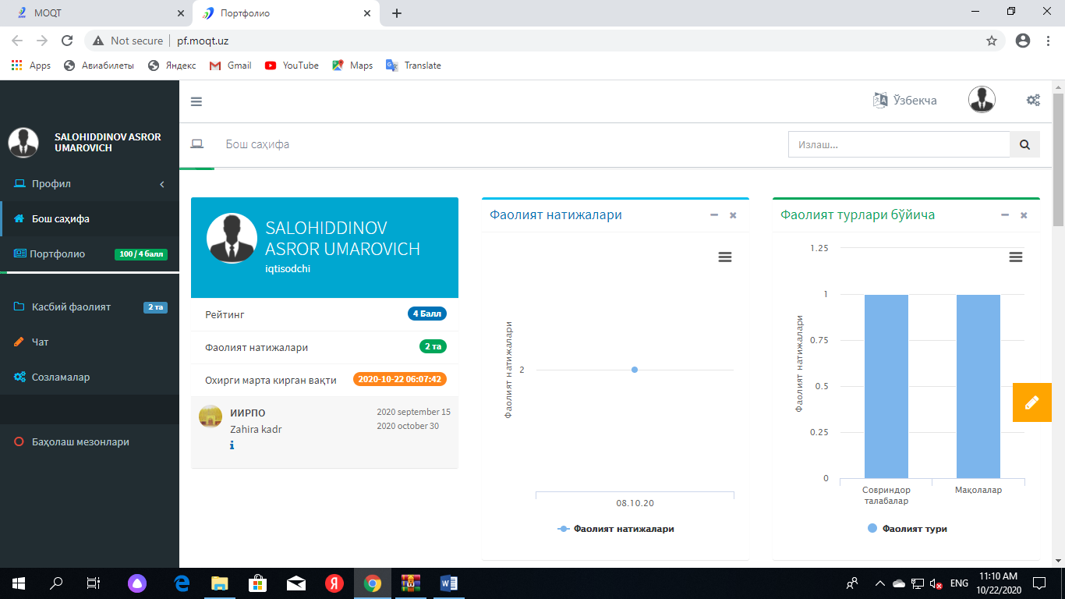
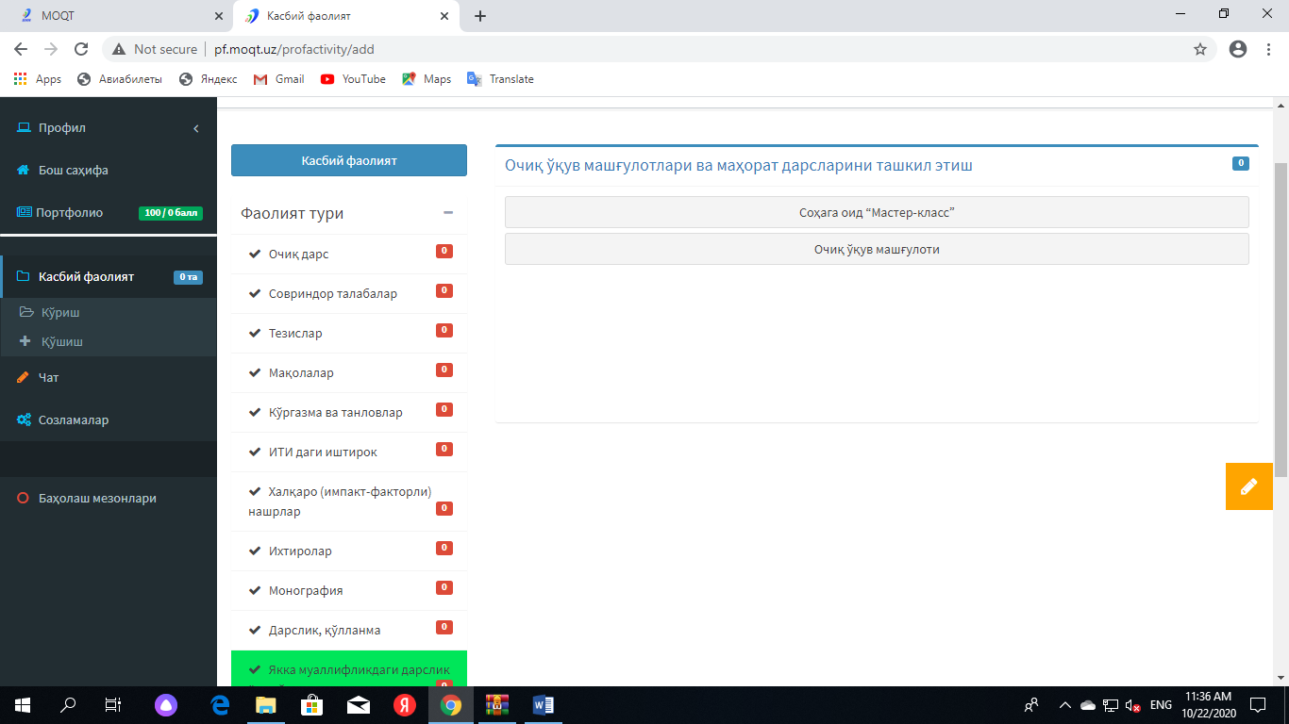
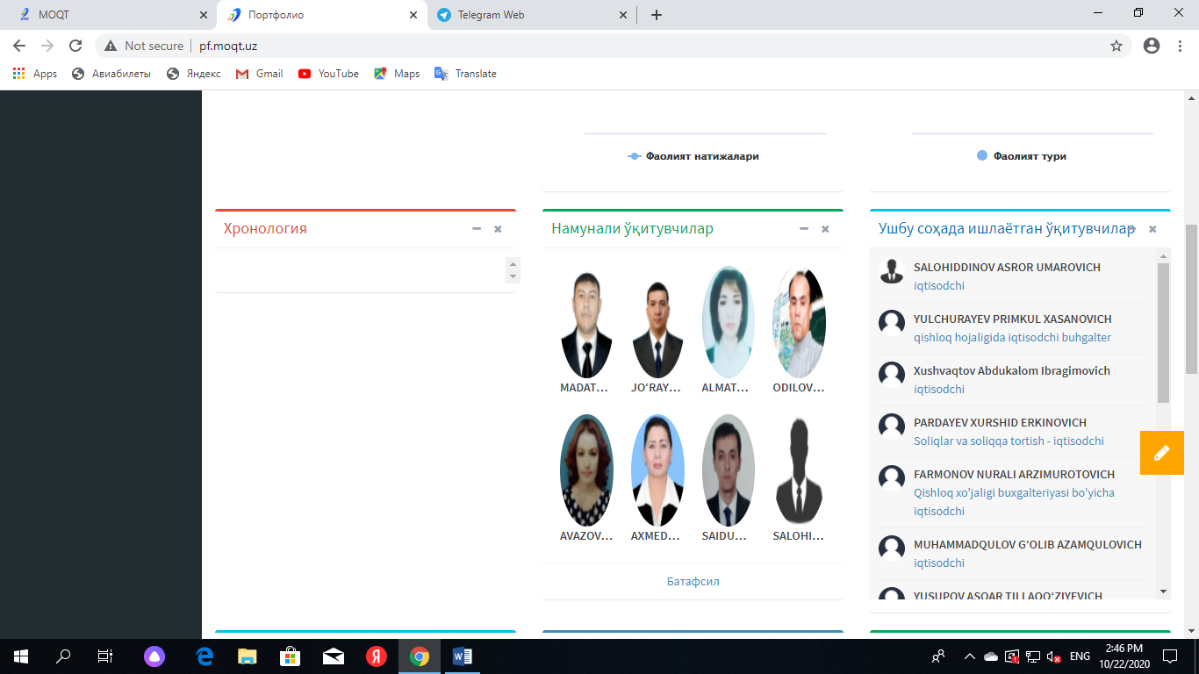
CONTINUING PROFESSIONAL DEVELOPMENT PLATFORMS AND METHODOLOGICAL SUPPORT OF THE VOCATIONAL EDUCATION AND TRAINING SYSTEM
my.moqt.uz platforms for professional development and methodological support of the vocational education and training system
982 persons have completed the advanced training courses until now

Slide 9
THANK YOU FOR YOUR ATTENTION!

