Slide 1

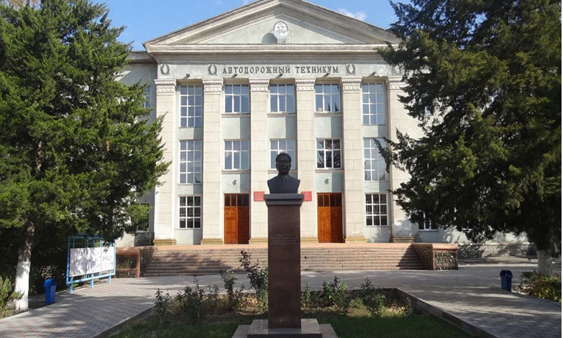
Characteristics of teaching activities in secondary vocational education institutions in the context of distance learning »
Bishkek Motor and Road College named after K. Kolbayev

Slide 2

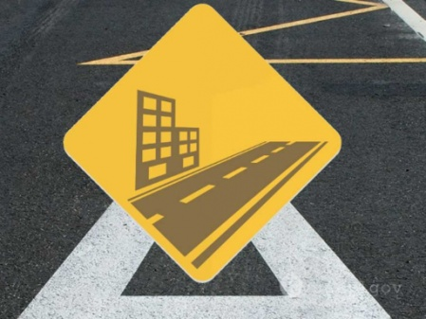

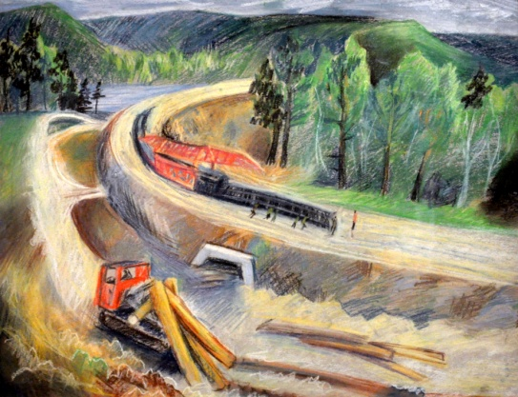
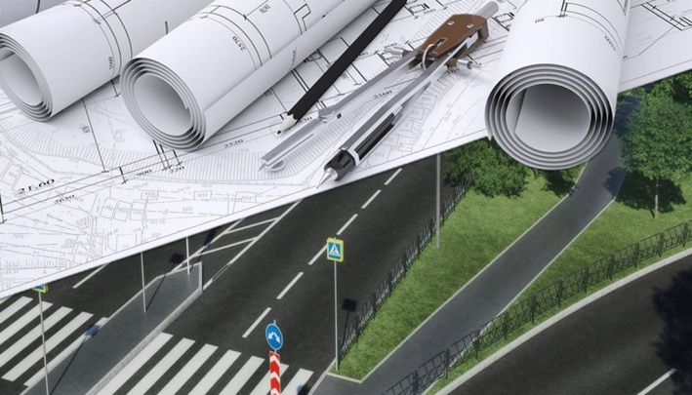
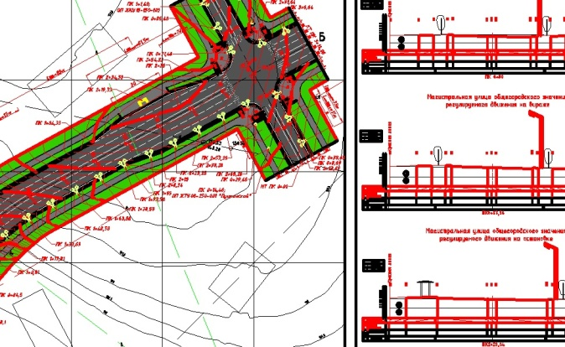
Monitoring the distance learning process
Activities for organizing the distance learning process at the Bishkek Motor and Road Technical College
The distance learning process has been organized
The procedure of monitoring the distance learning process has been established
Internal regulations have been developed for the qualitative organization of distance learning (Regulations on practical training, on conducting tests and exams, on conducting classes)
3

Slide 3
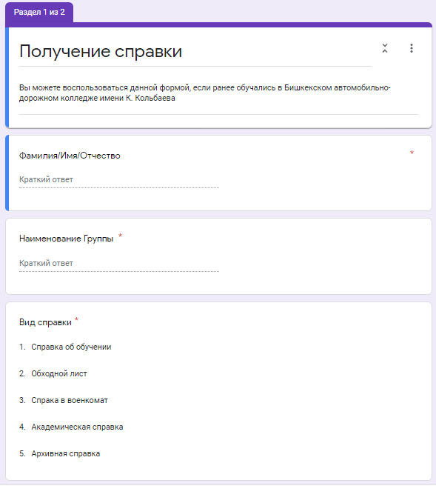
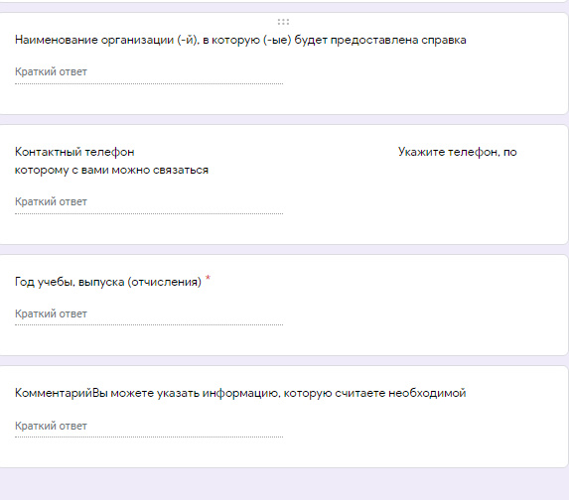

SINGLE WINDOW для студента
You can apply at the official website www.badk.kg in the section - Student Single Window.
You can get the certificates in the Single Window Office in the main building of the college (you need to have an identity document with you).
IF YOU HAVE ANY ADDITIONAL QUESTIONS, PLEASE CALL US
(0312) 596088

Slide 4
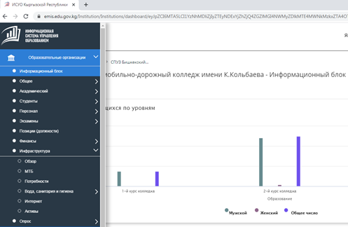
Information system for managing human resources (EMIS)
Education Management Information System is an electronic system which aims to collect, store, process, analyze and distribute information, to provide the operative data to the department and educational organizations of the country, and to improve the efficiency of decision making.

Slide 5
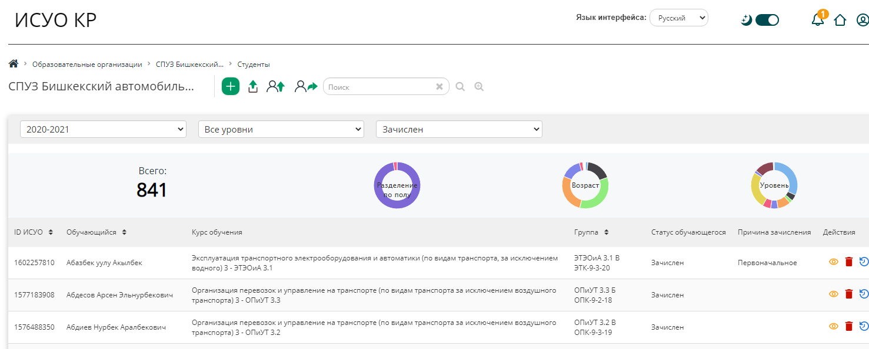
EMIS in the Kyrgyz Republic: information section:students

Slide 6
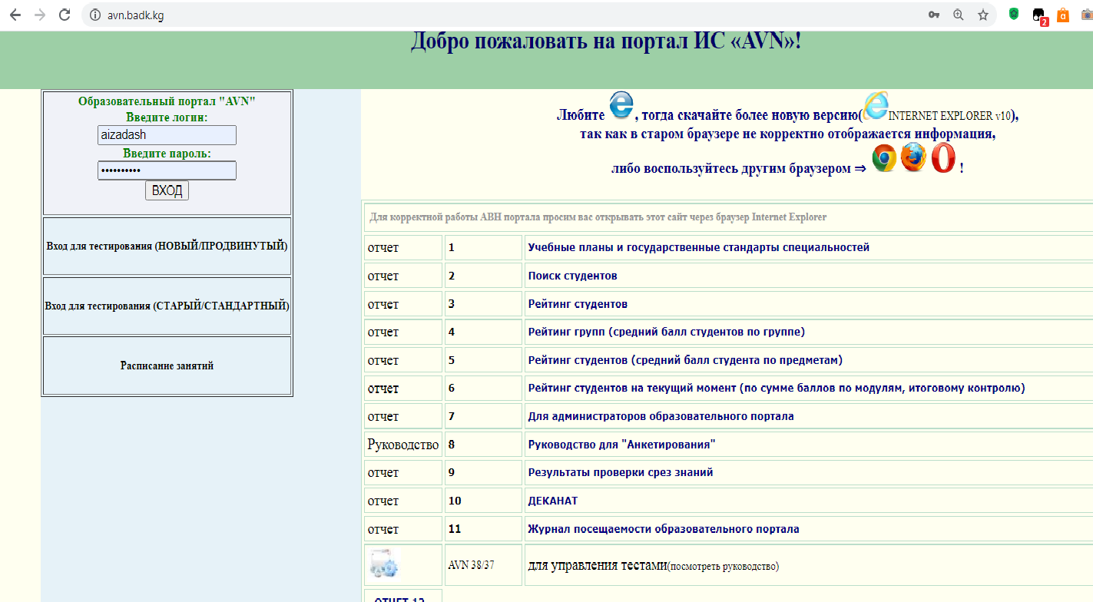
Образовательный портал AVN
AVN Information System and the education portal ensure the automation in education

Slide 7
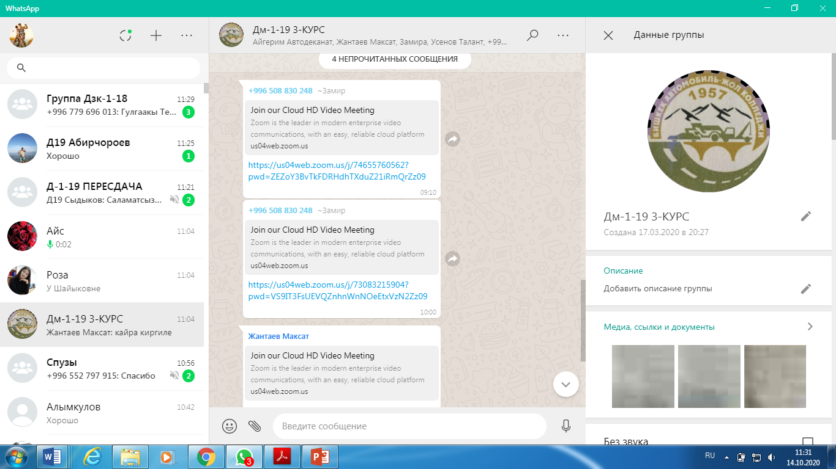
Procedure of conducting classes
1. College departments create groups in WhatsApp including students from certain study groups. Besides the teachers, who conduct the classes in the group, and the students, the education unit and the Dean's Office of the college are invited into the group to monitor the timeliness and quality of classes.
2. Following the schedule, the teacher sends the link to the group - an invitation to participate in the ZOOM conference. By this link students attend the online class following the schedule.

Slide 8
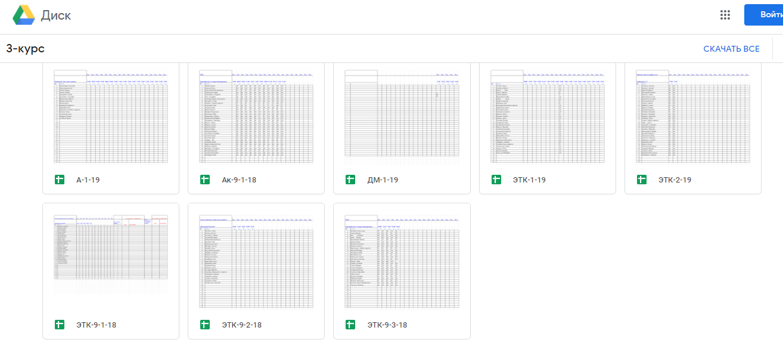
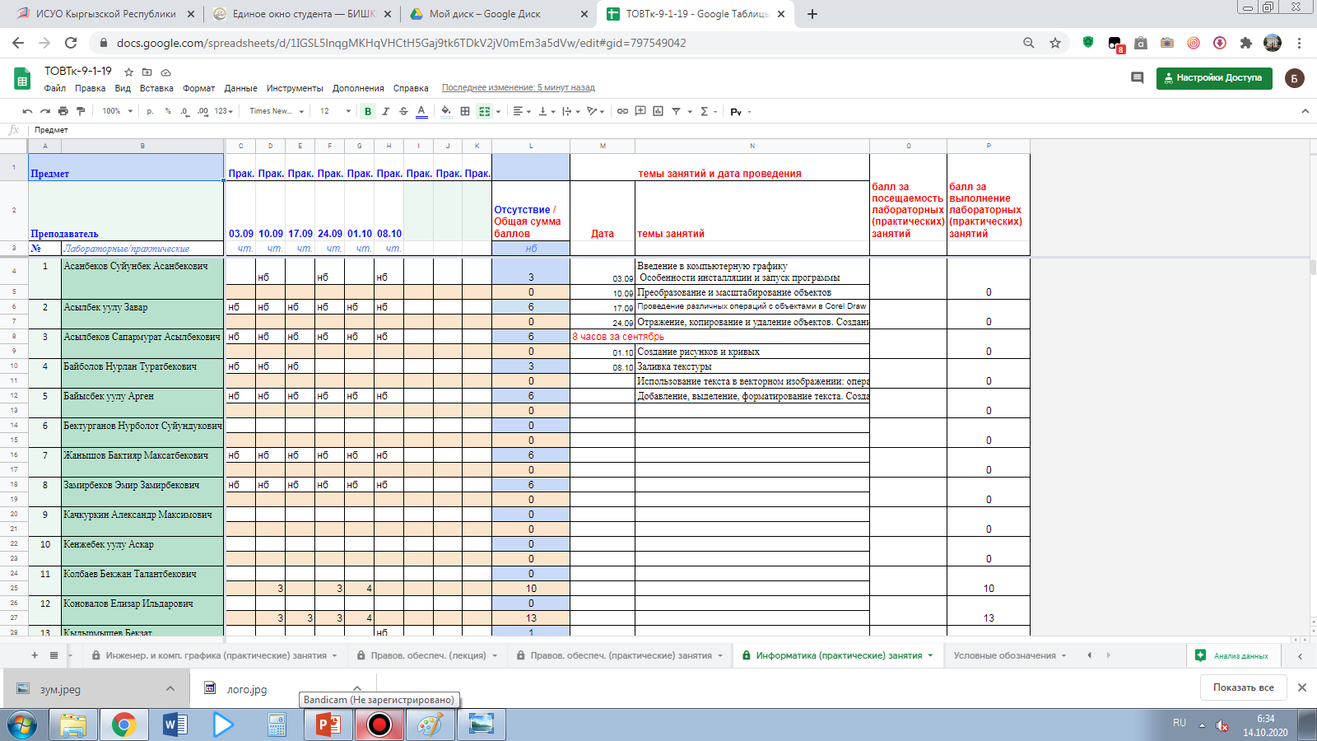
The teacher shall register the attendance of classes and the scores which students get in the electronic journal at each class.
The electronic journal of the college is created on Google Cloud Platform.
The teacher can edit only the data of the course he/she teaches. To ensure this, each page is protected by a password that only the teacher knows.
Departments, administration, students and their parents can view the electronic journal at any time only in view mode.

Slide 9
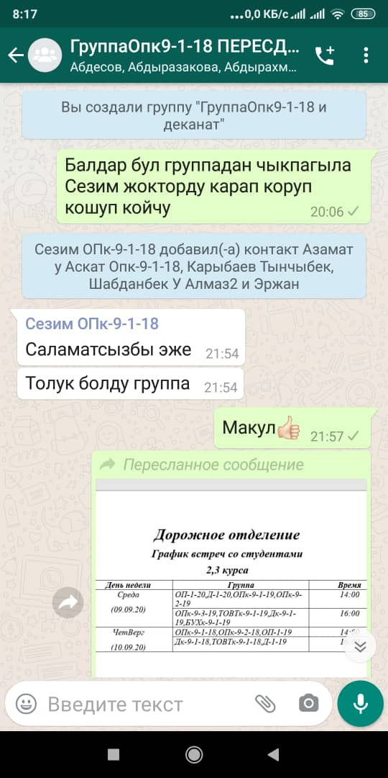
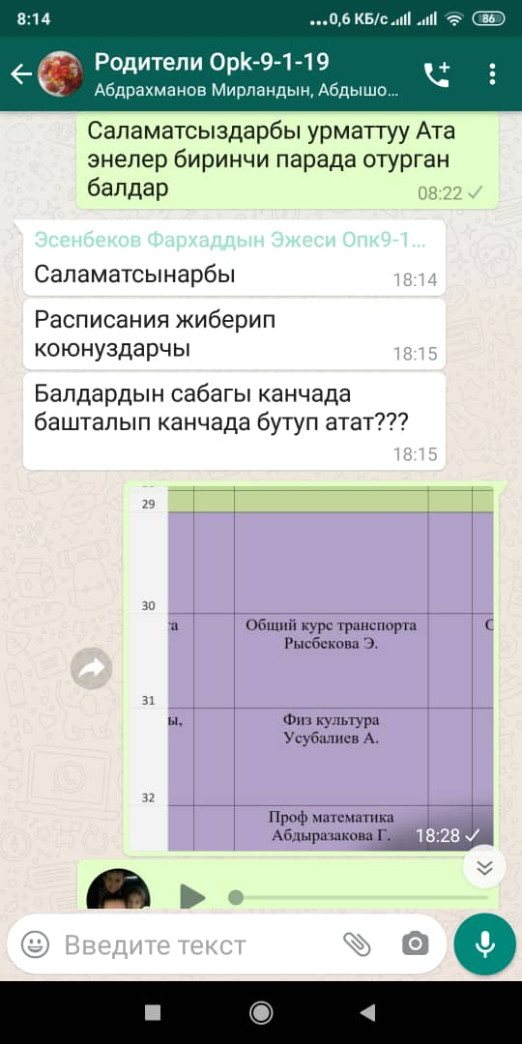
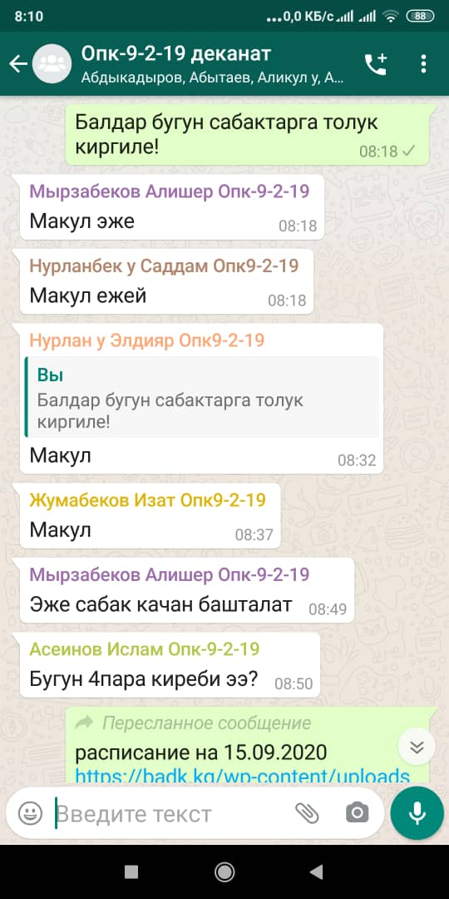
Responsibilities of the college departments
Based on the electronic journal’s data the college departments shall register the absences of students and identify the reasons why students were absent from classes

Slide 10
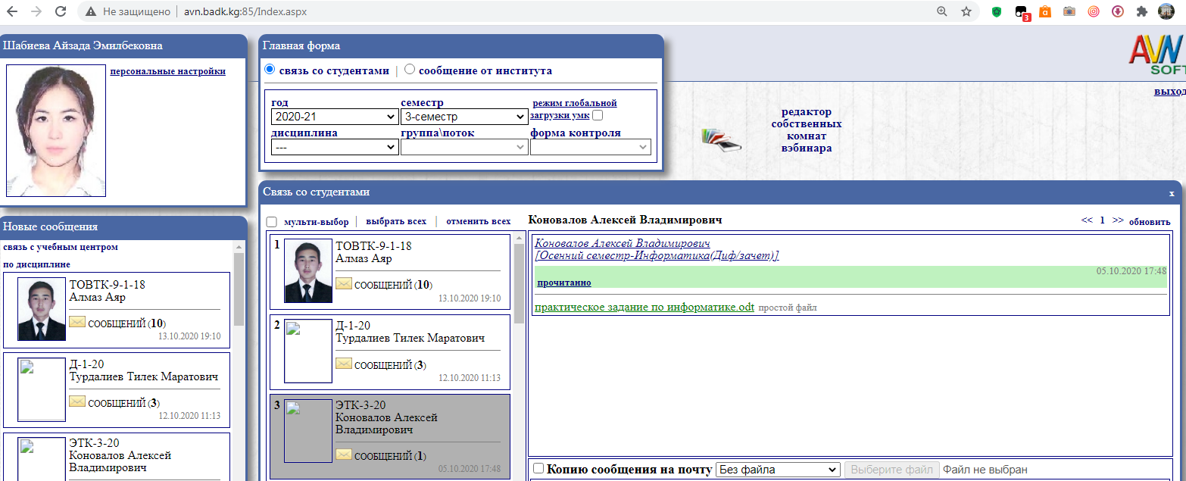
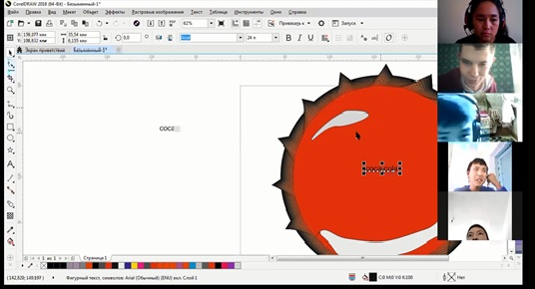
Feedback
Online - classes are recorded in the ZOOM cloud storage.
At the beginning of the class, the teacher shall inform the students about the assignment to be completed during the class or after a strictly established time. All assignments completed by a student are stored on the teacher's personal page in AVN or, if desired, on the teacher's work computer.
For convenient sorting of files sent by students, the teacher can set a convenient name format for each file.
For example: "D-1-20 Assanov Computer Science Practical Work #1", "D-1-20 Assanov English Exercise 3".
Teachers have created separate folders by groups and subjects for convenient storage of students' completed assignments on their work computer.

Slide 11
Duties of the teacher in distance learning
Planning of learning activities
Organization of learning activities (online - etiquette, organization of virtual working space for yourself and students)
Coordination of cognitive process of students learning with the use of ICT:
motivation. The component which gets a special role in cognitive process in distance learning. At the same time, the motivation goes away if the tasks do not correspond to the level of students' skills.
a step-by-step algorithm of the cognitive process
Adjustment of the course being taught with the use of network course development tools and multimedia technologies
Consulting students in real-time and in delayed mode

Slide 12
Organization of the laboratory work in distance learning
The first stage - introduction to the laboratory work. At this stage, students work with literature and computer simulators. The work is monitored with the help of testing programs. The main duty of the teacher is to provide advice.
At the second stage, students work with simulators that simulate a real facility. At this stage, the duty of the teacher is to provide advice to students only.
At the third stage, students carry out an experiment under real-life conditions. Remote access to the experimental facility is used, or the facilities of the branch office are used. Thus, during the organization of the laboratory work and its process in distance learning, the direct communication between the teacher and students is not excluded but it takes place mainly in the final stage.

Slide 13
THANK YOU FOR ATTENTION

