Slide 1

Labour Market Integration of Refugees and Syrians under Temporary Protection
Conference on Vocational Training
26-27 March 2019
Mövenpick Hotel, Ankara
Ankara, Turkey – 26-27 March 2019
Lida Kita, ETF(European Training Foundation)

Slide 2
WHAT IS THE EUROPEAN TRAINING
FOUNDATION (ETF)?
Agency of the European Union
To make vocational education and training
in the partner countries a driver for lifelong
learning and sustainable development,
with a special focus on competitiveness
and social cohesion.
The ETF has both
an analytical and a developmental role
and works within the
EU policy framework.

Slide 3
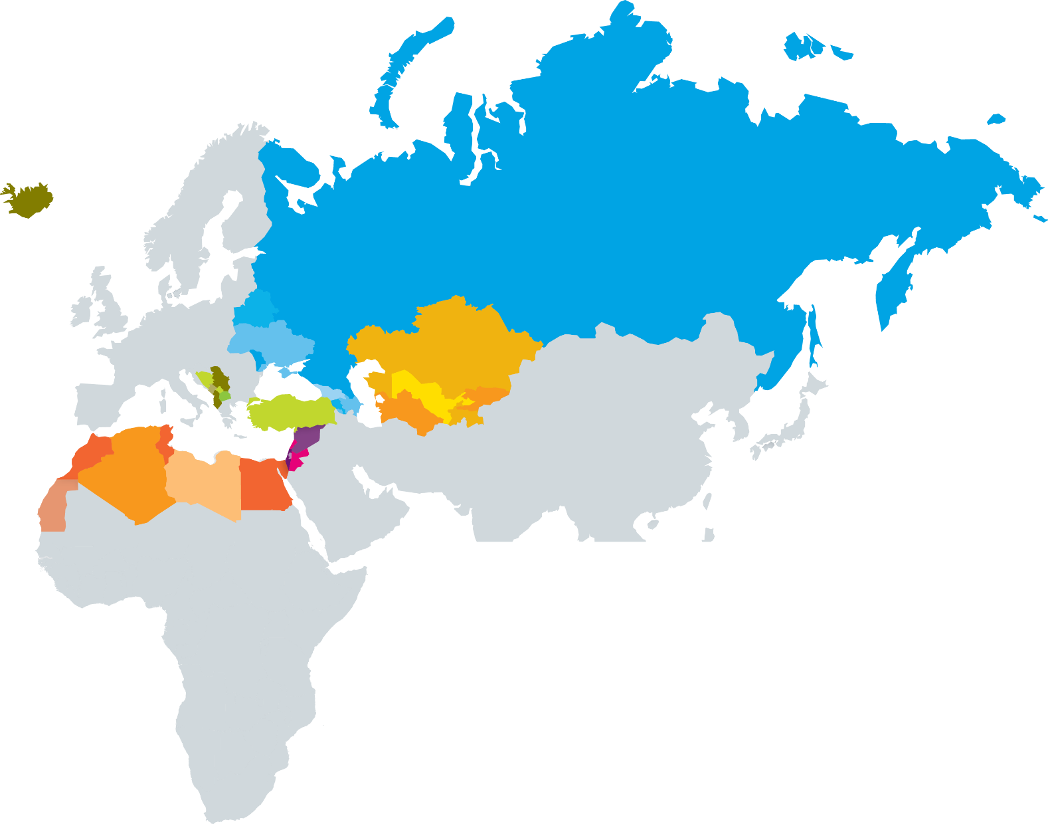
ETF
SOUTHERN AND EASTERN MEDITERRANEAN
SOUTH EASTERN
EUROPE
AND TURKEY
Algeria, Egypt, Israel,
Jordan, Lebanon, Libya, Morocco, Palestine,
Syria, and Tunisia
Albania, Bosnia and Herzegovina, former Yugoslav Republic of Macedonia, Kosovo, Montenegro, Serbia, and Turkey
EASTERN EUROPE
CENTRAL ASIA
Armenia, Azerbaijan, Belarus, Georgia,
Republic of Moldova, Russia, and Ukraine
Kazakhstan, Kyrgyzstan, Tajikistan, Turkmenistan,
and Uzbekistan

Slide 4
RIGA CONCLUSIONS AND
THE MEDIUM-TERM DELIVERABLES (MTDS)
MTD 1 WORK-BASED LEARNING
  Special attention to apprenticeships
  Involvement of social partners
  Stimulating innovation, entrepreneurship
MTD 2 QUALITY ASSURANCE IN VET
  Developing quality assurance systems
  Use of labour market information/feedback
  Establishing data collection systems
  Systematic use of learning outcomes
MTD 3 ACCESS TO VET AND
QUALIFICATIONS FOR ALL
  Flexible and permeable VET systems
  Efficient guidance/counselling services
  Validation of non-formal/informal learning
MTD 4 KEY COMPETENCES
  Key competences in VET curricula
  Improving basic skills of VET students
  Provision of work-specific skills
MTD 5 VET TEACHERS AND TRAINERS
  Continuous professional development in
  school and work-based settings
  Effective partnerships with stakeholders
  Provision of training opportunities
  TRANSVERSAL AREAS
  PARTNERSHIPS
  FUNDING
  EXCELLENCE AND INNOVATION
  LEARNING OUTCOMES AND TOOLS

Slide 5

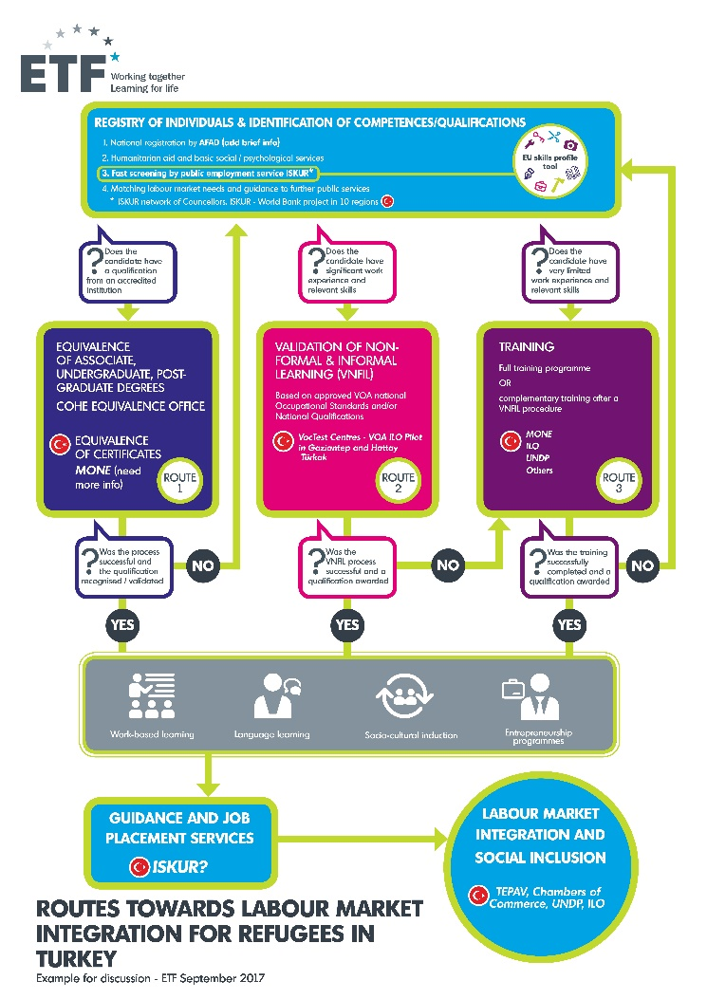
EU Skills Profile for Third Country Nationals- can be adapted to be used in recipient countries’ context
EU Skills Profile Tool for Third Country Nationals
As part of the New Skills Agenda for Europe, the European Commission has developed a Skills Profile Tool to support early profiling of the skills of refugees, migrants and citizens of non-EU countries who are staying in the EU (third country nationals).
The information collected can be used to:
support further assessment; form a basis for offering
guidance; identify up-skilling needs; support
job-searching and job-matching.
The tool is not intended as a recognition or
authentication tool.
Fast screening:
EU Skills profiling Tool for Third Country nationals

Slide 6
What is it?
The EU Skills Profile Tool for Third Country Nationals http://ec.europa.eu/avservices/video/player.cfm?sitelang=en&ref=I145869
Key features
The tool is multilingual, available in all EU languages (except Irish) and in Arabic, Farsi, Pashto, Sorani, Somali, Tigrinya and Turkish. It is possible to see two languages at the same time on one screen, reducing language barriers between case workers and citizens of non-EU countries.
The tool is available as a web-tool to be used on a voluntary basis and free of charge. Completed profiles are exportable as PDF or XML files.
Instructions on how to complete the fields are integrated in the tool. There is also a video and a user manual.

Slide 7
How to use EU Skills Profile Tool to local system and context for recognition and validation of refugees 'qualifications
Who can use it?
The Skills Profile Tool is specifically designed for use by:
national authorities responsible for reception and integration of refugees;
reception centres;
employment assistance services;
education and training advisers;
social services;
NGOs and charitable organisations
offering services to refugees and other
citizens of non-EU countries,
the tools are available for anyone to use.
Fast screening:
EU Skills profiling Tool for Third Country nationals

Slide 8
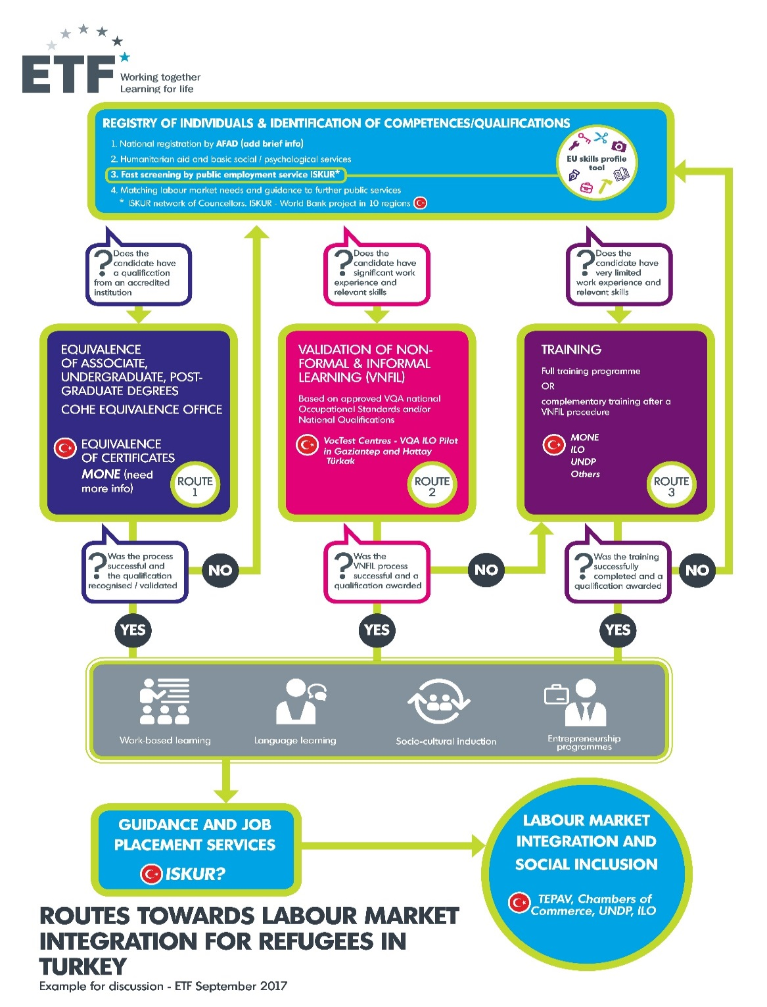
ETF- Recognition and validation of qualifications and skills for refugees-Turkey contextualisation
Routes towards labour market integration for refugees- ETF developed:
Fast screening
Route 1
Route 2
Route 3
From Recognition and Validation to Labour Market integration and inclusion

Slide 9
Recognition and validation of qualifications and skills for refugees – selected practices from Europe
Routes towards labour market integration for refugees
Relevant practices from Europe for Turkey/ other countries ?
Fast screening:
EU Skills profiling Tool for Third Country nationals

Slide 10
Recognition and validation of qualifications and skills for refugees – selected practices from Europe
Routes towards labour market integration for refugees
Route 1 - candidates with qualifications:
Discussions on implemented practises
Practices from Europe
Practises in Turkey
Practises from other participating countries

Slide 11
Recognition and validation of qualifications and skills for refugees – selected practices from Europe
Routes towards labour market integration for refugees
Route 2 - candidates with skills and
work experience:
Practices from Europe
Practises in Turkey
Practises from other participating countries

Slide 12
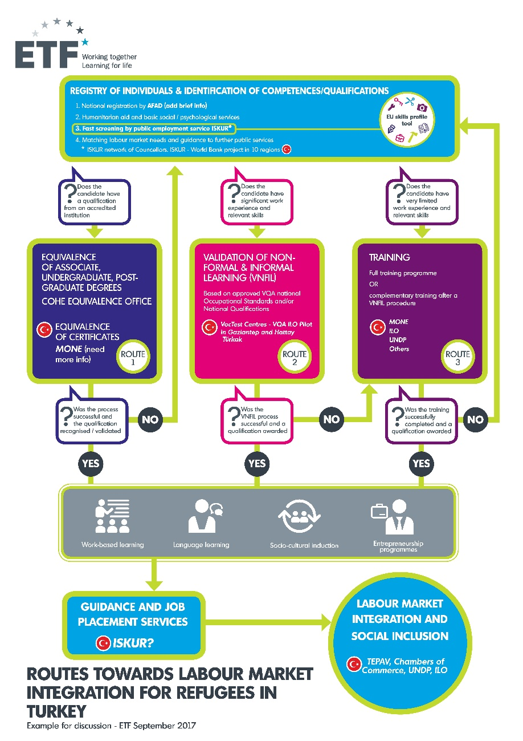
Recognition and validation of qualifications and skills for refugees – selected practices from Europe
Working Group: Labour market integration and social inclusion through skills development: building a future for refugees and host communities
Guiding questions:
How do refugees /hosting country citizens get a job after validation procedures and/or training? What are the key challenges and what are the practises that are working best/needs to be enhanced with additional support and services?
From your interventions and institutional experience, national and international actors, what are the most efficient and effective experiences/activities in the interventions for the labour market and social integration of refugees and/or supporting host communities in the recipient countries?
How can or at what stages do the employers or non-governmental have a primary role to advance issues that would facilitate refugees' participation in economic activities, including suggestions aimed to ensure their sustainability

Slide 13

Thank you
Lida.Kita@etf.europa.eu
http://www.etf.europa.eu
http://www.etfqual.eu

