Slide 1





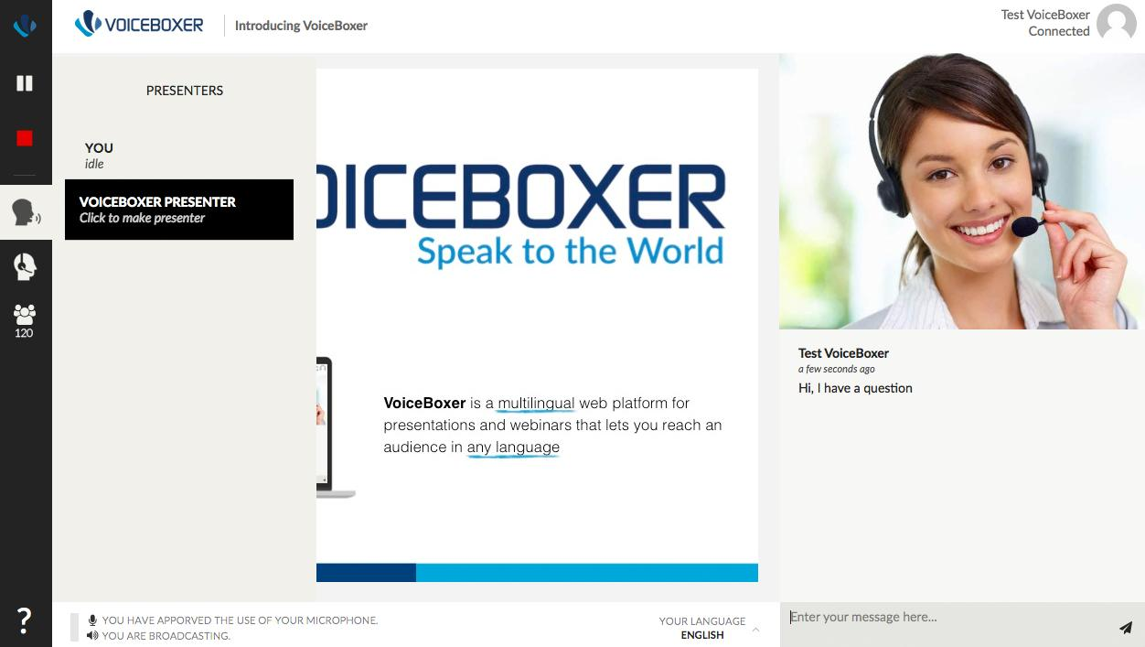



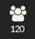



Present
VoiceBoxer Audience View
Presenter
Presentation
>
>
Ask questions here!
Select your preferred language
Zgjidhni gjuhën tuaj të preferuar
Изаберите жељени језик
Odaberite željeni jezik
Notes:
23-Aug-16
1
1

Slide 2


Digital Skills & Learning
A Silver Bullet for Education?
Part II - Webinar
29 november 2019

Slide 3


The European Training Foundation
29
Partner Countries
Notes:
The ETF is an Agency of the EU,
The ETF is based in Turin, Italy
Work in 29 countries, those countries surrounding the EU MS all countries in colours in the map

Slide 4

What is European Training Foundation
The ETF works together with its partner countries on the reform of Vocational Education and Training systems, the analysis of skills needs and the development of partner country Labour Markets.
Reform of Vocational Education & Training
Digital and Online Learning (DOL)
Digital Skills and Competence (DSC)
Notes:
In the context of the external relations of the European Union,
The ETF helps our PCs on the reform of the VET, in the analysis of Skills Needs and in the reform of the LM
In the process of the Reform of VET we analyse several aspects
Including the use of DOL and provision of DSC as two complementary elements for the modernisation of VET

Slide 5

Schools
Digital Readiness
1
3
Students
Digital Competence (CV)
Educators
Digital Competence
2
ETF Methodology for the Digitalisation of Education
Notes:
Analysing the digitalisation of E&T in a PC, ETF looks at 3 Dimensions, namely to
In this process, ETF makes use as a reference EU policies and tools to support the reform process

Slide 6

Today
Present the preliminary findings of a study
on Digital & Online Learning, Digital Skills and Competence
in VET in Kosovo*
* This designation is without prejudice to positions on status, and is in line with UNSCR 1244/1999 and the ICJ Opinion on the Kosovo declaration of independence.
Notes:
TODAY we present the preliminary findings of a study…. in XK
The study and the event of today aims to:
- Advance knowledge on policy and practices relevant to the digitalisation of VET in Kosovo
- Highlighting potential benefits of the digitalisation in the reform and modernisation of VET

Slide 7

Digital Skills and Competence - DSC
ICT
Professional
(advanced &
highly specialised)
Job-specific Digital Skills
(occupational standards)
Digital Competence
(critical, competent and creative use of ICT)
For digital innovation
For employability and
Active citizenship
For all learners, transversal, for Life Long Learning
https://www.etf.europa.eu/en/publications-and-resources/publications/digital-skills-and-competence-and-digital-and-online
Notes:
At this stage of the event , it is important to clarify the terminology
Analysing the provision of DSC in VET we look at 3 elements
- We look at the provision of DC as a combination of transversal DS and DK,
teaching & learning methods that foster a critical, a creative and innovative use of DT in learning
We look at the provision of Job-specific digital skills
keeping in mind that for example in Europe 90% of existing jobs require some degree of digital skills
We look at the provision of highly specialised digital skills for ICT Qualifications,
for learners that will play a key role in the digital innovation of their country

Slide 8

Digital (and Online) Learning - DOL
Active and personal learning
Learning Management System
Collaborative learning
Learning Analytics
Text book
Interactive eTextbook (e.g. OER)
Vocational skills
Simulation tools, VR, AR
Connecting VET Learning Environments
Video Pedagogy
Notes:
Analysing the use of DOL in VET
We look at the use of digital learning for Innovative pedagogy in the classroom,
for example for personalisation and engagement of learners,
We look at the use of digital resources, including OER
We look at the use of simulation tools and immersive technology (VR and AR) for the development of vocational skills
We look at the use of digital technology for connecting the different learning environments in VET
The use of DOL in schools, is a good way to improve the DC of learners. For this reason ETF considers useful to analyse the provision of DSC together with the use of digital technology in educational context
Flexibility for learners: the possibility for individual learners to go faster or slower or to follow only a part of the programme. (Examples of word cloud related words: flexible, modular, personalised, customised)
Adaptability to labour market demands: the curriculum is designed in such a way that it is easy to incorporate new skills and knowledge requested by the labour market. (Examples of word cloud related words: adaptable, labour market relevance, relevant)
Authenticity of the learning environment: learners work on realistic tasks in a learning environment that reflects their future workplace. (Examples of word cloud related words: authenticity, connection to real life)
Integration of theory and practice: related theory and practice are not offered as separate classes, but are closely linked to each other. Both theory and practice are offered just in time when a learner needs it to continue his/her learning process. (Examples of word cloud related words: competence based, transversal skills, practice oriented, interdisciplinary, modular)
Collaborative learning: learners have many opportunities to learn and work on assignments together or with others. (Examples of word cloud related words: cooperative, interactive, collaborative)

Slide 9
Methodology
ICT
Qualifications
VET CVs
Policies
Digital Skills & Competence of VET learners
Digital Skills and Competence of VET teachers & trainers
3 Experts
Facts
Digital and online Learning in Continuing VET
Digital and online Learning in Initial VET
Notes:
ETF recruited 1 Experts, one for each country, that analysed four interlinked elements:
Provision
DSC for VET learners in a school-based setting
DSC of VET T&T, looking at eventual digital requirements to enter the profession of VET teachers, if any,
and to the CPD opportunities to improve their DSC, for a example for confident and effective use of DOL options
Use of DOL in I-VET focusing on school-based settings
Use of DOL in C-VET, for example people in the workplace upskilling and reskilling of people in workplace
Looking at these 4 elements, the experts analysed
Existing education policies
for example: are policy simply promoting digital learning or aiming to embed digital learning in VET?
Existing ICT Qualifications in I-VET
Identified real examples of DOL in VET and of relevant national or international initiatives
Analysis of relevant data collections and statistics
----
The Cedefop ‘s study’s main findings were presented by Iraklis, who noted a crucial distinction between policies promoting digital competences (e.g. referencing digitalisation, raising awareness) and policies embedding them (providing concrete actions for incorporation in IVET). Iraklis noted that 67% of policies promoting digital competences also aim to embed them and that most of the policies identified do not solely focus on digital policies, but rather tend to focus on multiple competences

Slide 10
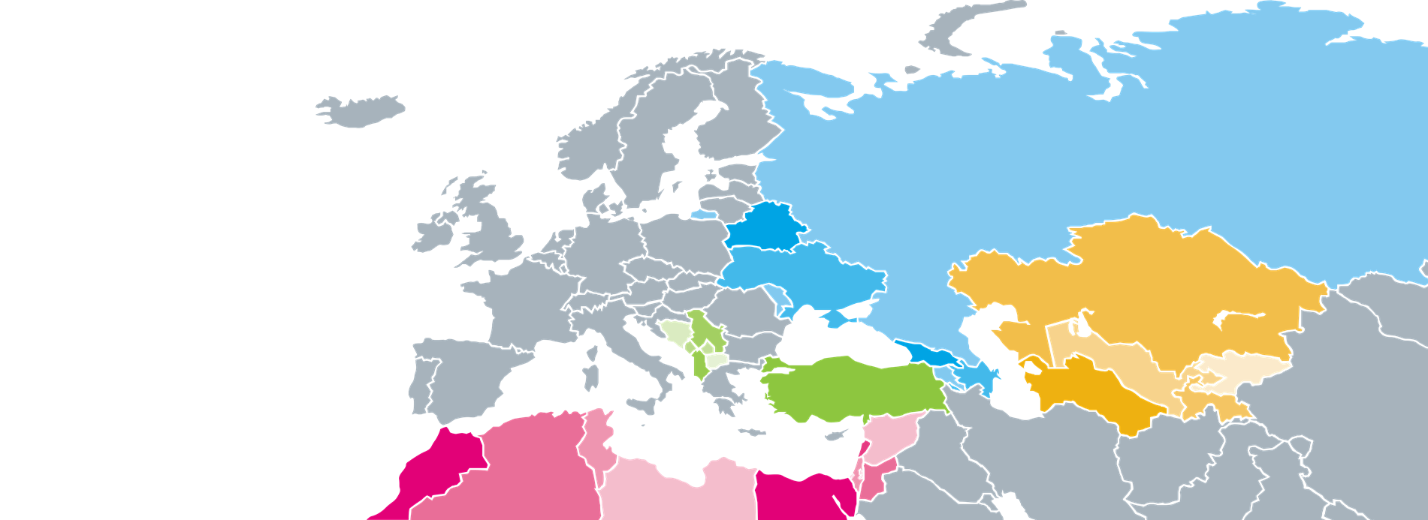

Driart Elshani
Expert
Kosovo*
* This designation is without prejudice to positions on status, and is in line with UNSCR 1244/1999 and the ICJ Opinion on the Kosovo declaration of independence.
Notes:
OK, now it’s time to pass the flow to Veronica..

Slide 11

POLICIES IN a nutshell
Kosovo* lacks specific policies and strategies on DSC and DOL for VET.
Current relevant policies in place:
  Kosovo* Digital Agenda 2013-2020
  Kosovo* National Strategy for IT 2016-2021
  EU Digital Agenda for Western Balkans including Kosovo*
  Kosovo* Education and Strategic Plan 2017-2021
Notes:
notes many challenges for VET and adult education and recognizes importance of ICT inclusion in schools, which is not integrated appropriately and needs to be addressed “in the next planning cycle” [KESP: p. 18]

Slide 12
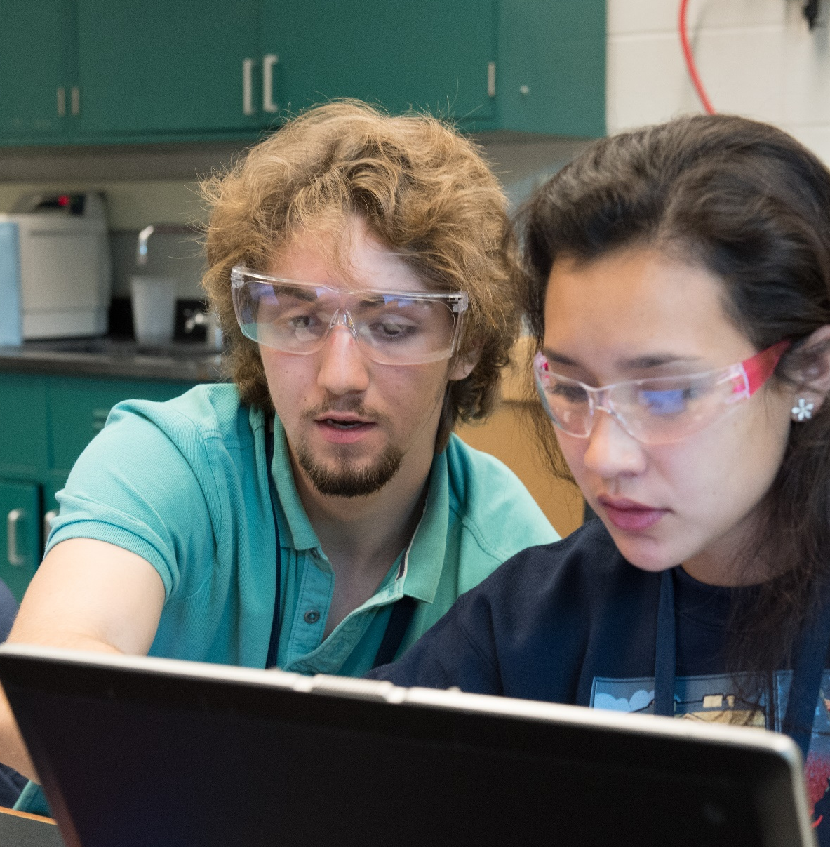
Digital Skills and Competence for Learners*
*DSC

Slide 13

DSC for VET LEARNERS
Kosovo* has
70
VET schools
  DSC is not streamlined with policies or strategies
  DSC provision is limited
  DSC provision is not monitored or assessed
  ICT industry is growing rapidly with the number of ICT business increasing
  Recruiting digitally skilled workers is a challenge to companies
Notes:
Developing more and better digitally skilled graduates is a challenge/opportunity in Kosovo
I-VET education system does not meet the needs and requirements of the market

Slide 14

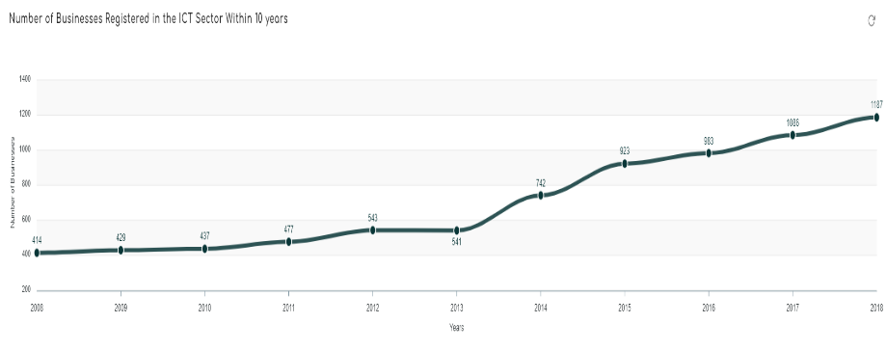


DSC for VET LEARNERS: FACTS and trends
No ICT specific
I-VET school
1:46
Ratio student to computer
ICT
2h/week

Slide 15
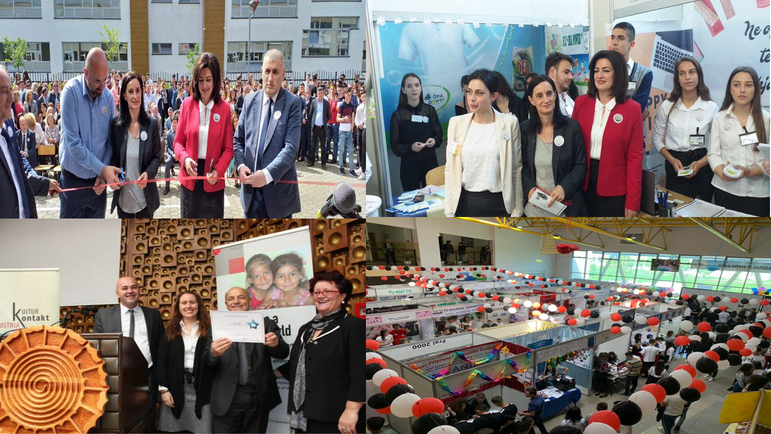
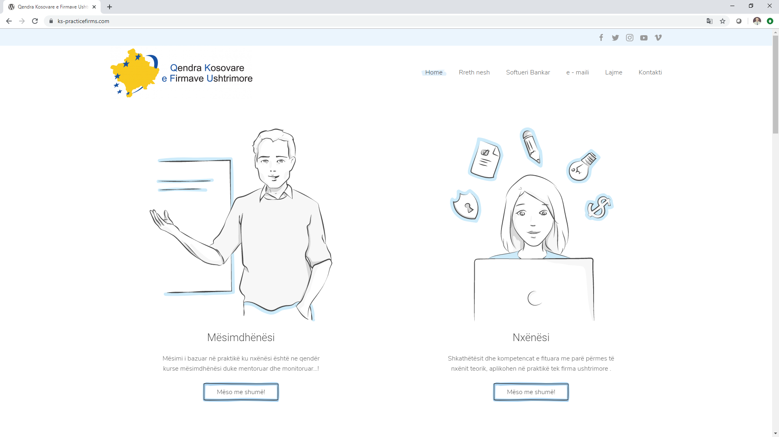
Show case: Practice Enterprises

Slide 16
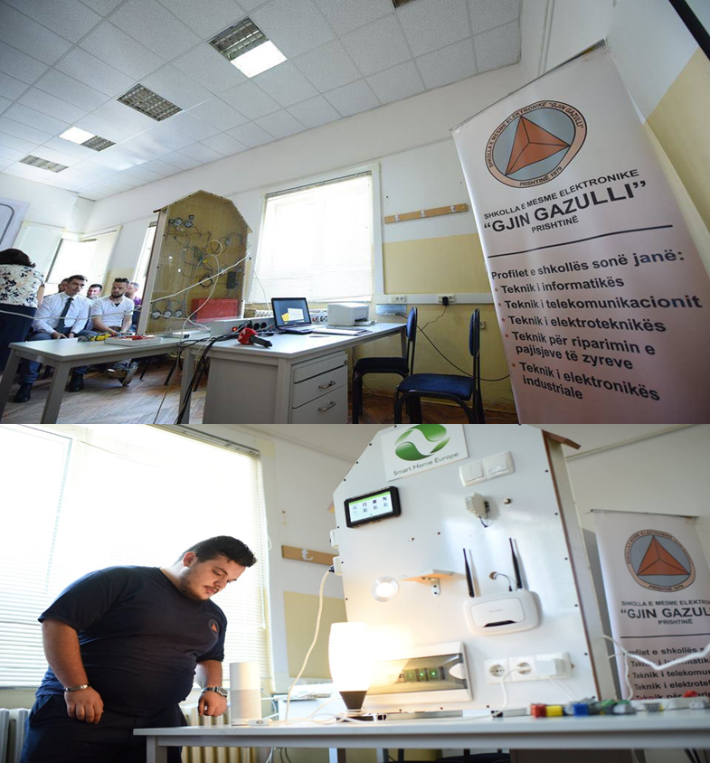
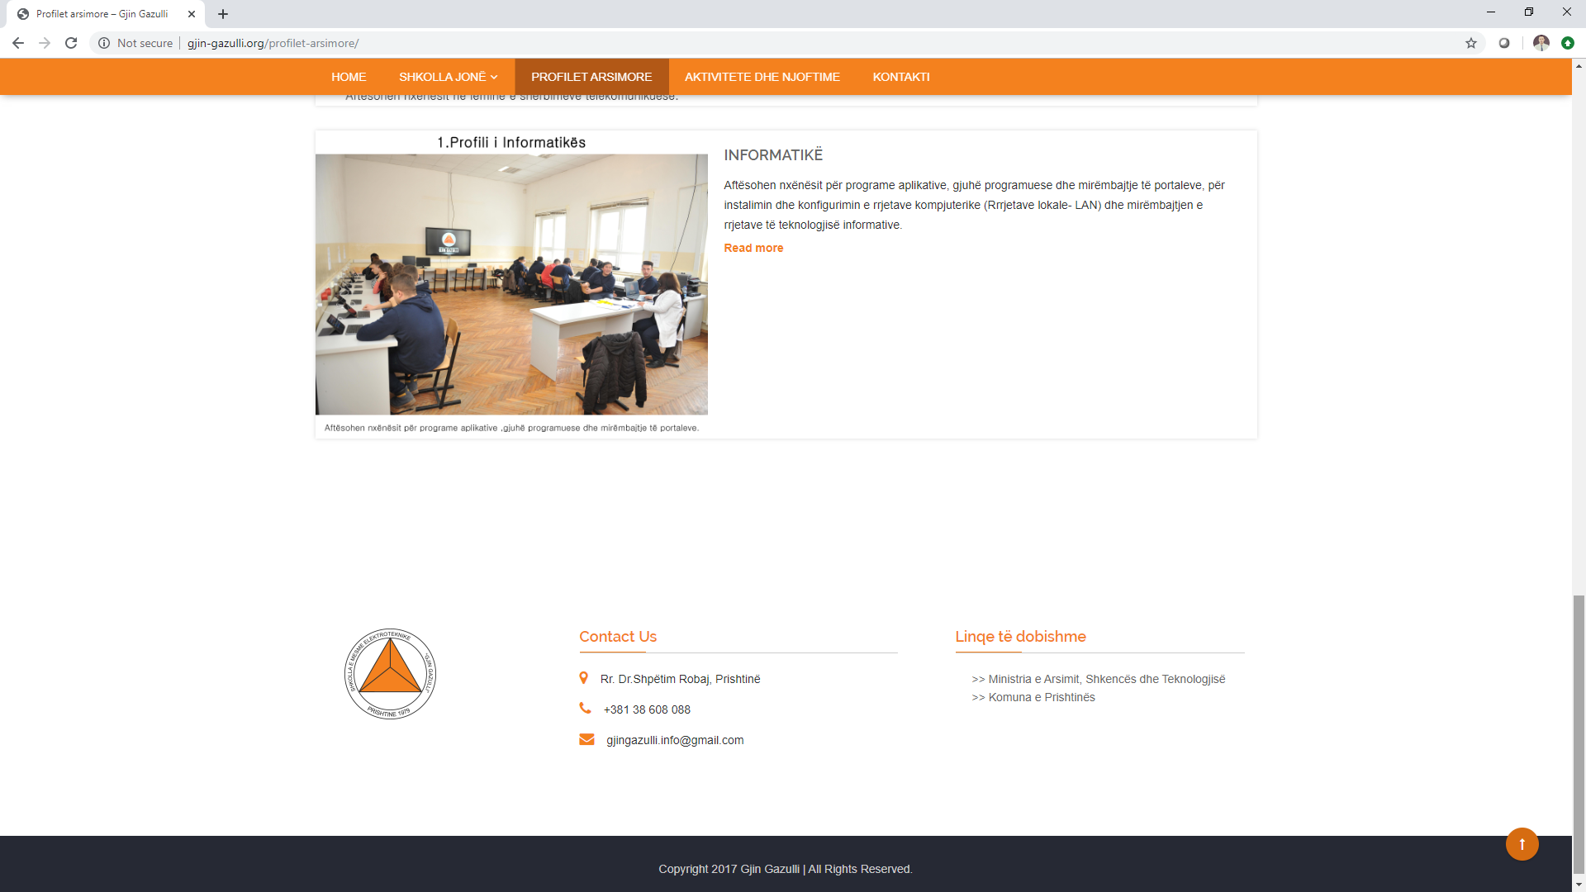
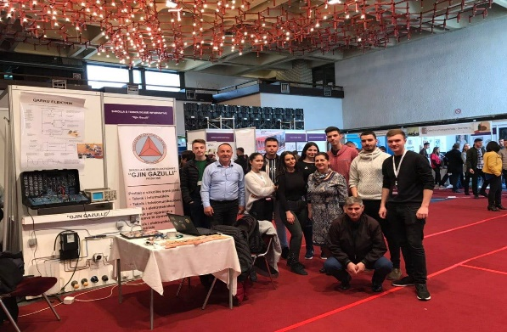
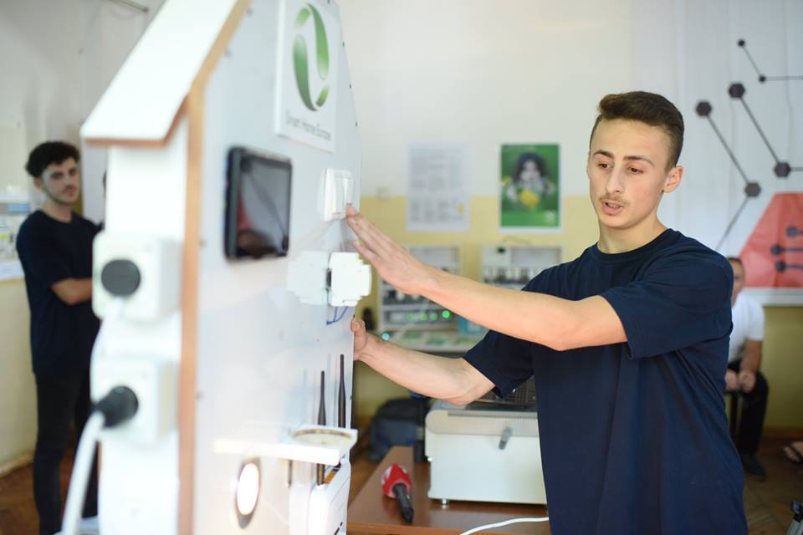
Show case: Gjin Gazulli I-VET school

Slide 17

Digital Skills and Competence for Teachers

Slide 18

Digital Skills and Competence for Teachers
Ministry of Education (MEST) since 2009 requires ECDL certification for all I-VET teachers
Agency for Vocational Education and Training and Adult Education (AVETAE) responsible for the continuing professional development of VET teachers and instructors
54% of teachers have received ECDL trainings
Notes:
82% of VET teachers in a survey by ETF say CPD is needed to help understand new technologies in workplace

Slide 19

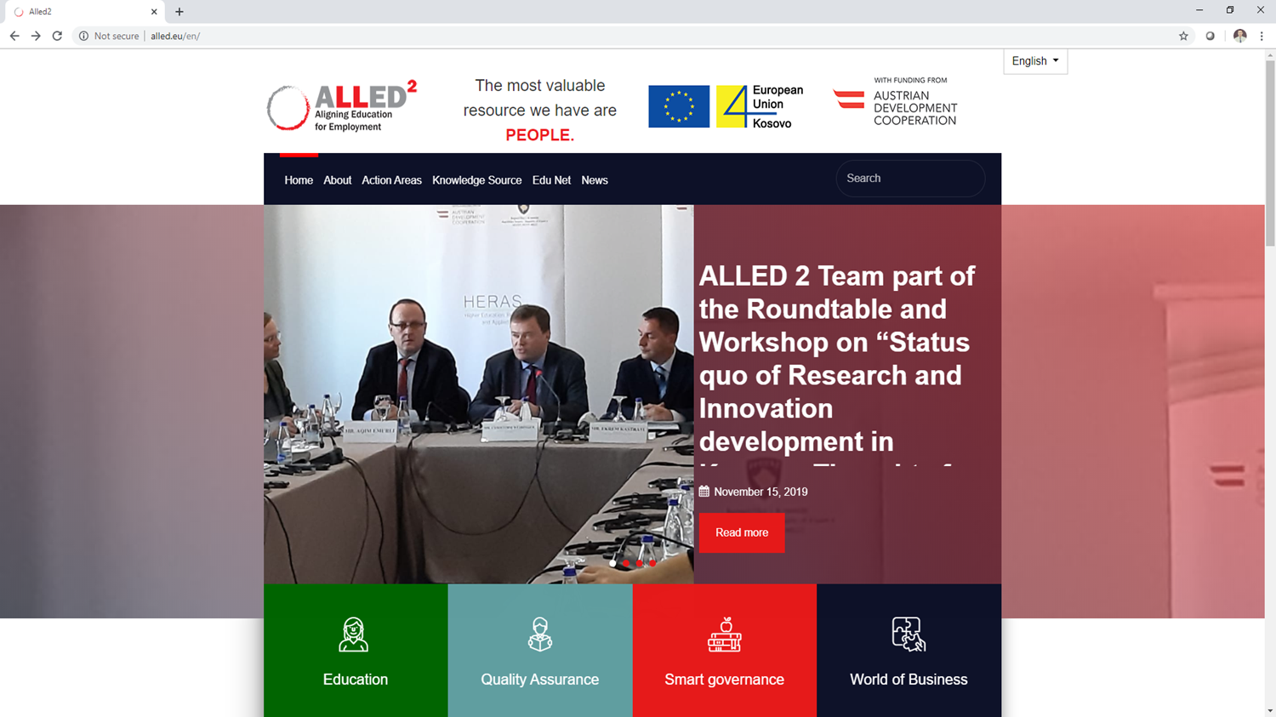

Show case: ALLED2
ALLED project financed by EU is helping VET schools offer qualitative programmes based on the labour market needs, including training of teachers in DSC, providing sustainable quality mechanisms and provision of relevant equipment.
200 I-VET teachers trained in MIEE
Trainings in , , …

Slide 20
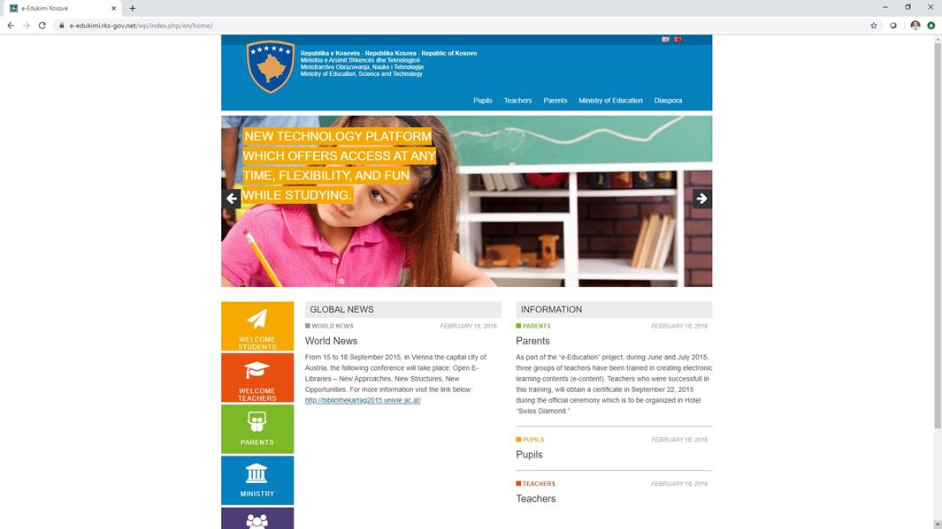
Show case: E-Education
This portal offers students a very interactive online learning platform, which makes it easier and more attractive to obtain new skills and knowledge.
It also provides teachers equal access to innovative teaching methods, new tools and resources, with the purpose of improving the teaching process among their students.

Slide 21
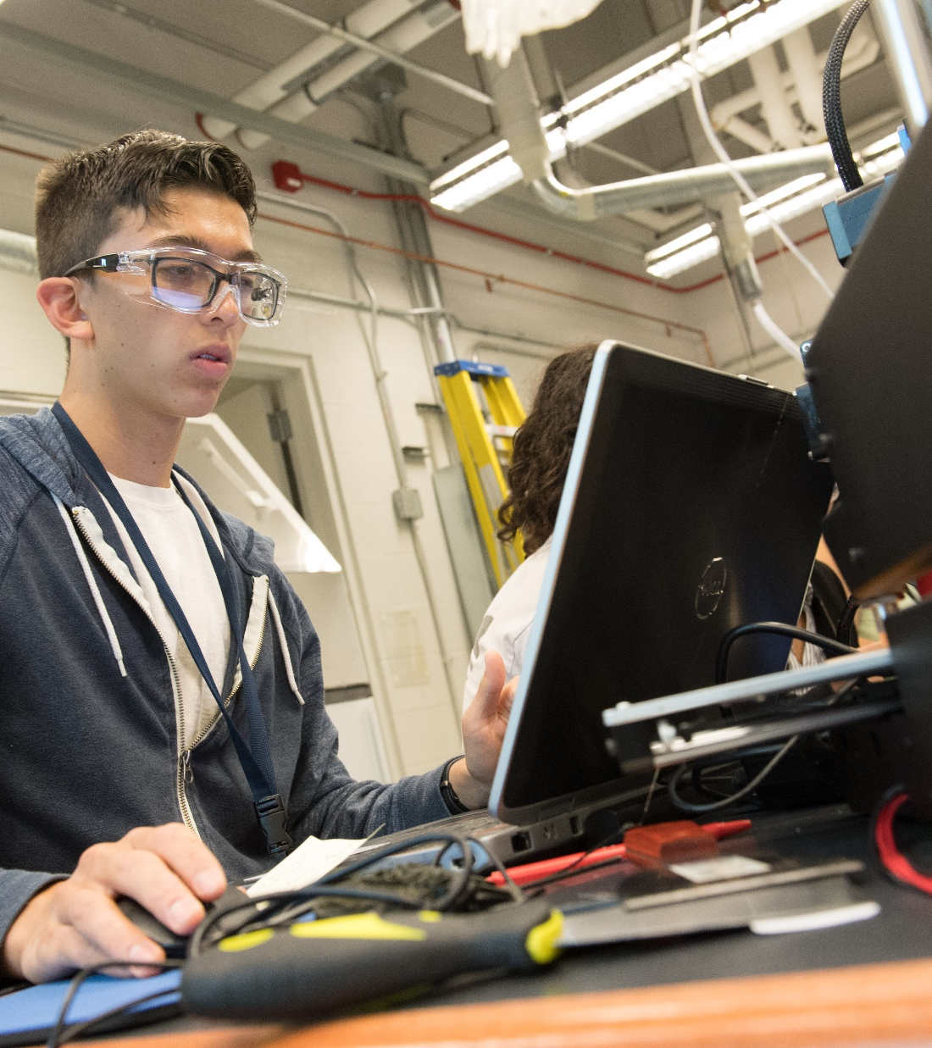
Digital and Online Learning
in initial VET

Slide 22
Digital and Online Learning in initial VET (I-vet)
Limited policies or strategies in place that cover DOL (in I-VET)
DOL has been used in I-VET teaching, learning or assessment only to some extent
No formal guidelines or standards defined for DOL
Yet, ICT infrastructure is growing
Standard monitoring mechanisms for DOL being piloted (SELFIE).
DOL is still not part of external school evaluation and/or quality assessment frameworks.

Slide 23
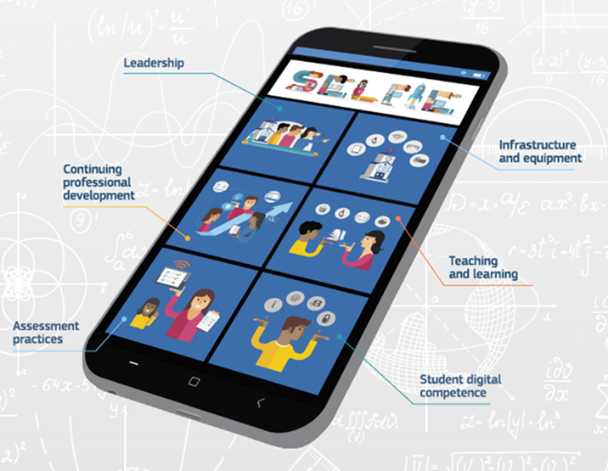
Digital and Online Learning in initial VET (I-vet)
Showcase: SELFIE
(Self-reflection on Effective Learning by Fostering the use of Innovative Educational Technologies)
SELFIE is a tool designed to improve the digital readiness of schools, including I-VET
Piloted in May 2019, in a set of schools, including I-VET.
WHAT NEXT
Analysis of outcomes & scale-up
Notes:
help schools embed digital technologies into teaching, learning and student assessment

Slide 24
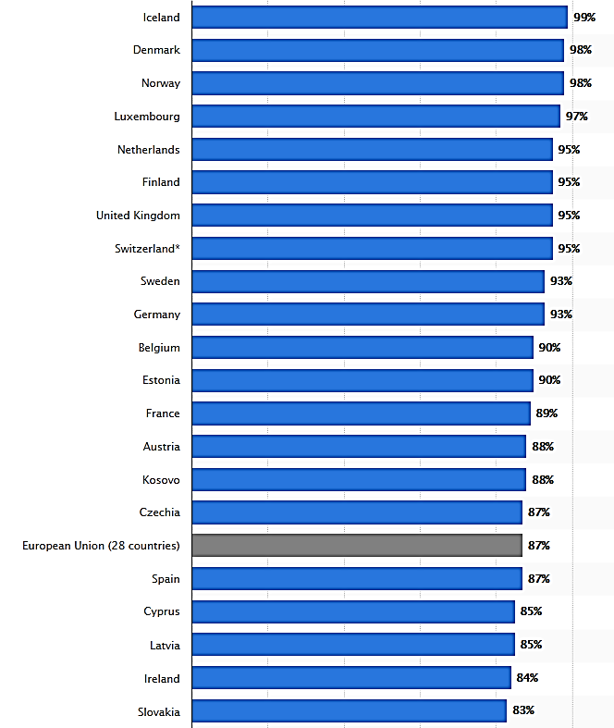
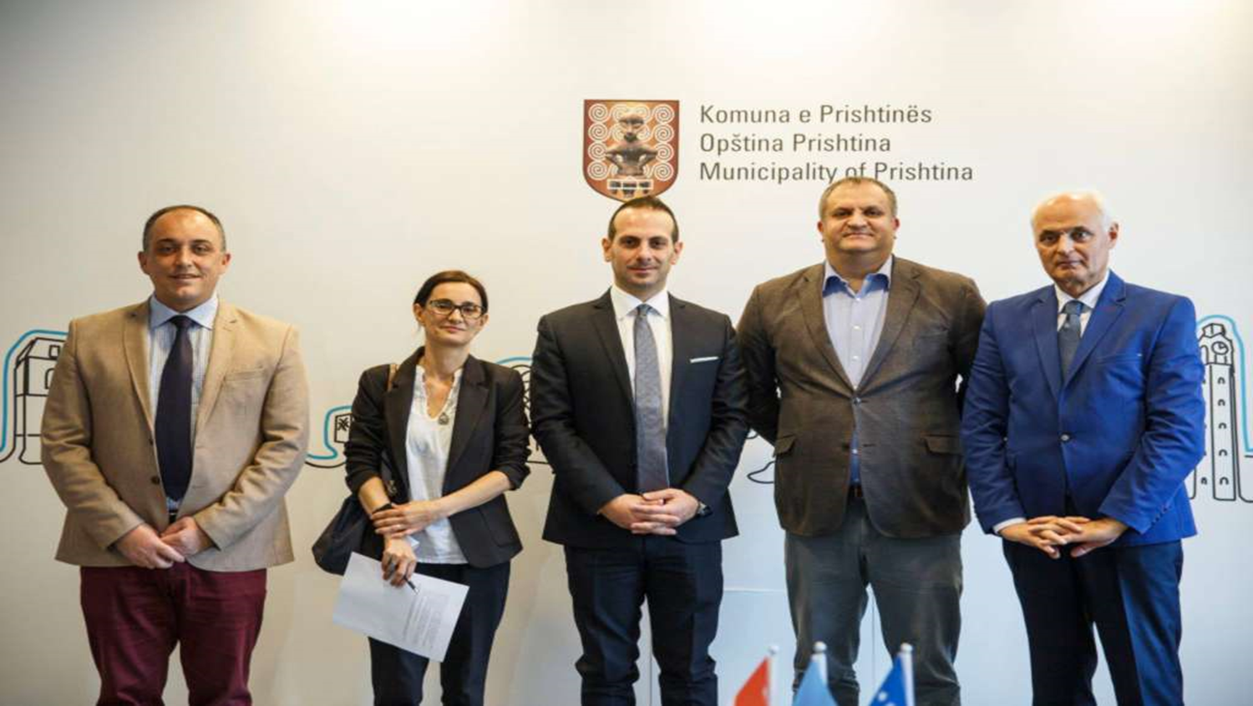
Digital and Online Learning in initial VET (I-vet)
Showcase Luxdev
Internet/broadband
in I-VET schools
100%
ICT Center of Competence
Supported by LuxDev and deployed at Gjin Gazulli VET school
Internet usage is high, above the EU average

Slide 25

Digital and Online Learning
in continuing VET

Slide 26





Digital and Online Learning in continuing VET
Private VET schools are filling in the gap. About 16 companies provide standardized trainings for , , etc. (this reference related to C-VET)
  STIKK, ICK and Cacttus Education have established training centres in an attempt to address this challenge.
of companies provide trainings in house
  600
average spending
per employee
on trainings
83%
      trend of
      Demand for DSC

Slide 27
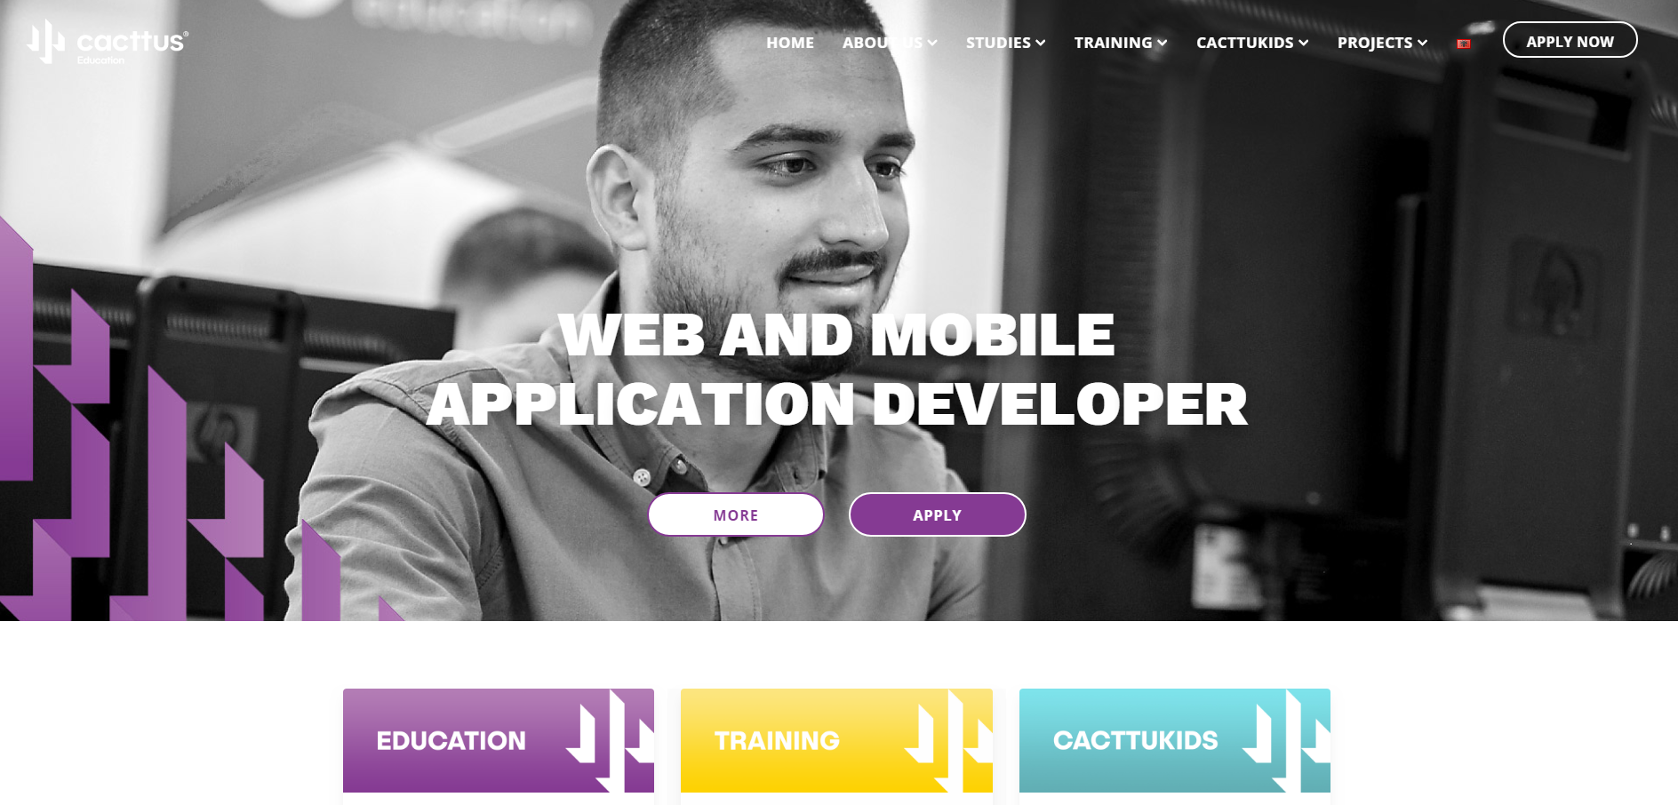

Digital and Online Learning in continuing VET:
Showcases
Cacttus Education
Kursori project to foster youth employability by providing an open access to critical ICT knowledge and skills
Techsperience project foster employability of Kosovo^{(*)}’s youth through leveraging the potential of modern technologies and intensive skill development

Slide 28
Conclusions:
Opportunities and challenges

Slide 29


Challenges and opportunities
Opportunities
Challenges
Growing demand for DSC
Limited supply but growing rapidly
Private sector initiatives filling the gap
Inadequate IT education available
Non compliance between market need and VET curricula
Notes:
Growing ICT infrastructure, yet very low usage of it for DSC and DOL
Kosovo in a ‘Start-Up’ mode regarding DSC and DOL in VET

Slide 30

RECOMMENDATIONS
Streamline education policies in line with EU Digital Agenda
Focus on specific Digital Skills policies
Monitor DSC & DOL progress in VET schools
Require certifications and qualification framework for Digital Skills
Invest in Digital Skills development
Leverage the potential of DOL and include it in education strategies
Increase awareness for DSC & DOL
Use SELFIE and other tools for DSC & DOL (etc.)

Slide 31
Q&A
Ask your question to
Driart Elshani
Let your voice be heard..

Slide 32




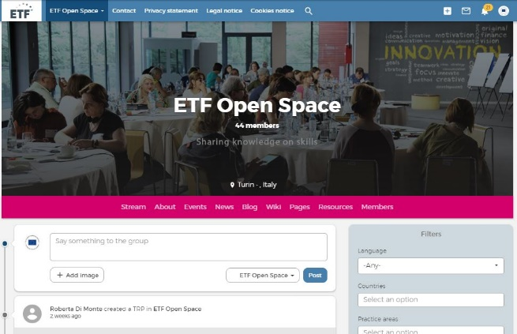
What did you think of the Webinar?
Take our quick survey and let us know.
https://bit.ly/34bKNBV
Stay tuned with ETF!
Join our plaftorm for further discussion on
Digital Skills and Competence and
Digital online Learning
www.openspace.etf.europa.eu

Slide 33
Wrap-up
DSC-DOL policy
promotion, no adoption*
not specifically on VET (covered?)
Digital Competence together with other ‘Key Competences’
A few qualifications for ICT
DSC of VET Learners
1
The Kosovar* ICT industry is rapidly evolving and expanding
Limited DSC offer, significant mismatching,
Yet EU projects, ALLED II (VET Innovation) & LuxDev (6 ICT qualifications)
1
DSC of VET of Teachers and Trainers
2
54% of VET teachers have received ECDL trainings
New CPD initiatives with EU projects ALLED II
I-VET Digital (and online) Learning
3
Limited use of DOL methods
Pilot of the EU tool SELFIE – digital readiness
ICT Centre of Competence – LuxDev project
C-VET Digital (and online) Learning
4
DOL for adults is limited and still a new formula,
Mainly a private endeavour, for DSC
*Policy adoption
CV Reform
Teachers Training
Assessment standards
Notes:
Gjin Gazulli VET School - ICT Centre of Competence
Let us draw some conclusions for the four component analysed in all 3 countries
** DSC of VET Learners
- XK – ICT sector is growing rapidly
- XK VET supply is limited and not matching needs
- To different extent, in all three countries, the VET system provides basic digital skills to all VET learners and job-specific digital skills to relevant students
- The delivery of DS in classroom could be cross-subject or in ICT classes with a teacher centred approach
- Job-Specific DS are mainly delivered in workshops with a learning by doing approach [GEORGIA]
- Assessment of DS is not always done. If done, is often integrated in the assessment of vocational skills
- DC is concept promoted by policies but partially implemented. And this is an issue as nowadays occupational digital skills are not enough
- European frameworks for DSC such as ECDL is and DigComp are used for national CV reforms [Ukraine] and for extra curricula initiatives
** The DSC of VET T&T
XK - No specific requiremnets
XK - ECDL certification is mandatory to all VET teachers
- In [Moldova] there are formal requirements to enter the VET teacher profession, yet these standards are still not applied
- Overall, VET teachers are interested to develop their DSC for DOL and for their vocational occupation
- Yet, the CPD offer is limited
- CPD remains mainly face-to-face, yet with good examples of online platform for digital learning for VET teachers
** The use of DOL in I-VET
XK – Pilot of SELFIE
XK - Limited use and reosurces , promsing that website and public social media are used, yet DOL is still regarded as something feasible, doable and beneficial
- The use od DOL in classroom is limited, mainly for traditional methods with digital tools (e.g. smartboard)
- Digital resources as mainly PDF documents or video lessons, no evidence of use of use of OER
- EU tools such as SELFIE to improve the digital readiness of VET schools are on the rise
** The use of DOL in C-VET
- DOL is still a new formula
- With an offer for DSC for adults still limited, NGOs and ICT companies on the lead
---------
DSC-DOL Policy
- Policies promote but do not support a real adoption (with plans for CV reforms, teachers training)
- DSC-DOL are for general education, not clear the extent to which covering VET
- Policies promoting DC also promote other ‘Key Competences’ [Ukraine]
- There are still a few qualifications for ICT, not up-to-date
- VET is under researched, lack of monitoring of policies

Slide 34

How your project can support DSC-DOL development in VET in Kosovo*?
Q&A
Questions to
Daniele Passalacqua
Chief Technical Adviser
LUX DEV
Chief Technical Adviser LUX DEV
Notes:
Dr. Daniele Cristian Passalacqua is a Senior Expert, with 17 years of experience in
Social and Economic Development;
Development and Transnational Cooperation;
Project and Programme Management; Implementation, Formulation,
Monitoring and Evaluation.
He is specialised in the sector of Education Governance and Management Development.
Are digital skills and learning a silver bullet for education and training in Kosovo?

Slide 35

How ETF can support DSC-DOL development in Kosovo*?
Q&A
Questions to
Mariavittoria Garlappi
ETF Country Coordinator Israel and Kosovo*
Notes:
Are digital skills and learning a silver bullet for education and training in Kosovo?

Slide 36



Silver Bullet? Could be!
Digital Transformation
(+ digital skills & Competence)
Faster Innovation Cycle
(+ upskilling & reskilling, LLL)
People live longer
(+ adult learning)
Innovation of
I-VET & C-VET
Notes:
Reforms of E&T are often complex, taking time and demanding significant resources.
And it will remain also the same in future
And DOL could be silver bullet as it can speed-up and improve the efficiency of the education reform process
Keeping the human dimension at the heart of any education reform, DOL offers new and unprecedented opportunity to improve access and quality of skills provision, in a context in which the internet penetration is high and several donors are operating
Post 2020 VET policies should explicitly refer to digitalisation as a driver for example, for CV reforms aiming at introducing more flexibility and adaptability to better integrate of theory and practice (VET), and foster collaborative learning
Similarly, VET to remain relevant for the world of work and attractive to learners has to provide relevant DSC, for better jobs, salary and more adaptability, especially in XK where the ICT sector is significantly
So in XK Digital Skills and Learning could be a silver bullet!
-------------
Flexibility for learners: the possibility for individual learners to go faster or slower or to follow only a part of the programme. (Examples of word cloud related words: flexible, modular, personalised, customised)
Adaptability to labour market demands: the curriculum is designed in such a way that it is easy to incorporate new skills and knowledge requested by the labour market. (Examples of word cloud related words: adaptable, labour market relevance, relevant)
Authenticity of the learning environment: learners work on realistic tasks in a learning environment that reflects their future workplace. (Examples of word cloud related words: authenticity, connection to real life)
Integration of theory and practice: related theory and practice are not offered as separate classes, but are closely linked to each other. Both theory and practice are offered just in time when a learner needs it to continue his/her learning process. (Examples of word cloud related words: competence based, transversal skills, practice oriented, interdisciplinary, modular)
Collaborative learning: learners have many opportunities to learn and work on assignments together or with others. (Examples of word cloud related words: cooperative, interactive, collaborative)
------------
Let us conclude returning to the opening question, are Digital Skills & Learning a Silver Bullet for Education?
My answer is that it could be!
Global trends such as the DT are putting a lot of pressure on VET with a demand for Innovation
In a LLL, post 2020 education policies should look at those opportunities offered by the DT
Bearing in mind that DOL offers NEW and fundamental solutions to improve access and provision of VET.
“To remain relevant for the world of work and attractive to learners, modern TVET systems need to adapt to new technologies and structural changes in the labour market. A main challenge of TVET is to create modern professions and career paths which attract and integrate youth. With ever-faster innovation cycles, the demand for peer learning is increasing, both in Europe and internationally.
In Europe, there is already a wealth of expertise in addressing TVET challenges, but little space to exchange on the experience of implementing new ideas and concepts. Such an exchange, however, could help improve and speed-up relevant action to ensure modern and relevant TVET both in Europe and beyond.”
https://unevoc.unesco.org//bilt/BILT
------
In general, the social and economic contributions of VET have so far been under researched and underappreciated, with VET institutions often being seen as simply providing skills rather than having a more extensive role in the innovation eco-system Dehmel, A.; Van Loo, J.B. 2014. HRD in the European Union.
Digital technology is increasingly playing a role in VET, whether in the classroom/workshops/workplace
The real value and impact of this is much debated, and hard evidence remains limited. However, it is generally accepted that technology can present important opportunities, though if not utilised well it can exacerbate inequalities. It is important for us to engage with this, whether in policy dialogue or through interventions, to optimise the educational impact of such reforms.
EU policies: Bruges communique and Riga Conclusions
And has also although the impact on learning outcomes is still questioned, DOL has big potential on
Digital Competence is becoming more and more a key factor in learning, in doing a job , in living our society.
There is a great potential for innovation and digitalisation to support high quality Vocational Education and Training (VET) and higher VET. Yet, in general, the social and economic contributions of VET have so far been under researched and underappreciated, with VET institutions often being seen as simply providing skills rather than having a more extensive role in the innovation eco-system Dehmel, A.; Van Loo, J.B. 2014. HRD in the European Union. In: Poell, R.F.; Rocco, T.S.; Roth, G.L. (eds). The Routledge companion to human resource development. London: Routledge, pp. 505-518.

Slide 37


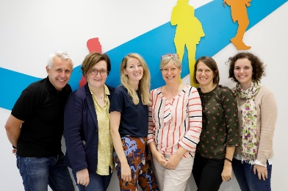
Thank you!

