Slide 1
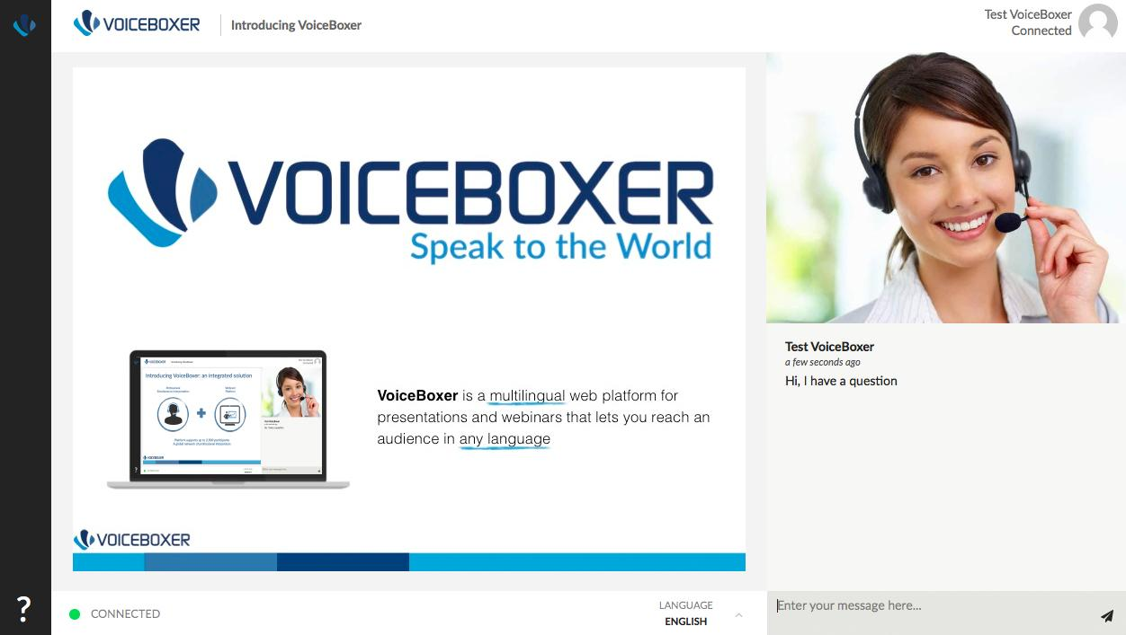

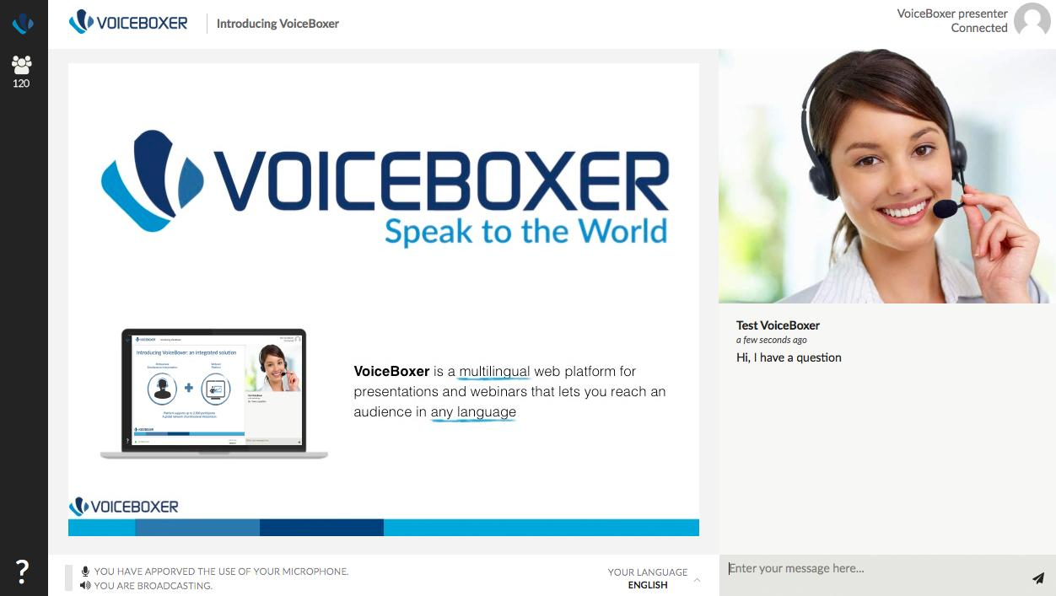


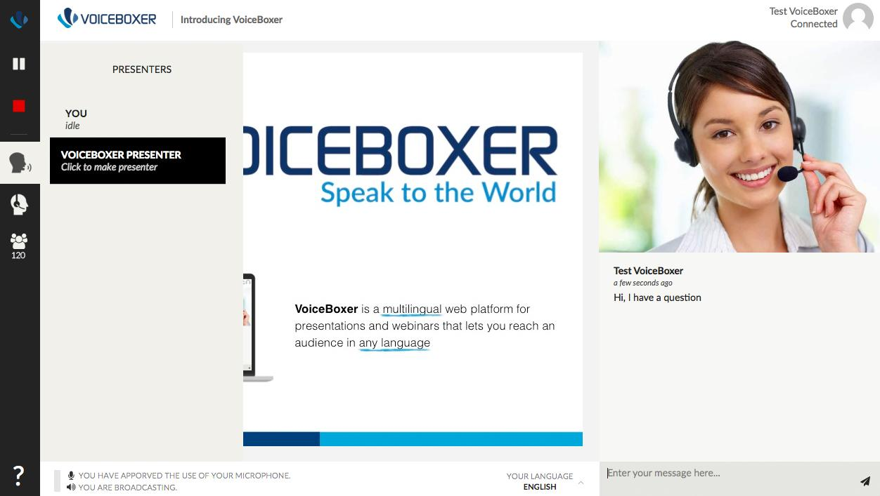



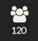


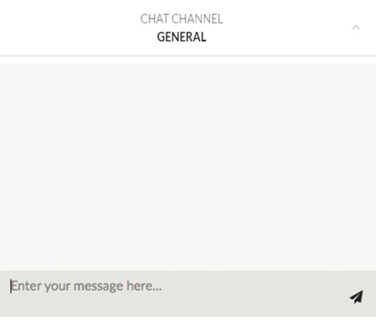
Present
Prikaz koji vidi auditorij VoiceBoxer-a
Prezentator
Presentation
>
>
Ask questions here!
Select your preferred language
Zgjidhni gjuhën tuaj të preferuar
Изаберите жељени језик
Odaberite željeni jezik
Notes:
23-Aug-16
1
1

Slide 2


Digitalne vještine i učenje
Srebreni metak za obrazovanje?
Dio II - Vebinar
29. novembar 2019. godine

Slide 3


Europska trening fondacija
29
partnerskih zemalja
Notes:
The ETF is an Agency of the EU,
The ETF is based in Turin, Italy
Work in 29 countries, those countries surrounding the EU MS all countries in colours in the map

Slide 4

Šta je Europska trening fondacija?
ETF radi u saradnji s partnerskim zemljama na reformi sistema strukovnog obrazovanja i osposobljavanja, analizi potrebnih vještina i na razvoju tržišta rada u partnerskim zemljama.
Reforma strukovnog obrazovanja i obuke
Digitalno i online učenje (eng.DOL)
Digitalne vještine i kompetencije (eng. DSC)
Notes:
In the context of the external relations of the European Union,
The ETF helps our PCs on the reform of the VET, in the analysis of Skills Needs and in the reform of the LM
In the process of the Reform of VET we analyse several aspects
Including the use of DOL and provision of DSC as two complementary elements for the modernisation of VET

Slide 5

škole
digitalna spremnost
1
3
učenici
digitalne kompetencije (CV)
nastavnici/edukatori
digitalne kompetencije
2
ETF metodologija za digitalizaciju obrazovanja

Slide 6

Danas
Prezentirati preliminarne nalaze studije
o digitalnom i online učenju, digitalnim vještinama i kompetencijama
u srednjem strukovnom obrazovanju i osposobljavanju na Kosovu*
* Ovim se nazivom ne dovode u pitanje stajališta o statusu te je on u skladu s RVSUN-om 1244/1999 i mišljenjem Međunarodnog suda o proglašenju neovisnosti Kosova.
Notes:
TODAY we present the preliminary findings of a study on Digital and Online Learning , and on Digital Skills and Competence
in VET in EE in Moldova, Georgia and Ukraine
The study and the event of today aims to
- Advance knowledge on policy and practices relevant to the digitalisation of VET.
- Highlighting potential benefits of the digitalisation in the reform and modernisation of VET

Slide 7

Digitalne vještine i kompetencije – eng.DSC
ICT
profesionalne
(napredne i visoko specijalizovane)
digitalne vještine za određeni posao
(standardi zanimanja)
digitalne kompetencije
(kritičko, kompetentno i kreativno korištenje ICT-a)
za digitalne inovacije
za zapošljivost i
aktivno građanstvo
za sve koji uče, transverzalne, za cjeloživotno učenje
https://www.etf.europa.eu/en/publications-and-resources/publications/digital-skills-and-competence-and-digital-and-online
Notes:
At this stage of the event , it is important to clarify the terminology
Analysing the provision of DSC in VET we look at 3 elements
- We look at the provision of DC as a combination of transversal DS and DK,
teaching & learning methods that foster a critical, a creative and innovative use of DT in learning
We look at the provision of Job-specific digital skills
keeping in mind that for example in Europe 90% of existing jobs require some degree of digital skills
We look at the provision of highly specialised digital skills for ICT Qualifications,
for learners that will play a key role in the digital innovation of their country

Slide 8

Digitalno (i online) učenje – eng.DOL
Aktivno i lično učenje
Sistemi upravljanja učenjem
Saradničko učenje
Analitika učenja
Udžbenik
Interaktivni udžbenici (npr. OER)
Stručne vještine
Alati za simulaciju, VR, AR
Povezivanje okoline koja uči VET
Video pedagogija
Notes:
Analysing the use of DOL in VET
We look at the use of digital learning for Innovative pedagogy in the classroom,
for example for personalisation and engagement of learners,
AND THIS IS A VERY GOOD WAY TO IMPROVE THE DC OF LEARNERS
We look at the use of digital resources, including OER
We look at the use of simulation tools and immersive technology (VR and AR) for the development of vocational skills
We look at the use of digital technology for connecting the different learning environments in VET

Slide 9
Metodologija
ICT
Kvalifikacije
VET CV-ji
Politike
Digitalne vještine i kompetencije VET učenika
Digitalne vještine i kompetencije
VET nastavnika i trenera
3 Stručnjaci
Činjenice
Digitalno i online učenje u kontinuiranom VET-u
Digitalno i online učenje u
inicijalnom VET-u
Notes:
ETF recruited 3 Experts, one for each country, that analysed four interlinked elements:
Provision
DSC for VET learners in a school-based setting
DSC of VET T&T, looking at eventual digital requirements to enter the profession of VET teachers, if any,
and to the CPD opportunities to improve their DSC, for a example for confident and effective use of DOL options
Use of DOL in I-VET focusing on school-based settings
Use of DOL in C-VET, for example people in the workplace upskilling and reskilling of people in workplace
Looking at these 4 elements, the experts analysed
Existing education policies
for example: are policy simply promoting digital learning or aiming to embed digita learning in VET?
Existing ICT Qualifications in I-VET
Identified real examples of DOL
Key data and statistics, although little monitoring in VET is regualrlay occuring

Slide 10
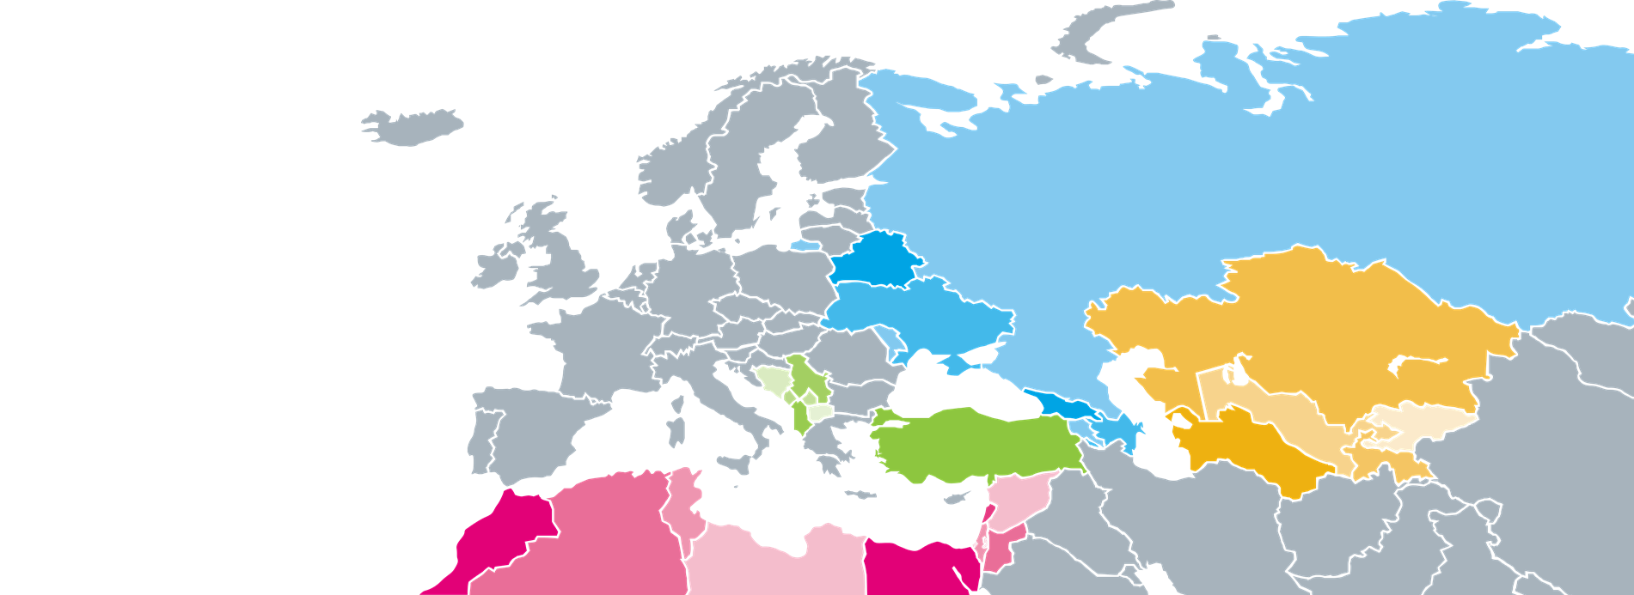
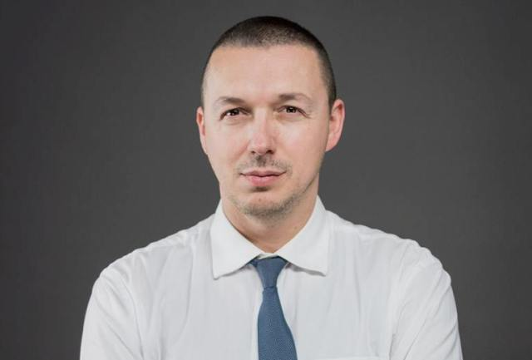
Driart Elshani
Stručnjak
Kosovo*
* Ovim se nazivom ne dovode u pitanje stajališta o statusu te je on u skladu s RVSUN-om 1244/1999 i mišljenjem Međunarodnog suda o proglašenju neovisnosti Kosova.
Notes:
OK, now it’s time to pass the flow to Veronica..

Slide 11

POLITIKE U OSNOVI
Kosovu* nedostaju posebne politike i strategije vezane za DSC i DOL za VET.
Trenutno važeće politike:
  Digitalna agenda za Kosovo* 2013-2020
  Nacionalna strategija Kosova* za IT 2016-2021
  EU digitalna agenda za zemlje Zapadnog Balkana uključujući i Kosovo*
  Obrazovni i strateški plan Kosova* 2017-2021
Notes:
notes many challenges for VET and adult education and recognizes importance of ICT inclusion in schools, which is not integrated appropriately and needs to be addressed “in the next planning cycle” [KESP: p. 18]

Slide 12
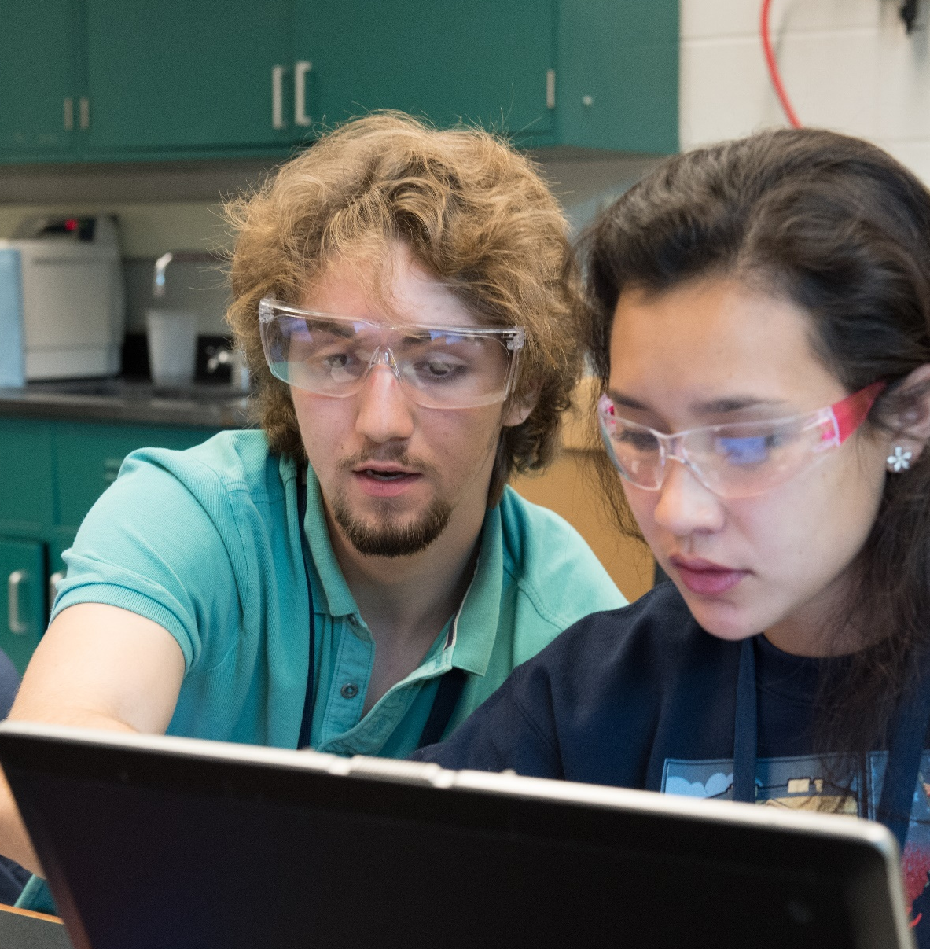
Digitalne vještine i kompetencije za učenike*
*DSC

Slide 13

DSC ZA UČENIKE U VET-U
Kosovo* ima
70
VET škola
  DSC nisu usklađene sa politikama ili strategijama
  DSC odredbe su ograničene
  DSC odredbe se ne nadziru niti procjenjuju
  ICT industrija rapridno raste uz povećanje broja ICT biznisa
  Zapošljavanje i angažovanje radnika koji posjeduju digitalne vještine
  predstavlja izazov za firme
Notes:
Developing more and better digitally skilled graduates is a challenge/opportunity in Kosovo
I-VET education system does not meet the needs and requirements of the market

Slide 14

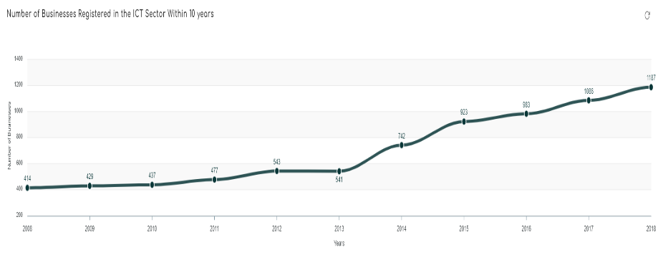


DSC ZA UČENIKE U VET-U: ČINJENICE I TRENDOVI
Nema ICT posebne
I-VET škole
1:46
odnos broja učenika i računara
ICT
2sata/sedmično

Slide 15
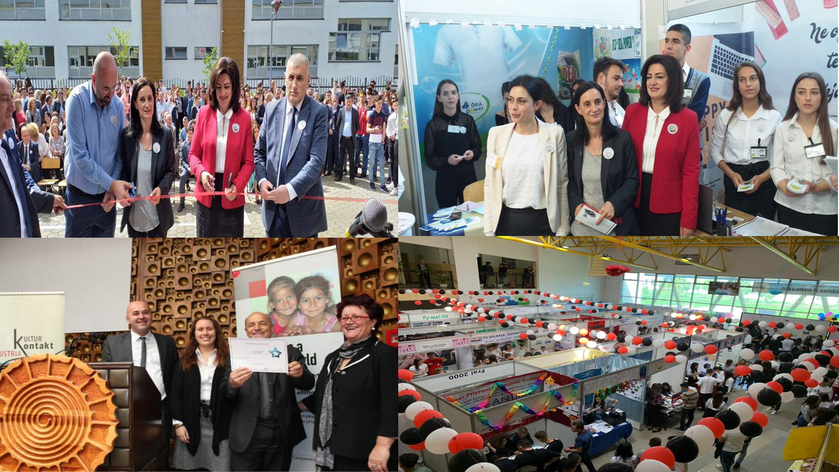
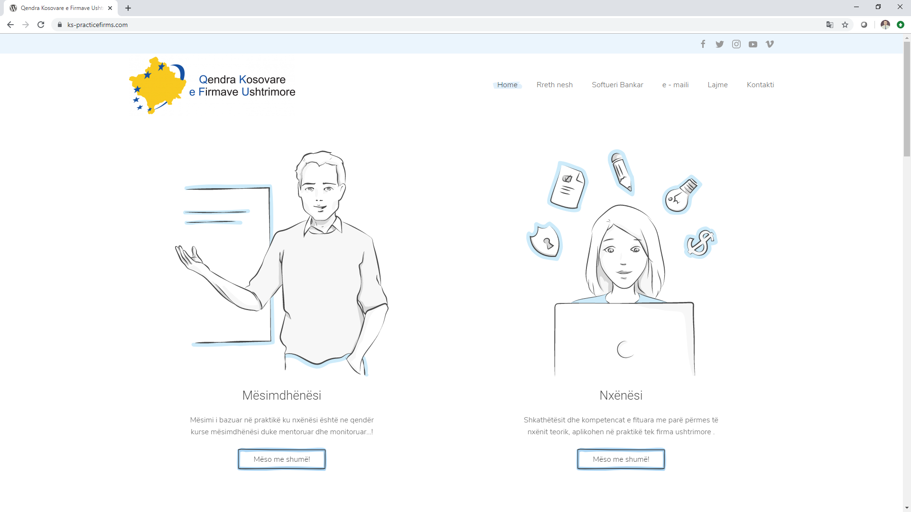
Prikaz slučaja: Praktična poduzeća

Slide 16
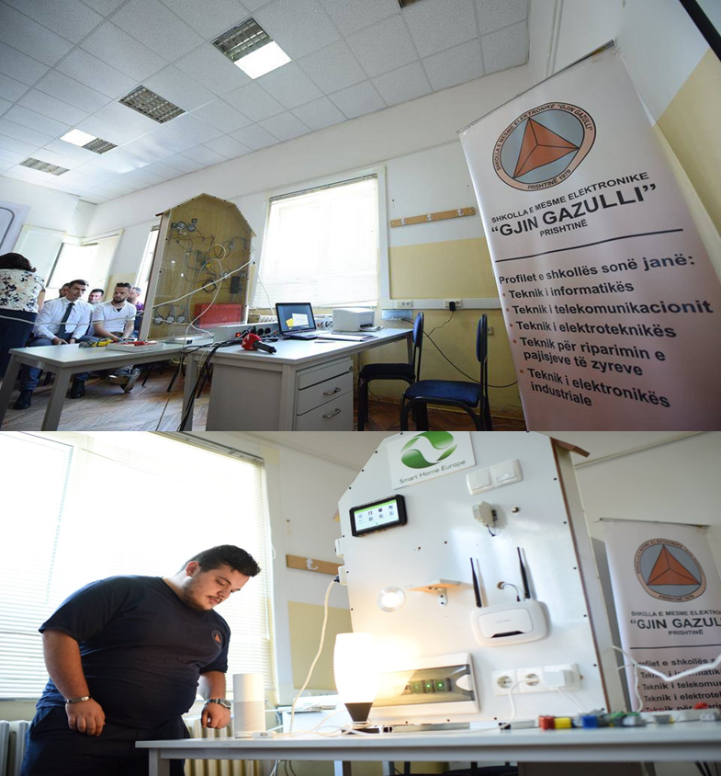
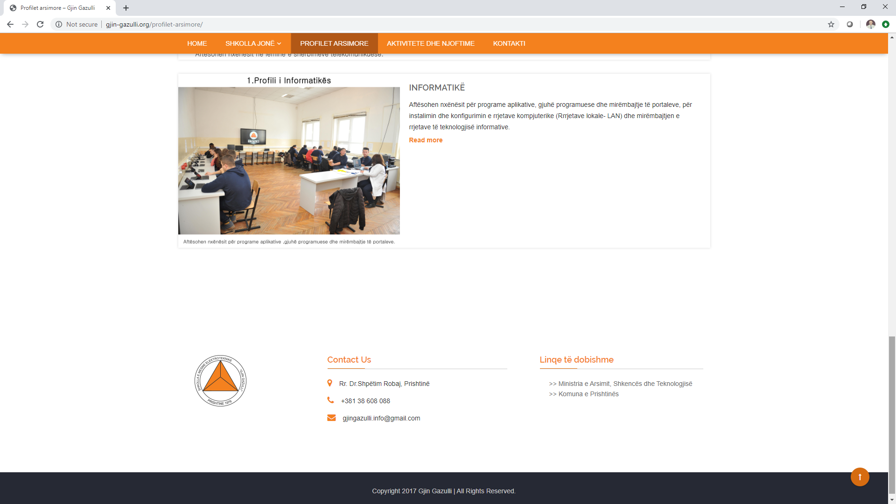
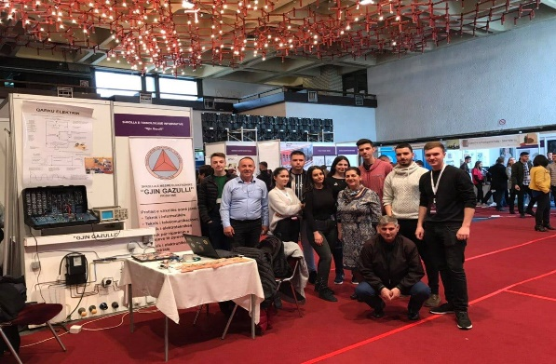
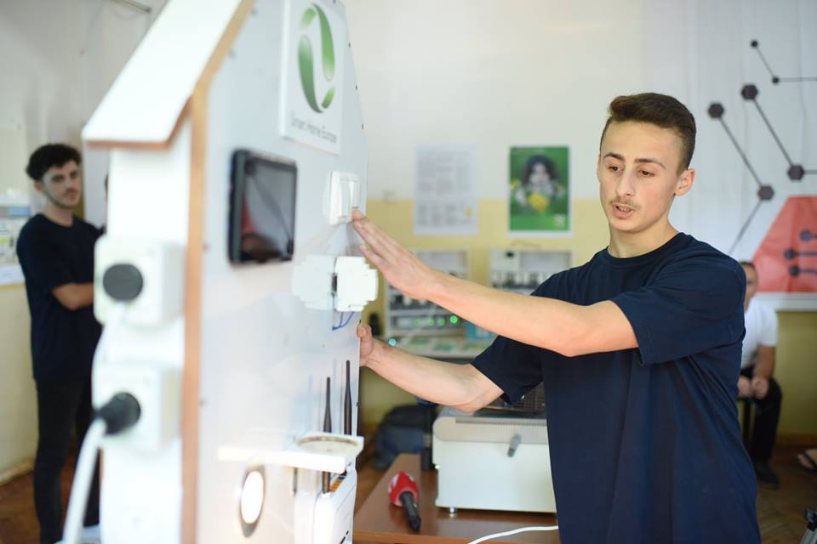
Prikaz slučaja: Gjin Gazulli I-VET škola

Slide 17

Digitalne vještine i kompetencije za nastavnike

Slide 18

DigitalNE VJEŠTINE I KOMPETENCIJE ZA NASTAVNIKE
Ministarstvo obrazovanja (MEST) od 2009. godine zahtjeva da svi I-VET nastavnici imaju ECDL certifikat
Agencija za strukovno obrazovanje i osposobljavanje i obrazovanje odraslih (AVETAE) odgovorna je za kontinuirani profesionalni razvoj VET nastavnika i instruktora
54% nastavnika dobilo je ECDL obuke
Notes:
82% of VET teachers in a survey by ETF say CPD is needed to help understand new technologies in workplace

Slide 19

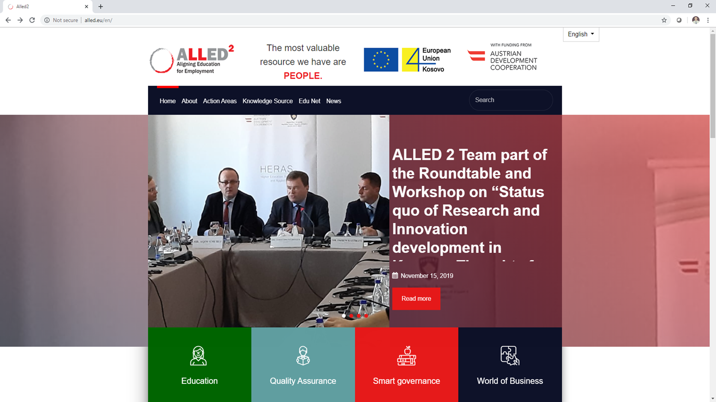

PRIKAZ SLUČAJA: ALLED2
ALLED projekt koji financira EU pomaže VET školama da ponude kvalitetne programe zasnovane na potrebama tržišta rada, uključujući obuke nastavnika za DSC, pružajući održive mehanizme kvaliteta i isporuku odgovarajuće opreme.
200 I-VET nastavnika obučeno u MIEE
obukama iz , , …

Slide 20
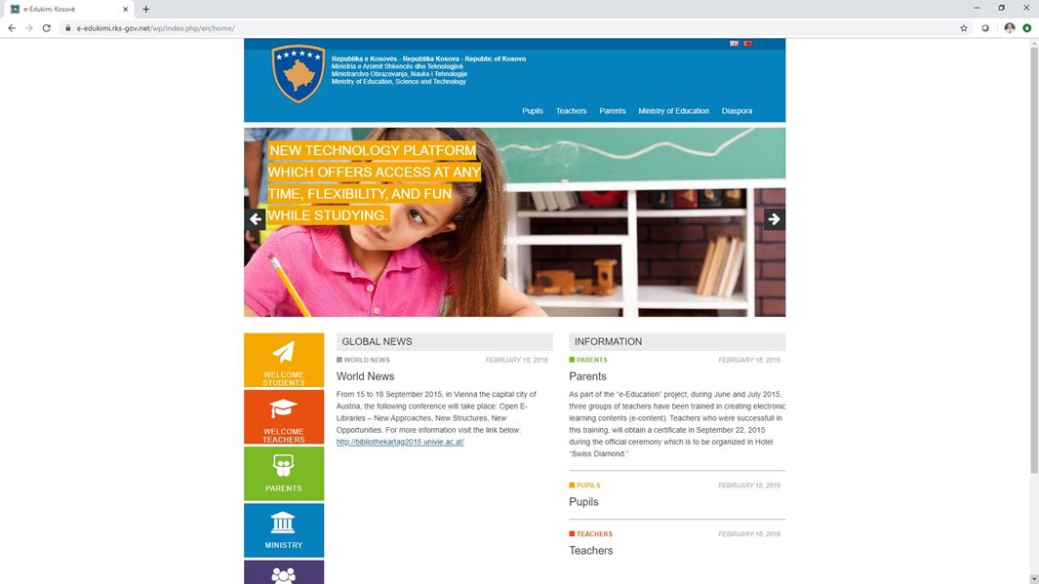
PRIKAZ SLUČAJA: E-OBRAZOVANJE
Ovaj portal nudi učenicima veoma interaktivne online platforme učenja, koje olakšavaju i čine privlačnijim sticanje novih vještina i znanja.
Također, pruža nastavnicima jednak pristup da inoviraju metode u nastavi, nove alate i resurse, sa svrhom unaprijeđenja procesa nastave sa učenicima.

Slide 21
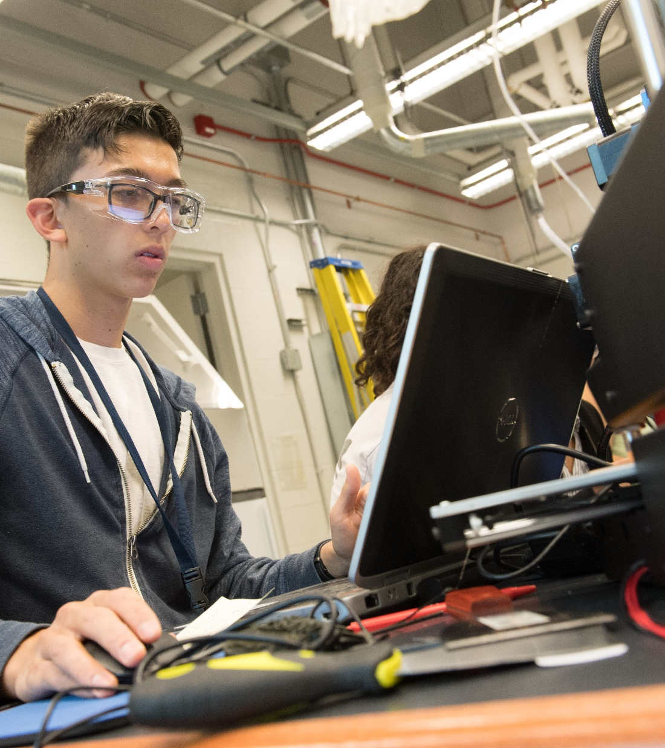
Digitalno i online učenje u inicijalnom VET-u

Slide 22
DigitalNO I ONLINE UČENJE
U INICIJALNOM VET-U (I-vet)
Ograničene politike ili strategije koje postoje i koje obuhvataju DOL (u I-VET-u)
DOL se koristilo u I-VET nastavi, učenju ili ocjenjivanju samo u određenoj mjeri
Nema formalnih smjernica ili standarda koji su definirani za DOL
Ipak, ICT infrastruktura je u porastu
Pilotirani su standardni mehanizmi monitoringa za DOL (SELFIE).
DOL još uvijek nije dijelom eksterne evaluacije škole i/ili okvira za procjenu kvalitete.

Slide 23
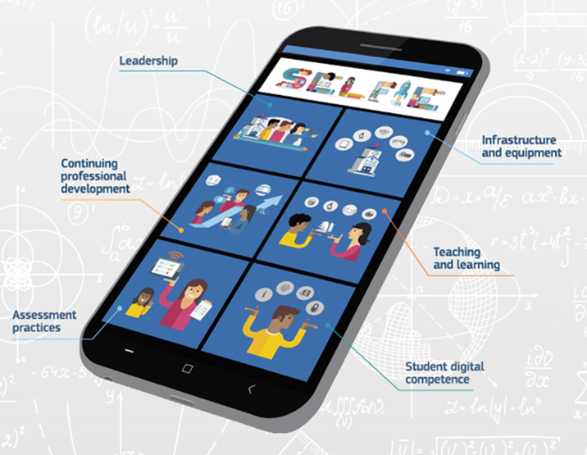
DigitalNO I ONLINE UČENJE U INICIJALNOM VET-U (I-vet)
PRIKAZ SLUČAJA: SELFIE
(Samorefleksija o efikasnom učenju poticanjem upotrebe inovativnih obrazovnih tehnologija eng.Self-reflection on Effective Learning by Fostering the use of Innovative Educational Technologies)
SELFIE je alat koji je osmišljen kako bi se unaprijedila digitalna spremnost škola, uključujući I-VET
Pilotirano je u maju 2019. godine, u nekoliko škola, uključujući I-VET.
NAREDNI KORACI
Analiza ishoda i širenje
Notes:
help schools embed digital technologies into teaching, learning and student assessment

Slide 24
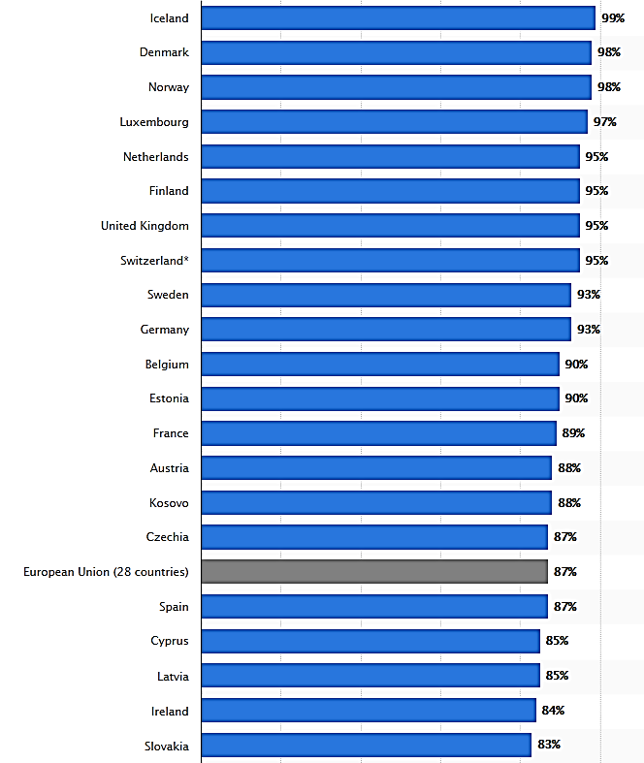
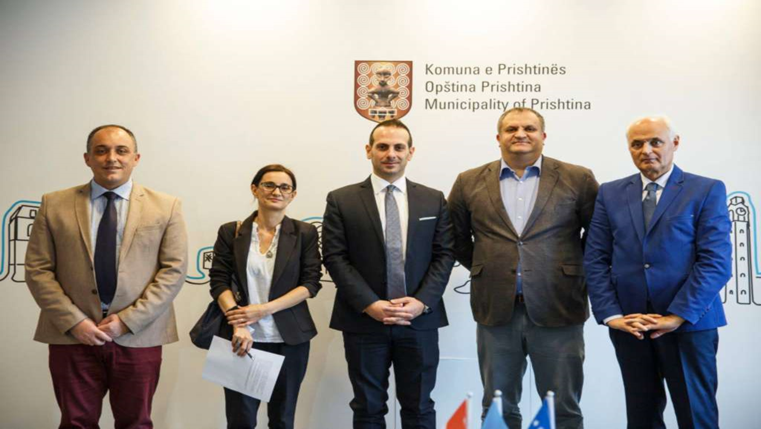
DigitalNO I ONLINE UČENJE U INICIJALNOM VET-U (I-vet)
Prikaz slučaja Luxdev
Internet/broadband
U I-VET školama
100%
ICT centar kompetencija
LuxDev podržava ovaj centar a razvijen je u Gjin Gazulli VET školi
Korištenje interneta je visoko iznad EU prosjeka

Slide 25

Digitalno i online učenje u kontinuiranom VET-u

Slide 26





Digitalno i online učenje u kontinuiranom vet-u
Privatne VET škole popunjavaju praznine. Oko 16 kompanija pruža standardizirane obuke za , , itd. (ova referenca vezana je za C-VET)
  STIKK, ICK i Cacttus uspostavili su centre za obuku u pokušaju da se dotaknu rješenja ovog problema.
Firmi rade obuke na licu mjesta
  600
se troši mjesečno po
Po zaposlenom
Po obuci
83%
      trend
      Zahtjeva za DSC

Slide 27
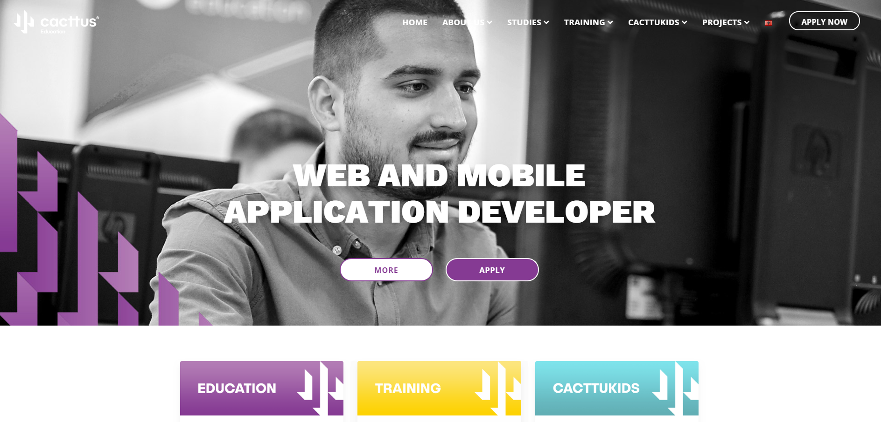
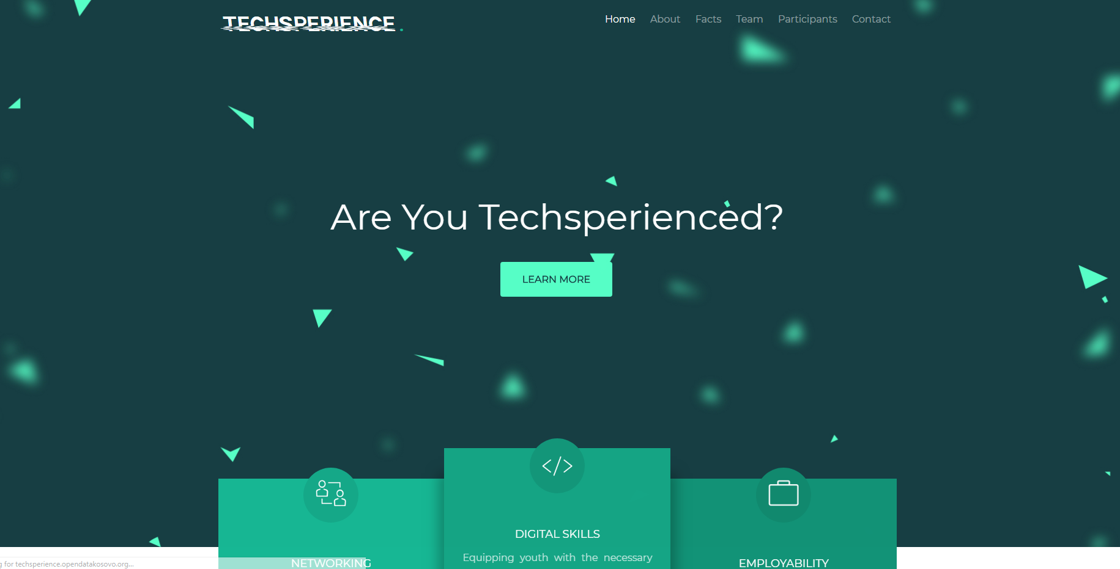
Digitalno i online učenje u kontinuiranom vet-u: prikazi slučaja
Cacttus obrazovanje
Kursori projekt kako bi se podržalo zapošljavanje mladih pružanjem otvorenog pristupa kritičkim ICT znanjima i vještinama
Techsperience projekt podržati zapošljivost mladih na Kosovu* kroz iskorištavanje potencijala modernih tehnologija i intenzivnog razvoja vještina

Slide 28
Zaključak: prilike i izazovi

Slide 29


IZAZOVI I PRILIKE
Prilike
Izazovi
Stalno raste potražnja za DSC
Ograničena isporuka ali raste brzo
Inicijative iz privatnog sektora nadomještaju praznine
Dostupno je neadekvatno IT obrazovanje
Neusaglašenost između potreba tržišta i VET nastavnog plana i programa
Notes:
Growing ICT infrastructure, yet very low usage of it for DSC and DOL
Kosovo in a ‘Start-Up’ mode regarding DSC and DOL in VET

Slide 30

PREPORUKE
Usmjeriti obrazovne politike sa EU digitalnom agendom
Fokus na posebne politike digitalnih vještina
Nadzirati napredak DSC i DOL-a u VET školama
Zahtjevati certificiranje i kvalifikacijski okvir za digitalne vještine
Investirati u razvoj digitalnih vještina
Iskoristiti potencijal DOL-a i uključiti ga u obrazovne strategije
Povećati svиjest o DSC i DOL
Koristiti SELFIE i ostale alate za DSC & DOL (itd.)

Slide 31
Q&A
Pitanja možete uputiti
Driart Elshani
Neka se čuje i vaš glas.

Slide 32



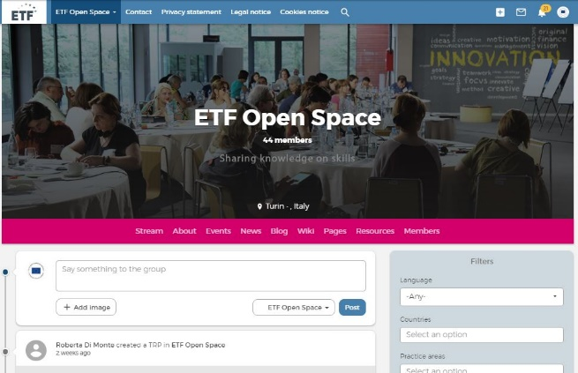
Šta mislite o vebinaru?
Ispunite kratku anketu i dajte nam do znanja vaše mišljenje.
https://bit.ly/34bKNBV
Ostanite u toku s ETF!
Pridružite se našoj platformi i diskutujte o
Digitalnim vještinama i kompetencijama i
digitalnom online učenju
www.openspace.etf.europa.eu

Slide 33
Sažetak
DSC-DOL politika
promocija, nema usvajanja*
Nije isključivo za VET (obuhvaćeno?)
Digitalna kompetencija skupa sa ostalim ključnim kompetencijama
Nekoliko kvalifikacija za ICT
DSC za VET učenike
1
ICT industrija Kosova* rapidno evolvira i širi se
Ograničen je broj DSC ponuda, značajno se smanjio što je dovelo do neusklađivanja,
Ipak tu su EU projekti ALLED II (VET Inovacije) & LuxDev (6 ICT kvalifikacija)
1
DSC nastavnika i trenera u VET-u
2
54% VET nastavnika prošli su kroz ECDL obuke
Nove CPD inicijative sa EU projektom ALLED II
I-VET digitalno (i online) učenje
3
Ograničeno korištenje DOL metoda
Pilotiranje EU alata SELFIE – digitalna spremnost
ICT Centar za kompetencije – LuxDev projekt
C-VET digitalno (i online) učenje
4
DOL za odrasle osobe je ograničeno i još uvijek nešto što je novo,
Uglavnom privatni napori, za DSC
*Usvajanje politike
CV Reforma
Obuka nastavnika
Standardi ocjenjivanja
Notes:
Gjin Gazulli VET School - ICT Centre of Competence
Let us draw some conclusions for the four component analysed in all 3 countries
** DSC of VET Learners
- XK – ICT sector is growing rapidly
- XK VET supply is limited and not matching needs
- To different extent, in all three countries, the VET system provides basic digital skills to all VET learners and job-specific digital skills to relevant students
- The delivery of DS in classroom could be cross-subject or in ICT classes with a teacher centred approach
- Job-Specific DS are mainly delivered in workshops with a learning by doing approach [GEORGIA]
- Assessment of DS is not always done. If done, is often integrated in the assessment of vocational skills
- DC is concept promoted by policies but partially implemented. And this is an issue as nowadays occupational digital skills are not enough
- European frameworks for DSC such as ECDL is and DigComp are used for national CV reforms [Ukraine] and for extra curricula initiatives
** The DSC of VET T&T
XK - No specific requiremnets
XK - ECDL certification is mandatory to all VET teachers
- In [Moldova] there are formal requirements to enter the VET teacher profession, yet these standards are still not applied
- Overall, VET teachers are interested to develop their DSC for DOL and for their vocational occupation
- Yet, the CPD offer is limited
- CPD remains mainly face-to-face, yet with good examples of online platform for digital learning for VET teachers
** The use of DOL in I-VET
XK – Pilot of SELFIE
XK - Limited use and reosurces , promsing that website and public social media are used, yet DOL is still regarded as something feasible, doable and beneficial
- The use od DOL in classroom is limited, mainly for traditional methods with digital tools (e.g. smartboard)
- Digital resources as mainly PDF documents or video lessons, no evidence of use of use of OER
- EU tools such as SELFIE to improve the digital readiness of VET schools are on the rise
** The use of DOL in C-VET
- DOL is still a new formula
- With an offer for DSC for adults still limited, NGOs and ICT companies on the lead
---------
DSC-DOL Policy
- Policies promote but do not support a real adoption (with plans for CV reforms, teachers training)
- DSC-DOL are for general education, not clear the extent to which covering VET
- Policies promoting DC also promote other ‘Key Competences’ [Ukraine]
- There are still a few qualifications for ICT, not up-to-date
- VET is under researched, lack of monitoring of policies

Slide 34

Kako vaš projekt može podržati razvoj DSC-DOL-a na Kosovu*?
Q&A
Pitanja uputiti
Daniele Passalacqua
Chief Technical Adviser
LUX DEV
Viši savjetnik za tehnička pitanja LUX DEV
Notes:
Dr. Daniele Cristian Passalacqua is a Senior Expert, with 17 years of experience in
Social and Economic Development;
Development and Transnational Cooperation;
Project and Programme Management; Implementation, Formulation,
Monitoring and Evaluation.
He is specialised in the sector of Education Governance and Management Development.
Jesu li digitalne vještine i učenje srebreni metak za obrazovanje i obuku na Kosovu?

Slide 35

Kako ETF može podržati razvoj DSC-DOL-a na Kosovu*?
Q&A
Pitanja uputiti
Mariavittoria Garlappi
ETF Koordinator za zemlje Izrael i Kosovo*
Notes:
Jesu li digitalne vještine i učenje srebreni metak za obrazovanje i obuku na Kosovu?

Slide 36



Srebreni metak? Može biti!
Digitalna transformacija
(+ digitalne vještine i kompetencije)
Brži ciklus inovacija
(+ usavršavanje i preobuka, LLL)
Ljudi žive duže
(+ obrazovanje odraslih)
Inovacije u
I-VET & C-VET
Notes:
Let us conclude returning to the opening question, are Digital Skills & Learning a Silver Bullet for Education?
My answer is that it could be!
Global trends such as the DT are putting a lot of pressure on VET with a demand for Innovation
In a LLL, post 2020 education policies should look at those opportunities offered by the DT
Bearing in mind that DOL offers NEW and fundamental solutions to improve access and provision of VET.
------
In general, the social and economic contributions of VET have so far been under researched and underappreciated, with VET institutions often being seen as simply providing skills rather than having a more extensive role in the innovation eco-system Dehmel, A.; Van Loo, J.B. 2014. HRD in the European Union.
Digital technology is increasingly playing a role in VET, whether in the classroom/workshops/workplace
The real value and impact of this is much debated, and hard evidence remains limited. However, it is generally accepted that technology can present important opportunities, though if not utilised well it can exacerbate inequalities. It is important for us to engage with this, whether in policy dialogue or through interventions, to optimise the educational impact of such reforms.
EU policies: Bruges communique and Riga Conclusions
And has also although the impact on learning outcomes is still questioned, DOL has big potential on
Digital Competence is becoming more and more a key factor in learning, in doing a job , in living our society.
There is a great potential for innovation and digitalisation to support high quality Vocational Education and Training (VET) and higher VET. Yet, in general, the social and economic contributions of VET have so far been under researched and underappreciated, with VET institutions often being seen as simply providing skills rather than having a more extensive role in the innovation eco-system Dehmel, A.; Van Loo, J.B. 2014. HRD in the European Union. In: Poell, R.F.; Rocco, T.S.; Roth, G.L. (eds). The Routledge companion to human resource development. London: Routledge, pp. 505-518.

Slide 37

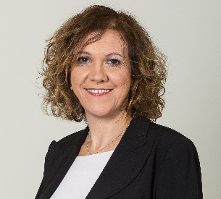
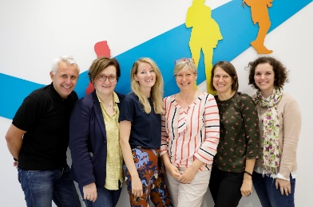
Hvala!

