Slide 1

Development of the National Register of Qualifications in the Republic of Moldova
Viorica CONDRUC
NQF Departmant
viorica.condruc@mecc.gov.md
KIEV, July 10, 2019

Slide 2
Lead NQF- Ministry of Education, Culture and Research Republic of Moldova: NQF Departament
NQF Departament – CNC National Coordination Point, responsible for the development of the CNC RM with the involvement of all stakeholders interested in training qualified labor market personnel and international reporting on the progress made – 2017, oct.
Status: structure of 5 persons within the Ministry of Education, Culture and Research.
ea depardrul

Slide 3
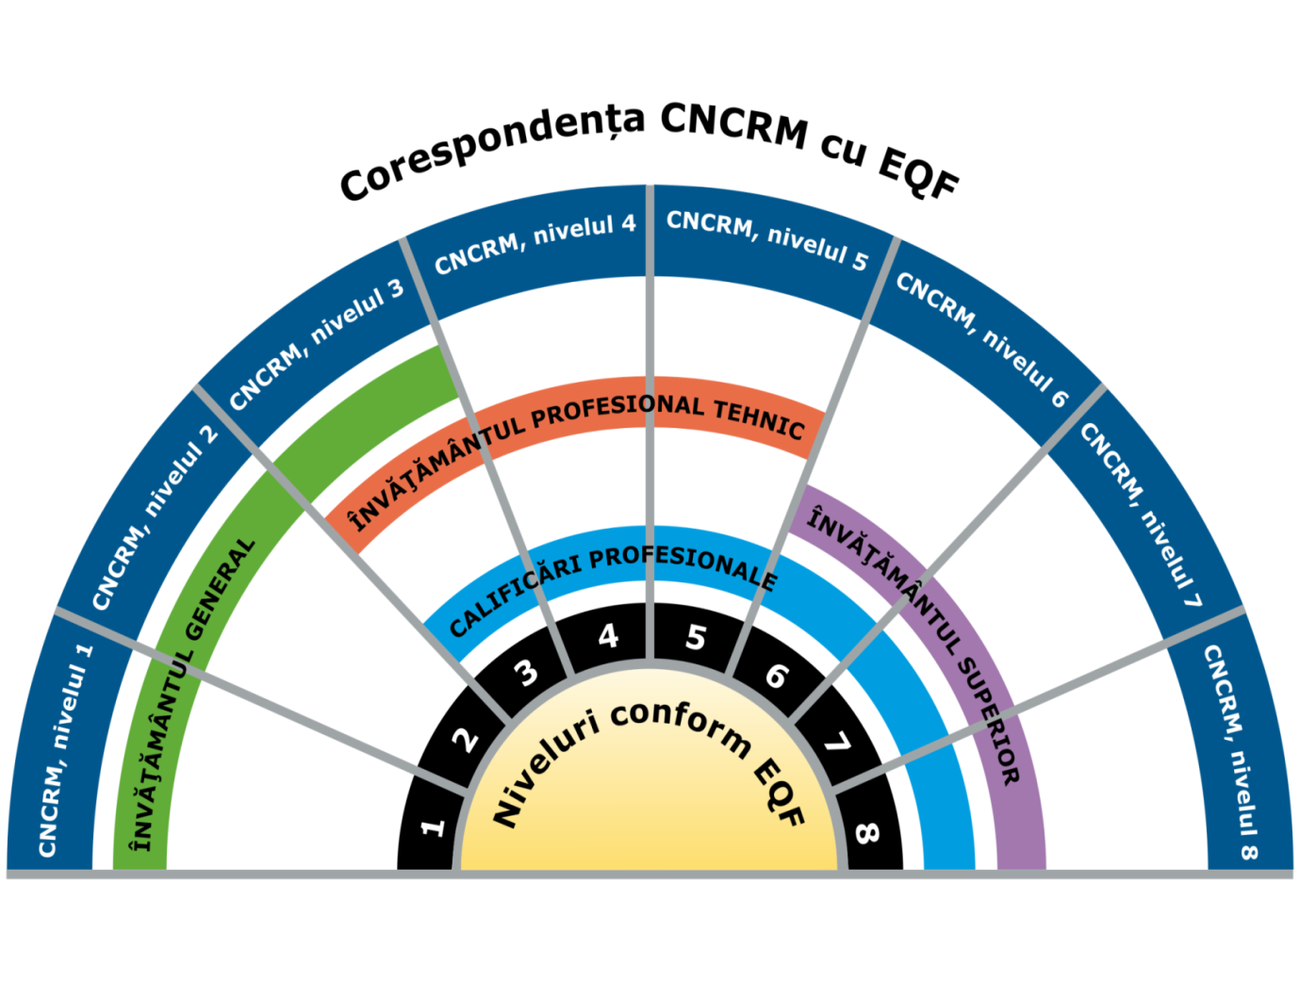
National Qualifications Framework of the Republic of Moldova
GD no.1016/26.11.2017

Slide 4
NQF Department – main activities:
Develop the National Qualifications Framework in Moldova in line with the EQF LLL;
Implement and ensure the functionality of the National Register of Qualifications in technical and higher education;
Monitoring the CNC implementation by training institutions;
Responsible for the process of authentication, recognition and equivalence of study papers and qualifications obtained in the national education system and abroad;
ENIC-NARIC National Center.

Slide 5
Achievements
National Qualifications Framework of the Republic of Moldova, GD no. 1016/2017;r
National Council for Qualifications;
Methodology for the development, revision and validation of qualification standards;
40 qualification standards for the fields of Education, ICT and Health
Training and certification NQF experts - 3 training sessions with ETF support;
GD 1199/2018 Approval of the National Qualifications Register: NRQ Technical Concept, NRQ Structure and NRQ Functioning Regulations;
Equivalence of qualifications obtained in the education and training system up to the RM NQF approval, CD no. 1167/2018;
It was approved by GD no. 1167/2018 Annex 3 to the NQF - access to studies, professional careers, recognition and employability;
Dissemination of information with reference to NQF - 5 republican seminars and 7 workshops;
The normative framework for carrying out the process of authentication, recognition and equivalence of study papers and qualifications and
ENIC-NARIC network - information related to the national education system and cooperation with Member States.

Slide 6
National Register of Qualifications
National Register of Qualifications, significantly
increases the transparency of the qualifications system in the country.
It will be used by different target groups:
Individuals: learners, unemployed, employees
Employers
Educational institutions
Career counsellors
Recognition bodies
http://lex.justice.md/viewdoc.php?action=view&view=doc&id=378836&lang=1

Slide 7
The Government Decision no. 1199/2018
Structure of NRQ and the Regulation regarding the NRQ
The Technical concept of the NRQ

Slide 8
Development of Database
2016-2017
Online platform Register for the VET qualificatins
2018
Developted:
- the Technical concept of the NRQ - Regulation regarding the NRQ
- Structure of the NRQ
2019
- Developted the ToR for the SIA NRQ
- Implemented the NRQ

Slide 9

Informational Management System in Education (for the general education)
http://sime.md/

Slide 10

National Portal for VET
http://www.ipt.md/
http://ipt.md/ro/produse-educationale

Slide 11


Database about students
https://ctice.md/verif/
http://ctice.md/

Slide 12
NRQ STRUCTURE
General Data
Title of qualification
Labor market / professional training connection
Typical occupations on the labor market identified by the CORM Code
Description of qualification by learning outcomes
Knowledge
Professional training field
Qualification code
NQF level
Study / training programs identified by the Nomenclature Code
Professional Skills
Responsibility and autonomy
Relevant Qualification Information
Admission requirements
Credit points or estimated workload to achieve learning outcomes
Diploma/ Certificate of qualification and supplement of the study document
Other information
Competent Authority for the qualification
Information on training providers
Date of registration / updating / expiry of the qualification

Slide 13
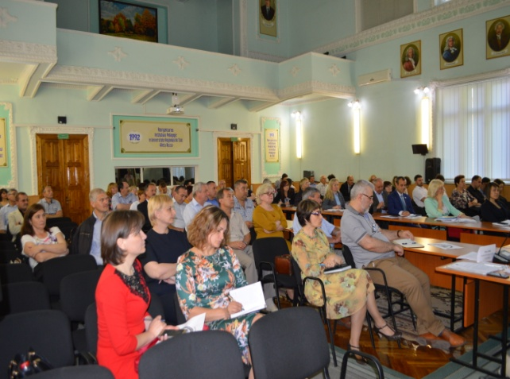
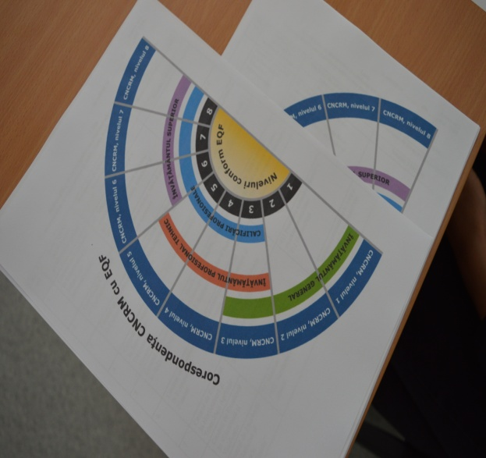
Description of the qualification
- Name of Q
- Type of Q
- Category of Q
- Duration
- Credits
- Admission requirements
- ISCED field
- NQF level
- Learning outcomes
- Assessment procedure
- Providers
- Possibility of progression to further education

Slide 14


Register kvalifikacij SOK
www.nok.si
It is connected by
EOK portalom
http://www.npk.si/npk-katalogi/

Slide 15
The role of the social partners in the development of the NRQ
Social partners – take part in the elaboration, consultation, approval of the normative framework for the development of NQR
The line ministries/autorities - coordinate the tehnical norm and consept of the NRQ
Educational Institutions – will participate in the development, review and implementation of the qualification standards, will updated the curricula conform to NQF provisions.

Slide 16
Priorities 2019 -2022
National Register of Qualifications - implementation, assurance of functionality and recording all accredited programs by 2021
Elaboration of the normative framework for the development of RM NQF, including recommendations of the European Commission
Developing qualification standards based on learning outcomes aligned with levels NQF
Implementation mechanisms for recognition and validation of skills acquired in non-formal and informal learning context
Self-certification – NQF compatibility with EQF - Report / european best practices.

Slide 17
Thank you for your atTention
www.mecc.gov.md
calificare.edu.md@gmail.com

