Slide 1
THE use of occupational standards in partner countries, the EU and internationally some lessons learned for Azerbaijan
Arjen DEIJ
BAKU 6 OCTOBER

Slide 2

WHAT ARE OCCUPATIONAL STANDARDS?
DESCRIBING THE REQUIREMENTS FOR A AN OCCUPATION IN TERMS OF ABILITIES
Different purposes
    Classification of existing jobs (list of occupations)
    State of the art working practice (benchmark)
    Description of the professional profile associated with a qualification

Slide 3
FROM IDENTIFYING LABOUR MARKET NEEDS TO GENERATING QUALIFIED INDIVIDUALS
THE ROLE OF STANDARDS

Slide 4
WHAT TO LEARN
HOW TO LEARN
Jobs
Occupational
standards
Qualification
standards
Education
standards
Curricula
Students
Notes:
4

Slide 5
WHAT TO LEARN
HOW TO LEARN
DEFINE NEEDS FOR EVERY SINGLE JOB
Jobs
Occupational
standards
Qualification
standards
Education
standards
Curricula
Students
Notes:
5

Slide 6
WHAT TO LEARN
HOW TO LEARN
DEFINE NEEDS PER OCCUPATION
Jobs
Occupational
standards
Qualification
standards
Education
standards
Curricula
Students
Notes:
6

Slide 7
WHAT TO LEARN
DEFINE NEEDS FOR ASSESSMENT/
CERTIFICATION
HOW TO LEARN
Jobs
Occupational
standards
Qualification
standards
Education
standards
Curricula
Students
Notes:
7

Slide 8
WHAT TO LEARN
HOW TO LEARN
Jobs
Occupational
standards
Qualification
standards
Education
standards
Curricula
Students
DEFINE A NATIONALLY HARMONISED CURRICULUM
Notes:
8

Slide 9
WHAT TO LEARN
HOW TO LEARN
Jobs
Occupational
standards
Qualification
standards
Education
standards
Curricula
Students
DEFINE THE CURRICULUM FOR EACH PROVIDER
Notes:
9

Slide 10
WHAT TO LEARN
HOW TO LEARN
Jobs
Occupational
standards
Qualification
standards
Education
standards
Curricula
Students
DEFINE AN INDIVIDUALISED PROGRAMME FOR EACH STUDENT
Notes:
10

Slide 11
THE QUALIFICATION CYCLE

Slide 12
1
2
3
4
IDENTIFY SKILL NEEDS
DEFINE COMPETENCES/ LEARNING OUTCOMES
GATHER FEEDBACK
ABOUT THE COMPETENCES/ QUALIFICATIONS OBTAINED
USE LEARNING OUTCOMES FOR LEARNING, ASSESSMENT AND CERTIFICATION

Slide 13



Labour Market
developing qualifications

Slide 14

Labour Market
Anticipation of skill needs
developing qualifications

Slide 15

Labour Market
Anticipation of skill needs
OS1
OS2
OS3
developing qualifications
OS1-2-3* = Occupational standards

Slide 16
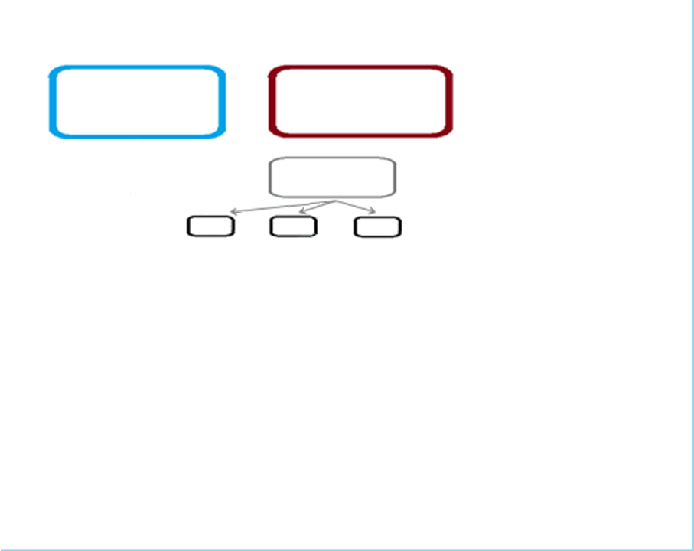
Education policy objectives
Labour Market
Anticipation of skill needs
OS1
OS2
OS3
developing qualifications

Slide 17
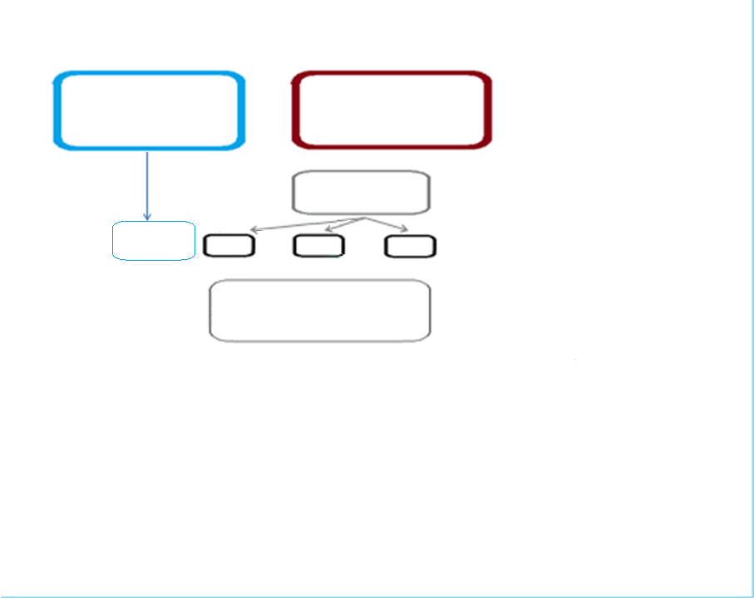
Education policy objectives
Labour Market
Anticipation of skill needs
Access and progression
OS1
OS2
OS3
Qualification Types
developing qualifications

Slide 18
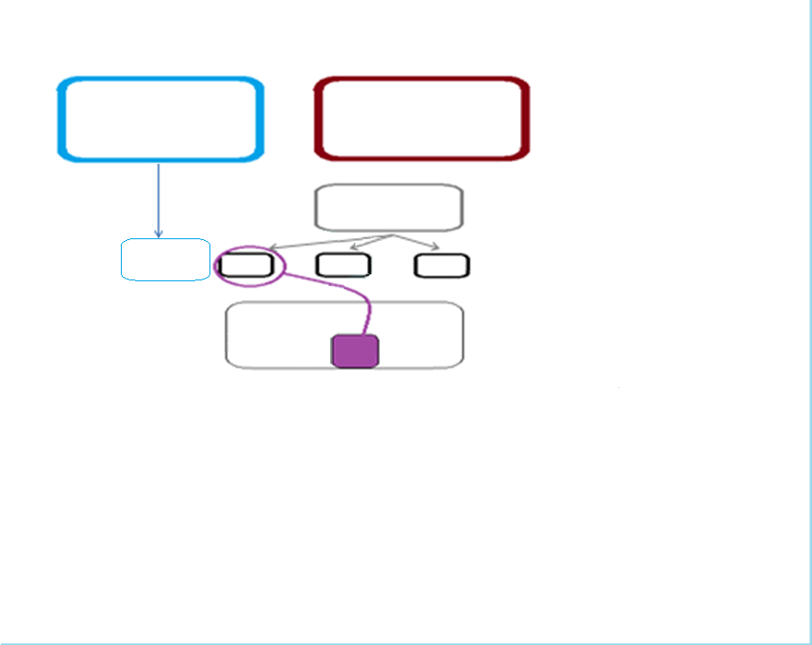
Education policy objectives
Labour Market
Anticipation of skill needs
Access and progression
OS1
OS2
OS3
Qualification Types
CBQ
developing qualifications
CBQ* - Competency based qualification directly developed from the professional competences in the Occupational Standard 1:1

Slide 19
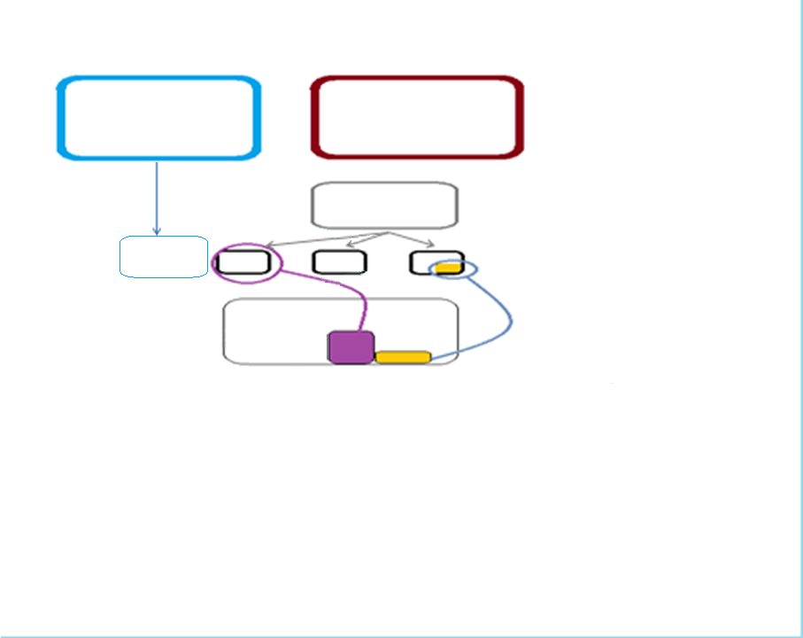
Education policy objectives
Labour Market
Anticipation of skill needs
Access and progression
OS1
OS2
OS3
Qualification Types
CBQ
Spec. Cert
developing qualifications

Slide 20
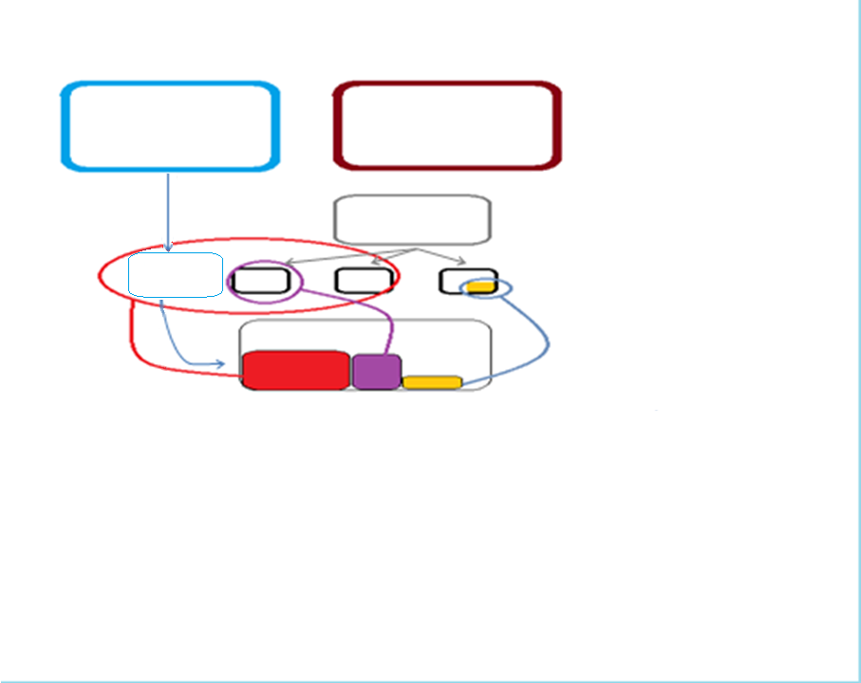
Education policy objectives
Labour Market
Anticipation of skill needs
Access and progression
OS1
OS2
OS3
Qualification Types
2ndary VET qualification
CBQ
Spec. Cert
developing qualifications

Slide 21
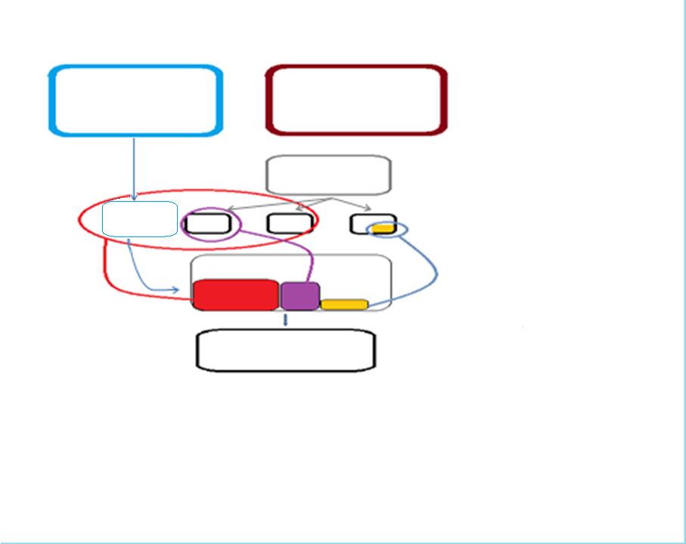
Education policy objectives
Labour Market
Anticipation of skill needs
Access and progression
OS1
OS2
OS3
Qualification Types
2ndary VET qualification
CBQ
Spec. Cert
developing qualifications
Qualification Standard

Slide 22
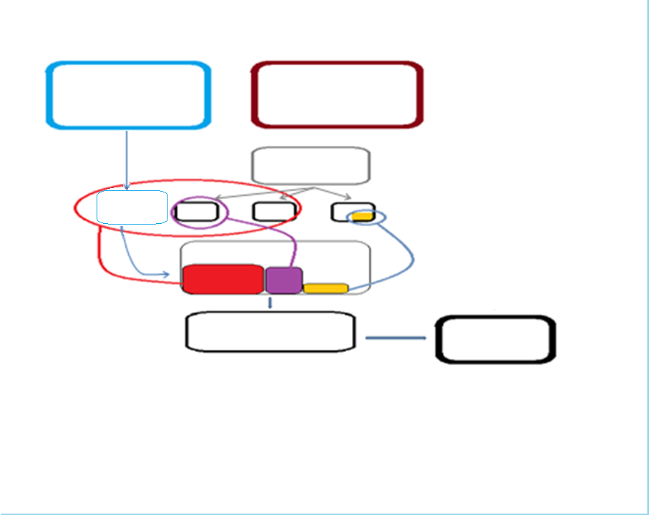
Education policy objectives
Labour Market
Anticipation of skill needs
Access and progression
OS1
OS2
OS3
Qualification Types
2ndary VET qualification
CBQ
Spec. Cert
developing qualifications
Qualification Standard
Final assessment

Slide 23
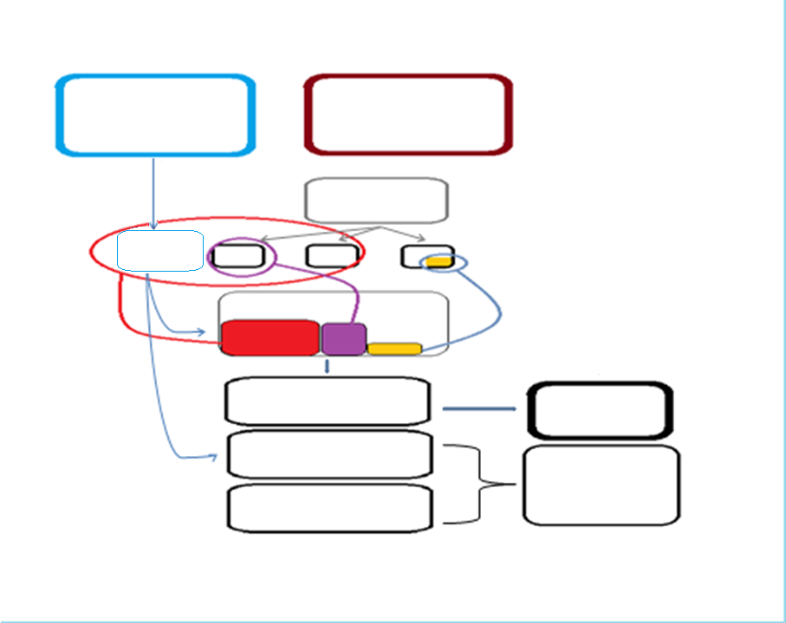
Education policy objectives
Labour Market
Anticipation of skill needs
Access and progression
OS1
OS2
OS3
Qualification Types
2ndary VET qualification
CBQ
Spec. Cert
developing qualifications
Qualification Standard
Final assessment
Educational standard
Core curriculum
Taught curriculum
School curriculum

Slide 24
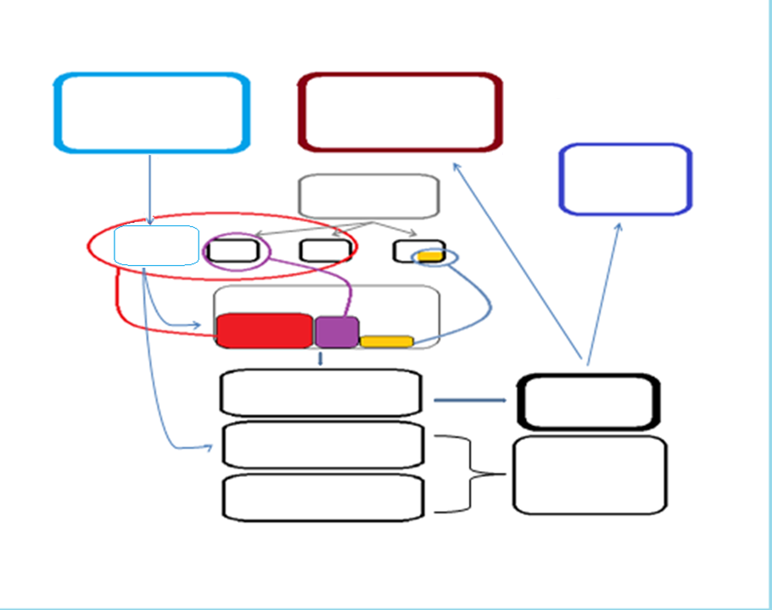
Education policy objectives
Labour Market
Further learning
Anticipation of skill needs
Access and progression
OS1
OS2
OS3
Qualification Types
2ndary VET qualification
CBQ
Spec. Cert
developing qualifications
Qualification Standard
Final assessment
Educational standard
Core curriculum
Taught curriculum
School curriculum

Slide 25
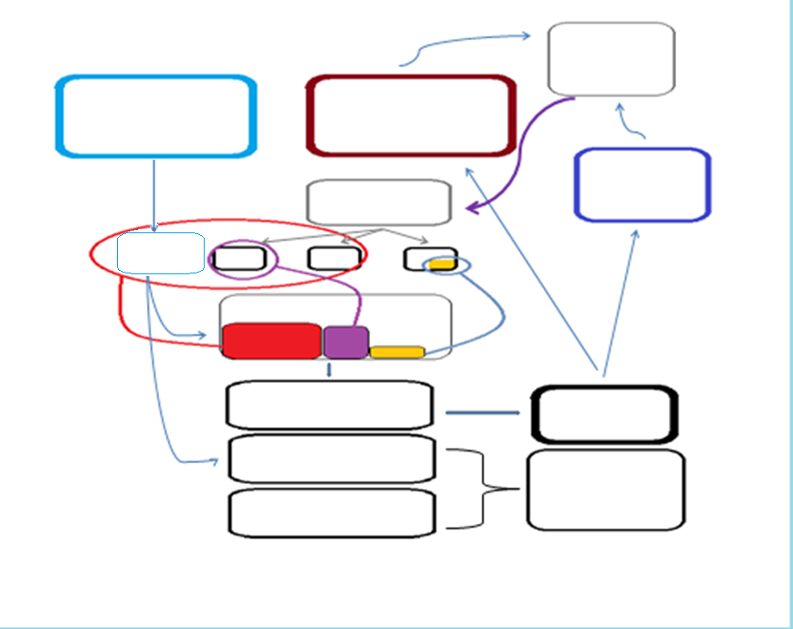
Feedback from and about graduates
Education policy objectives
Labour Market
Further learning
Anticipation of skill needs
Access and progression
OS1
OS2
OS3
Qualification Types
2ndary VET qualification
CBQ
Spec. Cert
developing qualifications
Qualification Standard
Final assessment
Educational standard
Core curriculum
Taught curriculum
School curriculum

Slide 26
OCCUPATIONAL ANALYSIS

Slide 29
OCCUPATION-SPECIFIC & TRANSVERSAL COMPETENCES

Slide 30

application of knowledge | health and safety |  | follow safety precautions in work practices
 | ICT technology | content-creation with ICT software | use personal organization software
 |  | digital communication data processing ICT safety | use e-services use online communication tools search for information online use databases safeguard online privacy and identity
 |  | problem-solving | carry out practical tasks with smart devices
 | numeracy/mathematics |  | carry out work-related measurements work with shape and space
 | working environment |  | apply quality standards support company plan
attitudes and values | attitudes |  | attend to quality cope with pressure meet commitments
 | values |  | follow ethical code of conduct
language |  |  | mother tongue
social interaction |  |  | accept constructive criticism instruct others negotiate compromise work in teams
thinking |  |  | develop strategy to solve problems evaluate information make decisions recognise opportunities
Work organization and management | inspect construction supplies work in a construction team follow health and safety procedures in construction
Interpretation of Drawings | interpret 2D and 3D plans
Setting out and measurement | build scaffolding
Construction | mix concrete lay bricks apply damp & waterproofing membranes fill up mortar joints
Finishing and presentation | Finish joints keep records of work progress maintain equipment

Slide 31
application of knowledge | health and safety |  | follow safety precautions in work practices
 | ICT technology | content-creation with ICT software | use personal organization software
 |  | digital communication data processing ICT safety | use e-services use online communication tools search for information online use databases safeguard online privacy and identity
 |  | problem-solving | carry out practical tasks with smart devices
 | numeracy/mathematics |  | carry out work-related measurements work with shape and space
 | working environment |  | apply quality standards support company plan
attitudes and values | attitudes |  | attend to quality cope with pressure meet commitments
 | values |  | follow ethical code of conduct
language |  |  | mother tongue
social interaction |  |  | accept constructive criticism instruct others negotiate compromise work in teams
thinking |  |  | develop strategy to solve problems evaluate information make decisions recognise opportunities
Work organization and management | inspect construction supplies work in a construction team follow health and safety procedures in construction
Interpretation of Drawings | interpret 2D and 3D plans
Setting out and measurement | build scaffolding
Construction | mix concrete lay bricks apply damp & waterproofing membranes fill up mortar joints
Finishing and presentation | Finish joints keep records of work progress maintain equipment

Slide 32
application of knowledge | health and safety |  | follow safety precautions in work practices
 | ICT technology | content-creation with ICT software | use personal organization software
 |  | digital communication data processing ICT safety | use e-services use online communication tools search for information online use databases safeguard online privacy and identity
 |  | problem-solving | carry out practical tasks with smart devices
 | numeracy/mathematics |  | carry out work-related measurements work with shape and space
 | working environment |  | apply quality standards support company plan
attitudes and values | attitudes |  | attend to quality cope with pressure meet commitments
 | values |  | follow ethical code of conduct
language |  |  | mother tongue
social interaction |  |  | accept constructive criticism instruct others negotiate compromise work in teams
thinking |  |  | develop strategy to solve problems evaluate information make decisions recognise opportunities
Work organization and management | inspect construction supplies work in a construction team follow health and safety procedures in construction
Interpretation of Drawings | interpret 2D and 3D plans
Setting out and measurement | build scaffolding
Construction | mix concrete lay bricks apply damp & waterproofing membranes fill up mortar joints
Finishing and presentation | Finish joints keep records of work progress maintain equipment

Slide 33
application of knowledge | health and safety |  | follow safety precautions in work practices
 | ICT technology | content-creation with ICT software | use personal organization software
 |  | digital communication data processing ICT safety | use e-services use online communication tools search for information online use databases safeguard online privacy and identity
 |  | problem-solving | carry out practical tasks with smart devices
 | numeracy/mathematics |  | carry out work-related measurements work with shape and space
 | working environment |  | apply quality standards support company plan
attitudes and values | attitudes |  | attend to quality cope with pressure meet commitments
 | values |  | follow ethical code of conduct
language |  |  | mother tongue
social interaction |  |  | accept constructive criticism instruct others negotiate compromise work in teams
thinking |  |  | develop strategy to solve problems evaluate information make decisions recognise opportunities
Work organization and management | inspect construction supplies work in a construction team follow health and safety procedures in construction
Interpretation of Drawings | interpret 2D and 3D plans
Setting out and measurement | build scaffolding
Construction | mix concrete lay bricks apply damp & waterproofing membranes fill up mortar joints
Finishing and presentation | Finish joints keep records of work progress maintain equipment

Slide 34
application of knowledge | health and safety |  | follow safety precautions in work practices
 | ICT technology | content-creation with ICT software | use personal organization software
 |  | digital communication data processing ICT safety | use e-services use online communication tools search for information online use databases safeguard online privacy and identity
 |  | problem-solving | carry out practical tasks with smart devices
 | numeracy/mathematics |  | carry out work-related measurements work with shape and space
 | working environment |  | apply quality standards support company plan
attitudes and values | attitudes |  | attend to quality cope with pressure meet commitments
 | values |  | follow ethical code of conduct
language |  |  | mother tongue
social interaction |  |  | accept constructive criticism instruct others negotiate compromise work in teams
thinking |  |  | develop strategy to solve problems evaluate information make decisions recognise opportunities
Work organization and management | inspect construction supplies work in a construction team follow health and safety procedures in construction
Interpretation of Drawings | interpret 2D and 3D plans
Setting out and measurement | build scaffolding
Construction | mix concrete lay bricks apply damp & waterproofing membranes fill up mortar joints
Finishing and presentation | Finish joints keep records of work progress maintain equipment
TRANSVERSAL SKILLS
JOB-SPECIFIC SKILLS

Slide 35
ON-LINE DATABASES FOR
COMPARING OCCUPATIONAL STANDARDS

Slide 36
DATABASES OF OCCUPATIONAL STANDARDS
USA: O*NET Canada: Red Seal-Sceau rouge Mexico: Estándares de Competencia
UK: UKCES Turkey: Ulusal Meslek Standartları France: ROME Italy: ISFOL, Professioni
Germany: Berufenet Switzerland: Anforderungsprofile
Russia: Национальный реестр профессиональных стандартов
Ukraine: Репозитарій професійних кваліфікацій
Kazakhstan: Проекты профессиональных стандартов «Атамекен»
Estonia: Kutseregister Slovenia Poklicni standard
Hong Kong List of Specification of Competency Standards
International ESCO WorldSkills innovativeapprenticeship
search also for sustainable professionalisation-professionnalisation durable
Not all countries publish their occupational standards in a single register /database
Azerbaijan/ Republic of Moldova / Netherlands
NOTE THAT MANY COUNTRIES HAVE A DATABASES OF QUALIFICATIONS RATHER THAN OCCUPATIONAL STANDARDS

Slide 37
Conclusions
Occupational standards ≠ qualifications
All countries have qualifications
Not all countries have occupational standards
Occupational standards can be useful for identifying labour market requirements with representatives from the world of work
It is also useful to compare your standards with those of other countries, many databases are existing
The breadth, depth and level of standards vary according to their contexts, so it is important to validate standards with potential users
Developing standards require considerable efforts, we must make sure that they are used. They should be user-friendly used and accessible to users

