Slide 1

REVERSE ENGINEERING QUALIFICATION SYSTEMS
THE EFFECTS FOR LEARNING

Slide 2

New ETF toolkit

Slide 3

How to improve benefits from skills and qualifications?

Slide 4



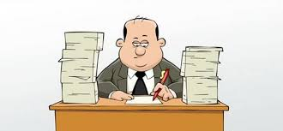
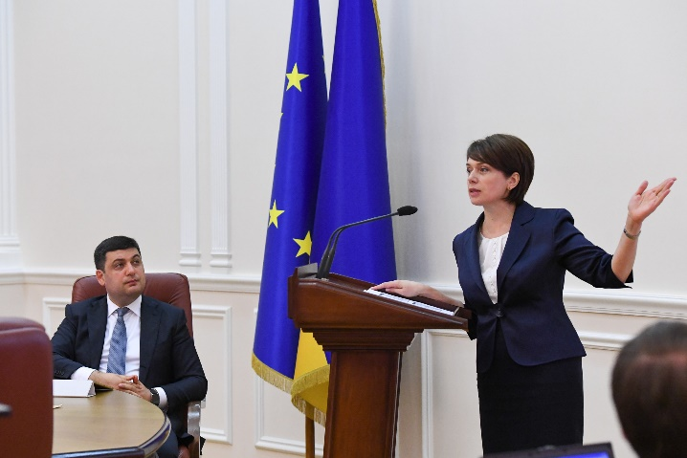
Final Beneficiaries
A TOOLKIT FOR WHOM?
actors and decisionmakers

Slide 5
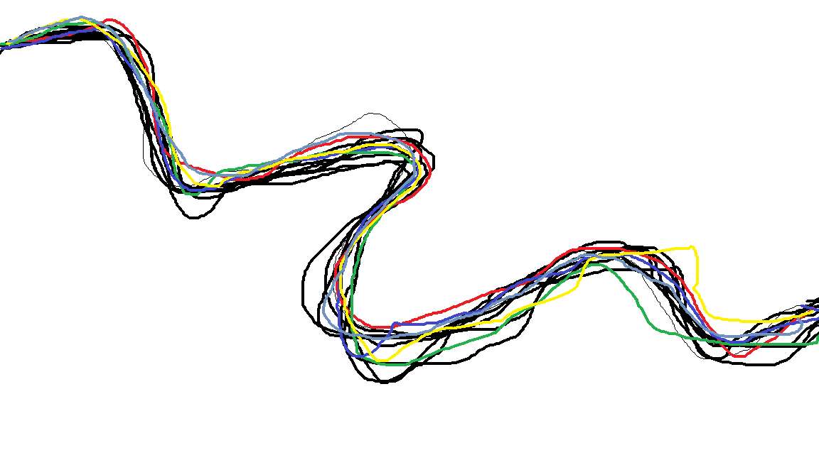
Rational How to improve benefits from skills & quals
Where to find what skills & quals generate benefits
What benefits can be obtained of skills & quals?
How to measure that benefits are achieved
How to develop & acquire these skills & quals
Recommendations

Slide 6
Rational How to improve benefits from skills & quals
Where to find what skills & quals generate benefits
What benefits can be obtained of skills & quals?
How to measure that benefits are achieved
How to develop & acquire these skills & quals
Recommendations

Slide 7
Rational How to improve benefits from skills & quals
Where to find what skills & quals generate benefits
What benefits can be obtained of skills & quals?
How to measure that benefits are achieved
How to develop & acquire these skills & quals
Recommendations

Slide 8

HOW TO DEVELOP AND ACQUIRE SKILLS AND QUALIFICATIONS?
What we already know:
Lifelong learning
Learning outcomes
Knowledge, skills and competences
Key competences, transversal skills, occupational specific skills

Slide 9
HOW TO DEVELOP AND ACQUIRE SKILLS AND QUALIFICATIONS?
What we already know:
Competency-based approach and modules
Learner-oriented approach
Informal, non-formal and formal learning
Alternative learning pathways
More learning in the workplace

Slide 10
HOW TO DEVELOP AND ACQUIRE SKILLS AND QUALIFICATIONS?
What we already know:
OCCUPATIONAL STANDARDS
EDUCATION STANDARDS
DECENTRALISED CURRICULA
What are decentralised curricula?
How will they function?

Slide 11

What we don’t know is how the future looks like?
INTERNATIONAL BACKGROUND STUDY
Trends,
Reform strategies, objectives, principles and characteristics
Analytical framework for gathering practice examples

Slide 12
INTERNATIONAL BACKGROUND STUDY
Changing Contexts and Trends
Lifelong learning is no longer just a slogan
A more important role for professionals in the workplace and in education and training
Flexible curricula

Slide 13

Teachers as a curriculum developer
Innovative pedagogy
  Experiential learning -> learning through practical experience, using cases, solving real problems, reflection on learning
STRATEGIES FOR DEVELOPING CURRICULA FOR VOCATIONAL EDUCATION AND TRAINING

Slide 14
Innovative pedagogics
  Dialogic and collaborative learning -> learning through dialogues and group work
  Blended learning -> combining face to face learning with e-learning including possibly in the workplace
STRATEGIES FOR DEVELOPING CURRICULA FOR VOCATIONAL EDUCATION AND TRAINING

Slide 15

SYSTEM AND LEARNING LEVELS FOR THE ELABORATION OF CURRICULA
System level
Networks for co-creation of new curricula
Continuing professional development
Evaluate the design and implementation of curricula

Slide 16
SYSTEM AND LEARNING LEVELS FOR THE ELABORATION OF CURRICULA
Learning level
Action- reflection cycles
Dialogue as an element of learning
Group work
Bridging the different learning environments with the help of technology

Slide 17

FOCUS ON EFFECTIVE PROFESSIONAL DEVELOPMENT OF TEACHERS
“Top down reform - a recipe for failure", it is necessary to involve teachers
Keep in mind the attitudes of teachers during different career cycles
First, change the mentality before deciding what role teachers will have, and explain to teachers how the reforms will be carried out
Develop a Theory of improvement (how to change the behaviour of teachers in order to change the learning process)

Slide 18
FOCUS ON EFFECTIVE PROFESSIONAL DEVELOPMENT OF TEACHERS
Link the reform process to the daily practice of teachers
Use informal and formal forms of continuous professional development
Jointly collect evidence on curriculum design - see what works

Slide 19
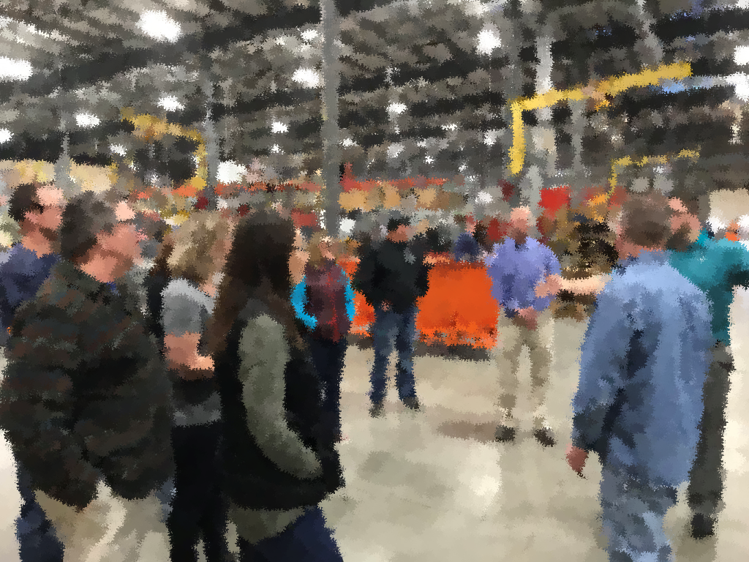
Joint development of VET curricula in regional networks (Are there examples of joint programs in regional networks)
Teachers who perform multiple roles, and cross into different learning environments (How is the role of teachers changing in the development of learning and how can this be analysed)
Establishing relationships for different learning environments through flexible curricula (development of modules, experimentation with new methods of pedagogy, mixing of groups of learners of different age groups, holding conferences for jointly designing curricula, etc.)
CAN YOU HELP US TO IDENTIFY INNOVATIVE PRACTICES?

Slide 20


