Slide 1







The quality assurance process in sectoral qualifications in Hotel and Restaurant sector : construction, assessment and recognition
3 octobre 2018

Slide 2
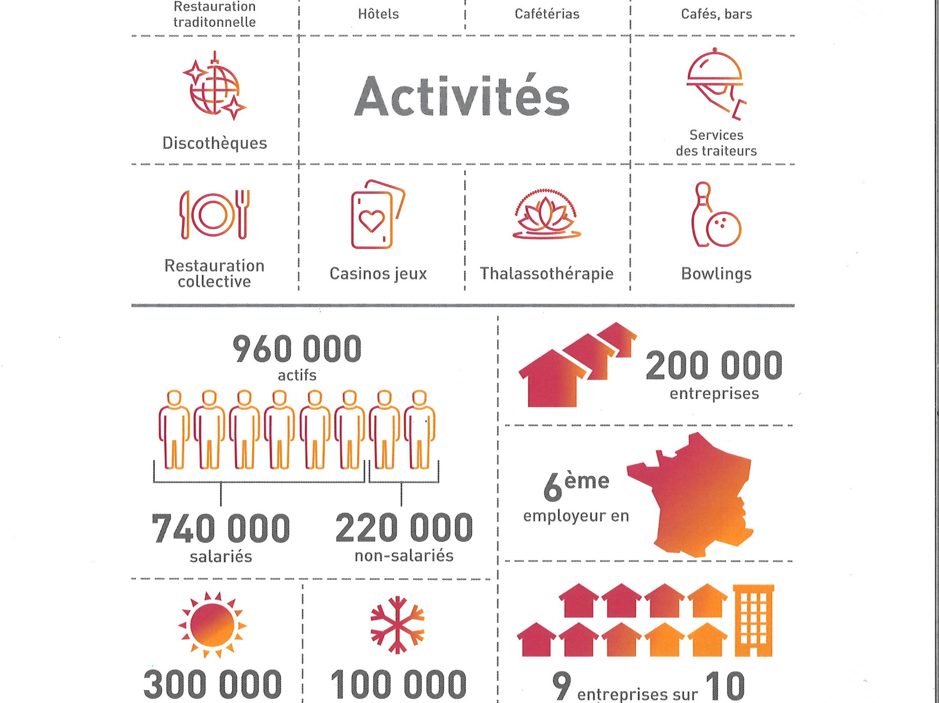
Notes:
The sector : hotels, restaurants, catering, casinos, bowlings, thalassotherapy, disco, cafés, bars
9 in 10 are very small companies
This industry is the sixth employer in France
Almost one million working people, employees and not employees
Seasonal workers in summer and winter

Slide 3

Vocational qualifications’s construction
© Fafih tous droits réservés

Slide 4













Implementation of sectoral qualifications
in hotels restaurants (CQP)
Refferal to the CPNEFP
The branch verifies the opportunity to create
a sectoral qualification (CQP)
The request and the Branch’s advice are submitted to the CPNEFP
An opportunity study is ordered
The job study is presented to the occupational national committee
Implementation of a task force
Notes:
Comment 1 :
Refferal to the National Joint Committtee Employment and Training (employers and employees : paritarism)
Paritarism joint management” “Paritarisme” is an issue of governance. It means that employers and employees representatives work together in decision-making bodies in which both parties are represented in equal numbers. The topics could be discussed at national, sectoral or regional level.
Everybody can ask for a
- an professionnal body or a trade union
- a training provider
Comment 2 :
1.Many employments concerned
2. Training needs (for first job entry)
3.Recognition of learning outcomes ( jobs)
4.No validation exists for a job. For example, we created a sectoral qualification for the pizza man and the crepe man, because in the professional qualification’s landscape, there was no recognition of these skills.

Slide 5







Implementation of sectoral qualifications
in hotels restaurants (CQP)
Presentation of the job and competency framework to the CPNEFP
Requests further information
Registration of the sectoral qualification on the occupational group list
Implementation of an experimentation
Validation of the end of the experimentation
Generalization
Request to the National Committee on Vocational Qualifications for registering on National Register of Vocational Qualifications
Notes:
Comment 3 :
- 4-8 experts in job or managing the jobs
- Presence of occupational group and trade unions (2 minimum)
- Task : describe the referentials of activity, competences and assesment
Comment 4 :
The CPNE deliberates :
- Registers the vocational qualification
Sets the access (what kind of people ; first entry in jobs, changing jobs, in jobs, changing career, people employed or not employed,…)
Sets the process of assessment and validation

Slide 6


Vocational qualifications’s assessment
© Fafih tous droits réservés

Slide 7



Assessment by Training
The candidate is at the center of the process
Training
The trainer carries out an initial assesment
Ongoing assessment by a two-person team, trainer- company tutor
Final assessment focus on core business by a assessment committee of a two-person team trainer and a professional expert
The National Professionnal Committee deliberates and delivers an opinion : favourable, unfavourable, full or partial validation,
defers its decision
Notes:
Tests are adapted to items and competences evaluated
The assessment and validation process responds to the standards for vocational qualifications :
Differents assessors for ongoing assessment and final assessment
Training providers are accredited thanks to a strong process (specifications, analysis and Certidev)
The National Occupational Committee of Certification considers the cases, controls that the process and the standards are respected
The National Occupational Committee of Certification includes 50% employers, 50% employees) et respects man woman parity, 4 people minimum.

Slide 8
Validation by Recognition of prior learning (RPL)
The candidate is at the center of the process
Recognition of prior learning (RPL)
The certification body analyses the candidate’s file then submit it to the National Professionnal Committee which deliberates
RPL guide if so
Examination of the case of validation
and professional situations focus on core business, cases study, oral interview…
carried out by a RPL committee of a two-person team trainer and a professional expert
Validation’s file and + preparation to the RPL Committe
The National Professionnal Committee deliberates and delivers an opinion : favourable, unfavourable, full or partial validation,
defers its decision

Slide 9
The Accreditation of training providers
© Fafih tous droits réservés

Slide 10

The accreditation of the training providers
The training providers accreditation’s process
Training providers must comply with strict specifications to the certification body Certidev
Certidev considers the request of accreditation and controls the training providers by visiting them
The request and Certidev’s advice are submitted to the CPNEFP which deliberates and makes a decision
The certification body Certidev notifies the training providers
In case of failure or dysfunction reported, the training provider may be audited
Notes:
If the request of the training provider is rejected, an appeal is possible with the National Professionnal Committe during a month after the advice

Slide 11


3 octobre 2018

