Slide 1
“Web Platforms for Professional Development" Piet Kommers Julian Stanley 1 Professions need Continuous Education and Training 2 The Web offers tool for Supporting VET Teachers through Learning Resources, News/Updating Collaboration

Slide 2

Communcation Platforms

Slide 3
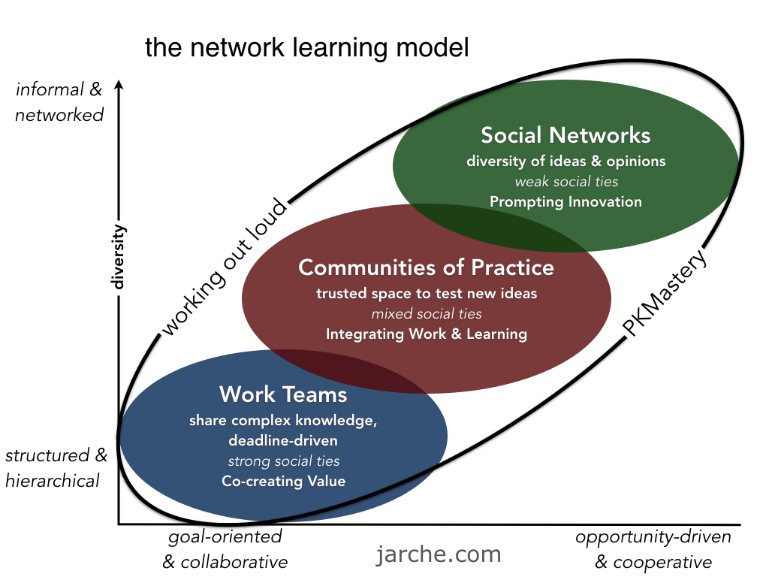

Slide 4
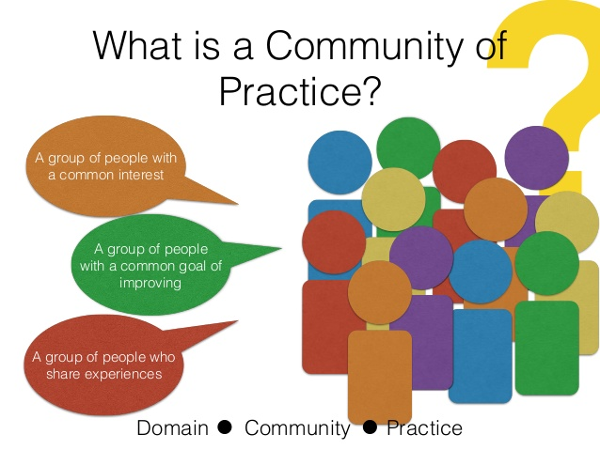
What do Virtual Platforms look like

Slide 5
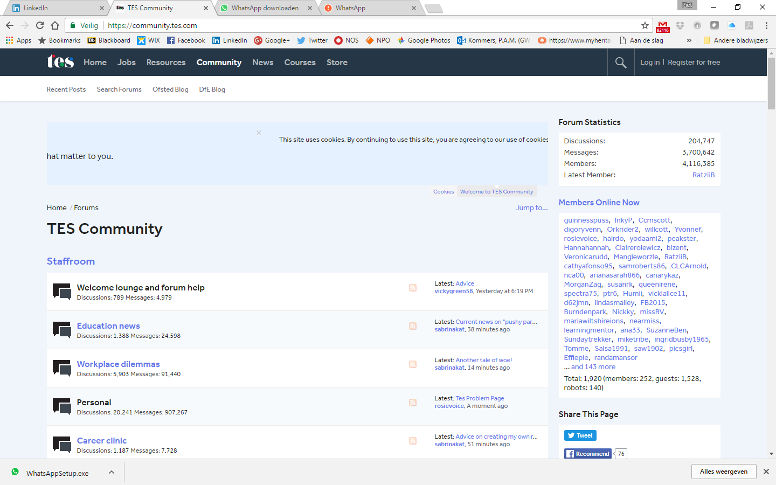

Slide 6
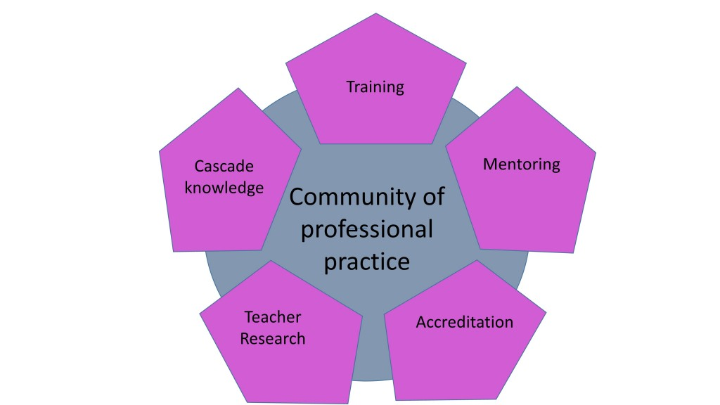
What functionalities are worth having?

Slide 7
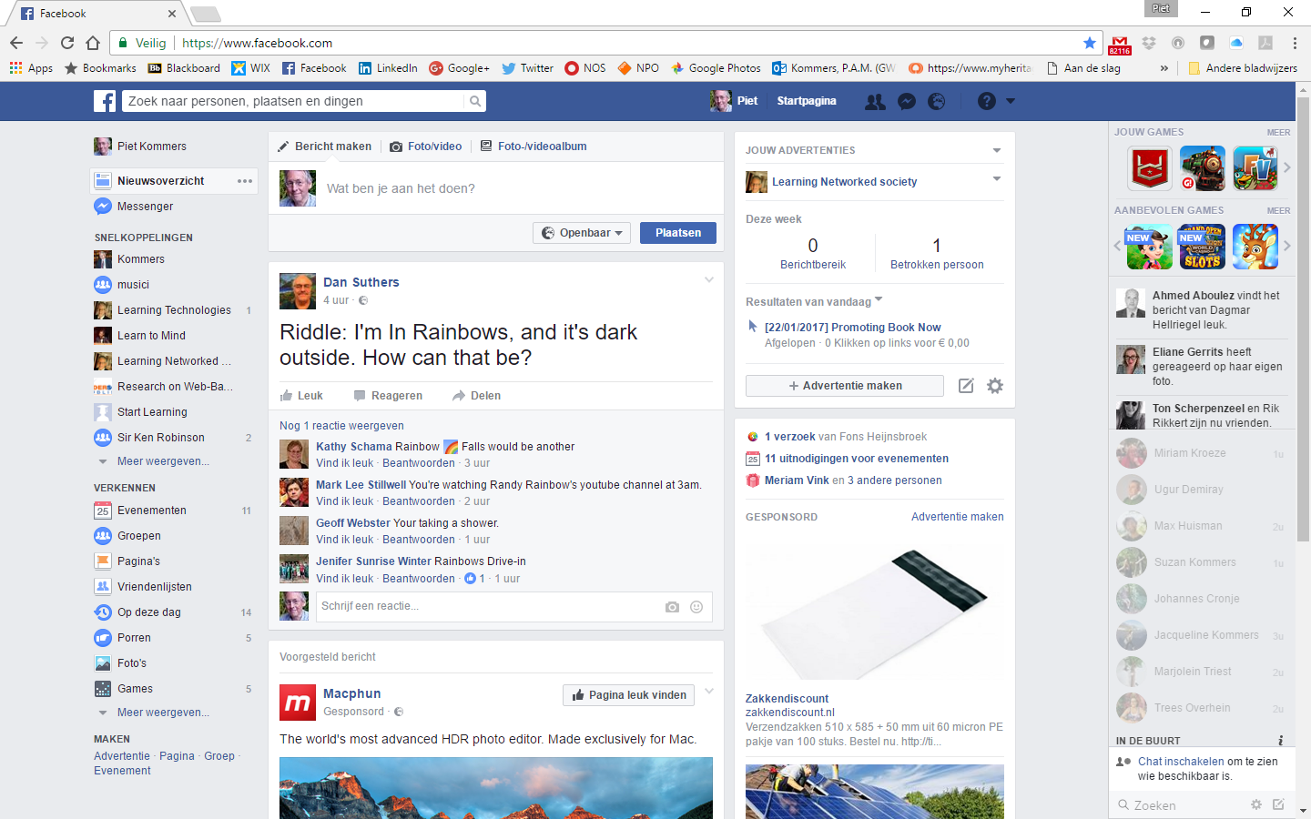
Add screen shot from whatsapp or facebook – we need to mention social media as possible tools for communications platforms

Slide 8
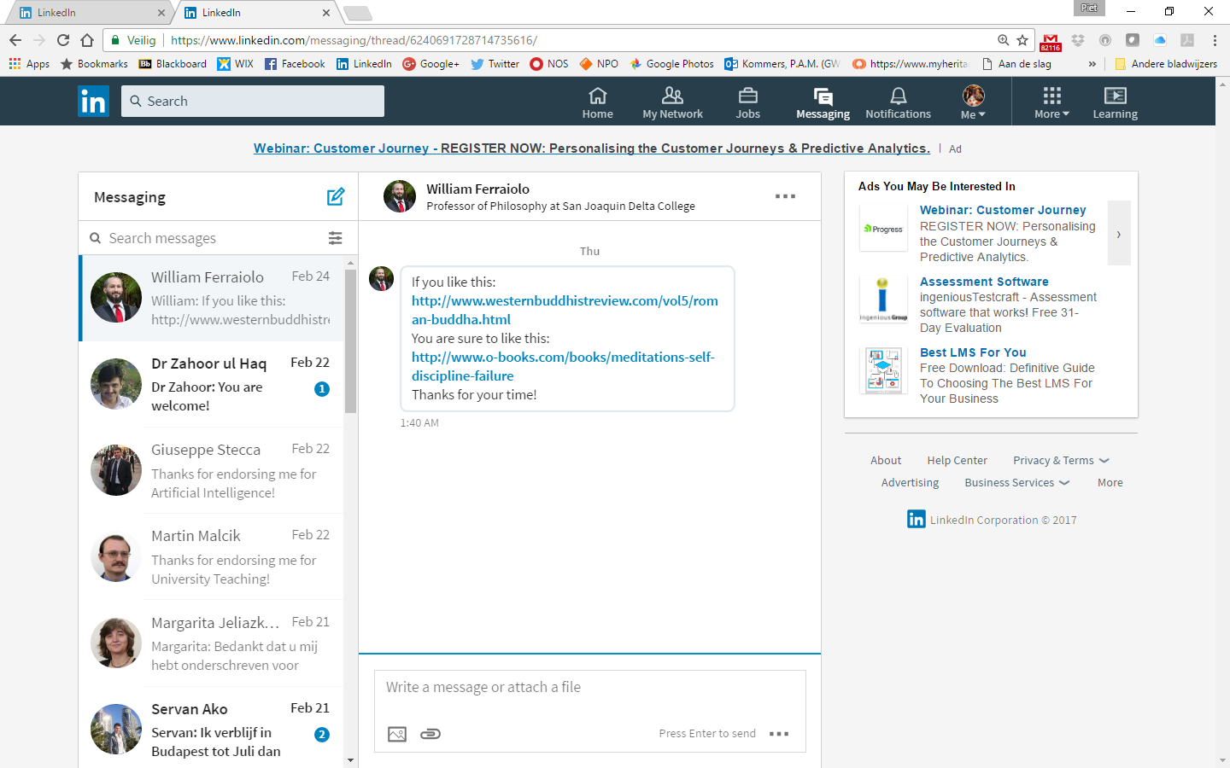
Add screen shot from whatsapp or facebook – we need to mention social media as possible tools for communications platforms

Slide 9
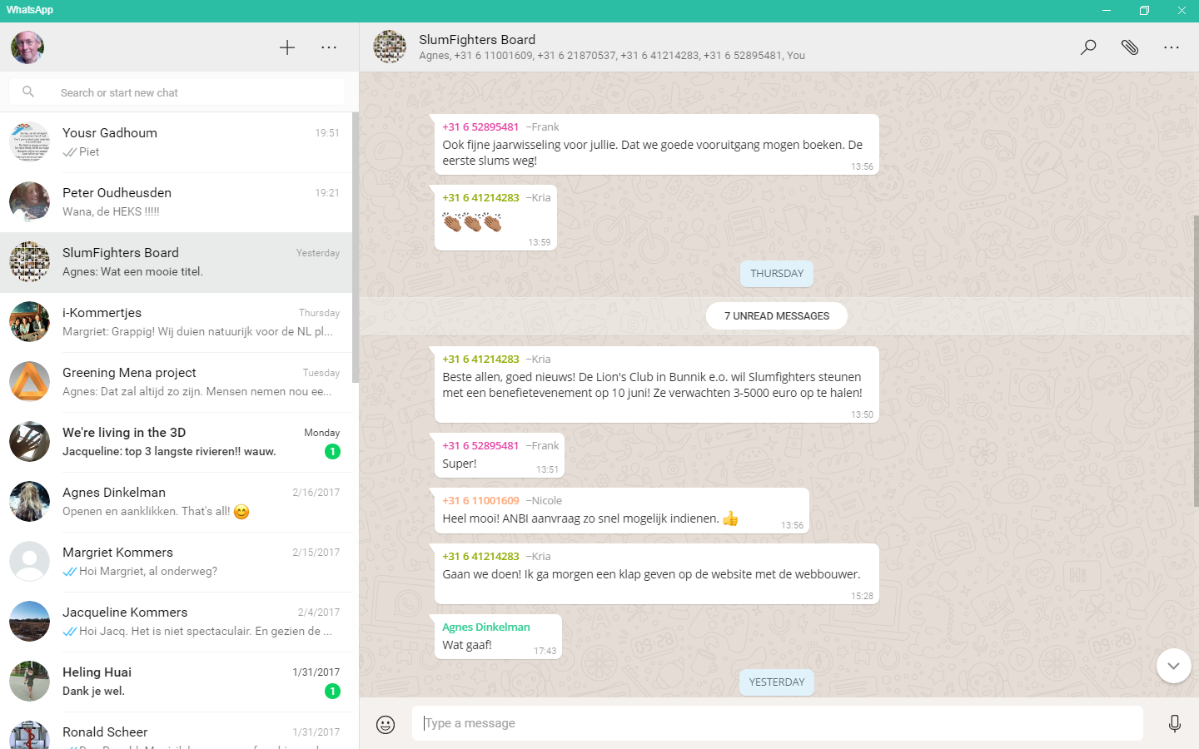
Add screen shot from whatsapp or facebook – we need to mention social media as possible tools for communications platforms

Slide 10
The main functionalities of a repository platform are:
- accumulation and archiving of materials
- upload and download of materials
- searchability
- review and ratings systems - QA
- OERs
- e-learning tools
- analytics
- market place
- commercialization

Slide 11
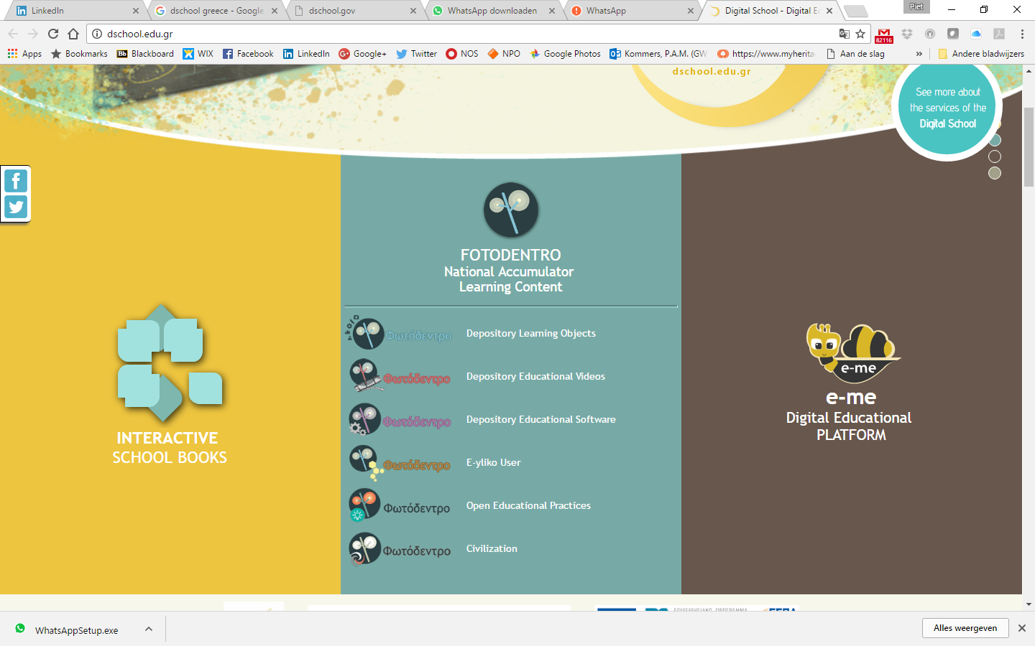
Give an example of repository DSCHOOL or TES

Slide 12
What do Virtual Platforms look like

Slide 13
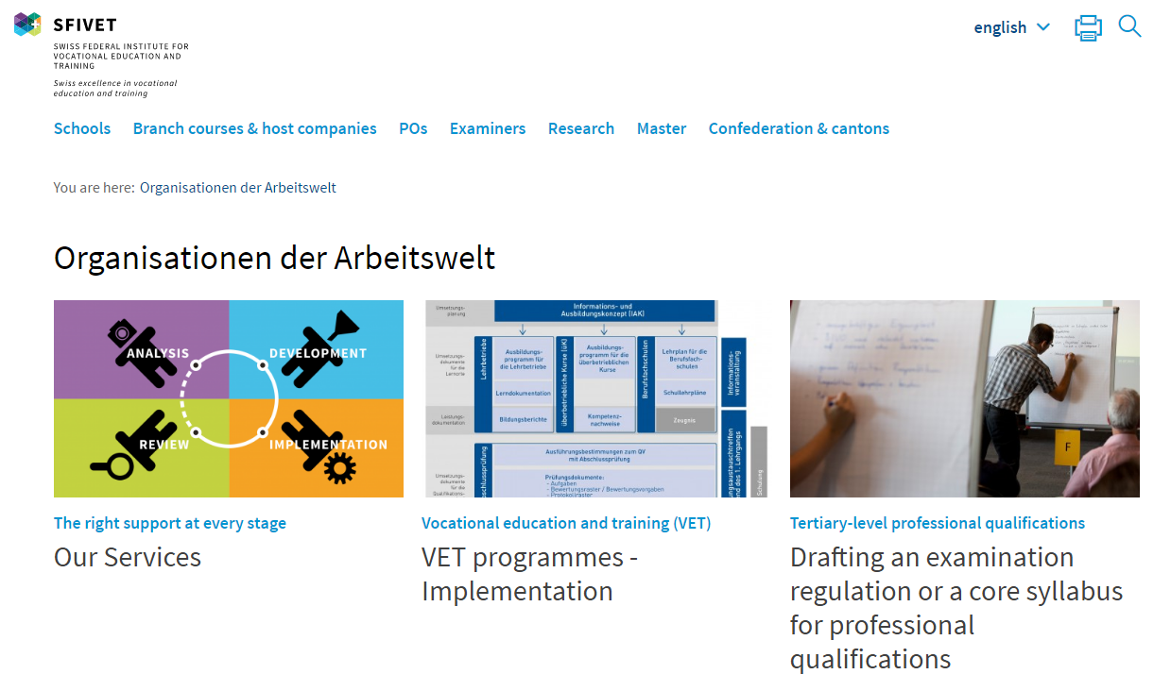
Actuality Platforms – could illustrate with screenshot official Agency page such as Swiss VET – which lists events and news…that connect to VET (I would remove slides 12 and 13 as I think they are a bit misleading – they have nothing to do with VET)

Slide 14
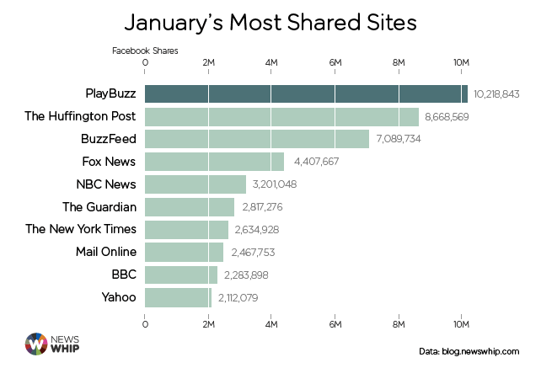
Actuality Platforms

Slide 15
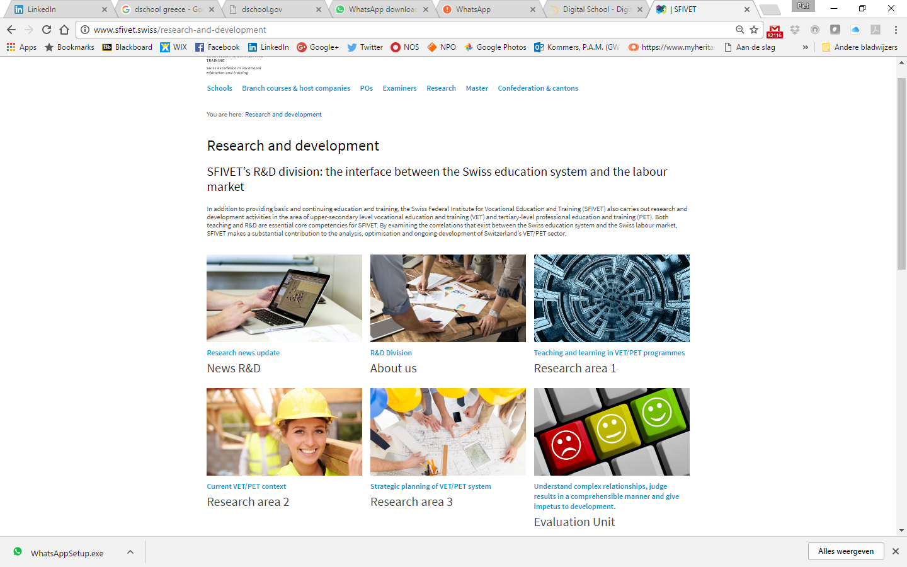
Actuality Platforms – could illustrate with screenshot official Agency page such as Swiss VET – which lists events and news…that connect to VET (I would remove slides 12 and 13 as I think they are a bit misleading – they have nothing to do with VET)

Slide 16
Teacher Platform Functionality | Direction of Initiatives | What is to be Delivered? | Please Circle how Important it looks to you
Repository | Top-Down | Long-term Lesson Materials | 1 – 2 – 3 – 4 – 5
Actuality / News | Horizontal | Last Moment Context | 1 – 2 – 3 – 4 – 5
Community | Bottom-up | Sharing and Working Together | 1 – 2 – 3 – 4 – 5

Slide 17
Advice for Designers of Web-Based Platforms
Map out what is already there and what is missing
Find out what has been successful and what has failed
Consult with stakeholders to try to agree the mix of purposes – repository, actuality and communication – this will influence choices about scale, management, technology, budget etc.
Make sure that the platform offers materials, contacts or news that teachers really want.
Design for trust – both for communication and for materials
Think about the future – how will content be renewed? What will keep teachers coming back to the site?
Make the technology serve the community and its members and their goals – not the other way around
Blend web-based platforms with face to face meetings, trainings and communities

