Slide 1

DigComp
https://ec.europa.eu/jrc/digcomp

Slide 2
What?
A competence framework
Identify and describe its key components, proficiency levels and examples
A conceptual model and proficiency levels guiding (self-) assessment
Why?
Provide an overall, complete and shared understanding of digital competences
DESI: 45% of EU population and 37% of labour force: unsufficient digital skills
Providing digital skills for all; tackling unemployment & changing nature of work
Method:
Developed by JRC
Strong scientific underpinning
Consensus building with multiple stakeholders
Updating and revising
Policy:
2006 Recommendation on Key Competences for Lifelong Learning
2016 New Skills Agenda for Europe

Slide 3
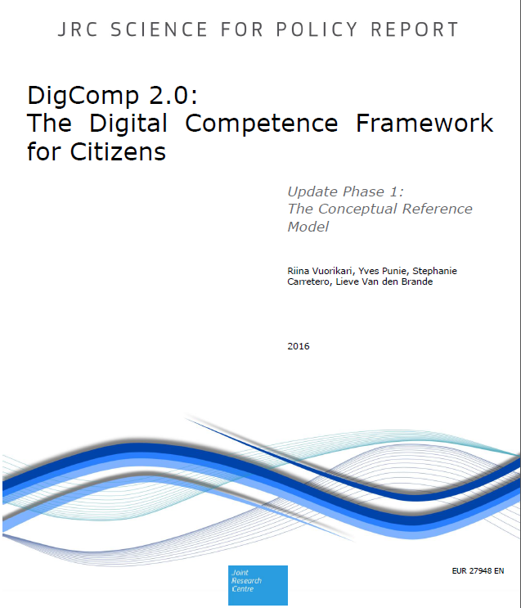
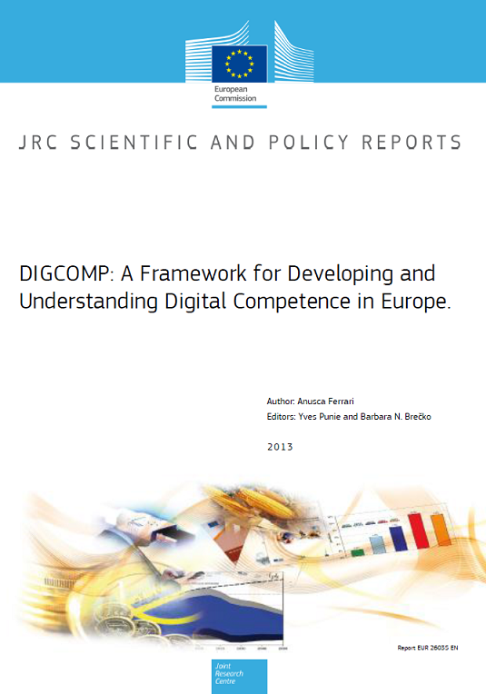
https://ec.europa.eu/jrc/en/digcomp

Slide 4
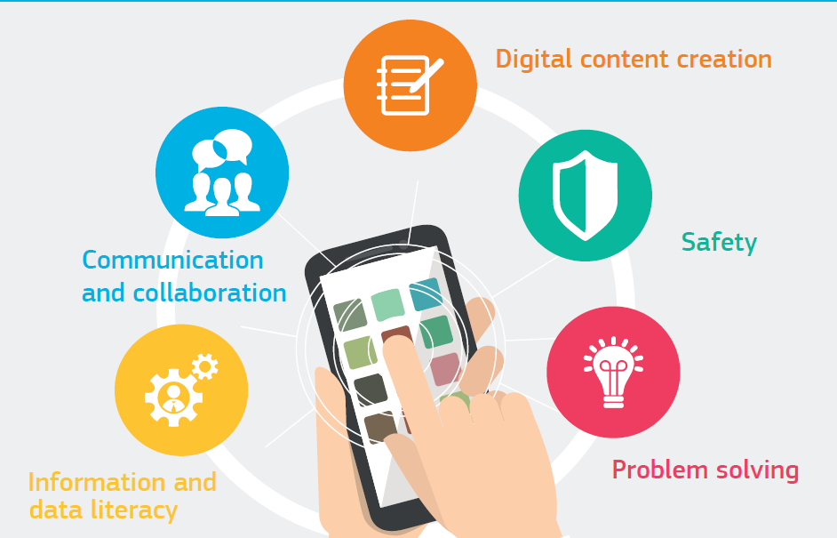

Slide 6
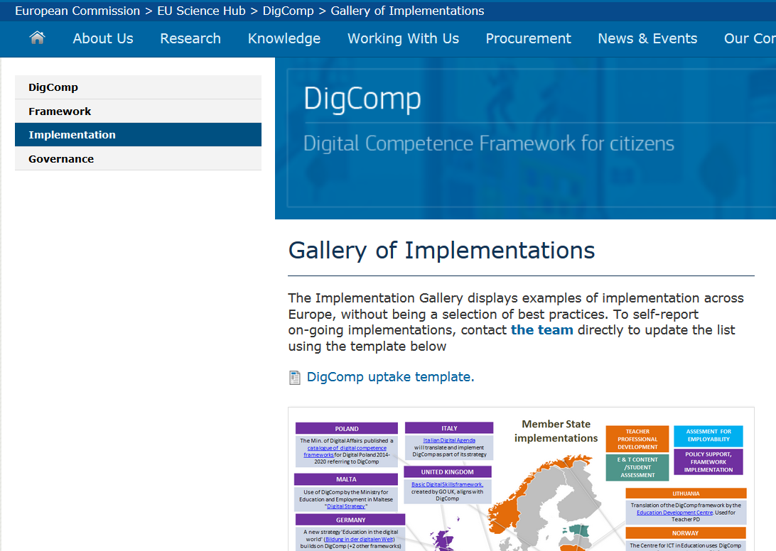
https://ec.europa.eu/jrc/en/digcomp/implementation
Report the uptake!

Slide 7
Member State implementations
Jan 2017
POLAND
The Min. of Digital Affairs published a catalogue of digital competence frameworks for Digital Poland 2014-2020 referring to DigComp
ITALY
Italian Digital Agenda will translate and implement DigComp as part of its strategy
TEACHER PROFESSIONAL DEVELOPMENT
E & T CONTENT /STUDENT ASSESSMENT
ASSESMENT FOR EMPLOYABILITY
POLICY SUPPORT, FRAMEWORK IMPLEMENTATION
UNITED KINGDOM
Basic Digital Skills framework, created by GO UK, aligns with DigComp
MALTA
Use of DigComp by the Ministry for Education and Employment in Maltese "Digital Strategy "
LITHUANIA
Translation of the DigComp framework by the Education Development Centre. Used for Teacher PD
GERMANY
A new strategy 'Education in the digital world' (Bildung in der digitalen Welt) builds on DigComp (+2 other frameworks)
NORWAY
The Centre for ICT in Education uses DigComp as a references to develop a DigComp framework for the teaching profession
NAVARRA, SPAIN
Navarra Department of Education uses DigComp as a key reference for strategic planning
SPAIN
The Min. of Education, INTEF created Common Framework for Teacher Digital Competence based on DigComp. Use agreed between State and Regional governments.
BASQUE COUNTRY, SPAIN
Ikanos project developed by the Basque Government to deploy the Digital Agenda. Free DigComp self-assessment and training
EXTREMADURA, SPAIN
Extremadura implements Teachers Digital Competence Portfolio based on DigComp
ANDALUCIA, SPAIN
"Andalucia digital" offers free DigComp self-assessment and training for job-seekers
PORTUGAL
The Min. of Education uses DigComp as an input for teachers' PD. Translation by CIDTFF, supported by the MoE
FLANDERS, BELGIUM
Dept. of Education use DigComp for a curricula review and development of adult education courses
FRANCE
PIX platform being developed by the Min. of Education to certify digital skills based on DigComp
ESTONIA
From 2017 on, all 9th graders will be evaluated using DigComp
CROATIA
e-Schools project by Croatian Academic and Research Network uses DigComp to support teachers
REBIUN, SPAIN
The Network of Spanish University Libraries (REBIUN) uses DigComp to upskill students in 76 Spanish universities
EMILIA-ROMAGNA REGION, IT
Uses DigComp to re-design courses/materials in Pane e internet, an e-inclusion initiative
POLAND
Training for certification purposes based on DigComp provided by ECCC Foundation and ECDL in Poland.
SLOVENIA
Translated by National Education Institute. DigComp used in assessing students in ICT

Slide 8
What's next?

Slide 9
May 2017
DigComp2.1: 8 proficiency levels (and examples)
DigComp 1.0 | Level in 2.1 | Complexity of tasks | Autonomy | Cognitive domain
Foundation | 1 | Simple tasks | With guidance | Remembering
 | 2 | Simple tasks | Autonomy and with guidance where needed | Remembering
Intermediate | 3 | Well-defined and routine tasks, and straightforward problems | On my own | Understanding
 | 4 | Tasks, and well-defined and non-routine problems | Independent and according to my needs | Understanding
Advanced | 5 | Different tasks and problems | Guiding others | Applying
 | 6 | Most appropriate tasks | Able to adapt to others in a complex context | Evaluating
New to 2.1 Highly-specialised | 7 | Resolve complex problems with limited solutions | Integrate to contribute to the professional practice and to guide others | Creating
 | 8 | Resolve complex problems with many interacting factors | Propose new ideas and processes to the field | Creating

Slide 10
NEW: The top line indicates the autonomy of a user. The level of responsibility increases.
The underlined verbs
are action verbs indicating the level of knowledge and skills.
New 8 levels are mapped to 3 levels from DigCom 1.0. E.g. Level 1 and 2 map to old "Foundation" level.
Information and data literacy
1.1 Browsing, searching and filtering data, information and digital content
To articulate information needs, to search for data, information and content in digital environments, to access them and to navigate between them. To create and update personal search strategies.
Proficiency levels
Level 1 | Level 2 | Level 3 | Level 4 |  | Level 5 | Level 6 |  | Level 7 | Level 8
Foundation |  | Intermediate |  |  | Advanced |  |  | Highly specialised (new)
At basic level and with guidance, I can: | At basic level and with autonomy and appropriate guidance where needed, I can: | On my own and solving straightforward problems, I can: |  | Independently, according to my own needs, and solving well-defined and non-routine problems, I can: | As well as guiding others, I can: |  | At advanced level, according to my own needs and those of others, and in complex contexts, I can: | At highly specialised level, I can: | At the most advanced and specialised level, I can:
● identify my information needs, ● find data, information and content through a simple search in digital environments, ● find how to access these data, information and content and navigate between them. ● identify simple personal search strategies. | ● identify my information needs, ● find data, information and content through a simple search in digital environments, ● find how to access these data, information and content and navigate between them. ● identify simple personal search strategies. | ● explain my information needs, ● perform well-defined and routine searches to find data, information and content in digital environments, ● explain how to access them and navigate between them. ● explain well-defined and routine personal search strategies. |  | ● illustrate information needs, ● organise the searches of data, information and content in digital environments, ● describe how to access to these data, information and content, and navigate between them. ● organise personal search strategies. | ● apply information needs, ● apply searches to obtain data, information and content in digital environments, ● show how to access to these data, information and content and navigate between them. ● propose personal information strategies. |  | ● assess information needs, ● adapt my searching strategy to find the most appropriate data, information and content in digital environments, ● explain how to access to these most appropriate data, information and content and navigate among them. ● vary personal search strategies. | ● create solutions to complex problems with limited definition, that are related to browsing, searching and filtering of data, information and digital content. ● integrate my knowledge to contribute to professional practice and knowledge and guide others in browsing, searching and filtering data, information and digital content. | ● create solutions to solve complex problems with many interacting factors, that are related to browsing, searching and filtering data, information and digital content. ● propose new ideas and processes to the field.

Slide 11
What's next? (contd.)
User guidelines: End 2017
JRC piloting, testing and validation of (self-)assessment: Mid 2018
Similar approach for Entrepreneurship Competence (EntreComp)
Stakeholder Event -12 May 2017, Brussels - *Save-the-Date*
Use and Dissemination of DigComp (and EntreComp)
Exhibition Style Session
Establishing Community around Frameworks

Slide 12

Thank you

