Slide 1
Belfast (UK)
‘Working in Partnership to Tackle the Digital Skills Gap’
PLA DSG ET 2020

Slide 2
Background
The UK, like many other EU countries, has a digital skills deficiency.
To tackle this agenda requires public, private and third sector organisation to work together.
This PLA will explore successful partnership working between the sectors to support leaners and the learner econ system.

Slide 3


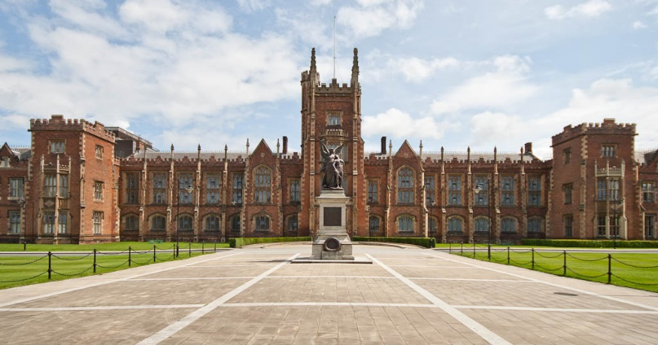
Location - Belfast
Belfast is the capital and largest city of Northern Ireland, the second largest on the island of Ireland, and the heart of the tenth largest Primary Urban Area in the United Kingdom.
Belfast was a centre of the Irish linen, tobacco processing, rope-making and shipbuilding industries: in the early 20th century, Harland and Wolff, which built the RMS Titanic, was the world's biggest and most productive shipyard.
Belfast is a safe, vibrant and lively city. Most of the attractions are within walking distance of the centre.

Slide 4
Belfast and Digital Industry
Over 100 global technology leaders have established business operations in Northern Ireland, including IBM, Intel, SAP, Fujitsu, Cybersource (VISA), BTI Systems and Rapid7.
Vibrant clusters and expertise in cyber security, financial software, mobile telecoms, network management, data analytics, payments technology and health IT.
Strong technology focus of the two universities (Queen’s University of Belfast and Ulster University), leading-edge R&D, availability of talented graduates and a competitive cost base.

Slide 5
Education in UK is Devolved
Education Policy in the UK is Devolved to the regions. This means there are differences in educational approach to digital skills across UK.
However, UK strategies have a strong influence on regional policy decision.

Slide 6
Northern Ireland Digital Skills Framework

Slide 7
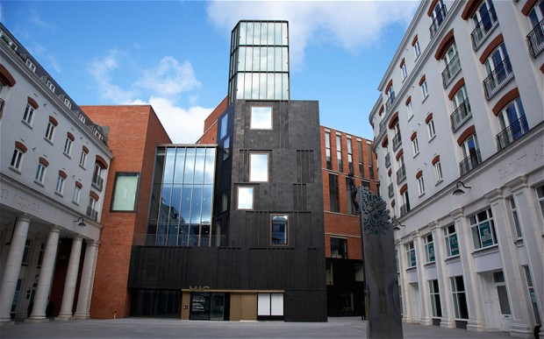

Day 1 – Conference 5th April 2017
Exploring, through case examples and discussion, projects which have involved employers and educator working collaboratively in digital skills.
Presenters from industry will explore projects in Primary, Post-Primary and Higher Education.
Local educators are invited to join the day to enhance the debate and discussion.
Conference Venue: The Mac (https://themaclive.com/ )

Slide 8
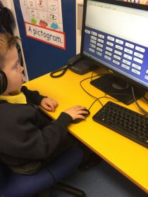
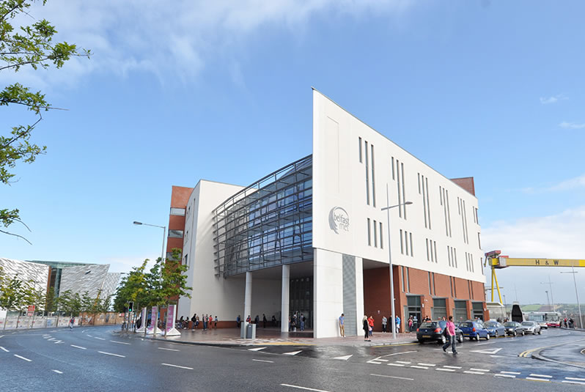

Day 2
Visiting Primary, Post-Primary and Vocational Education phases to see how employers have worked in partnership to develop digital skills.

Slide 9
Selected Accommodation in Belfast
There are three hotels near the conference venue. All provide good quality accommodation and are in walking distance of main venues.
  Ramada Encore (Closest) https://www.tripadvisor.co.uk/Hotel_Review-g186470-d1436044-Reviews-Ramada_Encore_Belfast_City_Centre-Belfast_Northern_Ireland.html
  Premier Inn (Good Value) https://www.tripadvisor.co.uk/Hotel_Review-g186470-d1202464-Reviews-Premier_Inn_Belfast_City_Cathedral_Quarter_Hotel-Belfast_Northern_Ireland.html
  Merchant Hotel (Good Reviews) https://www.tripadvisor.co.uk/Hotel_Review-g186470-d598106-Reviews-Merchant_Hotel-Belfast_Northern_Ireland.html

Slide 10
Travel - Airports
There are two airports in Belfast
  Belfast City Airport (recommended) (http://www.belfastcityairport.com/ ). Closest for travel in and out of centre.
  Belfast International Airport. Bus to city centre on regular basis.
You can also fly to Dublin Airport (https://www.dublinairport.com/ ) and take bus / train to Belfast.

Slide 11
Questions?

Slide 12
UK Gov Digital Strategy

Slide 13
What is it?
It is a policy commitment from the Department of Culture, Media and Sport.
Although it is penned a UK document, it is predominantly an England based strategy.
Policy matters for media, culture, arts and leisure (and education) are devolved to the legislative assemblies across the UK – England, Scotland, Wales and Northern Ireland.

Slide 14
Skills
The second section ‘Digital Skills and inclusion – giving everyone access to the digital skills they need’ is the section most relevant to skills. See http://bit.ly/2n9gLsk
It is broadly in keeping with the recommendations of the House of Lord report ‘Make or Break: UK digital future (2014)’ See http://bit.ly/1T3SorW

Slide 15
Structure of Digital Skills Policy
Digital Creators
‘1.2m additional high level skills jobs in digital by 2022’
Digital Workers
‘90% of jobs will require some form of digital skills’
Digital Users
‘1 in 20 have not accessed the internet.’

Slide 16
Digital Users
Develop the role of libraries in improving digital inclusion and make them the go to provider for digital access.
Council for Digital Inclusion (England Only) to increase collaboration between public, private and charity sectors.
Invest £1.1m through NHS to support excluded groups (homeless, mental health, disabled and prisoners).

Slide 17
Digital Workers
1.2m digital skilled people required by 2022.
England (claims) first country (region) in the world to mandate coding at key stage 2.
Code clubs (5,000) (see http://coderdojo.com )
Raspberry Pi Foundation (see http://raspberrypi.com )
BBC Make it Digital and micro:bit (see http://bbc.co.uk/makeitdigital )

Slide 18
Digital Creators
Reformed Technical Education Route (England Only) with specialist digital route.
Digital Degree Apprenticeships (England Only)
National College for Digital Skills (London)
Shadbolt review of Computer Science Degrees (see http://bit.ly/2n9io9l )

Slide 19
Digital Diversity
17% of people in tech industry are female, 9.5% of student taking computer science at A-Level (upper secondary examination) are female.
Development of a Tech Talent Charter – encouraging organisation to think differently.
50% of students at National College for Digital Skills to be female by 2020.

Slide 20
Business-Led Digital Skills
Microsoft – Cloud Skills Imitative (Digital Literacy)
Google – Digital Garage Initiative (start ups)
Lloyd’s Bank – Digital Champions (Digital Finance)
Barclays – Digital Eagles (Digital Banking)
Amazon Web Services – re:Start (military service reskill programme)
BT – Barefoot (Teacher CPD)
Apple – Everyone Can Code (primary skills)
Sky – Academy Skills (8-19 Digital Media)

Slide 21
Questions?

