Slide 1


From DigCompOrg model
to SELFIE tool
for schools’ digital capacity
Panagiotis Kampylis - Yves Punie
@pankampylis - @yves998
Please
DO NOT
cite or distribute
further!

Slide 2



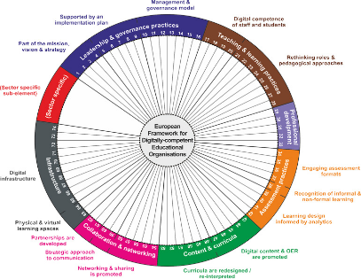
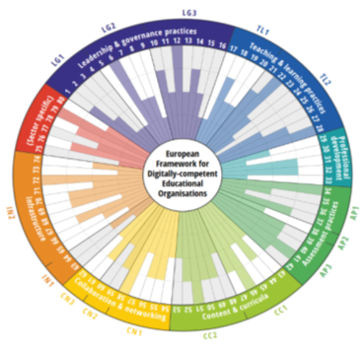

How to support the digital transformation of EU schools
Change
process
Current
state
Future
state
DigCompOrg
Conceptual Framework
DigCompOrg
self-assessment tool
External
evaluation & support
?
Dec 2015
Dec 2017
Holistic approach - Common understanding
Self-reflection, benchmarking
& action plan for improvement
External evaluation, recognition, training…

Slide 3

And the name is… SELFIE!
An online self-assessment tool for schools who want to reflect on their uptake of digital technologies for better learning.
The idea is that, every year, each schools reflect on their current uptake of digital technologies for innovative and effective learning and take snapshots of where they stand. So, this is like a selfie!! Schools can share their 'selfie' with the others, as they like, as people do with their selfies in social media.
SELFIE is the abbreviation for:
Self-reflection on Effective Learning by Fostering Innovation through Educational Technology

Slide 4
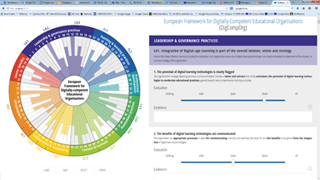
What can SELFIE offer?
For schools
Validated tool for self-reflection based both on research AND practice
Self-assessment process is owned by the school
School decides how and with whom to share the outcomes
Snapshot of their current level (visual presentation of analysis)
Recommendations for raising level
Benchmarking with others
Acknowledgement (badges)
For researchers and policy makers
Snapshot of the current (meso- & macro-)level through the analysis of aggregated, anonymized data
Strategic planning for research and policy interventions
Notes:
A large part of the framework (and later on the Q) does not make any direct reference to DTs! It aims at engaging organisations to reflect on their practices (pedagogical, technological, organisational). Therefore it should be understood as a blue‐print from which customised framework/questionnaire could be designed to suit the particular context of an organisation (or a group of organisations at local/regional/national level). ePOBMM
Aim: To develop a self-assessment questionnaire (SAQ - based on DigCompOrg descriptors) so schools (primary, secondary, VET) could review their organisational strategies and practices for integrating and using effectively digital technologies for more comprehensive learning outcomes.
Policy context: COM 2012 Rethinking Education, COM 2013 Opening Up Education, ET2020 WG DSC…
Why: Some (online) tools in the Member States but lack of systemic approach, uneven development among MS, duplication of work and little scope for mutual learning
What: (i) Draft SAQ (to be validated through expert consultation (ii) piloting the SAQ in 2-4 EU education systems (local, regional, national level) (iii) Consolidated version of conceptual framework and SAT that ongoing and future initiatives can refer to
When: validated SAQ by June 2016 the > pilots during school year 2016-2017 > consolidated framework and SAQ by end 2017
What for: Self-assessment at organisation level, Aggregated (anonymized) data at policy level - local, regional, national, EU(?) for strategic planning, monitoring, policy interventions…
Related and future JRC-IPTS work: DigComp and DigCompTeach

Slide 5

Theory and Practice: Online User Consultation
Survey statements
School leaders | Teaching staff | Students
58 | 45 | 17
58+45+17=74!!!
Statements for School leaders: 58
19
26
1
12
Statements for Teachers: 45
Statements for Students: 17
3
4
0
NO user identification
NO personal data collection
NO obligatory questions (only demographics)
Notes:
The duplication/triplication of the statement aims at comparing the opinion between user groups or at measuring individual experience at each level

Slide 6
User Consultation Survey – more than 5000 completed questionnaires!
5052 completed questionnaires!
 | School leaders | Teachers | Students | TOTAL
Estonian | 43 | 168 | 491 | 702
Italian | 51 | 338 | 769 | 1158
Spanish | 93 | 426 | 1516 | 2035
Danish | 12 | 96 | 569 | 677
English | 25 | 126 | 329 | 480
TOTAL | 224 | 1154 | 3674 | 5052
100+1 schools took part!
 | VET | General | All
Estonian | 5 | 13 | 18
Italian | 5 | 18 | 23
Spanish | 8 | 27 | 35
Danish | 6 | 0 | 6
English | 0 | 19 | 19
TOTAL | 24 | 77 | 101
JRC B.4 is conducting an in-house analysis of UCS quantitative and qualitative data (with the support of SELFIE experts and national coordinators):
Descriptive statistics
Item analysis (Item Response Theory)
Factor analysis
Thematic analysis
3400+ replies to open-ended questions!
 | School leaders | Teachers | Students | TOTAL
Estonian | 24 | 75 | 172 | 271
Italian | 45 | 139 | 722 | 906
Spanish | 70 | 249 | 1238 | 1557
Danish | 7 | 71 | 190 | 268
English | 49 | 110 | 250 | 409
TOTAL | 195 | 644 | 2572 | 3411
Notes:
The duplication/triplication of the statement aims at comparing the opinion between user groups or at measuring individual experience at each level

Slide 7
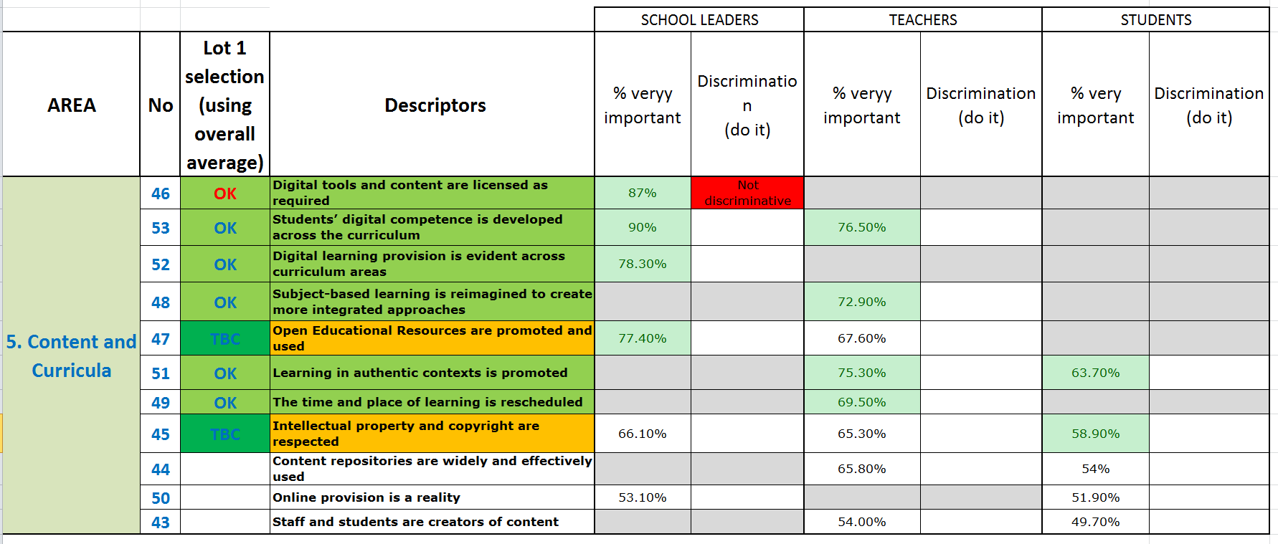
Evidence-based selection of standard set of SELFIE items

Slide 8
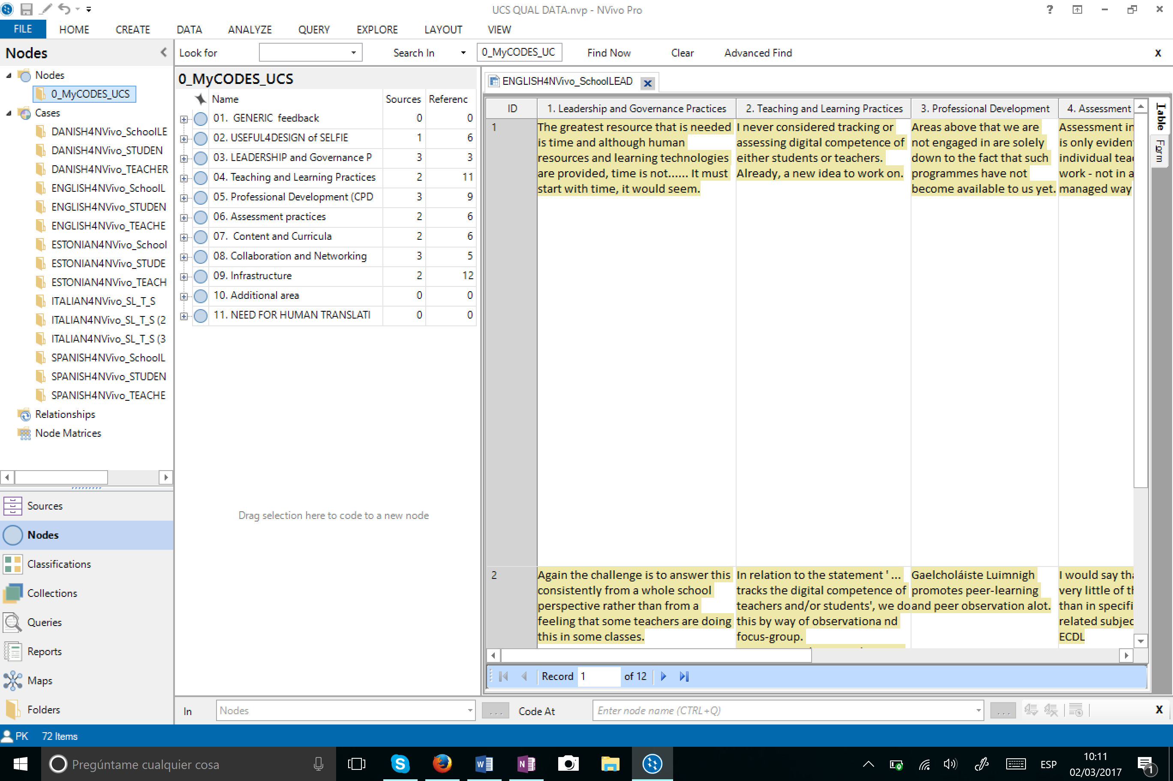
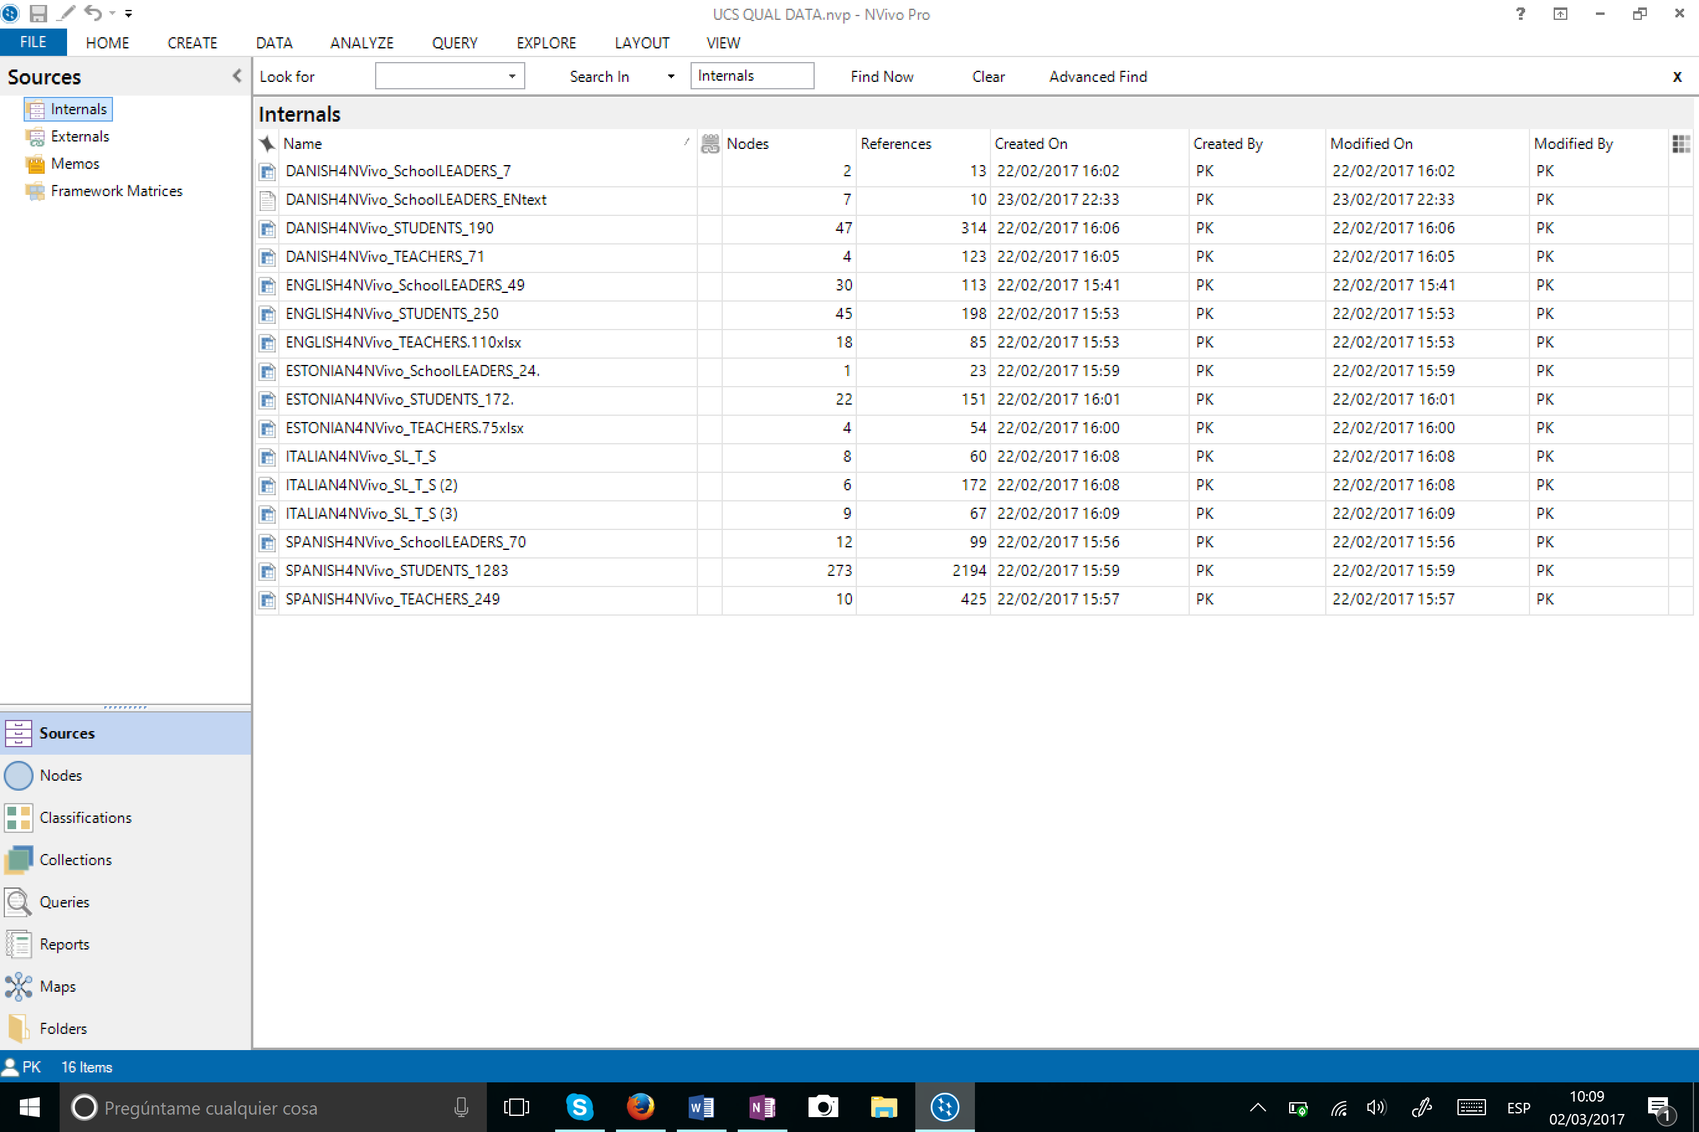
…complemented by analysis of qualitative data and iterative consultations

Slide 9
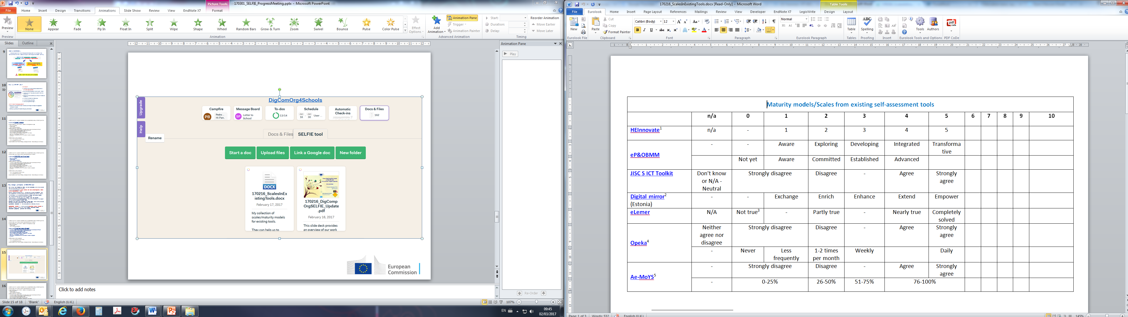
Key challenge: the scale(s)/progression model

Slide 10

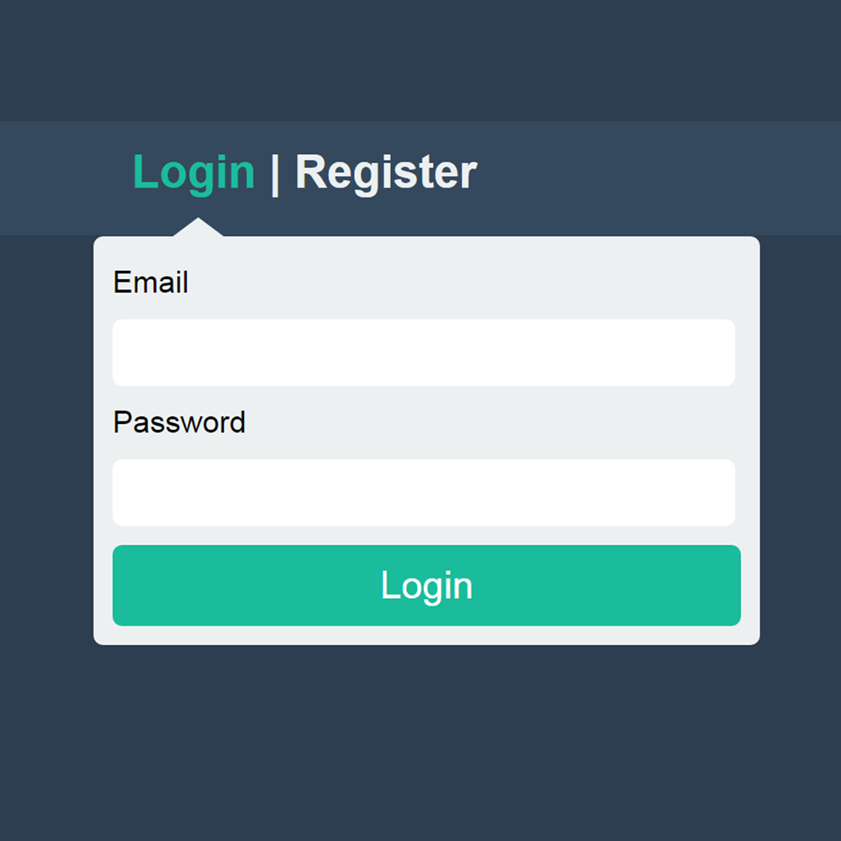

Key design principles of SELFIE tool
Online platform with different
versions of SELFIE for schools, IVET, HEIs
info@schoolname.net
Single entry point using
school’s official email
***************
X
NO PERSONAL DATA!
Notes:
Online tool, NO PERSONAL DATA will be collected, single entry point using school’s official email (school´s SELFIE coordinator)
Flexible and adjustable! Every school can add school-specific items to the standardised ones!
School leaders and teachers will indicate (not upload) 'evidence' that can support their self-evaluation (selecting pre-defined ones or 'other')
In the future, it will be complemented by a blog with Q&A, videos etc. Access to case studies, guidance notes etc.
Every school will be provided with a report with the results, recommendations and benchmarking with similar schools… The report can be used for school's action plan…
Schools will have full ownership of their data / each school decides to share or not the results (as in the real selfies!).
Qualitative research will be conducted to validate tool results.
Aggregated results will be available to education policy makers at regional, national and EU level, so to inform decisions about education programs, policies and funding.

Slide 11


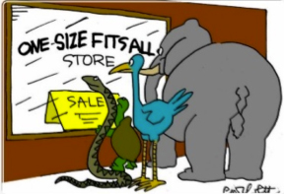

Key design principles of SELFIE tool
SELFIE coordinator
in each school
Supported by Q&A, videos, case studies…
X
Fully customisable:
standard set of items,
optional items,
school-specific ones
Users will indicate
(not upload) 'evidence'

Slide 12


Key design principles of SELFIE tool – Each school…
…will get a report with its aggregated results
… will benchmark with similar schools
… will have full ownership of its data

Slide 13



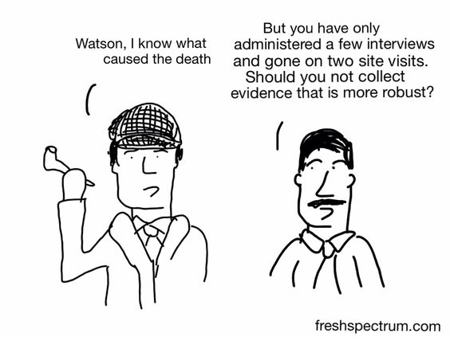
Key design principles of SELFIE tool
Internal dialogue based
on SELFIE results
Basis for school´s
action plan
Aggregated data
for policy
making at regional,
national, EU level
Complemented by
qualitative research

Slide 14
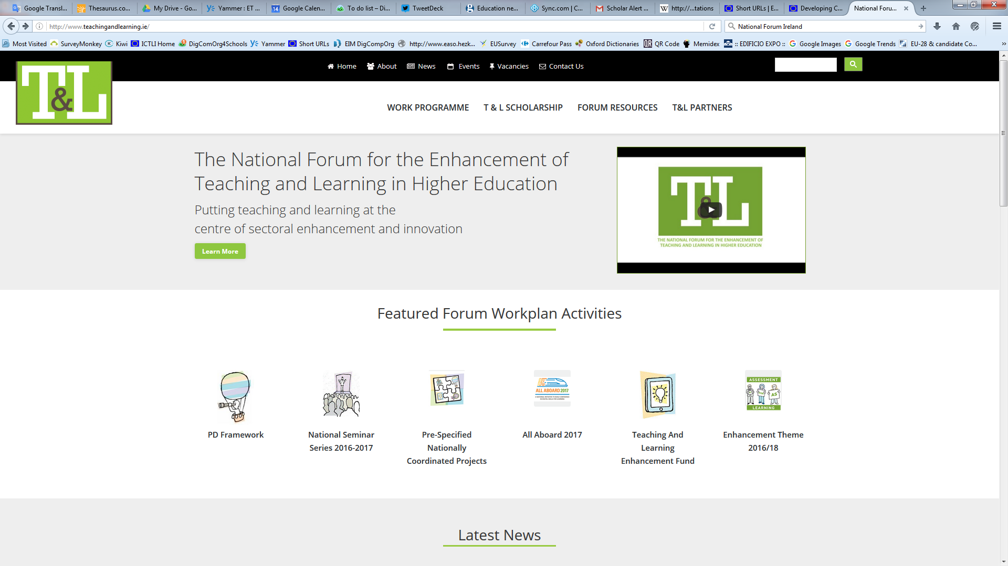
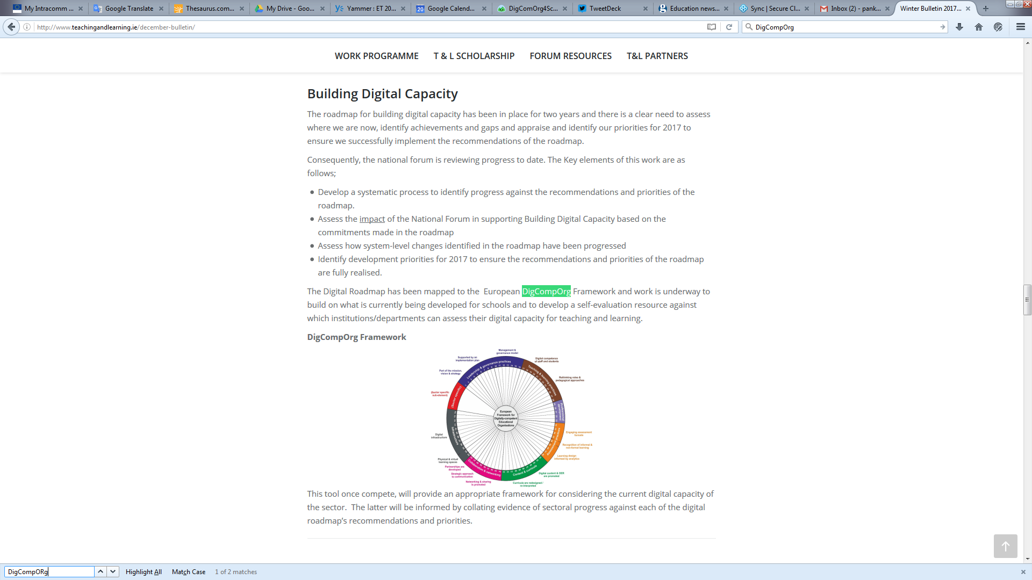
A self-assessment tool for HEIs is also under development!
The Irish National Forum for the Enhancement of Teaching and Learning in Higher Education is currently developing a self-assessment tool for HEIs digital capacity, based on DigCompOrg framework. The experts of the National Forum aim to use the same design principles and an adaptation of SELFIE tool for schools to run a pilot implementation in the course of 2017. Universities from Spain and Greece have expressed their interest to adapt and pilot the tool in their own context.
http://www.teachingandlearning.ie/december-bulletin

Slide 15
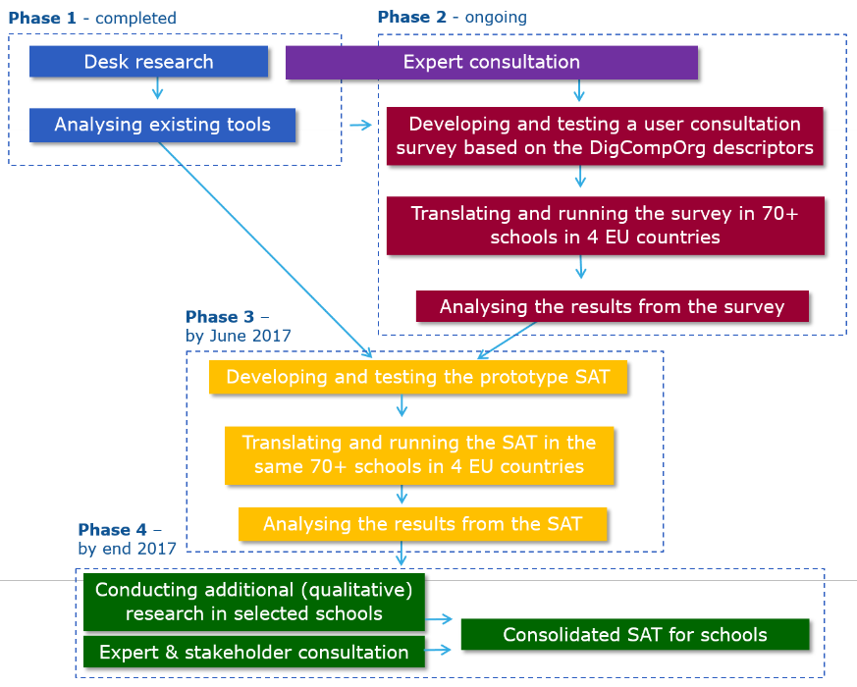
SELFIE Planning
Developing & testing a user consultation survey based on DigCompOrg descriptors
Translating and running the UCS in 100+ schools in 5+2 EU countries
In-house analysis of UCS results
Mid-March
Developing & testing the prototype SELFIE tool
May
Translating SELFIE
Piloting SELFIE in 300+ schools
June
September
Analysing the results from the pilots
October
Mid-November
Consolidated SELFIE(s)
Dec 2017
End-November
Notes:
In order to develop our SeLFiE-S tool, we have analysed existing tools that are similar in their scope.
In order to locate these tools, we consulted experts in the field, we did an internet search and we built on the inventory we had developed in the previous phase of our study.
Finally, we selected the 9 tools I will present you next, trying to have the best possible variety in terms of purpose, geographical coverage, type etc.
In order to analyse further these nine tools we collected data via desk research and interviews.

Slide 16


















Overview of the take up of DigComprOrg
Finland
Estonia
Russia
United Kingdom
Denmark
Lithuania
Ireland
Hungary
Croatia
Serbia
Italy
Spain
Greece
Cyprus
*EU member country
Designed by Showeet.com
Notes:
© Copyright Showeet.com

Slide 17
Participating in SELFIE tool pilots
Estonia
Russia
United Kingdom
Denmark
Ireland
Italy
Spain
Greece
*EU member country
Designed by Showeet.com
Notes:
© Copyright Showeet.com

Slide 18

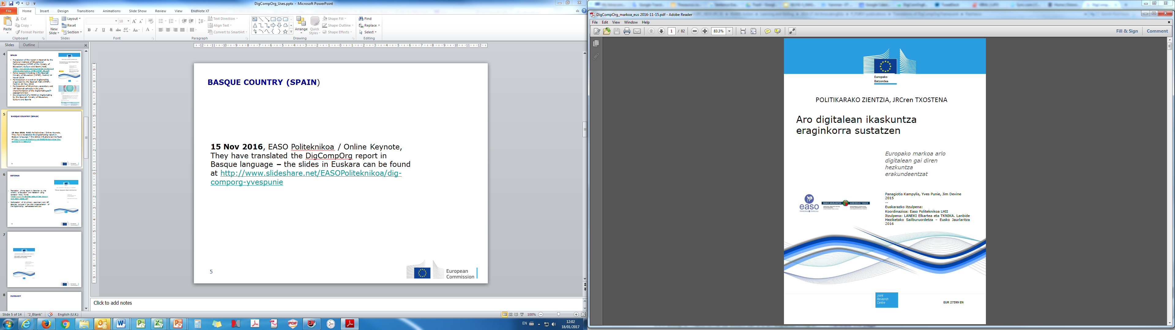
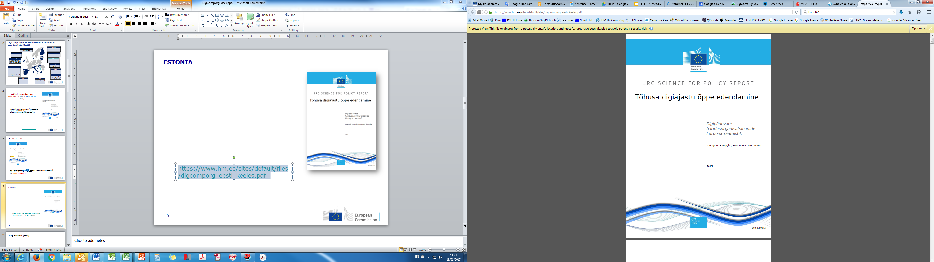
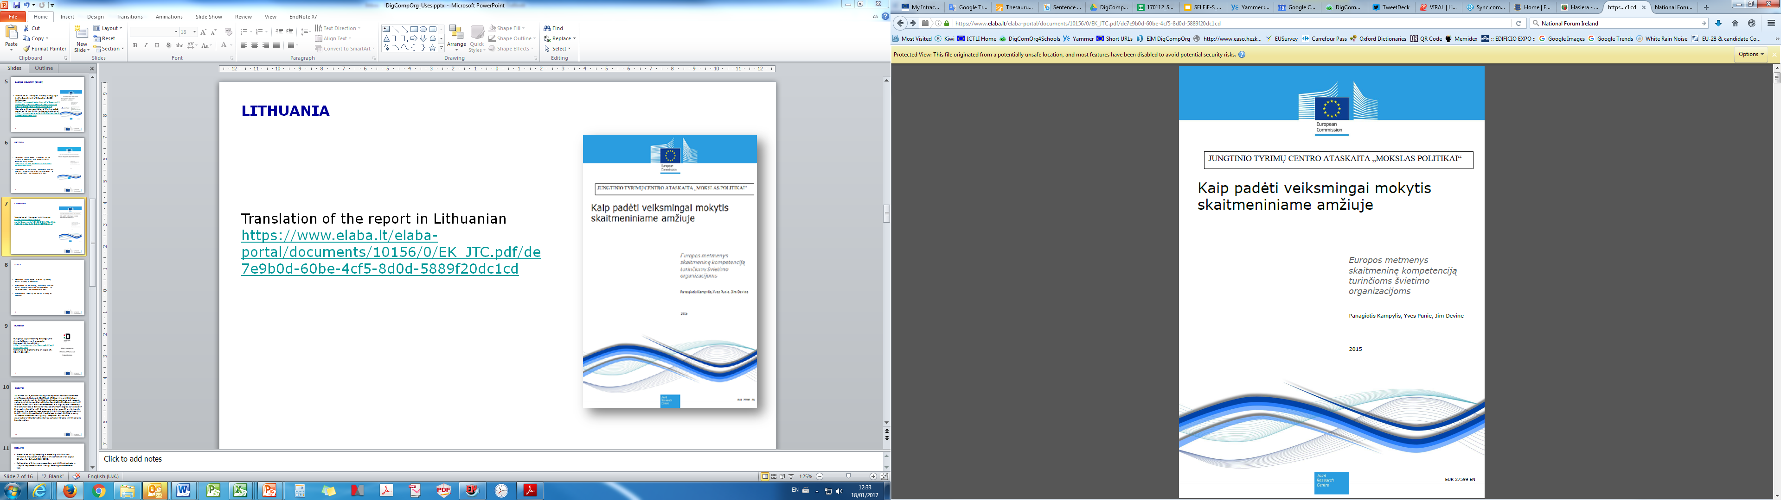
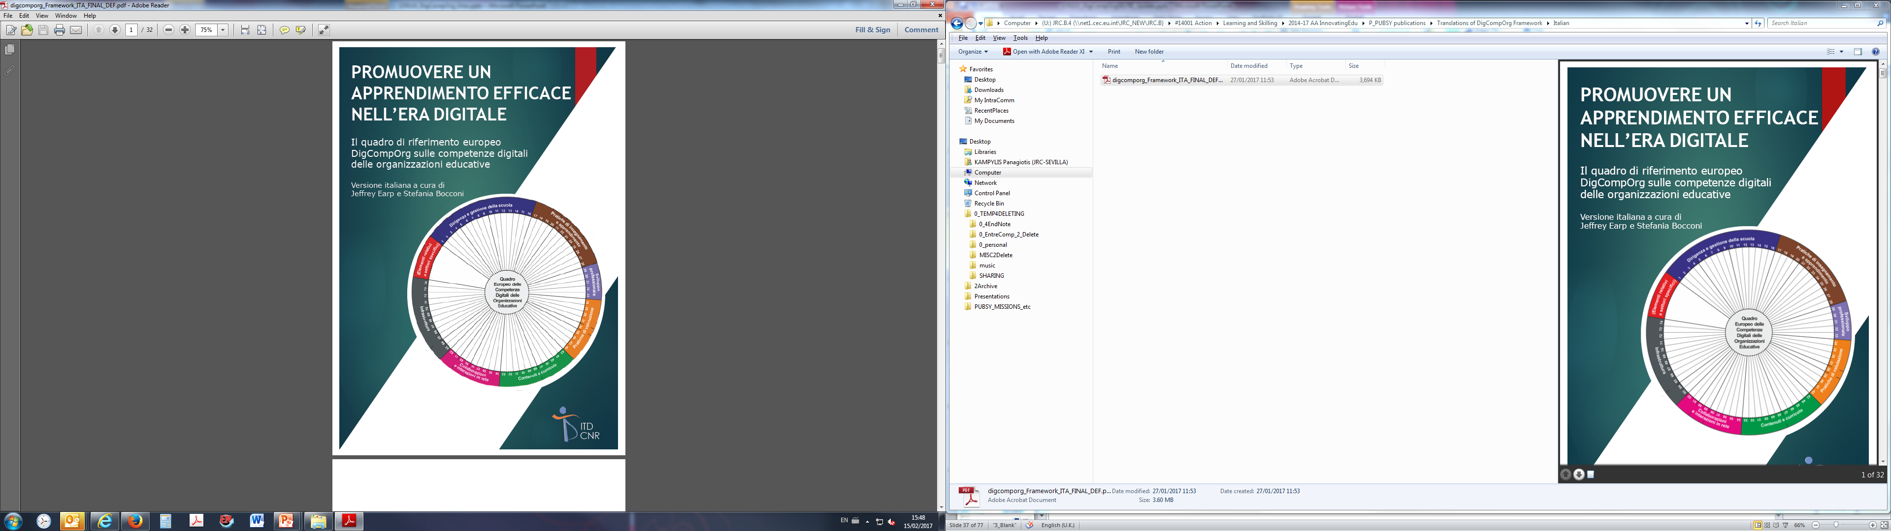
Translating DigCompOrg
report (MoEs, national agencies etc.)
Available in EN, IT, ES (& Basque Language), EL, EE, Lithuanian and partly in DK and HU
Estonia
Denmark
Lithuania
Hungary
Italy
Spain
Cyprus
*EU member country
Designed by Showeet.com
Notes:
© Copyright Showeet.com

Slide 19
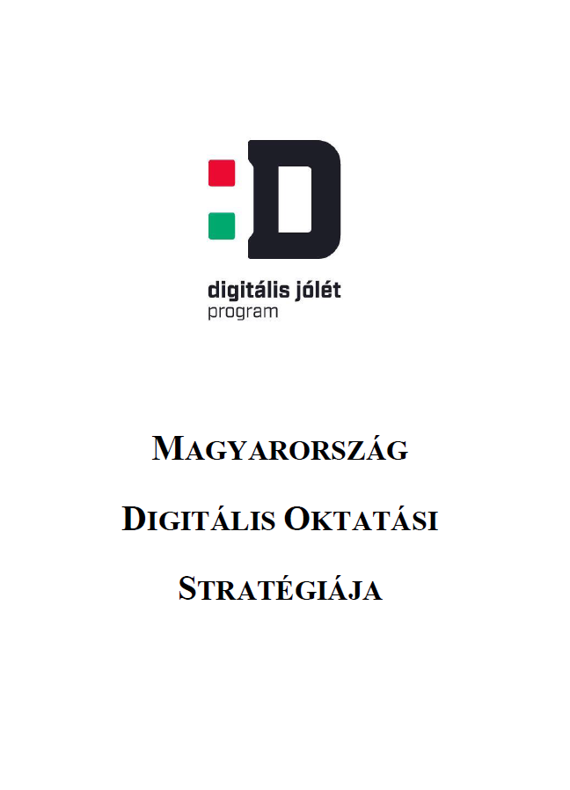
Reference model for national
digital strategies
Hungary
Croatia
Spain
*EU member country
Designed by Showeet.com
Notes:
© Copyright Showeet.com

Slide 20
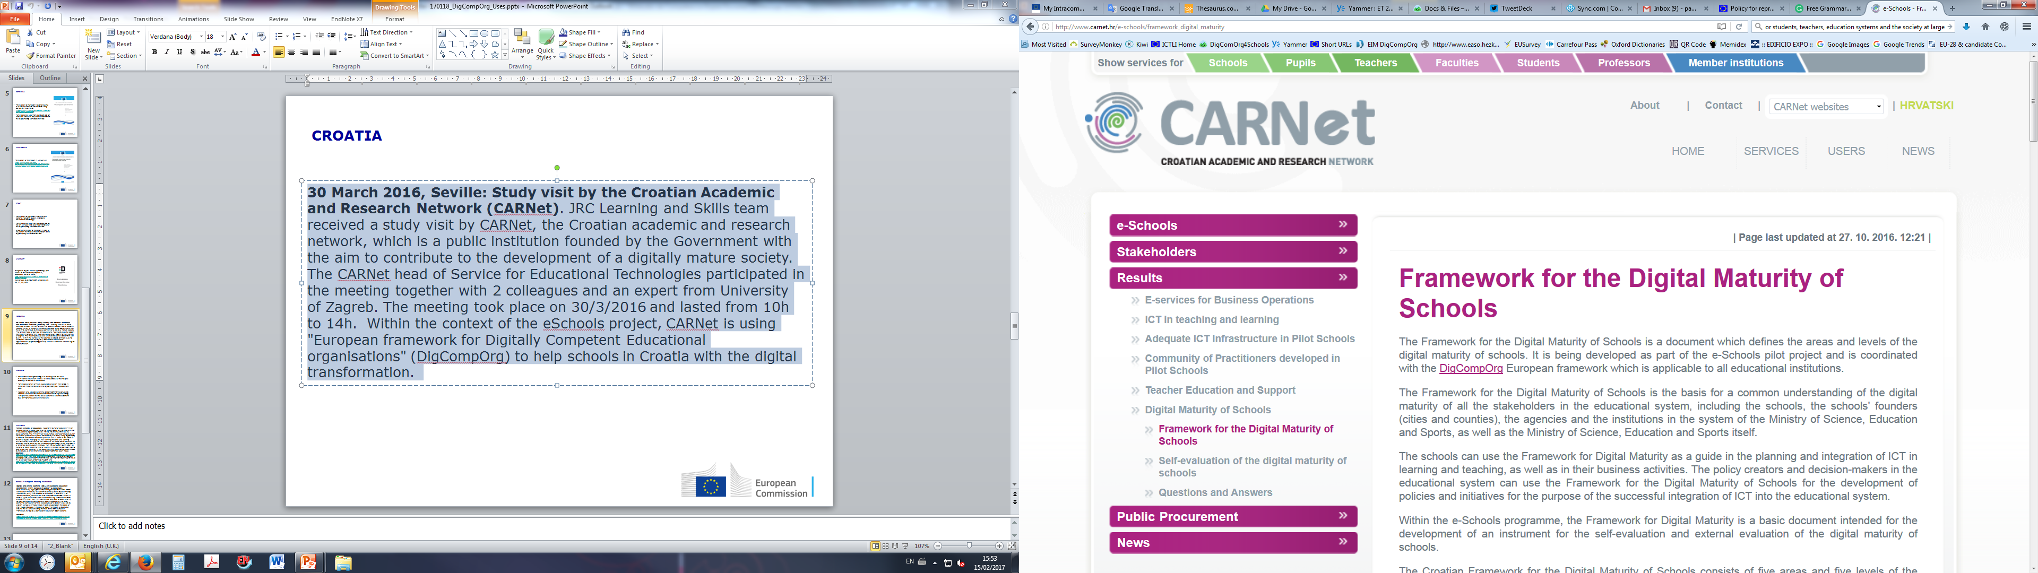
Reference model for
developing national tools
Finland
Estonia
Croatia
*EU member country
Designed by Showeet.com
Notes:
© Copyright Showeet.com

Slide 21
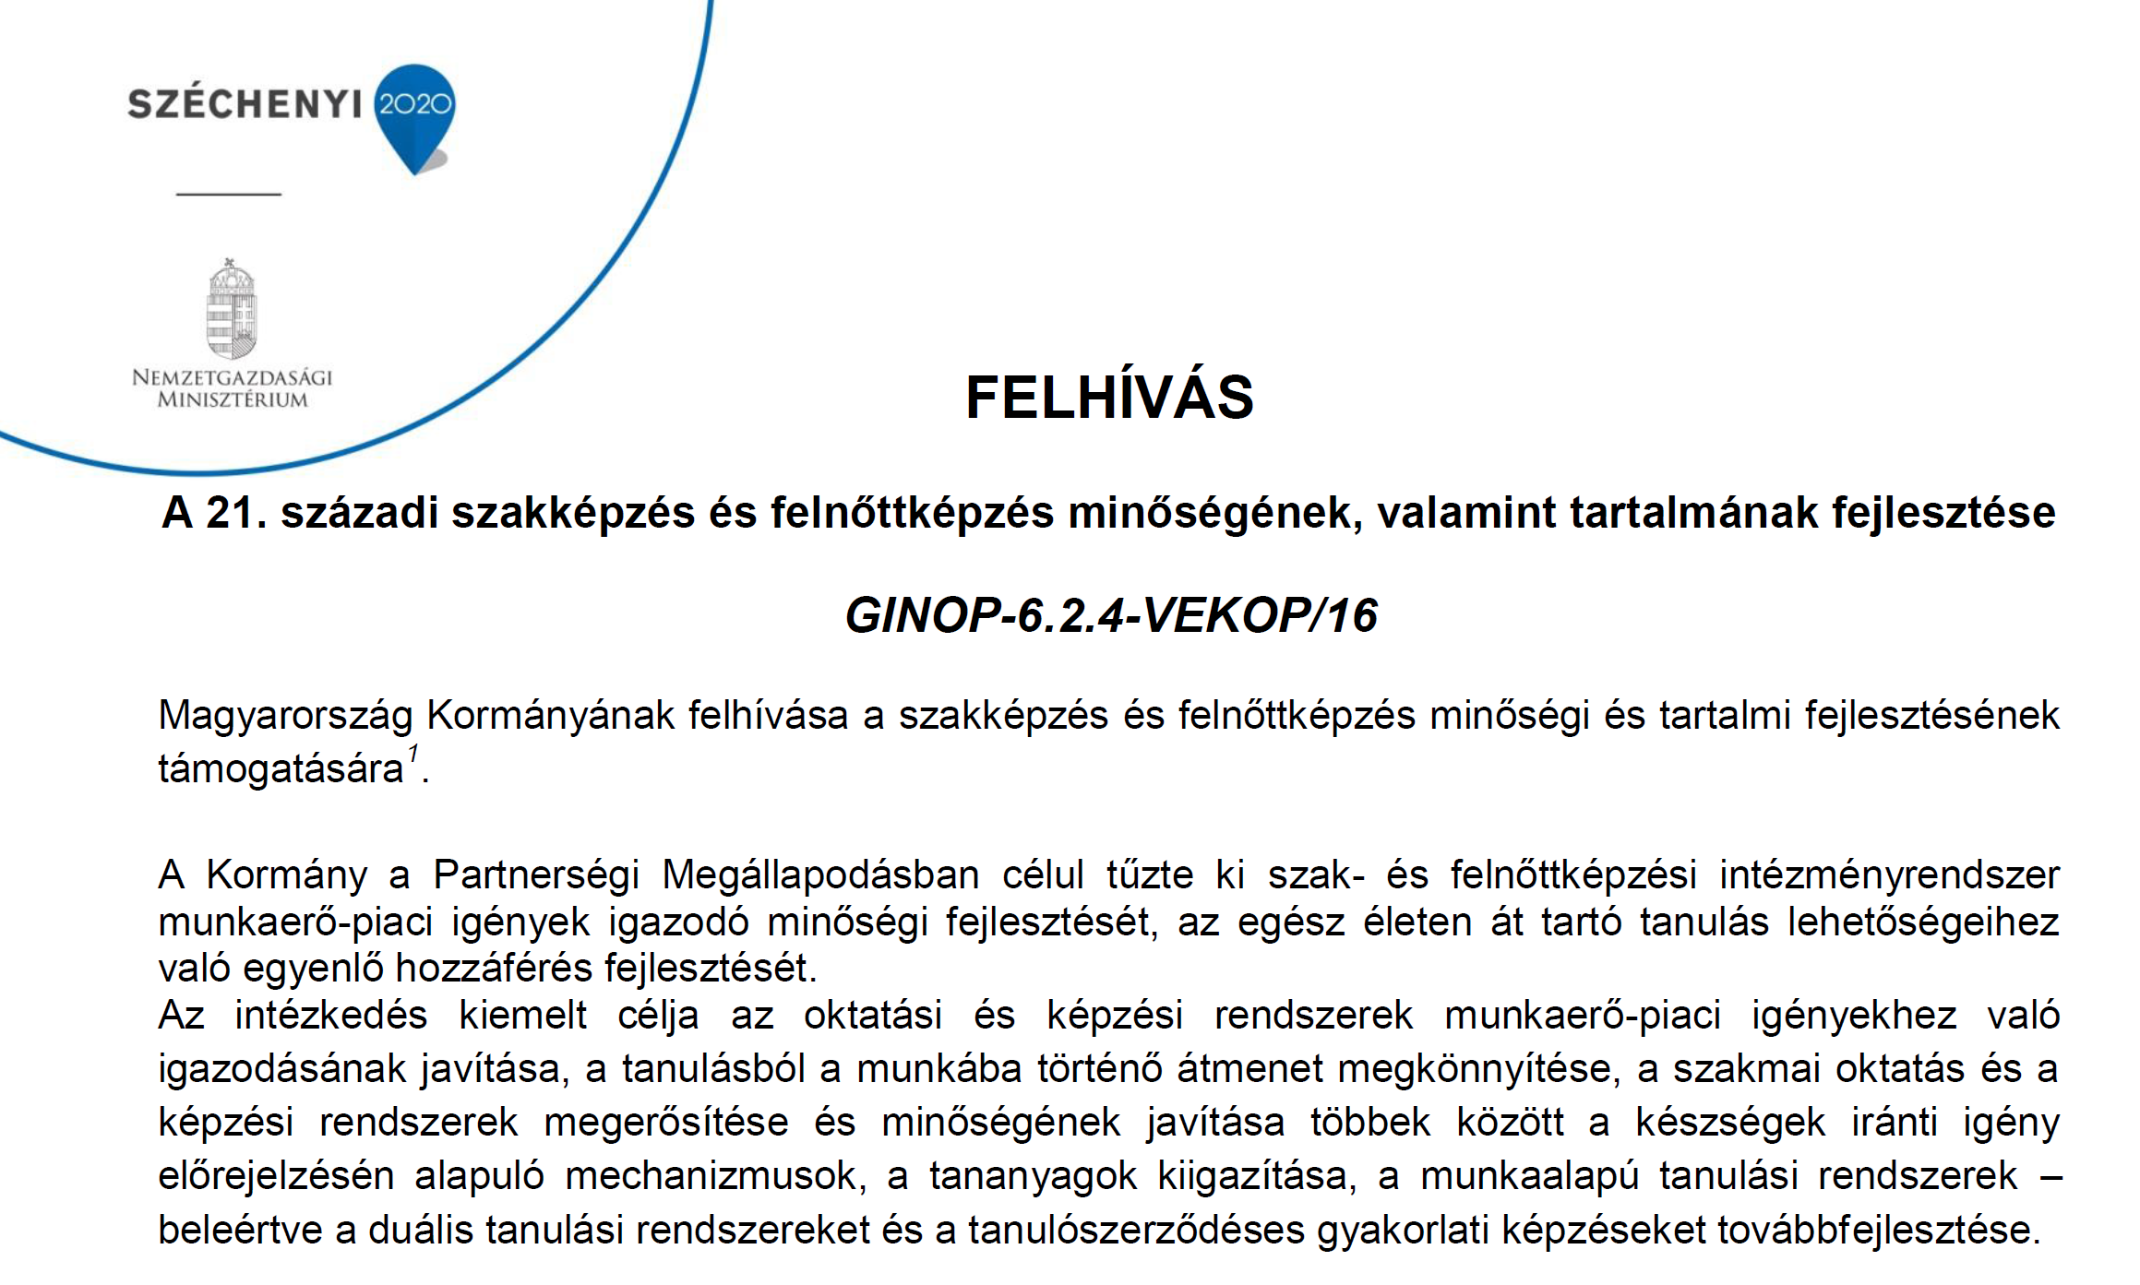
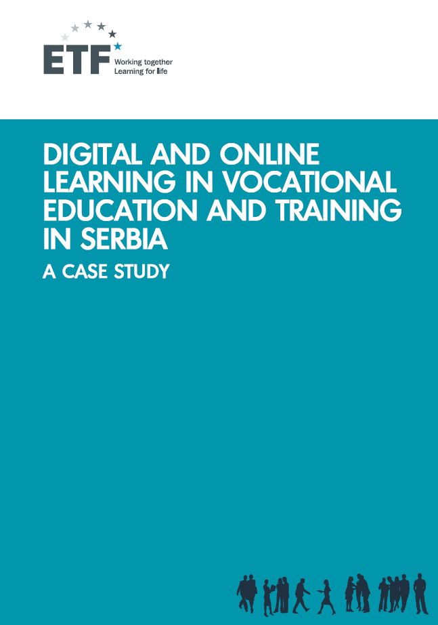
Reference model for national
calls, pilots and training
materials (e.g. MOOCs)
Finland
Hungary
Serbia
(in collaboration with ETF)
Spain
*EU member country
Designed by Showeet.com
Notes:
© Copyright Showeet.com

Slide 22
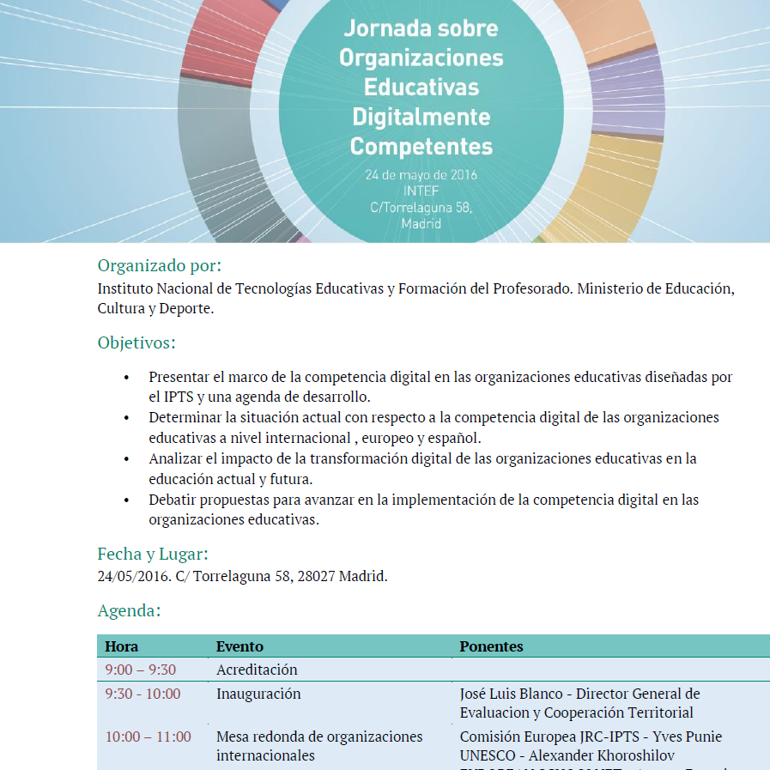
Policy support meetings
with JRC DigCompOrg team
Ireland
Croatia
Spain
Greece
*EU member country
Designed by Showeet.com
Notes:
© Copyright Showeet.com

Slide 23



It´s your turn now!
Which of these uses you think are most relevant for your country/context? Is there something that is missing that you would like to add to the current take-up of DigCompOrg?
Which of the design principles are the most relevant for your country/context? Is there something that you would like add/change?
Do you want to stay informed about the developments in DigCompOrg & DigCompEdu?
Do you want even to be involved? Please let us know!
Notes:
1. DigCompOrg framework and SELFIE tool are being used in different ways in different countries. Which of these uses you think are most relevant for your country? Is there something that is missing that you would like add to the current take-up of DigCompOrg?
2. There are different options and ways to design the SELFIE tool for schools' digital capacity (as explained in the presentation). Which ones are most relevant for your country/education system/context?

Slide 24
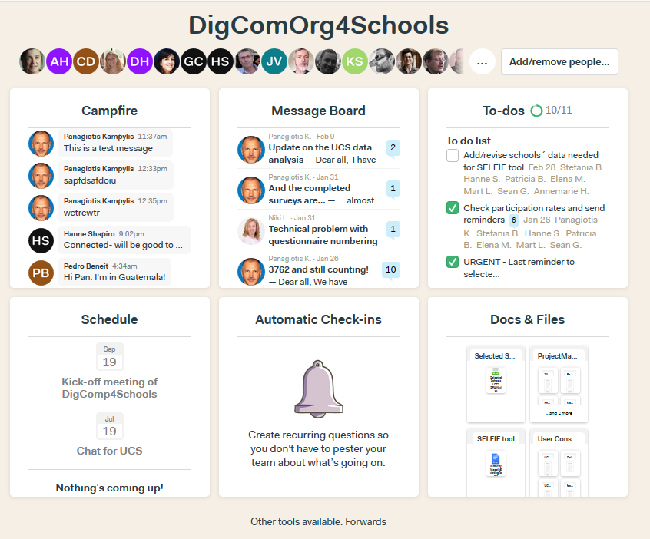




SELFIE Dream-Team
an international community is evolving around!
Jim Devine | Policy | Projects | Innovation, IRELAND
Timmus Limited, UK
Danish Technological Institute, DENMARK
Tallinn University - Centre of Excellence in Educational, Innovation, ESTONIA
EIM consultancy, SPAIN
National Research Council, Institute of Educational Technology & INDIRE, ITALY
UNESCO Institute for Information Technologies in Education
Professional Development Service for Teachers, IRELAND
National Forum for the Enhancement of Teaching & Learning in Higher Education, IRELAND
European Commission's (EC) Joint Research Centre, Human Capital and Employment Unit (JRC B.4 in short) has designed and run the study for EC's Directorate General Education and Culture (DG EAC). JRC B.4 collaborates with a group of international experts.
Designed by Showeet.com
Notes:
© Copyright Showeet.com

Slide 25
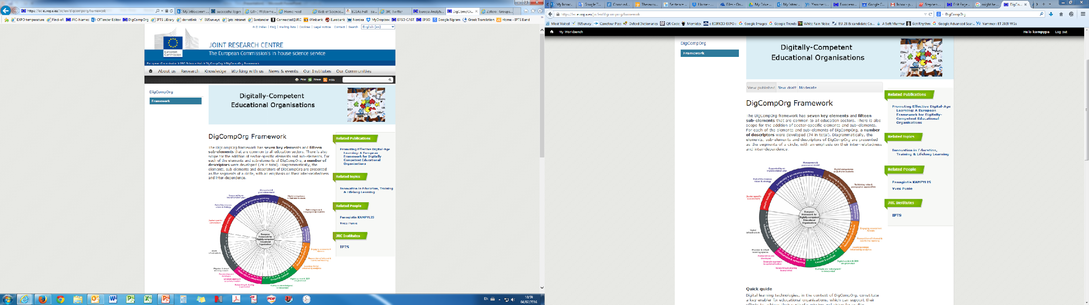

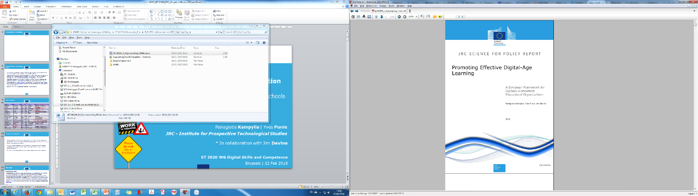



https://ec.europa.eu/jrc/en/digcomporg
http://europa.eu/!TP78Wq

