Slide 1
2nd World OER Congress What’s it about?
Davor Orlic, Jožef Stefan Institute
Mitja Jermol, UNESCO Chair on Open Technologies for OER and Open Learning
Borut Čampelj, Ministry of Education, Science and Sport
Gasper Hrastelj, UNESCO National Commission for Slovenia

Slide 2
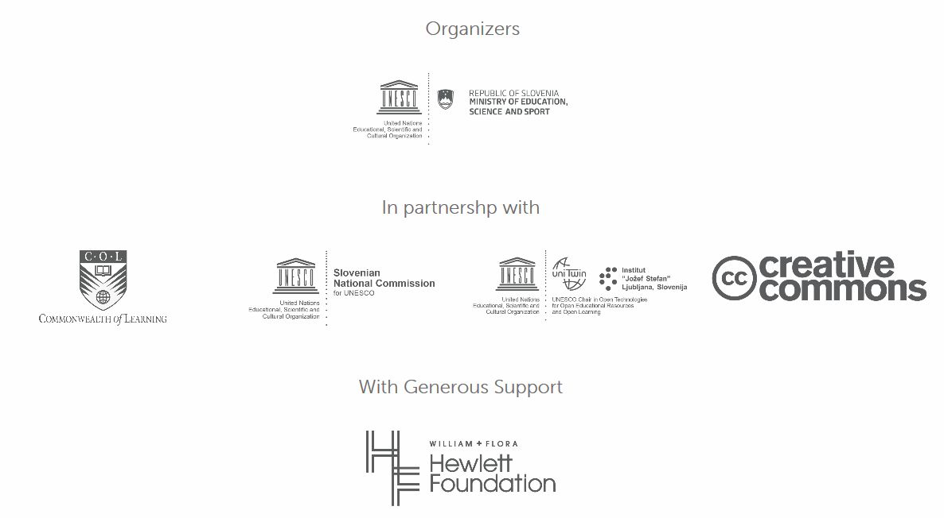

Slide 3
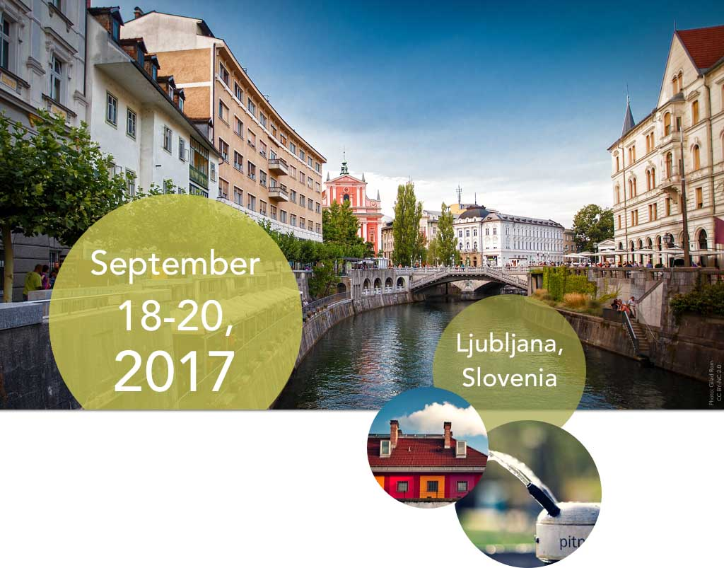
2nd World OER Congress - Basic info
Funders:
Hewlett Foundation ($400K)
Government of Slovenia ($200K)
Main organizers:
Government of Slovenia, Ministry of Education, Science and Sport
UNESCO
In partnership with:
Slovenian National Commission for UNESCO
Commonwealth of Learning
Creative Commons
UNESCO Chair on Open Technologies for OER and Open Learning
Satellite Events organizers:
Knowledge 4 All Foundation
OpeningupSlovenia
Date:
18 – 20 September, 2017
Location:
Ljubljana, Slovenia

Slide 4
Congress details
Main Theme:
The proposed theme is “OER for Inclusive and Equitable Quality Education: From Commitment to Action”
Main Structure:
UNESCO and COL to send OER two Questionnaires: one for Governments, and one for stakeholders
COL to plan and organize 6 Regional consultations
COL to create Synthesis Report to other partners Results will feed into the 2nd World OER Congress
UNESCO Chair in OER, K4A to plan and organize 6+ Satellite events

Slide 5
Congress details (II)
Obstacles to achieving the mainstreaming of OER
Commercial interests
Language and cultural barriers
Ensuring inclusive and equitable access to quality content
Capacity of users to access, re-use, and share OER -
Development of appropriate policy solutions
Need for clarity on the term ‘open’
Result:
Congress and Regional consultations must result in a commitment to adopt OER policy and to identify concrete actions that would be implemented within a specific time framework

Slide 6
Objectives
Review the progress of OER since the World OER Congress 2012
Examine solutions to meeting the challenges of mainstreaming OER practices into education systems worldwide
Showcase the world´s best practices in OER policies and inistiatives as well OER experts
Provide recommendations and identify strategies for the mainstreaming of OER, with links to best practices
Adoption of Action Plan for OER

Slide 7
Programme (draft)
DAY 1 – 17 September 2017
Registration, Opening Reception and Dinner
DAY 2 – 18 September 2017
Launch, Welcome Addresses, Key Addresses
Keynote
Setting the context
Presentation of the results of the 6 regional consultations
Presentation of the results of OER studies
Presentation of “A Global OER Story”
Networking event

Slide 8
Programme (draft)
DAY 3 – 19 September 2017
Keynote
Group work on Mainstreaming OER practices: Challenges and Solutions
Plenary session on Technology and OER
OER Bar Camp
Networking event
DAY 4 – 20 September 2017
Keynote
OER Market Place: Presentation of best practices
Closing Plenary:
Report
Adoption of the Ljubljana Action Plan
Call for Action
Roadmap with recommendations on the future international collaboration in the field of OER

Slide 9
Structure (draft)
OER Research Conference
(K4A, EU and UNESCO OER Chairs)
MyMachine Global
(MMG, OUS)
OER Congress
(UNESCO and SI Government)
iCore
(iCore)
Formal Reception
OER Business Conference
(Slovenian Post and UPU)
Open Access
(MJU)
Asia regional meeting
SiRIKT Teachers Annual Conference
(MIZS Ministry)
Opening Up Balkans
(MIZS, OUS)
Africa regional meeting

Slide 10
Links, Tech Assets and Software stack applicable to OER
Initiatives:
http://www.ouslovenia.net
Institutions, laboratories involved in the network:
http://k4all.org (1000+ researchers in Artificial Intelligence, 60+ members)
http://ijs.si
http://ct3.ijs.si
http://ailab.ijs.si
http://sensorlab.ijs.si
Products:
http://videolectures.net (1014 events, 14156 authors, 19041 lectures, 22097 videos)
http://opencast.org/matterhorn
http://scienceatlas.si
http://qminer.ijs.si
Software and applications:
http://eventregistry.org
http://enrycher.ijs.si
http://newsfeed.ijs.si
http://www.cyc.com
http://www.cyc.com
iDiveriNews on App Store
Curious Cat on GooglePlay

Slide 11
OpeningupSlovenia Members and Advisory Board – all have an active role
Advisory Board:
Mary McAleese, Chair of the EU High Level Group on the Modernisation of HEI
Fred Mulder, UNESCO Chair in OER
Alek Tarkowski, Creative Commons
Mariana Patru, UNESCO
Cecilia D'Oliveira, OpenCourseWare MIT
Dominic Orr, researcher & policy analyst
Andreia Inamorato Dos Santos, policy research
Civil Society, IGOs, NGOs, Government:
Knowledge 4 All Foundation Ltd.
Ministry of Education, Science and Sport
Chamber of Commerce and Industry
National Commission for UNESCO
Intellectual Property Institute
Industry and major Slovenian companies:
Slovenian Post Office
Topolšica Hospital
Lek d.d.
Kolektor Group
Gorenje d.d.
Schools and Representatives:
Savsko Naselje primary school
Trnovo kindergarten
School centre Kranj
Elected representative of the primary school headmasters of Slovenia
Elected representative of the high school headmasters of Slovenia
Elected representative of the kindergarten headmasters of Slovenia
Representative of public health institutions
Representative of the public administration workers
Student society representative
Representative of the visually impaired people organisation
Research and HEI:
Jožef Stefan Institute
University of Maribor
University of Primorska
University of Ljubljana
University of Nova Gorica

Slide 12



Stay in touch
2nd World OER Congress Website: Latest News and Updates
VideoLectures.Net:
Conferences and Workshop series
Facebook:
OpeningupSlovenia Daily Updates
Twitter: @OpenupSLO , @OERcongress
OpeningupSlovenia Website: Projects, Policy, Strategy
UNESCO Chair on Open Technologies for OER and Open Learning Website: Capacity Building, Global penetration

Slide 13
How to participate (registration)?
UNESCO will send in March/April 2017 invitations to the Ministers of Education to nominate the national delegations (leading by ministers/state secretaries/directors)
European Commissioner Tibor Navracsics confirmed the participation
More information in Yammer in March/April 2017 about Satellite Events
Extended invitation to join a dynamic coalition on OER and Open Education (lead by the Republic of Slovenia)

