Slide 1
How can ICT contribute to integration of immigrants and refugees?
Senior Adviser Jan Peter Strømsheim
Brussels 7-8 March, 2017

Slide 2
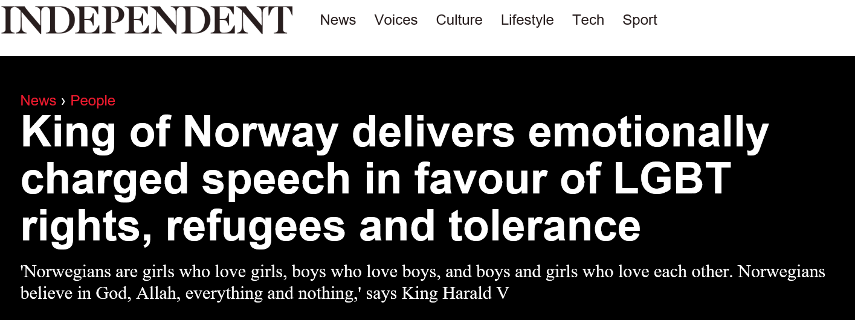
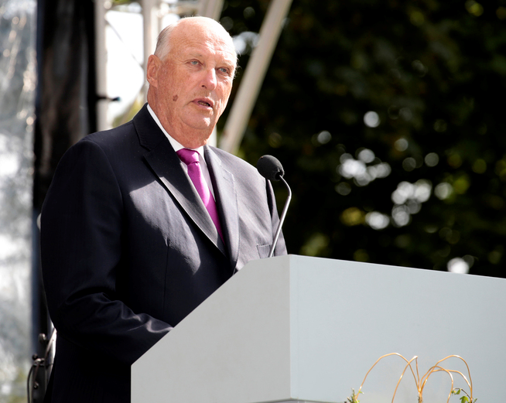
Norwegians are also immigrants from Afghanistan, Pakistan, Poland, Sweden, Somalia and Syria.
My grandparents emigrated from Denmark and England 110 years ago.
URL: https://www.youtube.com/watch?v=ShLacHMG6Q4

Slide 3
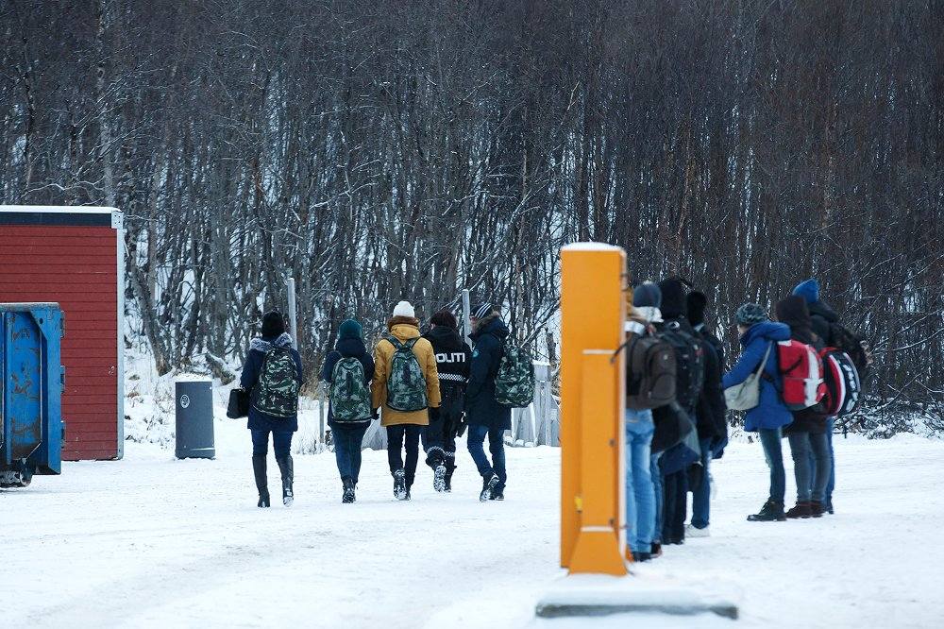
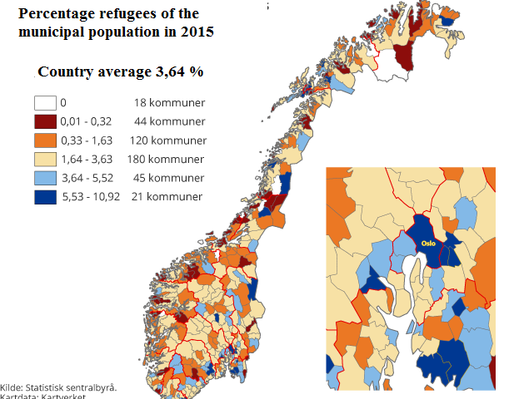
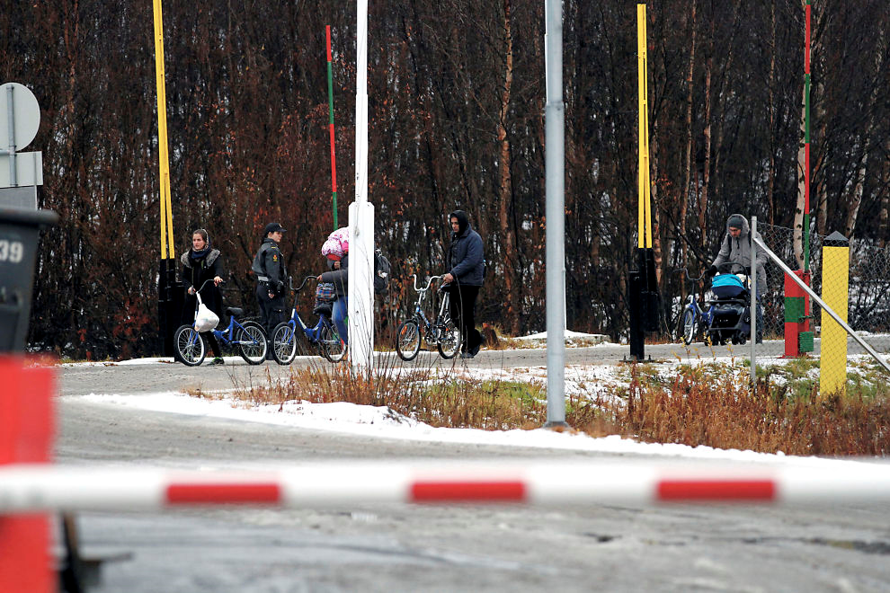
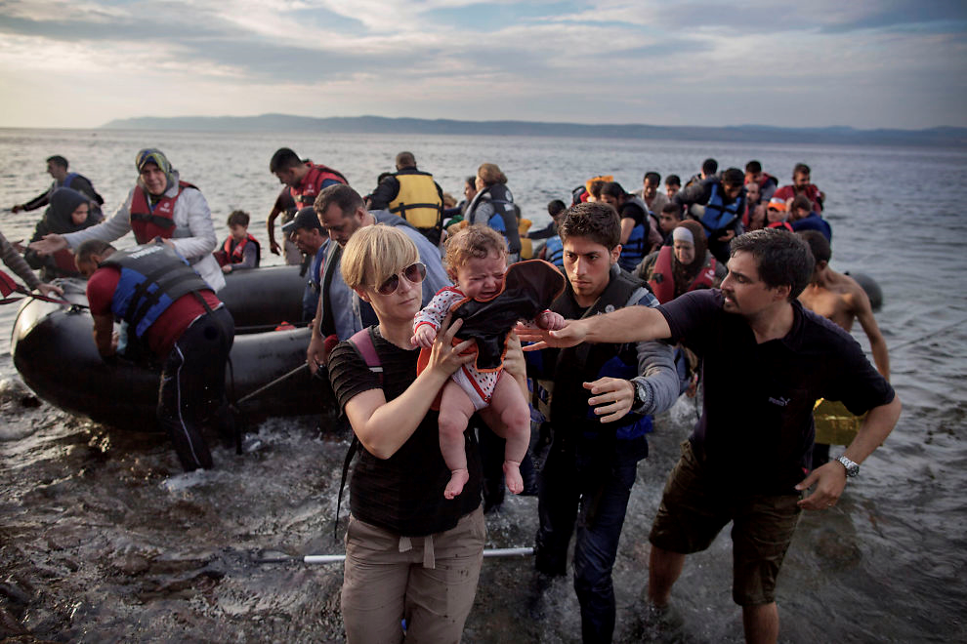
The number and proportion of immigrants and refugees in 2015
 | Number | Of which refugees | Proportion of the population
 |  |  | Immigrants (%) | Refugees (%)
Immigrants | 669380 | 188130 | 13 | 3,6

Slide 4
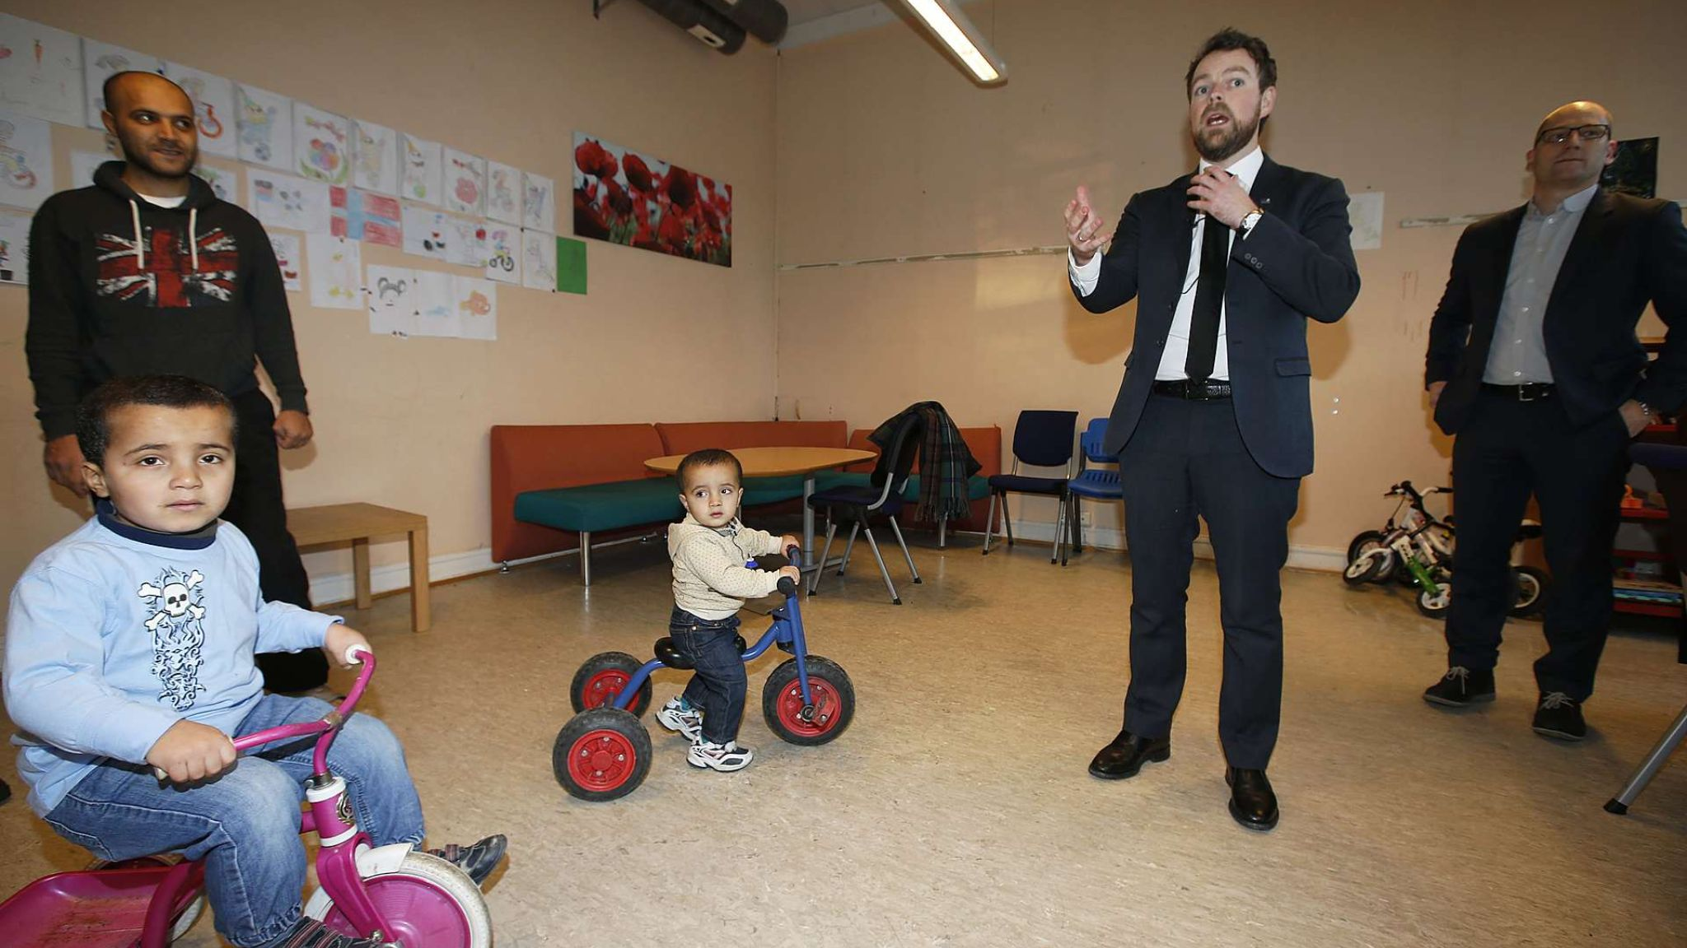
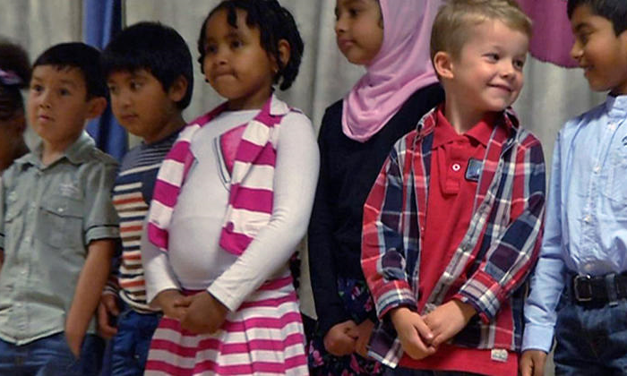
Calls for teachers who can teach 7,400 asylum children
(January, 2016)
615,327 pupils in Norwegian Primary and Lower Secondary School.
83,820 children aged 6-15 years with an immigrant background
  (in addition: pupils in Upper Secondary Schools)
All children seeking asylum should receive training as soon as they come to Norway.
Primary/secondary-school pupils with another mother tongue than Norwegian or Sami are entitled to special language training until they have sufficient knowledge of Norwegian to take part in ordinary education in the school.

Slide 5
What happens upon arrival of refugees/asylum seekers?
Upon arriving, the refugees will stay at a reception centre for refugees for a certain time.
Those who receive residence permits will be assigned a place to stay - somewhere in Norway
  Many of them are children and adolescents
For school-children/adolescents:
  Some end up in small, rural municipalities, where the possibilities of having teachers with proper background in mother-tongue is quite small compared to what might be expected in the bigger cities or municipalities

Slide 6
Challenges and obstacles
As indicated above – need for more mother-tongue/bilingual teachers
  More teachers, covering multiple languages
  Needs to compensate for lack of mother-tongue/bilingual teachers locally
Access to learning resources in multiple languages.
Conceptual development – in subjects (e.g. Math, Science, ..)
  Needs to link subject teachers with mother-tongue/bilingual teachers

Slide 7
Some major actors/players
These three agencies/centres have been instrumental in the development of the resources that will be described :
The National Centre for Multicultural Education (NAFO):
  established in 2004
  promotes inclusive and equal education for linguistic minorities in kindergartens, schools and institutions of adult education.
The Norwegian Centre for ICT in Education (IKTsenteret)
The Norwegian Directorate for Education and Training (Udir)

Slide 8
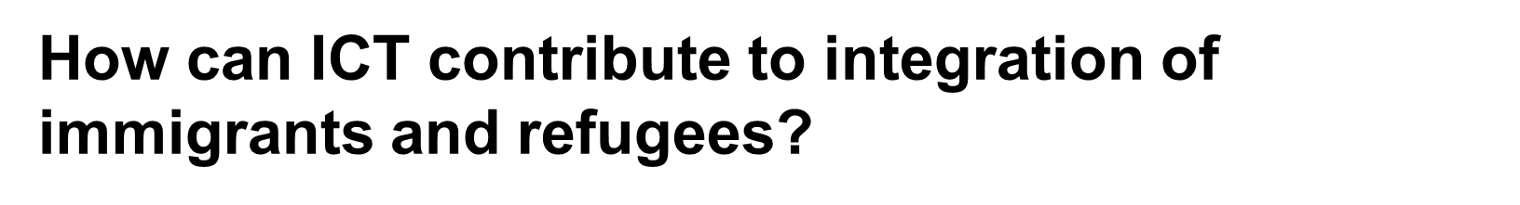
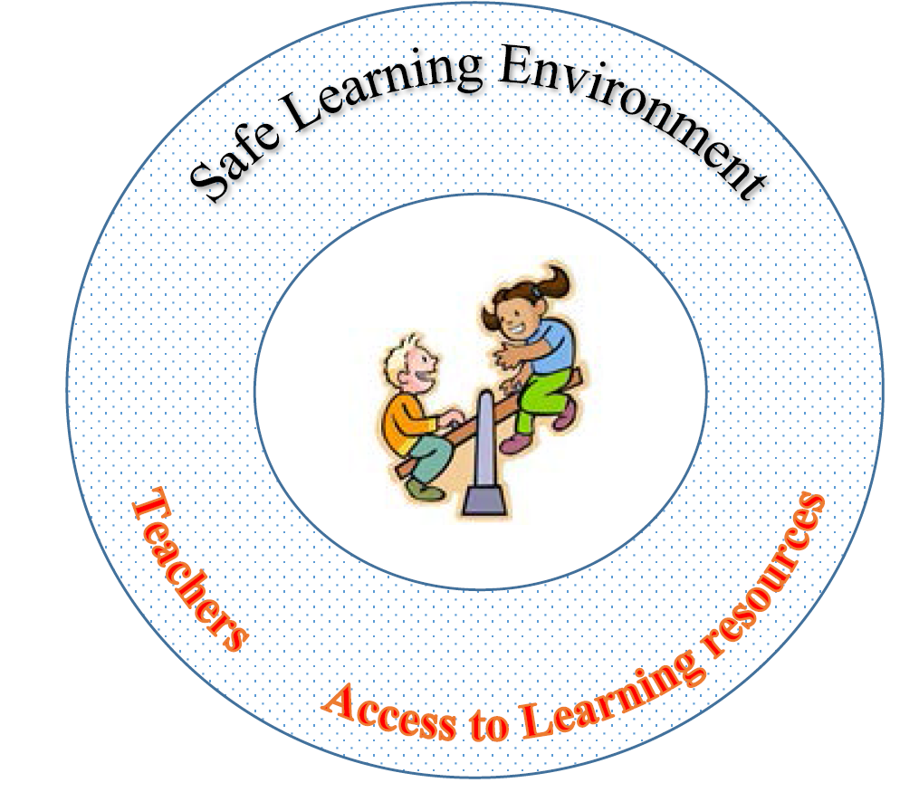
Morsmaal.no
- DLR
Skolekassa.no
- Digital learning resources for pupils/teachers:
Fleksibel opplæring
(Flexible training)
- Virtual support by online teacher

Slide 9
Morsmaal.no: Digital based materials – for teachers
Morsmaal.no(developed by NAFO in cooperation with Sweden)
  The purpose of the site is to create a meeting place for mother tongue teachers and bilingual teachers in school and bilingual staff in kindergartens.
Norwegian language pages Swedish language pages

Slide 10
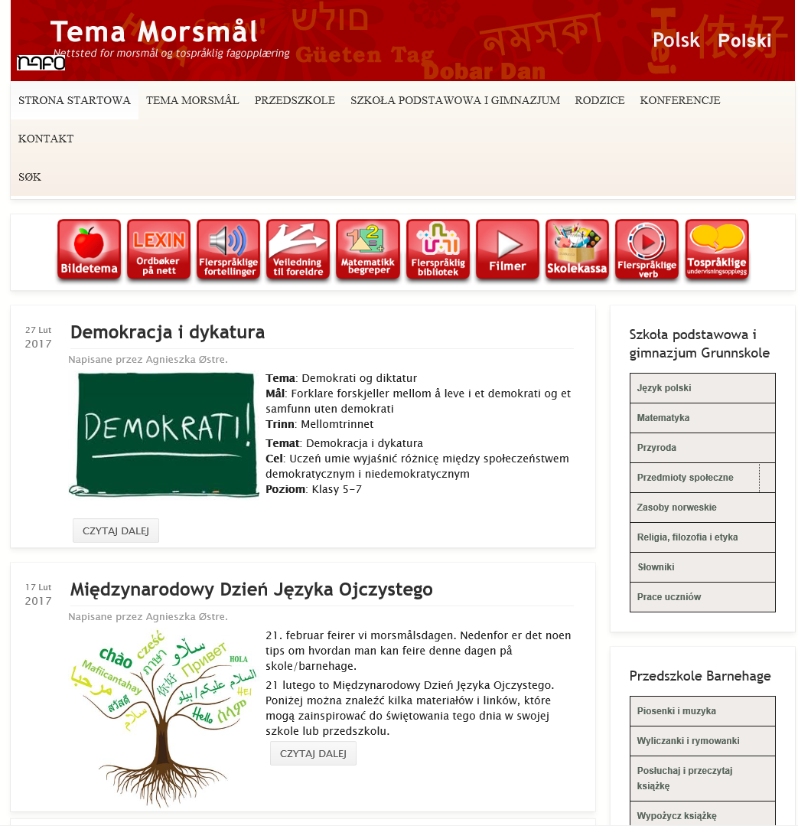

Slide 11
Morsmaal.no (continued)
Mainly users from No/Sw
  Entries from Sweden nearly doubled from 2015->2016
+ users from Iran, Poland, Afghanistan, Russia, Thailand, Pakistan and India
The service is free of charge
(with some exceptions

Slide 12
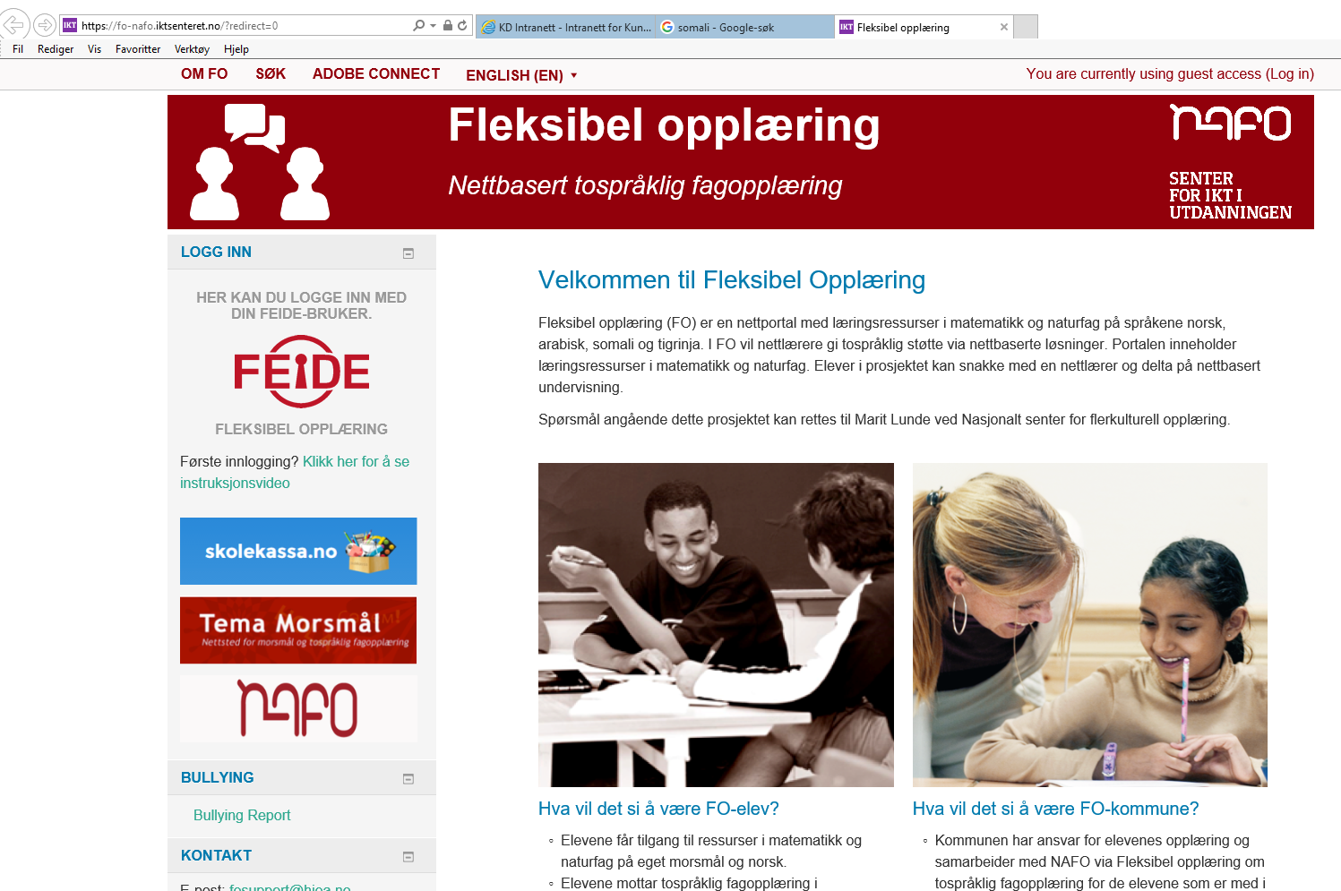
Fleksibel opplæring (Flexibel training - FT)
NAFO has been commissioned by the Directorate of Education and Training to test whether, and how, to offer a bilingual instruction via online services.
https://fo-nafo.iktsenteret.no/

Slide 13
Fleksibel opplæring (Flexible training - FT)
Aims at testing bilingual support in science/mathematics for minority students in 8th and 9th grade.
It is not intended to be a substitute for bilingual teachers, but is (so far) offered to schools that have failed to provide bilingual teachers in Arabic, Somali and Tigrinya.
The challenge:
How to develop good educational modules for the same subject in two different languages ​​(e.g. Arabic and Norwegian) in a way that students learn BOTH the subject AND Norwegian
Based on experiences from the Virtual School for Mathematics, Moodle (a Learning Management System) is used as the platform for the project.
Online services will consist of bilingual learning resources and bilingual online teachers in these languages. Adobe Connect is used to conduct real-time teaching sessions for bilingual online teachers, local teachers and students.
The project is now developed, in collaboration with 5 municipalities + 1 county; 50 pupils are taking part.
This phase will be terminated by the end of 2017, evaluated and a decision will be made whether to pilot

Slide 14
Skolekassa.no
The Skolekassa website contains many educational resources designed for children and young people of school age who have recently arrived in Norway.
A Partneship where EdTech-companies provide digital learning resources.
Skolekassa contains a mixture of free resources, available to everyone, and restricted resources that are available only to licensed users.
  Access to restricted resources: log on by Feide username and password;
  a prerequisite from EdTech for making their resources available
The site is designed to be as self-explanatory as possible, so it can be used by pupils on their own.
  However, it is important that teachers provide guidance

Slide 15
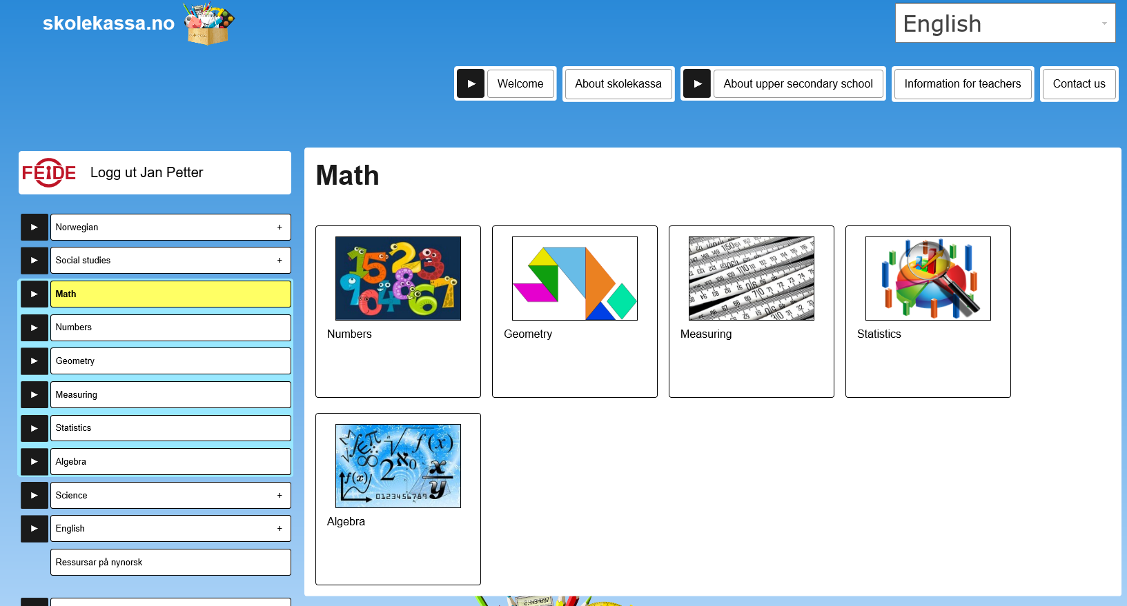

Slide 16
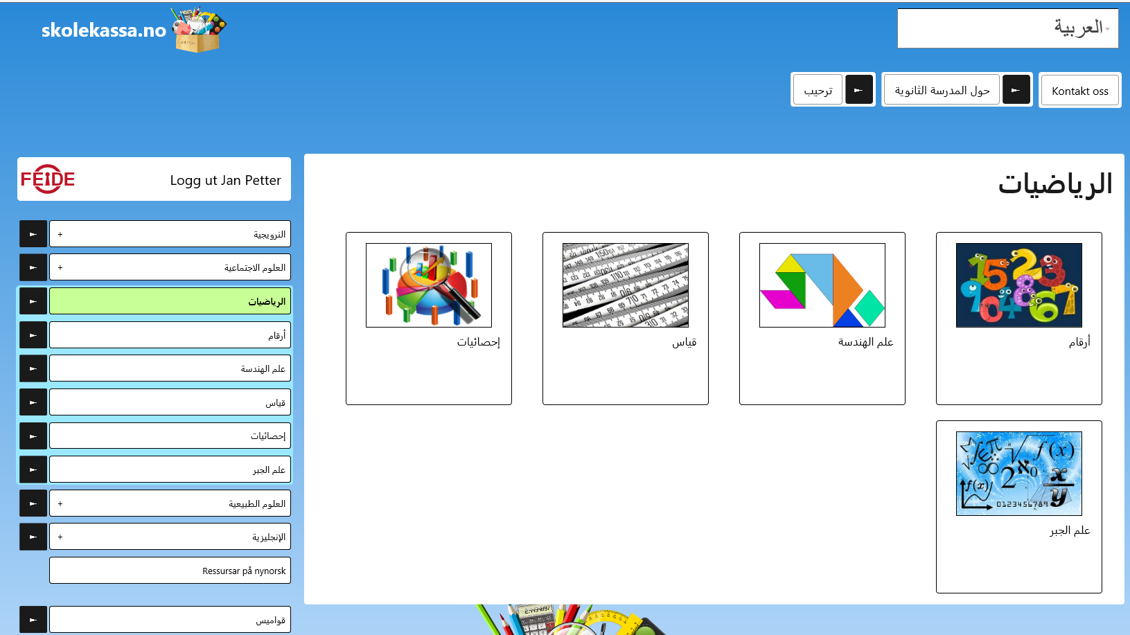
Skolekassa - arabic

Slide 17
Skolekassa.no: status
Developed/Piloted in 2016
The available resources free of charge in 2016
From 2017: school owners have to pay for licensed resources.
  How many will continue when this is not a free service
More than100 school-owners have signed up.

Slide 18
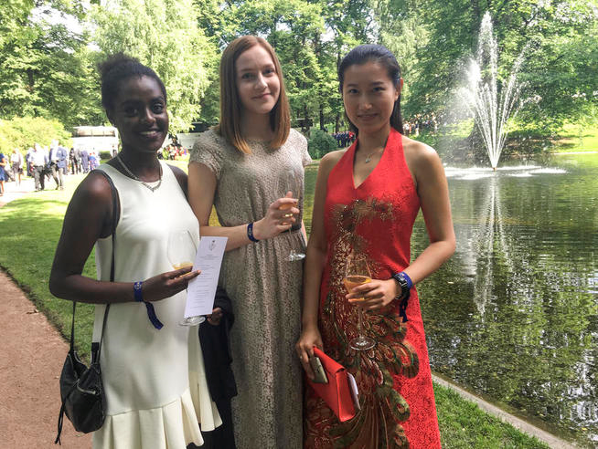
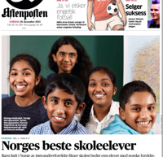
Some concluding remarks
In 2015 we had a large increase in numbers of asylum seekers between the age of 6-18 years. This group also has the right to education.
  Children who arrive in Norway during their school age – especially those who arrive late in their school age- are facing tougher challenges than most other students:
  learn Norwegian as soon as possible and make up for lost schooling.
Can ICT contribute to better integration?
  ICT allows for more flexibility and reuse of resources (e.g. Morsmaal.no)
  ICT allows for more easy access to learning resources
    Reduced costs for both school-owners (municipalities and counties) and service providers, partly due to Feide (e-Id for education).
  The experiences so far indicate that these services are requested by the school-owners
  The school-owners are increasingly prepared to pay for digital services, given they will get value for money
    They now have to pay for using Skolekassa.no, and
    since January this year, 1 in 4 school-owners have subscribed
"Norway's best pupils"

Slide 19
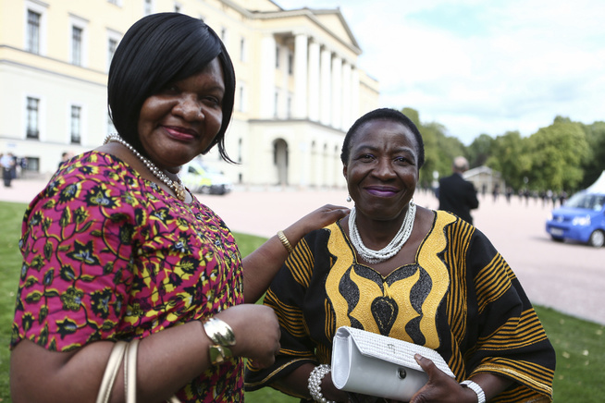
Thank you for your attention!

