Slide 1
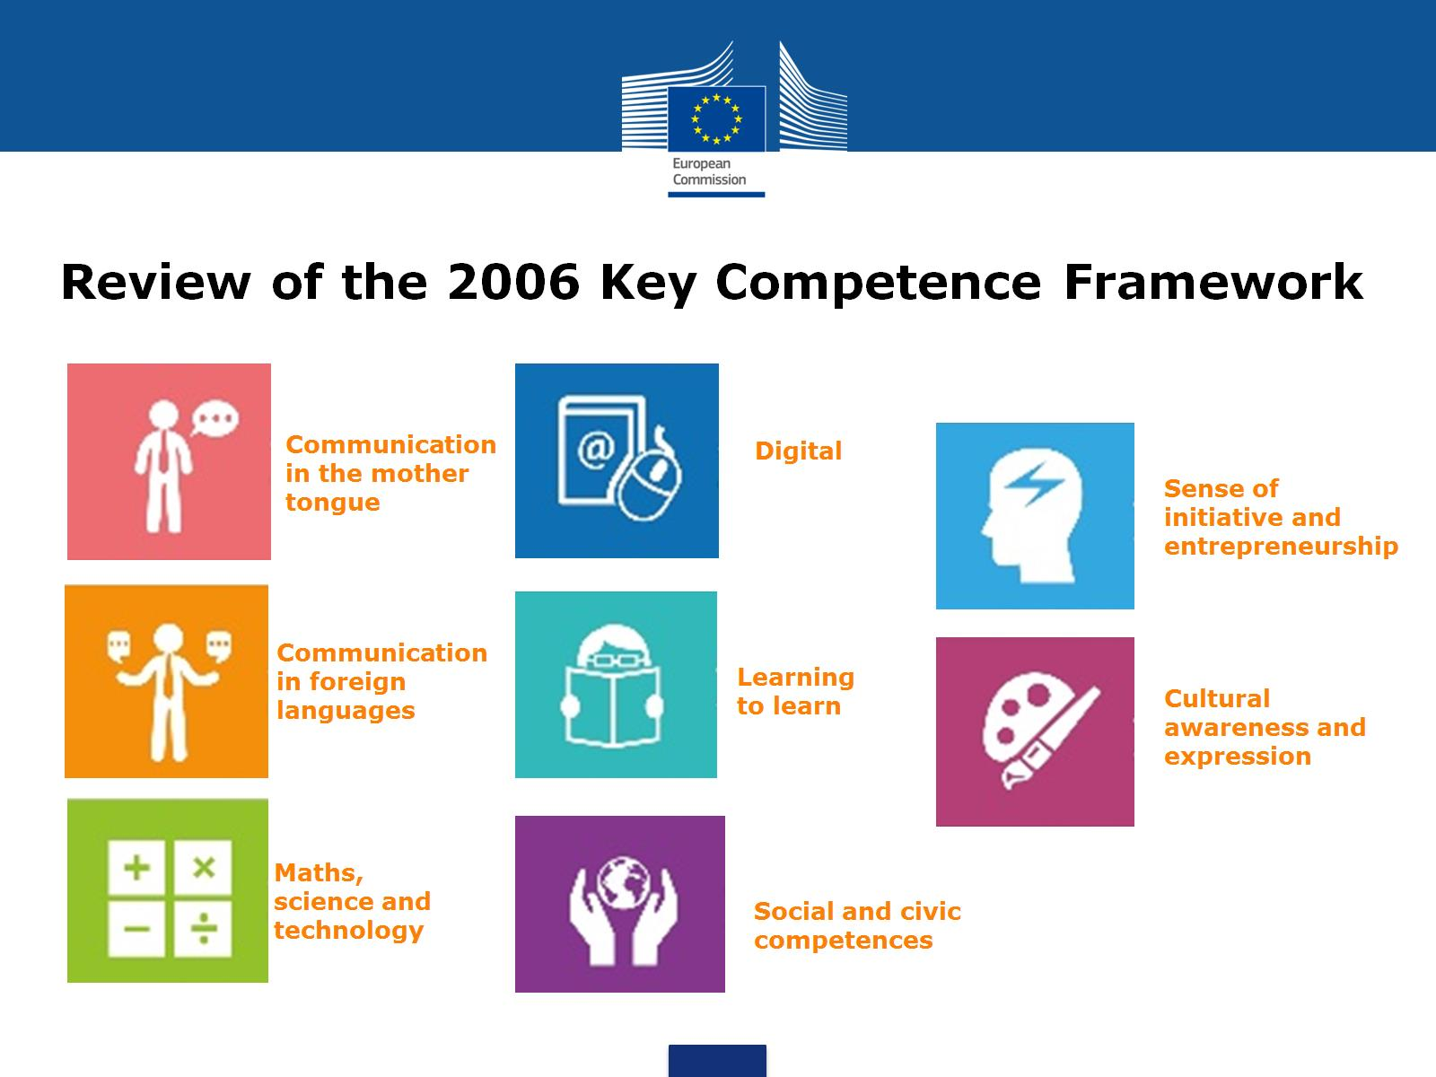

Slide 2

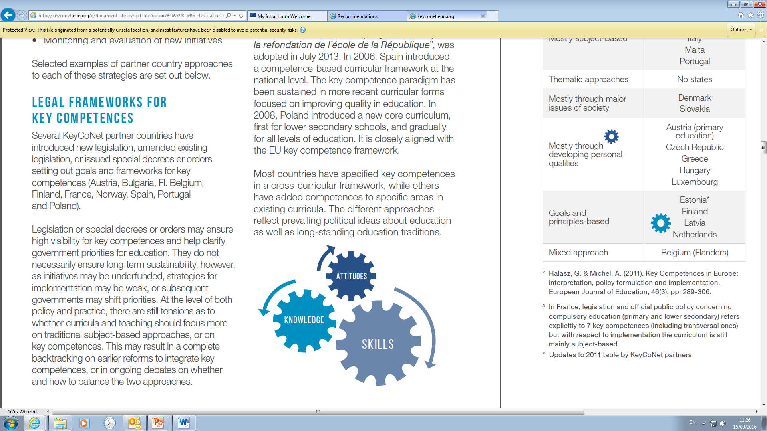
…appropriate to a given context…

Slide 3

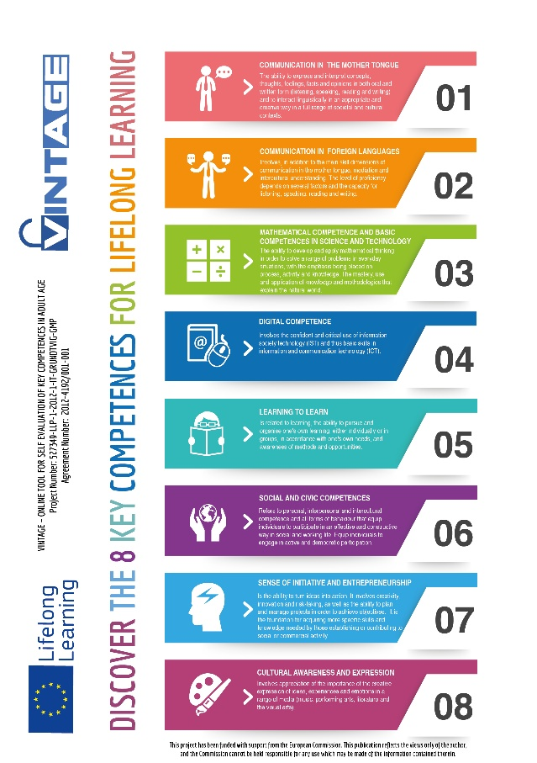
inclusion empowerment sustainability
Communication in foreign languages
Communication in the mother tongue
Digital
Cultural awareness and expression
Maths, science and technology
Social and civic
Learning to learn
Entrepreneurship
2006

Slide 4


Protecting the now
Empowering the future

Slide 5
Empowering the now
Protecting the future

Slide 6

Why review the Key Competence Framework?

Slide 7
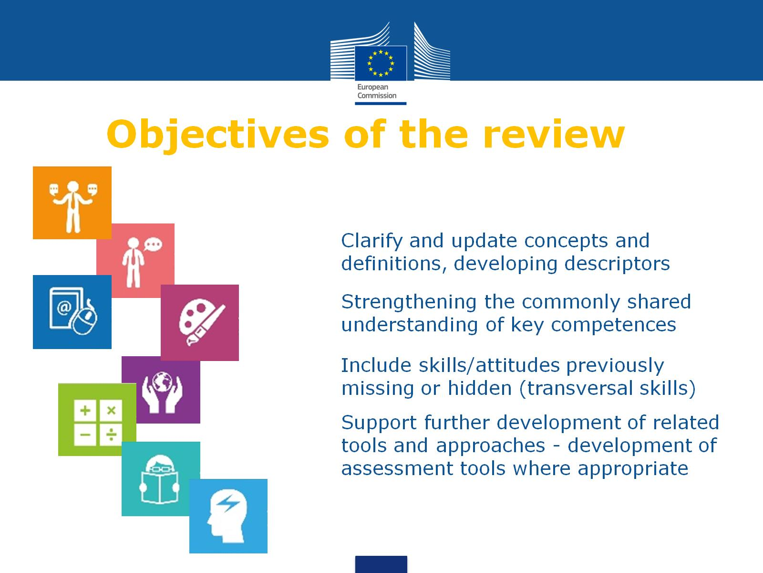

Slide 8
(self)assessment tools
meanings & objectives
monitoring & evaluation
vision of understanding and shaping world

Slide 9


Slide 10
Timeline
Review process 2017
- Meetings
- Consultation (Mar-May)
- Conference (June)
- Drafting (July)
- Approval (Oct/Nov)

Slide 11
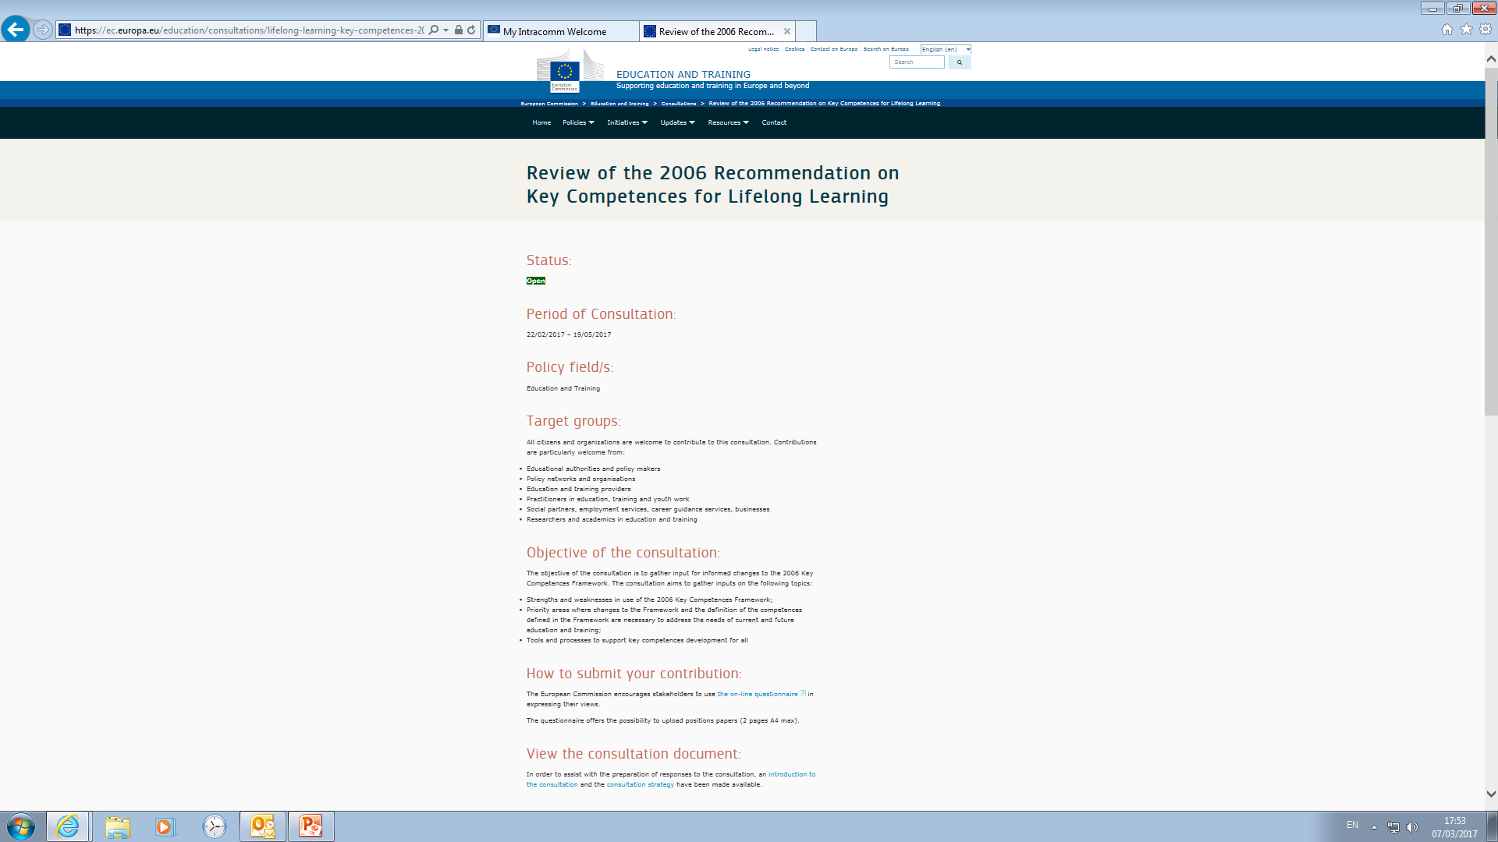
PUBLIC CONSULTATION
- hyperlink

Slide 13
How to submit your contribution:
The European Commission encourages stakeholders to use the on-line questionnaire in expressing their views.
The questionnaire offers the possibility to upload positions papers (2 pages A4 max).

Slide 14
PART A: About you
PART B: Consultation Questions
The Key Competence Framework – the overall concept
II. Key Competence Definitions
III. Future use of the Key Competence Framework
IV. Other responses
Closes 19 May 2017

Slide 15
QUESTIONS?

