Slide 1
DigCompEdu
Towards a framework for Educators' Digital Competence
Christine Redecker & Yves Punie (JRC B4)
ET2020 WG Digital Skills and Competences
Brussels, 7-8 March 2017
Notes:
The teaching professions face rapidly changing demands, which give rise to a broader and more sophisticated set of competences than before. The ubiquity of digital devices and applications, in particular, requires educators to develop their digital competence.
On International and national level a number of frameworks, self-assessment tools and training programmes have been developed to describe the facets of digital competence for educators and to help them assess their competence, identify their training needs and offer targeted training. Analysing and clustering these instruments, this report presents a common European Framework for the Digital Competence of Educators (DigCompEdu).
The DigCompEdu framework is directed towards educators at all levels of education, from early childhood to higher and adult education, including general and vocational training, special needs education, and non-formal learning contexts. It aims to provide a general reference frame for developers of Digital Competence models, i.e. Member States, regional governments, relevant national and regional agencies, educational organisations themselves, and public or private professional training providers.

Slide 2
Policy Background
New Skills Agenda for Europe, COM(2016) 381
Opening Up Education Communication, COM(2013) 654
*http://ec.europa.eu/education/policy/strategic-framework/education-technology_en
"There is a need for boosting teachers' digital competences"*
63% of nine year olds do not study at a 'highly digitally-equipped school' (with appropriate equipment, fast broadband and high 'connectivity'). (2)
Only 20-25% of students are taught by digitally confident and supportive teachers. (2)
Between 50% and 80% of students in the EU never use digital textbooks, exercise software, broadcasts/podcasts, simulations or learning games.
Almost all jobs, require some level of digital skills, as does participation in society at large. (1)
70% of teachers in the EU recognize the importance of training in digital-supported ways (2)
Learners expect more personalization, collaboration much of it being possible through digital-supported learning (2)
A new digital divide in the EU, between those who have access to innovative, technology-based education and those who do not, is on the rise (2)
Reality
Expectations

Slide 3
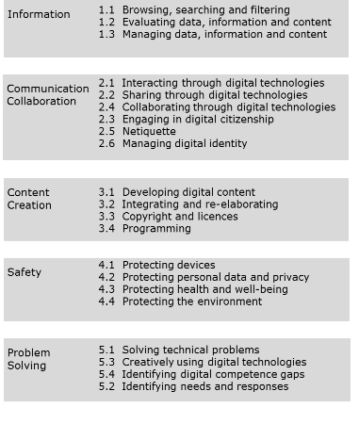
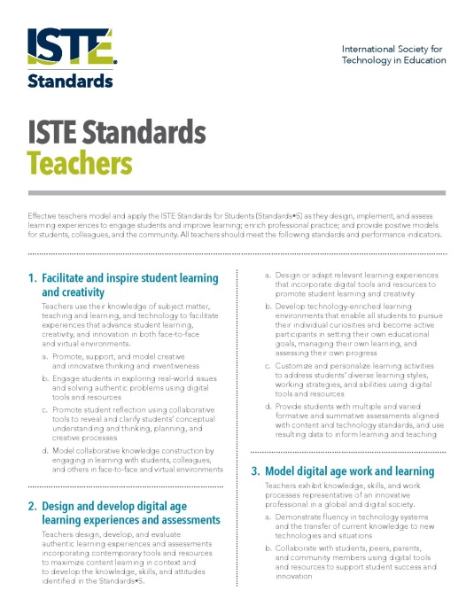
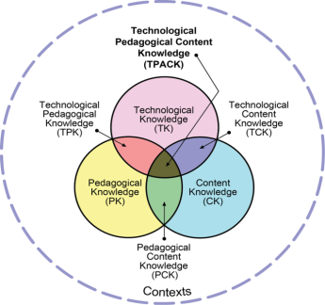
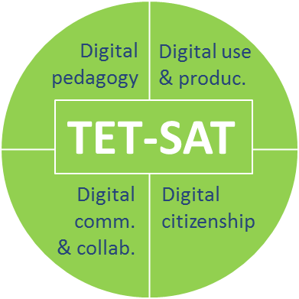
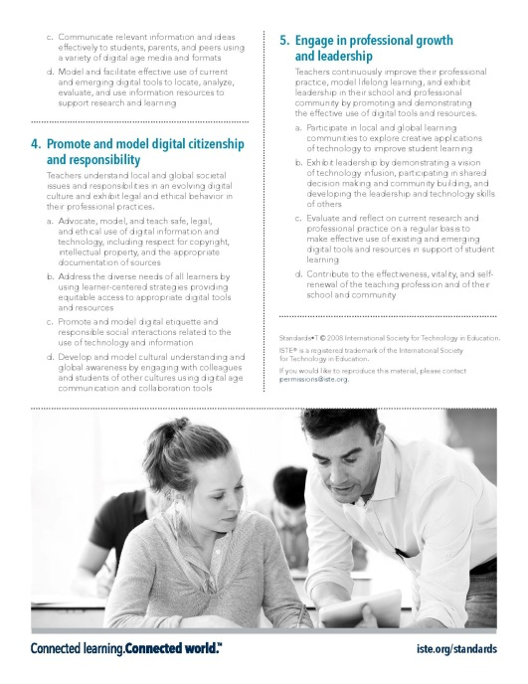
Why a new European framework?
DIGCOMP
TPACK
UNECO ICT CFT
ISTE Standards-T
MENTEP
UNESCO ICT Competency Framework for Teachers, 2011
Not targeted at educators
Used as teacher competence framework in Spain and France, amongst others
Model often quoted in the scientific literature and used as a point of departure by some member states (Austria, Finland)
Version 2.0 form 2011; 3rd version currently underway
Internationally recognized
Take-up with adaptations and transformations in many African countries
In Europe, Ireland is using it as a basis
Part of a set of standards
for students, educators, administrators, coaches and computer science educators)
International Society for Technology in Education, US-based.
In Europe, used in Estonia
Developed by EUN & MS consortium (Erasmus+)
Integrates DIGCOMP
Linked to a self-assessment tool for teachers which is currently being piloted
Designed for developing countries
incomplete
US discourse
Basis to build on

Slide 4
Expectations for DigCompEdu
DIGCOMP
Information
Communication
Content creation
Safety
Problem solving
Transversal
competences
Synthesize
all existing models and instruments into one generic framework as a
common frame of reference
Educators' personal competences
Learners' overall learning objectives
Pedagogic competences
Subject specific
competences
Subject specific
competences

Slide 5
What can a European framework contribute?
Shared understanding
Provide a common language and shared understanding of the key elements of educators' digital competence (all levels)
Explain how educators' digital competence can contribute to innovation in education
Indicate how digital competence progresses and can be developed, on the individual level
Allow to understand current levels of digital competence and development needs
Understand what kind of training and CPD could boost educators' competences
Innovation
Progression
Assessment
Training

Slide 6
DigCompEdu Project Methodology
On behalf of DG EAC
Desk Research
June-Oct2016
Phase I
Literature Review
Inventory
Meta-Analysis
Oct. 2016
Proposal
Stakeholder Consultation
October 2016-
February 2017
Phase II
Experts
Teachers
Expert Workshop
Revision
eTwinning Workshops
March 2017
Draft Framework
Experts
Policy makers
Stakeholder Consultation
Teachers
March-
May 2017
Phase III
Peer Review
Validation
Online Consultation
June 2017
Final Framework
Incl. S-A questions

Slide 7
Inventory of Instruments
Phase I
International Frameworks | European Frameworks | National Frameworks | Self-assessment tools | Courses & certificates | Research & Expert opinion
UNESCO ICT-CFT | MENTEP | EE-HITSA | HU-eLEMÉR | ECDL | Tondeur et al. (2016)
GESCI-H2O ICT-CPD | EIfEL | ES-MCCDD | AT-DIGIcheck | EPICT AT | Almerich et al. (2016)
ICTeTSA | eTQF | NL-KB-ICT | FI-Opeka | EPICT UK | Johnson & Mielke (2013)
ISTE-T | uTeacher | AT-Digi.kompP | SE-LIKA | UK-CMALT
 | EPICT | SI-eCom | UK-DigiLit
 |  | ICT-UKPSF | UK-RAPTA
 |  | UK-JISC | UK-Ed-Assess
 |  | NO-PfDK
 |  | AU-GTS-ICT
 |  | IE-TEL-DNA
 | eVirtue | Kennisnet (NL) | UK: JISC-PriDE | Blended Learning Essentials (UK) | Muñoz Carril et al. (2013
 | ePortfolios & Open Badges Maturity Matrix | IE: e-Learning Roadmap | NO: Laerermentor | British Council: TeachingEnglish | Bawane & Spector (2009)
UNESCO MIL | OEF: Open Educators Factory | IE: All Aboard | Legend All education sectors School education Higher education Further Education Not specified |  | TPACK (2006)
 |  | UK: LSE |  |  | EdTech (2015)
 |  | UK: Information literacy lens
 |  |  |  |  | Jeff Dunn(2014)
 |  | China: CETS |  |  | T.H.E Journal (2014)
 |  |  |  |  | Pool (2012)
 |  |  |  |  | Andrade (2012)
 |  |  |  |  | Turner (2005)

Slide 8
Framework Development
Phase I
Frameworks
Analysis
Mapping
Clustering
DigCompEdu
Framework
Backcasting
A
B
A
B
A
B
A
B
A
B
2
1
2
4
1.1
1.2
1.3
1
1
1a
1
5
1
2.2
1a
2.1
1
5
4.1
2
2
1b
2
4.1
1b
2
3
3
2
3
3a
1
3a
1
1.1
2
3.1
3
2
2.1
2.2
4
4
3a
4
1b
2
1a
5a
2
2.1
3a
1.2
4
5
5
3b
5a
3.1
3b
2.2
5a
3b
3
3
3
3.1
-
6
4
5b
3b
3
4.2
4
5b
5
6
1a
5a
1.3
5
4.2
6
4
1b
2
4
4.1
4.2
4
6
4
4
6
5b
5b
5b
Proposal October 2016

Slide 9
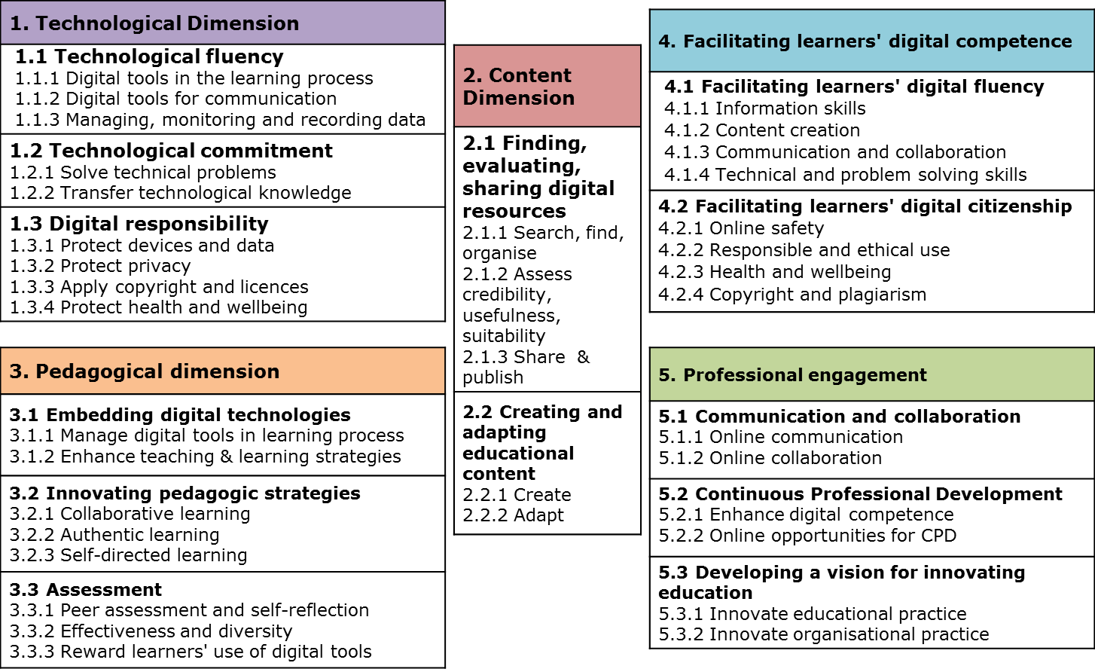
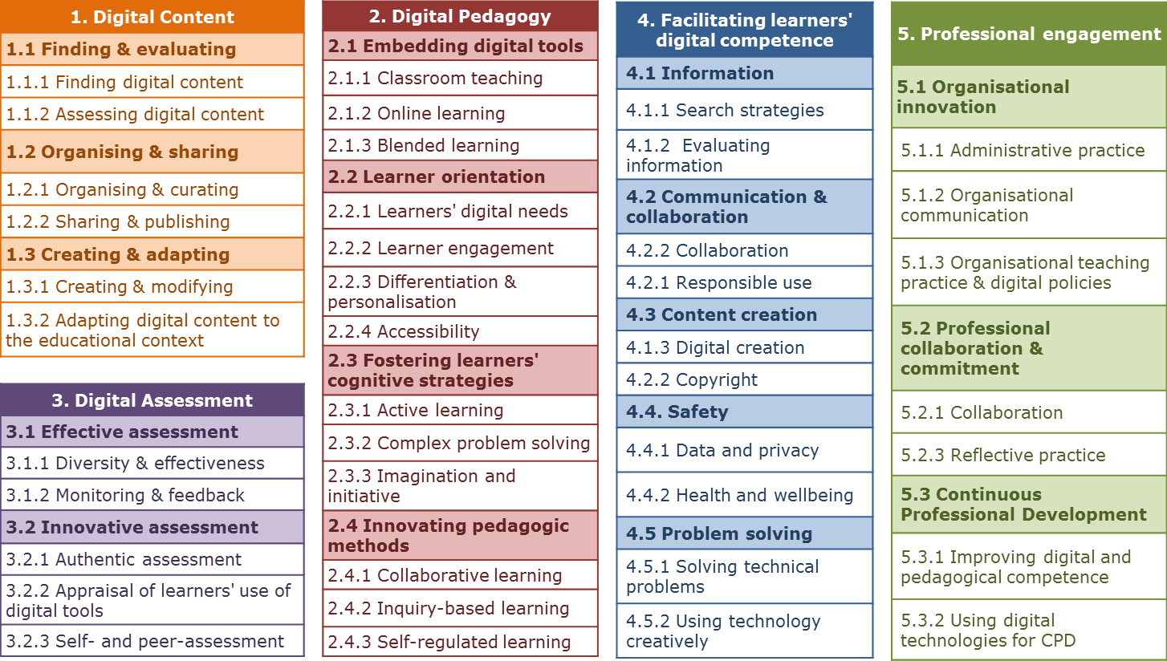
Phase II
Proposal October 2016
Proposal January 2017
eTwinning
Workshops
In-house consultations
Expert Workshop
In-house consultations
Draft Framework
February 2017

Slide 10
Draft Framework February 2017
6 Areas
2.
Digital
Resources
1.
Professional Engagement
6.
Facilitating
Learners' Digital Competence
3.
Digital
Pedagogy
5.
Empowering
Learners
4.
Digital
Assessment

Slide 11
Draft Framework February 2017
23 Competences
1. Professional engagement
1.1 Data management
1.2 Communication
1.3 Professional collaboration
1.4 Reflective practice
1.5 Continuous professional development (CPD)
2. Digital Resources
2.1 Selecting
2.2 Organising & sharing
2.3 Creating
5. Learner Empowerment Using digital tools to empower learners through:
5.1 Accessibility & inclusion
5.2 Differentiation & personalisation
5.3 Actively engaging learners
6. Facilitating learners' digital competence
6.1 Information & media literacy
6.2 Communication
6.3 Content creation
6.4. Wellbeing
6.5 Problem solving
3. Digital Pedagogy Using digital tools to enhance & innovate
3.1 Instruction
3.2 Teacher-learner interaction
3.3 Learner collaboration
3.4 Self-directed learning
4. Digital Assessment Using digital tools to enhance & innovate
4.1 Assessment formats
4.2 Analysing evidence
4.3 Feedback & planning

Slide 12
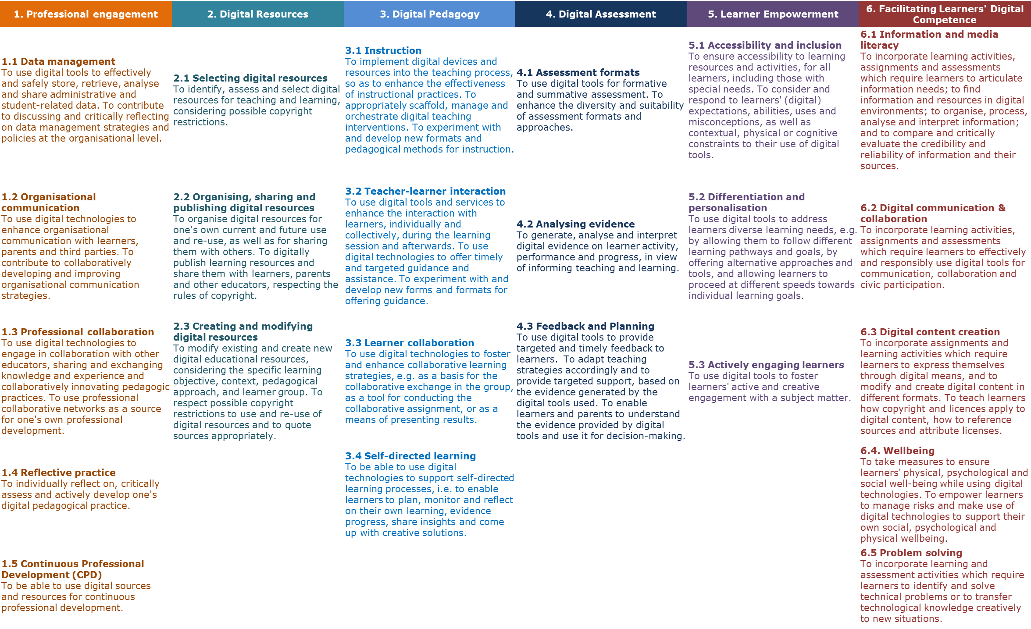
Draft Framework February 2017

Slide 13
Proficiency levels
 | Newcomer (A1) | Explorer (A2) | Enthusiast (B1) | Professional (B2) | Expert (C1) | Pioneer (C2)
1. Professional Engagement | Making little use; Being unsure | Being aware; Basic tool use | Effective use; Responsible use; Experimentation | Structured; Creative; Responsive; Transparent; Reflected practice | Critically, Strategically: Evaluating, Discussing, Reflecting | Re-designing, Innovating
2. Digital Resources | Making little use; Being unsure | Being aware; Basic tool use | Basic criteria; Basic strategies Some advanced features | Advanced strategies; Complex criteria; Creating resources | Comprehensively using Advanced tools; Publishing resources | Professionally creating & publishing
3. Digital Pedagogy | Making little use; Being unsure | Being aware; Basic tool use | Integrating & Implementing meaningfully | Enhancing, Scaffolding | Orchestrating; flexibly adapting; strategically; purposefully | Innovating teaching
4. Digital Assessment | Making little use; Being unsure | Basic tool use within traditional approaches | Employing digital tools to enhance traditional approaches | Strategic, Effective use | Comprehensive, Critical, Reflective practice | Innovating assessment
5. Empowering Learners | Making little use; Being unsure | Being aware; Basic tool use | Addressing learner empowerment | Strategically using a Range of tools to empower | Comprehensively, Critically Enhancing | Innovating strategies
6. Learners' DC | Making little use of strategies for learners' DC | Encouraging learners to use digital tools | Implementing activities fostering learners' DC | Strategically using a range of strategies | Comprehensively and critically fostering learners' DC | Using innovative formats for fostering learners' DC

Slide 14
Example:
Digital Resources

Slide 15
Sample competence description
2. Digital Resources
2.1 Selecting digital resources To identify, assess and select digital resources for teaching and learning, considering possible copyright restrictions.
To formulate appropriate search strategies To identify suitable resources To critically evaluate the credibility and reliability sources and resources To consider possible restrictions to their use or re-use (e.g. copyright, file type) To assess their usefulness in addressing the learning objective, the competence levels of the concrete learner group as well as the pedagogic approach chosen
Newcomer (A1) | Explorer (A2) | Enthusiast (B1) | Professional (B2) | Expert (C1) | Pioneer (C2)
Making little use of the internet to find resources | Being aware and making basic use of digital tools for finding resources | Identifying and assessing suitable resources using basic criteria | Identifying and assessing suitable resources using complex criteria | Comprehensively identifying and assessing suitable resources, considering in all relevant aspects | Improving access to digital resources
I only rarely, if at all, use the internet to find resources for teaching and learning, | I use simple internet search strategies to identify digital content relevant for teaching and learning. I am aware of common educational platforms which provide educational resources. I am aware that some resources distributed on the Internet are copyrighted. | I adapt my search strategies based on the results I obtain. I filter results to find suitable resources, using appropriate criteria. I evaluate the quality of digital resources based on basic criteria, such as e.g. place of publication, authorship, other users' feedback. I select resources that my learner may find appealing, e.g. videos. I understand the copyright rules that apply to the digital resources I use for school purposes (images, text, audio and film). | I adapt my search strategies to identify resources which I can modify and adapt, e.g. searching and filtering by license, filename extension, date, user feedback etc). I locate apps and games for my learners to use. I evaluate the reliability of digital resources and their suitability for my learner group and specific learning objective. I give feedback and recommendations on the resources used. | In addition to search engines I use a variety of other sources, e.g. collaborative platforms, official repositories, etc. I evaluate the reliability and suitability of content based on a combination of criteria, verifying also its accuracy and neutrality. When I use resources in class, I contextualise them for the students, e.g. by pointing out their source and potential bias. I know the differences between licenses and how they affect digital content. | I provide guidance to colleagues on effective search strategies and suitable repositories and resources I set up my own repository of (links to) resources, appropriately annotated and rated, and make it available for other colleagues to use

Slide 16
On the proficiency levels…
Not everyone can be / should be expert or pioneer
Not even for one competence – certainly not for all
Depends on the role of the teacher, the subject, the education level, the education sector, etc…
Several perspectives: individual, class, school, region, country, EU…
It is a reference framework
Self-evaluation allows for understanding one's strength and weaknesses, to look for training and to improve on some competences
Allows for monitoring and measurement at school and aggregate level
Crucial links with frameworks for educational organisations (DigCompOrg), Educators (DigCompEdu), learners and citizens (DigComp), Open Education (OpenEdu) -> holistic approach

Slide 17
Next steps
Stakeholder Consultation
Experts
Policy makers
March-
May 2017
Teachers
Phase III
Peer Review
Validation
Online Consultation
April: Launch of online consultation (survey)
eTwinning; DigCompOrg teachers
Invitation to other stakeholders (e.g. LinkedIn)
24 Feb: Invitation to peer review (30 experts)
8 March: Consultation ET 2020 WG Digital Skills
14/15 March: Discussion at UNESCO Expert meeting
https://ec.europa.eu/eusurvey/runner/DigCompEduSAQ
Focus on framework
Focus on self-assessment questionnaire
June 2017
Final Framework
Notes:
We are in phase 3 now (click)
The aim of this phase is to finalise the framework by June this year (click)
We will do this first by a series of expert consultations which we have started two weeks ago, by inviting all experts previously involved to peer review the framework. As you can see, this meeting here forms part of these consultations and we hope you will offer us your comments and feedback. (…) (click)
In april we will broaden the circle of experts to be consulted, trying to get as much feedback as we can from teachers themselves, but also inviting all other stakeholder groups again, because… (click)
… the current consultations focus on getting the framework right, whereas in April we will focus on getting the sample questions for the self-assessment questionnaire right, which will help us refine the proficiency levels of the framework
To make it easier for you and also all the other experts we have contacted to contribute to refining the framework we have launched today a survey environment, with some targeted questions for a quick feedback. This survey should only take around 20 minutes and we would really appreciate if you could find the time to go through the questions.

Slide 18
ET 2020 WG Digital Skills consultation 8 March:
Supporting survey
https://ec.europa.eu/eusurvey/
runner/DigCompEduConsultation
Further involvement: Expression of interest sheet

Slide 19


Thank you
Christine.Redecker@ec.europa.eu
Yves.Punie@ec.europa.eu
@yves998

