Slide 1

Digital development in Danish General Upp. Sec. Schools
By Hans Laugesen
Senior Educ. Policy Officer in GL
(representing ETUCE in TWGs)

Slide 2

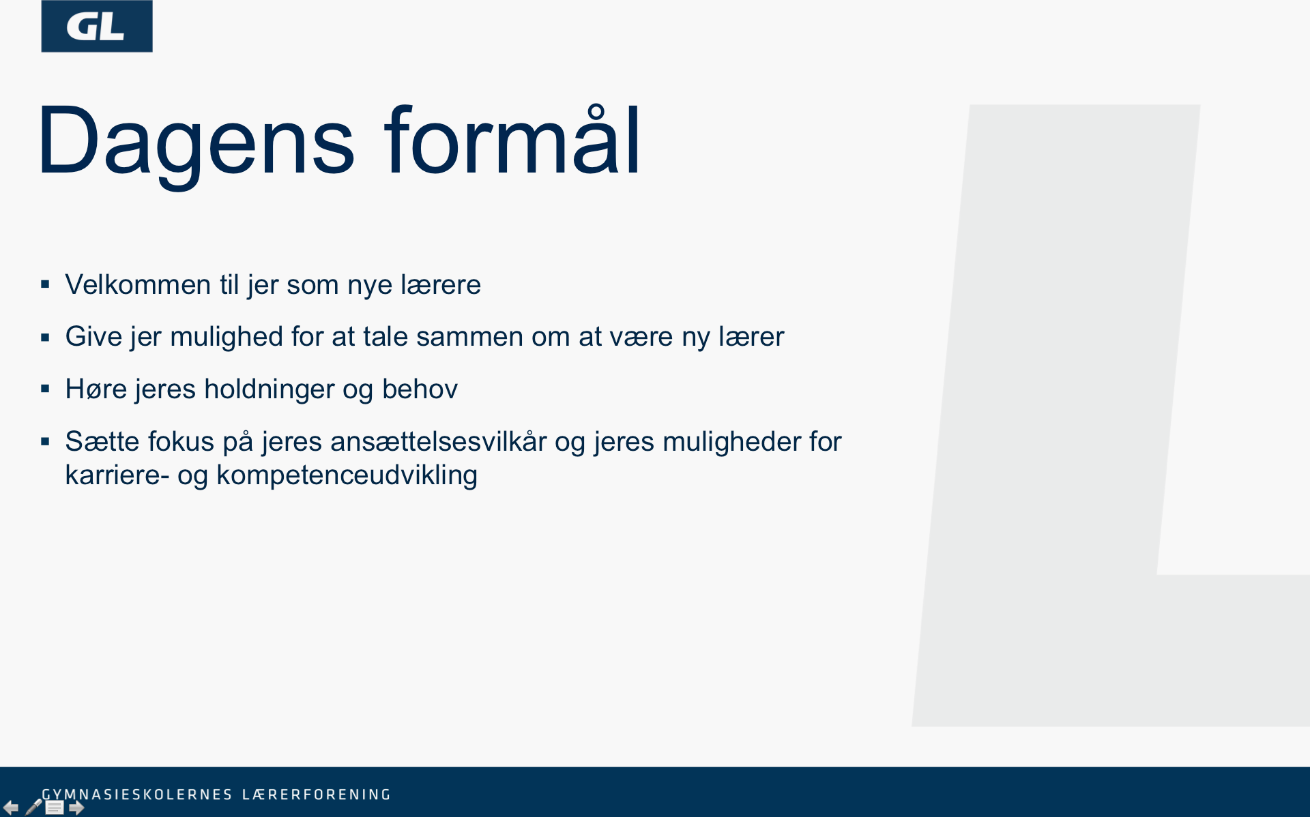
2017 reform of Gen. Upp. Schools
Former 2005 reform focused on 21. Cent. Skills incl. teams, cross curricular cooperation and projects
2017 reform elements:
  Access control to increase quality level
    expected to stimulate flow to vocational educ.
  More focus on subject knowledge
  Keep, but modernise ‘buildung’ concept, include
    Global Competence
    Innovative Competence
    Career Competence
    Digital Competence

Slide 3
Students Digital Competences
All subject curricula contains section on use of ICT
Focus on how to use ICT so it support the learning process and learning outcome
Different focus depending on subject
  Critical information search
  Simulation and/or Analysis
  Presentations, Models, Diagrams
  Communication including knowledge sharing and active participation in debates

Slide 4
ICT at final exams
General principle: exam should reflect daily practice
Students use own pc at written exams. Some subjects allow free access to Internet, but most forbid external communication
Oral exams gives students access to own notes also in the sky but restrict access to communication
Ministry consider requirement of installation of sniffer program on students pc to check communication
But increased focus on cheating – harder punishment
  All written exam paper are controlled for plagiarism

Slide 5
Additional digital initiatives - 1
Governmental priority to digitise public services where possible – including educational sector
  ICT at exams:
    Electronic distribution of exam questions
      Including new ICT based assignments
    Electronic delivery of students exam products to two external censors
      Saves time, saves postage and permits control of plagiarism
  Virtual lessons up to 25% of all lessons

Slide 6
Additional digital initiatives - 2
Initiatives to increase knowledge sharing
  Case description of schools with existing successful and innovative use of ICT
  Support to five display schools who develop organisational and pedagogical initiatives in cooperation between management, teachers and support staff to develop practice with the use of ICT
Focus on pedagogical use of ICT in reform of teachers initial pedagogical training and in teachers CPD

