Slide 1
TEACHER PLACEMENTS IN INDUSTRY IN MONTENEGRO
Julian STANLEY,
European TRAINING FOUNDATION
16° May 2017, podgarica

Slide 2
A Success story
Improving COOPERATION BETWEEN SCHOOLS AND INDUSTRY
HELPING TEACHERS TO RENEW THEIR PROFESSIONAL SELVES
PARTNERSHIP APPROACH – MINISTRY, CHAMBER OF THE ECONOMY, SCHOOLS, BUSINESSES, VET CENTRE
SCALING UP OF INPUTS: 2 PLACEMENT ORGANISERS & SCHOOL COORDINATORS
SCALING UP OF OUTPUTS:
2016 = 20 TEACHERS IN INDUSTRY
2017 = 70 TEACHERS IN INDUSTRY

Slide 3
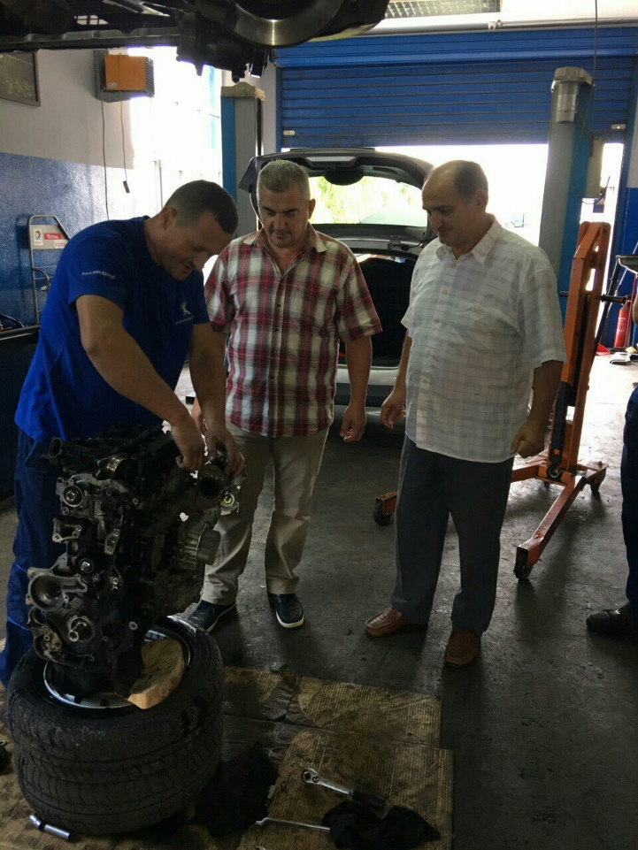
WORK IN PROGRESS
Getting THE RIGHt PLACEMENT FOR THE RIGHT TEACHER AT THE RIGHT TIME
GETTING better teaching and learning
Partnership projects with employers
Learning materials and projects
Making vocational classes relevant to the workplace
Sharing and communicating
Debriefing and Planning
Certification and recognition

Slide 4
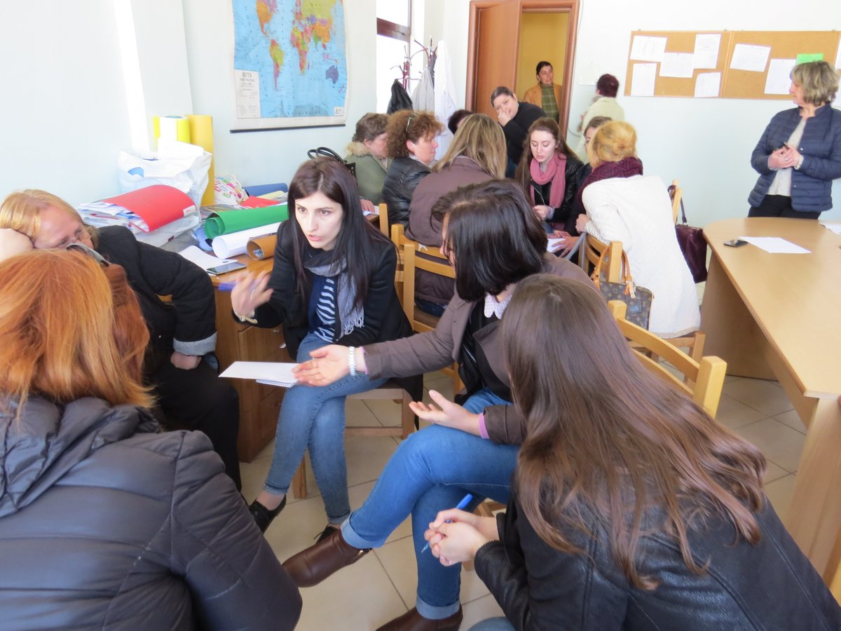
MORE Opportunities for learning
Other projects in South east europe and turkey:
E-portFolios,
CAD skills,
digital instructional materials,
pedagogical skills,
CRITICAL THINKING
QUALITY ASSURANCE OF CPD
PEER LEARNING AND MENTORING, ETC.

Slide 5
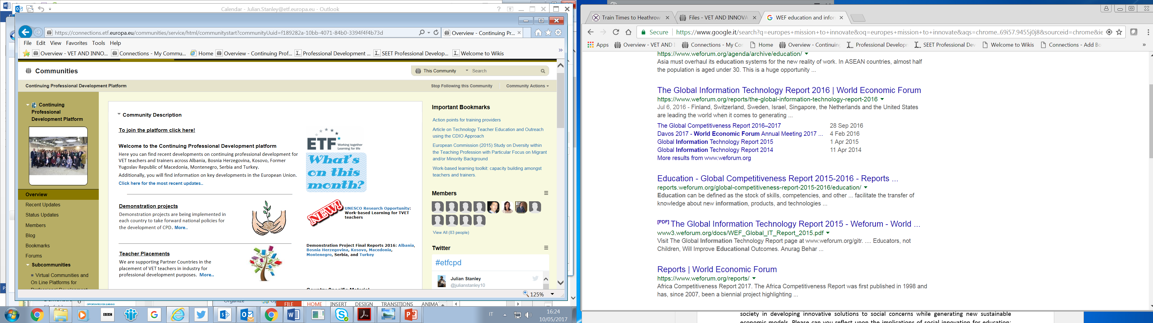
LEARNING THROUGH NETWORKS
Etf’S network:
https://connections.etf.europa.eu/communities/service/html/communitystart?communityUuid=f189282a-10bb-4071-84b0-3394f4f4b73d
COMING NEXT:
NETWORKS FOR VOCATIONAL TEACHERS IN MONTENEGRO…

Slide 6
Stay in touch!
Visit our website: www.etf.europa.eu
To learn more see the ETF CPD virtual platform at https://connections.etf.europa.eu/communities/community/cpd
Email: Julian.stanley@etf.europa.eu
ON twitter:
#etfcpd
@julianstanley10
@ETF

