Slide 1
Virtual networks for PROFESSIONAL DEVELOPMENT FOR VOCATIONAL TEACHERS and trainers IN montenegro
Julian STANLEY,
European TRAINING FOUNDATION
podgorica, october 12° 2017

Slide 2
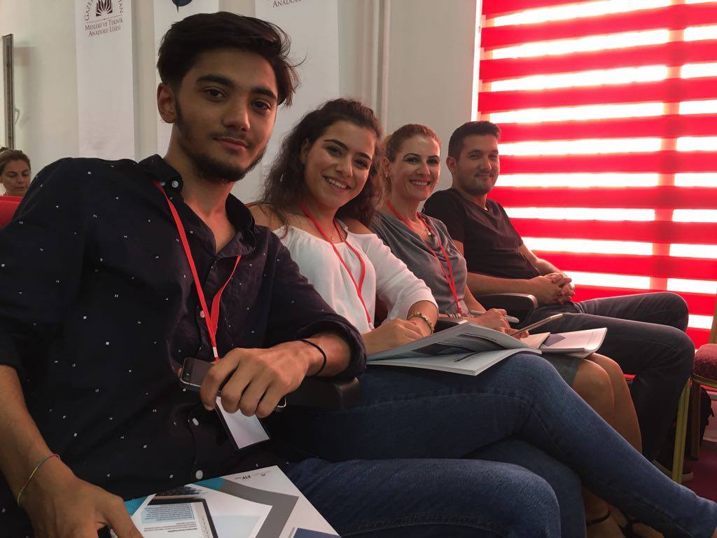
Why Virtual networking?
Sharing Open educational resources
making collaboration easy
Making professional development responsive to needs
Supporting teaching practice
Blending training events with virtual platforms
Empowering teachers to take a lead in improvement

Slide 3
Some examples of platforms
TES Resources. For teachers, by teachers
FORAUS Germany
Website of the Swiss Federal Institute for Vocational Education and Training SFIVET
DSCHOOL Greece
Meslek Öğretmeni, tuRKEY: http://www.meslekogretmeni.com
Notes:
1,500-2,000 single visits each day for Turkish site

Slide 4
Relevance of professional networks to montenegro
Strategy for VET 2015-2020 advocates using on-line learning and platforms to share practice and develop digital skills.
National Strategy on Teachers’ Education 2017-25 emphasises need for digital skills.
Specialist vocational teachers cannot easily collaborate as they are spread around the country
Travel and expenses of face-to-face training increase training costs
Some vocational subjects lack good teaching, assessment and learning resources in the Montenegrin language
Currently IPA programme in Montenegro to renew 10 curricula – teachers will need new instructional materials: face to face training could be supported by on-line communities

Slide 5
Etf supporting networks
Etf PLATFORM
https://connections.etf.europa.eu/communities/community/cpd
IN SOUTH EAST EUROPE:
  ALBANIA
  SERBIA
  FORMER YUGOSLAV REPUBLIC OF MACEDONIA

Slide 6
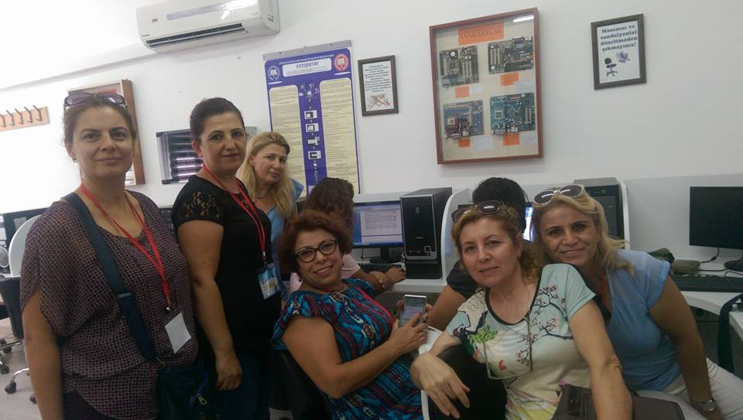
Stay in touch!
Visit our website:
www.etf.europa.eu
To learn more see the ETF CPD virtual platform at
Email:
Julian.stanley@etf.europa.eu
ON twitter:
#etfcpd
@julianstanley10
@ETFEUROPA

