Slide 1
Virtual networks for PROFESSIONAL DEVELOPMENT of VOCATIONAL TEACHERS and trainers IN macedonia
Goce Armenski, phd,
ETF national expert

Slide 2
Introduction to the research
Mapping of Provision of On-Line Networks for Vocational Teachers
Analysis of options and recommendations for future development

Slide 3
Mapping of Provision of On-Line Networks for Vocational Teachers
The goal of this assignment was to:
Identify and engage partners, contributors, institutions and authorities in the use of virtual networks for the professional development of vocational teachers;
Identify Open Education Resources (OERs) and practice that can be included and shared on virtual networks or platforms;

Slide 4
Mapping of Provision of On-Line Networks for Vocational Teachers
Data collection methodology:
Extensive desk and online research in order to identify the key stakeholders in the field relevant for this assignment;
Analysis and categorization of the gathered data;
Face-to-face interviews with those stakeholders that were identified as relevant actors that have current and future capacity and aspirations to use and promote the use of virtual networks and digital and on line learning (DOL) in the area of VET.
14 interviews were conducted with 18 interviewees.

Slide 5
Mapping of Provision of On-Line Networks for Vocational Teachers
Identified on-line virtual networks (1/3):
Name | Owner(s) | Registered Users
http://digitalschool.mk | Citizen Association “Harvesting knowledge” | 2000 Students 100 Teachers
Open Educational Resources Initiative http://www.oer.mk | Metamorphosis Foundation | 585
http://www.skoool.mk | Ministry of Education and Science | There is no registration module, resources are available to unregistered users
http://www.e-ucebnici.mon.gov.mk | Ministry of Education and Science | There is no registration module, resources are available to unregistered users

Slide 6
Mapping of Provision of On-Line Networks for Vocational Teachers
Identified on-line virtual networks (2/3):
Name | Owner(s) | Registered Users
http://eduvideos.mon.gov.mk/ | Ministry of Education and Science | There is no registration module, resources are available to unregistered users
http://elektronskoucenje.mk/ | Association for Adult Education, Lifelong Learning Center | 15 teachers
https://education.microsoft.com | Microsoft | 157 teachers
https://pilmacedonia.wordpress.com/ | Microsoft | 695 teachers
http://courses.finki.ukim.mk | Faculty of Computer Sciences and Information Technology | 120 Teachers 8000 Students

Slide 7
Mapping of Provision of On-Line Networks for Vocational Teachers
Identified on-line virtual networks (3/3):
Name | Owner(s) | Registered Users
http://hiponproject.eu | 5 Universities from Athens, Skopje, Zagreb, Amsterdam and Nicosia | 30 Teachers 500 Students
http://www.cs.org.mk/moodle/ | Association of IT Teachers in Macedonia | 100 IT high school teachers
http://mendo.mk/ | Association of IT Teachers in Macedonia | 9915 Students from high schools
http://kupikurs.mk/ | iVote | 130

Slide 8
Mapping of Provision of On-Line Networks for Vocational Teachers
Identified Facebook groups:
Name | Creator(s) | Members
Math for primary and secondary education in R. Macedonia https://www.facebook.com/groups/176535725796211/ | Goran Atanasov Petar Sokoloski Jasmina Anancevska | 6031
Association of Teachers https://www.facebook.com/groups/142650482461718/ | Jelena Savova | 4582
Teachers in first grade 2016/2017 https://www.facebook.com/groups/1575056969389505/ | Valentina Todorova Mirjana Dimoska-Miki | 3500
Association of Educational Teachers https://www.facebook.com/groups/142258909198490/ | Biljana Ugrinovska | 3293

Slide 9
Mapping of Provision of On-Line Networks for Vocational Teachers
Initial Findings (1/2):
Although there is a high interest in all Governmental institutions connected with the education, at the moment there is no digital virtual network for teachers in primary and secondary schools that operates on a country level.
There are several initiatives on a country level for creation of Open Educational Resources. The impression is that the activities for creation of these OER were more intensive in the past than it is at the moment. Several portals have been created years ago, but only few of them are regularly updated and maintained.
Most existing online communities for VET teachers are limited within the schools where they work, with one example where 11 schools in a specific region in the country cooperate;
Most existing online communities are result of initiatives and enthusiastic work of local teachers. The acceptance of these communities by other teachers is also a result of local recognition of their enthusiastic work.

Slide 10
Mapping of Provision of On-Line Networks for Vocational Teachers
Initial Findings (2/2):
The success and availability of the locally created online communities often relies on a large input of voluntary work that creates a serious risk for the continuous existence of these communities.
Facebook is the most common social media used by VET teachers. The existence of tens of groups on Facebook for different purposes shows that teachers recognize the need for collaboration and communication.
Moodle is the Learning Management System that is mostly used by those who had an initiative to create online communities.
There are several examples where funds from international donors are used to gather international experience in distance learning and to create virtual networks. These examples can be used in the future to identify ways to get international experience, content and technology that is not easy to find in the country.

Slide 11
Analysis of options and recommendations for future development
The goal of this assignment was to:
Analyse the identified networks in order to identify their strengths and weaknesses and to assess their potential for further development;

Slide 12
Analysis of options and recommendations for future development
Five general approaches to developing virtual networks can be distinguished:
National virtual networks that function as top-down repositories of digital teaching materials such as e-Ucebnici (http://www.e-ucebnici.mon.gov.mk), Skoool (http://www.skoool.mk) and EduVideos (http://eduvideos.mon.gov.mk/).;
“Teacher created” virtual networks such as DigitalSchool (http://digitalschool.mk) and Courses@FINKI (http://courses.finki.ukim.mk) that follow the bottom-up approach;
Virtual networks created as a result of a specific project, usually financed by some international donor(s), such as Oer.mk (http://www.oer.mk), Elektronskoucenje (http://elektronskoucenje.mk/), Mendo (http://mendo.mk/) and Hipon (http://www.hiponproject.eu).
Virtual networks on social media, such as Facebook.
Virtual networks created by commercial companies such as education@microsoft (https://education.microsoft.com) and Kupikurs (http://kupikurs.mk/).

Slide 13
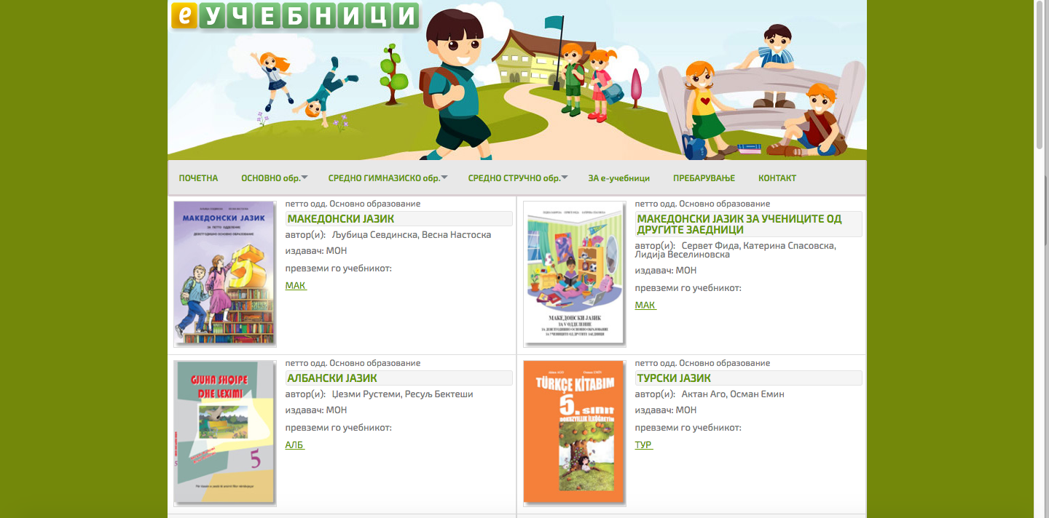
E-Ucebnici

Slide 14
E-Ucebnici
E-Ucebnici (http://www.e-ucebnici.mon.gov.mk):
is a virtual platform managed by the Ministry of Education and Sciences.
It is a digital library for storing, searching and viewing electronic textbooks intended primarily for students and teachers in primary and secondary education
At the moment the portal has 193 textbooks for primary education and 570 textbooks for secondary education (9 for general and 561 for vocational schools) on Macedonian, Albanian Turkish and Serbian language. The textbooks are for 654 courses that are being taught in the primary and the secondary education at this moment. In the past three years in total 884 textbooks have been published on the portal.
Redundant with EduVideos (http://eduvideos.mon.gov.mk/) and Skoool (http://www.skoool.mk).

Slide 15
E-Ucebnici
e-Ucebnici platform strengths:
It is supported by the main Government stakeholders in the educational sector;
Almost all teachers in the country are aware of its existence;
There are digital resources available from high variety of subject areas;
The content is continuously following the changes in the official and approved curricula in the country;
Strong emphasize is given on VET teachers and lots of digital textbooks are available for VET teachers.

Slide 16
E-Ucebnici
e-Ucebnici platform weaknesses:
The platform is highly centralized;
It doesn’t encourage teachers or students to produce their own content. In contrast, the content is always produced at central level;
It does not offer neither promote services for collaboration between teachers;
The motivation of the teachers to use the platform is very low because it is seen as an additional activity for them besides all other activities they have during their regular working days;

Slide 17
E-Ucebnici
Recommendations for future:
Management and advisory committee needs to be created with representatives from all relevant stakeholders in the educational area: Governmental institutions, Higher Education Institutions, NGOs, Institutions for Life Long Learning and Adult Learning, teachers etc. These committees will be responsible for creation of short and long term strategies for development of e-Ucebnici portal towards a National Virtual Network of teachers;
Integration of all other similar, redundant virtual platforms into e-Ucebnici. Digital content from all similar virtual platforms created using the “top-down” approach, financed and produced by the Government (like EduVideos and Skoool for example) shall be integrated into one platform, in this case e-Ucebnici. The content from these platforms shall be categorized in the appropriate categories in e-Ucebnici according to the level and type of education;
Efforts shall be made to integrate (or at least to link) the content from as many existing platforms as possible (made them interoperable) with the e-Ucebnici platform (including those that are developed by the NGOs or developed as a result of a project financed by international donors) so that the content produced or uploaded in these platforms become available in the e-Ucebnici platform as well;
Develop and upload additional digital content on the e-Ucebnici platform that will relate to the content of the textbooks and made this content useful for the students and teachers, for example, exercises, case studies, projects, tests, e-learning

Slide 18
E-Ucebnici
Recommendations for future:
Extend the functionalities on the e-Ucebnici platform by providing services for collaboration between the teachers;
Extend the e-Ucebnici platform by providing functionalities for encouraging teachers or students to produce and exchange their own content;
Develop a methodology for motivating teachers to create, share and use digital content from the virtual platform during their everyday activities;
Implement changes in the way the textbooks are procured from the publishers and authors (always procure copyrights for the electronic versions of all textbooks together with the ones for the printed versions). This will increase the number of textbooks available on the platform;
Provide sustainable financial and technical support for the e-Ucebnici platform, since at the moment only few people are responsible for all activities related to its maintenance and development.

Slide 19
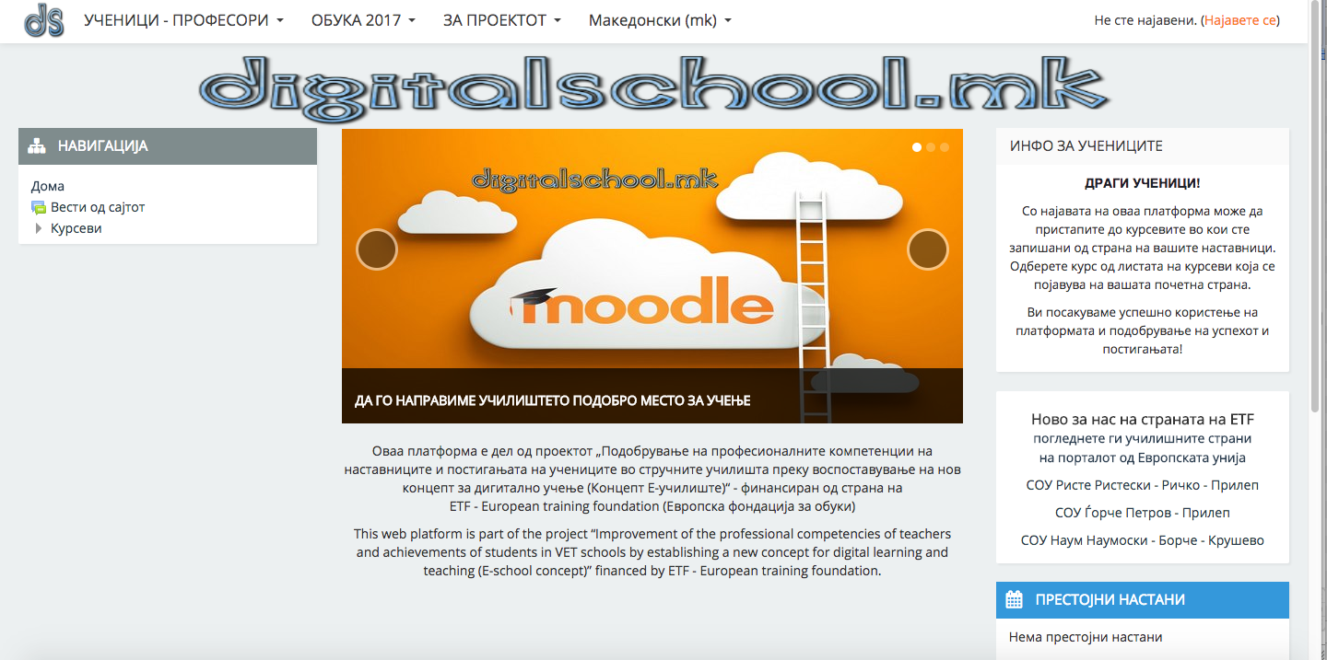
DigitalSchool

Slide 20
DigitalSchool
DigitalSchool (http://digitalschool.mk)
virtual network created and managed by two teachers from two different secondary VET schools in Macedonia (under the umbrella of the Civic Association – Harvest of Knowledge).
Moodle open source Learning Management System was set up for the purposes of this network with the appropriate adaptations
At the moment 2000 students and 100 teachers use the platform on regular basis. Teachers are using it for creating and uploading learning materials, quizzes, forums and webinars.
Used by the following VET schools: SOU Riste Risteski Ricko from Prilep, SOU Gorce Petrov from Prilep and SOU Naum Naumoski Borche from Krusevo and (by the end of September 2017): SOU Krste Petkov Misirkov from Demir Hisar, SOU Car Samoil from Resen, OEMUC St. Naum Ohridski from Ohrid, SOSU St Cyril and Methodious from Ohrid, SOU T. Daskalo from Bitola, SOEU Jane Sandanski from Bitola, SOU O. Copela from Prilep and SOEPTU Kuzman Josifovski Pitu from Prilep..

Slide 21
DigitalSchool
DigitalSchool platform strengths:
It is created using “bottom-up” approach by VET teachers that makes it more acceptable to their colleagues;
It is the biggest virtual platform used by VET teachers in the country;
It is officially approved to be used in 11 VET schools who have chosen freely to participate,
Training for teachers is blended with the development of the web-based network

Slide 22
DigitalSchool
DigitalSchool platform weaknesses:
All content is self-uploaded by VET teachers, so there is no quality check or quality assurance;
Lack of extensive server capacity for hosting the Moodle platform. This issue will become more important as the new users start to use the platform;
The management, coordination and maintenance of the virtual network mostly depends on enthusiastic work of the two VET teachers, although teachers in other schools have been motivated to be local coordinators;
Using these new techniques in teaching increases the workload of teachers, which causes some teacher resistance;

Slide 23
DigitalSchool
Recommendations for future:
There is a strong need for financial and technical support for the purposes of sustainability of this virtual network. As the number of users grows it will be harder for the VET teachers to maintain the platform themselves while at the same time performing their everyday activities. It is strongly recommended that a special technical person shall be engaged for technical maintenance of the Moodle platform. Also a dedicated person shall be engaged that will maintain the Moodle platform and provide administrative support on a daily basis.
Motivate the teachers to create, share and use digital content as well as use some of the services offered by this virtual platform during their everyday activities. Motivation can be supported by: formal and informal recognition; funding for small projects; high level national and international publicity etc.
Improve the technical infrastructure in the schools that are using this platform. The old or non-existing technical infrastructure (for example, old and unreliable computers) is a major barrier to extensive use of a virtual network such as DigitalSchool. Coordinated action with the Ministry of Education or the Local Self Government may result with improvements in the infrastructure;
Provide technical and pedagogical support for the existing and future VET teachers so that they are able to fully utilize the potential of the tools offered by the Moodle platform. This support can be in the form of face2face trainings by experts and linked to other trainings linked to curriculum and assessment. The Digital Schools project has shown that teachers themselves can be trained to pass on such skills and also motivate one another.

Slide 24
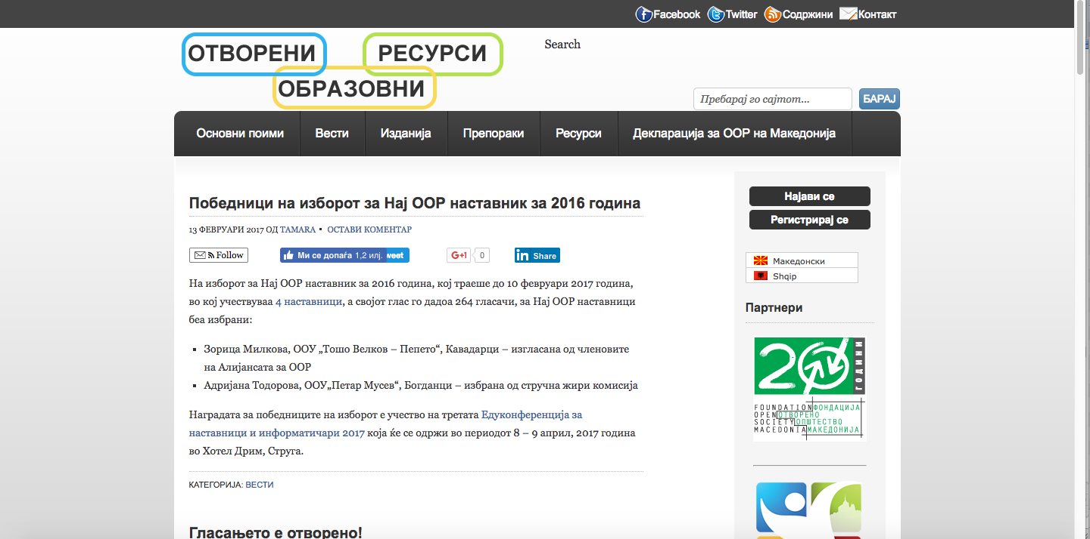
OER

Slide 25
OER
OpenEducationalResources - OER (http://www.oer.mk)
is a virtual network created and managed by the Civic Association – Metamorphosis Foundation (Macedonia).
The main goal of the network is to increase the quantity and quality of educational, scientific and academic e-content in the country.
At this moment there are 585 registered members that have uploaded more than 400 educational resources of various types.
The users of the platform every year are nominating and selecting the best teacher that creates and uses open educational resources. This is an additional motivation for the teachers since they are receiving public recognition for their work.

Slide 26
OER
OpenEducationalResources platform strengths:
There is coordinated set of activities for creation and sharing of open educational resources as well as activities for improvement of the legal and institutional frameworks in the country to make them more convenient for e-content development;
There is an innovative method for public recognition of teachers that create and share open educational resources;
There is a good set of partners supporting the initiative that assures good coordination of all activities related to the platform;

Slide 27
OER
OpenEducationalResources platform weaknesses:
All content is self-uploaded by the teachers, so there is no quality check or quality assurance;
Activities may be substantially reduced upon finalization of the project and the financial support from the international donors;
The usage of the platform is on voluntary basis and besides self-motivation there is no other stimuli for the teachers to create, share and use the open educational resources;
The platform is not officially approved by the formal educational institutions;
The platform does not have a strong focus on vocational education
Besides the functionality to share open educational resources, the platform does not offer services for collaboration, neither other services that the teachers can use during the formal teaching;

Slide 28
OER
Recommendations for future:
There is a need for coordination with the similar projects in the country that have the same or similar goals. Instead of creating different platforms and locking the educational resources into these platforms, the coordinated activities may result with much bigger number of users and resources;
Promoting the use of international standards for creation of open educational resources that will make them transferable to other similar platforms;
Extend the functionalities on the OER platform by providing services for collaboration between the teachers;
Provide technical and pedagogical support for the teachers so that they can learn new, innovative ways how to create interoperable and interactive content that will be more interesting to the students. This support can be in the form of face2face trainings by experts in the e-Learning area or experts in the area of creation and management of digital content.

Slide 29
RECOMMENDATIONS FOR FUTURE DEVELOPMENT
Use a multi-track approach
Supporting the creation of the central national virtual network at the Ministry of Education and Sciences
Supporting projects and local initiatives that result in creation of local or regional virtual networks that can be utilized by the VET teachers;
Supporting the use of social media;

Slide 30
RECOMMENDATIONS FOR FUTURE DEVELOPMENT
National Web-based Network
Coordinated action of all relevant educational institutions in the country and it has to include teachers as the end users of that network.
Combine all digital resources that are available at national level at this moment (e-Ucebnici, EduVideos and Skoool for example)
Implement functionalities that will promote collaboration between teachers.
Guidelines and well-defined standards for creation of digital content shall be adopted in the country so that the exchange of digital content between different platforms becomes possible.
face2face trainings of the teachers, creation of user manuals and workshops that will increase the teacher capacities for using virtual networks for collaboration and teaching.

Slide 31
RECOMMENDATIONS FOR FUTURE DEVELOPMENT
Local, regional, branch or sectoral web-based networks
The local or regional virtual networks that are result of local initiatives, in most cases by the teachers themselves, complement the national virtual network
They can fill the gap that exists until the national virtual network is developed and fully operational and at the same time will raise the awareness and the competences of the teachers for using such networks.
The local and the regional aspect of these networks makes them less formal and more acceptable to the teachers.
Such local networks can be supported by national and international project funding, guidance, awards, networks for sharing practice, training and formal and informal recognition.
Support and recognition from the Ministry and key national agencies such as the VET Centre for example will encourage teachers and principals to participate in such networks. The National Erasmus plus Office may be able to support funding development..

Slide 32
RECOMMENDATIONS FOR FUTURE DEVELOPMENT
Project Networks
Existing projects in the VET area may also offer opportunities for developing web-based communities for those teachers involved in the developments
While these networks would not be supported after the completion of the projects, it is possible to plan that the resources and relationships developed should be made accessible through other platforms and networks
It is desirable to explore whether web-based communities could be constructed to support such projects as they offer a strong motivation for participation and for opportunities for blended Continuing Professional Development (CPD).

Slide 33
RECOMMENDATIONS FOR FUTURE DEVELOPMENT
Social Media
Social networks may offer a way of making connections between different platforms and to engage more teachers to participate in ways that are relevant and attractive
through social media teachers can work together in smaller trusted groups where they are prepared to reflect upon their practice and collaborate.
Teachers can be supported to use social media by embedding social media in platforms and by making more routine use of social media for example as part of the Continuing Professional Development (CPD) offered by the VET Agency or the Bureau for Development of Education.
Special interest groups of teachers may be encouraged to use social media to collaborate and to share ideas.

Slide 34
RECOMMENDATIONS FOR FUTURE DEVELOPMENT
Coordination of Developments
Set up a national working group for the development of web-based networks for vocational teachers in Macedonia
The working group shall include representatives of providers and users of networks and could provide forum to share ideas and developments.
The forum could meet from time to time and operate as an on-line forum.
The Working Group could undertake to produce guidance and templates to support inter-operability and convergence.

Slide 35
What can different stakeholders do to support the development of the National Web-based Network
Governmental Institutions
Teachers
International Donors
NGOs

Slide 36
What can different stakeholders do to support the development of the local, regional, branch or sectoral web-based networks
Governmental Institutions
Teachers
International Donors
NGOs

Slide 37
What can different stakeholders do to support the development of the Project Networks
Governmental Institutions
Teachers
International Donors
NGOs

Slide 38
What can different stakeholders do to support the development of the Networks on Social Media
Governmental Institutions
Teachers
International Donors
NGOs

Slide 39
What can different stakeholders do to support the development of the Working Group for coordination of developments
Governmental Institutions
Teachers
International Donors
NGOs

Slide 40

THANK YOU!

