Slide 1
Web-based networks for PROFESSIONAL DEVELOPMENT FOR VOCATIONAL TEACHERS and trainers
28° february 2017
WELCOME TO THE Webinar!
@ETF
#ETFCPD

Slide 2
Why web-based networking for vocational teachers?
Open educational resources
making collaboration easy and productive
Putting the ‘Professional’ back in professional development
Blending training events with virtual platforms
Digital video
Empowering Local ‘heroes’

Slide 3
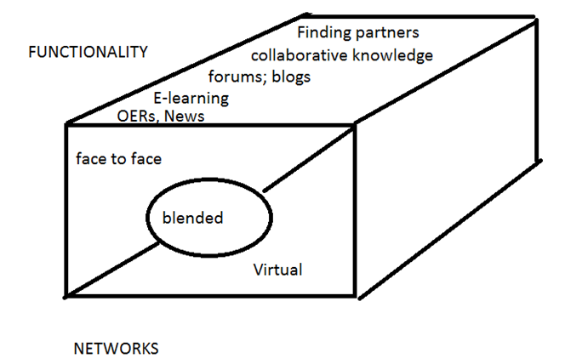

Slide 4
Relevance of professional networks TO SOUTH EASTERN EUROPE AND TURKEY
Specialist vocational teachers cannot easily collaborate as they are spread out..
Travel time and expense of face-to-face training limit provision
Formal training events often irrelevant to vocational teachers and with low impact on teaching and learning
Some vocational subjects lack good teaching, assessment and learning resources in national languages
Ongoing support is required if new ideas are going to be used in teaching and learning
Rising expectations for the quality and effectiveness of teaching
Changes in curriculum – learning outcomes approaches - imply changes in pedagogy

Slide 5
Help and support with etf
Guidance on good practice in networks – launch of draft consultation https://goo.gl/nEYH08
Guidance on how to develop networks (Draft to follow)
ETF platform: https://connections.etf.europa.eu/wikis/home?lang=en-gb#!/wiki/W5d6783a44efb_4f07_b375_e897124cc465/page/Virtual%20networks%20%26%20digital%20and%20online%20learning

Slide 6
Continue the conversation!
Visit our website: www.etf.europa.eu
To learn more see the ETF CPD virtual platform at https://connections.etf.europa.eu/communities/community/cpd
Contribute your thoughts on our forum:
https://connections.etf.europa.eu/forums/html/topic?id=4b95eeee-a326-49a4-ab50-b2203ea149e2&ps=25
Email: Julian.stanley@etf.europa.eu
ON twitter:
@julianstanley10
@ETF
#ETFCPD

