Slide 1


Slide 2

Why
Low education level of the working population of Rotterdam
High drop-out rate and poor graduation results in the schools
Educated people leaving Rotterdam

Slide 3

ROTTERDAM ACADEMY
Collaboration between Rotterdam University, a university of applied science and two institutions for vocational training.
Start in September 2011
Separate positioning from the rest of the university
Now hosting 12 Associate degree programmes, ranging from Arts to Technology and Health Care
Right now sept. 2017 approx. 2700 students

Slide 4

Warm transfer &
intensive counselling
Good alignment to entry level
Educational programme & professional orientation
Coaching for competencies
Making students feel at home

Slide 5
Key Success Factors
General
Specific
Intensive collaboration with companies and organisations
Flexible organisation and method of education: modular structure, blended learning and learning on the job
Flexible programme content
Commitment and support from the Executive Board
Collaboration with regional colleges for vocational training, also at the level of the Executive Boards
Collaboration with the related bachelor programmes: lecturers, course programmes and examination boards
Awareness among employers of graduates

Slide 6
Main themes of Rotterdam Academy
Associate degree programmes are developed in close cooperation with all stakeholders.
Rotterdam Academy serves a unique group of students who would otherwise not go for a continued education (new target group).
Rotterdam Academy is an example to the rest of the Netherlands with respect to its collaboration structure: secondary and higher eduction.
The Associate degree graduates fill a clear demand in the labour market.

Slide 7
Profile of the Ad student
The Ad student:
Was not going for a new study, but...
Focused, enthusiastic and energetic, because in two years....
Learning skills: mainly DOING
Wide range of cultures, areas and levels.

Slide 8
Study programme
Practice-oriented programme with project periods
Small-scale setup and workshops
Coaching for competencies
Space for keeping up with topical developments
Lecturers from secondary and higher education
Practice elements in the programmes are linked to companies or branches.

Slide 9
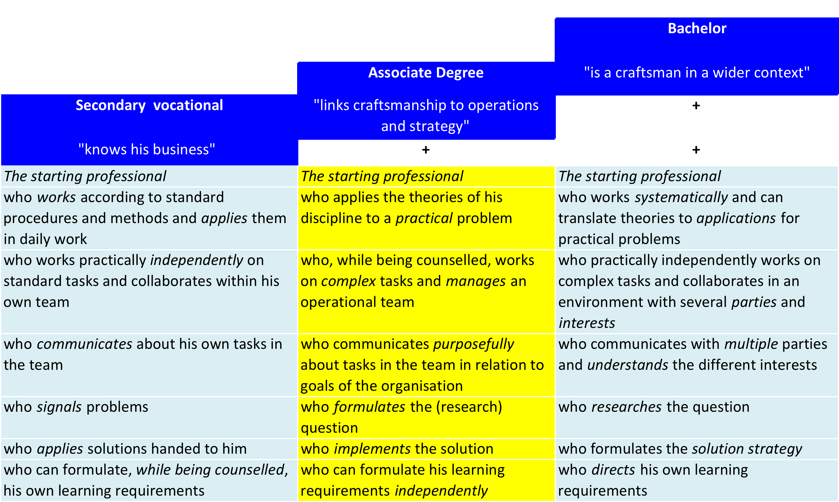
Ad in perspective

Slide 10

Results
2011 | 2012 | 2013 | 2014 | 2015 | 2016
New students | New students | New students | New students | New students | New students
190 | 475 | 761 | 990 | 1033 | 1170
Graduates | Graduates | Graduates | Graduates | Graduates
107 (56%) | 272 (57%) | 379 (50%) | 409 (41%)
Drop-outs | Drop-outs | Drop-outs | Drop-outs | Drop-outs
74 (39%) | 161 (34%) | 285 (38%) | 339 (34%) | 289 (28%)
Maximum yield 61% | Maximum yield 66% | Maximum yield 62% | Maximum yield 66% | Maximum yield 72%

Slide 11
Alumni
Students studying on in the bachelor programme
Graduates | 2013-2014 | 71 | 32%
 | 2014-2015 | 112 | 26%
 | 2015-2016 | 122 | 30%

Slide 12

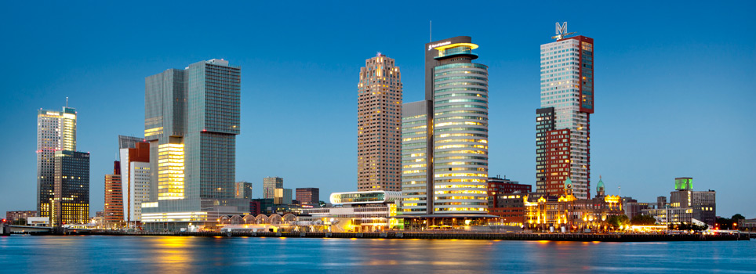
Workforce Development Centre
“ Improving, intensifying and organising the collaboration with the business community in the Rac Workforce Development Centre, in such a way that after 2 years of study we supply to labour market flexible and result-oriented graduates that fit in seamlessly in the professional practice and are fully operational right after graduation (plug-and-play students)”

Slide 13
Future of
WDC
Developing work training companies in collaboration with colleges for vocational training.
WDC positioned as the city laboratory for Rotterdam SMEs
Promotor of the Associate degree level in the business community
Future of Rotterdam Academy
Independent school for level 5 programmes
Leading national example
Serving the Rotterdam labour market
Offering a wide range of part-time study programmes

Slide 14
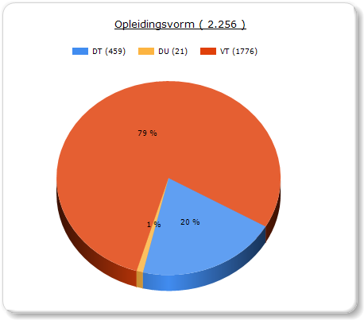
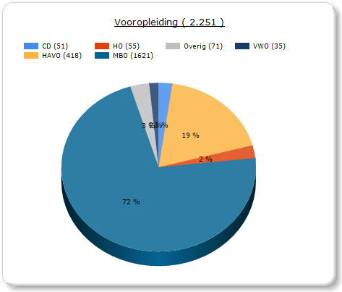
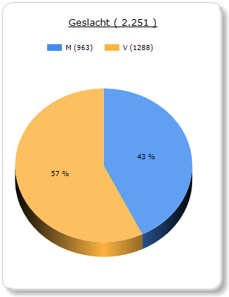
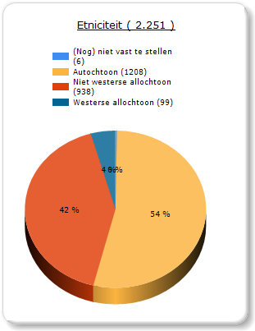
Programme (full-time, part-time), previous education, gender and ethnicity (2016)
Programme
Previous education
Gender
Ethnicity

Slide 15
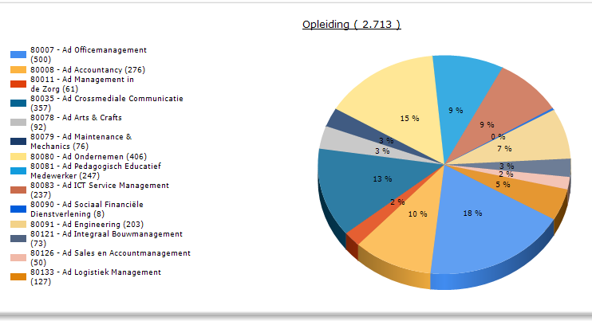
Ad programmes (2017)

