Slide 1

ETF CONFERENCE 7-8 June 2018, Sermig, Torino
SHAPING LEVEL 5
Workshop 3: Occupational links and employability of level 5 qualifications

Slide 2
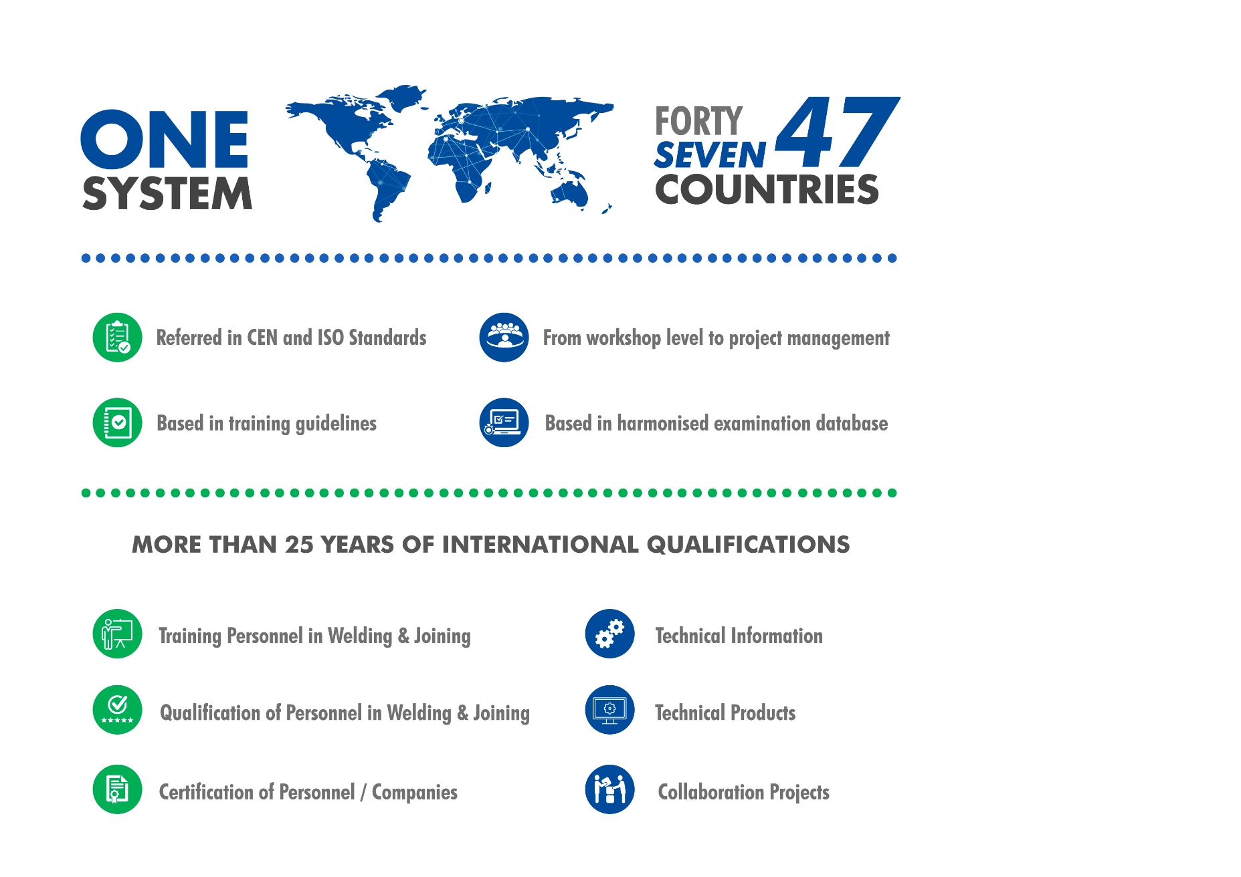

EWF’s Education, Training and Certification System

Slide 3
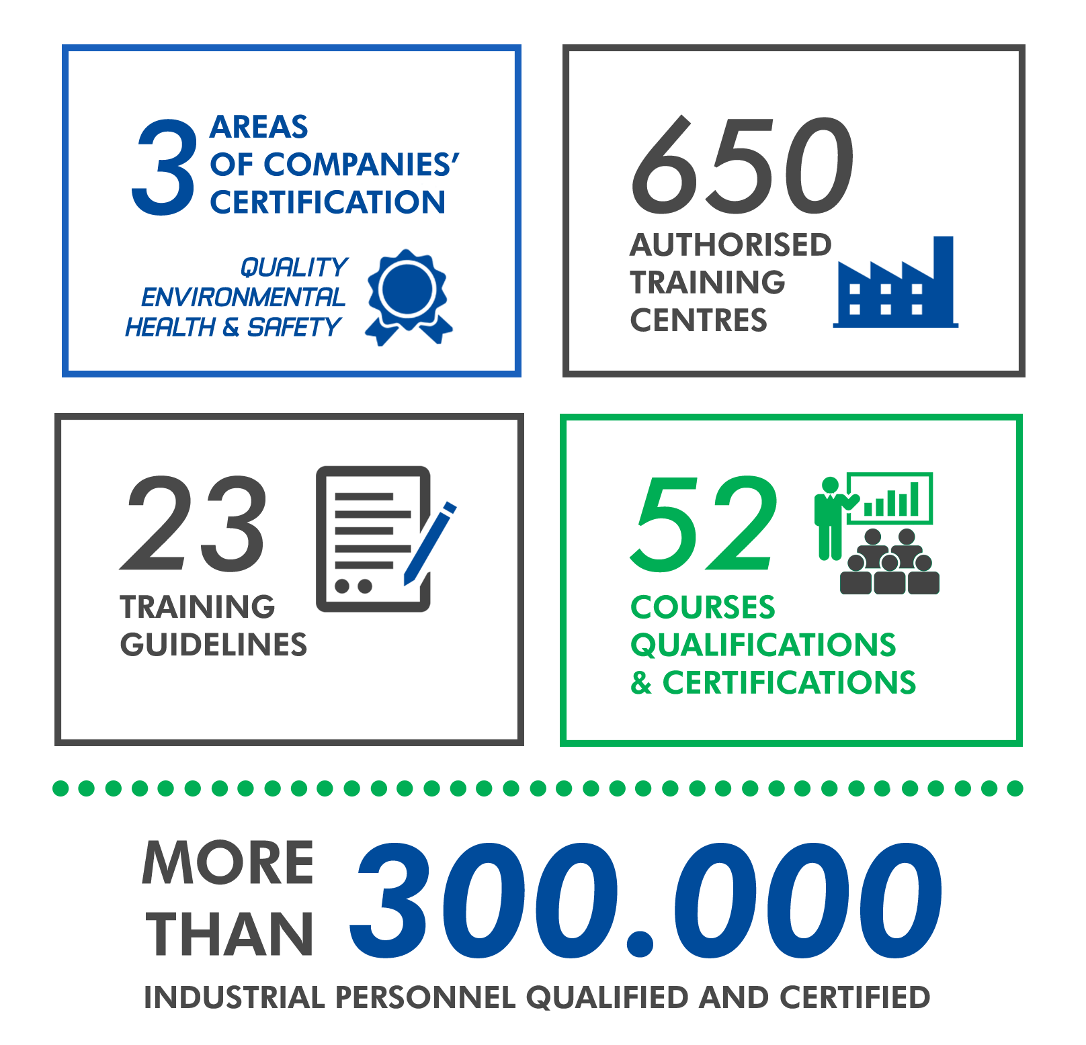
EWF’s Education, Training and Certification System

Slide 4
QUALIFICATION SYSTEM
School Class Learning
Distance Learning
Minimum hours
On job Learning
Hands on learning
Minimum hours
Theoretical
Practical
Access Conditions Includes: School diploma Informal and Non-formal competences
Training Course Theoretical / Pratical
Examination: Theoretical / Pratical
Diploma
(Qualification System)
Certificate
(Certification System)
EN ISO
Standards
Theoretical
Practical
Harmonised, based on multiple choice questions
Open: essay questions
Harmonised, based on preset exercises
Open: add-ups defined by ATBs

Slide 5
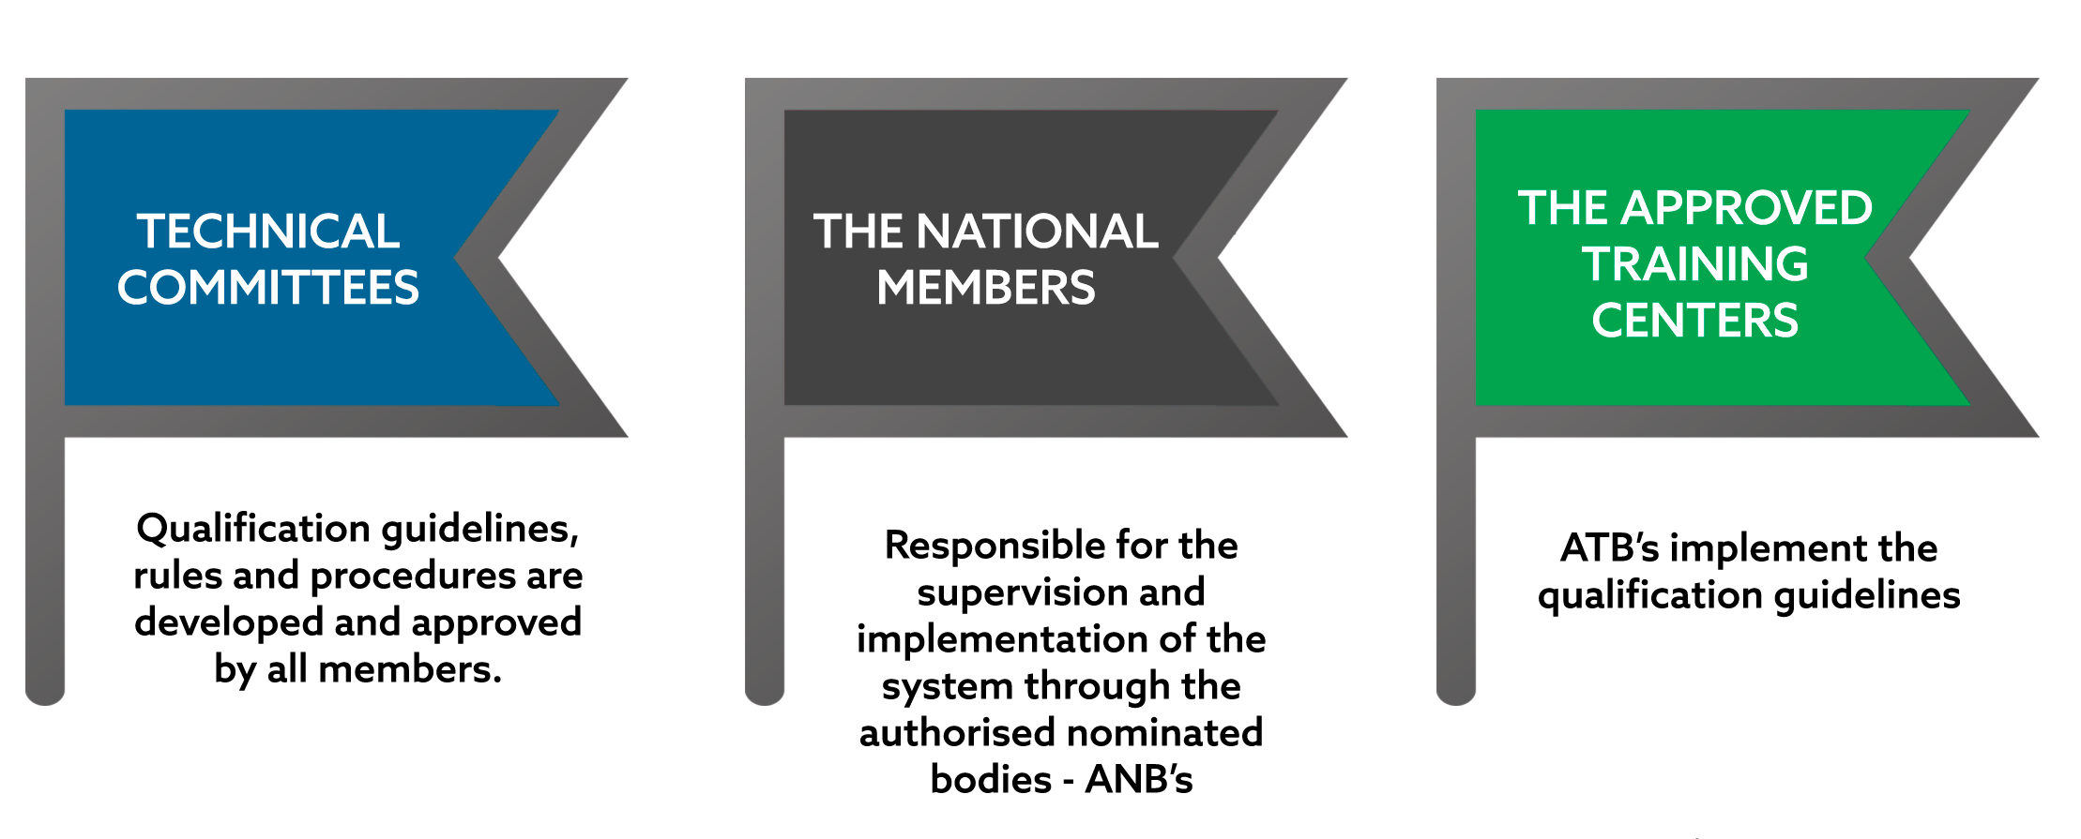
QUALIFICATION ASSURANCE – SYSTEM PILLARS

Slide 6
QUALIFICATION ASSURANCE SYSTEM
Audited by the ANBs.
Need to comply with the EWF system rules.
National vocational training schools
Private vocational training schools
Audited by EWF Assessors.
Needs to comply with the EWF quality system rules.
Accredited by National Autorities
EWF Member
Example:
In Germany: DVS - Deutscher Verband für Schweißen
In Czech Rep.: ANB - Czech Welding Society
In Portugal: ISQ – Instituto de Soldadura e Qualidade
ATBs (Authorised Training Body)
In Germany: GSI-SLV - GESELLSCHAFT FÜR SCHWEISSTECHNIK INTERNATIONAL MB
In Czech Rep.: Skola Welding
In Portugal: IEFP – Instituto do Emprego e Formação Profissional
ANB
(Authorised Nominated Body)
Manages the EWF System in the Country
In Germany: DVS-PersZert
In Czech Rep.: CZECH WELDING SOCIETY
In Portugal: ISQ Formação

Slide 7

RULES FOR IMPLEMENTATION
Rules doc. EWF-416
Rules for the implementation of EWF Guidelines for the education, examination and qualification of welding personnel
(based in EN ISO 17024, in future to be in line with EN ISO/CD 21001)

Slide 8
LEVEL 5 - TRAINING AND QUALIFICATIONS
QUALIFICATION | DESIGNATION
E/IWS | European Welding Specialist
EWI-S | EUROPEAN Welding Inspector Level STANDARD
EWCP-1090-2-S | European Welding Coordination Personnel for EN 1090-2 LEVEL STANDARD
EWS-RW | European Welding Specialist for Resistance Welding
EAS | European Adhesive Specialist
ETSS | European Thermal Spraying Specialist
Sc-PHT-S | Heat Treatment - Standard
Sc-PNNEx - S | Macroscopic and microscopic metalographical examination
Sc-WINDTP | Weld Imperfections for NDT Personel
E/IWS - SECOND QUALIFICATION WITH MORE DIPLOMAS ISSUED

Slide 9



EUROPEAN / INTERNATIONAL WELDING SPECIALIST
Professional Profile
E/IWS – Knowledge, Competence and Management
A candidate completing the E/IWS training under this program is expected to acquire a specialized and factual knowledge in the field of welding technology.
He/she shall have competence and skills at a level that is required in the field of welding technology which demonstrate:
Being able to develop solutions on common/regular problems;
Being able to manage and supervise common or standard welding applications and related professional activities;
Taking responsibility for decision making in common or standard work;
Taking responsibility to supervise the tasks of welding and related personnel.
Tasks and responsabilities defined according to ISO 14731:2016 (Welding Coordination)

Slide 10








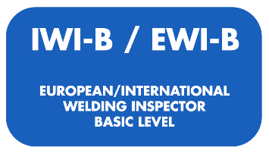
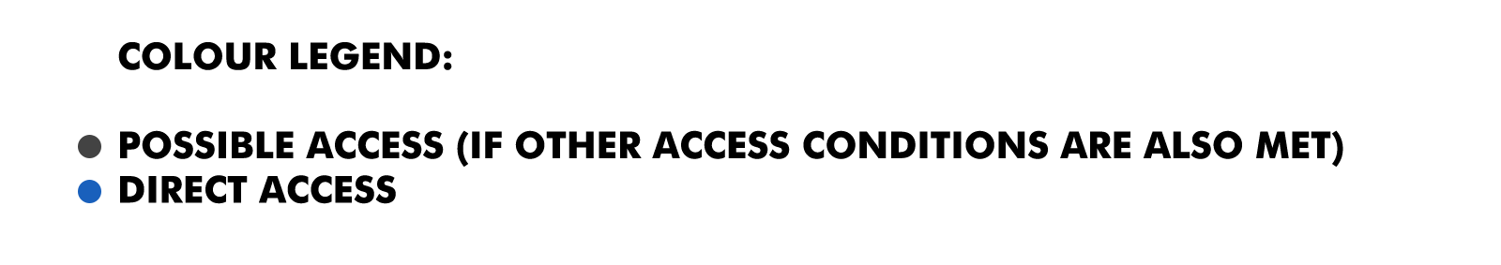
E/IWS - Progression scheme

Slide 11


Policy-Making Recommendations on EQF Level 5
Recommendations from TANDEM project on Qualifications EQF level 5 | EWF Situation | How?
International jobs foreseeing similar activities in the workplace, that include international requirements, need international diplomas and certificates. |  | Harmonised qualifications with international recognition of diplomas
Strong compliance with international quality standards (e.g. ISO) |  | Welding coordination job functions are referred in ISO 14731
Promotion of flexible learning pathways for adult learners |  | Qualifications delivered under a modular approach
Devise progression routes for learners (what’s the next step?) |  | Training and qualification system for lifelong learning with vertical and horizontal progression schemes)
Design recognition of prior learning schemes |  | Alternative route

Slide 12


INTERNATIONAL QUALIFICATIONS & EQF & NQF
EQF CAN BE APPLIED TO A WELL ESTABLISHED
INTERNATIONAL QUALIFICATION SYSTEM
TRIGGER TO MODERNISE THE SYSTEM
TRANSPARENT PROGRESSION WITHIN THE SYSTEM
COMPARABILITY AND TRANSFER AT NATIONAL LEVEL
MAP THE LEVEL OF QUALIFICATIONS

Slide 13

ALIGNMENT OF INTERNATIONAL QUALIFICATIONS AND NQF
What are challenges?
Understand the added-value of EQF
Communication across Europe
Need for compliance with different procedures in each country
Consistency (of procedures) across Europe
Different level of maturity of VET systems and NQF
Adoption of EQF level in voluntary bases
Strategic approach for EWF Qualifications, having the same EQF level for technical contents in each country
Quite complicated bureaucratic and time consuming process
What are opportunities?
Enhanced transparency
More costumer/industry /market orientation

Slide 14








LESSONS LEARNT – PORTUGUESE CASE
What lessons can be learnt from countries that have already aligned welding qualifications to their NQF
1200 Diplomas
14 Public training centres are EWF ATBs
82 Qualified Trainers
700 Qualified Welders (E/IW)
200 Qualified Practitioners (E/IWP)
Employment rate 94 %
Growing ALLIANCE between STAKEHOLDERS and GOVERNMENT lead to creation of more and better JOBS:

Slide 15
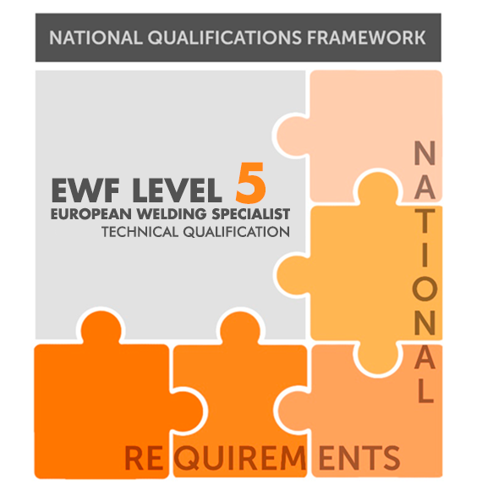

KEY FACTORS OF SUCCESSFUL REFERENCING TO NQF
1
Mutual trust between involved stakeholders
2
Compliance with EWF Quality Assurance Procedures
3
Transforming public training center into authorised training providers
4
Integration of EWF qualifications in the NQF
5
Trainee’s qualification and certification

Slide 16
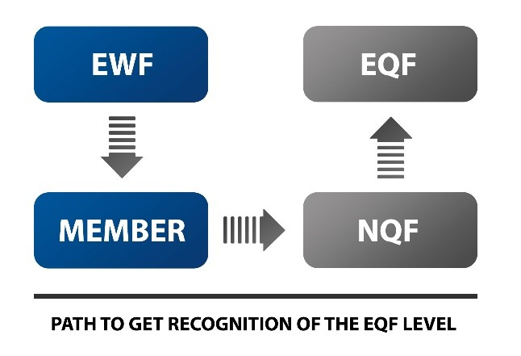
CONCLUSION - ALIGNMENT OF IQ TO NQF AND EQF
STRATEGIC APPROACH FOR THE EWF SYSTEM
EWF system is a technical / sectorial qualification
LOs completed and renewed for the EWF Qualifications /Guidelines
EWF members in close contact with NQAs in their own countries
NQAs agreeing in the same integration procedures / to define procedures and get agreement about EWF Qualifications
Ensuring commitment
This alignment for EWF Qualifications can be done for all levels, including level 5

