Slide 1


Reforming TVET and shaping level 5 with the help of Teacher education in Finland

Slide 2
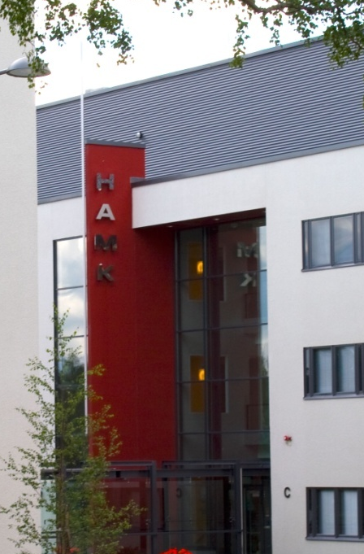





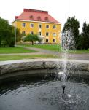

Seija Mahlamäki-Kultanen, dean
Häme University of Applied Sciences, School of Professional Teacher Education
Education – Research - Development

Slide 3
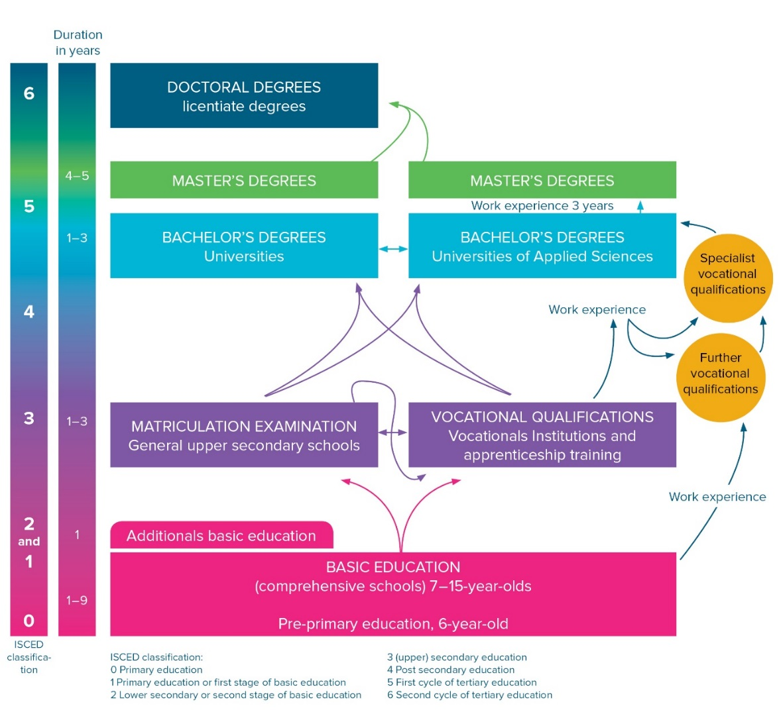
Reforms in the whole Education System of Finland under Sipilä`s government period
All people have equal access to free basic, post-compulsory and higher education.
Development of quality, efficiency, equity and internationalisation.
Decisions on the contents of legislation regarding education and research are made by the Parliament.
The Government and the Ministry of Education and Culture are responsible for preparing and implementing the education and science policy.

Slide 4
Reform in VET starting from 1.1.2018
Streamlines the administration of all VET and VET qualifications
Merges adult education with the education of younger students into an entity
Abolishes several, too narrow qualifications in all levels, especially level 5 and also level 4, which have evolved from the needs of the world of work but are not anymore relevant and popular
One specific era in the development of adult education is developing to a new one. During 1990-2010 vocational adult education was establishded, it grew enormously and the key features matured
The paradigms of adult education have brought several contributions to the mainstrean of VET
  Personalisation of learning
  Accreditiation of prior knowledge
  Competence based qualifications
  Authentic assessment
  Paradigm shift in the teachers´role

Slide 5
Background history of the level 5 upper secondary VET qualifications in Finland
They were established year 1994, after careful political preparation to meet the needs of the changes in the world of work and the lack of necessary skills among adult population
Separate administration, the responsibility was on specific independent bodies close to the world of work in a country were vocational education is mainly public and has been quite school-based
The qualifications and administrational processes started develop slightly into their own directions although they had the same principles. The popularity of different qualifications varied enormously from some few to several thousands in a year. Some of the qualifications documented the traditional skills and competences, some were more dynamic and future oriented (opinion by the author.)
The primary aim was to gain qualifications irrespective of the way how adults gain their competences (informal and non-formal learning popped up in the discourse). The paradigm shift from teaching to learning meant a profound change in teachers work in adult education organisations
The quality assurance of the system needed supportive measures like an education to the teachers and supervisors in the world of work
Altogether close to 19 000 specialists in competence-based qualifications (NTM) were educated during years 2007-2017

Slide 6
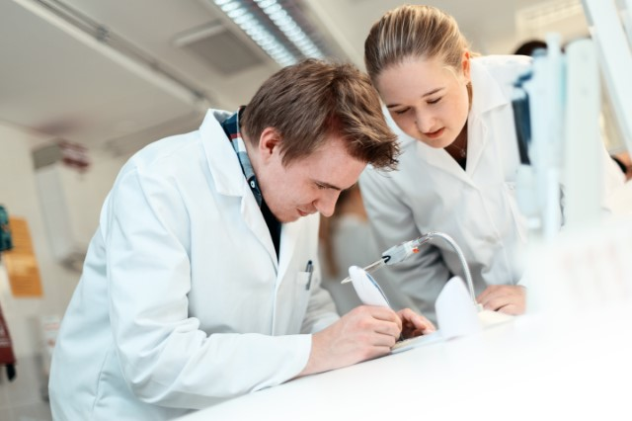
Specialists in competence-based qualifications (Näyttötutkintomestari NTM)
An important measure to develop special qualifications in level 5 in Finland was the training of teachers in VET institutions and trainers in the work places in a specific programme called “näyttötutkintomestari”, valid for 15 credits
The responsible actors in educating them were teacher education units in the universities of applied sciences. In Finland, higher education is based on a dual model, where more academically oriented traditional universities (14) and more practically oriented universities of applied sciences (23) complement each other. Both award legally equivalent academic Bachelor’s and Master’s degrees.
UASs are mainly multidisciplinary and regional institutions of higher education and have a very clearly statutory objective in regional development. They provide teacher education in TVET.
Universities of applied sciences -
with their combination of theory
and practice - provide an
interesting alternative to traditional
scientific universities.

Slide 7
Personalisation of adult learning
One key principle and prerequisite for the success of level 5 learning and completion of qualifications is still the personalisation of adult learning
This principle was fully acknowledged in UAS when they organised the education of specialists in competence-based qualifications, who could then get a lived-through experience about the way they would then themselves act with the adult learners in level 5 studies.
Päivi Kilja´s doctoral dissertation 4.5.2018:
  ”Freedom, decision making and understanding possibilies built the experiental meaning of participation.”
  ”The adult learner´s involvement in their own studies was realised through the existing operating environment, interactions between people and guidance and support systems.”

Slide 8
Conclusions (Kilja, P. 2018)
Personalisation of studies owned by the learner
Creation of personalisation of studies in social action
Hearing the adult learner in personalising studies
Personalisation of studies´commitment to appreciating the competence of the adult learner
Moving from the structures of education and the concept of administration towards a service culture

Slide 9
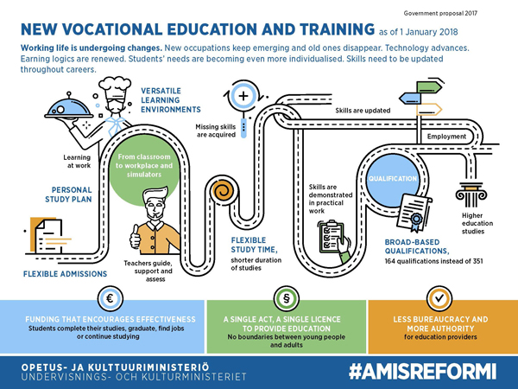
VET Reform model from 1.1.2018

Slide 10
Reforming teacher education for the future, Teacher Education Forum
http://minedu.fi/documents/1410845/4183002/Teacher+Education+Development+Programme+2016
MEC implements the government key project and puts it into action together with autonomous actors like universities and stakeholders
Teacher education reform takes into account the reforms in all education levels. #OPEKE project develops VET teachers education to fulfill the needs of the reform (http://www.hamk.fi/verkostot/opeke/Sivut/opeke-in-english.aspx)
OPEKE cooperates with Parasta osaamista project (The best possible competence) to develop new teacher education programmes

Slide 11
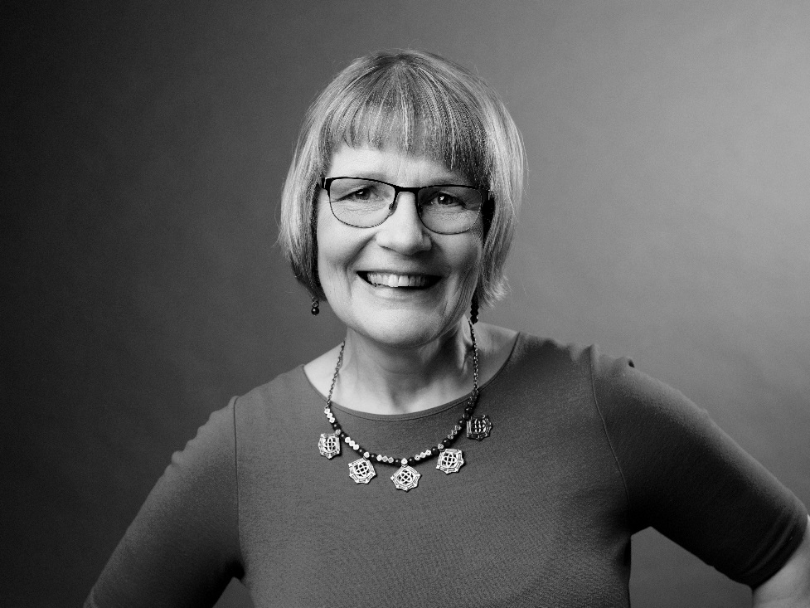
HAMK
PL 230 13100 Hämeenlinna
FINLAND
tel: +358 40 5878 029
Seija.mahlamaki-kultanen@hamk.fi

