Slide 1
ESCO: connecting education and labour market Focus on occupations – skills pillars
Eduarda Castel-Branco
28/02/2019

Slide 2
What is ESCO?
A European reference language to:
Reduce “noise” in the labour market
Exchange information supply & demand - LMIS
Communicate between labour market and education/training
Cooperate across borders / languages
Match CVs of candidates with job vacancies
Available in 26 European languages and Arabic

Slide 3
What is ESCO? ESCO: European Skills/Competences, Qualifications and Occupations
ESCO is FREE TO DOWNLOAD AND USE
3 ESCO pillars
Qualifications:
8136 from 6 EUMS
2942 occupations
13 485 skills
https://ec.europa.eu/esco/portal

Slide 4
How ESCO can be used
Information on learning
opportunities
Performance management, appraisals
Job matching
Matching at skills level
Guidance & counselling
Big data analysis
Labour Market
Skills/ Competences
Education/
Training
Occupations
Qualications

Slide 5
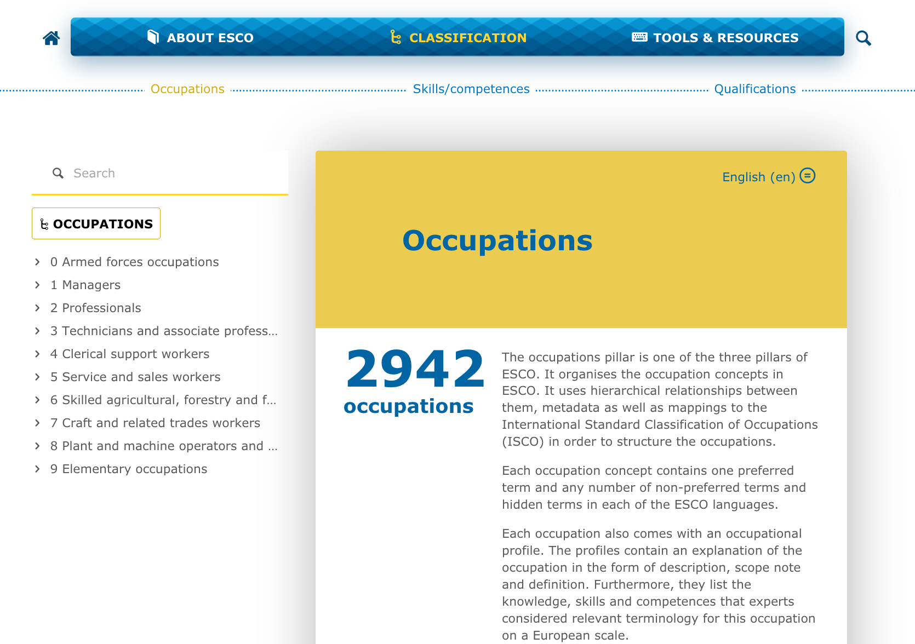
ESCO: PILLAR occupations

Slide 6
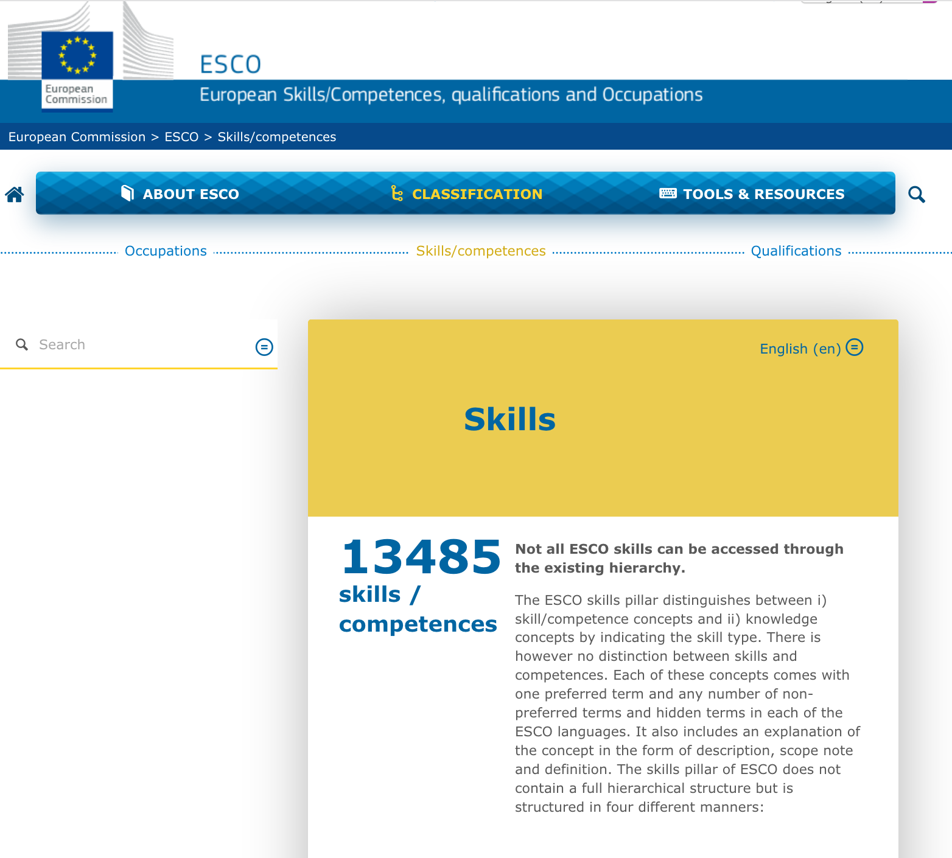
ESCO: PILLAR SKILLS/competences

Slide 7
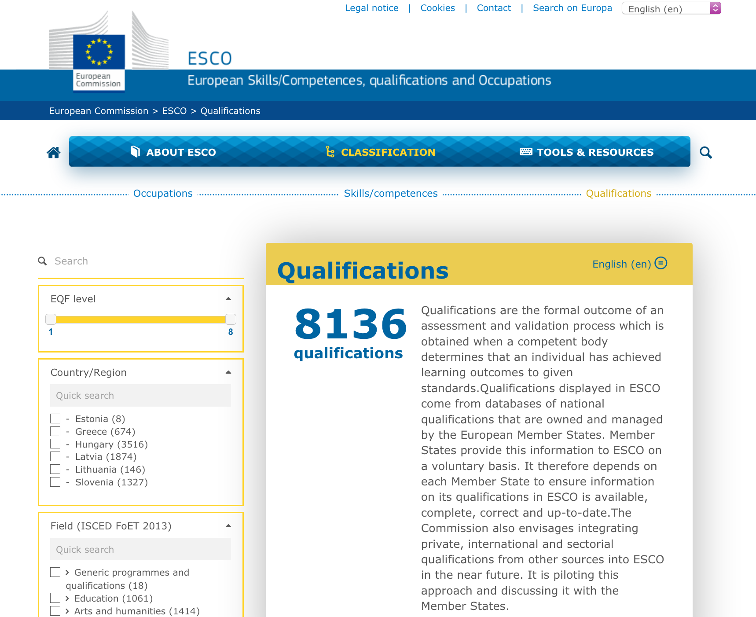
ESCO: PILLAR qualifications

Slide 8
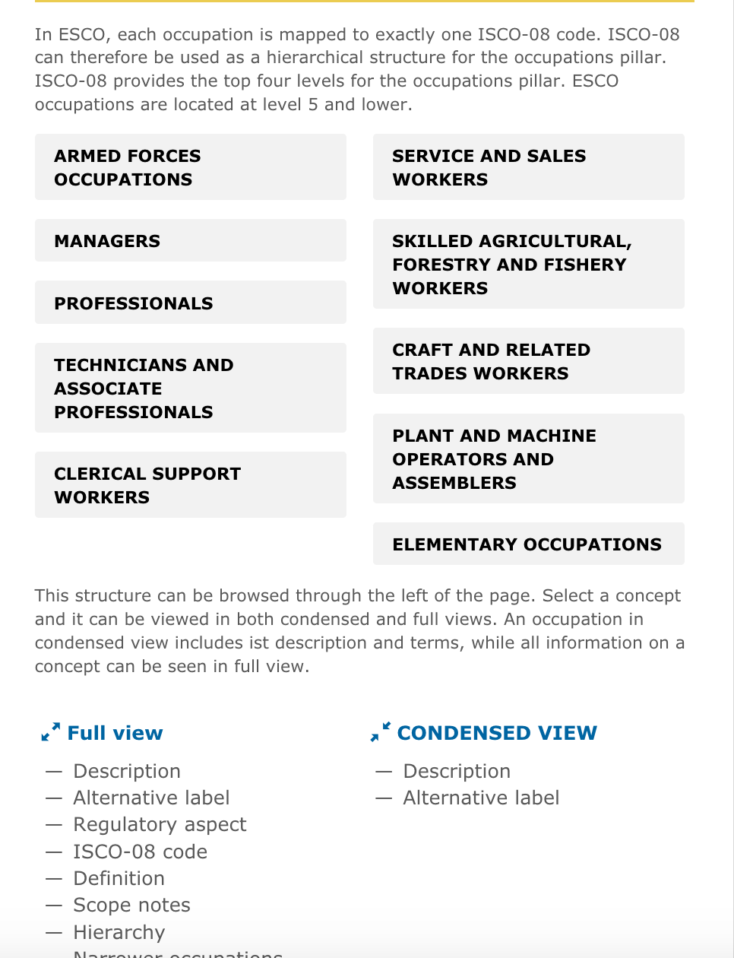
ESCO: PILLAR occupations
Hierarchy of classification of occupations in ESCO is based on ISCO 08:
ISCO 08: is the hierarchical structure for the occupations pillar
Level 1 – 4 of hierarchy = ISCO 08
ESCO – at level 5 (or lower) of occupations hierarchy

Slide 9
ESCO: a common language between Education and labour market
ESCO skills terms
Match CVs and job vacancies
Standards (OS…)
LMIS: Big Data analysis demand

Slide 10
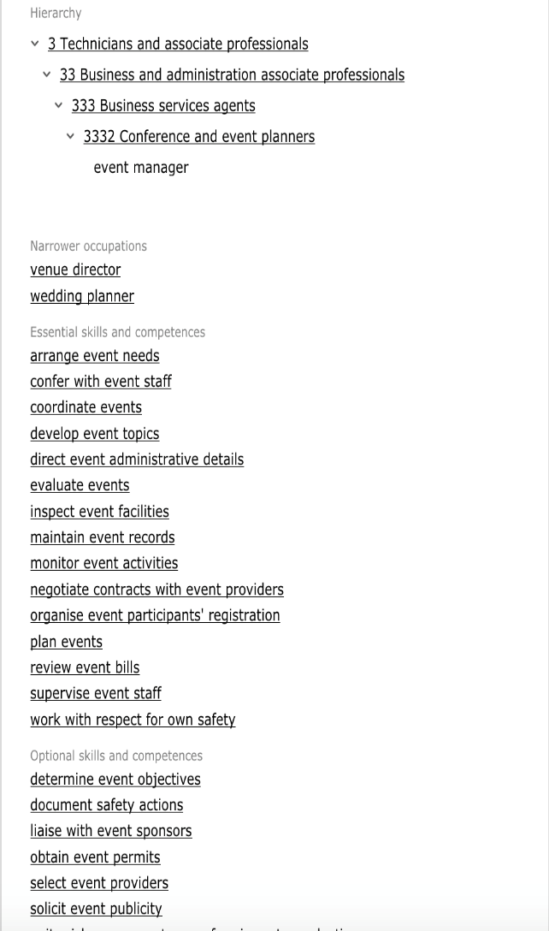
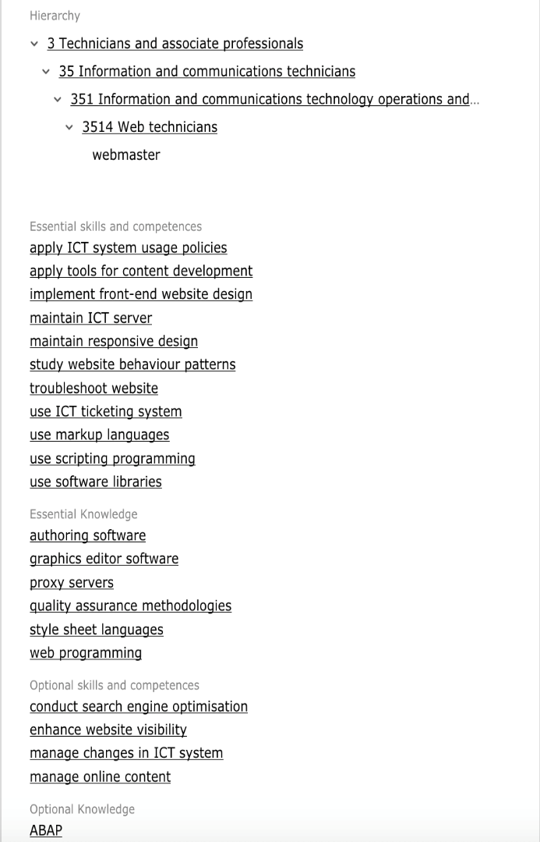
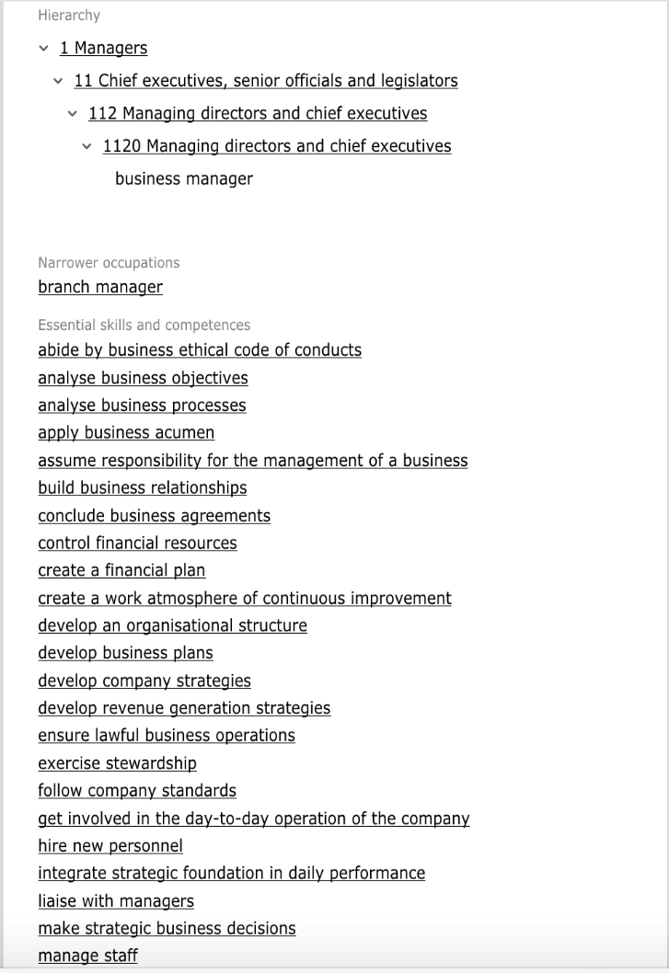
ESCO profiles at Occupations pillar (examples)

Slide 11
ESCO: european skills/competences, qualifications and occupations
This is a promotional video showing some use cases of the ESCO classification.
An Employer, a jobseeker, and a graduate enter the ESCO lab and are shown a demonstration of the ESCO reality goggles.
Looking through the Goggles we see how ESCO can transpose CV’s across borders.
In the final chapter of the film we see that the technology is available to everyone as a download via the ESCO portal.
https://www.youtube.com/watch?time_continue=2&v=HnREEetR87s
https://youtu.be/HnREEetR87s

Slide 12

ESCO: european skills/competences, qualifications and occupations
https://ec.europa.eu/esco/portal/news/5a2cc873-5fd6-4235-ad3e-fedbcb037023

Slide 13
Thank you!
www.etf.europa.eu
ecb@etf.europa.eu

