Slide 1
Identifying and analysing skills and qualifications needs a shared responsibility: we are all in
Ukraine
Eduarda Castel-Branco
28/02/2019

Slide 2
Main topics
Skills anticipation:
    Why?
    How?
    Who?
    Uses and outputs (annex)
Methodological help and sources (annex)
Cases / models
Ukraine moving ahead
SWOT Ukraine
Options

Slide 3
Why?
Skills anticipation and matching:
      Why?

Slide 4
Skills Anticipation: why?
SHAPE NOT WAIT
Transformation:
Occupations, jobs, tasks
Digital revolution - automation of jobs / tasks – which will be more affected?
Demographic and social trends: aging, migration
Skills: technical vs transversal
Qualifications – types, sizes, LLL
Modes of learning and getting certification
In calling for more and better anticipation of future skills, one of the Ministers at the meeting of WEF:
“The future is not something we wait for, but something we make.”
WEF, 13/11/2016
Notes:
Recent discussions about the employment impact of
disruptive change have often been polarized between those
who foresee limitless opportunities in newly emerging job
categories and prospects that improve workers’ productivity
and liberate them from routine work, and those that foresee
massive labour substitution and displacement of jobs. It is
clear from our data that while forecasts vary by industry and
region, momentous change is underway and that, ultimately,
it is our actions today that will determine whether that
change mainly results in massive displacement of workers
or the emergence of new opportunities.

Slide 5
Shaping our future
In our era of uncertainty anticipation serves the purpose of managing surprise and astonishment, reinforcing a culture of strategic management, supporting and orienting change.
Anticipating means combining quantitative and qualitative information, joining forces of all participants, integrating data and analyses and helping regain strength when crises hurt our potentialities.

Slide 6
Drivers of change in skills demand
Business strategy,
Competition
(e.g. growth of high/low
Skills jobs)
Policy/regulation
Change
e.g. Change in
Priority sectors
Migration
Skills demand
Markets
Environmental
change
Technology
change
Demographic
change
Source: ILO, Paul Comyn, Asia Decent Work Decade, PPT LM analysis and HR demand in developing economies

Slide 7
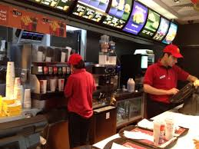
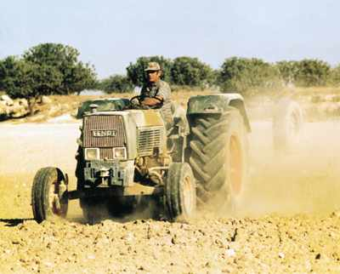
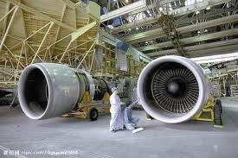

Right skills for occupations, employment: today and tomorrow
1. Types of skills: occupational (job) specific; transversal
2. Policy issues: skill mismatch: gaps, shortage; over- & under-qualification; over- and underskilling;
Mismatch priority occupations
Notes:
Types of skills: occupational-specific; transversal…
Emerging skills...
Green skills...
Obsolete skills...
Skill gap...
Skill shortage

Slide 8
Anticipation is not prediction of precise numbers of workers and vacancies…
In times of rapid change (and crisis) – anticipation is more necessary than ever
Not prediction of precise numbers of labour for specific jobs and occupations, based on top-down forecasting exercises…
But (participative) responses to the question: which professions and which skills on demand? Which qualifications / skills in supply?
  How will technologies and digitization further affect and change our ways of working, and the skills needed?
  Do we face risk of critical skills gaps and shortages? In which critical sectors / occupations?
  How can we act more effectively and efficiently to turn around anticipated risks and prepare for change?

Slide 9
Why anticipation and matching is essential
Some degree of misalignment between supply and demand for skills is inevitable, given the features of the market economy and rapid technological and environment changes; choices of individuals; work conditions
However, the costs of persistent and severe mismatches (over- and underqualification, shortages) are substantial (for individuals, firms, society…)
  Higher risk of unemployment, wage penalties, underutilization of skills, lower productivity, reduced investments in new technologies…
  The aggregate costs of field-of-study and qualific mismatch can = > 1% GDP (losses in productiv + sunk cost of developing skills that are not used) - OECD
Policy intervention can help address mismatches and shortages, but doing so relies on having good information on current and future skills needs and on the true nature and impact of mismatch

Slide 10
HOW?
Skills anticipation and matching:
      How?

Slide 11
Skills anticipation is complex and demanding but necessary
Evaluate system, improve, sustain
Data, sources, models, analysis, expertise
Interpret, dialogue, use, disseminate
Governance: cooperation, coordinationmonitor
All these elements are necessary

Slide 12
ETF Position on principles of skills anticipation & matching systems
1. An integrated cycle of 3 functions: knowledge creation + dissemination to actors + deliberate action for matching
2. Collaboration – both technical expertise and institutional processes at the centre of anticipation system. Networked approach for synergy; top-down and bottom-up interactions; involve users; target products for users’ needs
3. Mix of approaches and methods: quantitative and qualitative; covering the long-medium-short term and macro-meso-micro dimensions. No one single solution and method – innovation
4. Reinforce tools and methods, robustness of data, keep-up with new methodological developments (Big Data, use of administrative databases…)

Slide 13
Unpacking: mix of Data sources and methods
Data | Analysis / methods
Regular surveys statistical offices: LFS, households, business, wages… Administrative data: registers Special surveys: employers; workers; graduates; Qualitative sources: in-depth interviews Job vacancies DBs, online portals Education statistical data (admission, graduates) In a word: “Labour market information and intelligence” (LMII) | Foresight (qualitative) Quantitative medium / long-term forecasting LM skills Scenario building on sectors’ development, prospects Analysis of skill mismatch (various types) Use of Big Data analytics
Multi-disciplinary teams: statistician; labour economist; sociologist; data analyst…

Slide 14
Source: ETF Position Paper

Slide 15
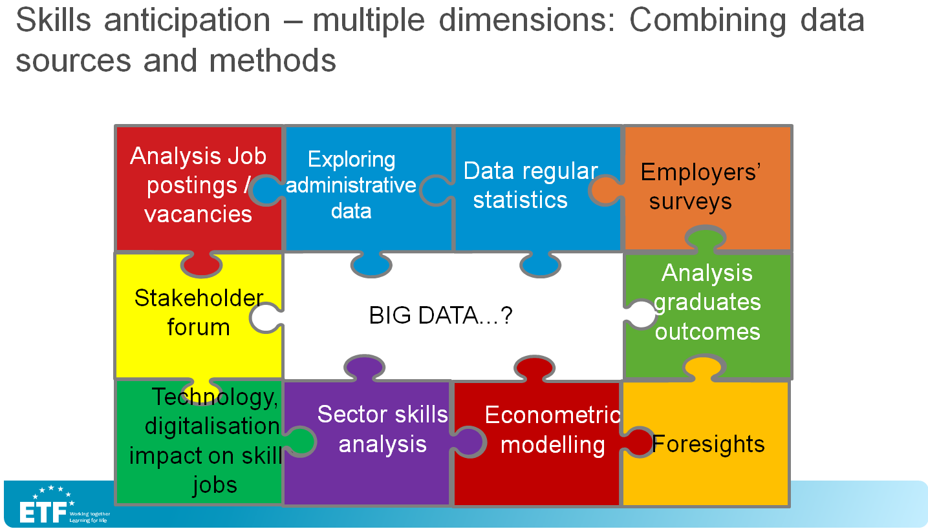

Slide 16

Issues, challenges: summing-up...
Mix of sources?
Administrative, Big Data, surveys…
QA of LMI?
Cost, resources
Qualitative / quantitative
Past / future dimensions
Institutional collaborations/roles
Quality methods, data: variations
Systematic data collection and analysis. Real Time…
Acceptance / use of results
REVIEW & IMPROVE MODEL! TIME!

Slide 17
Cases, models
Skills anticipation and matching:
    Who?

Slide 18
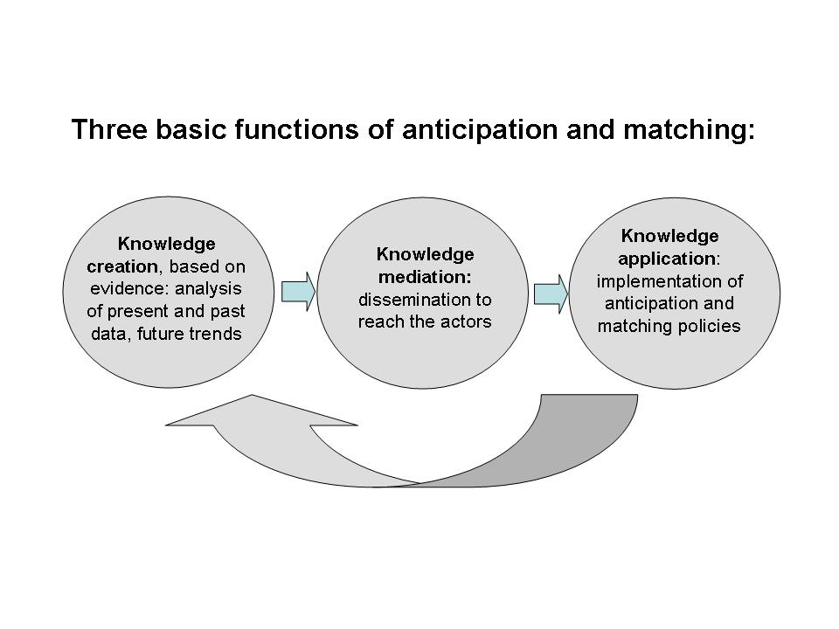
Functions - model

Slide 19
model
Lead, coordination, funding: government bodies
1.Knowledge creation
2.Knowledge mediation
3.Knowledge application
Analysis, intelligence
Dissemination to reach actors, final users:
- Reports, recommendations
- Insights, indicators
- Career info & guidance
- Digital platforms
- Dialogue
- Design options, policies, strategies (education & training LLL, employment, career guidance, social…)
- Action
Data collection
Compare data & insights, interpret trends
Evaluate and improve models, results. Innovate
Statistical Service
Research units / centres / Academia
Sectoral organisations
Analytical units PES / Ministry
Government bodies
Research
Statistical Service
Government bodies, social partners…

Slide 20
Examples…
GOV:
– Always in Lead, coordination
Always in 3
Ministry never in 1
Netherlands:
Lead, coordination, owner: Gov
Academia: ROA (STAT+ other research)
ROA - Gov
Gov + SPs
1 Knowl creation:
– Always: specialised research (public or non-state / academia) + STAT
- Never: Ministry
Ireland:
Lead, coordination, owner: Gov - SOLAS (FET)
SLMRU (+regional fora, CSO)
SLMRU
Nat Skills Council - EGFSN – Government departments
France:
Lead, coordination: Gov (France Strategie)
FS (+ INS + DAREC + Observatories) + regions (Observ)
FS - Gov
Gov + SPs
ESTONIA
Lead, coordination, owner: Kutsekoda
Special OSKA (+STAT)
OSKA - Gov
Gov + SPs

Slide 21
Skills Needs Identification in Ireland
National Skills Council
Regional Skills Fora
Skills & Labour Market Research Unit
Expert Group on Future Skills Needs
National Skills Database

Slide 22
National Skills Council
Chaired by the Minister of Education & Skills
Department of Education & Skills
Department of Employment Affairs & Social Protection
Department of
Business Enterprise & Innovation
Department of Public Expenditure and Reform
Other:
Employers,
Science Foundation Ireland
Identification of Skills Needs in Ireland
Notes:
National Skills Council – made up of approx 20 people representing Gov depts and agencies as well as a number of employers (Combilift, Vocafone, SAP and the Shed Distillery)

Slide 23
Who - steps
Data creation
PES
Analysis and interpretation
Statistical office (partially - analysis)
Research
USE:
Dissemination
Action
Policy
Councils / socio-econ partners
Research (academic, sectors, others)
Observatories
Councils / groups socio-econ partners (recommendations)
Career guidance mechanisms …
Government
Observatories
Statistical Office
Min Economy
Objectives & architecture

Slide 24
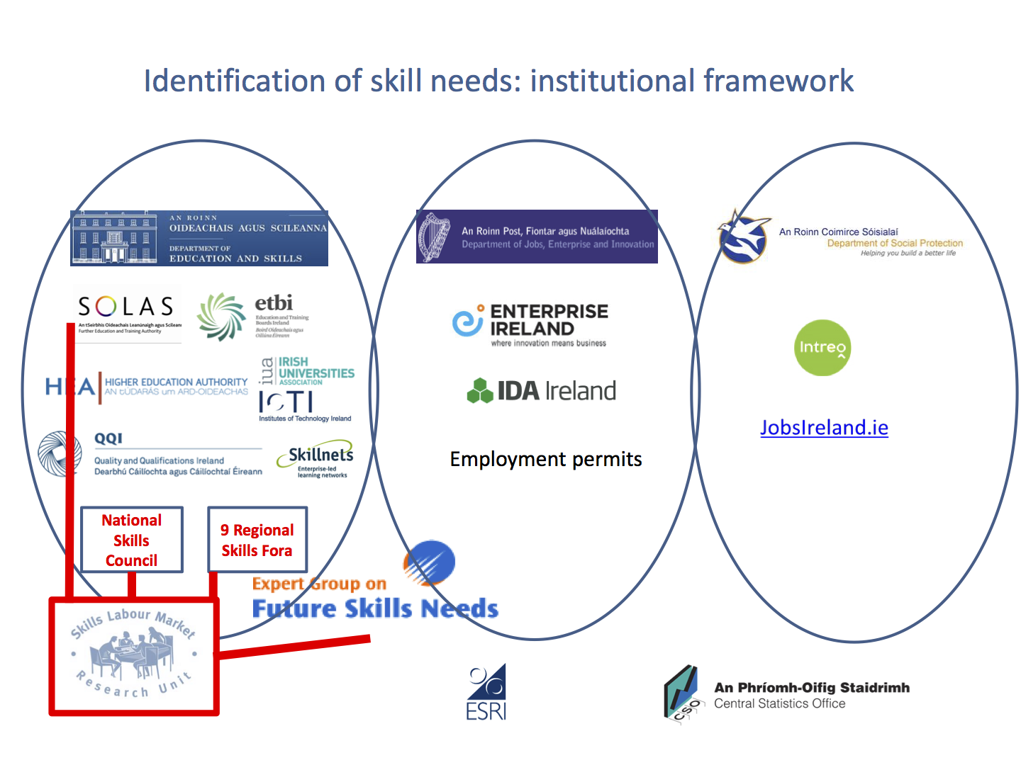
IrelanD
National Skills DB
National Skills Bulletin 2015
Vacancy Overview 2015
Occupational employment projections 2020
Others…
Notes:
Central Statistical Office (CSO)
Economic Social Research Institute (ESRI) in early 1990 developed the occupational employment forecasting model (in cooperation with FAS). In 2009 the model was transferred to Skills and LM Research Unit (SLMRU). Now the SLMRU is based on SOLAS – it maintains and updates the model and produces employment projections at occupational level.

Slide 25
France: The Various levels
National level: France Strategie
Long-term forecast ("Occupations 2030")
Network Employment-Skills
Regional level
Network Observatories CARIF-OREF (Regional Observatories Employment and Training)
Sectoral level
Prospective Observatories of Occupations Qualifications and Skills (ex.: Food Industry: "Observia")

Slide 26
France: The Various levels Observatories LM and training
National: “france strategy” (wide range domains, including LM forecasting, foresight)
  Network “Emploi Competences”
RegionaL:
  “OREF”: Observatoires regionaux emploi-formation (established in 1988)
  Network “CARIF-OREF” (established in 2011)
Branch observatories (sector)
  Metallurgy, food industry, others
Chambers: CCI Ile de france

Slide 27
Different CASE: LATVIA
3 functions:
LT Skills forecast: Ministry of Economy
ST skills forecast: PES
Min Economy and PES
Min Educ + Min Welfare (Empl) + SP committees
GOV:
– Lead, coordination
Active in the 3 functions
Ministry does LT forecast

Slide 28
Moving to the ukraine: exercice
A) SWOT (partial)
Main strengths and weaknesses, opportunities and threats – related to the 3 functions of skills anticipation:
1.
2.
3.
B) OPTIONS
For an articulated system with the 3 functions that
Delivers
Is credible / trusted
Is efficient
“Learns” (evolves)
Takes account of country size, regional dimension

Slide 29
Moving to the ukraine: exercice
Define why and what for a better organised skills anticipation system is needed! What are the consequences if it does not get better?
Reflect: where are you now - data, institutional capacity and mandates, technical / research capacity, resources, networks and collaborations.
Which main gaps? Where is the problem?
How to make this collaboration and joint work happen? What can trigger such decision and motivate the actors (beyond decrees and laws…)
What about the regions, sectors?
What will be your first step?

Slide 30
Options (one of the possible ways…)
Option 1:
Lead, coordination: GOV (which body)
1. STAT + PES + Instit Demogr + NAK / regional level
2. ?
3. GOV + SP = Committee xx
Option 2:
Lead, coordination: GOV
1. STAT + NAK (with Instit Dem)
2. NAK – dedicated platform
3. GOV + SP
Networked approach: needs coordination, shared-responsibility
F1: Gov, but clarify body in charge
F2: unknown
F3: is there such a committee, council…how to activate it
F1, F2: NAK – but much capacity development needed
F3: is there such a committee, council…how to activate it

Slide 31
Guide 1: using LMI
  Why matching skills supply and current and future labour market matters
  Using labour market information (LMI) for matching and anticipating skills
    Step 0: building a conducive institutional setting
    Step 1: Formulating the analysis aims
    Step 2: Data audit
    Step 3: Capability building
    Step 4: Analysis
    Step 5: Dissemination and use of LMI
Support:
References and sources
3 case studies
Technical terms

Slide 32
ANCILLARY MATERIAL
COMPLEMENTS FOR SELF-LEARNING

Slide 33
Uses
Outputs

Slide 34
USE of results iN INFORMING…
Employment policy
  Training and re-training, upskilling, apprenticeship programmes, transition to work…
  Occupational standards
Education and training policy
  Curricula and qualifications; info for students and graduates; decide funding courses; update career guidance; ….
  3. Other policies: SME, foreign investment, migration, green growth, digital economy
  4. Use by social partners:
  Influence labour and education policies; collective bargaining; retraining

Slide 35
Uses: LATVIA- Integration skills anticipation
in active labour market policy measures
Profiling,
Job search assistance,
Career guidance,
Key competences
Regional mobility
For unemployed with occupational background but without needed skills
Specific programmes for youth
Disadvantaged unemployed (with disabilities, long term unemployed etc)
Short term training
(languages, IT etc)
For all unemployed
Vocational training
First work place, Voluntary work,
Youth workshops, Training at the employer
Unemployed with no vocational background or with insufficient level of education for entering labour market
Subsidised employment
Unemployed with appropriate education or with entrepreneurship skills
Business
start-ups

Slide 36
Various types of outputs
1. Vacancy Overviews: analyses quantitative and qualitative; trends; comparisons; distribution across NACE groups, occupationshttp://www.solas.ie/SolasPdfLibrary/VacancyOverview2015.pdf
2. LM forecasting (short, medium-term): whole economy; by sector, occupation; demand; supply; imbalances. Ex.:
Latvia: results of short-term forecasts (1 year), SEA
Czech Republic: Czech Future Skills - medium-term forecast (NOET)
The LM by education and occupation 2020, NL (ROA)
3. Sector studies: CZ NOET; EU sector studies
4. Professional cards: CZ (NOET)
5. Info for career guidance (Latvia)

Slide 37


Job vacancy analysis: example (CZ, NOET)
341 Finance and sales associate professionals
512 Housekeeping and restaurant services workers
342 Business services agents and trade brokers
123 Other specialist managers
241 Business professionals
931 Mining and construction labourers
712 Building frame and related trades workers
311 Physical and engineering science technicians
213 Computing professionals (Computer systems designers, analysts and programmers)
343 Administrative associate professionals
214 Architects, engineers and related professionals
832 Motor vehicle drivers
521 Shop and market salespersons
913 Helpers and cleaners
222 Health professionals (doctors)
312 Computer associate professionals
932 Manufacturing labourers (in production)
828 Assemblers
722 Blacksmiths, tool-makers and related trades workers
422 Client information clerks
122 Production and operations managers
721 Metal moulders, welders, sheet-metal workers, structural-metal preparers, and related trades workers
713 Building finishers and related trades workers
131 Managers of small enterprises
724 Electrical and electronic equipment mechanics and fitters
TOP 25

Slide 38
mismatch Priority occupations EU (cedefop)
STEM professionals
ICT Professionals
Medical doctos
Nursery & midwifery
Teachers
Building & rel trades workers
Labourers in mining, manuf, transp
Elementary occupations
Social professionals
Secretaries
Shortages
Surplus

Slide 39
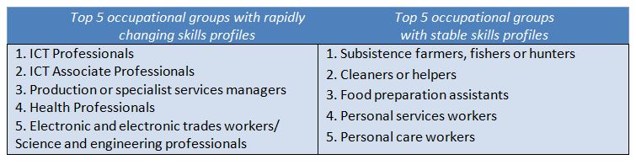
Future jobs, skills and changes: a million-dollar question

Slide 40
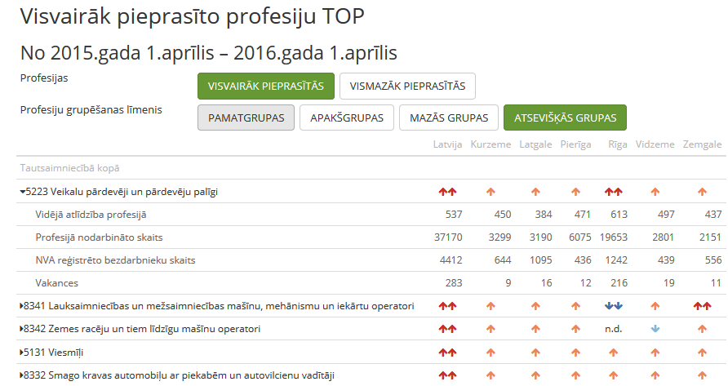
LM INFO for WIDER PUBLIC: Results of short-term forecasts

Slide 41
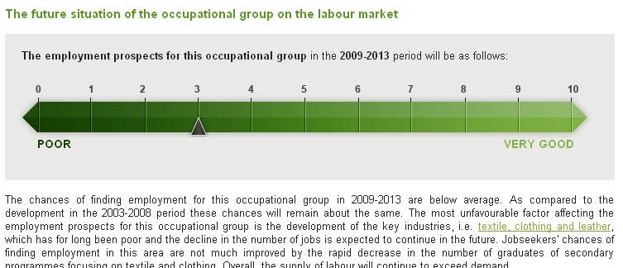
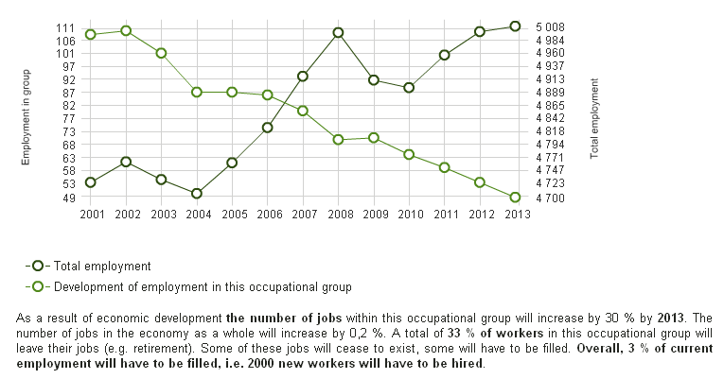
LM PROSPECT OCCUPATIONS - Quantitative forecasting, CZ -
Notes:
Substitute Demand
Allows to evaluate the situation on the labour market for specific educational group assuming that persons with certain level and field of education can do the same job as persons with similar education. There are 2 main assumptions for the substitute algorithm: 1) Substitution is possible only between same levels of education or from higher towards the lower level., 2) Substitution is possible only between specific fields of education on the basis of trends included in LFS. Substitution improves the IFLM indicator (indicator of future labour market prospects) because increases the number of fields of assertions.
Shift-share analysis
Allows to analyse the cause of employment shift in educational or occupational groups in the projected period. Distinguishes three types of effects: 1) sectoral effect, 2) occupational effect, 3) educational effect
Attractiveness of fields of study
Allows to measure the attractiveness of fields of study. The coefficient is composed from: 1) IFLM indicator, 2) monthly wage of graduates of fields of study, 3) average year growth of the hourly wage of graduates, 4) unemployment rate of graduates in 2007.
41

Slide 42
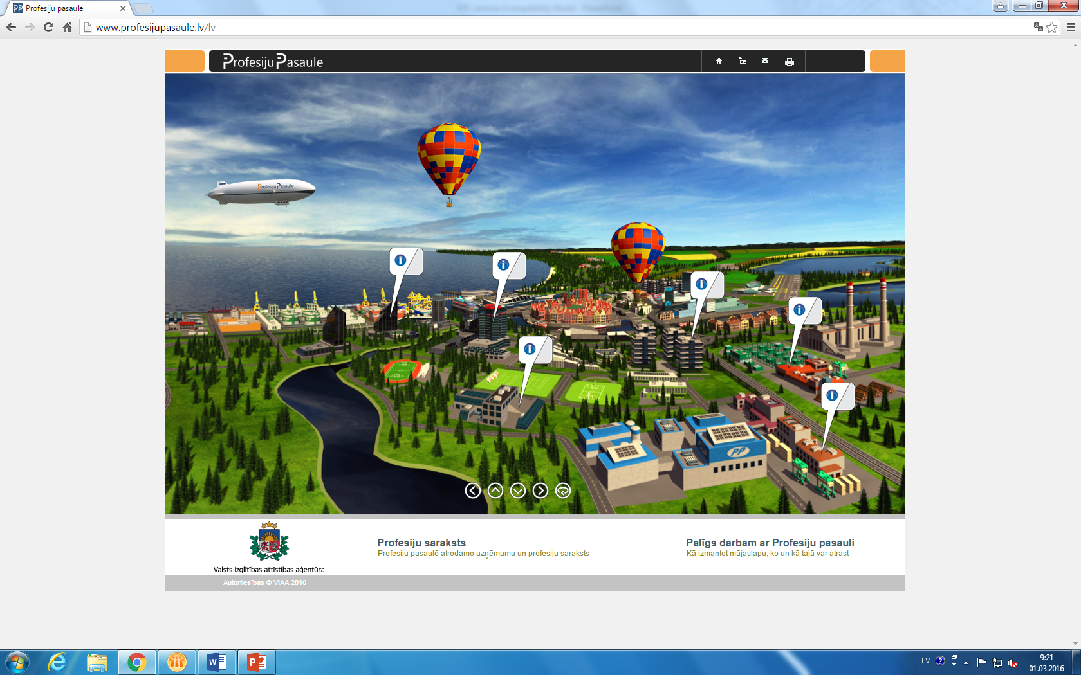
LATVIA - Attractive information on occupations www.profesijupasaule.lv
Notes:
Trailer «Profesiju pasaule»: https://www.youtube.com/watch?v=jnl6EmEBGXw

Slide 43
Success factors, constraints and transferability
Success factors
Time to grow and refine the models
Organizational continuity to build analytical capacity
Dialogue stakeholders
Relationship building to support access to data, refine methods
Focus on occupations as main unit of analysis and key to data matching
Constraints
Varying data quality
Data granularity
Key requirements for transferability
Macroeconomic forecasts provide a starting point
Central resource for data access. Handling and analysis

Slide 44
NEW! The power of DIGITAL
BIG DATA
Large potential for analysis of LM, skills dynamics
Timely, agile, innovative
Methodology developments but still several issues at stake
Notes:
Issues: statistical representativeness; credibility of job portals (selection, criteria)

Slide 45
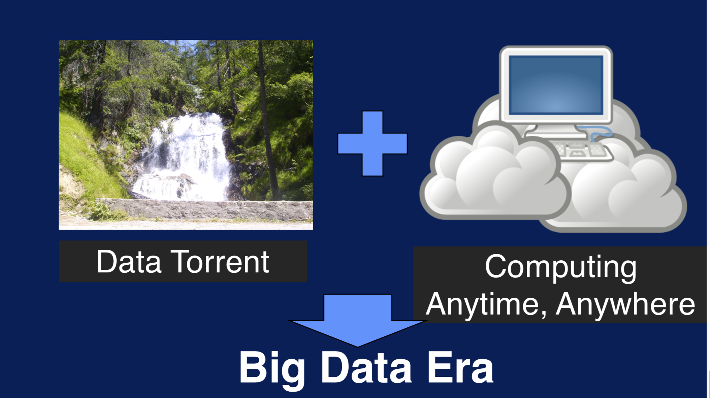
AI algorithms

Slide 46

Big data: 6 “V”
Volume
Variety
Velocity
Veracity
Valence
Value

Slide 47
LMI is key…how to improve it in the digital era? Challenges of “traditional” LMI
?
Timeliness
Accuracy
Analysis
Integration
Usage
Cost

Slide 48
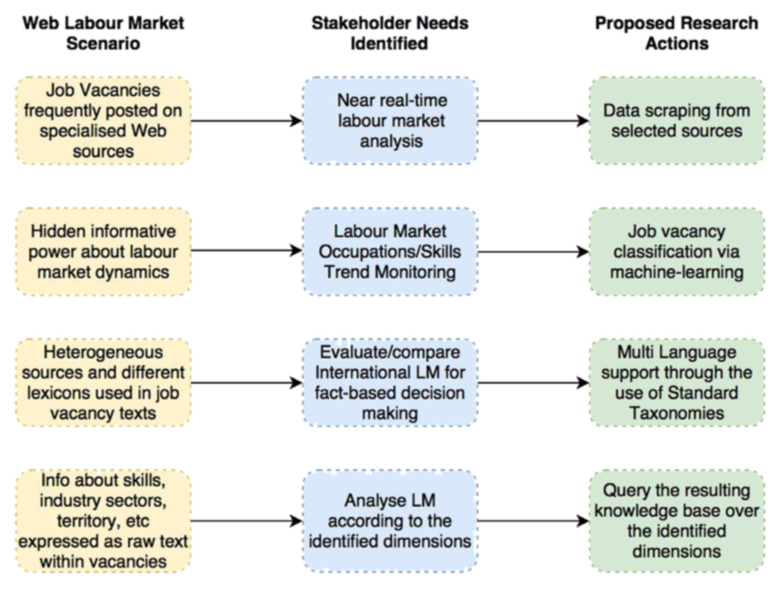
Turning Big data in LMI

Slide 49
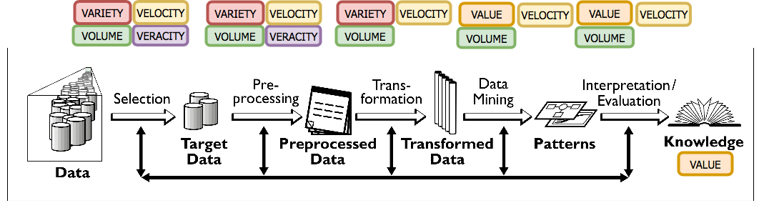
Turning Big data in LMI: kdd (knowledge discovery in databases) – 5 main steps

Slide 50
Real Time: how does it work? Data Model structured as…
Web scraping: download page from site and extract meaningful data
Structured data reconciliation
Detect and remove duplication
Text classification
Skills extraction – skill taxonomy
Skill classification
Identification of new skills
ISCO
ESCO
O’NET

Slide 51
Big Data and LMI: challenges
Over-representation vs. absence of sectors
Occupational bias…Web job vacancies
Digital divide across countries and regions
Instant and big volume of information…information is unstructured and imperfect.
Relatively low running costs…costs for cleaning the information & noise.
GDPR…
Notes:
KDD = Knowledge discovery in DBs

Slide 52
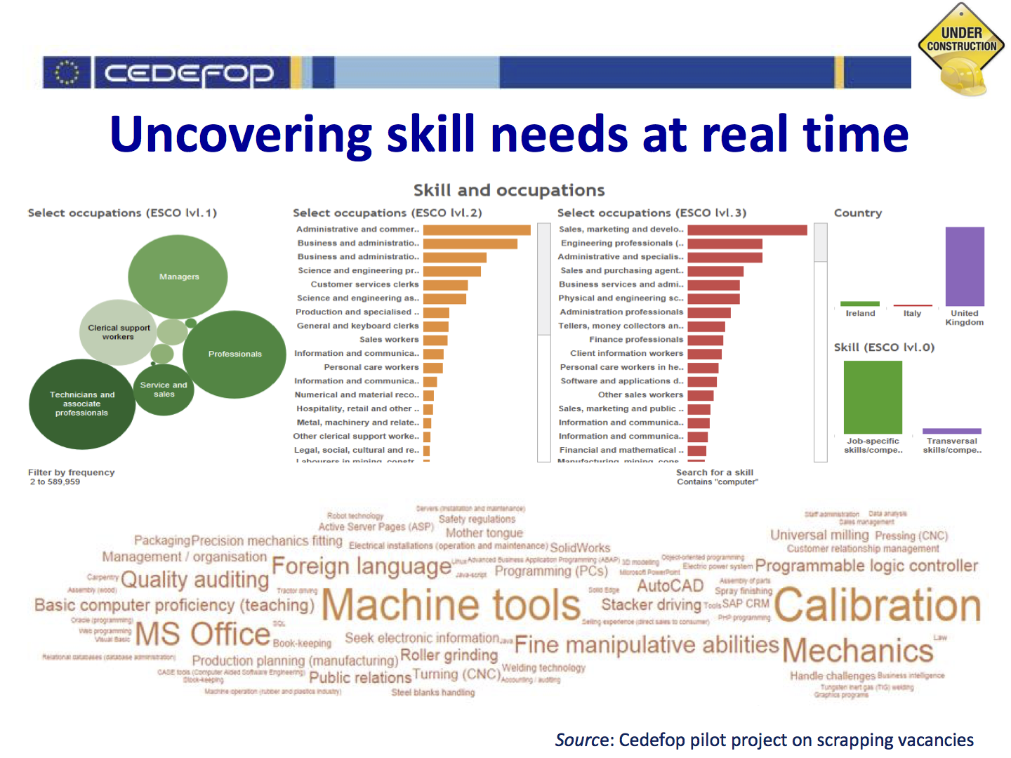
Pilot phase: CZ, DE, IE, IT, UK + all 28 EU MS

Slide 53
You are not alone:
Sources and networks

Slide 54
Methodological Guides: ETF-ILO-CEDEFOP
A set of 6 methodological guides developed in cooperation with CEDEFOP and ILO (all published)
Better understanding of matching and anticipation processes and methodologies
Dissemination and integration of thematic work in ETF partner countries’ activities

Slide 55





6 Methodological guides and 7 technical notes
Using LM information
Developing skills foresights, scenarios and forecasts
Working at sector level
The role of employment service providers
Developing and running an establishment skills survey (not yet published)
Carrying out tracer studies (graduates)

Slide 56


Sources: 6 Methodological Guides
Using Labour Market Information
https://www.etf.europa.eu/en/publications-and-resources/publications/using-labour-market-information-guide-anticipating-and
2. Developing skills foresights, scenarios and forecasts
https://www.etf.europa.eu/en/publications-and-resources/publications/developing-skills-foresights-scenarios-and-forecasts-guide
3. Working at sector level
https://www.etf.europa.eu/en/publications-and-resources/publications/working-sectoral-level-guide-anticipating-and-matching
4. The role of employment service providers
https://www.etf.europa.eu/en/publications-and-resources/publications/role-employment-service-providers-guide-anticipating-and
5. Developing and running an establishment skills survey
https://www.etf.europa.eu/en/publications-and-resources/publications/developing-and-running-establishment-skills-survey-guide
6. Carrying out tracer studies
https://www.etf.europa.eu/en/publications-and-resources/publications/carrying-out-tracer-studies-guide-anticipating-and-matching

Slide 57


Sources (2): Summary notes
Labour Market Information Systems: collecting information and data on labour market trends
https://www.etf.europa.eu/en/publications-and-resources/publications/labour-market-information-systems-collecting-information
2. Skills Forecasts
https://www.etf.europa.eu/en/publications-and-resources/publications/skills-forecasts-matching-right-workers-and-skills-right
3. Skills Foresights
https://www.etf.europa.eu/en/publications-and-resources/publications/skills-foresight-making-sense-emerging-labour-market-trends
4. Sector-based skills anticipation
https://www.etf.europa.eu/en/publications-and-resources/publications/sector-based-skills-anticipation-making-sense-emerging
5. Employment service providers: developing labour markets
https://www.etf.europa.eu/en/publications-and-resources/publications/employment-service-providers-developing-better-labour
6.. Employer surveys: producing the right skills for the right employers
https://www.etf.europa.eu/en/publications-and-resources/publications/employer-surveys-producing-right-skills-right-employers-and
7. Tracer studies
https://www.etf.europa.eu/en/publications-and-resources/publications/tracer-studies-evaluating-impact-training-programmes
8. Labour Market and Training Observatories
https://www.etf.europa.eu/en/publications-and-resources/publications/labour-market-and-training-observatories-providing

Slide 58
You are not alone: some Big Data Networks and sources (many…)
European Data Forum
https://2015.data-forum.eu/
Big Data Europe
https://www.big-data-europe.eu/big-data-labour-market-impacts/
CRISP Milan
http://www.crisp-org.it/
Encyclopedia of Big Data Technologies
https://link.springer.com/referenceworkentry/10.1007%2F978-3-319-63962-8_276-1
EU Skills Panorama
http://skillspanorama.cedefop.europa.eu/en
And soon: ETF practical guide…

Slide 59
Many other useful portals, libraries – a couple of examples
Network “Make it Match” – Eastern Partnership: supported by ETF
EU Skills Panorama
http://skillspanorama.cedefop.europa.eu/en
2. Skills Ireland
http://www.skillsireland.ie/
http://www.solas.ie/SolasPdfLibrary/OccupationalEmploymentForecasts2013.pdf
3. DARES – Ministry of Labour and Employment France
http://dares.travail-emploi.gouv.fr/dares-etudes-et-statistiques/

Slide 60
Thank you!
www.etf.europa.eu
ecb@etf.europa.eu

