Slide 1



Vocational Schools at Sakarya University and
3+1 Education Model
Prof. Dr. Mehmet Sarıbıyık
“Shaping Level 5” ETF Conference, Torino 7/06/18

Slide 2
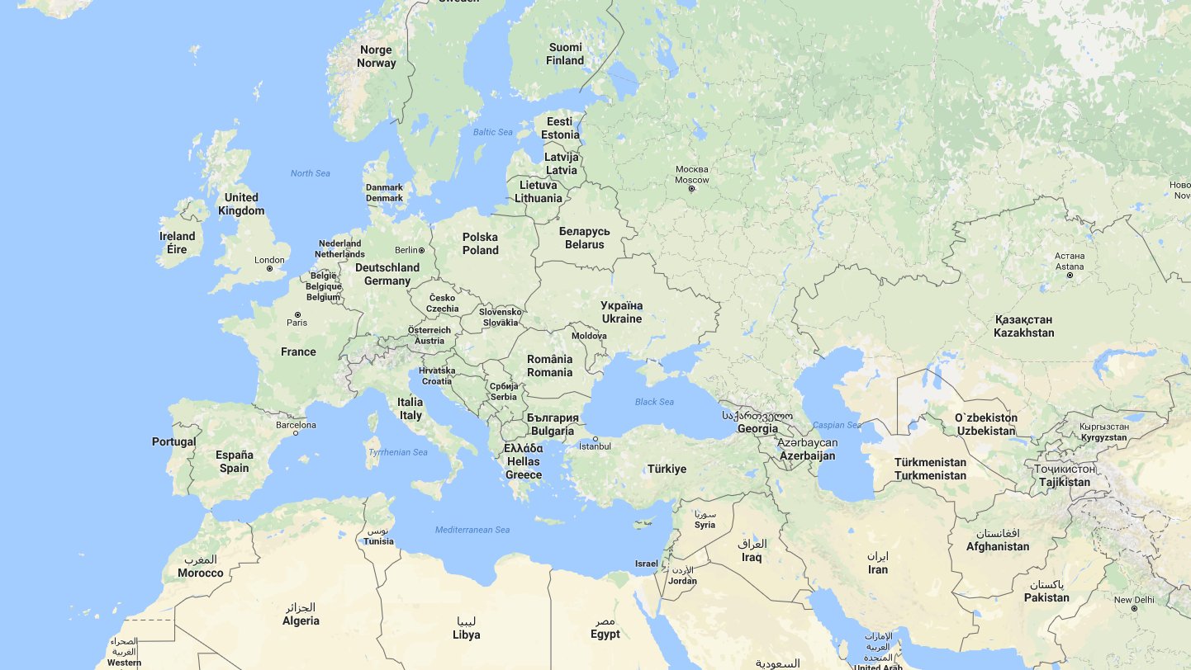

Slide 3
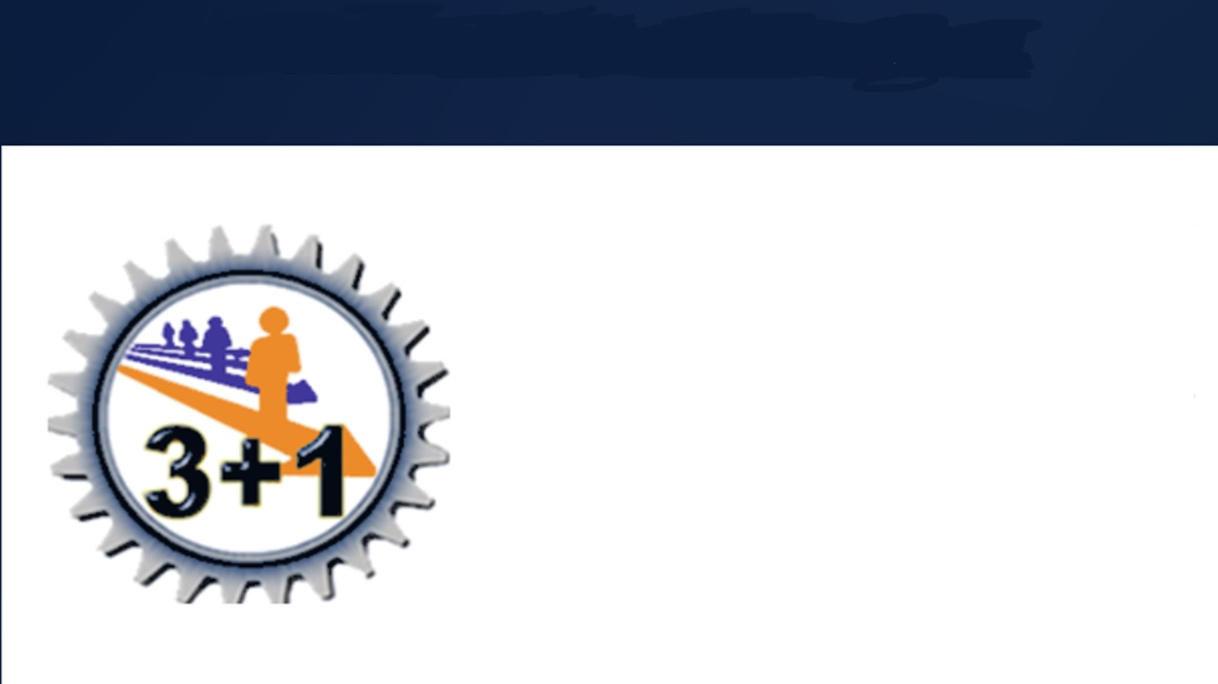
Vocational Schools in Turkey
Vocational school, which aims to educate qualified manpower for specific professions, is an institution of higher associate degree.
The total educational period is lasts two years. The process may be either four or six semesters, total 120 ECTS.

Slide 4
Post-Secondary Vocational Higher Schools in Universities
970 Nation wide vocational schools
2,5 Milion Students (1,4 milion distance and e-learning)
219 Different programmes
%52 of students comes from Vocational High Schools (Level 4)
Everybody can attend, mostly young people between 18 – 25 ages
Ability to continue barchelors by national exam

Slide 5
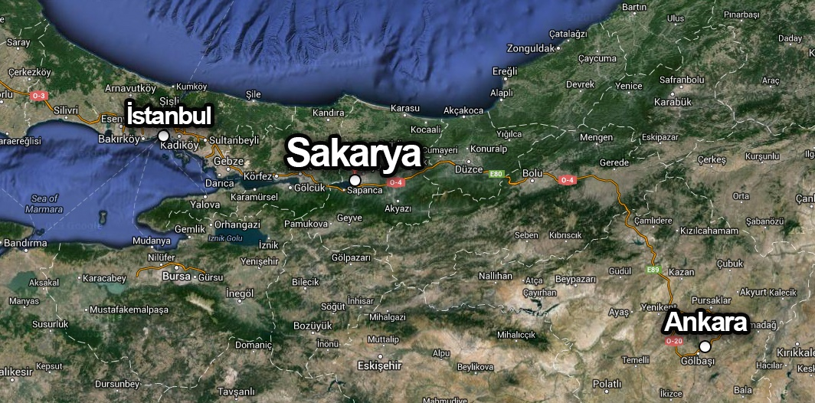

Slide 6
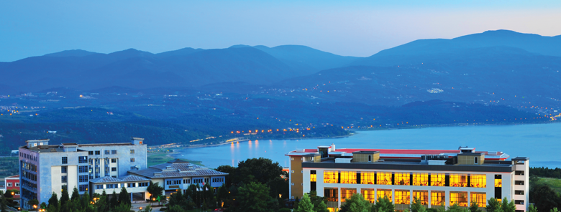

Total Students 92.100 Foreign Students 3.400
Staff 2.700
Vocational Schools 15
Active programmes 51
Students 29.325
Staff 372

Slide 7
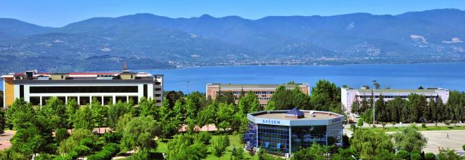
Programmes are oriented by coordination of employers, NGOS, sector, govermental bodies and needs of market (3+1 system)
Graduates already have national vocational accreditation (MYK)

Slide 8

Programmes
Auto Paint and Body Covers
Automotive Technology
Interior Design
Climate and Cooling Technology
Construction Technology
Welding Technology
Laboratory Technology
Logistics
Machine
Machine Painting and Construction
Computer Aided Design and Animation
Computer Programming
Environmental Protection and Control
Mechatronics
Metallurgy
Architectural Restoration
Furniture and Decoration,
Electricity
Electronic Technology
Industrial Molding
Gas and Plumbing Technology
Graphic Design
Textile Technology
Fashion Design
Landscape and Ornamental Plants
Tourism Animation
Tourism and Hotel Management
Tourism and Travel Services
Cooking
Food Quality Control and Analysis
Food Technology
Press and Publishing
Office Management and Executive Assistance
Child Development
Foreign Trade
Accounting and Tax Practices
Marketing
Real Estate and Property Management
Retail and Store Management
Banking and Insurance
Public Relations and Publicity
Business Administration
Finance
Media and Communication
First and Emergency Help
Occupational Health and Safety
Physiotherapy
OpticianMedical Documentation
and Secretariat
Medical Laboratory Techniques
Elderly Care

Slide 9

Relation between
acreditation and
programmes
Vocational school programmes offers education in wide vocational field. However MYK (National Qualification Framework) defines vocational qualifications specificly for a one job.
Mostly vocational school graduaters have more than one qualifications in Level 5

Slide 10

What is innovative about Vocational School Programmes in Sakarya University at Level 5 ?

Slide 11
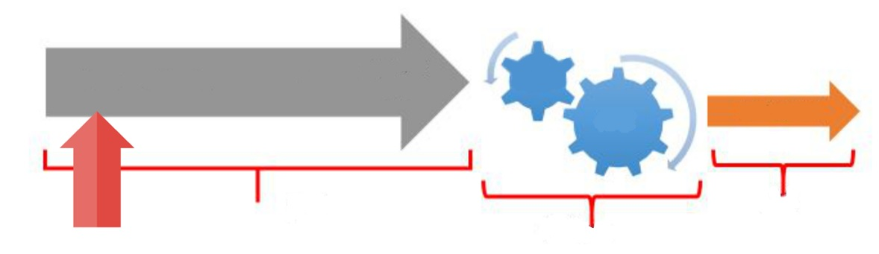
Everything starts with a human,
Human, Machine, Information, Energy, Material etc.
Manufacturing
Product/Service
Process
Input
Output
Process
and is shaped by qualified people and applied to the life.

Slide 12
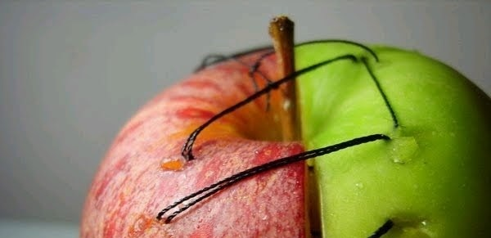
A strange paradox:
While one side is talking about unemployment,
employers look for qualified people (!)

Slide 13

What is needed?
Qualified people with practical skills

Slide 14
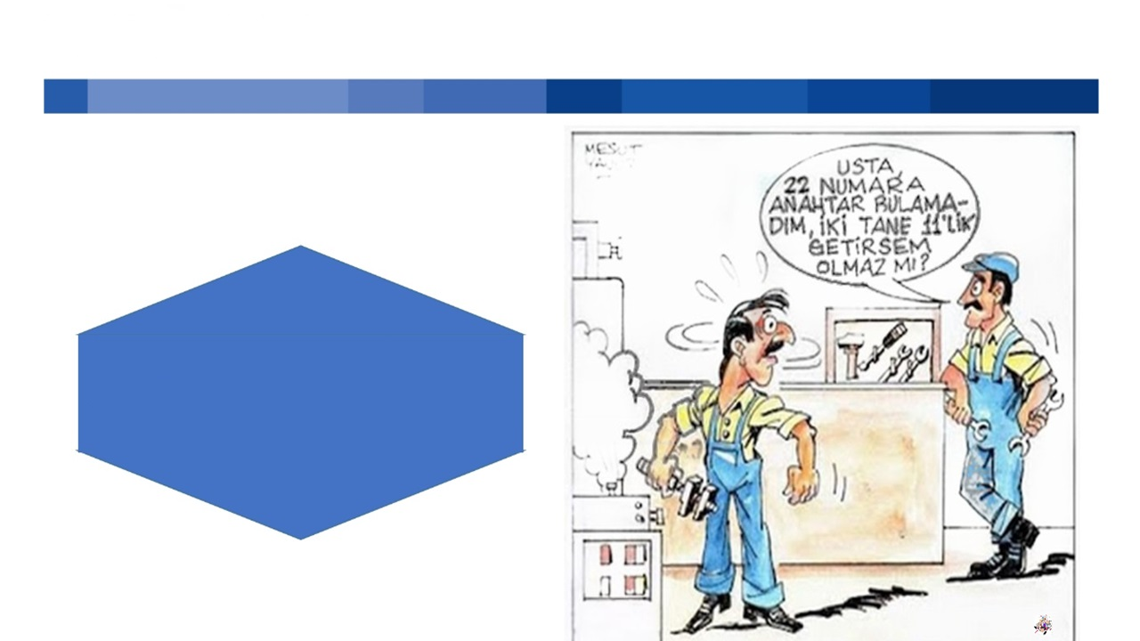
What is the main problem?
I didn’t find 22M Wrench, can I give two of 11M Wrenches?
Lack of practical skills

Slide 15

You don’t learn to walk by following rules. You learn
by doing and
by falling over.
Richard Branson

Slide 16
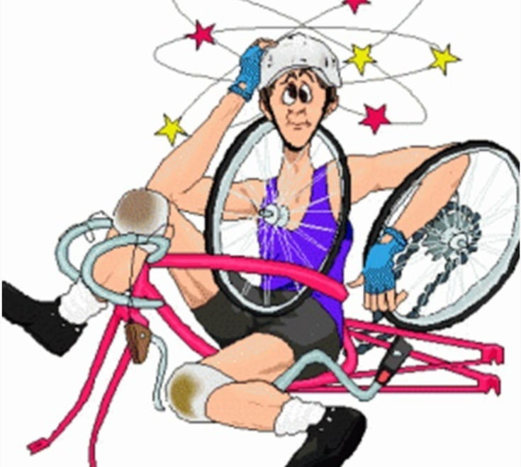
No matter how much riding a bicycle is theoretically described,
you cannot learn without riding.
You don’t learn to walk by following rules. You learn
by doing and
by falling over.
Richard Branson

Slide 17
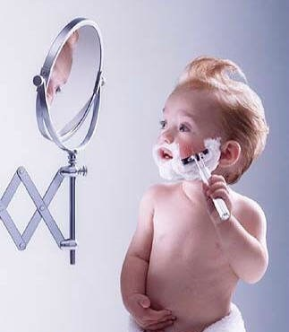

The actual learning starts with practice

Slide 18
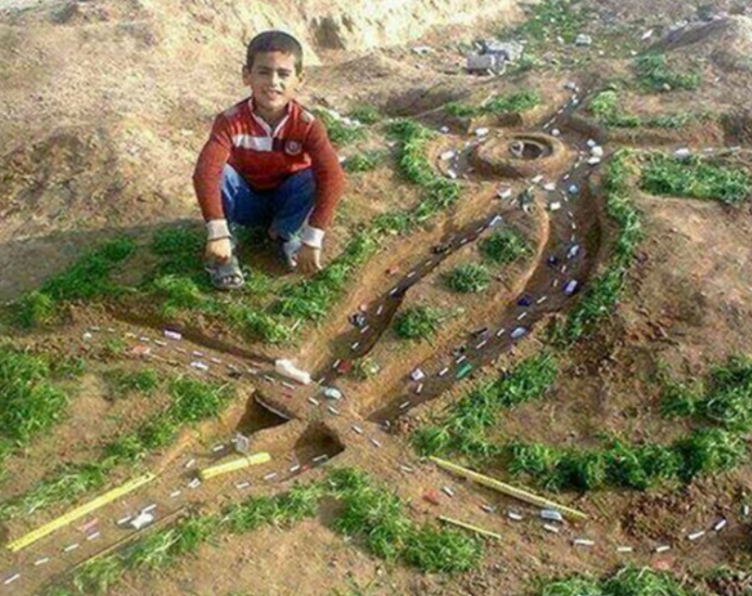
I HEAR AND I FORGET,
I SEE AND I REMEMBER,
I DO AND I UNDERSTAND.
CONFUCIUS

Slide 19

The Methods of Practical Skills Gain;
Internships
Professional practices
Applied courses
Workplace practices

Slide 20
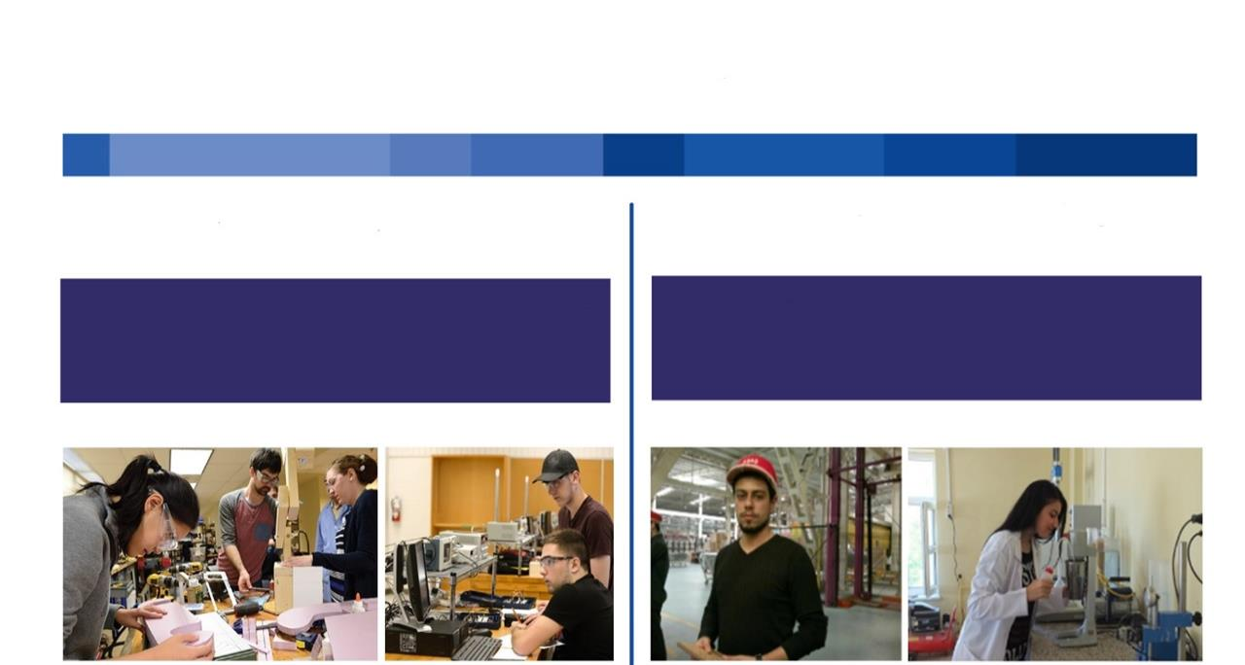
Professional Practices
Applied Courses
Workplace Practices
Includes, the activities that the students work as employee candidate of that workplace .
Includes laboratories , workplaces and the other applied courses.

Slide 21

One Year
Workplace
Practice Model
Three Master
Model
(3+3 Model)
Workplace Practice
Model
1 semester
Workplace Practice
(3+1 Education
Model)
Part-time
Workplace
Practice Model
Proposal and Goal
In order to train the students as qualified people, they should complete workplace practice at least 1 semester.

Slide 22

How do we achieve this goal?
To educate the students with the business world;
3 + 1 Education Model

Slide 23
The Aim of 3+1 Education Model
Follow-up the technological developments
Understand the organization structure
Transform the theoretical knowledge into practical skills
Establish the work experience and work discipline
Gain
Team-work habit
Increase the knowledge and experience
QUALIFIED PERSON

Slide 24

Benefits of 3+1 Education Model
Student
University
Business World
Society

Slide 25
The Process of the Model
Practice
Period
Precondition
Duration
Evaluation
3rd or 4th semester
1,8 GPA
16 Week Full-Time
Passed (YT) Failed (YZ)
( Requires Min. 65 out of 100. The grades are given together with the authorized person in the company.)

Slide 26
The Process of the Model
Priorities
Pursuit
Insurance premium
Payment
Company request
Trust
Payment
Food
Transportation
Student preference
Authorized teaching stuff
Authorized person in workplace
By University
By the company

Slide 27
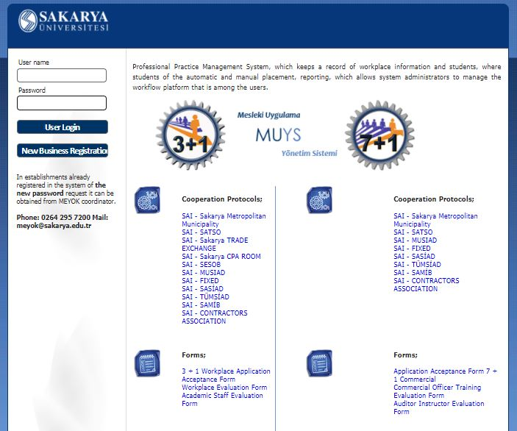
Professional Practices Management System
www.muys.sakarya.edu.tr

Slide 28
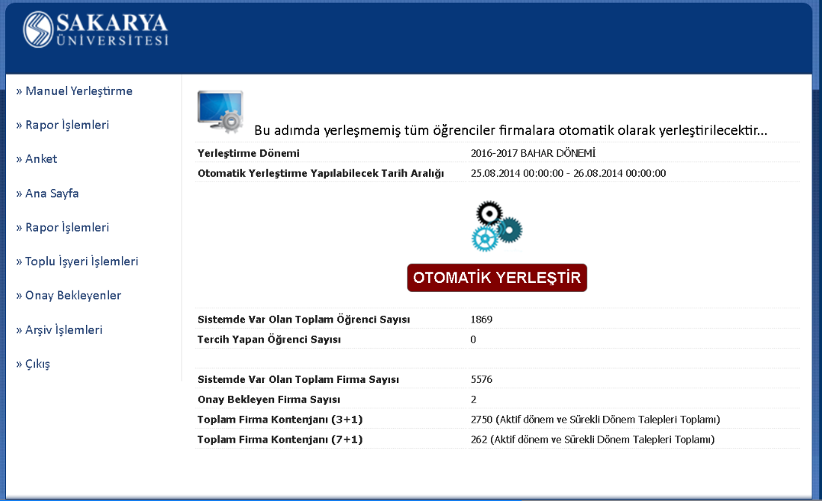

Slide 29
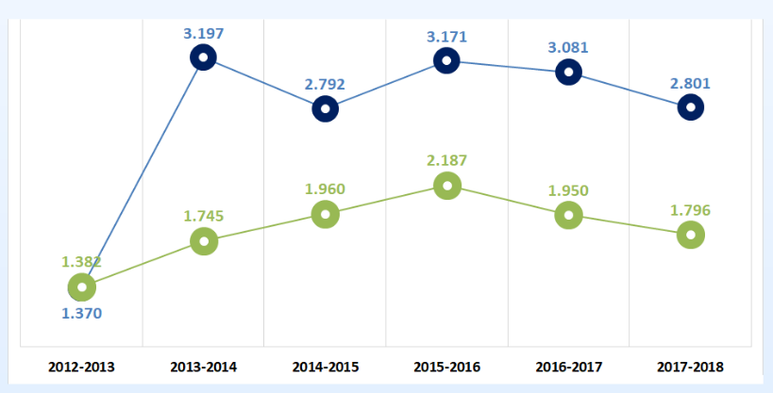
The Numerical Data of Workplace Practice
Requested
Settled
TOTAL | 3+1 request number | 3+1 settled student number
 | 32.819 | 22.027

Slide 30
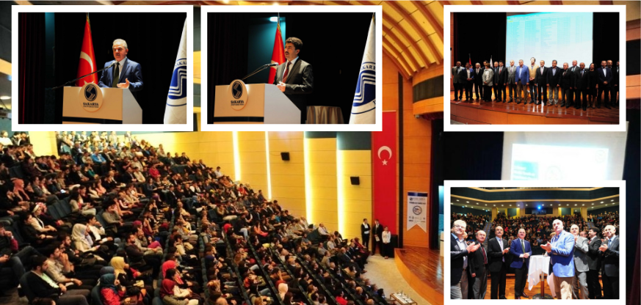
We are with our partners to place the students in companies.

Slide 31
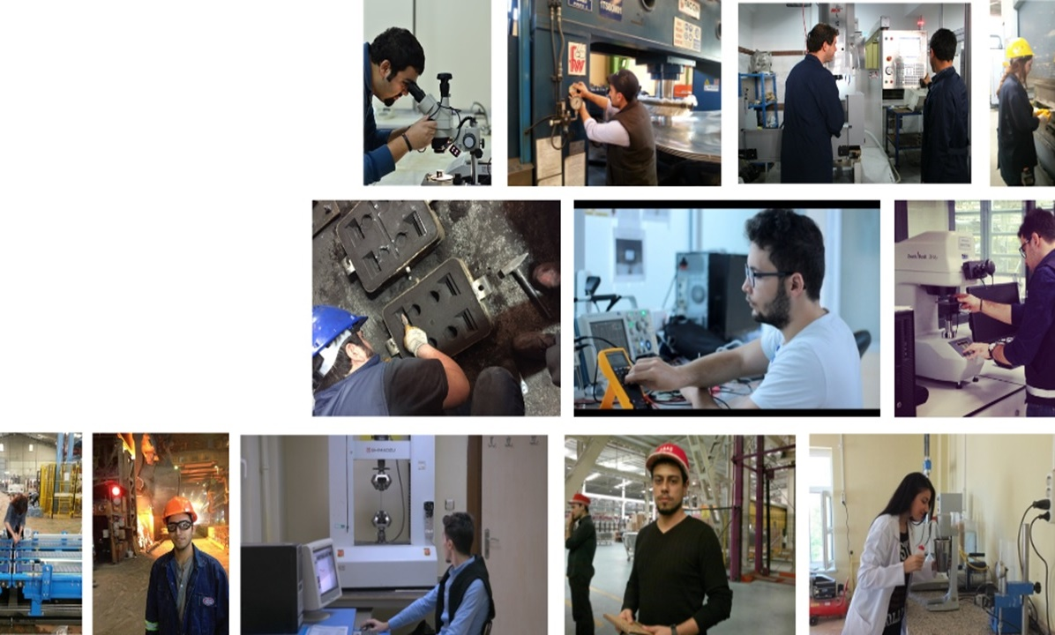
Student Profiles
in Practices

Slide 32

Satisfaction Surveys
It is applied the
Teaching stuff
Students
Employer
after the workplace practice.
These surveys are aimed to determine the strengths and weaknesses, the points to be improved and some statistical information such as Sectoral distribution, Preferred areas, the locations of the firms etc.

Slide 33
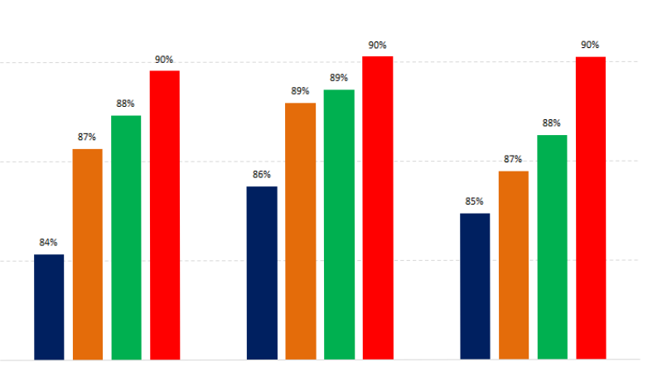
Satisfaction Values
STUDENT EMPLOYER TEACHING STAFF
2013 - 2014
2014 - 2015
2015 - 2016
2016 - 2017

Slide 34
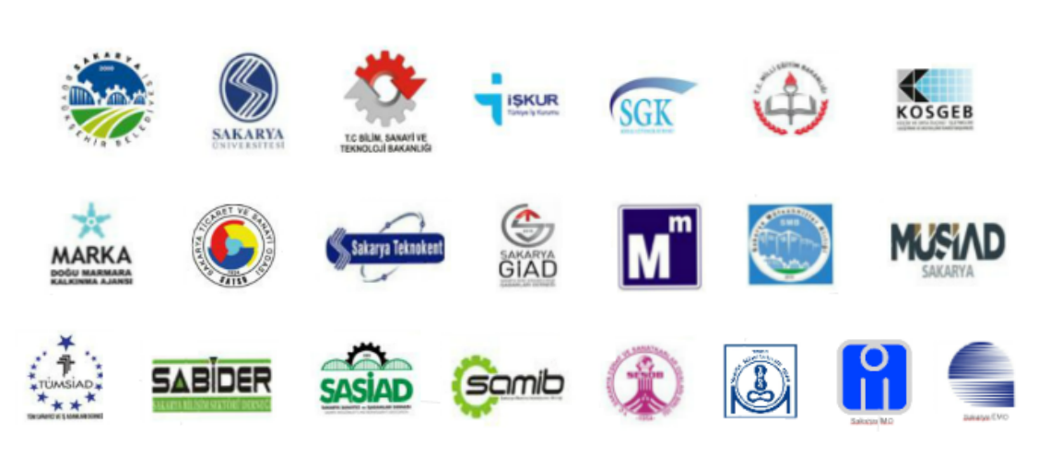
Main Partners

Slide 35
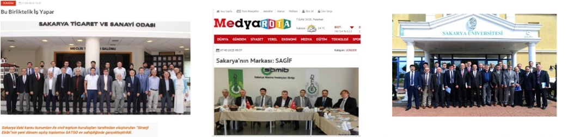
Sakarya Synergy Team and Meeting with Sectors
The Sakarya synergy team consist of public institutions and NGOs
Hundreds of businessmen and industrialists together with students and university members.

Slide 36
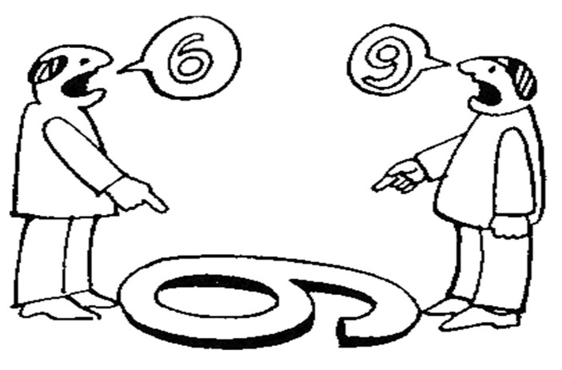
Thanks to the 3+1 Education Model,

Slide 37

We have the same view.

Slide 38


Infrastructure
Following up the current technology
Usage of firm infrastructure.
Students
Practical skills
Easy job finding
Work experience
Achievement Summaries
Teaching Stuff
Joint R & D
Following up the current technology
Business world cooperation.
Business world
Programs
Qualified People
Cooperation with the University
Solution-focused R & D
Suitability for business needs
Coordination in the programs
Keeping curriculums up to date
.........................
.........................

Slide 39
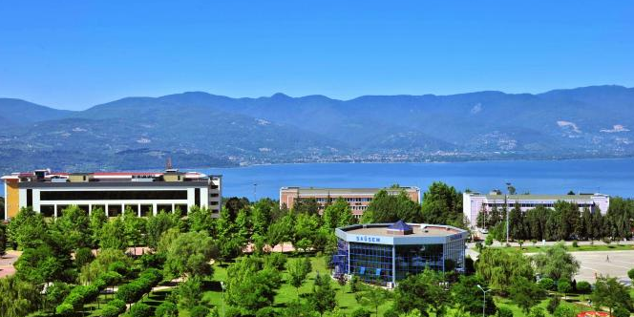

Thank you!

