Slide 1
EQF Level 5 | Knowledge | Skills | Responsibility and autonomy
Level 5 (*1) The Learning outcomes relevant to Level 5 are | comprehensive, specialised, factual and theoretical knowledge within a field of work or study and an awareness of the boundaries of that knowledge | a comprehensive range of cognitive and practical skills required to develop creative solutions to abstract problems | exercise management and supervision in contexts of work or study activities where there is unpredictable change; review and develop performance of self and others
Notes:
MSE 15.06 draft 16.05.2011
1

Slide 2
  Level 5 matters
  at the junction of VET, general and higher education
  many types of qualification, many providers, many learning paths
  in demand – by employers, young people, adult learners, job-changers
  Yet often invisible or outside NQFs
Notes:
MSE 15.06 draft 16.05.2011
2

Slide 3
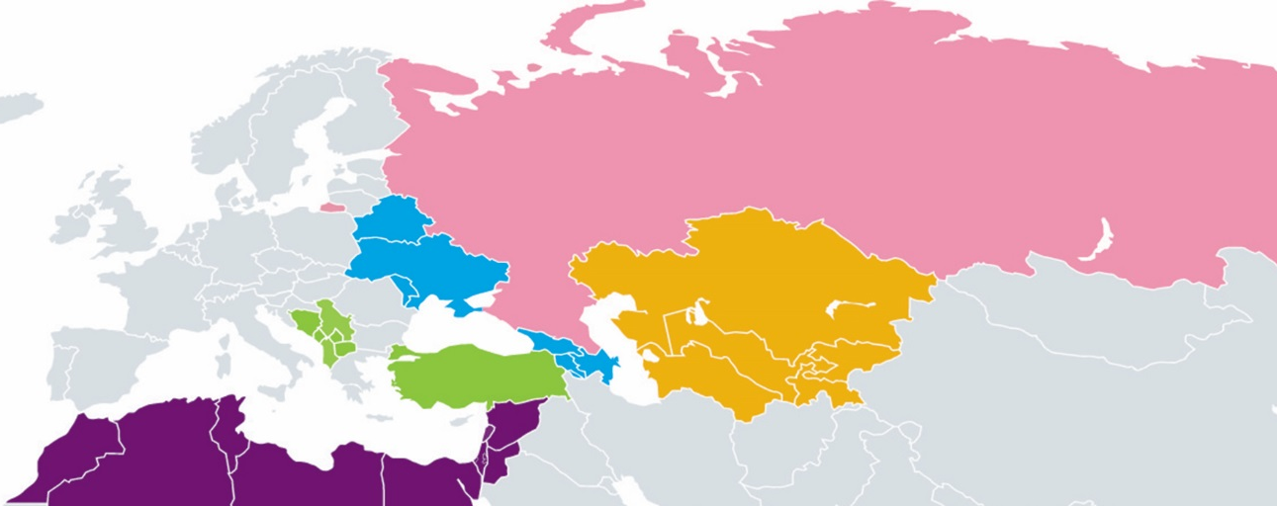
South Eastern Europe
Albania, Bosnia and Herzegovina, Kosovo*, former Yugoslav Republic of Macedonia, Montenegro, Serbia
Turkey
Southern and Eastern Mediterranean
Algeria, Egypt, Jordan, Lebanon, Libya, Morocco, Palestine**, Syria, Tunisia and Israel
Eastern Partnership:
Armenia, Azerbaijan, Belarus, Georgia, Republic of Moldova, Ukraine
Central Asia:
Kazakhstan, Kyrgyzstan, Tajikistan, Turkmenistan, Uzbekistan
Russia
* This designation is without prejudice to positions on status, and is in line with UNSCR 1244 and the ICJ Opinion on the Kosovo declaration of independence.
** This designation shall not be construed as recognition of the State of Palestine and is without prejudice to the individual positions of the EU Member States on this issue.
Notes:
Comms to update

