Slide 1
The double nature of level 5: challenges and opportunities
Jean Philippe RESTOUEIX
Higher Education unit
Council of Europe
Torino, 7 June 2018

Slide 2
EHEA ministerial communiqués
Bucharest 2012
A common understanding of the levels of our qualifications frameworks is essential to recognition for both academic and professional purposes. School leaving qualifications giving access to higher education will be considered as being of European Qualifications Framework (EQF) level 4, or equivalent levels for countries not bound by the EQF, where they are included in National Qualifications Frameworks. We further commit to referencing first, second and third cycle qualifications against EQF levels 6, 7 and 8 respectively, or against equivalent levels for countries not bound by the EQF. We will explore how the QF-EHEA could take account of short cycle qualifications (EQF level 5) and encourage countries to use the QF-EHEA for referencing these qualifications in national contexts where they exist

Slide 3
EHEA Ministerial communiqués
EREVAN 2015
“to include short cycle qualifications in the overarching framework of qualifications for the European Higher Education Area (QF-EHEA), based on the Dublin descriptors for short cycle qualifications and quality assured according to the ESG, so as to make provision for the recognition of short cycle qualifications in their own systems, also where these do not comprise such qualifications;”

Slide 4
EHEA Ministerial Communiqués
Paris 2018,
Appendix III,
Short cycle qualifications:
Qualifications that signify completion of the higher education short cycle are awarded to students who:
- have demonstrated knowledge and understanding in a field of study that builds upon general secondary education and is
typically at a level supported by advanced textbooks; such knowledge provides an underpinning for a field of work or vocation, personal development, and further studies to complete the first cycle;
- can apply their knowledge and understanding in occupational contexts;
- have the ability to identify and use data to formulate responses to well-defined concrete and abstract problems;
- can communicate about their understanding, skills and activities, with peers, supervisors and clients;
- have the learning skills to undertake further studies with some autonomy.
Typically include 90- 120 ECTS
Inclusion of level 5 in NQF Higher Education

Slide 5
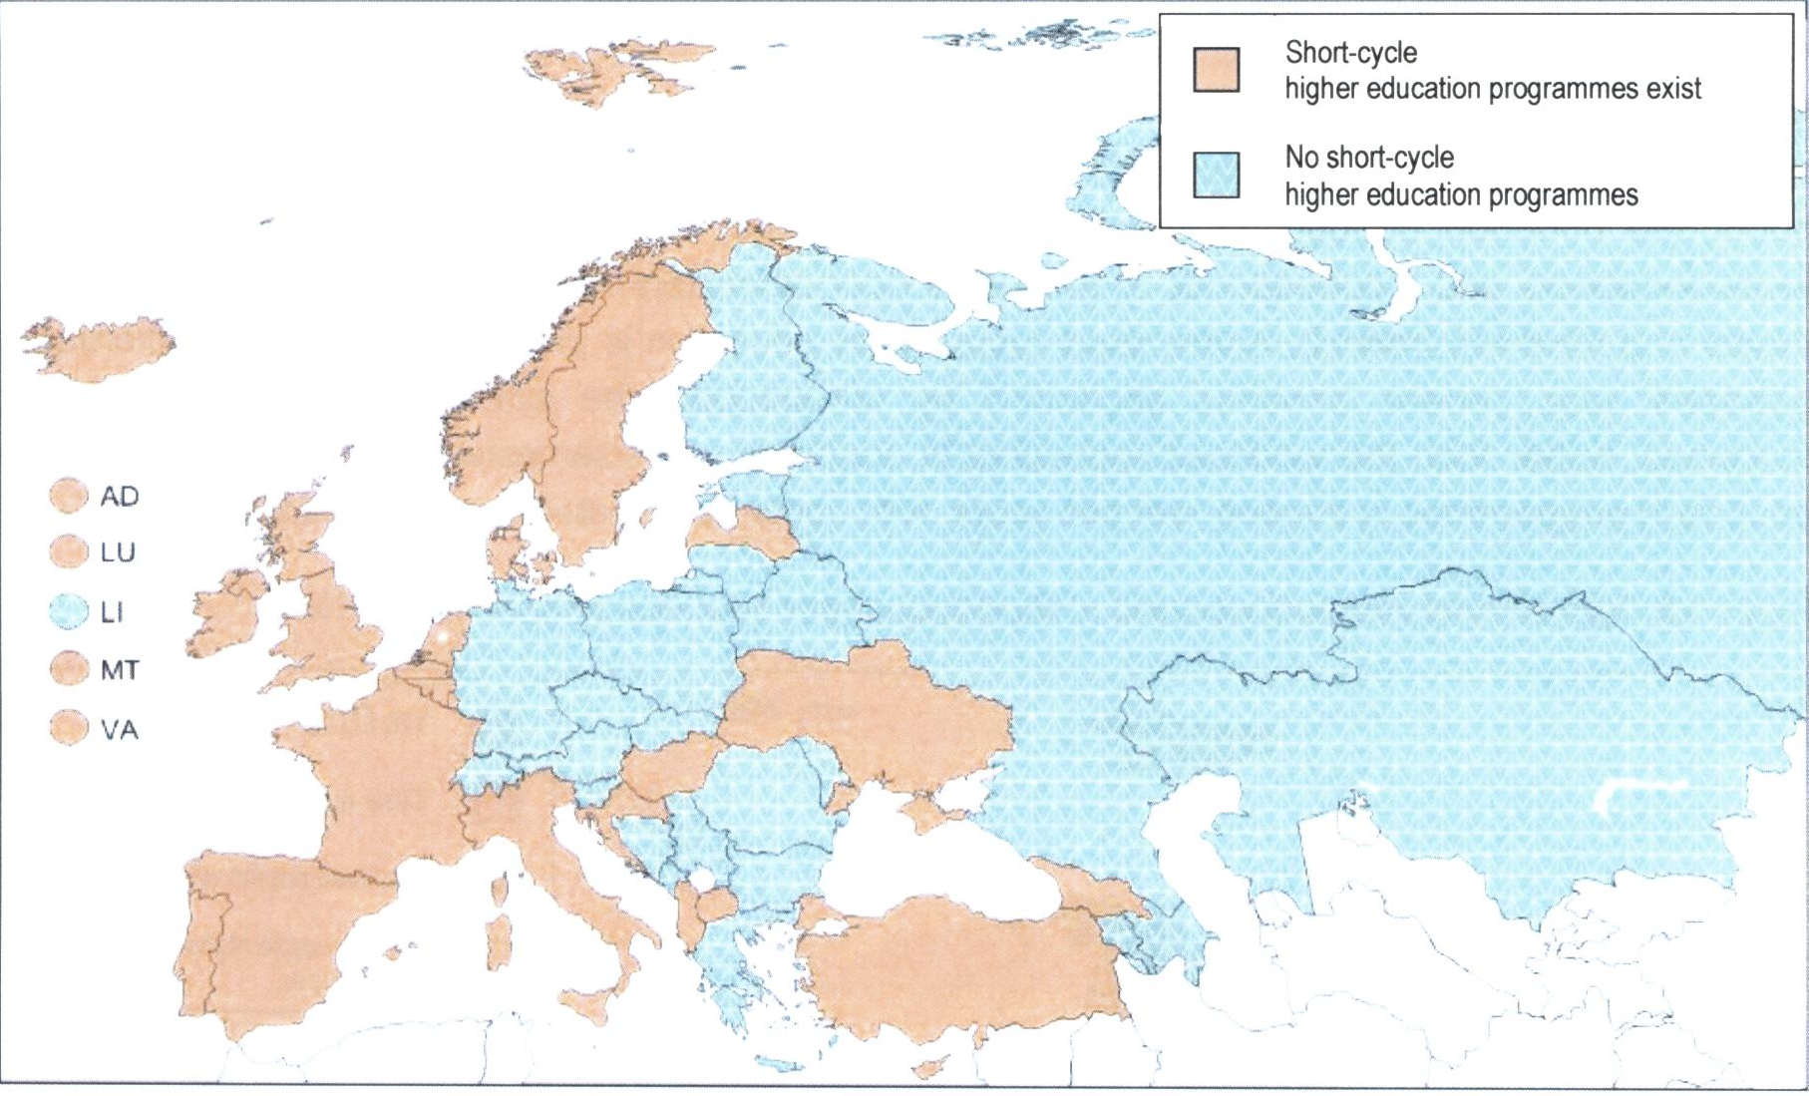
Figure 3.7: Presence of short-cycle programmes considered as part of higher education, 2016/17 Source: BFUG data collection. The presence of short-cycle programmes considered as part of higher education refers to situations where national qualifications frameworks and/or top-level steering documents recognise the short cycle (or short-cycle qualifications) as part of the higher education system.

Slide 6
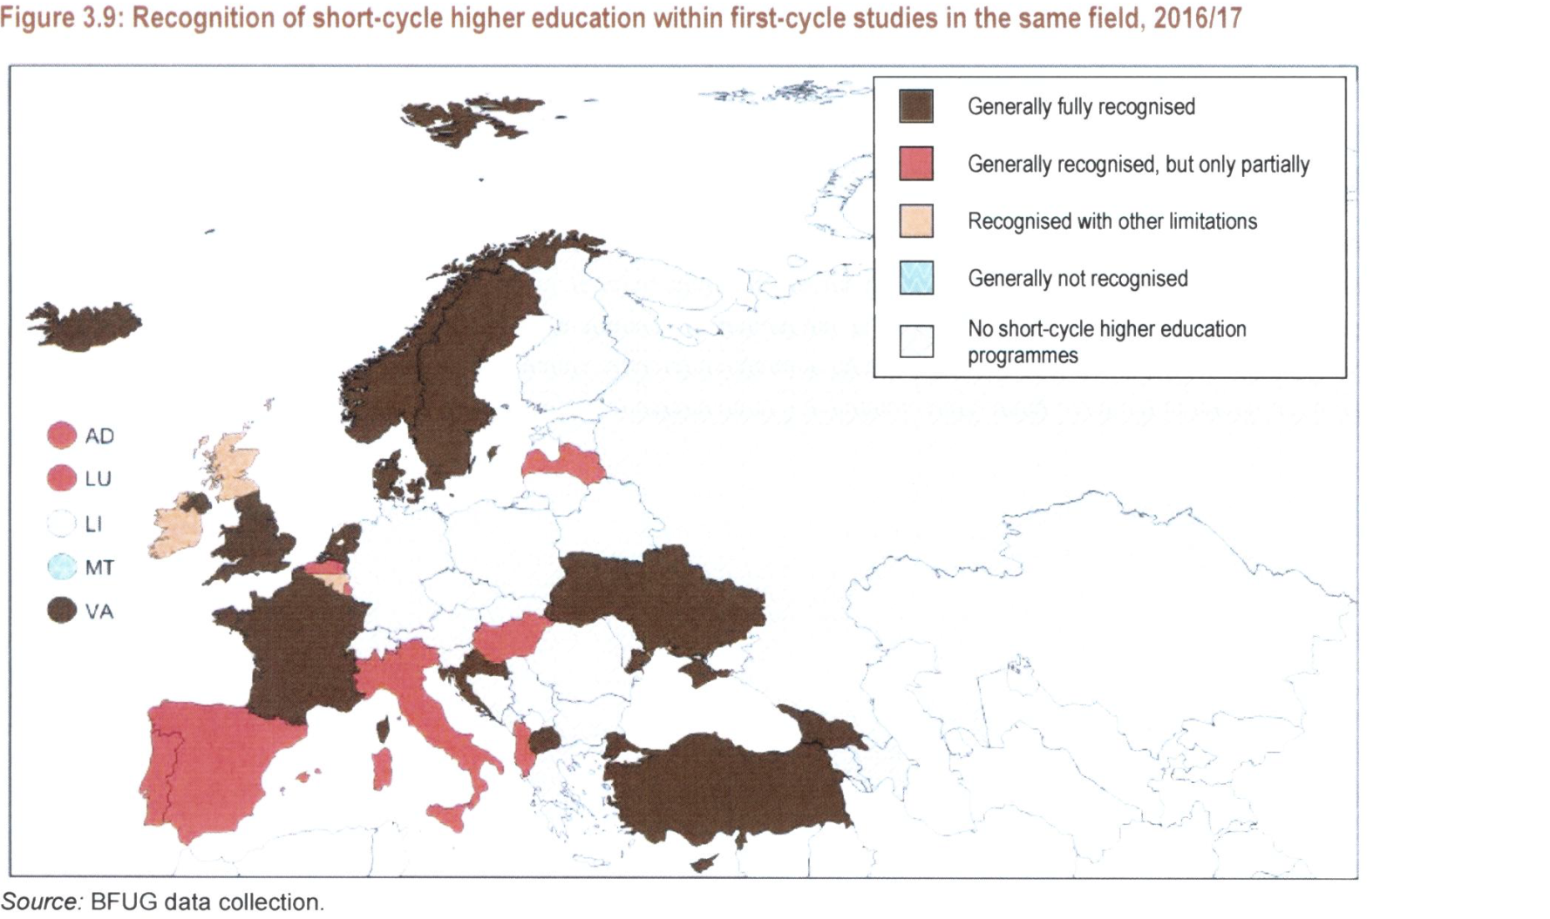
Short cycle and first cycle

Slide 7
Question of recognition
From several ENIC NARIC centres:

Slide 8
Challenges and opportunities of level 5
Trust between HE and VET is sometimes a challenge
Quality assurance
Base of comparaison : workload ? Or Learning Outcomes?
Different learning paths:
Guarantee the bridges between the paths
In terms of integration/ reintegration within higher education
The social dimension

