Slide 1



Training for the staff of the National Qualifications Agency
of Ukraine - European Training Foundation
From ANQ to ANQEP: the story of the National Agency for Qualification and VET 2007-2019
Portugal
Ana Cláudia Valente
National Agency for Qualification and VET (ANQEP)
Turin, 28th February 2019
Notes:
sandra

Slide 2
Summary
From ANQ to the National Agency for Qualification and Vocational Education and Training (ANQEP)
1.1. Main milestones (2007 - 2017)
1.2. ANQEP’s mission and main attributions
1.3. Participation in international working groups
1.4. Staff and structure
1.5. Budget and funding
ANQEP and the National Qualification System (NQS): main structures and instruments
2.1. The National Qualifications Framework
2.2. The National Catalogue of Qualifications
2.3. The Sector Councils for Qualification
2.4. The Qualifica Programme, the Qualifica Centres and the VNFIL process
2.5. The Qualifica WebPortal and the Qualifica Passport
2.6. The National Credit System for VET
2.7. Quality assurance systems in line with the EQAVET Framework
2.8. VET planning and provision - Skills Needs Anticipation
Lessons learned

Slide 3

1.1. Main Milestones
New Opportunities Initiative: Governmental programme to upgrade the qualifications of young people and adults (minimum upper-secondary education)
2005
2006
Creation of the National Agency for Qualification (ANQ)
Creation of the National Qualifications System to reform VET within the education system and within the labour market by creating common objectives, structures and instruments
2007
2012
Creation of the National Agency for Qualification and VET (ANQEP), replacing the former ANQ (but carrying on the same mission)
2016
Launch of the Qualifica programme
Revision of the legislation of the National Qualifications System and creation of new instruments
2017

Slide 4
1.2. ANQEP’s mission
The National Agency for Qualification and Vocational Education and Training (ANQEP) is a public body under the joint supervision of the Ministry of Education and the Ministry of Labour, Solidarity and Social Security, in coordination with the Ministry of Economy.
ANQEP’s mission is to coordinate the implementation of policies regarding the vocational education and training of young people and adults, as well as to ensure the development and management of the National System for the Recognition, Validation and Certification of Competences.

Slide 5
1.2. ANQEP’s main attributions
To develop and manage the RVCC system – academic and/or professional (VNFIL) and to coordinate the network of centres specialised in the provision of adult-learning services (Qualifica Centres);
To monitor, assess and regulate the RVCC system in close cooperation with the providers from the National Qualifications System;
To guarantee the monitoring, assessment and regulation of the VET supply for young people and adults;
To coordinate and promote the design of pathways, curricula development and specific methodologies and materials for VET (both for young people and adults);
To coordinate, foster and manage the VET supply - addressed both at young people and adults;
To cooperate with other public or private, national or international stakeholders, in order to foster the development of quality lifelong learning;

Slide 6
1.2. ANQEP’s main attributions
To promote the development, at European level, of exchange and cooperation dynamics, as well as mobility between VET systems;
To promote, particularly through the design and continual updating of the National Catalogue of Qualifications, the diagnosis, production and comparability of national and international qualifications that are considered essential to a modern and competitive economy;
To participate in the development of initial and continuous Training Standards for teachers, trainers and other professionals working in VET, as well as in the RVCC System, in full cooperation with namely higher education institutions.

Slide 7
1.3. Participation in international working groups
National Coordinator for the Implementation of the European Agenda for Adult Learning
National Support Service for European Platform for Adult Learning in Europe (EPALE)
National Coordination Point for the implementation of the EQF
Member of the EQF AG
Member of the ECVET Users’ Group
Member of the EQAVET Network
Member of the WG on ESCO
Member of the Directors-General for VET
Member of the Advisory Committee on Vocational Training
Member of the ET 2020 WG on VET and WG on Adult Learning
Member of the OECD Group of National Experts on VET and Adult Learning
Member of the Board of Participating Countries in PIAAC

Slide 8
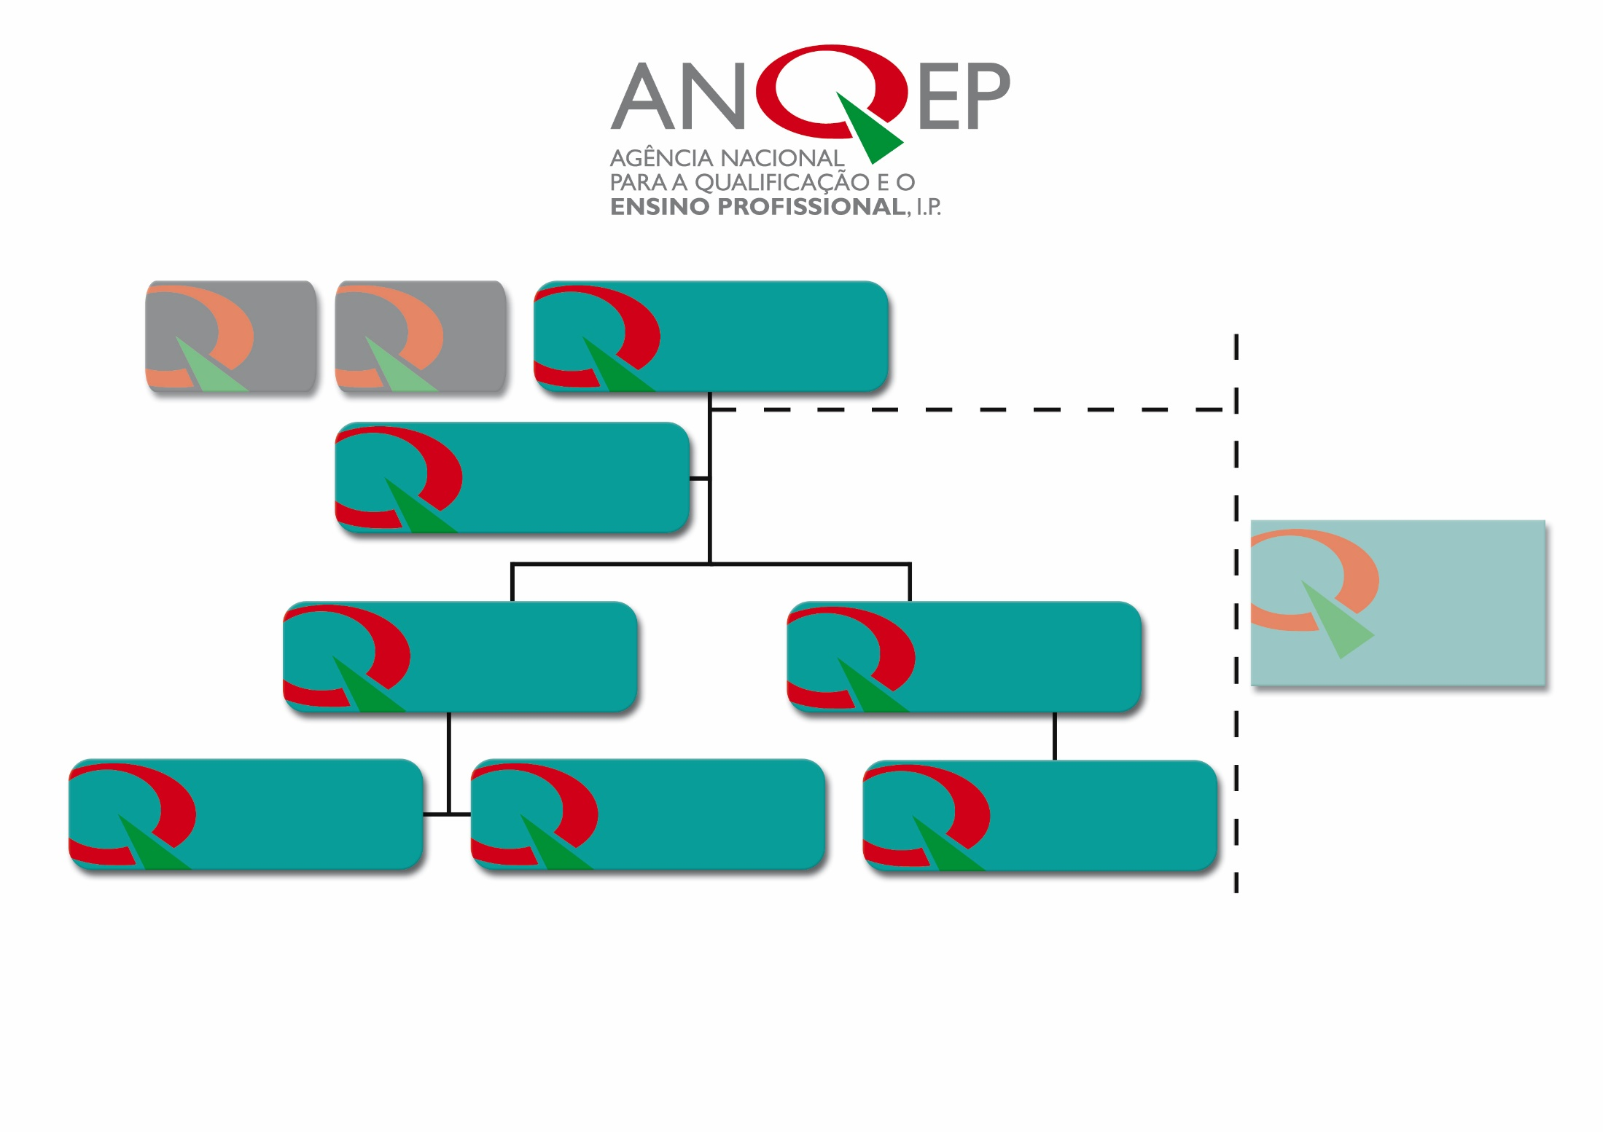
GENERAL BOARD
EXTERNAL AUDITOR
BOARD OF DIRECTORS
Communication and Image Office
Multidisciplinary Team
Department of Integrated Management of Qualification Systems (DGISQ)
General Administration Department (DAG)
Division for the Management of the Network of Qualification Structures
Division for the management of the National Catalogue of Qualifications
Division for the Management of Human Resources
1.4. Staff and Structure

Slide 9
1.4. Staff and Structure
BOARD OF DIRECTORS – executive body, composed by a Director and two Deputy Directors.
GENERAL BOARD – statutory body which advises, supports and participates in the definition of ANQEP’s general lines of action. It is composed by representatives of the supervisory ministries, social partners, independent experts (maximum 25 members). It meets twice a year.
EXTERNAL AUDITOR – independent body, responsible for checking the legality, regularity and sound financial and asset management of ANQEP (Society of Chartered Accountants).

Slide 10
1.5. Budget and funding
 | Global Budget | Human Resources
2016 | € 7.785.031,00 | 88
2017 | € 7.722.558,00 | 87
2018 | € 7.982.288,00 | 95
Funding Sources 2018
General State Budget | € 3.500.000,00 | 43,8%
Ministry of Labour, Solidarity and Social Security Budget | € 4.087.506,00 | 51,2%
European Union Funding | € 394.782,00 | 5 %

Slide 11
2. The National Qualifications System (NQS) – 2007 up today
In PT the VET system is centrally governed by the ministries responsible for Education and Labour. In 2007 the NQS was created to reform VET within the education system and within the labour market by creating common objectives, tools and structures.
The key strategy was to ensure the relevance of VET for the personal development of individuals, as well as for the modernisation and competitiveness of companies and the economy.
The main objectives of the NQS were (and still are):
To make upper-secondary education the reference objective for the qualification of young people and adults;
To strengthen the integration between general education and professional training in all VET pathways ensuring for all of them the principle of double certification (a school and a professional certification);
To create mechanisms for the certification of academic and professional competences via recognition of prior learning;
To ensure that VET qualifications better match labour market needs.

Slide 12
The National Qualifications System (NQS) – 2007 up today
STRUCTURES
INSTRUMENTS
System for the Anticipation of Qualifications Needs (SANQ)
Sector Councils for Qualification
National Catalogue of Qualifications
Training Providers network
National Qualifications Framework
Quality Assurance EQAVET
New Opportunities Centres
National Credit System for VET
Qualifica Centres
Individual Skills Handbook
Qualifica Portal
SIGO
Qualifica Passport
2007
2017
2007 up today

Slide 13
2.1. The National Qualifications Framework (NQF)
The NQF, in force since 2010 and referenced to the EQF, is a unique reference tool to classify all qualifications produced in the national ET system, regardless of the access pathways (general education, VET, VNFIL, higher education).
The NQF improves the legibility, transparency and comparability of qualifications in the ET system and in the labour market, easing the mobility of citizens and facilitating LLL.
It is structured in 8 qualification levels, each defined by descriptors that specify the LO in terms of Knowledge, Skills and Attitudes.

Slide 14

2.1. The National Qualifications Framework (full integration of VNFIL in the NQF)
NQF Level
Qualifications
EQF Level
Level 1
2nd cycle of basic education or VNFIL
Level 1
3rd cycle of basic education (lower-secondary education) obtained in basic education or via VET pathways or VNFIL
Level 2
Level 2
Level 3
Upper-secondary education obtained via general education or via VNFIL
Level 3
Level 4
Upper-secondary education obtained via double certification paths (VET) or via VNFIL
Level 4
Level 5
Post-secondary non-higher education qualification with credits to pursue higher education studies
Level 5
Level 6
Bachelor degree
Level 6
Level 7
Master degree
Level 7
Level 8
Doctorate degree
Level 8

Slide 15
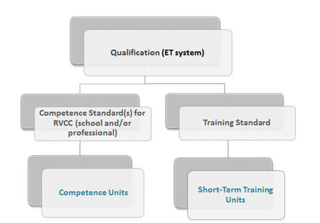
2.2. The National Catalogue of Qualifications (NCQ)
The NCQ (www.catalogo.anqep.gov.pt) is a dynamic tool for the strategic management of national double certification qualifications (non-higher education) which promotes the effective link between the competences necessary to the social and economic development of the country and the qualifications developed within the NQS. It facilitates the access to qualification, by promoting the flexibility in attaining qualifications.
The NCQ progressively integrates qualifications based on LO, identifying for each qualification a competence standard and a training standard in its technological component:

Slide 16
2.2. The National Catalogue of Qualifications (NCQ)
The Catalogue standards are used in IVET, CVET and RVCC (VNFIL). The standards used in RVCC are equivalent to the training standards used in formal education;
The Catalogue ensures the connection to the EQF and each qualification is referenced to the National Qualifications Framework;
Currently, it includes:
40
education and training areas
qualifications
key competences standards
about short-term training units
professional RVCC standards
qualifications adapted to disabled people
311
2
7076
157
22

Slide 17
2.3. The Sector Councils for Qualification (SCQ)
The SCQ work as a platform for updating/revising the NCQ and bring together the worlds of ET and of work by joining stakeholders from both worlds (social partners, reference companies, education and training providers, experts). They seek to ensure a sectoral representation of the national economic activity and they are an example of a bottom-up approach in the design of qualifications.
No qualification is integrated in the NCQ without being submitted to the respective Sector Council for analysis and approval by consensus.
Associations of Employers
Trade Unions
Ministries
ANQEP
Reference Enterprises
Training Providers
Independent Experts
maximum of 10 members

Slide 18

2.3. The Sector Councils for Qualification (SCQ)
PT has 16 SCQ:
- Personal services
- Tourism and leisure activities
- Craft and jewelry
- Wood, furniture and cork
- Healthcare and services to the community
- Fashion
- Transports and distribution
- Computers, electronics and telecommunications
- Metallurgy and metalworking
- Chemical industries, pottery, glass and others
- Agriculture and nourishment
- Building construction and urban services
- Services to enterprises (finance activities, consulting activities, secretarial services)
- Energy and environment
- Culture, heritage and production of contents
- Trade and marketing

Slide 19

2.4. The Qualifica programme (a political priority of the Government)
In order to tackle the deficit of qualifications, in 2016 the Government created the Qualifica programme (an integrated strategy to foster the training and qualification of adults).
Main objectives
Raise the qualification level of adults and their employability;
Increase digital and functional literacy;
Better align the training provision with labour market needs;
Facilitate tailored training pathways that lead to raising the qualification level of adults (better combining RVCC with adult education and training).
Target groups
Less qualified adults;
Unemployed people;
NEET (Not in Education, Employment or Training).

Slide 20

2.4. The Qualifica programme
Goals until 2020
300 Qualifica Centres in 2017;
50% of the active population with upper secondary education;
15% of adults in LLL activities;
Contribute to 40% of 30-34 year-olds with higher education.
Key Tools
Qualifica Centres and ET providers;
Qualifica Passport;
National Credit System for VET.

Slide 21
2.4. Qualifica Centres
They are structures that contribute to increase the qualification levels in Portugal through the process of RVCC, combined with training activities;
They provide information, guidance and referral of adults (18 or over) and NEET to:
- RVCC processes (academic and/or professional, levels 1 to 4 of the NQF)
and
education and training pathways
These centres allow adults to certify prior learning that was acquired in formal, non-formal and informal contexts (Portugal has a VNFIL system since 2000);
They play a key role in motivating adults for LLL and in the local networks for qualification (employers, ET providers, municipalities).

Slide 22
2.4. Intervention stages in a Qualifica Centre
Enrolment
Diagnosis
Information and guidance
Referral
Recognition and validation of competences (includes minimum 50 hours of training)
Other training or education supplies
Enrolment in external providers
Total certification
Partial certification
Certification
Personal Qualification Plan

Slide 23

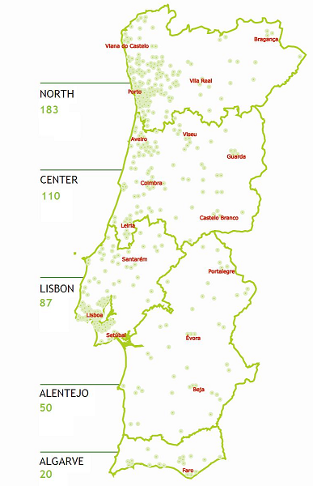
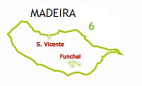
2.4. Qualifica Centres
294 Qualifica Centres in 2019 (promoted by diverse types of institutions, namely public and private schools, professional training centres, municipalities, companies, among others)
113
81
49
3
37
11

Slide 24
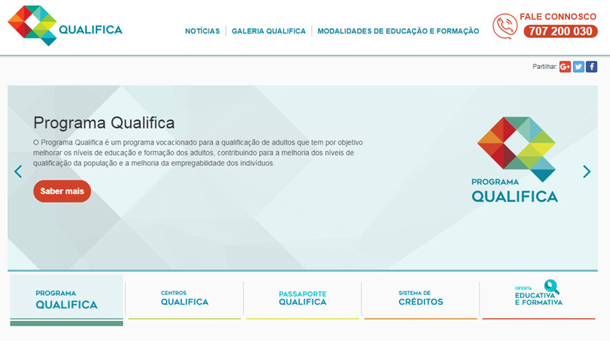
2.5. Qualifica WebPortal
The Qualifica portal (www.qualifica.gov.pt) aims at easing access to information, services and tools included in the Qualifica programmme (i.e. the National Credit System for VET and the Qualifica Passport). It is targeted at trainees, employers and adult education and training providers. It enables people to find a Qualifica Centre, to consult education and training opportunities and to update the Qualifica Passport. It is also used as a lifelong guidance tool.

Slide 25

2.5. The Qualifica Passport
It is an online tool (www.passaportequalifica.gov.pt) where qualifications and skills acquired are recorded;
It provides guidance to pathways that lead to complete or to obtain a new qualification, taking into account the training already attained and the skills acquired;
It is an important lifelong guidance tool;
The Passport can be modified, updated and printed at any time, thus being a tool that accompanies the adult throughout his life.

Slide 26
2.6. The National Credit System for VET
It is in line with some ECVET principles;
The system is based on units of learning outcomes which are part of qualifications and can be assessed and validated;
It enables learners to transfer and accumulate assessed learning outcomes;
This enables learners to attain a qualification at their own pace by accumulating the required units, achieved in different countries and different contexts (formal, non-formal and informal);
It facilitates the legibility and the flexibility of qualification pathways;
It will foster permeability among VET pathways and also with higher education;
It enables the allocation of credit points to:
level 2, 4 and 5 qualifications of the NQF included in the NCQ;
certified training recorded in SIGO complying with quality assurance criteria in place.

Slide 27
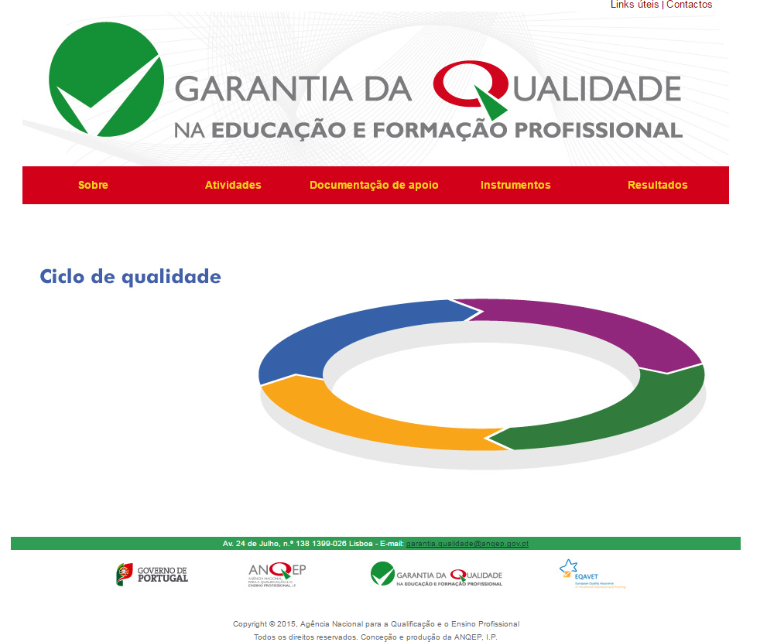
2.7. The EQAVET Framework - national approach for quality assurance in VET
Definition and implementation by VET providers with upper-secondary of a national approach aligned with the EQAVET Framework, including:
the adoption of a quality assurance and improvement cycle;
quality criteria;
and indicative descriptors.

Slide 28
2.7. The EQAVET Framework - national approach for quality assurance in VET
Selection and use of a set of EQAVET indicators:
Indicator no. 4: Completion rate in VET programmes
Percentage of learners having successfully completed VET courses (awarding a qualification) in relation with the number of learners enrolled in these courses
Indicator no. 5: Placement rate in VET programmes
a) Destination of VET learners 12 to 36 months after completion of training
Indicator no. 6: Utilisation of acquired skills at the workplace
a) Percentage of learners having successfully completed courses who work in jobs directly related with the course/education and training area they have completed
b) Satisfaction rate of individuals and employers with acquired skills/competences
Assessment of VET providers alignment with EQAVET made by external experts nominated by higher education institutions (includes polytechnic institutes);
ANQEP awards a quality seal to VET providers that are aligned with the EQAVET Framework (valid for 3 years).

Slide 29

2.8. The System for the Anticipation of Qualifications Needs (SANQ)
SANQ, implemented since 2015, provides Portugal with a diagnostic tool to identify qualification needs at national and regional levels and set priority levels for qualifications, which will be taken into consideration when planning ET provision and in the updating of the NCQ.
It assesses the dynamics of the economy and the labour market which influence the demand for skills in the short and medium term with the involvement of relevant stakeholders (SCQ, Inter-Municipal Communities, Qualifica centres, social partners, VET providers).
It gathers key information for lifelong guidance.
SANQ’s website (http://sanq.anqep.gov.pt) provides information on:
Working methodology
Components
Results

Slide 30
3. Lessons learned
Qualifying people, especially through adult learning, needs to be a political priority that goes beyond political cycles. It also implies allocating the necessary financial and human resources at medium and long term.
The involvement of relevant ministries, inter-ministerial coordination and stakeholders’ engagement lead to better skills policies and outcomes.
ANQEP is an example of cross-ministerial coordination (Education, Labour and Economy) and acts as a promoter of coordination and dialogue among different actors of the skills system (e.g. the SCQ, the Inter-Municipal Communities, the network of VNFIL Centres and ANQEP’s General Board).
Designing, implementing and monitoring tasks of ANQ, in what concerns specific ET policies and system reforms, require considerable and growing technical expertise of the staff

Slide 31
3. Lessons learned
Comprehensive communication campaigns/strategies help increasing the educational attainment of the population and improving the social image of VET and of RVCC.
The creation of a network of centres specialised in the provision of adult-learning services, covering the whole territory, has contributed both to motivate adults to enrol in ET system and to make LLL a reality.
Evaluation, monitoring and quality assurance arrangements are an important basis as they generate information on the effectiveness of ET policies and the returns of learning.

Slide 32
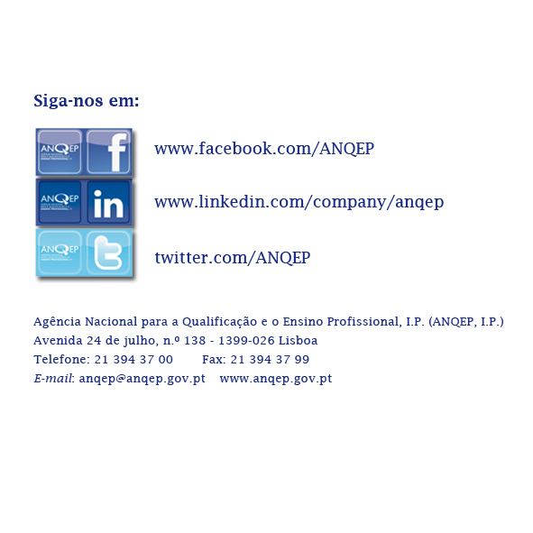
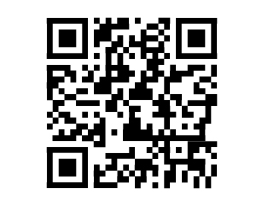
Thank you!

